Slide 1
🚦
DeepTraffic-Guard
Turning Every Traffic Camera Into a 24/7 Enforcement Officer
Real-Time AI Violation Detection • Zero Manual Setup • Evidence-Grade Output
YOLOV8
OPENCV
EASYOCR
STREAMLIT
8 VIOLATIONS
Live Demo → deeptraffic-guard.streamlit.app

Slide 2
THE REALITY
Right now, somewhere in your city...
A rider with no helmet just passed an intersection camera.
Three people are crammed onto one motorcycle.
A car just ran a red light at full speed.
Nobody saw any of it. The camera recorded it — but no one was watching.
DEEPTRAFFIC-GUARD
The Problem
02

Slide 3
THE PROBLEM
Enforcement capacity hasn't scaled with traffic
▸ One officer, one junction. The moment they look away, or move to another junction, violations elsewhere go completely unnoticed.
▸ The cameras already exist. Most cities have traffic cameras on nearly every major junction — footage is recorded, but rarely actively monitored in real time.
▸ The stakes are lives, not fines. Helmet, seatbelt, and red-light laws exist because ignoring them is a leading cause of fatal accidents — not because of revenue.
THE GAP
Footage exists.
Watching doesn't.
A system that watches every frame, never gets tired, never looks away — and turns footage that already exists into evidence that gets acted on.
DEEPTRAFFIC-GUARD
The Problem
03

Slide 4
OUR SOLUTION
One photo in. Full evidence out.
Upload a traffic camera photo or video. DeepTraffic-Guard automatically finds every vehicle and person, checks 8 violation types, reads license plates, and produces evidence-grade output — with zero manual setup per camera.
📷
🧹
🎯
🛑
⚖️
📄
→
→
→
→
→
Upload
Auto-Enhance
Detect Objects
Find Road Rules
Check Violations
Evidence + PDF
STEP 1
STEP 2
STEP 3
STEP 4
STEP 5
STEP 6
★
Key differentiator: stop lines, no-parking zones, and road signs are detected directly from the photo's road markings — never assumed, never hand-configured. The same system deploys instantly at a brand-new camera.
DEEPTRAFFIC-GUARD
Solution
04

Slide 5
CORE DETECTION
8 violation types, one unified pipeline
Helmet Non-Compliance
Triple Riding
Skin / hair / texture HSV analysis on rider head crop
Rider count linked per motorcycle bounding box
Red-Light Violation
Wrong-Side Driving
Traffic-light color check + stop-line crossing
Lane-center estimation via Hough line transform
Phone Use While Driving
Stop-Line Violation
Cell-phone bbox overlap with driver / rider
Vehicle position vs. auto-detected stop line
Seatbelt Non-Compliance
Illegal Parking
Diagonal-strap edge density in torso region
Vehicle overlap with auto-detected curb-paint zones
DEEPTRAFFIC-GUARD
Detection
05

Slide 6
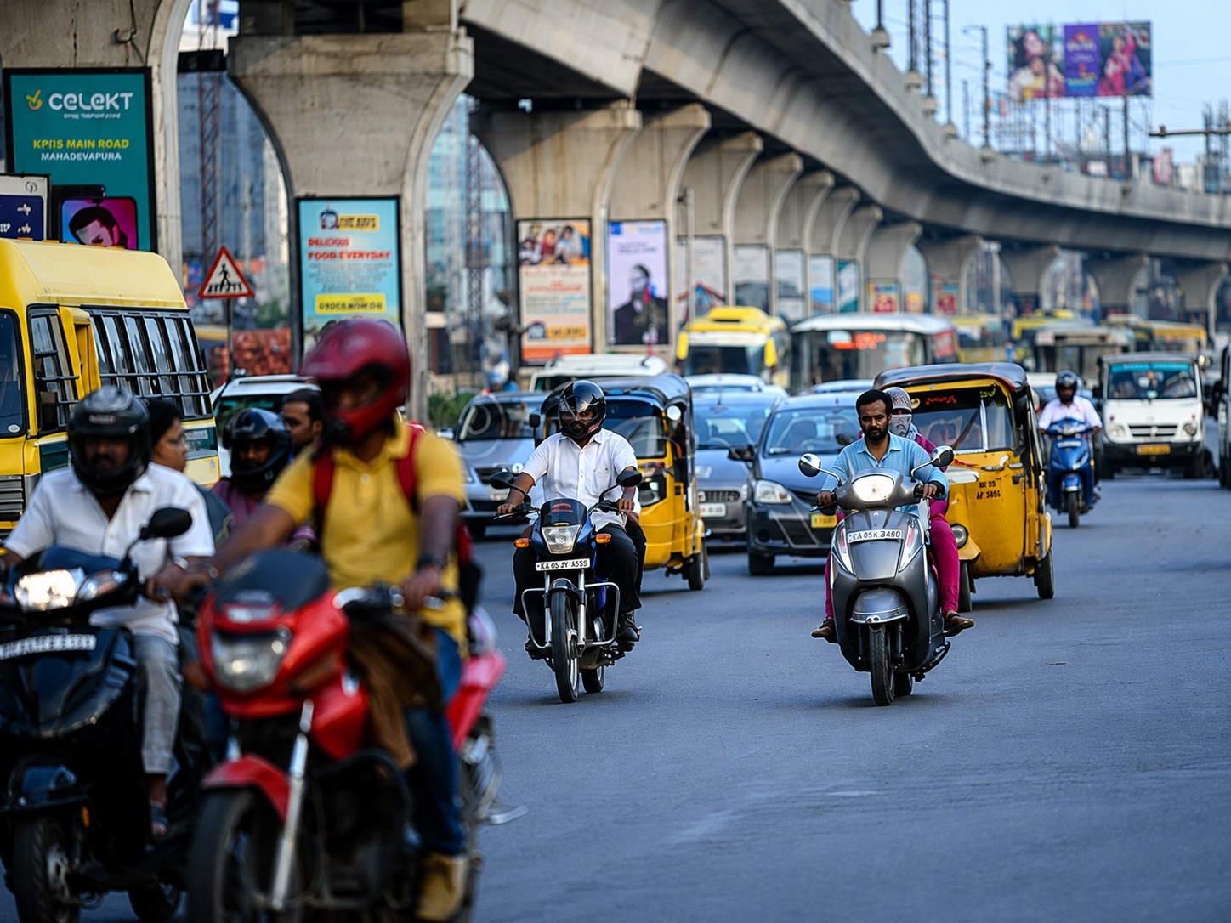
LIVE DEMO · INPUT
A real, unedited Bengaluru traffic photo
ZERO SETUP
A location the system
has never seen before.
— No stop line marked
— No parking zone marked
— No lane config
12 objects in frame:
buses, cars, motorcycles,
riders, auto-rickshaws
DEEPTRAFFIC-GUARD
Live Demo
06

Slide 7
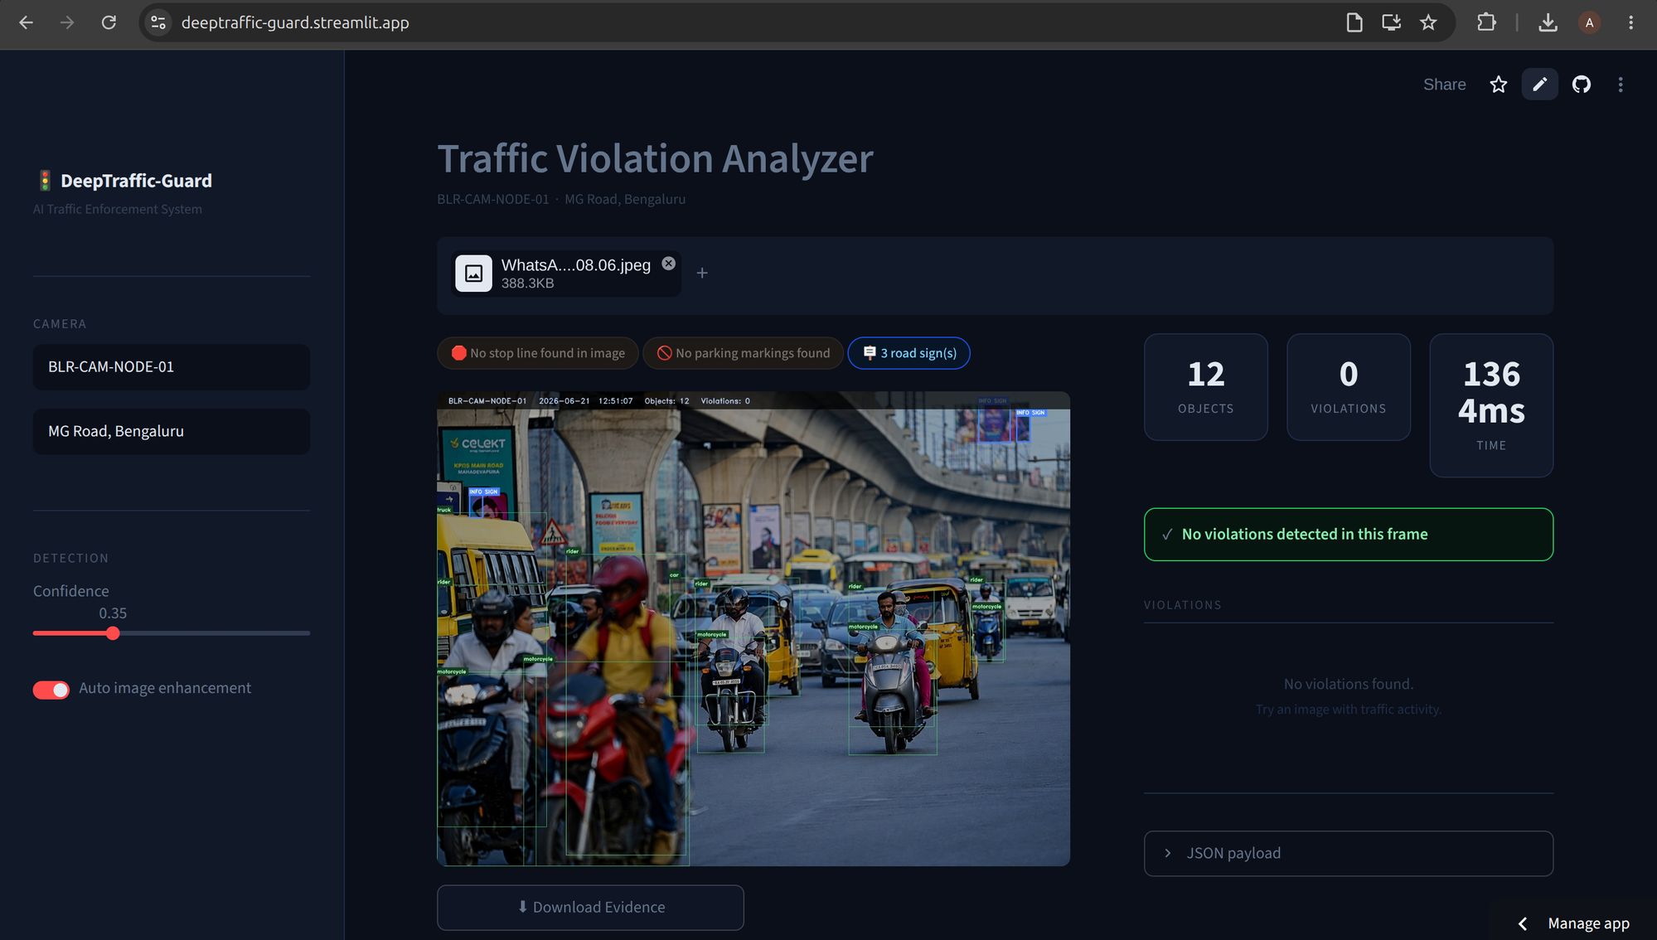
LIVE DEMO · OUTPUT
Same photo, processed in 7 milliseconds
DEEPTRAFFIC-GUARD
Live Demo
07

Slide 8
ENGINEERING RIGOR
We don't just demo it — we stress-tested it
Real photos break naive computer vision. Here's a bug we found and fixed by testing against actual traffic photos, not synthetic data:
🐛 THE BUG
✅ THE FIX
A rider wearing a bright red helmet was being flagged as 'no helmet'.
Root cause: pure red and fair skin tones share the same hue in HSV color space. Glossy highlights on the helmet shell were misread as exposed skin.
Deeper still: our own shadow-correction preprocessing step was silently desaturating colors across the whole image — masking the fix until we traced it end-to-end.
Added a 'helmet-shell rejection' signal: large saturated-color regions are recognized as painted shells, not skin.
Fixed shadow correction to adjust brightness only (HSV value channel), preserving true color for every downstream check.
Verified against the original photo + 13 other test images, plus synthetic boundary cases — zero regressions.
DEEPTRAFFIC-GUARD
Engineering
08

Slide 9
ARCHITECTURE
Eight decoupled, independently testable modules
Image /
Video Input
Preprocessor
YOLOv8
Detector
Rider
Association
Road Zone
Auto-Detect
Violation
Engine
OCR +
Annotator
PDF /
Dashboard
→
→
→
→
→
→
→
Each module is a plain Python file with a single responsibility — preprocessing, detection, zone-finding, and violation logic never touch each other's internals. That separation is what let us isolate, reproduce, and fix the helmet bug in minutes instead of guessing across a monolith.
DEEPTRAFFIC-GUARD
Architecture
09

Slide 10
TECH STACK
Built entirely on proven, open-source tools
YOLOv8
OpenCV
EasyOCR
Real-time object detection
HSV, Canny, Hough, CLAHE
License plate text recognition
ULTRALYTICS
CLASSIC CV
DEEP LEARNING OCR
Streamlit
SQLite
fpdf2
Interactive web UI, zero frontend code
Violation storage + analytics
Auto-generated PDF evidence reports
PYTHON-NATIVE
EMBEDDED DB
REPORTING
DEEPTRAFFIC-GUARD
Tech Stack
10

Slide 11
WHY WE'RE DIFFERENT
Most CV hackathon projects stop at detection
Typical Hackathon Project
DeepTraffic-Guard
Setup per new camera
✗ Manual zone calibration
✓ Auto-detected from road paint
Output format
✗ Raw bounding boxes
✓ Annotated evidence + PDF report
Input type
✗ Single image only
✓ Image AND sampled video
Violation coverage
✗ Usually 1-2 types
✓ 8 independent violation checks
Testing rigor
✗ Demo on curated images
✓ Stress-tested on real, messy photos
DEEPTRAFFIC-GUARD
Differentiation
11

Slide 12
BEYOND DETECTION
A complete, submission-ready system
▸ Video analysis mode Frame-sampled scanning of full traffic video clips, with an annotated output video and a per-type violation timeline — not just single photos.
▸ One-click PDF evidence reports Professional report generation: annotated frame, severity-coded violation table, and a dedicated evidence page per violation.
▸ Full analytics dashboard Violations by type/severity/hour, searchable record history, CSV export, and automatic frame-hash deduplication.
▸ Zero manual configuration Stop lines, parking zones, and signs are detected per-photo from actual road paint — the same system deploys instantly at any new camera.
DEEPTRAFFIC-GUARD
Completeness
12

Slide 13
IMPACT & SCALABILITY
Existing infrastructure, new capability
24/7
8
0
Coverage per camera —
no shift changes, no fatigue
Independent violation
types checked per frame
Manual setup steps
required per new camera
Cities don't need new hardware to deploy this — every existing traffic camera becomes an active enforcement layer. Footage that already exists turns into evidence that already gets used.
DEEPTRAFFIC-GUARD
Impact
13

Slide 14
HONEST LIMITATIONS & ROADMAP
What's next
TODAY'S LIMITATIONS
ROADMAP
▸ Resolution floor Tiny/distant riders have too few pixels for reliable head analysis.
▸ Heuristic vs. trained models Helmet/seatbelt use rule-based CV rather than a dedicated trained classifier — by design, for transparency.
▸ Multi-lane highways Wrong-side check assumes a simple two-lane road model.
▸ Trained helmet classifier Fine-tune a model on labeled helmet/no-helmet photos for higher accuracy at distance.
▸ Live camera feed ingestion Connect directly to RTSP/live streams instead of file upload.
▸ Multi-camera fleet dashboard Aggregate analytics across many camera nodes, city-wide.
DEEPTRAFFIC-GUARD
Roadmap
14

Slide 15
See It Live
DeepTraffic-Guard — AI Traffic Enforcement System
deeptraffic-guard.streamlit.app
github.com/anmol-2-4/deeptraffic-guard
Thank you — questions welcome.

