Slide 1
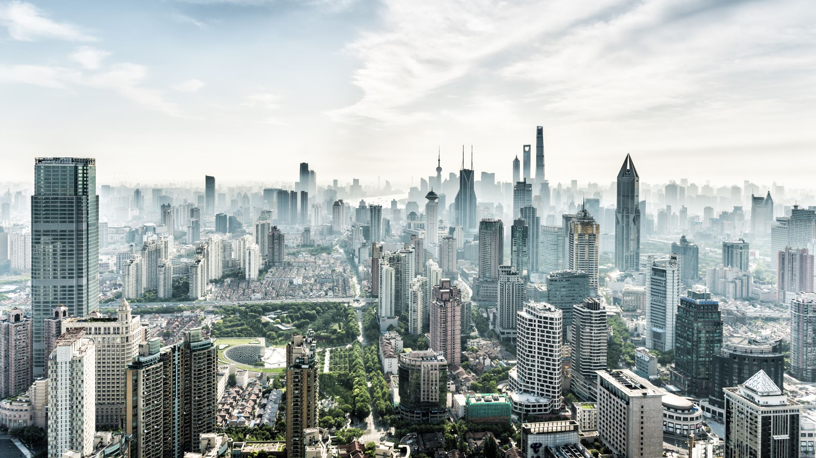
Seattle Vehicle Collision Analysis
Project in partial fulfilment of IBM Data Science Professional Certificate Anmol Tripathi

Slide 2
Background
According to the annual United States road crash statistics by ASIRT, more than 38,000 people die every year in crashes on U.S. roadways. The U.S. traffic fatality rate is 12.4 deaths per 100,000 inhabitants.
It is evident that with the increasing number of vehicles on urban and suburban roads, the cases of vehicle accidents are also increasing. This project aims to analyse vehicle collision data available in public domain provided by Seattle Geo Data (SDOT) and derive some useful insights.

Slide 3
Problem
Data provided by the Seattle Department of Transportation (SDOT) on vehicle collisions along with its severity might be useful to derive insights and may show some pattern with the environmental factors like weather, road conditions etc.
Interest
This project might interest the local government, SDOT and all the stakeholders of Seattle Traffic Management.

Slide 4
Data Sources
Data used for this analysis was originally fetched from Seattle Geodata. Click here to visit the page. The dataset has been modified as per requirement of the Capstone Project of IBM Data Science Professional Certificate.
The modified dataset can be downloaded in csv format. The timeframe of the data starts from 2004. For this analysis, original data is being used.

Slide 5
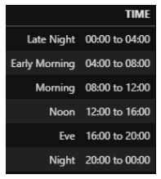
Feature Engineering
70% of data has time associated with each collision. It is easier to analyse with respect to time if we segregate the data in certain categories. I have segregated the data in 6 categories as following

Slide 6
Analysing the severity
62% of accidents belong to category 1 which is property damage only collision and 26% belong to category 2 which is injury collision.
It shows that majority of accidents happening are just causing property damage. Fatal collisions are ~0.15% of dataset. Whereas, we do not have any data about 10% of collisions.

Slide 7
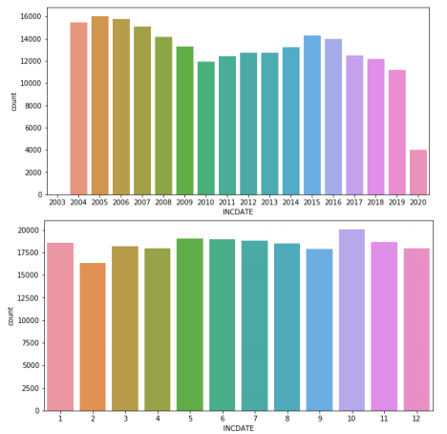
Analysis by Month and Year
Although is no clear trend visible, but it seems that cases are declining yearly. There is no pattern with month visible

Slide 8
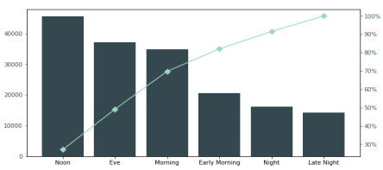
Analysis by Time
We can see that almost 50% of cases happen during the daytime i.e. between 12:00 P.M. and 08:00 P.M
By splitting the data on severity shows that cases of injury collision are almost always half of that of property damage only collision. In general, cases of property damage is maximum followed by injury collision.

Slide 9
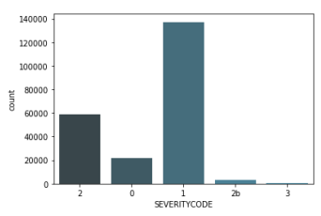
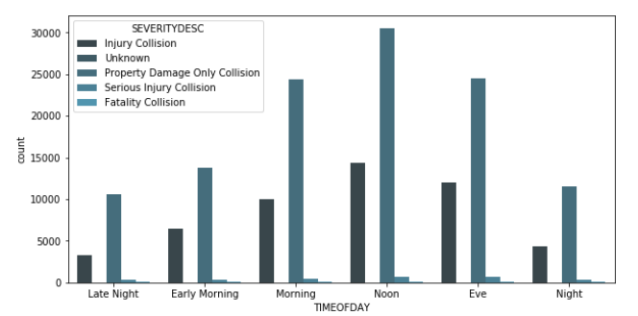
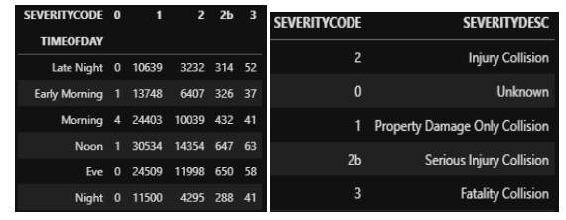

Slide 10
There is no clear relation between severity of accidents and time of the day. During late night, cases of severity 1 (“Property Damage only Collision”) incidents are higher that rest of the day percentage wise.
3 of 4 accidents happening during late night are just doing property damage.

Slide 11
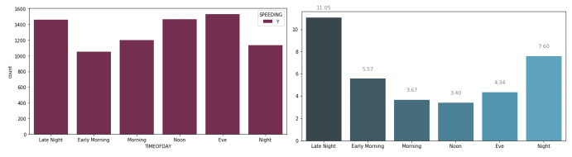
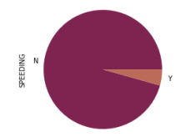
Analysis on Speeding
5% of all the collision cases are because of speeding. Distribution with time shows that there are lot many cases of speeding during evening and late night.

Slide 12
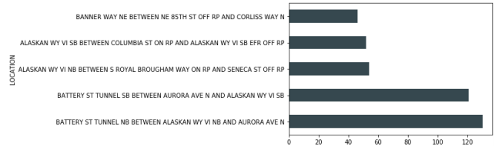
Percentage wise tells some other story. There are a lot many (11.05%) speeding accidents in late night as compared to any other time. If we see location wise, we notice that there are a lot many cases of speeding collisions at “Battery St. Tunnel”.

Slide 13
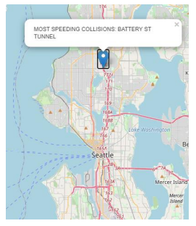

Slide 14
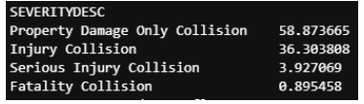
It is worth noting that percentage of Injury collision increases to 36.3% from 26.52% Serious injury collision increases to 3.92% from 1.39% Fatality injury collision increases to 0.89% from 0.15% because of speeding.

Slide 15

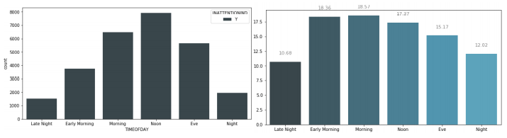
Analysis on collision due to inattention

Slide 16
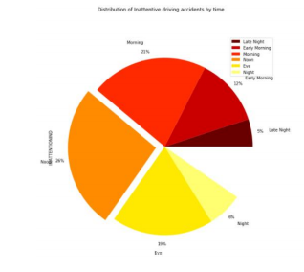
We can see that ~18% of collisions happening in morning and early morning are due to inattention of drivers.

Slide 17
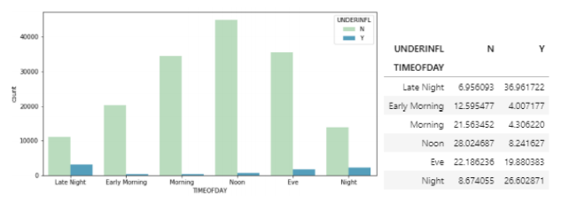
Analysis on collision due under influence of drug/alcohol
Alcohol/drug influenced accidents are becoming a huge problem for metropolitans. It is quite evident from the data that majority of accidents under influence are happening in late night and in evening.

Slide 18
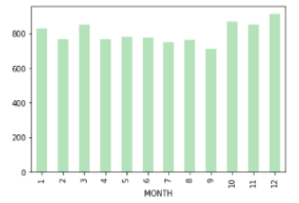
We can see there are relatively more cases of alcoholic and drug influenced collision during December (Probably because of holiday season)

Slide 19
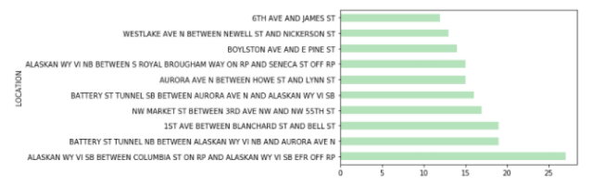
"ALASKAN VI SB BETWEEN COLUMBIA ST ON RP AND ALASKAN WY VI SB EFR OFF RP" has the greatest number of cases of under influence collisions.

Slide 20
Analysis by collision type
We can analyze the distribution of collisions by the collision type. Collision type is further bifurcated by SDOT collision code. Since there are a lot many categories, it is better to plot them and have an overview.

Slide 21
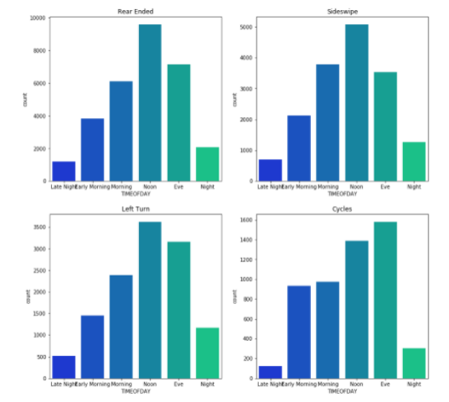

Slide 22
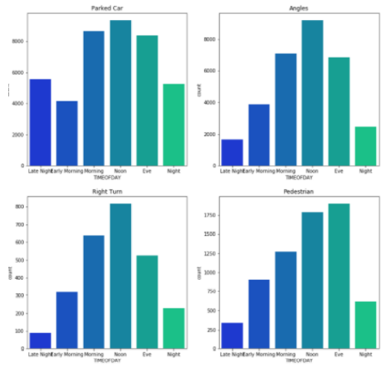

Slide 23
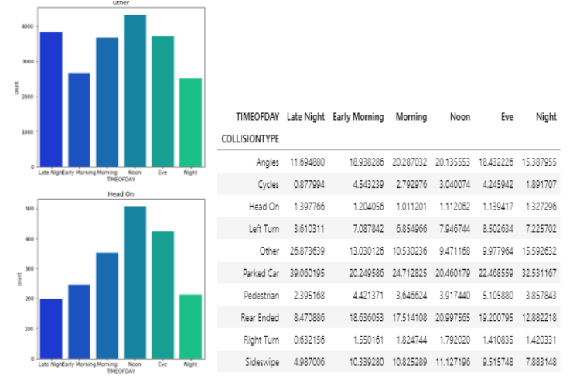

Slide 24
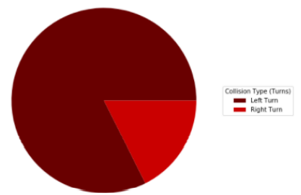
People are more likely to hit Parked car during Night. We can also see there are a lot of "Other" collision type of cases in late night
There is ~65% more chance to encounter a collision while taking a Left turn than taking a Right turn.

Slide 25
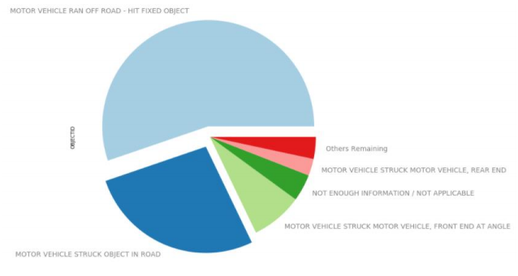

Slide 26
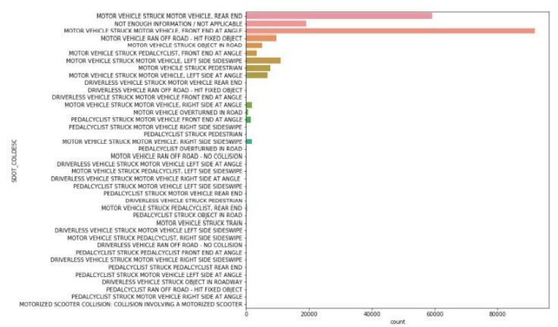
Analysis by collision type specified

Slide 27
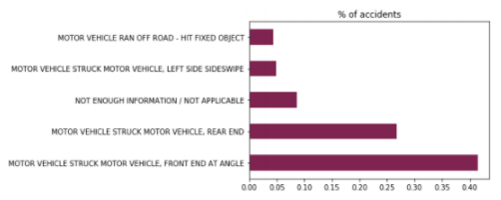
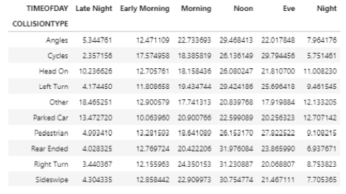
We can see ~40% of collisions are of motor vehicle striking another motor vehicle’s front end at an angle.

Slide 28
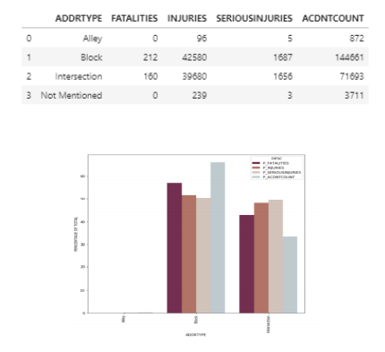
Analysis on location

Slide 29
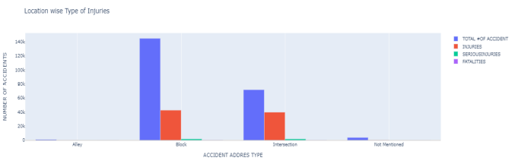

Slide 30
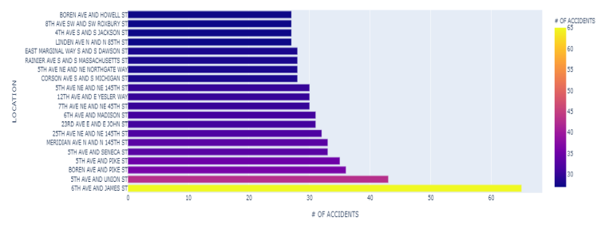
Location "6th AVE AND JAMES ST" has abnormally high number of collisions since 2016

Slide 31
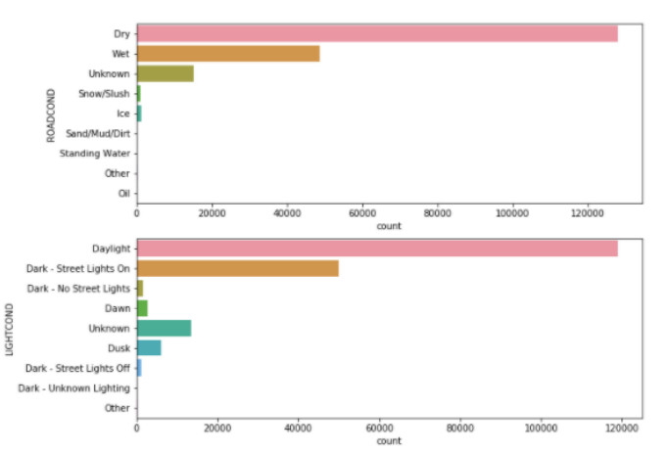
Analysis of road and light conditions
We have data of road and light conditions where the collision happened.

Slide 32
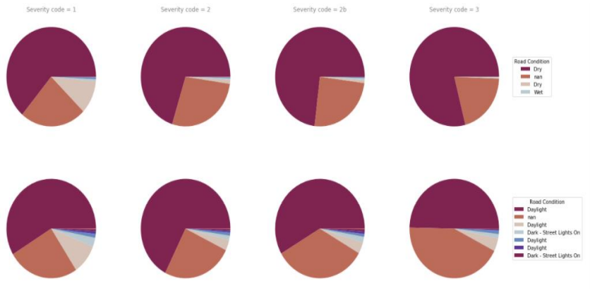
We can see that majority of collisions happened at dry roads and in daylight. We can check for severity on these conditions.

Slide 33
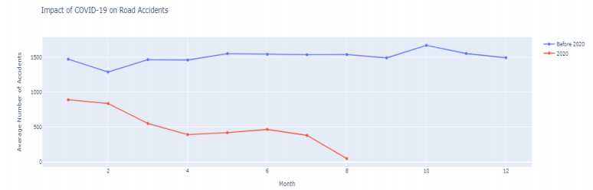
Effect of COVID-19 pandemic on vehicle collisions
In 2020, whole world faced a pandemic of the COVID-19 outbreak. Its effect on travel behaviour have also been sudden and wide ranging. We can see that there is a sudden drop in accident cases in 2020, due to COVID-19 pandemic.

Slide 34
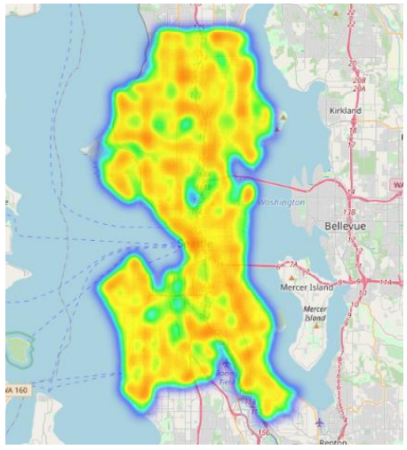

Slide 35
Conclusion
Road safety is very important nowadays as there has been too much of increase in vehicles on road and it becomes crucial that we follow the traffic rules and laws and save ourselves and our families from road accidents. Also making other people aware of road safety rules could make our roads safe.

