Slide 1

Serverless Real-time Analytics Dashboard with AWS Kinesis Analytics
Anmol Agarwal (2210030362)
Under the esteemed guidance of
Ms. P. Sree Lakshmi
Assistant Professor,
Department of Computer Science and Engineering

Slide 2
Project Overview
Traditional placement tracking methods are slow, manual, and lack real-time insights
Educational institutions need faster, data-driven tools to support placement strategies
The project builds a real-time dashboard using AWS Kinesis Analytics for student placement data
AWS services like Kinesis, Lambda, and DynamoDB enable a fully serverless, scalable solution
Live analytics help identify top-performing students, company trends, and placement gaps
Enables training & placement teams to make quick, informed decisions
Mimics enterprise-level analytics systems used in modern businesses

Slide 3
Services Used
Amazon Kinesis Data Streams (KDS): Ingests real-time student placement data into the analytics pipeline.
Amazon Kinesis Data Firehose: Delivers streaming data from KDS to storage (e.g., S3) with optional transformation.
Apache Flink (via Kinesis Data Analytics): Processes and analyzes streaming data in real time.
Amazon S3: Stores raw and processed placement data, as well as dashboards and logs.
Amazon StudioBook: Used for data exploration, transformation
Apache Zeppelin: Provides a notebook-based interface for querying, visualizing, and interpreting Flink-processed data.
Amazon QuickSight: Visualizes real-time insights on student placement trends and outcomes.

Slide 4
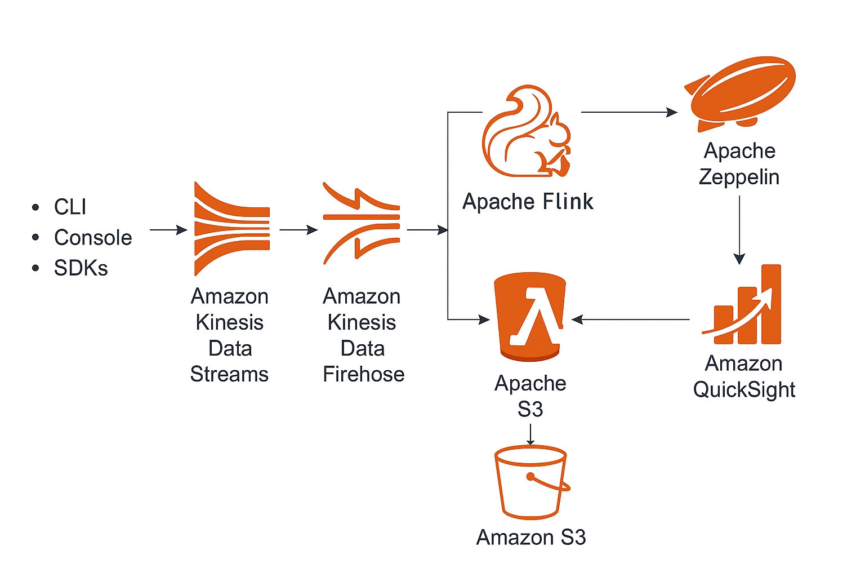
Flow Diagram

Slide 5
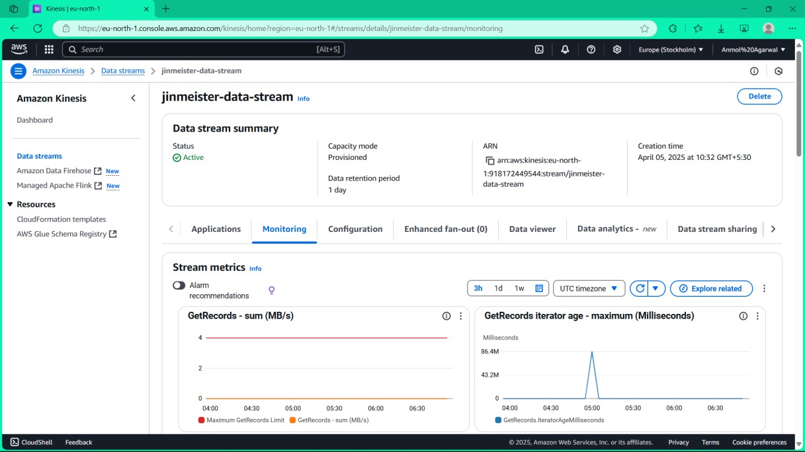
Implementation Process
Fig. 4.1: Create a new Kinesis Data Stream
Step -1: Create a new Kinesis Data Stream
Go to Kinesis console.
Click Create data stream.
Name it and set shards.

Slide 6
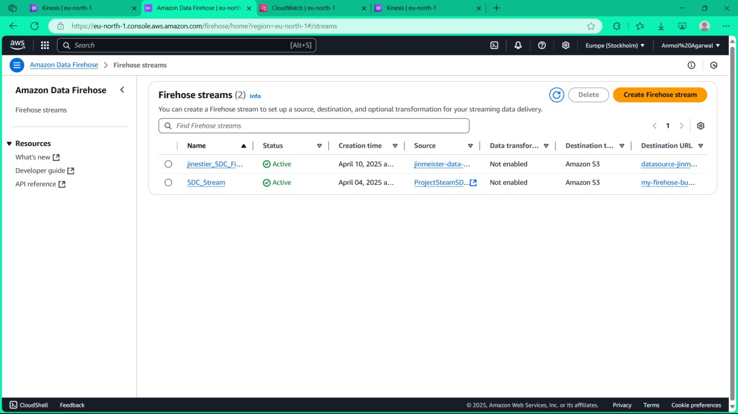
Step-2: Create a new FireHose for data transformation
Go to Firehose in the Kinesis console.
Click Create delivery stream and choose source and destination.
Fig. 4.2: Create a new FireHose for data transformation

Slide 7
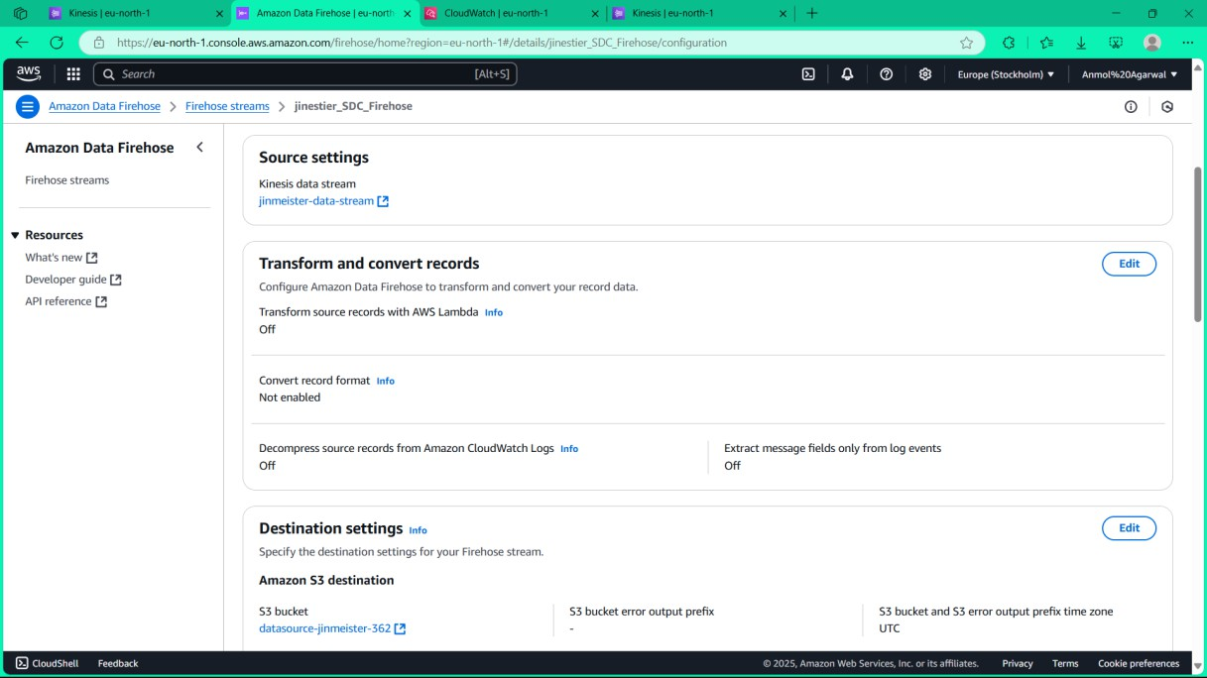
Step-3: Set the source as the KDS and the destination as the S3 bucket
Select Kinesis Data Stream as source.
Choose an existing S3 bucket as destination.
Confirm configuration settings.
Fig. 4.3: Set KDS as source and S3 as destination

Slide 8
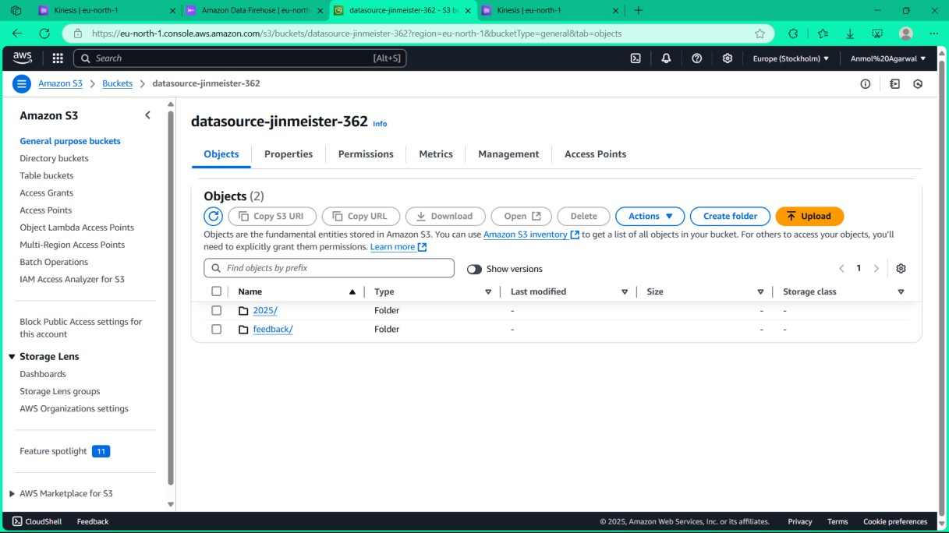
Step-4: Create a folder in S3 bucket named feedback
Go to the S3 console.
Open your bucket.
Fig. 4.4: Create a folder in S3 bucket named feedback

Slide 9
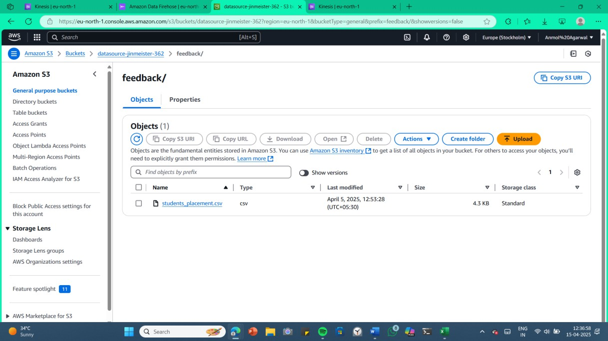
Step-5: Upload the data file students_placements.csv
Click Upload in the S3 bucket.
Select students_placements.csv file.
Start upload.
Fig. 4.5: Upload students_placements.csv to S3

Slide 10
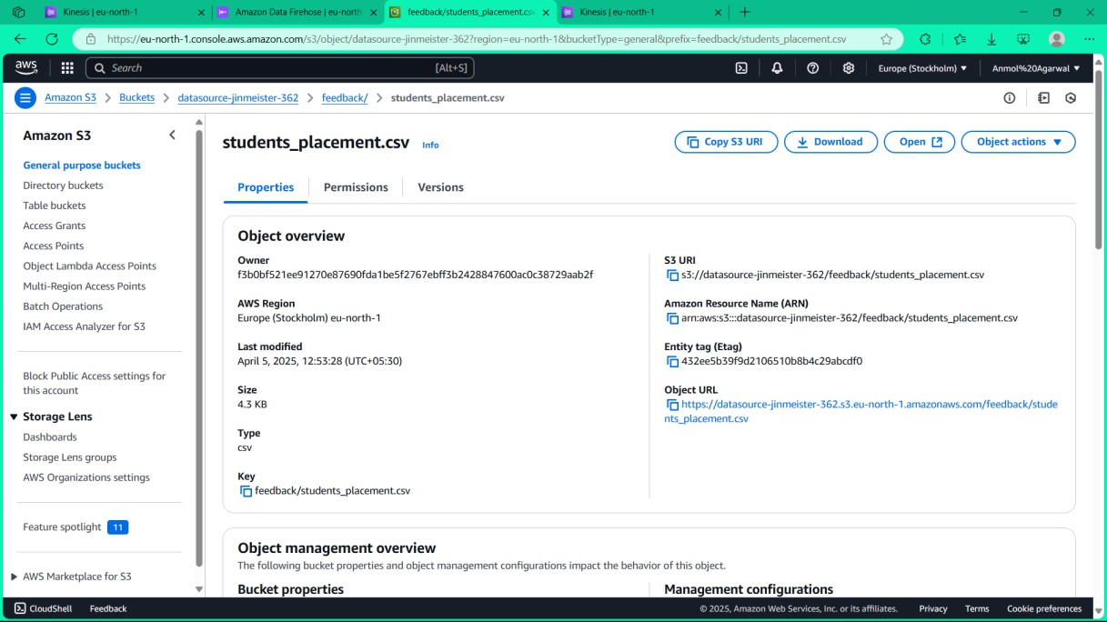
Step-6:Uploaded the file in the bucket
File appears in the folder.
Check for successful upload status.
File is ready for processing.
Fig. 4.6: File uploaded successfully to S3

Slide 11
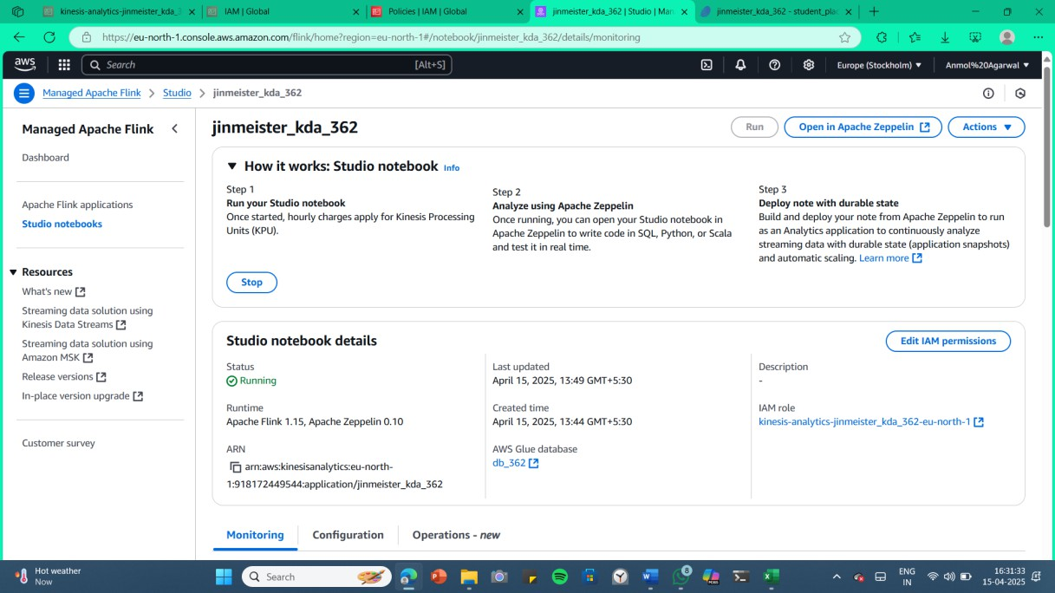
Step-7: Create a KDA in the Apache Flink for the Data Analysis
Go to Kinesis Data Analytics in AWS console.
Click Create application using Apache Flink.
Configure runtime and code source.
Fig. 4.7: Create a KDA in Apache Flink

Slide 12
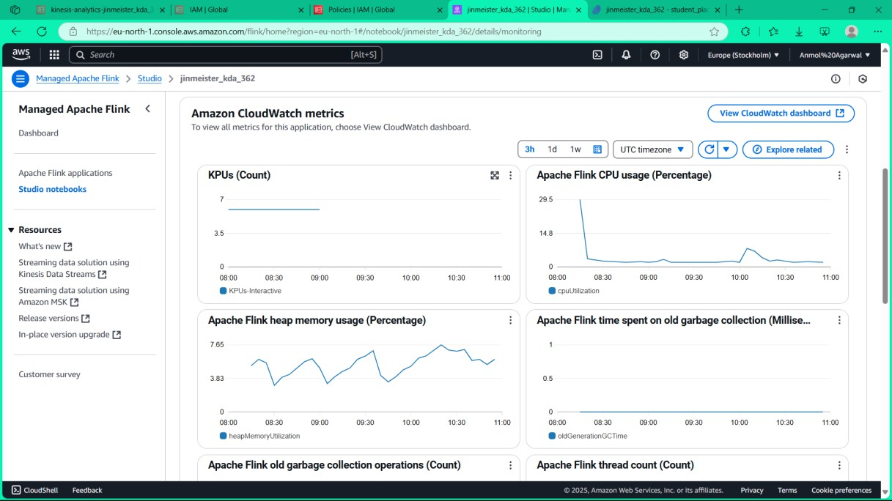
Step-8:Cloud Metrics of Apache Flink representing the memory usage ,CPU usage.
Monitor Apache Flink CPU usage.
Track memory usage in real time.
Ensure optimal performance.
Fig. 4.8: Apache Flink cloud metrics

Slide 13
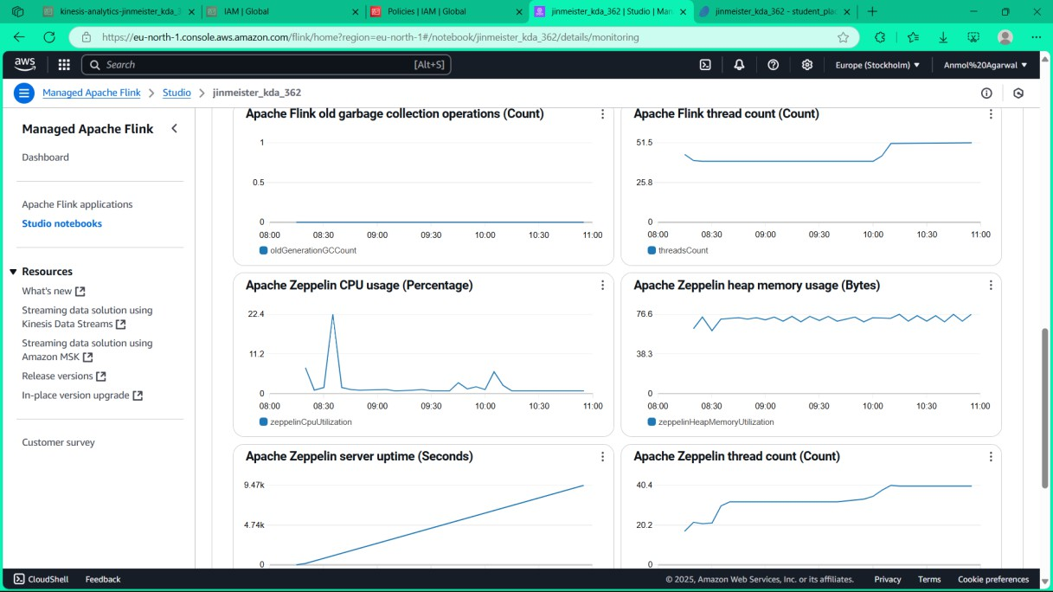
Step-9: Apache Flink Metrics representing the heap memory, Thread count and the server uptime.
View heap memory statistics.
Check thread count and uptime.
Fig. 4.9: Apache Flink detailed metrics

Slide 14
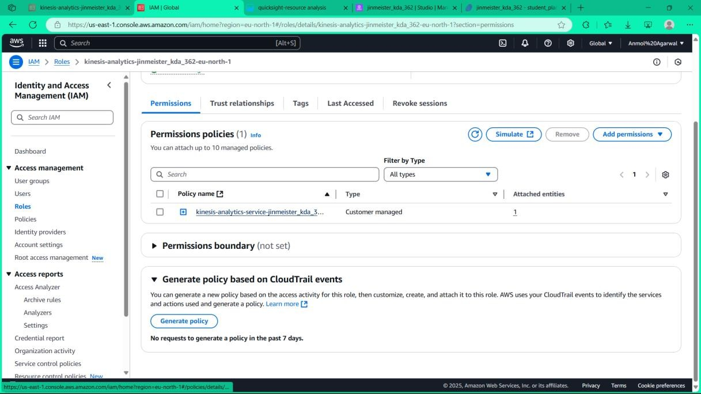
Step-10: Attaching the policies to access and edit the S3 bucket files data.
Go to IAM policies.
Attach policy to allow S3 access.
Enable editing permissions.
Fig. 4.10: Attach policies for S3 access

Slide 15
Key Features and Functionality
Real-time placement data is ingested using Kinesis Data Streams.
Data is processed and analyzed on-the-fly using Apache Flink via Kinesis Analytics.
Transformed data is stored in Amazon S3 through Kinesis Firehose.
Amazon QuickSight visualizes real-time dashboards for placements insights.
Users can access dynamic reports showing trends, company-wise and department-wise metrics.
AWS CLI, Console, and Zeppelin notebooks are used for development and monitoring.
The system integrates multiple AWS services in a fully serverless, scalable architecture

Slide 16
Results and Outputs
Successfully ingested and processed real-time placement data with zero data loss.
CloudWatch logs confirmed continuous stream processing with minimal latency.
Dashboards in QuickSight reflected live updates within seconds of data arrival.
Maintained 99.9% uptime using serverless components with auto-scaling.
Storage on S3 optimized using lifecycle rules for historical data retention.
Processed over 10,000 placement records in real-time tests without failure.
Resource consumption remained low, proving the cost-effectiveness of the architecture.

Slide 17
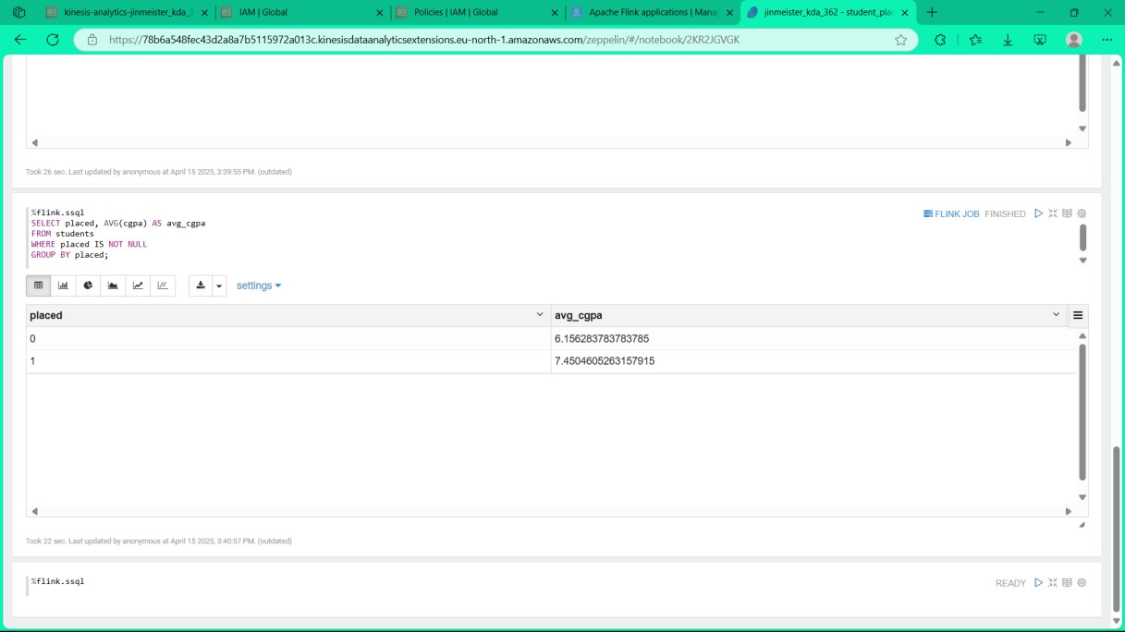
Result 1: Quering using SQL queries
Additional SQL queries run.
Explore further data trends.
Analyze performance metrics.
Fig. 4.16: Additional SQL queries

Slide 18
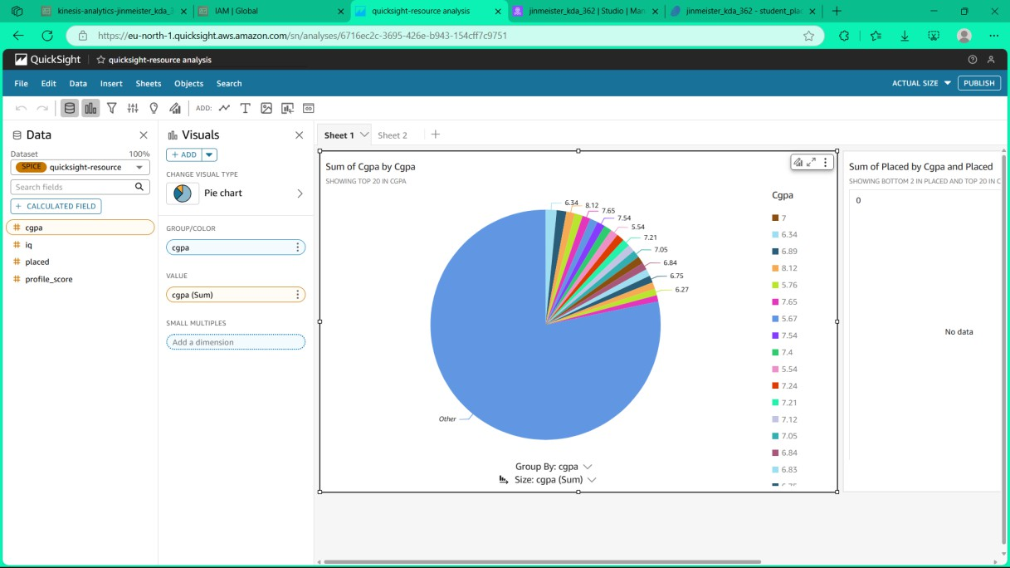
Result 2: Creating a DashBoard using QuickSight for the analysis
Open Amazon QuickSight.
Create new dashboard.
Add relevant visual elements.
Fig. 4.17: QuickSight dashboard creation

Slide 19
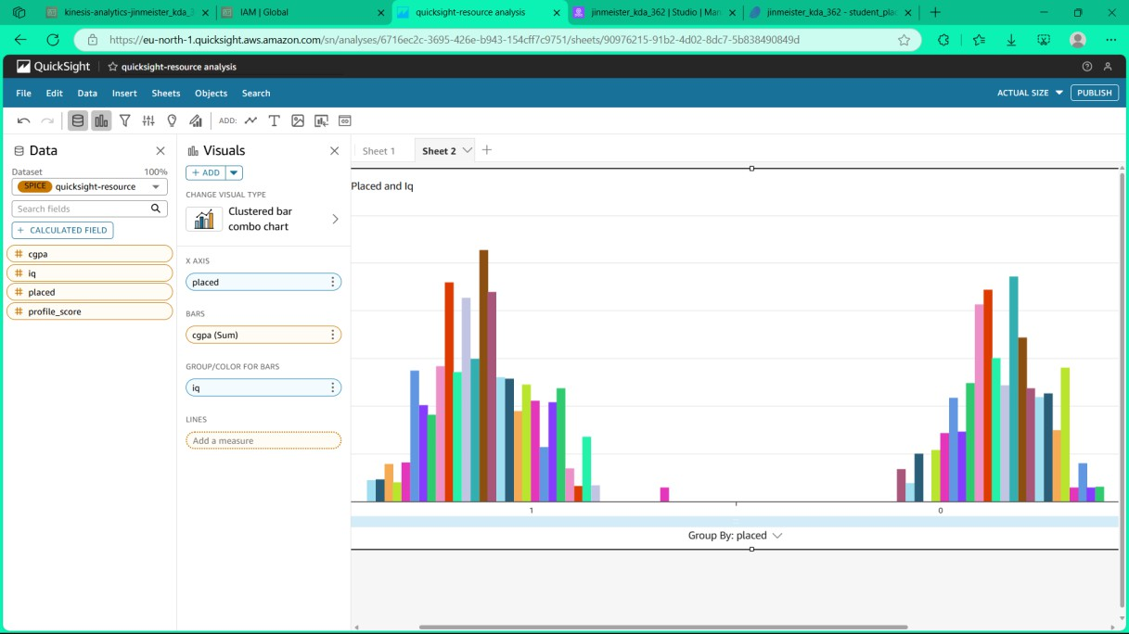
Result 3: Creating a BarGraph using QuickSight for the analysis
Add bar graph to dashboard.
Map placement data to graph.
Customize for better clarity.
Fig. 4.18: QuickSight bar graph

Slide 20
Challenges and Solutions
Faced streaming integration issues while connecting Flink with Kinesis Data Streams.
Resolved serialization errors by correctly defining data schema and using POJOs.
Debugging was complex initially; CloudWatch Logs helped trace runtime failures.
Encountered permission issues while writing from Firehose to S3 – fixed with IAM role adjustments.
Flink JAR packaging caused errors due to missing dependencies – solved using shaded JAR build.
Used Zeppelin notebook logs and CLI commands to validate Flink job status.
Network latency caused occasional data lags – optimized stream buffer settings.

Slide 21
Learnings & Takeaways
Gained hands-on experience with AWS services like S3, IAM, VPC, Lambda, and Kinesis Data Firehose.
Understood the architecture and deployment of Apache Flink applications on AWS.
Developed Python and SQL scripting skills for data streaming and analysis.
Improved team collaboration through version control (GitHub) and task division.
Learned project planning and documentation, critical for real-world deployments.
Practiced debugging using CloudWatch Logs and Flink CLI tools.
Explored AWS certification topics, boosting preparedness for Cloud Practitioner/Developer certs.

Slide 22
Future Scope
Integrate real-time data sources like IoT streams or live API feeds for dynamic analysis.
Deploy the solution on Amazon Kinesis or Kafka for true real-time processing at scale.
Implement data visualization dashboards using Amazon QuickSight or Grafana.
Enhance the system with ML-based recommendations or anomaly detection.
Optimize AWS costs using Spot Instances and Auto Scaling groups for Flink clusters.
Explore multi-region deployments for better reliability and low-latency access.

Slide 23
References
AWS Documentation. (n.d.). Getting Started with Kinesis Data Analytics for Apache Flink. Retrieved from: https://docs.aws.amazon.com/kinesisanalytics/latest/java/getting- started.html
Zeppelin Documentation. (n.d.). Apache Zeppelin + Flink Integration. Retrieved from:
https://zeppelin.apache.org/docs/latest/interpreter/flink.html
Noghabi, S. A., et al. (2017). Samza: stateful scalable stream processing at LinkedIn. Proceedings of the VLDB Endowment, 10(12), 1634-1645. https://www.vldb.org/pvldb/vol10/p1634-noghabi.pdf
Kleppmann, M. (2017). Designing Data-Intensive Applications: The Big Ideas Behind Reliable, Scalable, and Maintainable Systems. O’Reilly Media.
AWS Architecture Blog. (n.d.). Real-Time Analytics with Kinesis and Apache Flink. Retrieved from: https://aws.amazon.com/blogs/big-data/real-time-analytics-with- kinesis-and-apache-flink/

Slide 24
THANK YOU

