Slide 1
SHARE thE MEAL
Group Members – Satyajeet Yadav (220343120095)
Anmol Jadhav (220343120013)
Aniket Patil (220343120012)
Shrikant Patange (220343120069)
Project Guide – Mrs. Harshita Maheshwari

Slide 2
Contents
Introduction
Choice of topic
Methodology
Proposed System Model
Proposed Approach
Screenshot
System Requirements
Applications
Advantages & Limitations
Conclusion
Future Scopes
References

Slide 3
Introduction
in today’s world. One third of all food produced in the world goes to waste.
Some restaurants/cafés have a policy to not serve food from previous day, despite being perfectly edible. This is all thrown away as “waste”, at the end of day. At the same time, worldwide most of people do not have enough to eat. That means one in nine people are suffering from hunger. Also many street animals haven`t get food minimum one time in a day.
Our project provides a way to bridge the gap between the wastage and deficit, by letting restaurants donate this food to needy like food community, animal care organizations, Food processing units etc.

Slide 4
Choice of topic
Through this project Any one can donate waste food .
Companies can find donated food for making feed products(for waste food recycling).
Feed product which are made using waste food can be sell in this project.

Slide 5
Methodology
The objective is to create a web site that can perform the following:-
Connecting to an HTTPS site through GPRS/WIFI.
Opening the relevant React page using HTTPS POST & GET methods.
Read the data logically into admin, donor and company.
Creating a local database.

Slide 6
Proposed System Model
There are three main modules:
Admin Donor Company
1 Home 1 Home 1 Home
2 Add donor 2 Add food 2 See all donators
3 delete donor 3 Donate 3 Get foods
4 View profile 4 Delete food 4 Sell products
5 Log Out 5 Log Out 5 Log Out

Slide 7
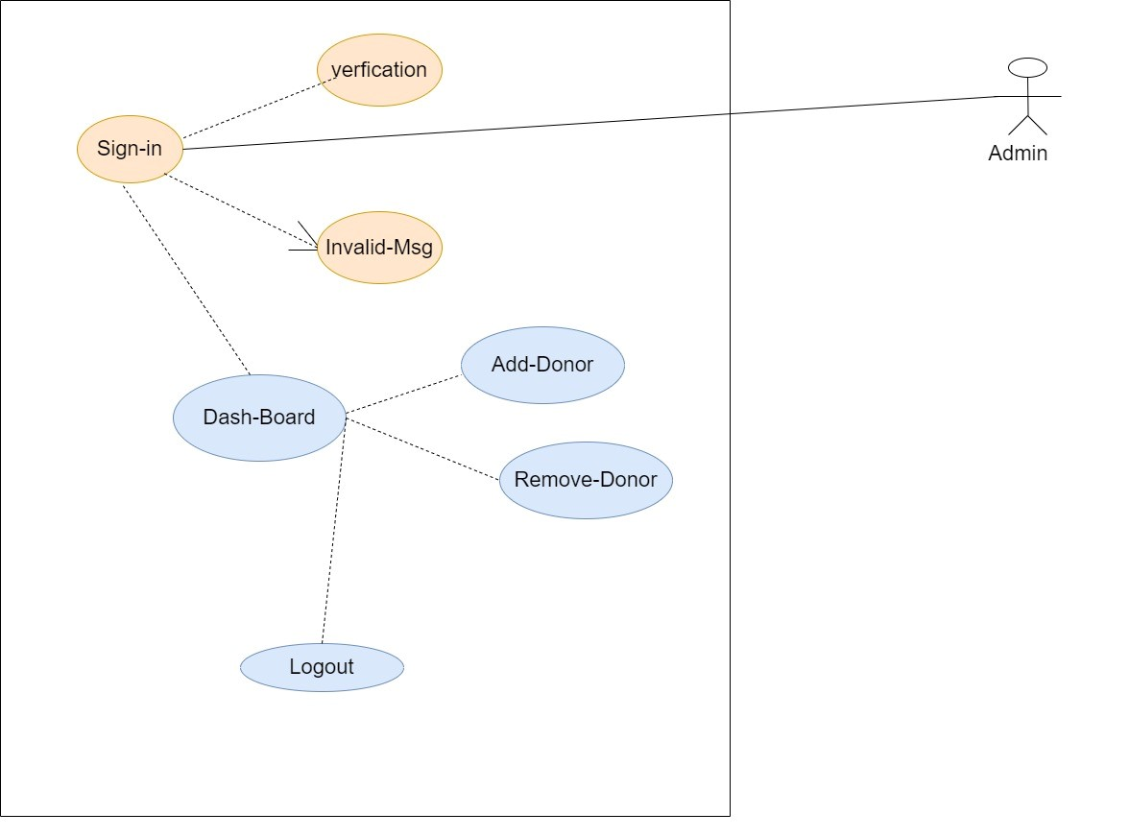
Proposed Approach

Slide 8
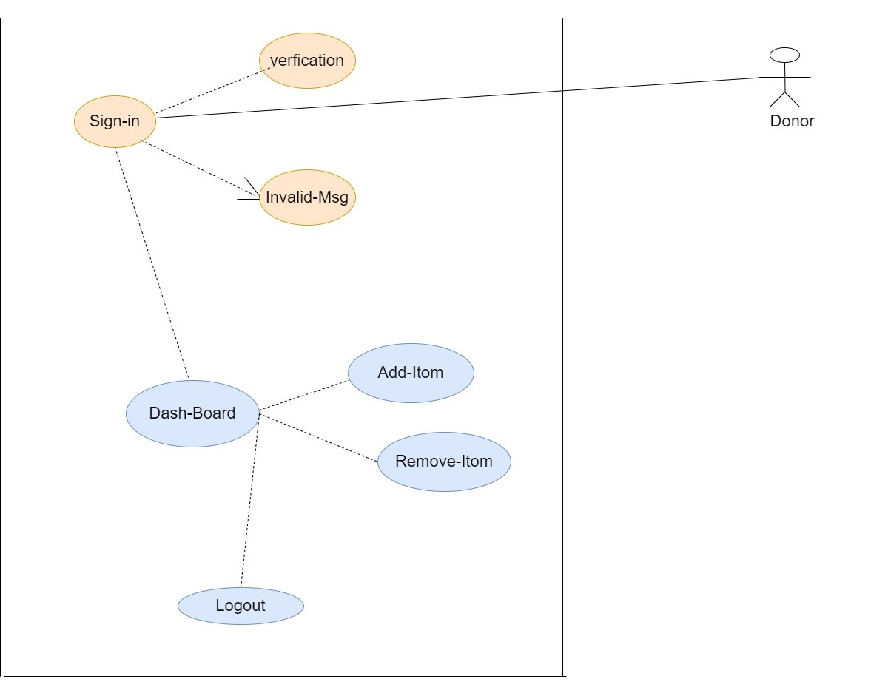

Slide 9
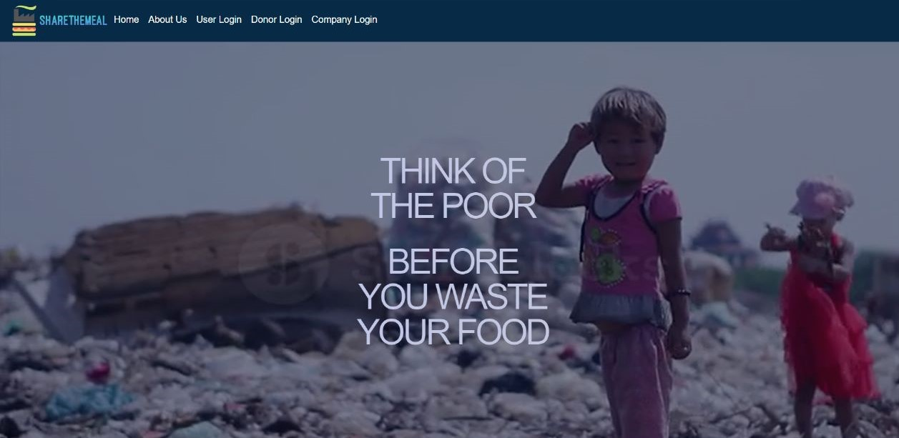
Screenshots

Slide 10
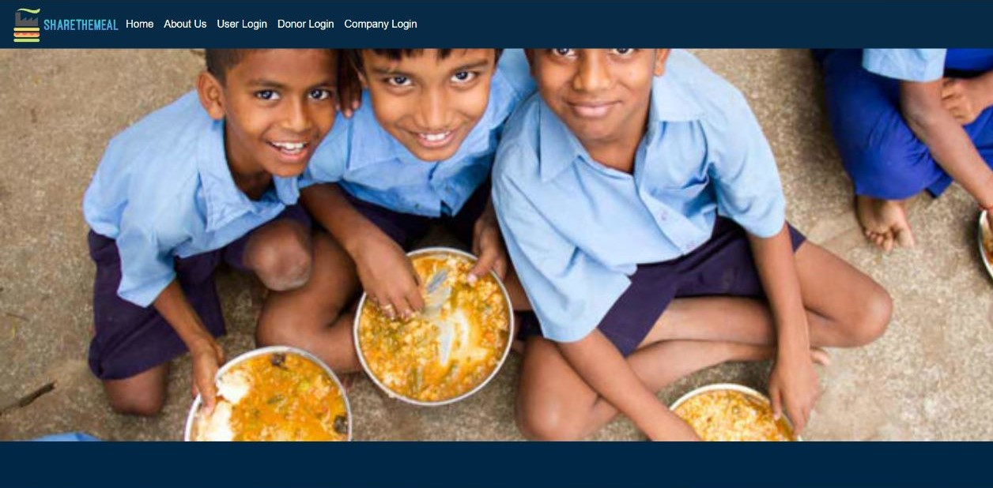
Home

Slide 11
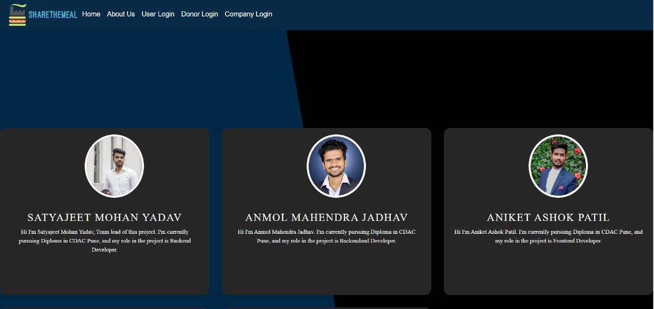
About us

Slide 12
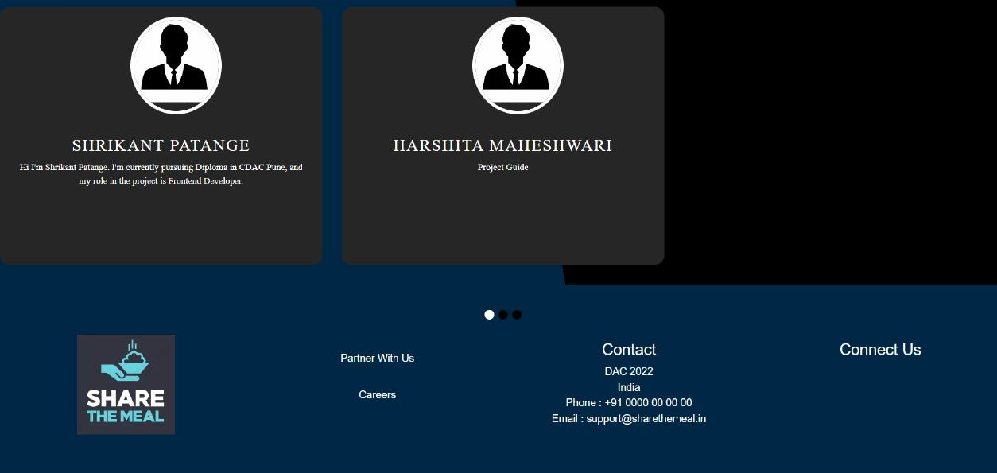

Slide 13
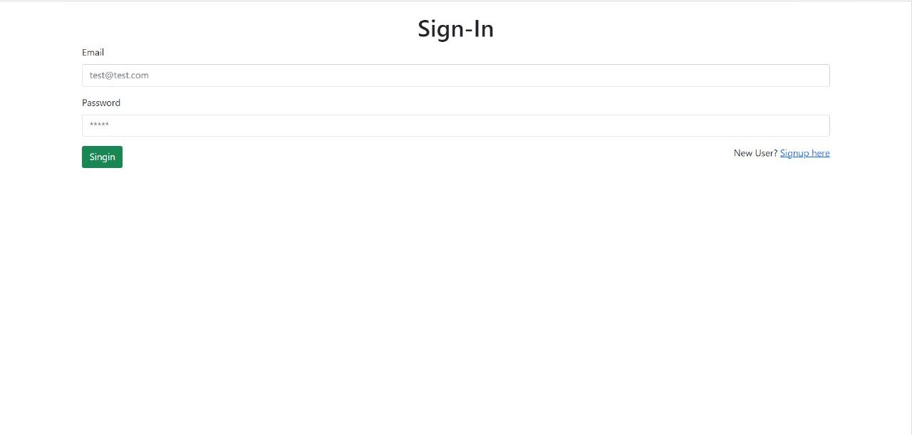
Admin Sign in

Slide 14
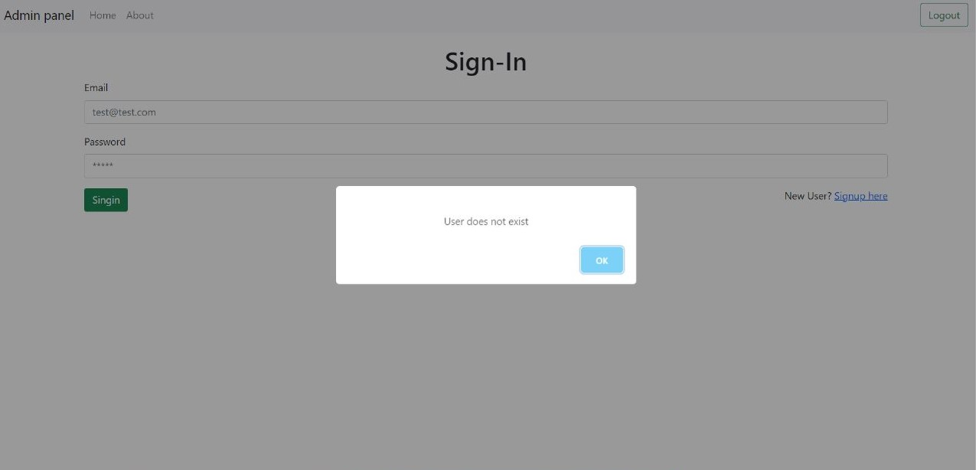

Slide 15
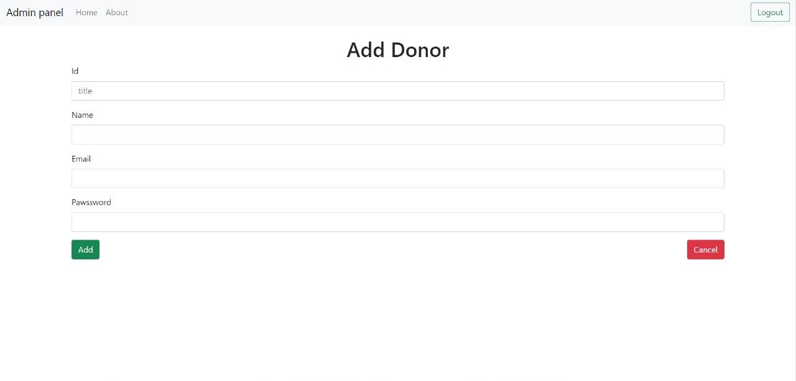
Admin Add Donor

Slide 16
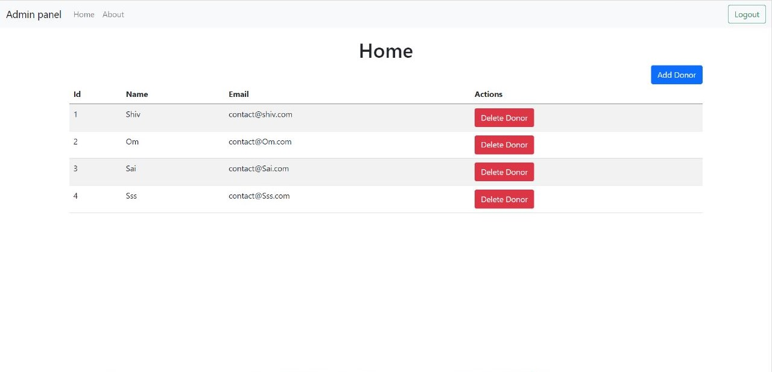
Admin Home

Slide 17
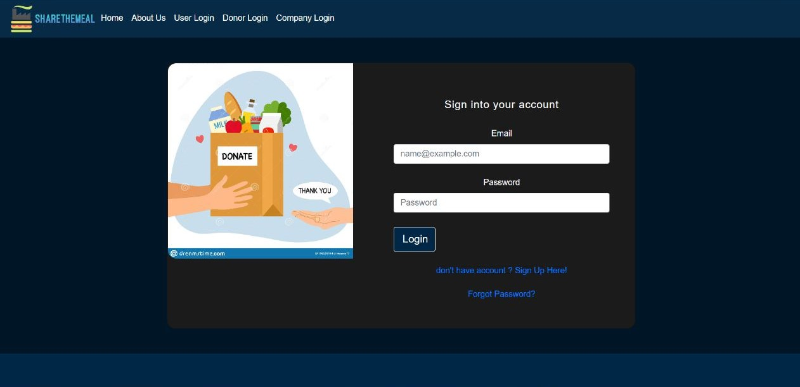
Donor Sign-in

Slide 18
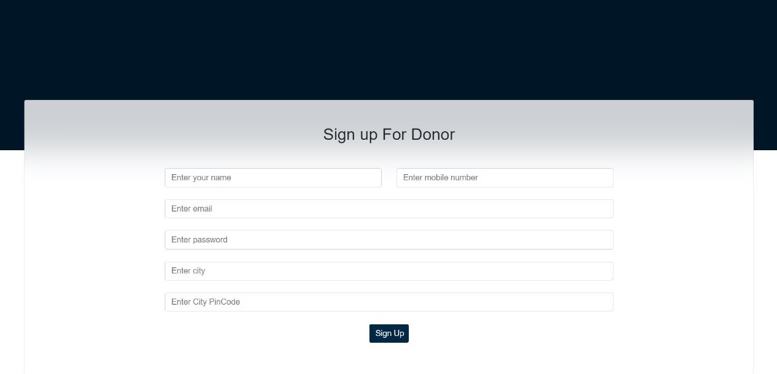
Donor Sign-up

Slide 19
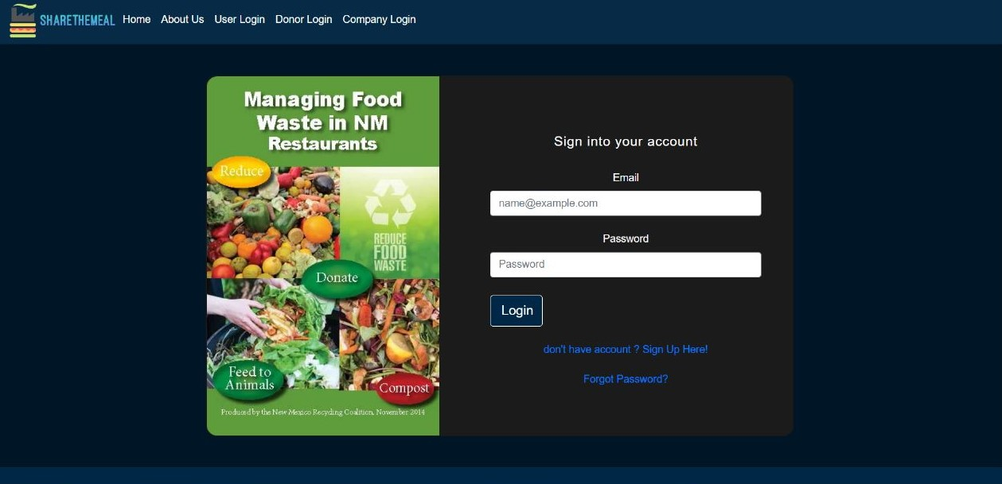
Company Sign-in

Slide 20
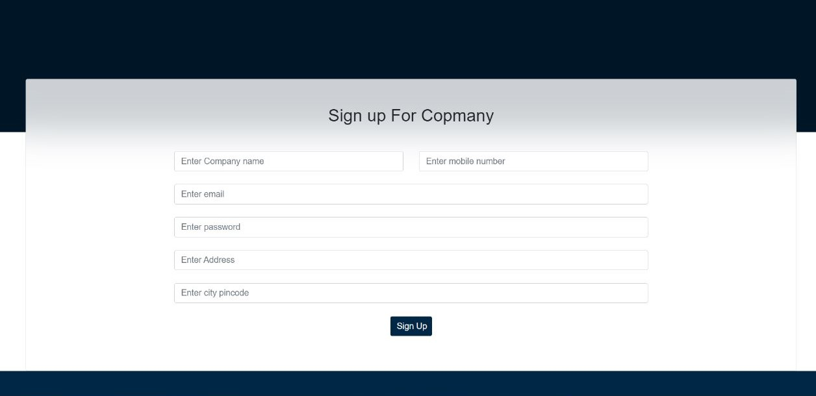
Company Sign-up

Slide 21
System Requirements
Software Requirements:
• Windows (All Versions)
• Node.js , React.js, Express.js
• STS, MySQL
Hardware Components:
• Processor – i3
• Hard Disk – 5 GB
• Memory – 1GB RAM

Slide 22
Technologies Used
React : All front end logic has been written in React.
JAVA : All the business logic has been written in JAVA.
MySQL : MySQL database has been used as database.
STS :To make app of spring boot.
Postman: To check API without frontend.

Slide 23
Applications
Donate waste food.
Find waste food donors .
For companies find waste food donors and after food processing sell products which are made after recycling.

Slide 24
Advantages
Transparency in the system.
Saves Time, cost and energy.
Easy system to donate waste food .
Easy to find donors .
For companies simple platform to sell products.

Slide 25
Limitations
Accurate verification of the users cannot be done online .
It requires an extensive database and memory .

Slide 26
Conclusion
Share The Meal will be designed and developed to overcome the drawbacks of old manual system of sharing waste food. This system will digitalize the waste food donation . It will bring transparency between donors and receivers . It will save time & energy of everyone using this portal. For companies also this system is easy to find waste food donors . Company get platform to sell their products in same project .

Slide 27
Future Scope
Improvement in design.
Mobile Application
Online payment system.

Slide 28
References
Mr. Saleel Bagde for Database.
Mrs. Harshita Maheshwari for React.
Mrs.Mayuri Fakirpure for Java & Advance Java.
A special thanks to Infoway Technologies.

Slide 29
THANK YOU

