Slide 1


By – Anmol Khandelwal(181520009) FullStack Developer Intern Technovert Solutions
Bank Application
Employee Directory

Slide 2
About Company:
Cloud Transformation
Artificial Intelligence
Product Engineering
Data Analytics
Experience Design
Digital Transformation

Slide 3
Technologies Used in Backend:
C# using .Net framework
.netcore Application 3.1
Visual Studio
For Database Connectivity:-
SSMS (SQL Server Management studio)
(A). ADO.net
(B). Entity Framework
Github

Slide 4
UseCase
It is console application that Simulate a bank account which supports creation of account, closing an account, withdrawals, deposits, transfer funds
Use cases to be taken into consideration while developing the application:
Setup new Bank
A Set Default RTGS and IMPS charges for same bank
1 RTGS-0%
2 IMPS-5%
B Set Default RTGS and IMPS charges for other bank
1 RTGS- 2%
2 IMPS- 6%
3 Add default accepted currency as INR
Create a page where user will get options to login as account holder or bank staff

Slide 5
If User is bank staff then he should be able to perform following actions
a Create new account and give username and password to account holder
b Update / Delete account at any time
c Add new Accepted currency with exchange rate
d Add service charge for same bank account
RTGS
IMPS
e Add service charge for other bank account
RTGS
IMPS
f Can view account transaction history
g Can revert any transaction

Slide 6
If User is account holder he should be able to perform following actions
Deposit amount (any currency but bank will convert it to INR and will accept the deposit)
Withdraw amount (INR only)
Transfer funds (INR only)
Can view his transaction history
NOTE:
Bank ID pattern - Starting letters of bank name + current date
Account ID pattern - Starting 3 letters of account holder name + current date
Transaction ID Pattern – “TXN” + bank ID + Account ID + current date
Github Link: https://github.com/anmol26/ATM

Slide 7
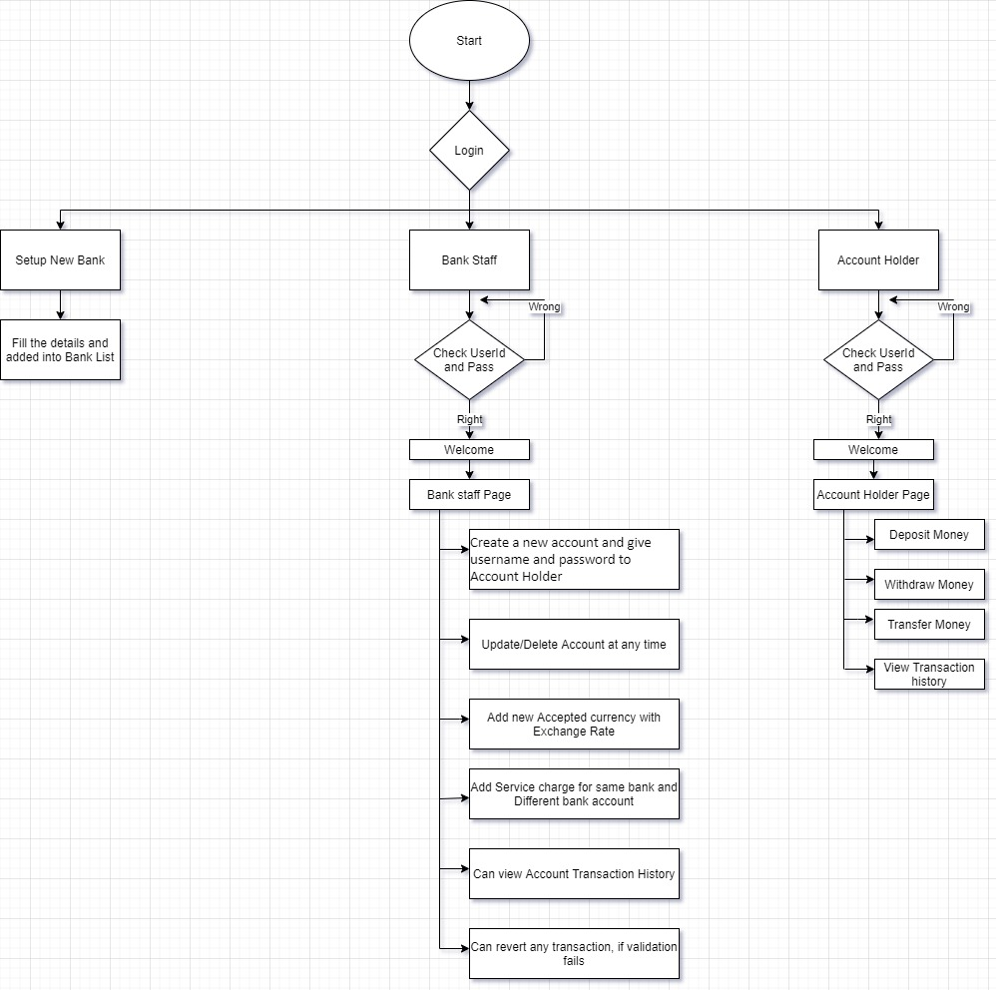
Flow Chart

Slide 8
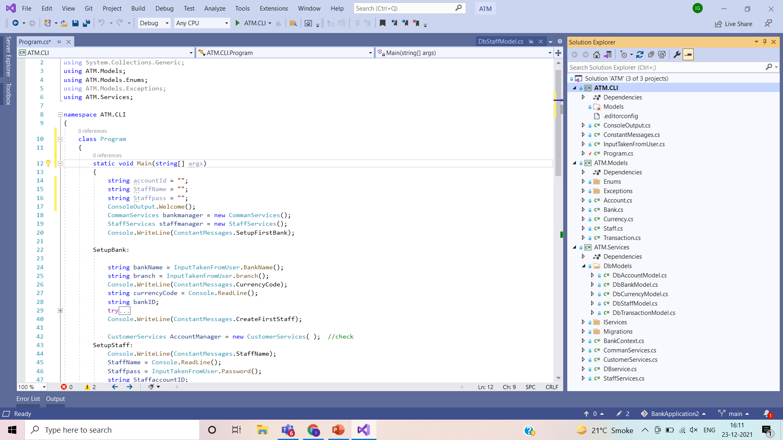
Project Overview

Slide 9
Models

Slide 10
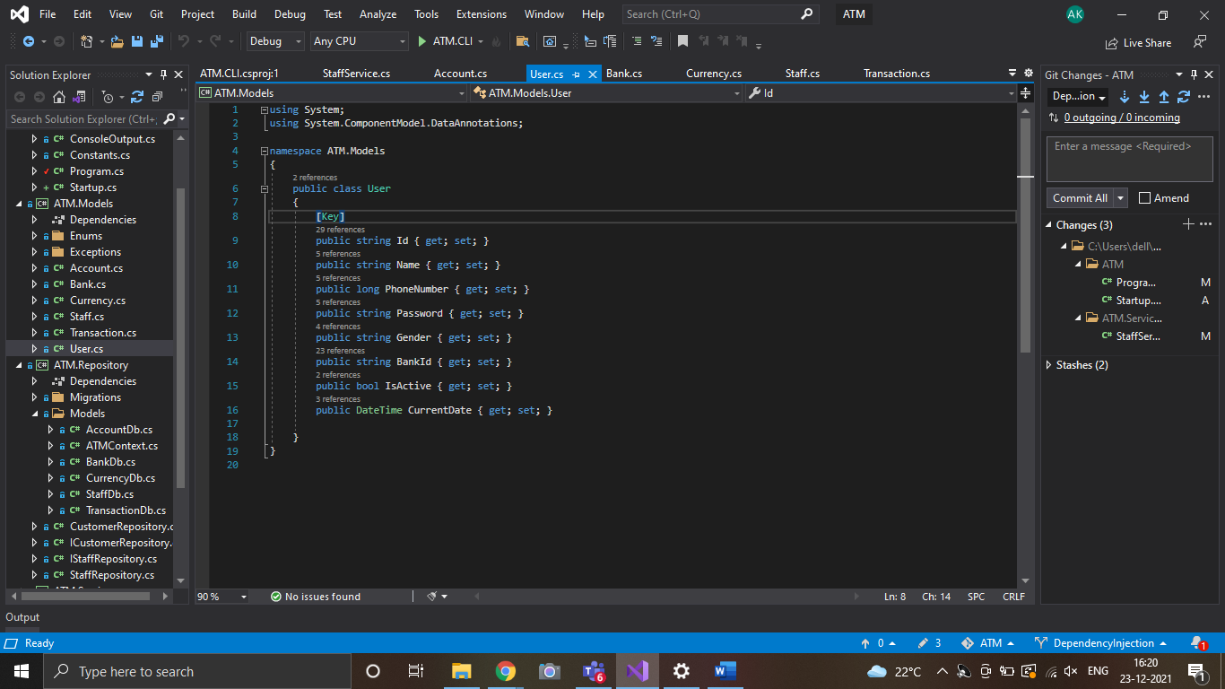

Slide 11
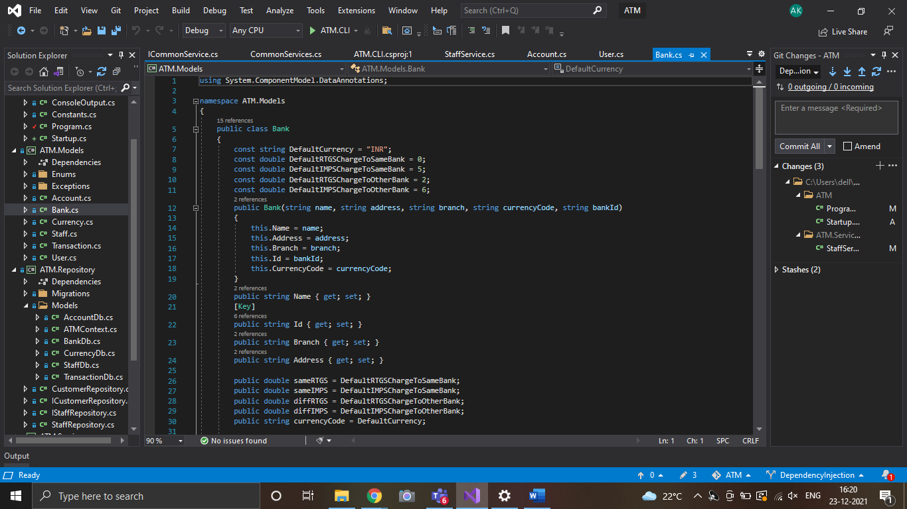

Slide 12
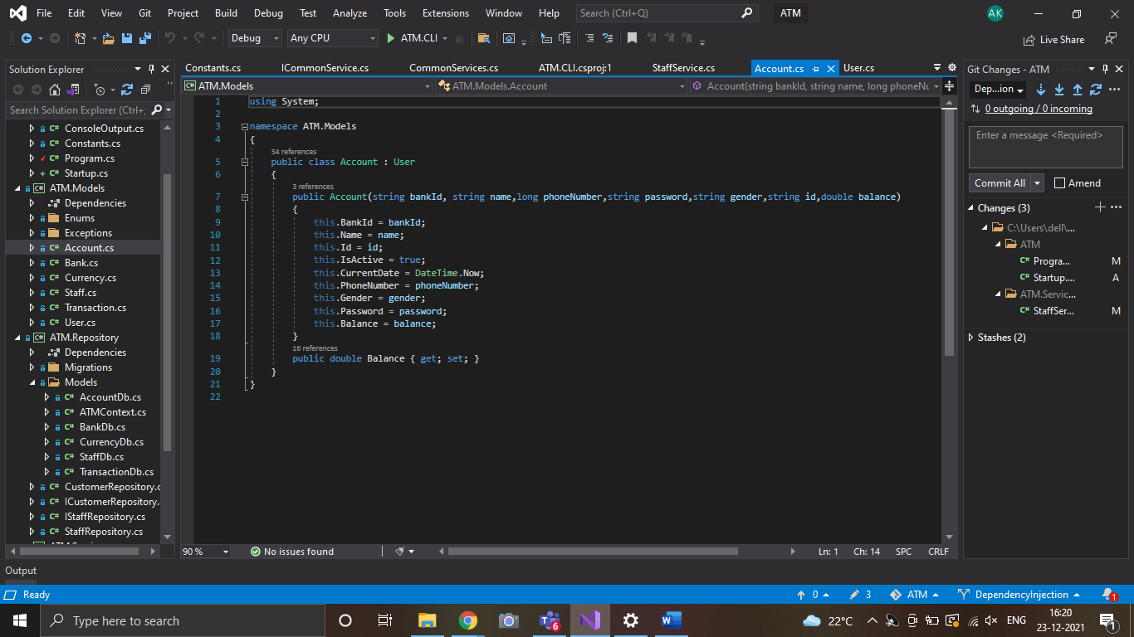

Slide 13
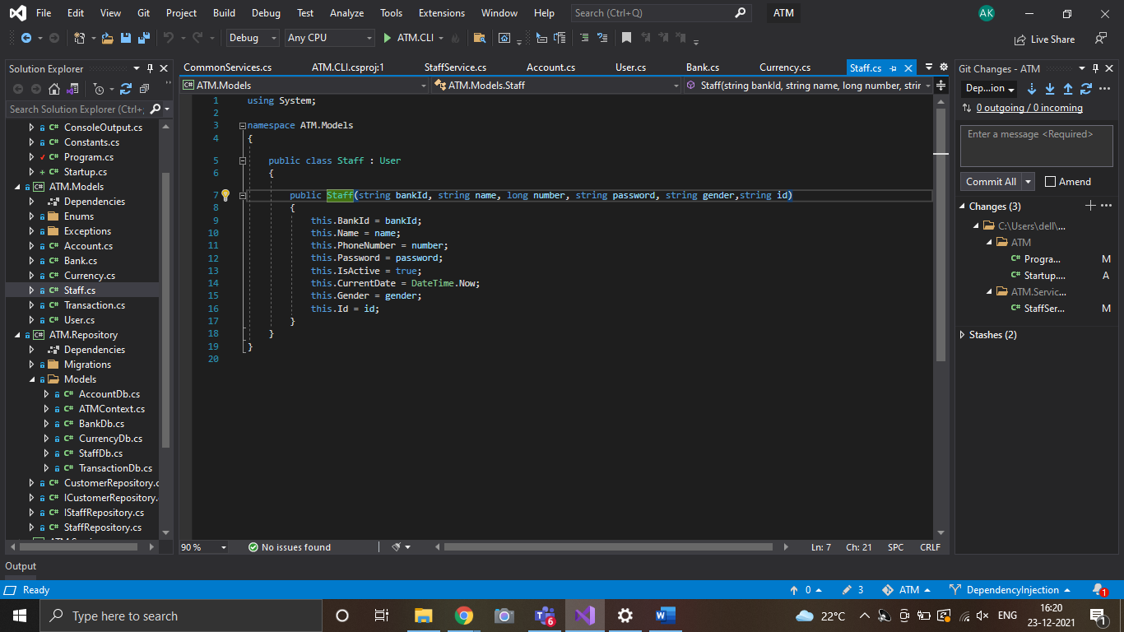

Slide 14
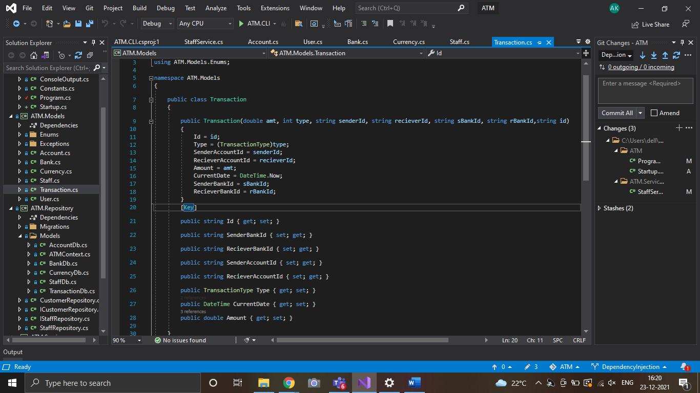

Slide 15
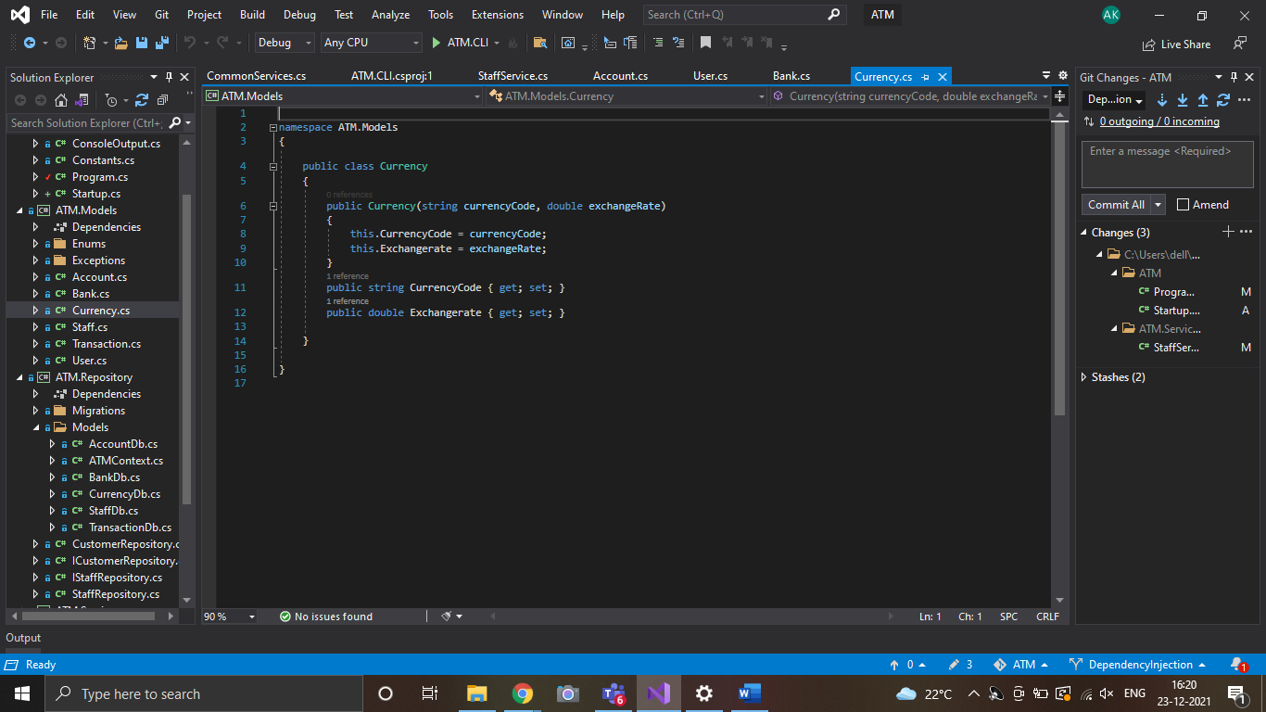

Slide 16
SQL Server DataBase

Slide 17
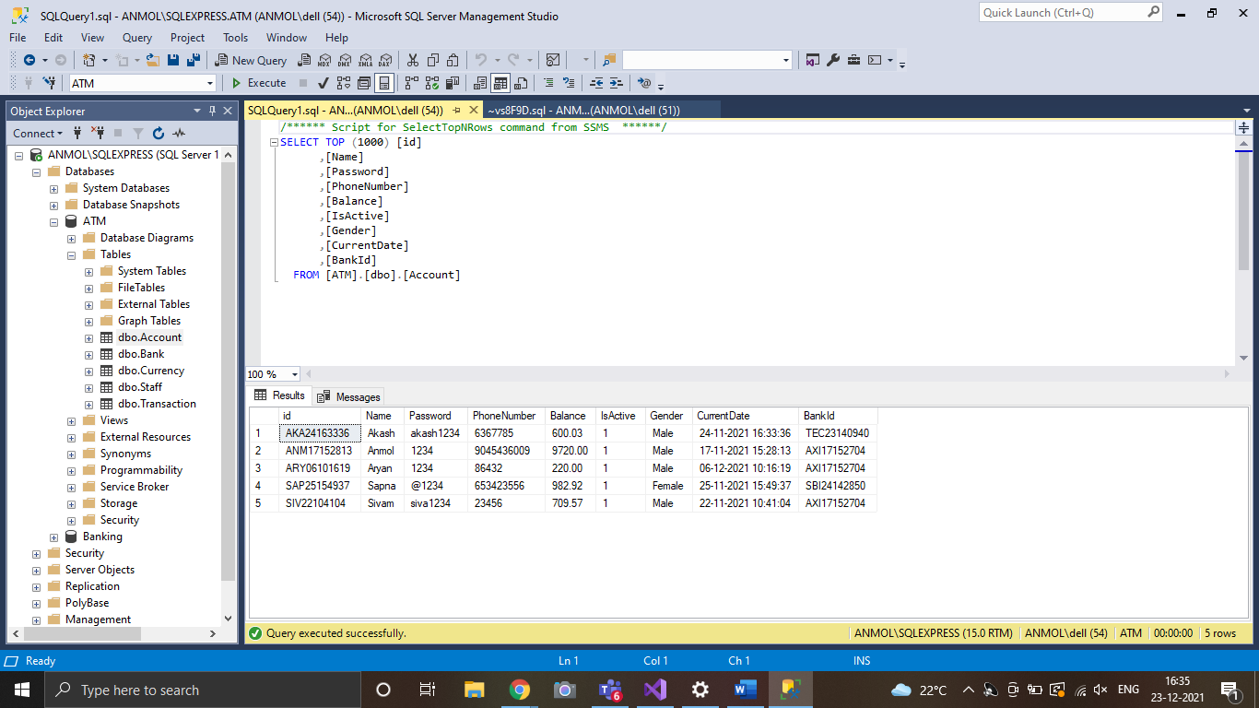

Slide 18
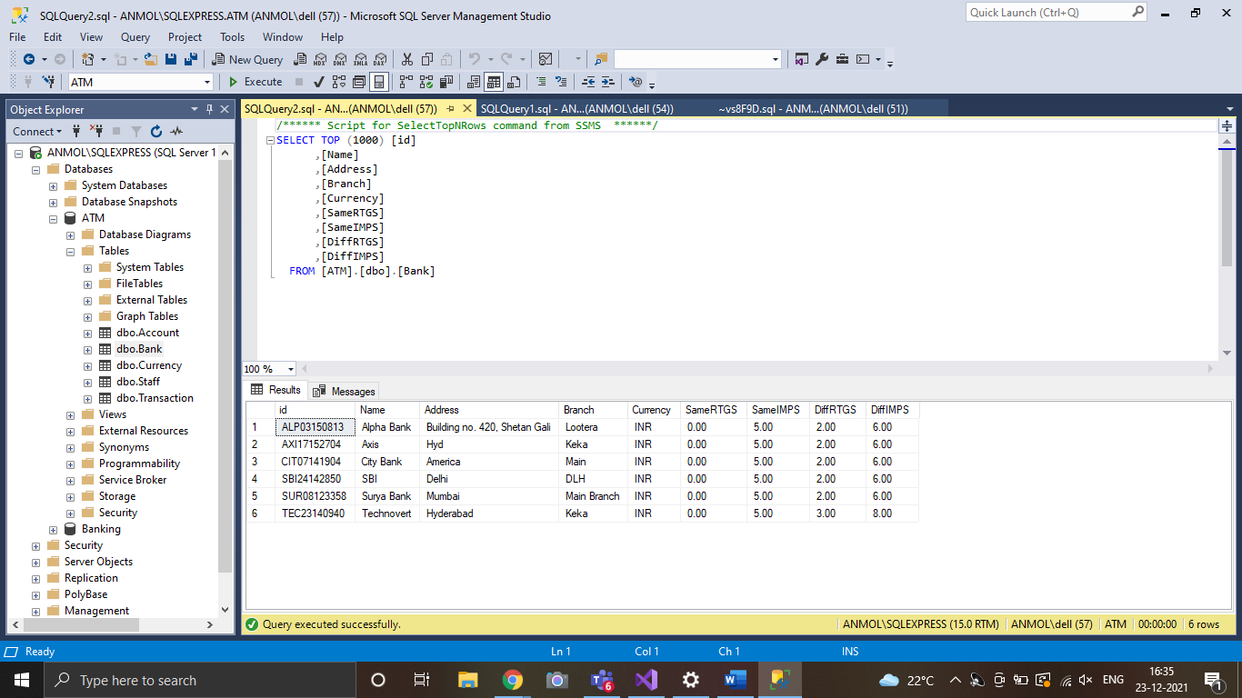

Slide 19
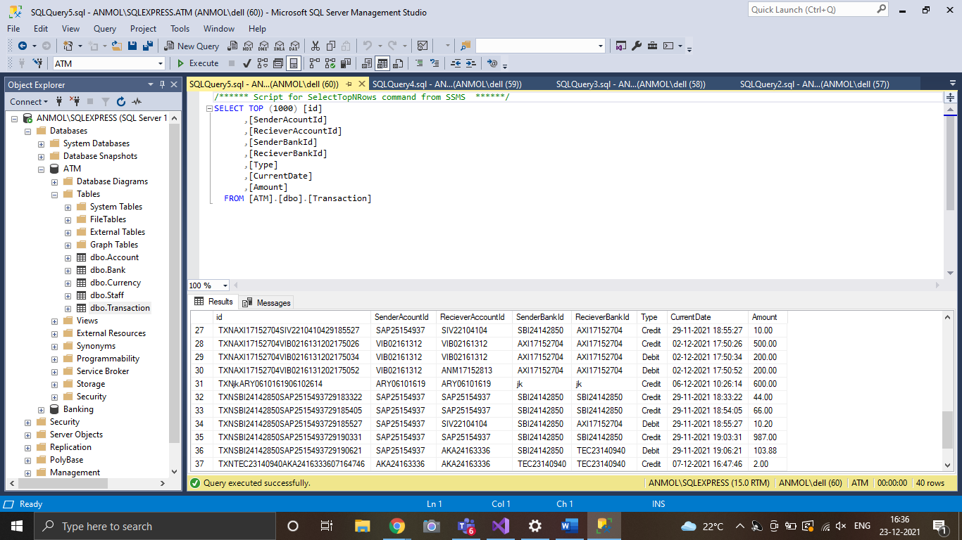

Slide 20
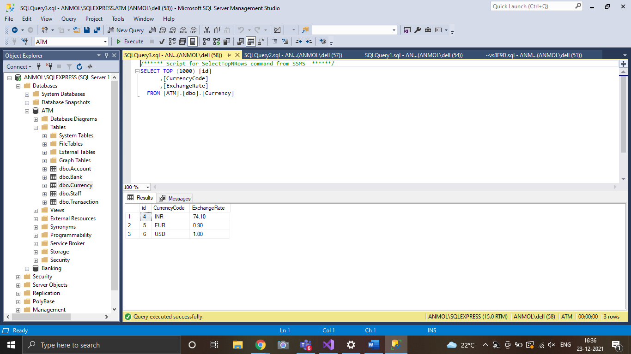

Slide 21
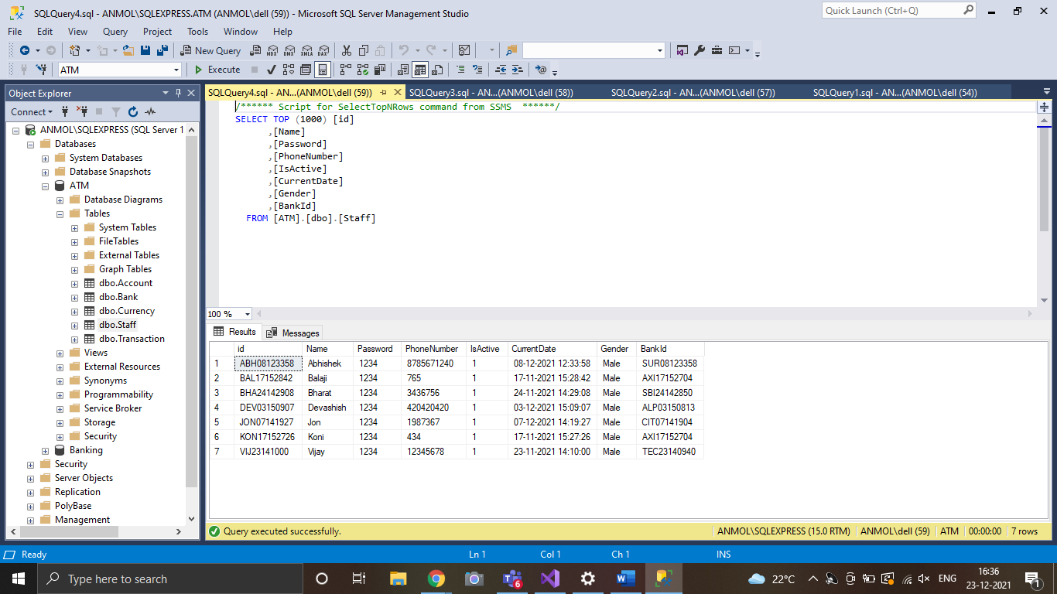

Slide 22
Front-End Project: Address Directory

Slide 23
Technologies Used in Frontend:
HTML5
HTML stands for Hyper Text Markup Language.
It is used to design web pages using markup language. HTML is the combination of Hypertext and Markup language.
Hypertext defines the link between the web pages. Markup language is used to define the text document within tag which defines the structure of web pages.
HTML 5 is the fifth and current version of HTML. It has improved the markup available for documents and has introduced application programming interfaces(API) and Document Object Model(DOM).

Slide 24
1. Syntactically Awesome Style Sheet is the superset of CSS. 2. SCSS is the more advanced version of CSS. SCSS was designed by Hampton Catlin and was developed by Chris Eppstein and Natalie Weizenbaum. 3. Due to its advanced features it is often termed as Sassy CSS. 4. SCSS have file extension of .scss. 5. SCSS contains all the features of CSS and contains more features that are not present in CSS which makes it a good choice for developers to use it. 6. SCSS is full of advanced features. 7.SCSS offers variables, you can shorten your code by using variables. It is a great advantage over conventional CSS.
Scss:-

Slide 25
1. JavaScript is the Programming Language for the Web. 2. JavaScript can update and change both HTML and CSS. 3. JavaScript can calculate, manipulate and validate data. 4. What can JavaScript Do? Following are some examples of what JavaScript can do: a. JavaScript Can Change HTML Content b. JavaScript Can Change HTML Attribute Values c. JavaScript Can Change HTML Styles (CSS) d. JavaScript Can Hide HTML Elements e. JavaScript Can Show HTML Elements
Javascript:-

Slide 26
1. Bootstrap 5 is the newest version of Bootstrap, which is the most popular HTML, CSS, and JavaScript framework for creating responsive, mobile-first websites. 2. Bootstrap will no longer be using the jQuery library. 3. It has improved grid system. 4. We can use unlimited bootstrap icon library. 5. Bootstrap 5 is completely free to download and use!
Bootstrap5:-

Slide 27
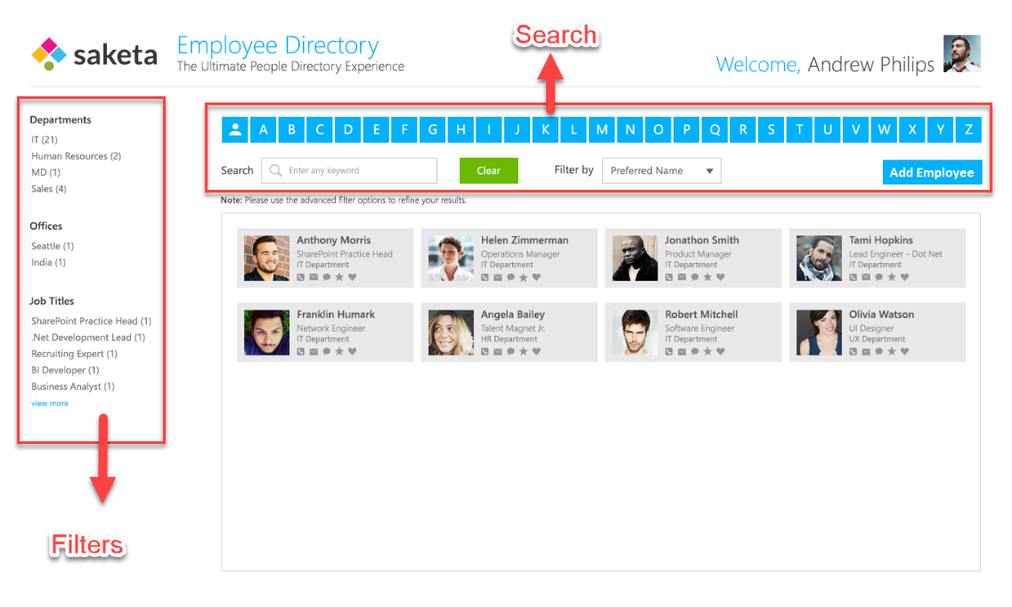
---MockUp Page:-
UseCase:

Slide 28
1. The directory homepage should be designed as the mock-up above. 2. Employee will have properties like - First Name - Last Name - Preferred Name (auto populated from First Name and Last Name) - Email - Job Title - Office - Department - Phone Number - Skype ID 3. Create a pop-up to add new employees with all the above properties with validations. 4. Employees should be searchable by properties mentioned above. Search should be available by both Alphabet and input on selected Filter By property. (See search in Image) 5. Functionality should be added to filter employees by Department, Offices and Job Title. (See filters in image) Github Link: https://github.com/anmol26/EmployeeDirectory

Slide 29
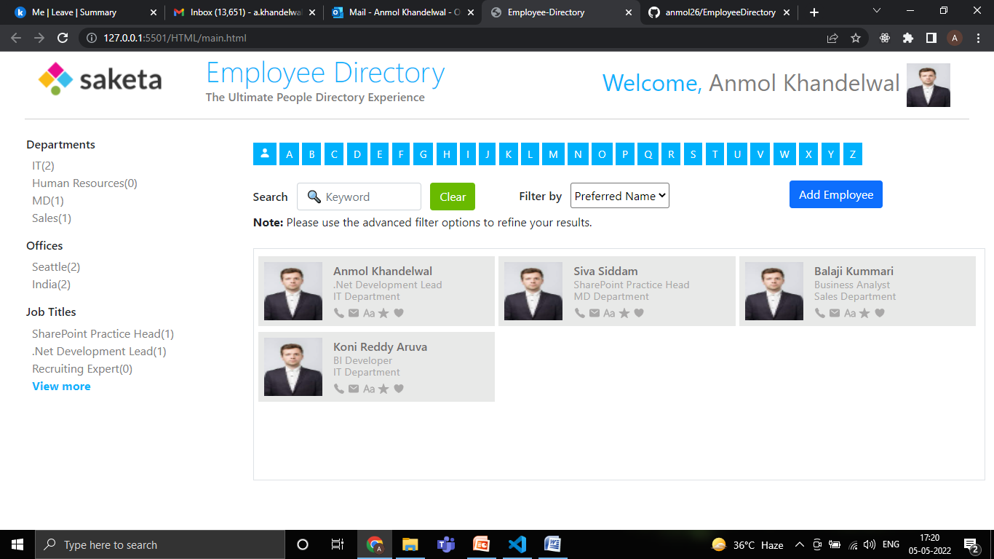
Final Output Screen:-

Slide 30
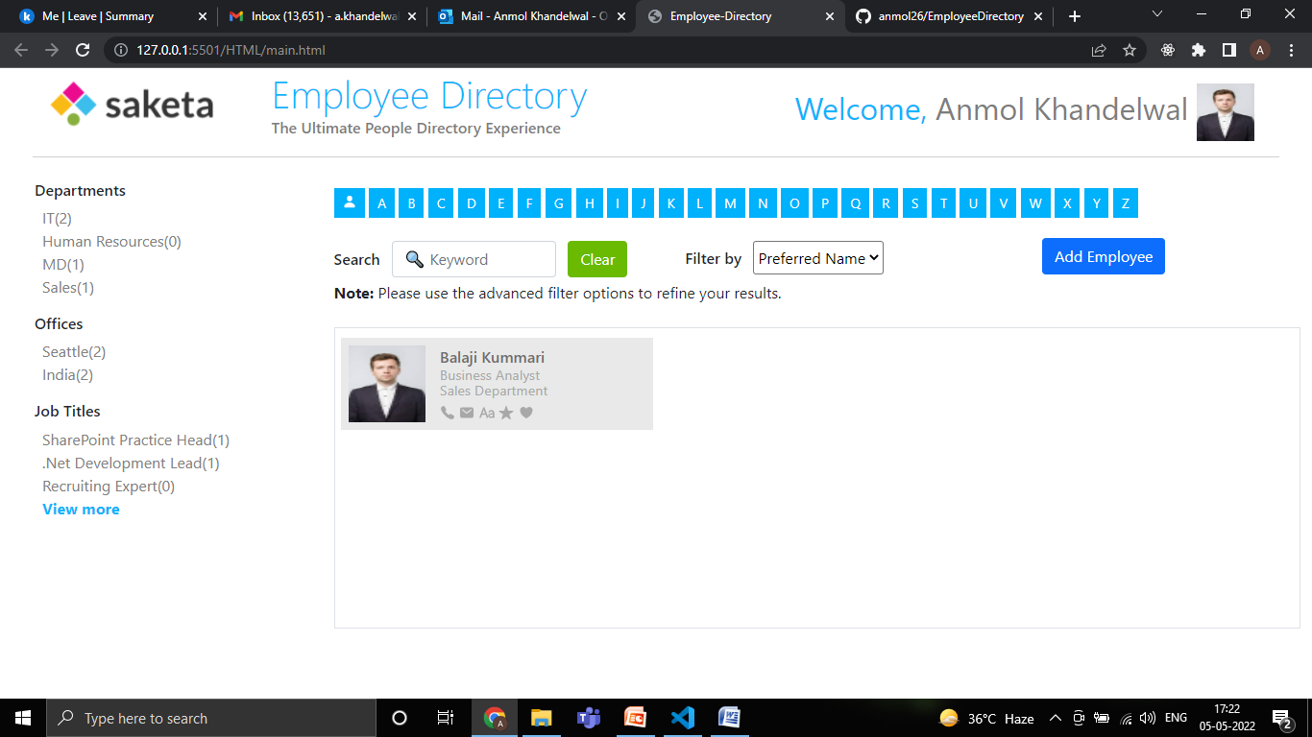
Using Filters:- if we apply the filter on Departments-> Sales then this result will come

Slide 31
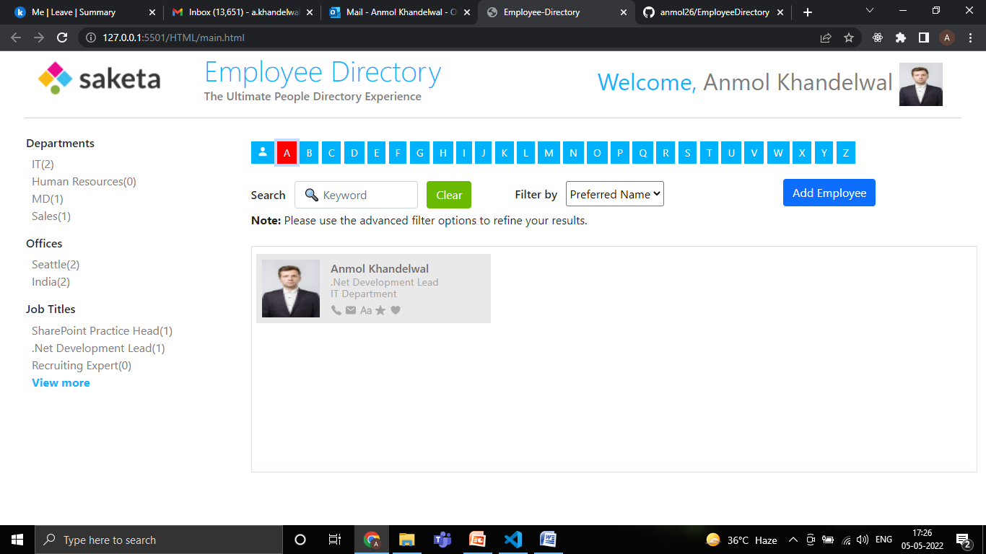
Using Search buttons:- if we click on button “A” then this result will come

Slide 32
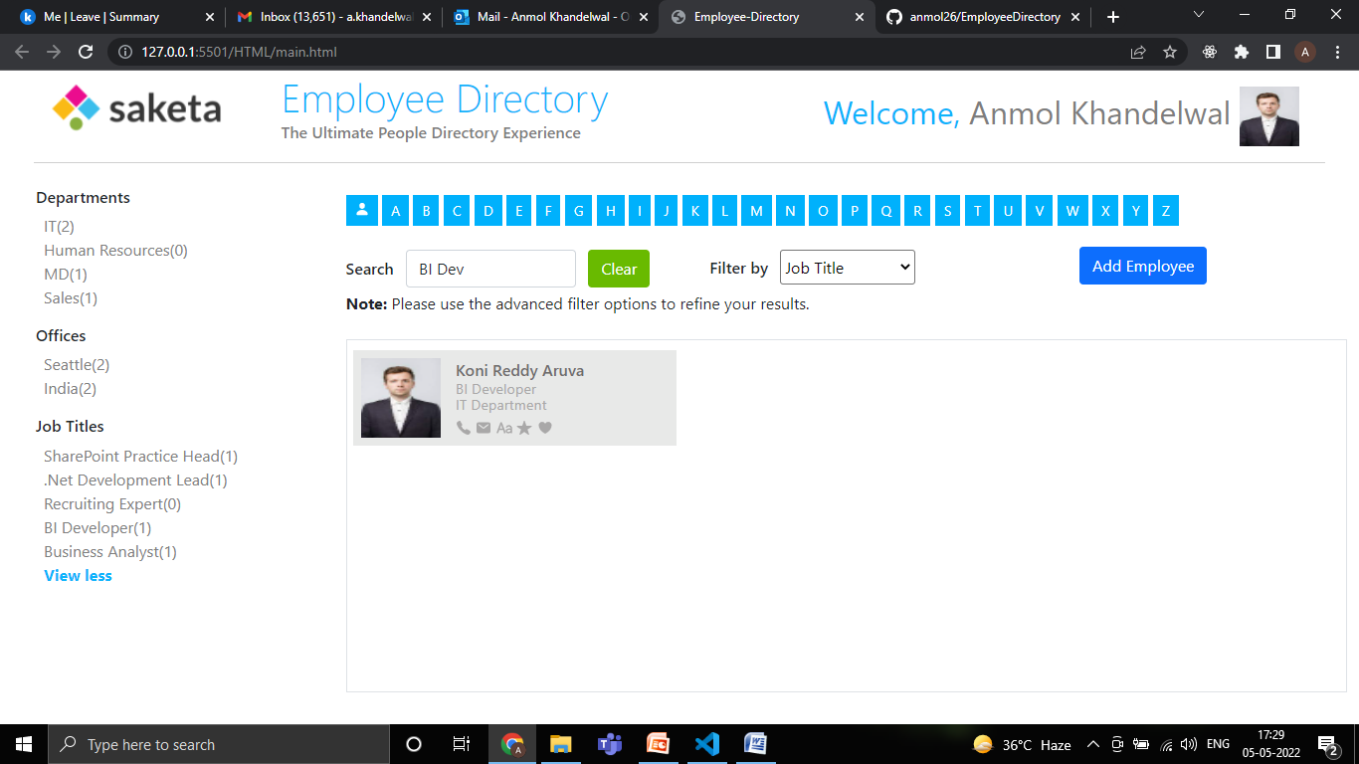
Filter by Input:- If we apply filter by “Job Title” and input “BI dev” then this result will come

Slide 33
Thank You!

