Slide 1
MOOD ME

Slide 2
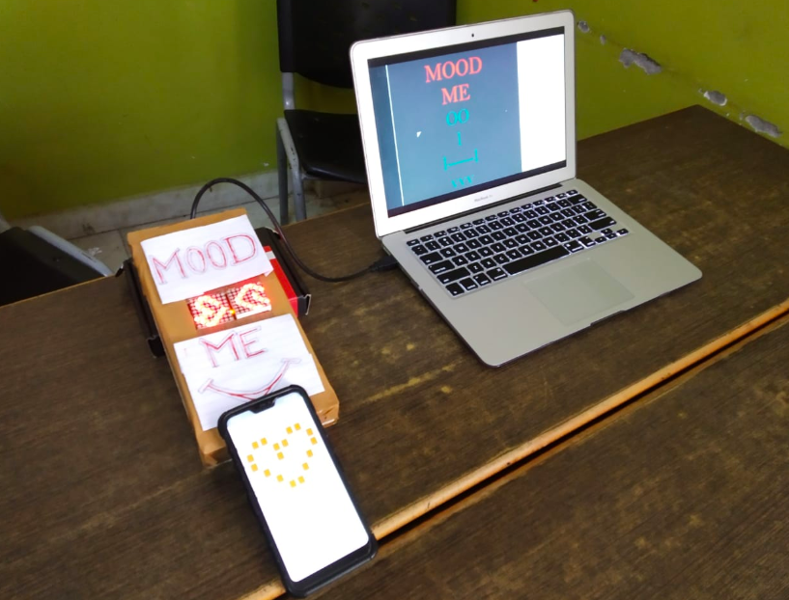
MOOD
ME
OO l l-----l vvv
.

Slide 3
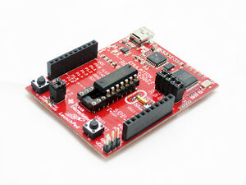
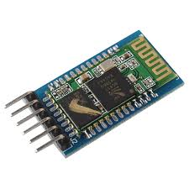
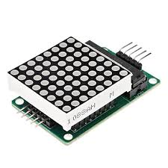
MSP430 LAUNCHPAD FROM TI
8X8 LED MATRIX
HC-05 BT MODULE
JUMPER WIRES
COMPONENTS USED

Slide 4
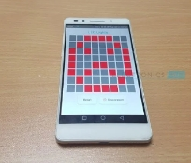
1.INPUT FROM USER (USING APP)
2.HC 05 BLUETOOTH MODULE
3.MSP430 BOARD
4.8X8 LED PANEL
5.MAX7219 LED DRIVER IC
6.LED
WORKING

Slide 5
ENERGIA IDE : FOR ALGORITHM
APP : - GOOGLE PLAYSTORE
SOFTWARE USED

Slide 6
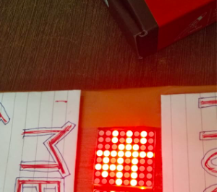
OUTDOOR DISPLAYS
POSTER DISPLAY.
PIXEL GAMING
CHARACTER DESIGN.
CAN BE USED IN BOTH TYPES :-
A). SHOW TEXT
B). ANY DESIRED SHAPE FIGURE
(DEPENDING UPON ONES MOOD)
IT REQUIRES LOW MAINTENANCE.
IT WILL WORK VIA APP.
LESS SPACE REQUIRED.
RANGE UPTO 10 MTRS(CAN BE EXTENDED)
ADVANTAGES

Slide 7
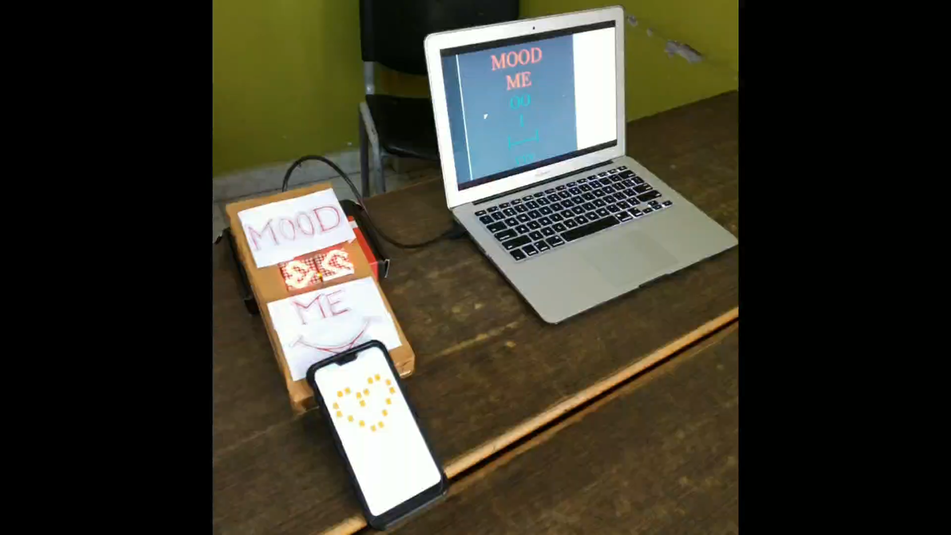
WORKING VIDEO

Slide 8
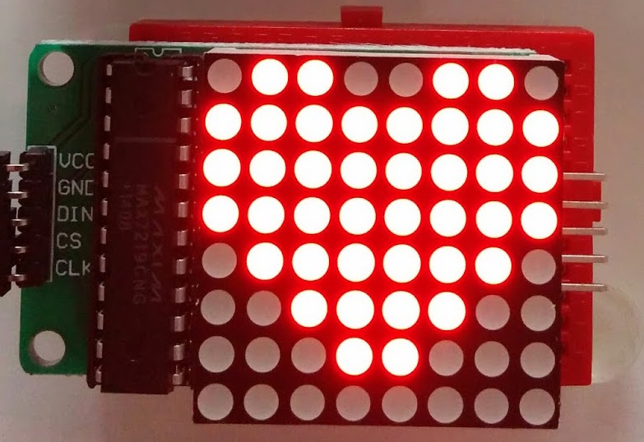
THANK YOU

