Slide 1
Static Testing

Slide 2
Overview
What is Static testing ?
What can be tested by Static testing ?
Participants in Static Testing
Benefits of Static Testing
Static vs Dynamic Techniques
Review Techniques
Formal vs Informal / Inspection vs Walkthrough
How to Review ?
Tips for Successful Review Process

Slide 3
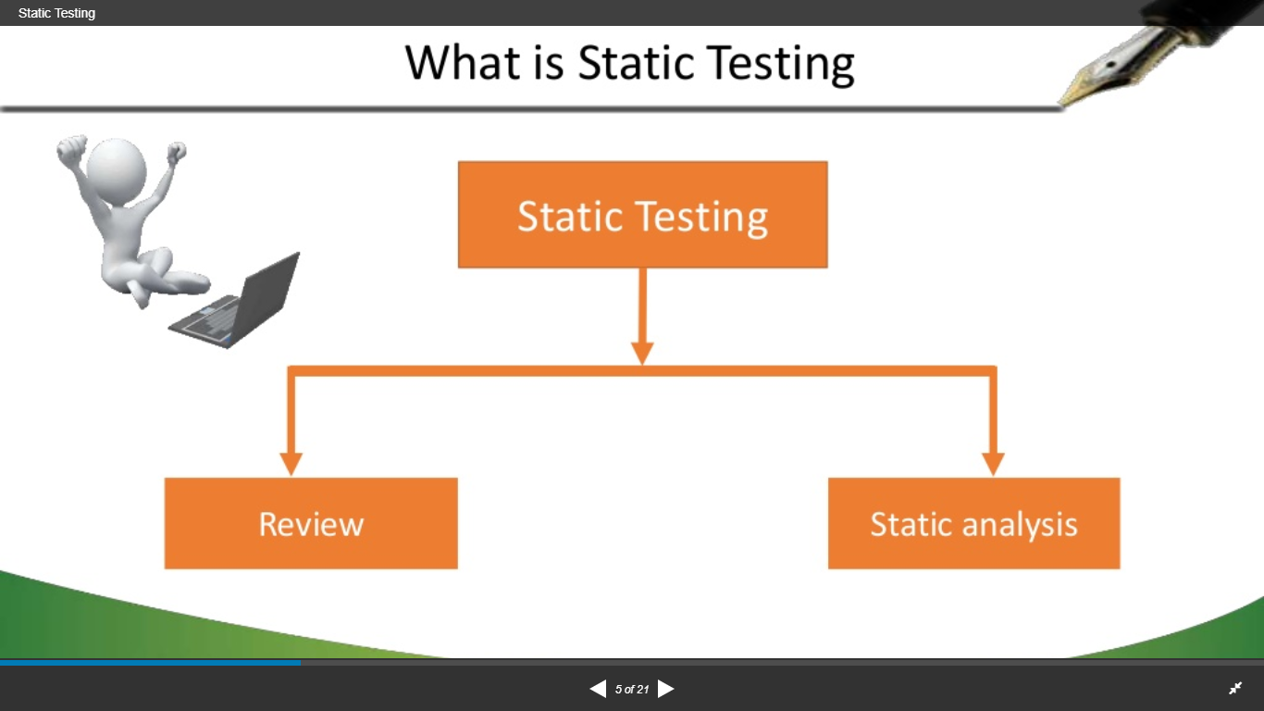
What is Static Testing ?
Static Testing is a software testing method that involves examination of program’s code and its associated documentation.
Also called as Dry-Run Testing.
Static testing is a stage of White Box testing.
Most static testing techniques can be used to test any form of document including source code , design documents and models, functional specifications and requirement specifications.

Slide 4
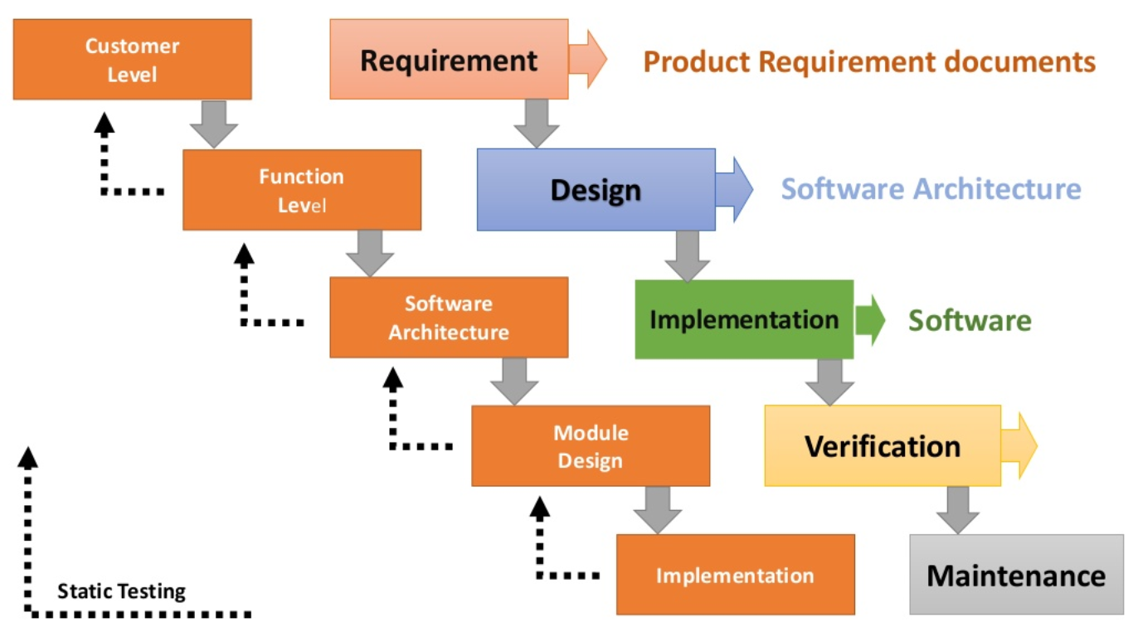

Slide 5
What can be tested by Static Testing ?
Requirement specifications
Design Document
Code
Schedules
Test plans, test cases, defect reports

Slide 6

Participants in Static Testing
Moderator
Author
Scribe
Reviewer
Manager

Slide 7
Participants in Static Testing
The moderator :
Also known as Review leader
Performs entry check
Follow-up on the rework
Schedules the meeting
Coaches other team
Leads the possible discussion and stores the data that is collected.

Slide 8
Participants in Static Testing
The Author :
Illuminate the unclear areas and understand the defects found.
Basic goal should be to learn as much as possible with regard to improving the quality of the document.
The Scribe :
Scribe is a separate person to do the logging of the defects found during the review.

Slide 9
Participants in Static Testing
The Reviewers :
Also known as checkers or inspectors
Check any material for defects, mostly prior to the meeting
The manager can also be involved in the review depending on his or her background.
The Manager :
Manager take decision on the execution of reviews.
Allocates time in project schedules and determines whether review process objectives have been met.

Slide 10
Benefits of Static Testing
Early Testing Principle
Rework cost in average is responsible for ~40% of the total software development cost
Engineers spend most of their compiling & testing, relying on these activities to detect defects
Development productivity can be improved and timescales reduced
Testing costs and time can be reduced
Reductions in lifetime costs
Improved communications results
Aiding in professional development for team members

Slide 11
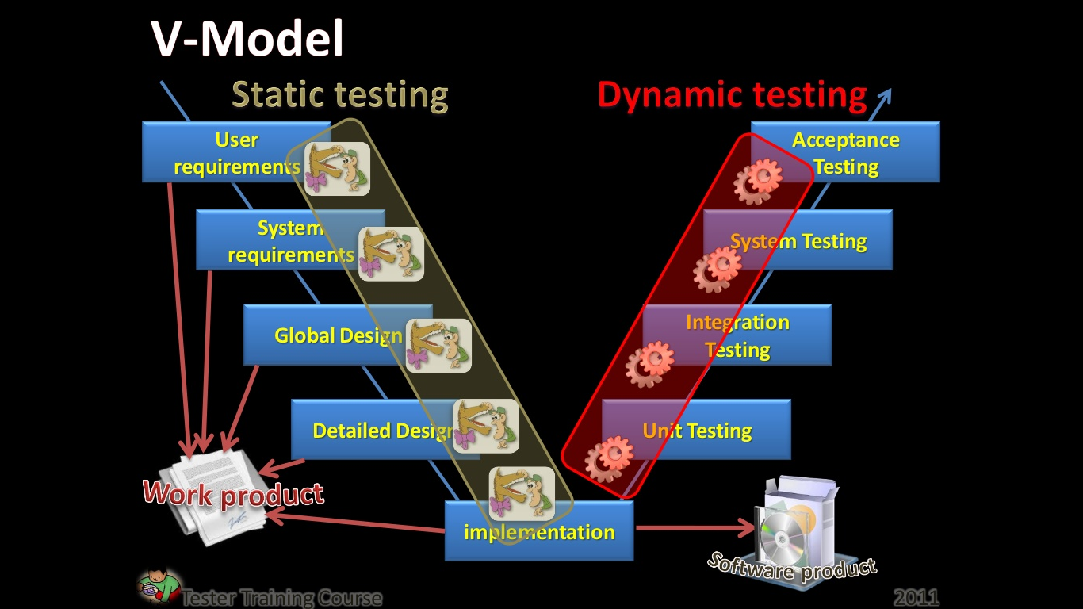
Static Testing vs Dynamic Testing

Slide 12
Verification vs Validation
Verification | Validation
Are we building the system right? | Are we building the right system?
Verification is the process of evaluating products of a development phase to find out whether they meet the specified requirements. | Validation is the process of evaluating software at the end of the development process to determine whether software meets the customer expectations and requirements.
Execution of code not comes under Verification. | Execution of code comes under Validation.
Following activities are involved in Verification: Reviews, Meetings and Inspections | Following activities are involved in Validation: Testing like black box testing, gray box testing etc.

Slide 13


Static Testing vs Dynamic Testing
Static Testing
To find defects
Examine the work product for errors
Without executing the code
Dynamic Testing
To find defects
Use the product to collect failures
Must execute the code

Slide 14
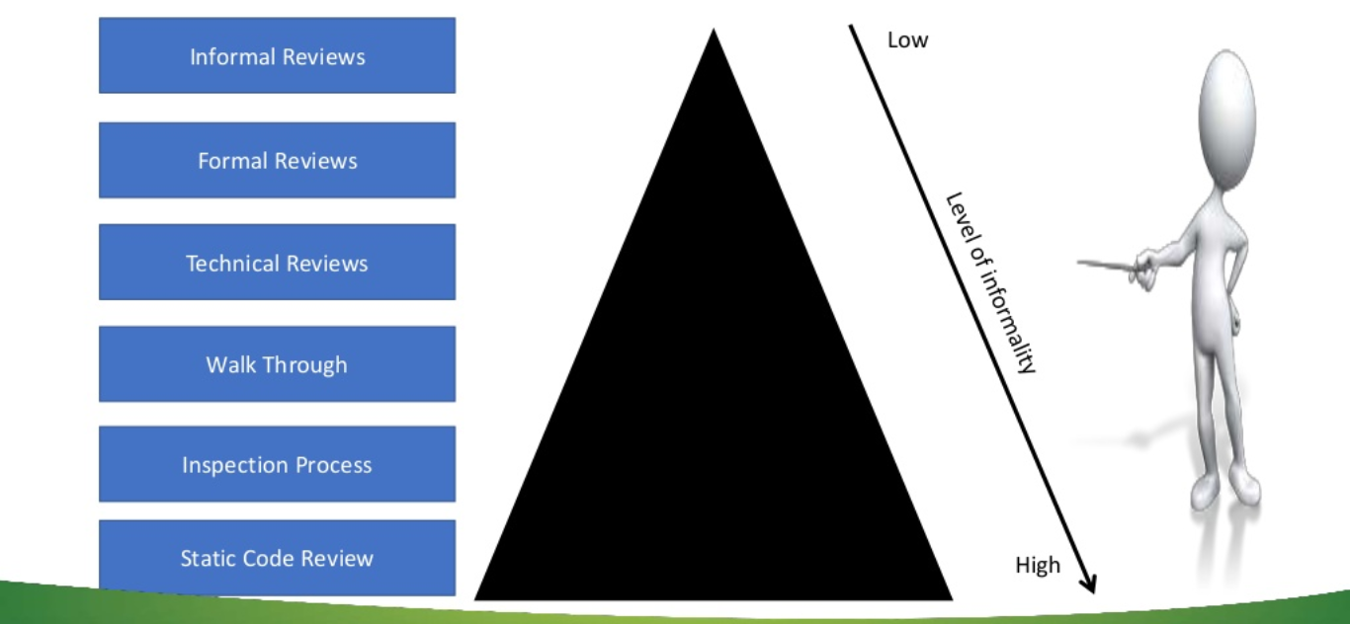
Review Techniques

Slide 15
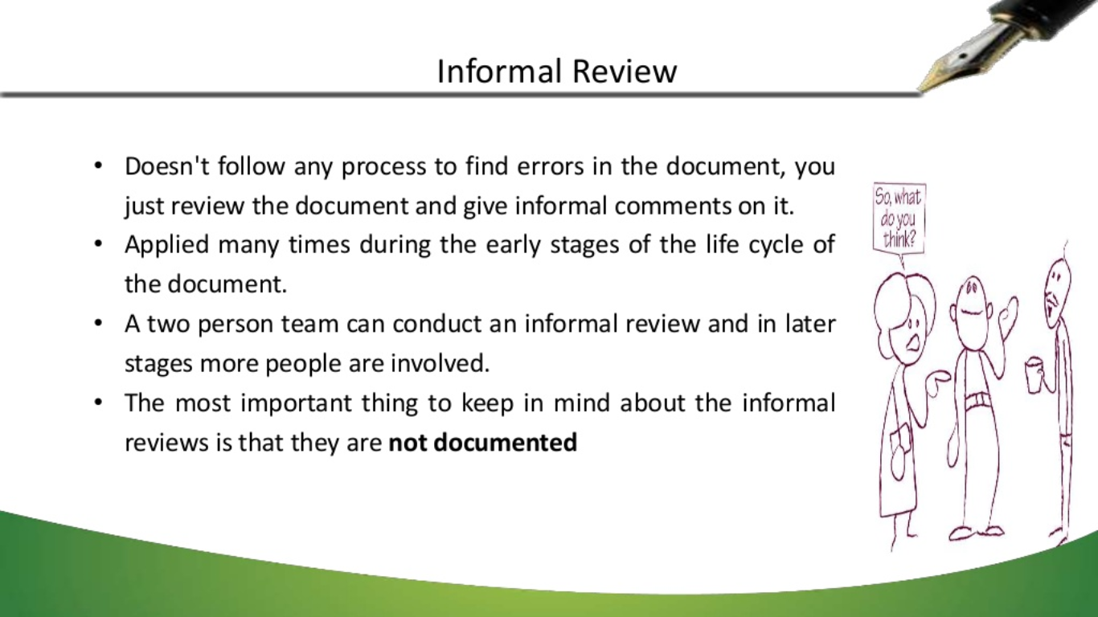
Informal Review
Doesn’t follow any process to find errors in the document, you just review the document and give informal comments on it.
Applied many times during the early stages of the life cycle of the document.
A two person team can conduct an informal review and in later stages more people are involved.
The most important thing to keep in mind about the informal reviews is that they are not documented.

Slide 16
Formal Review
Formal reviews follow a formal process. It is well structured and regulated (Controlled). Team consists of Manager, Moderator, Author, Reviewer, Recorder. A formal review process consists of six main steps :
Planning : a request to review is made by the author to the moderator (also known as the review leader).
Kick-off : In this stage, a brief introduction about the goal and objective of the review meeting or document is given to everyone at the meeting.
Preparation : In this stage, the reviewer (also known as Inspectors) reviews the document individually based on related documents, checklists, rules and procedures provided.

Slide 17
Formal Review
Review Meeting : This stage consists of three phases :-
Logging Phase
Discussion Phase
Decision Phase
Rework : If the number of defects found in each page exceeds the certain level than the document has to be reworked & is done by Author.
Follow-Up : In this stage, the author has taken care (action) of all the defects is assured by the moderator.

Slide 18
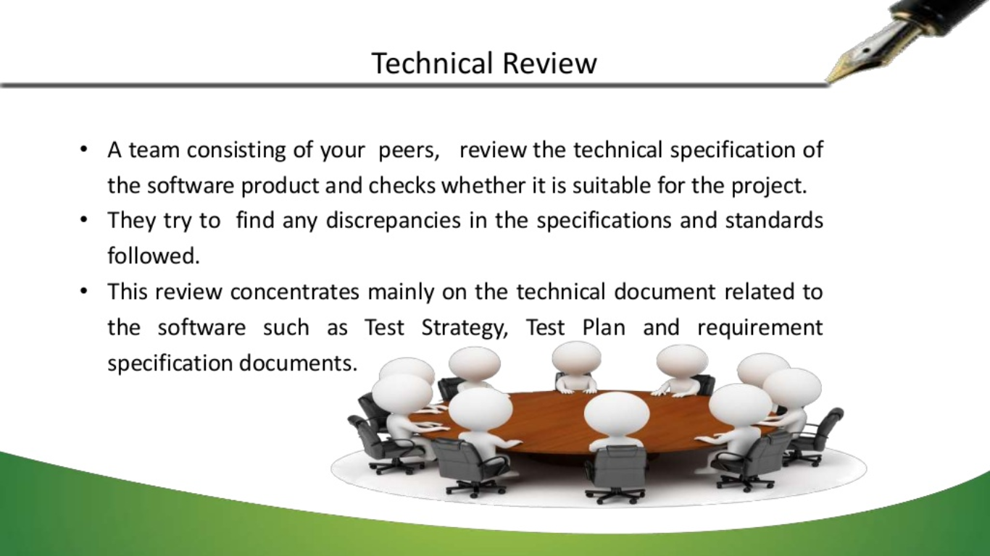
Technical Review
A team consisting of your peers, review the technical specification of the software product and checks whether it is suitable for the project.
They try to find any similarities in the specifications and standards followed.
This review concentrates mainly on the technical document related to the software such as Test Strategy, Test Plan and requirement specification documents.

Slide 19
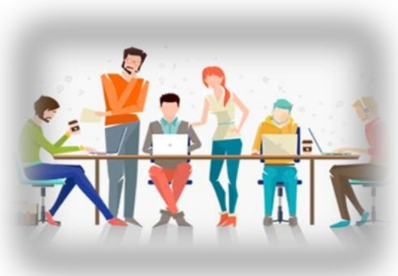
Walkthrough
The author of the work product explains the product to his team.
Participants can ask questions if any.
Meeting is led by the author.
Scribe makes note of review comments.

Slide 20
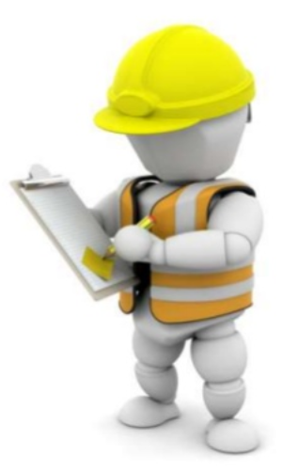
Inspection
The main purpose is to find defects and meeting is led by trained moderator.
This review is a formal type of review where it follow strict process to find the defects.
Reviewers have checklist to review the work products.
They record the defect and inform the participants to rectify.

Slide 21
Static Code Review
This is systematic review of the software source code without executing the code.
It checks the syntax of the code, coding standards, code optimization, etc.
This is also termed as white box testing.
This review can be done at any point during development.

Slide 22
Formal vs Informal Reviews
Informal Reviews | Formal Reviews
Identify errors and issues. Examine alternatives. Forum for learning. | Evaluate conformance to specification and plans. Ensure change integrity.
The designer makes all decisions. Change is the prerogative of the designer. | Review team petitions management or technical leadership to act on recommendations.
2-7 people. | 3 or more people.
Change verification left to other project controls. | Leader verifies that action items are documented; incorporated into external processes.

Slide 23
Inspection vs Walkthrough
Inspection | Walkthrough
Initiated by the project team | Initiated by the author
Reader reads the product code. Everyone inspects it and comes up with defects. | Author reads the product code and his team mate comes up with defects or suggestions
Recorder records the defects | Author makes a note of defects and suggestions offered by teammate
Moderator has a role in making sure that the discussions proceed on the productive lines | Informal, so there is no moderator

Slide 24
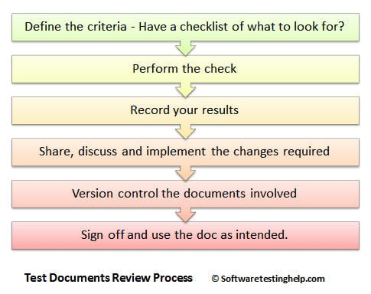
How to Review ?

Slide 25
Tips for Successful Review Process
Focus only on things that really count
Explicitly plan and track review activities. A software walkthrough and inspection are generally composite into peer's reviews
Resolve people issues
Keep process formal as the project culture
Continuous Improvement – Process and Tools
By removing the major delays in test execution, testing cost and time can be reduced

Slide 26
QAs ?

Slide 27
What is the main difference between a walkthrough and an inspection ?
An inspection is lead by author, walkthrough is lead by a trained moderator.
An inspection has trained leader, walkthrough is lead by a trained moderator.
A walkthrough is lead by the author, inspection is lead by a trained moderator.
Authors are not present during inspection, they are during walkthroughs

Slide 28
Which of the following statements about reviews is true ?
Reviews cannot be performed on user requirements specifications.
Reviews are the least effective way of testing code.
Reviews are unlikely to find faults in test plans.
Reviews should be performed on specifications, code and test plans

Slide 29
In formal review, Rework: fixing defects found typically done by ?
Moderator
Author
Reviewer
Recorder

Slide 30
Thank You

