Slide 1
Testing Phases
In different software testing methodologies

Slide 2
Overview
Waterfall Model
Incremental / Iterative development
Spiral Model
V-Model
Agile methodology
Extreme Programming

Slide 3
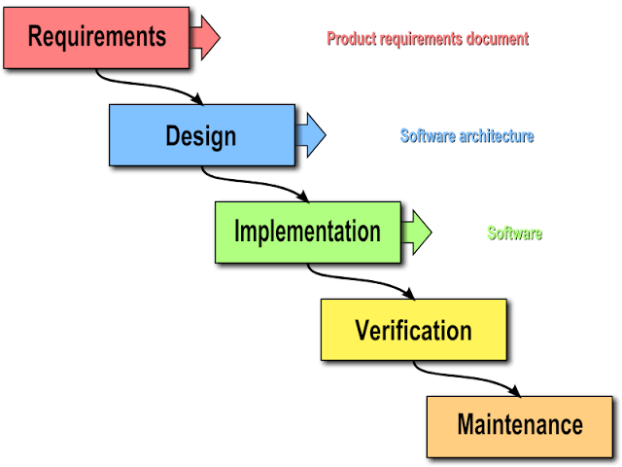
Waterfall Model
After the development phase, the product should experience a thorough quality assurance and software testing to discover defects in a system. Testers are involved in finding and reporting issues that need to be resolved. To store registered issues, a bug tracking system can be utilized with the goal that the issues could be handled during the maintenance life-cycle phase. Integration of different modules are undertaken soon after they have been coded and unit tested. The software can be conveyed when the code issues are fixed.

Slide 4
Contd.
The client is engaged with the acceptance testing to evaluate it for the utilization. System testing consists three different kinds of testing activities as described below :
Alpha testing: Alpha testing is the system testing performed by the development team.
Beta testing: Beta testing is the system testing performed by a friendly set of customers.
Acceptance testing: After the software has been delivered, the customer performed the acceptance testing to determine whether to accept the delivered software or to reject it.

Slide 5
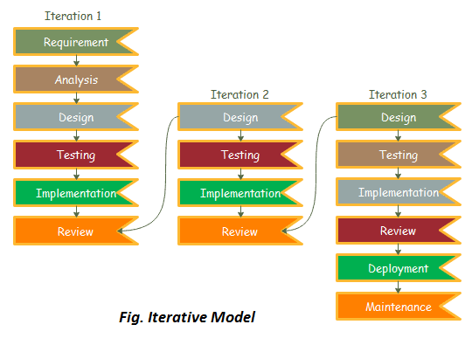
Incremental / Iterative Model
In this, we test each module individually in unit testing phase, and then every module is combined incrementally, i.e., one by one till all modules or components are added logically to make the required application, instead of integrating the whole system at once and then performing testing on the end product. Integrated modules are tested as a group to ensure successful integration and data flow between modules. This process is repeated till the modules are combined and tested successfully.

Slide 6
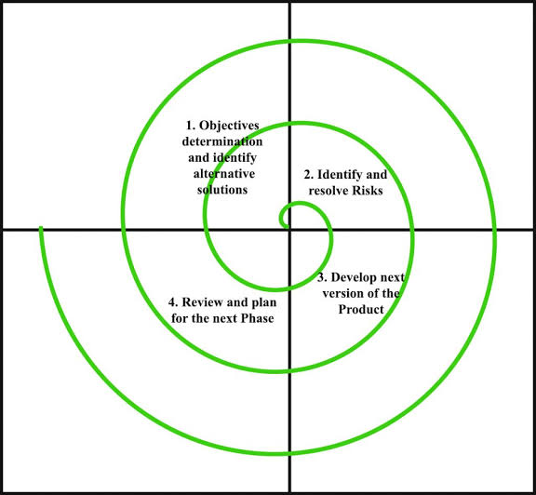
Spiral Model
Spiral testing is a risk based testing, where testers will take risk due many factors at the same time they will equipped with solutions for that risks. In the spiral and rapid application development testing environment there may be no final functional requirements for the system. They are probably informal and evolutionary. In the spiral development environment, software testing is again described as a continuous improvement process that must be integrated into a rapid application development methodology. Testing as an integrated function prevents development from proceeding without testing.

Slide 7
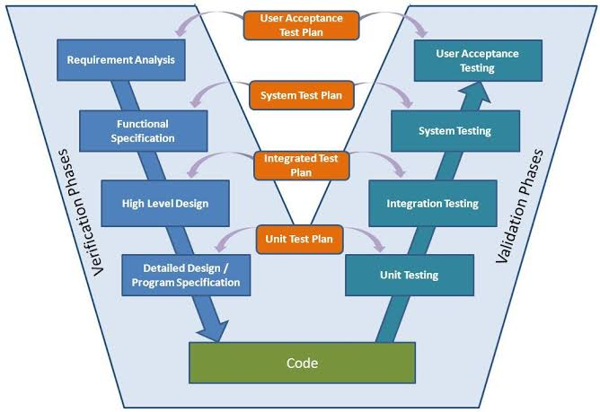
V - Model
Testing Phases :
Unit Testing: Unit Test Plans are developed during module design phase. These Unit Test Plans are executed to eliminate bugs at code or unit level.
Integration testing: After completion of unit testing Integration testing is performed. In integration testing, the modules are integrated and the system is tested. Integration testing is performed on the Architecture design phase. This test verifies the communication of modules among themselves.

Slide 8
Contd.
System Testing: System testing test the complete application with its functionality, inter dependency, and communication. It tests the functional and non-functional requirements of the developed application.
User Acceptance Testing (UAT): UAT is performed in a user environment that resembles the production environment. UAT verifies that the delivered system meets user’s requirement and system is ready for use in real world.

Slide 9
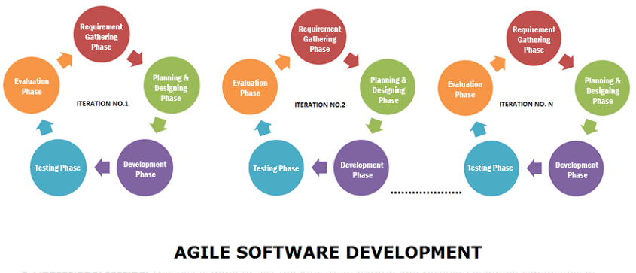
Agile Methodology
Agile testing aligns with iterative Development Methodology in which requirements develop gradually from customers and testing teams. The development is aligned with customer requirements.

Slide 10
Contd.
There are various agile testing methods as follows:
Behavior Driven Development (BDD) :- Improves communication amongst project stakeholders so that all members correctly understand each feature before the development process starts. There is continuous example-based communication between developers, testers, and business analysts. The examples are called Scenarios which are written in a special format
Acceptance Test Driven Development (ATDD) :- Focuses on involving team members with different perspectives such as the customer, developer, and tester. The acceptance tests are a representation of the user’s point of view and it describes how the system will function. It also helps to verify that the system functions as it is supposed to.

Slide 11
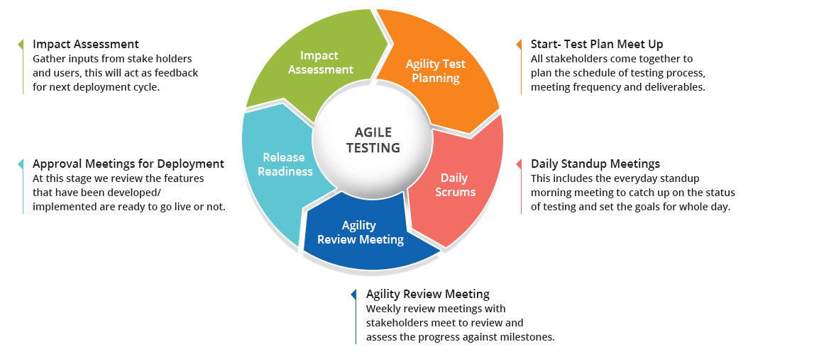
Contd.
Exploratory Testing :- In this testers identify the functionality of an application by exploring the application. The testers try to learn the application, and design & execute the test plans according to their findings.

Slide 12
Extreme Programming
Procedure of testing is usually conducted not after the final or intermediate product is done, but along with the procedure of code writing. Extreme program integrates testing with the development phase rather than at the end of the development phase. All codes have unit tests to eliminate bugs, and the code passes all such unit tests before release.
Another key test is customer acceptance tests, based on the customer specifications. Acceptance test run at the completion of the coding, and the developers provide the customer with the results of the acceptance tests along with demonstrations.

Slide 13
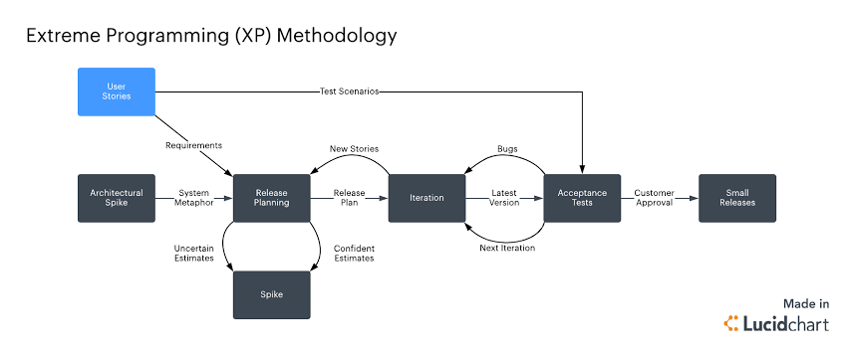
Contd.
Occasionally, there are developers and teams where they write the tests first and write the codes later because that will give them some idea of what their codes need to do. They are also called Unit Tests and the purpose of doing them is to remove bugs before the delivery. Alternatively, there is an approval test run at the end of the coding to deliver the client with approval results.

Slide 14
Thank You

