Slide 1
CONSUMER PERCEPTION FACTOR ANALYSIS

Slide 2
Background:
The dataset contains 5,048 responses and 26 hair-care attributes.
The variables are binary (0 = No, 1 = Yes) and represent customer preferences.
EDA was performed to understand the dataset and identify data-quality issues.
EFA was used to identify underlying/latent factors among related attributes.
CFA was used to validate the identified factor structure.
Construct reliability was assessed to evaluate the consistency of the factors

Slide 3
Project Objectives:
Understand the dataset
Examine distributions
Find missing values/duplicates
Assess relationships
Prepare data for Factor Analysis

Slide 4
Business Objectives:
Identify key customer needs and preferences in hair-care products.
Understand different customer preference dimensions to support product development.
Identify opportunities for product differentiation based on customer needs.
Support targeted marketing and customer segmentation.
Improve product positioning by aligning offerings with customer preferences.

Slide 5
EXPLORATORY DATA ANALYSIS

Slide 6
EDA Objectives:
To understand the structure and characteristics of the dataset.
To identify missing values and duplicate records.
To examine the distribution and frequency of the variables.
To analyze relationships and correlations among variables.
To identify patterns and trends that support further Factor Analysis.

Slide 7
Data Understanding:
Rows/Respondents: 5,048
Variables: 26
Data type: Binary responses (0/1)
Nature of variables: Product/attribute-related responses

Slide 8
Data Quality Assessment:
Data Quality Check | Result | Action
Missing values | 10 | Imputation
Missing data % | 0.20 | Assessed
Original Dataset
Missing Data
Imputation
Clean Dataset
Key Finding:
Data Quality checks were performed to identify missing values and were handled through imputation.

Slide 9
Frequency Analysis — Before vs After Imputation:
Variable | Before: 0 | Before: 1 | After: 0 | After: 1
Is.good.for.people.with.hair.like.mine. | 2343 | 2703 | 2343 | 2705
Gets.rid.of.dry.itchy.scalp. | 3675 | 1371 | 3677 | 1371
Moisturizes.my.hair.better.than.other.brands. | 3015 | 2031 | 3017 | 2031
Makes.my.life.easier. | 2796 | 2248 | 2800 | 2248
Key Finding:
The overall response pattern remained broadly consistent after imputation.

Slide 10
Frequency Analysis:

Slide 11
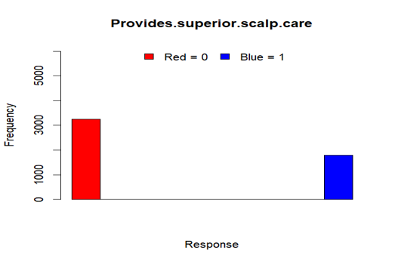
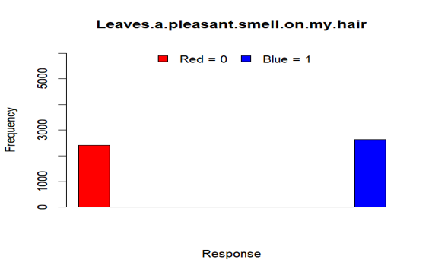
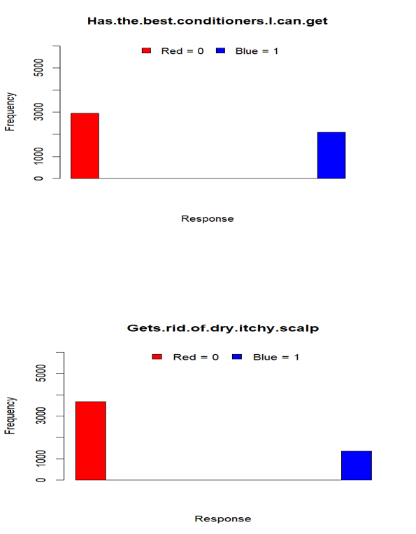
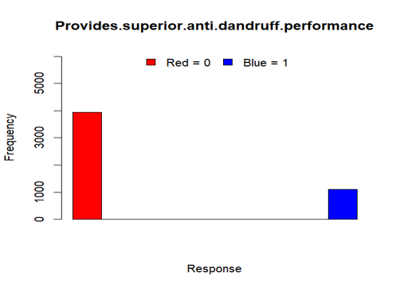
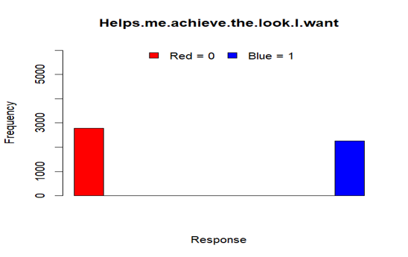
Distribution of Variables(A):

Slide 12
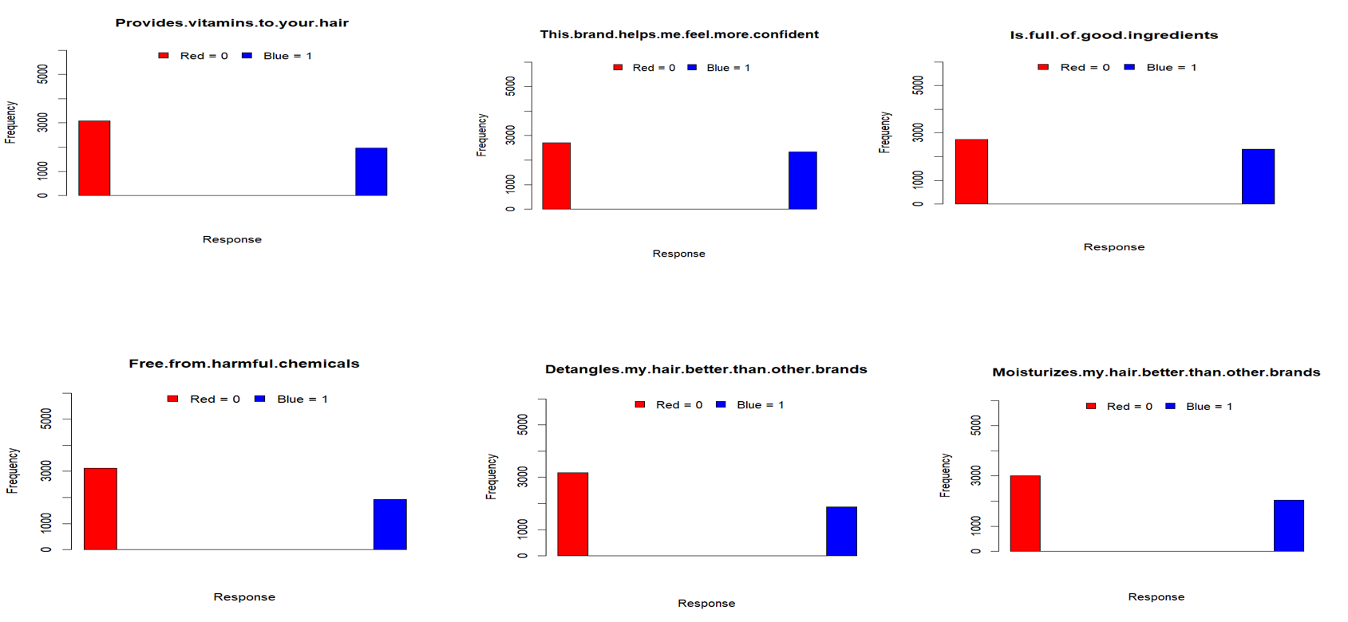
Distribution of Variables(B):

Slide 13
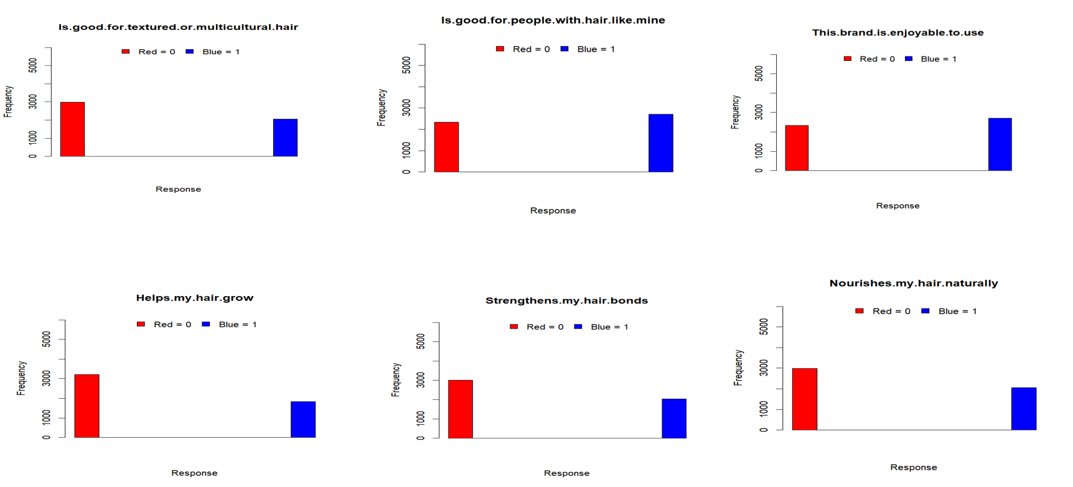
Distribution of Variables(C):

Slide 14
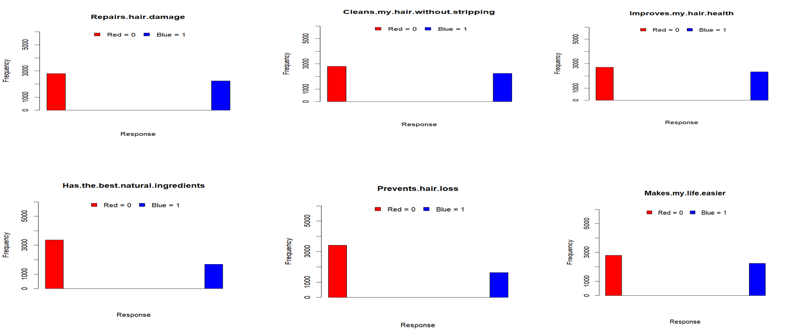
Distribution of Variables(D):

Slide 15
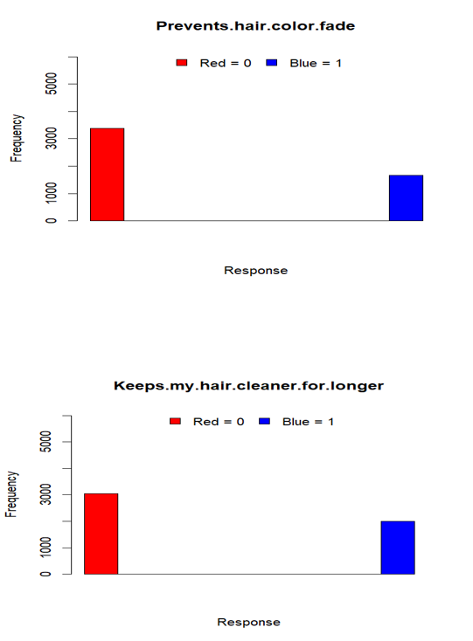
Distribution of Variables(E):
INSIGHTS
Several variables showed a high frequency of positive responses (1).
A few variables had higher frequencies of 0.
No unusual peaks.
The histograms showed that response patterns were consistent across the dataset.
Most respondents agreed that the shampoo repairs hair damage.

Slide 16
Row-Level Standard Deviation & Data Cleaning
Row-Level Standard Deviation:
Measures the variation in responses across variables for each respondent.
A higher SD indicates greater variation in a respondent's responses.
Row-level SD was used as part of the data-cleaning process.
Imputed Dataset
Calculate Row-Level SD
Identify Unusual Response Patterns
Clean Dataset
Final Dataset Size: 4,311 respondents

Slide 17
Correlation Analysis:
Variable Pair | r
Anti-dandruff performance ↔ Dry/itchy scalp | 0.50
Achieve desired look ↔ Confidence | 0.50
Hair bonds ↔ Hair damage repair | 0.47
Harmful chemicals ↔ Natural ingredients | 0.49
Hair bonds ↔ Hair health | 0.49
Key Findings:
Several variable pairs show moderate positive correlations, with the strongest relationships reaching r = 0.50. These relationships indicate that some variables may share common underlying characteristics.
The correlation patterns provide a basis for exploring underlying dimensions through Factor Analysis.

Slide 18
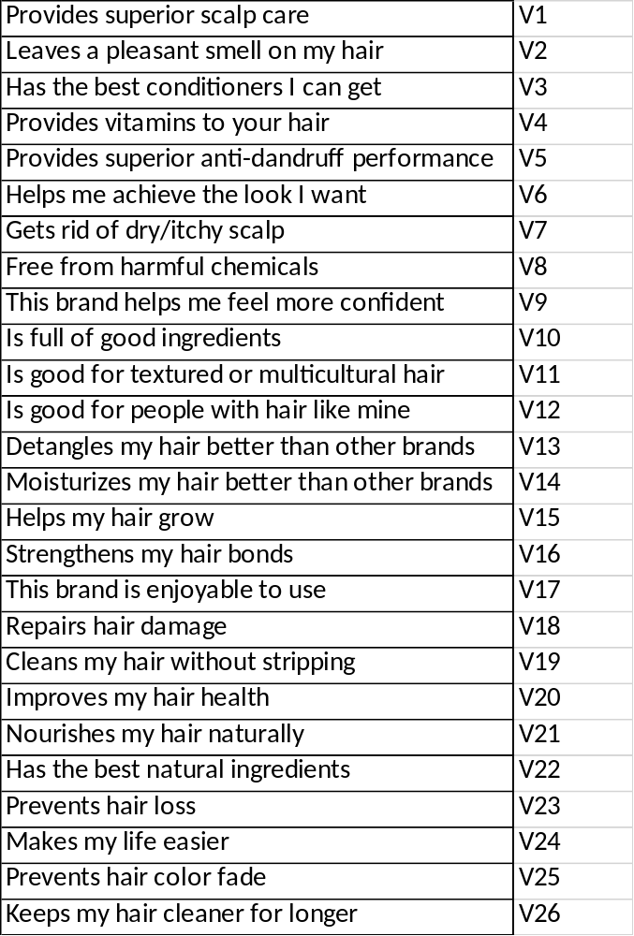
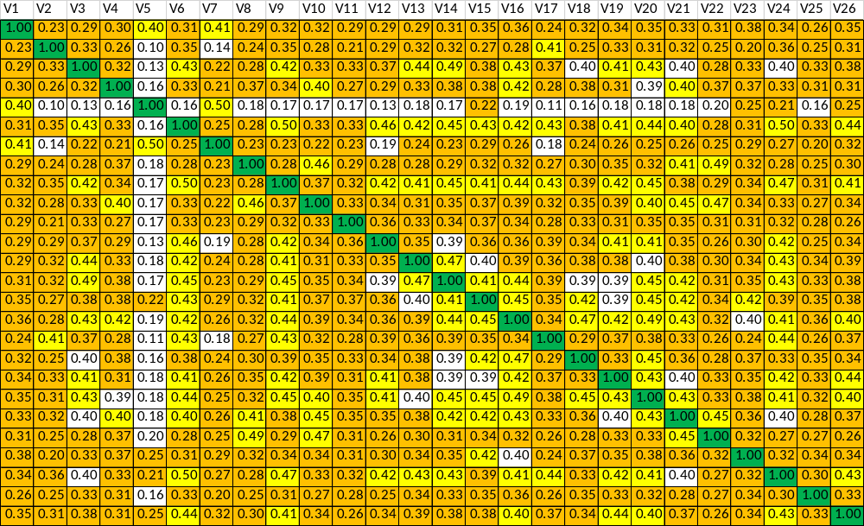
Correlation Analysis:

Slide 19
EDA findings:
Dataset structure and variable characteristics were examined.
Missing values and duplicate records were assessed.
Missing values were handled through imputation.
Frequency distributions were compared before and after imputation.
Histograms were used to examine the distribution of the 26 variables.
Row-level standard deviation was assessed for respondent-level variability.
Correlation analysis was performed to examine relationships among variables.
EDA Completed → Factor Analysis

Slide 20
Exploratory Factor Analysis (EFA)

Slide 21
Objectives:
To identify the underlying dimensions among the 26 observed variables.
To reduce the variables into a smaller number of meaningful factors.
To identify groups of variables that share common patterns.

Slide 22
Suitability for Factor Analysis:
Test | Result | Interpretation
KMO (Overall MSA) | 0.94 | Excellent sampling adequacy
Bartlett's Test of Sphericity | P < 0.05 | Variables are sufficiently correlated
The KMO and Bartlett's Test indicate that the data is suitable for conducting Exploratory Factor Analysis.

Slide 23
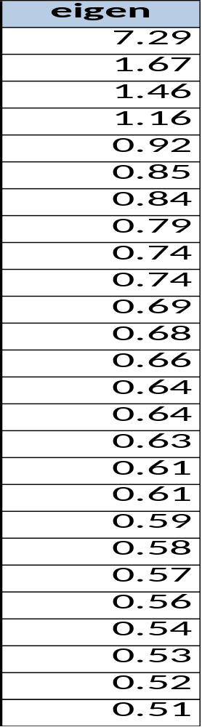
Eigenvalues:
Note: The eigenvalue criterion provides an initial indication of the number of factors. The scree plot and factor interpretability are also considered.
Four factors have eigenvalues greater than 1 based on the Kaiser criterion.

Slide 24
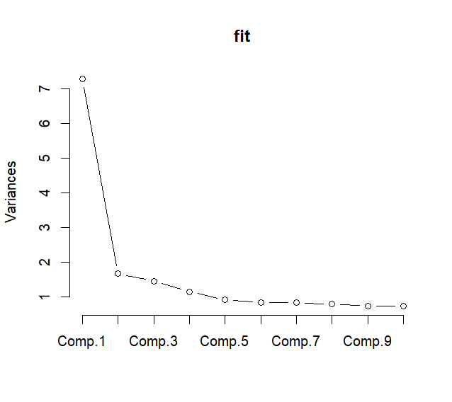
Scree Plot:
Key Finding: The scree plot shows a sharp decline in variance after Component 1, followed by gradual flattening, indicating that the first few components explain most of the variance..

Slide 25
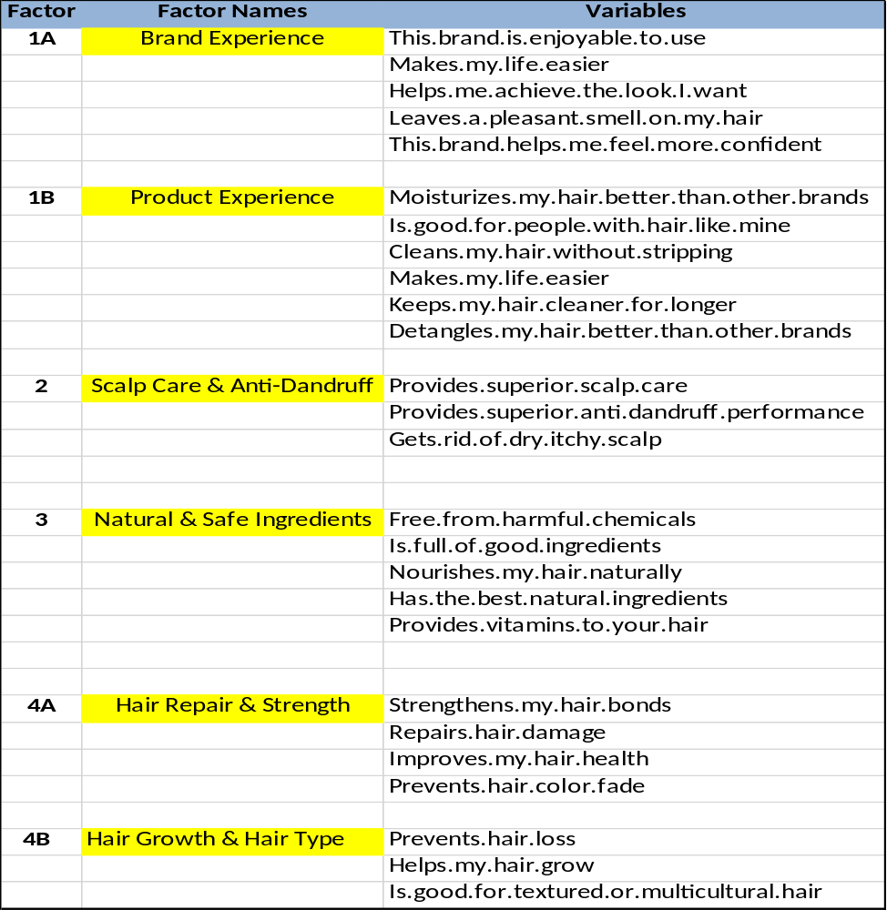
Rotated Factor Loadings – 4 Factor Solution
Clear factor loadings observed.
No cross-loadings.
Items are distinctly grouped under factors.
Solution is stable and interpretable.

Slide 26
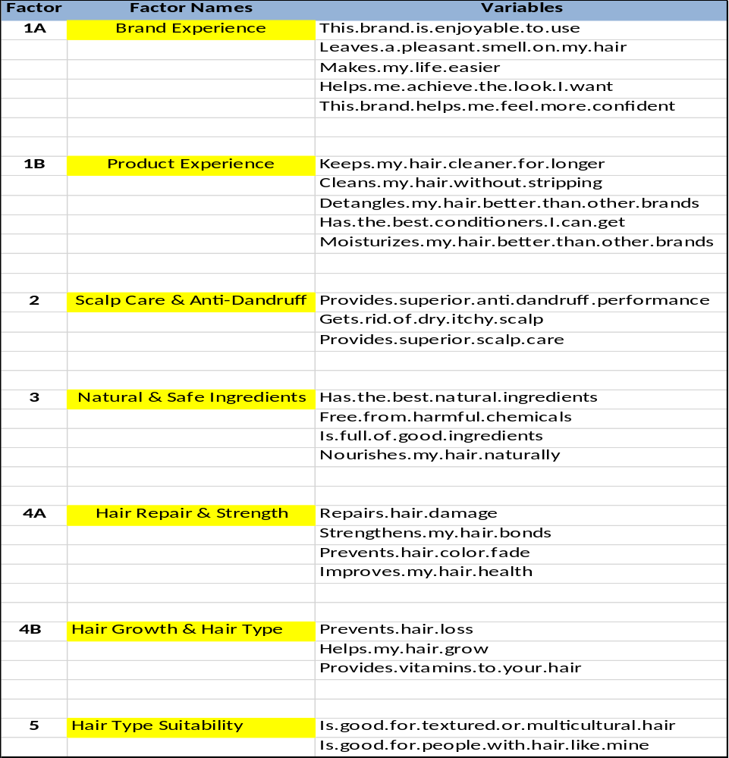
Rotated Factor Loadings – 5 Factor Solution
Clear factor loadings are observed across the 5-factor solution.
Most items load strongly on one primary factor.
No major cross-loadings are observed for the key items.
The five factors show distinct and interpretable dimensions.
Structure is cleaner than factor 4.

Slide 27
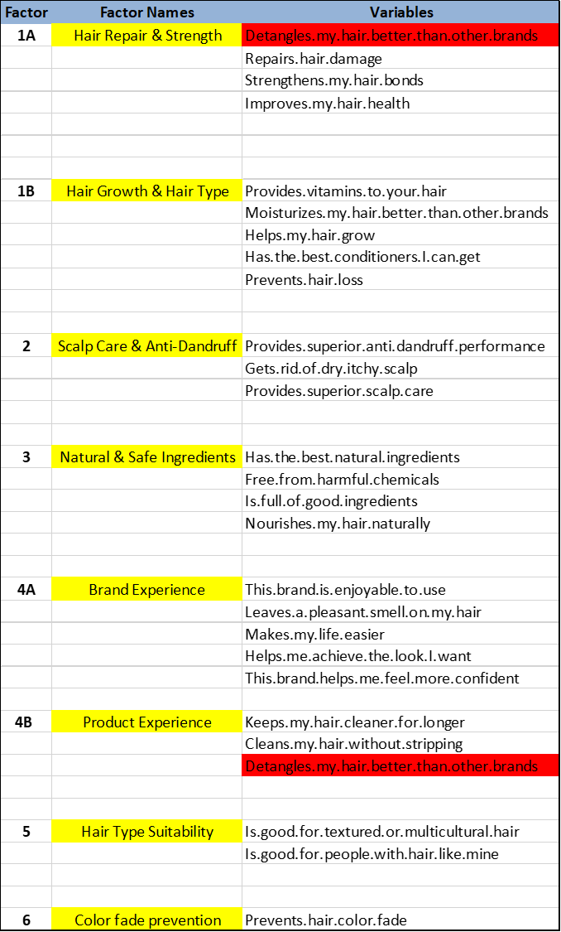
Rotated Factor Loadings – 6 Factor Solution
Brand and Product experiences flips.
One item shows a potential cross-loading.
The remaining items are well differentiated across factors.
Not ideal for CFA.

Slide 28
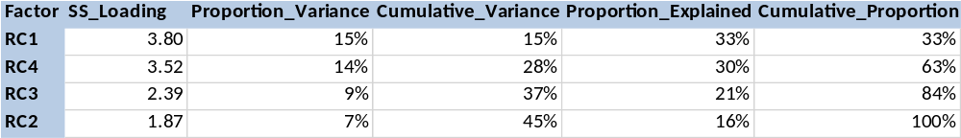
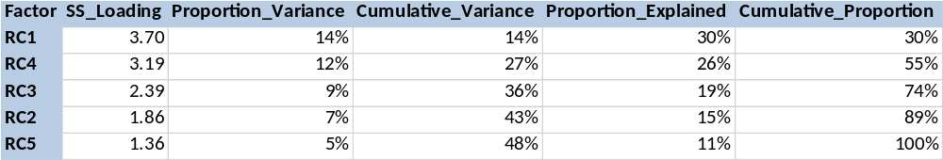
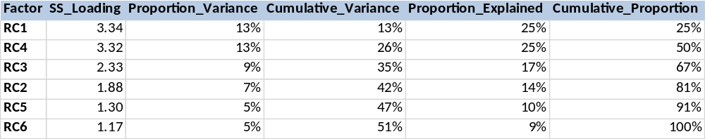
Variance:
4 Factor solution:
5 Factor solution:
6 Factor solution:

Slide 29
H2(Communality), U2(Uniqueness) and COM(Complexity):
H² (Communality):
The proportion of variance in an observed variable that is explained by the common factors extracted in the EFA.
U² (Uniqueness):
The proportion of variance in an observed variable that is not explained by the common factors. It represents variable-specific variance and error.
COM (Complexity):
Indicates how many factors are substantially associated with an observed variable. A value close to 1 means the variable mainly belongs to one factor, while a higher value indicates that the variable loads on multiple factors

Slide 30
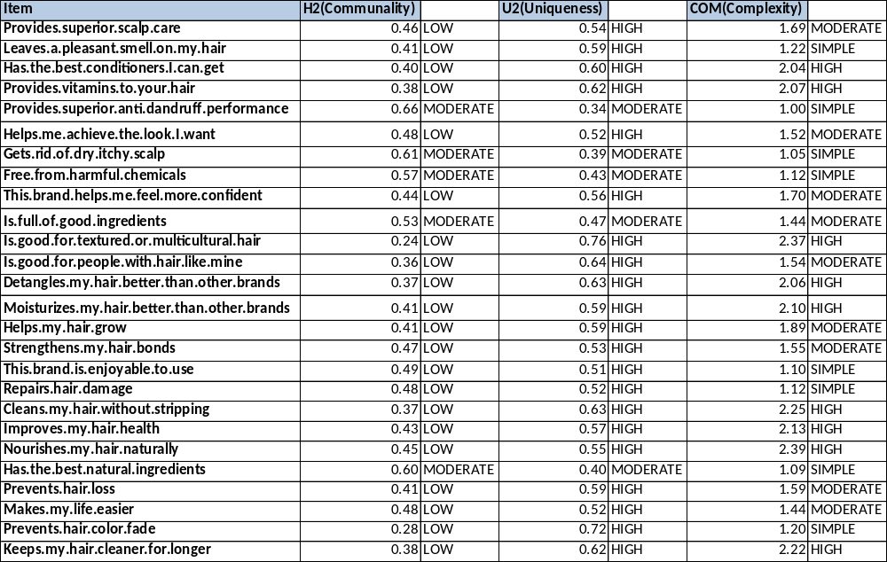
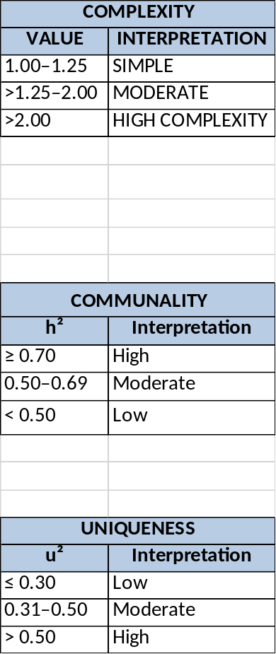
H2_U2_COM- 4 Factor solution:

Slide 31
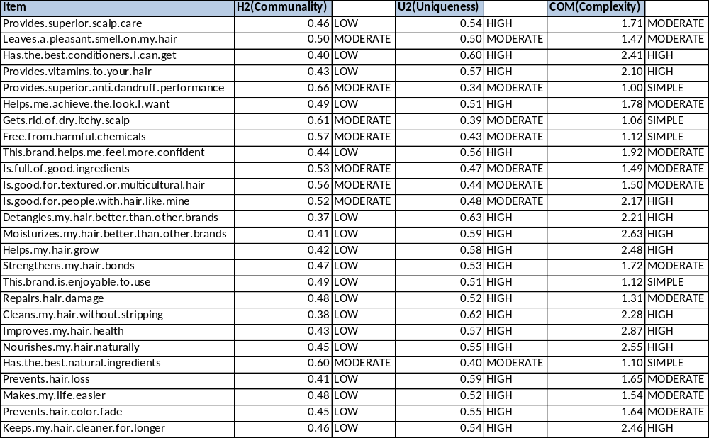
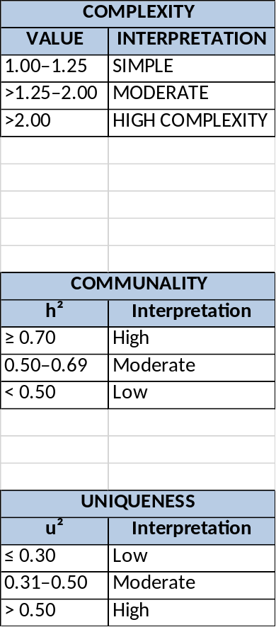
H2_U2_COM- 5 Factor solution:

Slide 32
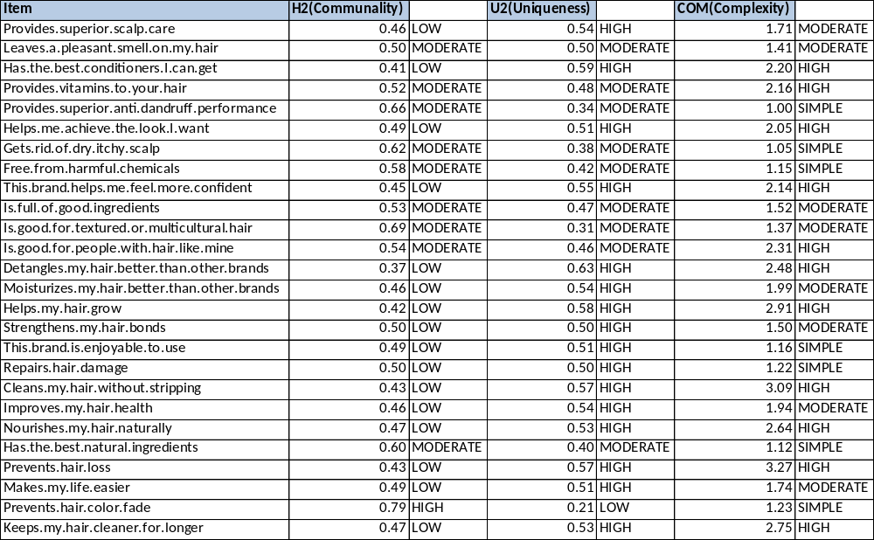
H2_U2_COM- 6 Factor solution:

Slide 33
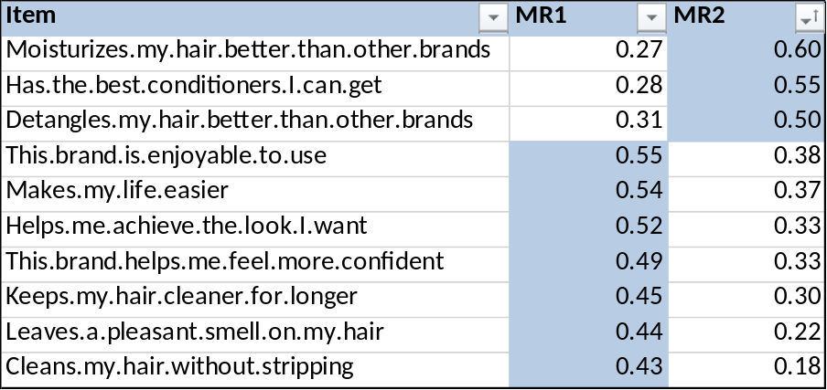
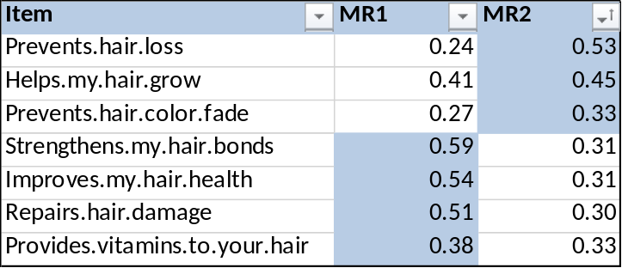
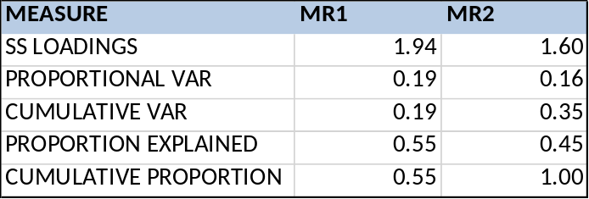
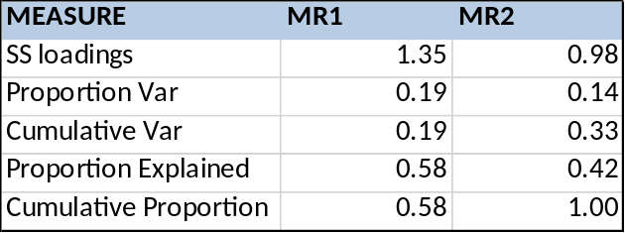
Factor Dissection- 5 Factor Solution
Factor 1:
Factor 4:
Factor1_Variance
Factor4_Variance

Slide 34
CFA (Confirmatory Factor Analysis).

Slide 35
CFA Objectives:
To validate the factor structure identified through EFA.
To assess how well the proposed factor structure fits the observed data.
To evaluate the strength of relationships between factors and their observed variables using standardized factor loadings.
To assess the reliability and validity of the measurement model.
To identify whether the proposed final factor structure is suitable for further analysis.

Slide 36
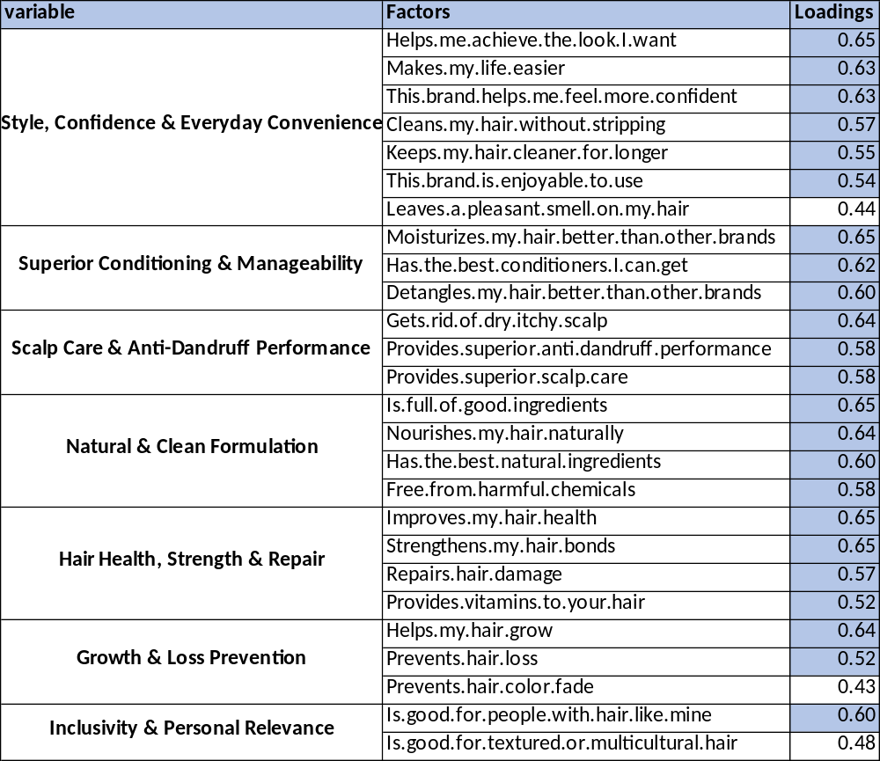
CFA Reliability:
Note: Factor loadings of 0.50 or above are considered acceptable.

Slide 37
Technical Insights from Factor Analysis:
KMO and Bartlett’s Test confirmed that the data is suitable for factor analysis.
7 meaningful factors were identified through EFA.
Most factor loadings were 0.50 or above, indicating strong relationships between items and factors.
The 7-factor structure was also tested using CFA and showed consistency with the EFA structure.
These factors provide a clear and simplified understanding of the key dimensions in the dataset.

Slide 38
Business Insights from Factor Analysis:
Customer preferences are multidimensional: Hair-care decisions are driven by several distinct dimensions rather than one overall preference, allowing the business to develop more targeted strategies.
Functional and emotional benefits are connected: Attributes related to hair performance, appearance, confidence, and convenience cluster together, suggesting that products can be positioned using both functional and emotional benefits.
Specialized needs can be targeted: The emergence of distinct scalp-care and hair-type-related factors indicates opportunities for more specialized product segments.
Ingredient preferences form a separate dimension: Natural and clean-ingredient attributes cluster together, providing a potential basis for product differentiation and positioning.
Factor-based segmentation can support marketing: The identified dimensions can help the business target different customer needs with tailored products, messaging, and campaigns.

Slide 39
THANK YOU

