Slide 1
Restaurant Offers and Reviews around the University

Slide 2
Background
Users are students, faculty and staff of University of Maryland and people living in College Park
Data sources include Yelp, Trip Advisor and RetailMeNot

Slide 3
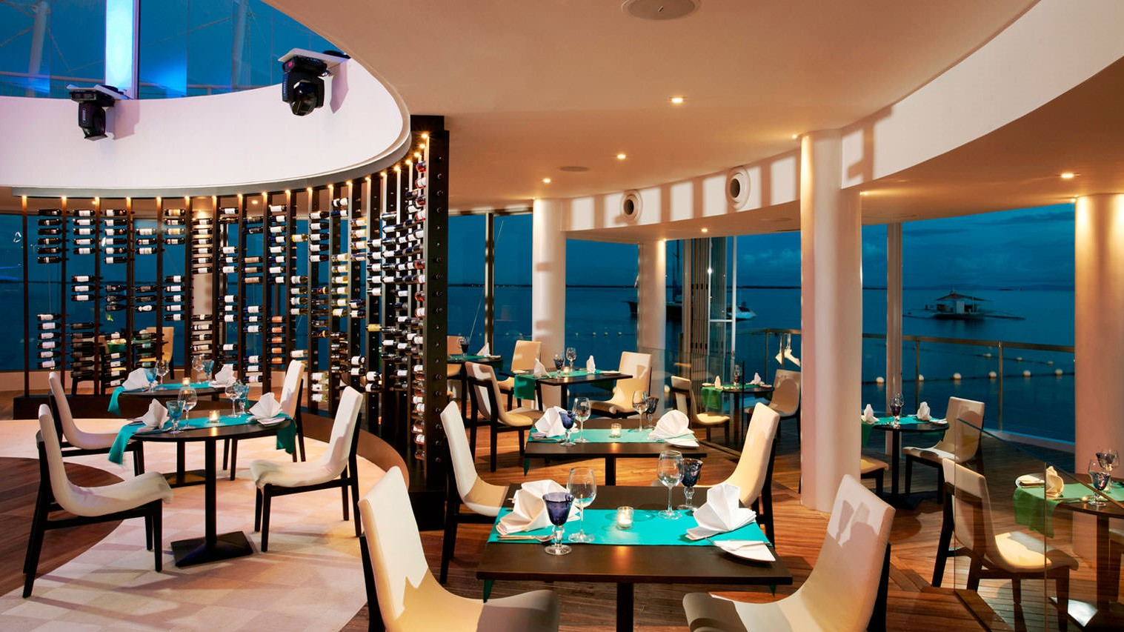
Brand Name
Restropedia

Slide 4
Introduction
Mission Statement
To provide a perfect online platform for people to find the best restaurant of their choice near the University of Maryland, based on the facilities available, offers provided and customer reviews.

Slide 5
Mission Objectives
The system shall assist the users in restaurant search near the University based on the cuisines available in each restaurant.
The system shall help the users filter their restaurant search by parameters like distance from the Smith School, location, opening hours and availability of facilities like car parking, free wifi, outdoor seating and door delivery.
The system shall provide a review section where the users can check the overall rating/comments and individual ratings for ambience, value for money, quality of food and service which would greatly help customers choose a particular restaurant.
The system shall provide users information on various offers provided by each restaurant along with their validity.

Slide 6
DESIGN

Slide 7
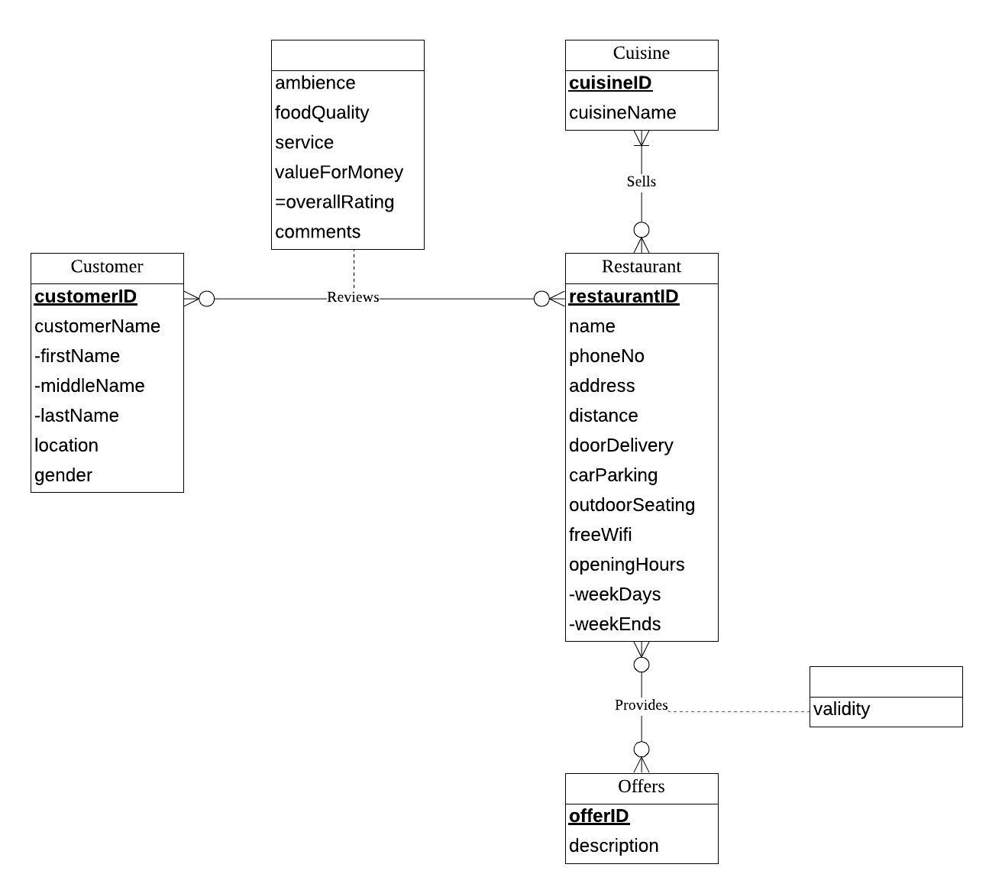
Conceptual Database Design ER Diagram

Slide 8
Logical Database Design Relational Schema
Restaurant (restaurantID, name, phoneNo, address, distance, doorDelivery, carParking, outdoorSeating, freeWifi, openingHoursWeekdays, openingHoursWeekends)
Customer (customerID, customerFirstName, customerMiddleName, customerLastName, location, gender)
Offers (offerID, description)
Cuisine (cuisineID, cuisineName)
Provides (restaurantID, offerID, validity)
Sells (restaurantID, cuisineID)
Reviews (restaurantID, customerID, ambience, foodQuality, service,
valueForMoney, comments)

Slide 9
Physical Database Design
CREATE TABLE [Restropedia.Reviews] (
restaurantID INTEGER NOT NULL,
customerID INTEGER NOT NULL,
ambience DECIMAL (3,2),
foodQuality DECIMAL (3,2),
[service] INTEGER DECIMAL (3,2),
valueForMoney DECIMAL (3,2),
comments VARCHAR (200),
CONSTRAINT pk_Reviews_restaurantID_customerID PRIMARY KEY (restaurantID,
customerID),
CONSTRAINT fk_Reviews_restaurantID FOREIGN KEY (restaurantID)
REFERENCES [Restropedia.Restaurant] (restaurantID)
ON DELETE CASCADE ON UPDATE CASCADE,
CONSTRAINT fk_Reviews_customerID FOREIGN KEY (customerID)
REFERENCES [Restropedia.Customer] (customerID)
ON DELETE CASCADE ON UPDATE CASCADE,
CONSTRAINT rng_Reviews_ambience CHECK (ambience >= 1 AND ambience <= 5),
CONSTRAINT rng_Reviews_foodQuality CHECK (foodQuality >= 1 AND
foodQuality <= 5),
CONSTRAINT rng_Reviews_service CHECK ([service] >= 1 AND [service] <= 5),
CONSTRAINT rng_Reviews_valueForMoney CHECK (valueForMoney >= 1 AND
valueForMoney <= 5)
);

Slide 10
USE CASES (Business Transactions)

Slide 11
Which is the Best Rated Thai Restaurant around the University of Maryland ?
SQL QUERY
CREATE VIEW [vw.summary]
AS
SELECT res.restaurantID, res.name, res.address, res.freeWifi, res.carParking, res.outdoorSeating, c.cuisineName,
AVG(rev.ambience) AS avgAmbience, AVG(rev.foodQuality) AS avgfoodQuality,
AVG(rev.service) AS avgService, AVG(rev.valueForMoney) AS avgValueForMoney,
(AVG(rev.ambience + rev.foodQuality + rev.service + rev.valueForMoney)/4)
AS avgRating
FROM [Restropedia.Restaurant] res,[Restropedia.Reviews] rev,[Restropedia.Cuisine] c,
[Restropedia.Sells] s
WHERE res.restaurantID = rev.restaurantID AND res.restaurantID = s.restaurantID
AND c.cuisineID = s.cuisineID
GROUP BY res.restaurantID, res.name, res.address, res.freeWifi, res.carParking, res.outdoorSeating, c.cuisineName ;
SELECT name AS 'Best Rated Thai Resturant', address AS 'Address', carParking AS 'Car Parking',
outdoorSeating AS 'Outdoor Seating', freeWifi AS 'Free Wifi', cuisineName AS 'Cuisine', avgRating AS 'Rating'
FROM [vw.summary]
WHERE cuisineName = 'Thai' AND avgRating = (SELECT MAX(avgRating) FROM [vw.summary]
WHERE cuisineName = 'Thai’) ;

Slide 12
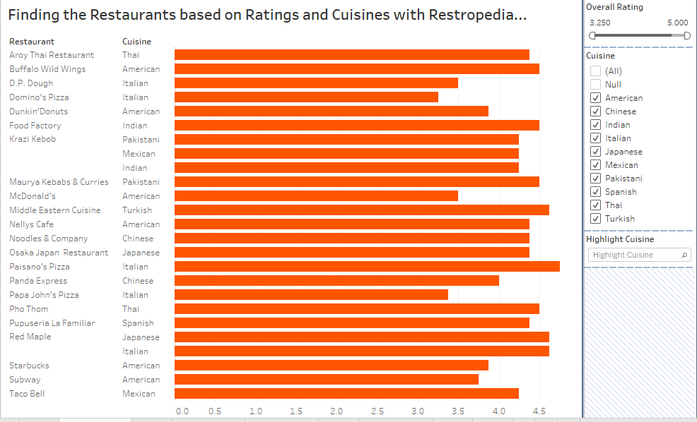
Which is the Best Rated Thai Restaurant around the University of Maryland ?
TABLEAU SCREEN SHOT

Slide 13
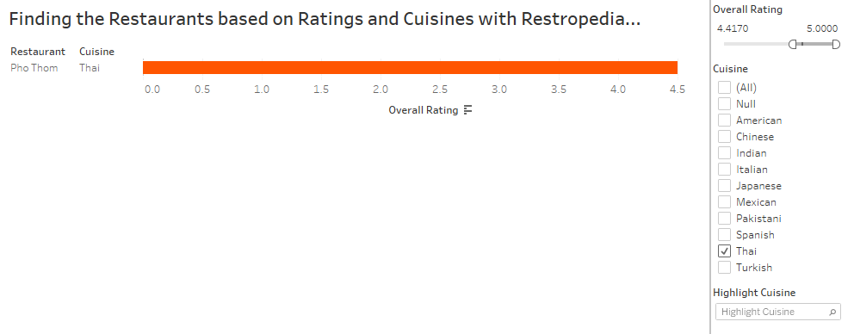
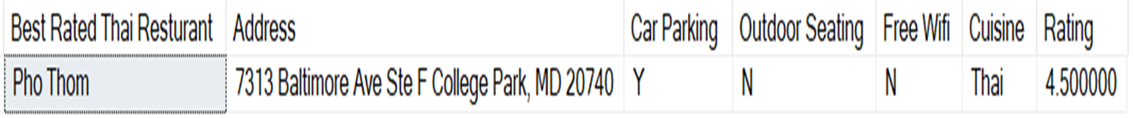
Which is the Best Rated Thai Restaurant around the University of Maryland ?
TABLEAU Screenshot
SQL Screenshot

Slide 14
Which Mexican Restaurant has the Best Ambience and is providing any offer?
SQL QUERY
SELECT *
FROM
(SELECT res.Name AS 'Restaurant Name', res.address AS 'Address', res.freeWifi AS 'Free Wifi',
res.carParking AS 'Car Parking', uu.avgAmb AS 'Ambience', c.cuisineName AS 'Cuisine',
o.description AS 'Description', p.validity AS 'Validity'
FROM
(SELECT tt.restaurantID, tt.avgAmb
FROM
(SELECT ee.restaurantID, ee.avgAmb, c.cuisineName
FROM
(SELECT restaurantID, AVG(ambience) as avgAmb
FROM [Restropedia.Reviews]
GROUP BY restaurantID) ee, [Restropedia.Cuisine] c, [Restropedia.sells] s, [Restropedia.Offers] o,
[Restropedia.Provides] p
WHERE ee.restaurantID = s.restaurantID AND s.cuisineId = c.cuisineId AND o.offerID = p.offerID AND c.cuisineName = 'Mexican'
AND ee.restaurantID=p.restaurantID) tt

Slide 15
Which Mexican Restaurant has the Best Ambience and is providing any offer?
SQL QUERY (continued)
WHERE tt.avgAmb=
(SELECT MAX(pp.avgAmb)
FROM
(SELECT ee.restaurantID, ee.avgAmb, c.cuisineName
FROM
(SELECT restaurantID, AVG(ambience) as avgAmb
FROM [Restropedia.Reviews]
GROUP BY restaurantID) ee, [Restropedia.Cuisine] c, [Restropedia.sells] s, [Restropedia.Offers] o,
[Restropedia.Provides] p
WHERE ee.restaurantID = s.restaurantID AND s.cuisineId = c.cuisineId AND o.offerID = p.offerID AND c.cuisineName = 'Mexican'
AND ee.restaurantID=p.restaurantID) pp)) uu, [Restropedia.Restaurant] res,[Restropedia.Cuisine] c, [Restropedia.sells] s, [Restropedia.Offers] o, [Restropedia.Provides] p
WHERE uu.restaurantID = res.restaurantID AND res.restaurantID = s.restaurantID AND s.cuisineId = c.cuisineId
AND o.offerID = p.offerID AND uu.restaurantID=p.restaurantID) ll
WHERE ll.Cuisine = 'Mexican' ;

Slide 16
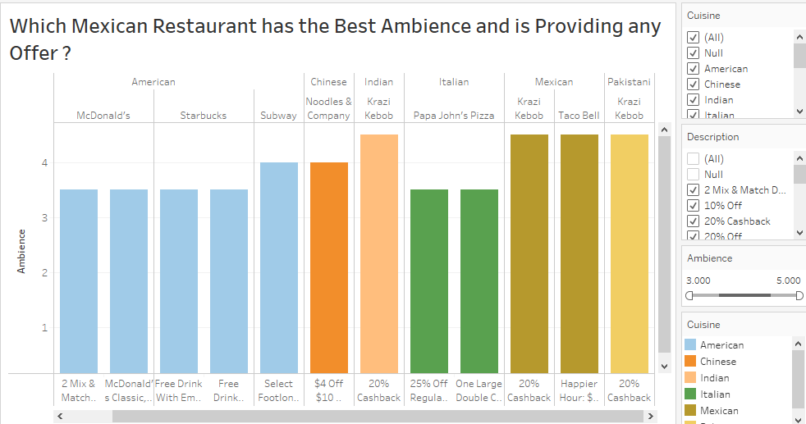
Which Mexican Restaurant has the Best Ambience and is providing any offer?
TABLEAU SCREEN SHOT

Slide 17
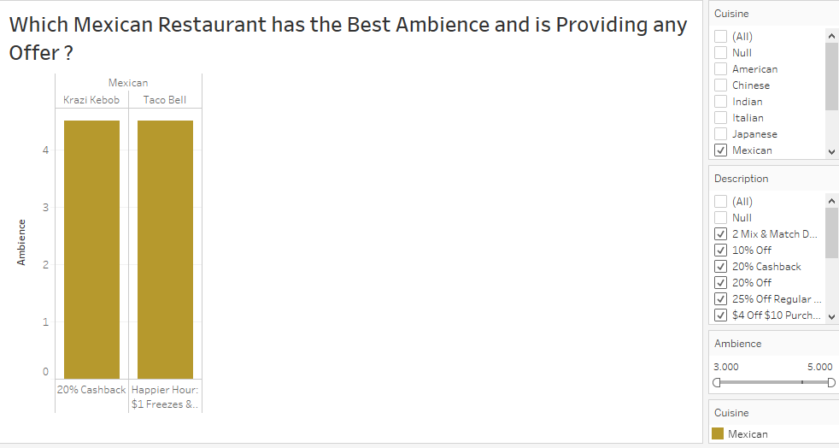
Which Mexican Restaurant has the Best Ambience and is providing any offer?
TABLEAU Screenshot
SQL Screenshot

Slide 18
THANK YOU

