Slide 1
Model Extraction Attacks via Active Reinforcement Learning (RL) Policies
Anmol Dwivedi

Slide 2
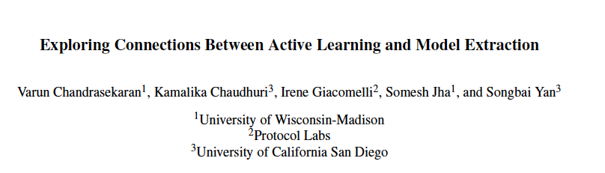
Introduction – Covered Seminar Paper
Problem Category: Belongs to the first category of topics covered in this course, i.e., attack models
Paper: Exploring Connections between Active Learning and Model Extraction
Conference: 29th USENIX Security Symposium
Dates: August 12th-14th, 2020

Slide 3

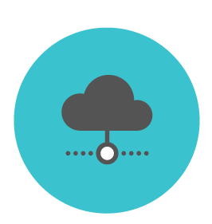

Model Extraction Attacks
Query
MLaaS
(Oracle Access)
Experiment:
Objectives:
Learn an approximation of the model
Use as few queries as possible – (Main motivation for Active Learning)

Slide 4
Model Extraction via Active Learning
Active learning is formulated such that it tries to achieve an objective with lower sample complexity
i.e, active learning algorithms adaptively choose so that they require as few queries as possible!
Round 1
Oracle
Until query budget is exhausted
Learner
- final model learned by adversary
Round r

Slide 5
Drawbacks of Current Active Learning Methods
Assumes that the adversary can employ off-the shelf sophisticated active learning algorithms
to perform model extraction
This requires advance knowledge of mathematics behind algorithms and furthermore, depending on
the hypothesis class to be extracted, the complexity of the algorithms can differ widely
For example, the authors use:
Extended Adaptive Training (EAT) algorithm from the paper "Fast Kernel Classifiers with Online and Active Learning" to extract SVMs models.
Importance Weighted Active Learning algorithm from the paper "Agnostic Active Learning Without Constraints" to extract Decision Tree models.

Slide 6
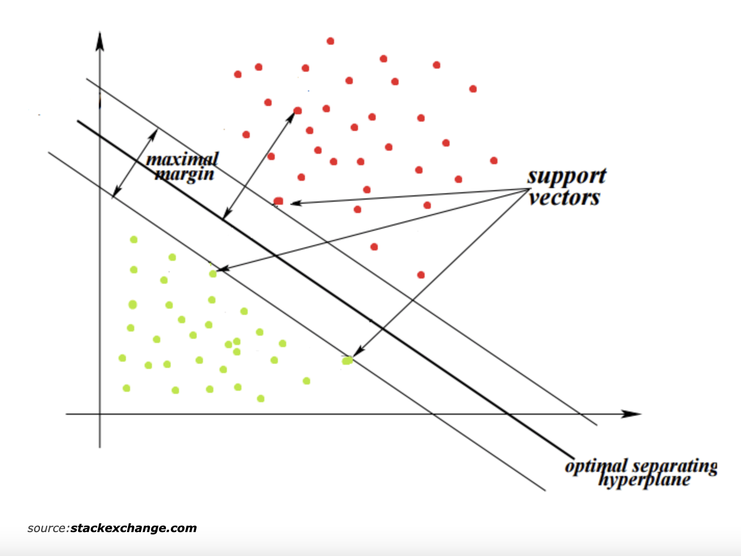
Why is this an Issue?
While for simple models like SVMs, it is relatively simple to develop these algorithms since the support vectors uniquely determine the hyperplane
What about complex models? Not sure as to how to develop efficient active learning algorithms!

Slide 7
Question: Can a naïve adversary craft sophisticated attacks without explicitly relying on Active Learning algorithms?
Proposed Approach: Learn a policy (a local ML model) by training an RL agent so that the agent can learn an optimal active learning policy in a simulation environment
The hope is that the RL agent can find a policy that can assist the naïve adversary in extracting the target model for a given hypothesis class

Slide 8
Problem Setting – This Work
Two class SVMs with linear kernels - Binary Classification
Adversary can make direct queries to API, i.e., queries for arbitrary input x
This is because training data distribution of the of the target model is unknown
- distance from hyperplane
1 or 0 - depending on either side of the hyperplane
Next, I will show a competing approach on how to train such an RL agent to extract the parameters of a linear SVMs

Slide 9
Model Extraction as a Markov Decision Process (MDP)
MDP described by the 4-tuple
The goal of the agent is to maximize rewards for an episodic sequence starting from a given state s by taking actions in A

Slide 10
Model Extraction as Markov Decision Processes (MDPs)
State :
Hyperplane parameters of the local model
Random feature vectors drawn from a uniform distribution.
The number of actions in each round is a hyperparameter but ultimately will choose one anyway
To given an ordering to actions, we can sort them in the distance to the hyperplane
Action :
After choosing action, train the local model on chosen action to obtain new local model w’
Evaluate w and oracle on a held-out test set and calculate the error – E1
Reward :
Evaluate w’ and oracle on a held-out test set and calculate the error – E2
Reward = (E1 – E2)

Slide 11
Model Extraction as a Markov Decision Process (MDP)
Transition Probabilities:
Captured by how the parameter vector of the current local model changes after it is trained on the chosen action/feature vector.
Terminal State:
Determined by the query budget.
When the query budget is over, we terminate the process, call this an episode and restart the training for another episode.

Slide 12
Model Extraction as a Markov Decision Process (MDP)
Use the Q-learning algorithm to learn a policy from states to actions.
Employ a 1-layer Neural Network to approximate the Q- function for a given state and for all actions associated with that state.
This guides adversary to choose ”informative” data points as learned by the policy.

Slide 13
Baselines
Lowd-Meek Attack [1]: The first work to develop the idea of generalized Binary Search.
2. Retraining Approaches [2,3]:
Retraining with Uniform Queries [2]:
Retraining with Line-Search [2]:
Adaptive Retraining [2]:
Extended Adaptive Retraining [3] - The most competitive model for low query budget
[1] D Lowd, Christopher Meek, “Adversarial learning”, ACM SIGKDD international conference on Knowledge discovery in data mining, 2005
[2] Tramer, Florian, Z Fan, J. Ari, R Michael, R Thomas, “Stealing Machine Learning Models via Prediction APIs”, USENIX security symposium 2016.
[3] C. Varun, et al. “Exploring connections between active learning and model extraction”, USENIX Security Symposium 2020.

Slide 14
Experimental Results
Implemented Extended Adaptive Retraining from [3] and compared the performance with the learned deep-Q network policy that was trained offline on many different SVM with linear kernels.
For performance, I use the classification accuracy of the model when used for inference on a held-out test data set.
Publicly Available Datasets (Used by the authors in the paper):
Moons Dataset (2 features)
Circles Dataset (2 features)
Diabetes (8 features)
Breast-cancer (10 features)

Slide 15
Experimental Results (Diabetes Dataset)
Extended Adaptive Retraining Approach [3]
RL Approach (Action Space of size 20)
No. of Queries | Extraction Error on Test Data Set
46 | 0.1059
101 | 0.051
183 | 0.0543
292 | 0.054
147 | 0.0489
256 | 0.0489
No. of Queries | Extraction Error on Test Data Set
46 | 0.10869
101 | 0.0788
183 | 0.0679
292 | 0.0516
147 | 0.0461
256 | 0.04347

Slide 16
Experimental Results (Moons Dataset)
Extended Adaptive Retraining Approach [3]
RL Approach (Action Space of size 10)
No. of Queries | Extraction Error on Test Data Set
7 | 0.178
31 | 0.179
59 | 0.164
96 | 0.156
142 | 0.144
197 | 0.152
No. of Queries | Extraction Error on Test Data Set
7 | 0.176
31 | 0.12160
59 | 0.132
96 | 0.116
142 | 0.106
197 | 0.104

Slide 17
Experimental Results (Circles Dataset)
Extended Adaptive Retraining Approach [3]
RL Approach (Action Space of size 10)
No. of Queries | Extraction Error on Test Data Set
16 | 0.502
35 | 0.502
63 | 0.502
100 | 0.502
146 | 0.502
201 | 0.502
No. of Queries | Extraction Error on Test Data Set
16 | 0.3584
35 | 0.3984
63 | 0.445
100 | 0.41
146 | 0.379
201 | 0.376

Slide 18
Take Aways and Future Directions
Trained a RL agent to extract the parameters of a SVM model with linear kernel.
The agent was trained on multiple linear SVMs offline where it was able to find a policy to select the “informative points” on which if the local model is trained, will lead to similar local and target models.
The performance is compared with a recent work of [3] and showed competing performance for the same query budget.
Next, the goal is to try to extract other kind of models and see if they can be formulated in the MDP framework.
For instance, how can the state of the MDP be described when one wants to extract a decision tree?

Slide 19
Q&A
Thank You

