Slide 1

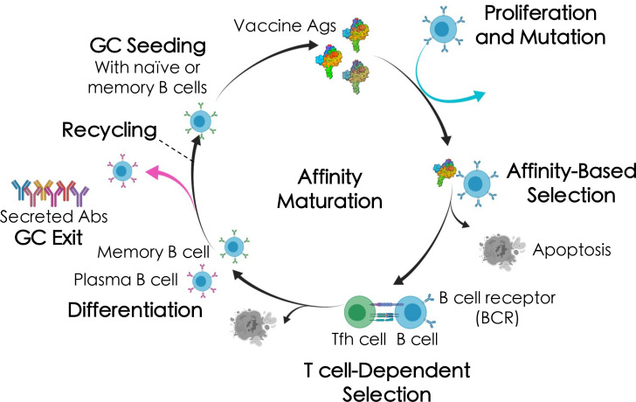

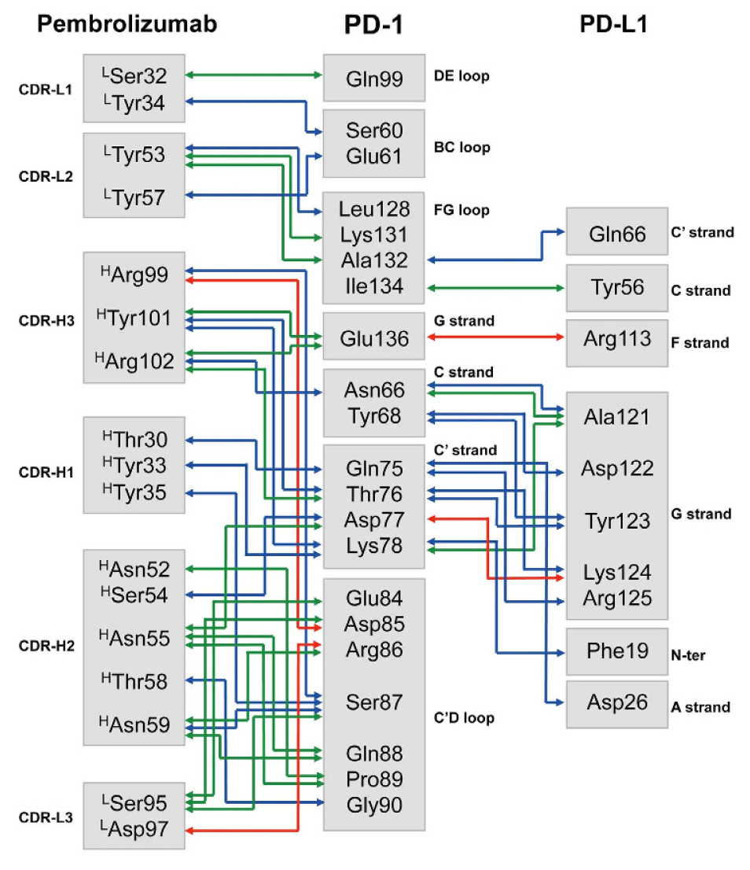
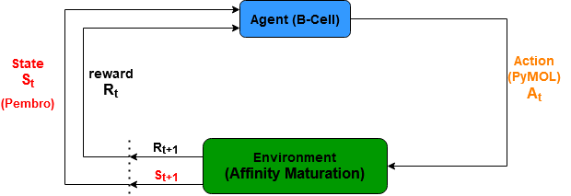
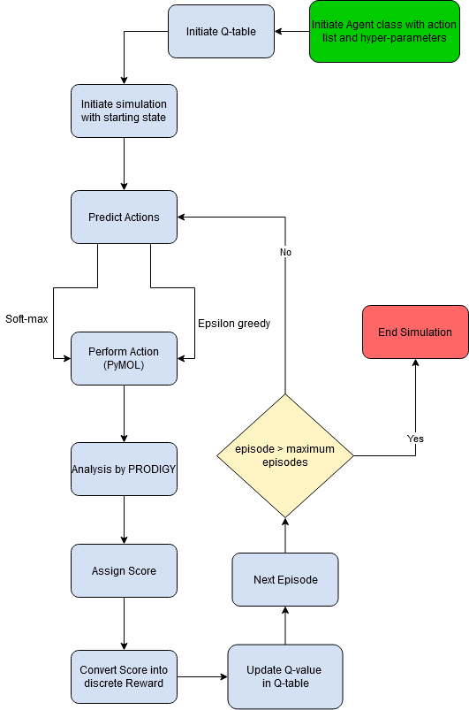
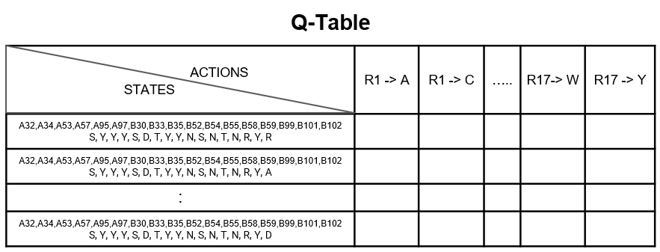
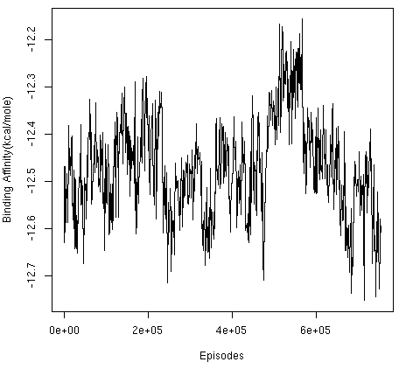
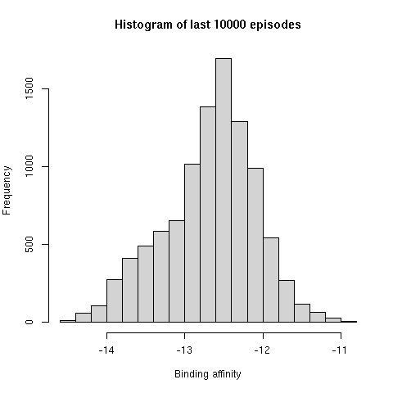
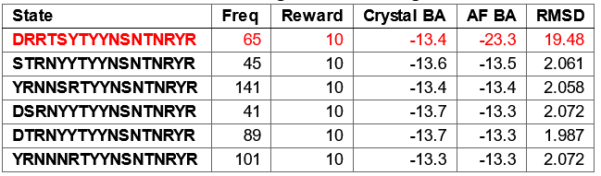
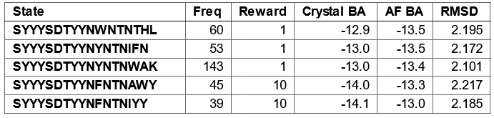
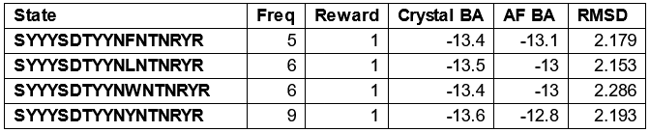
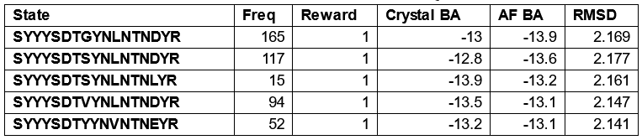
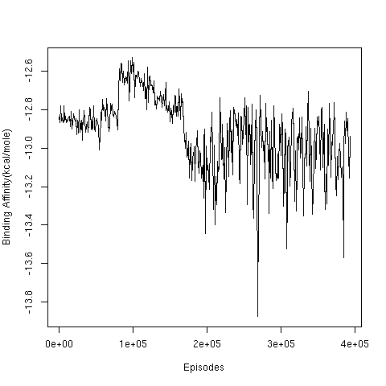
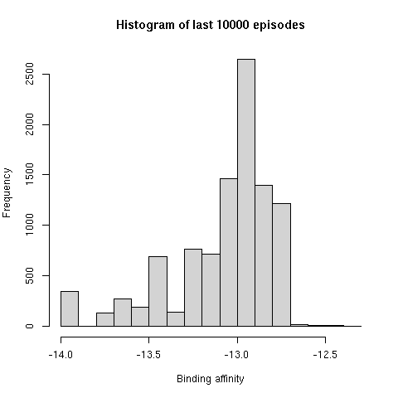
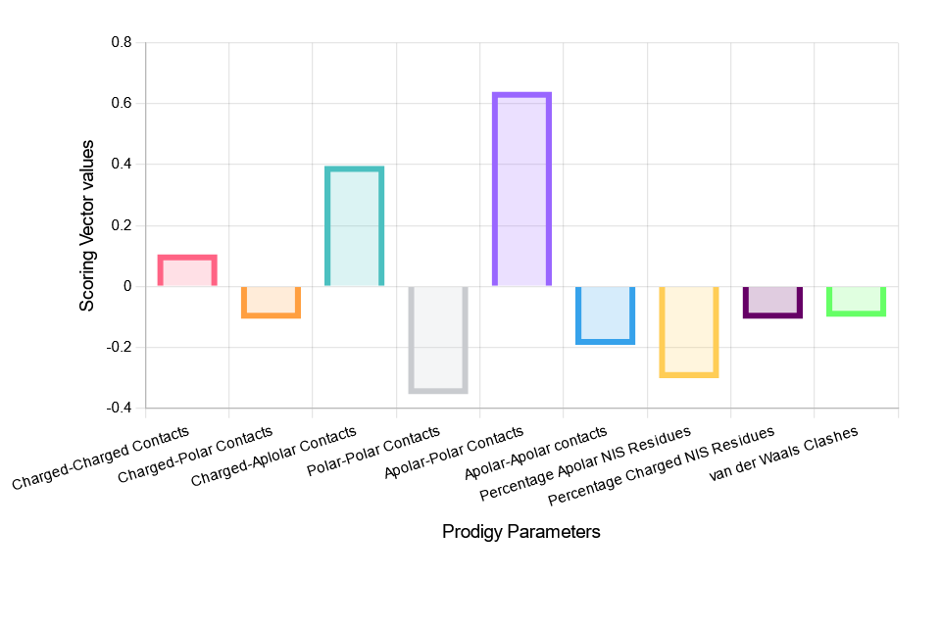
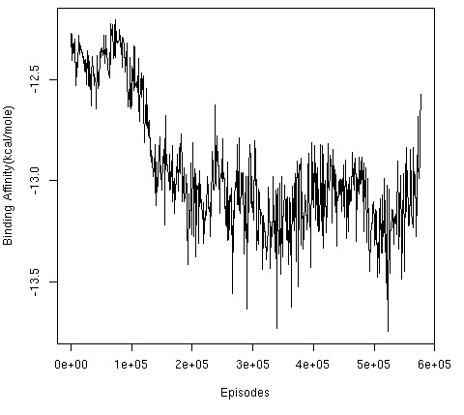
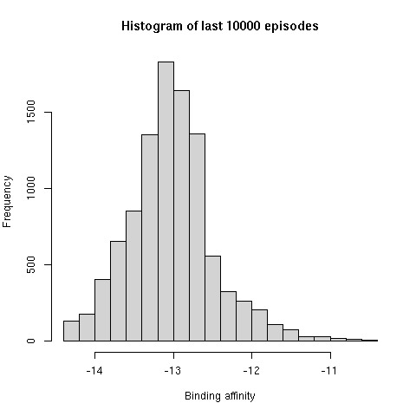
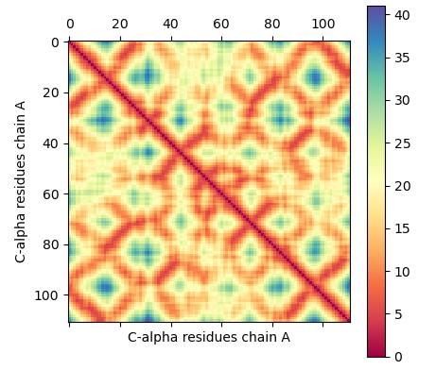
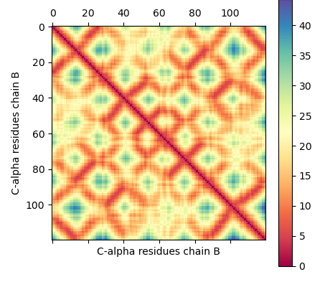
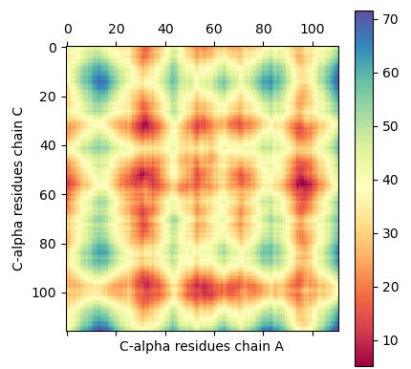
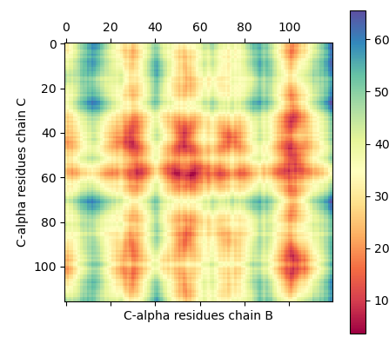
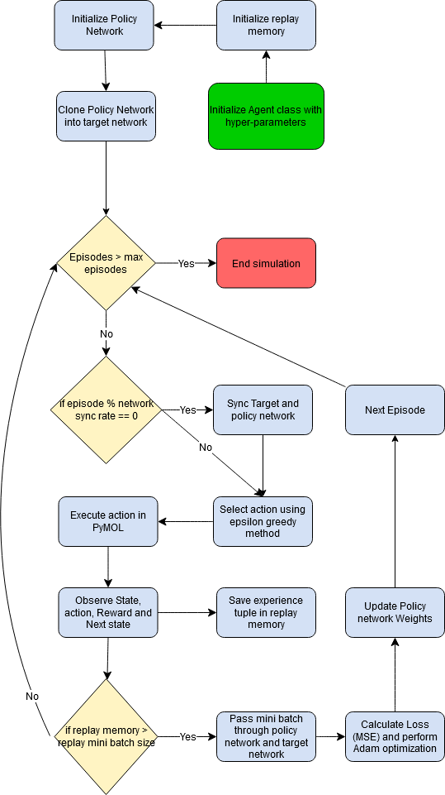
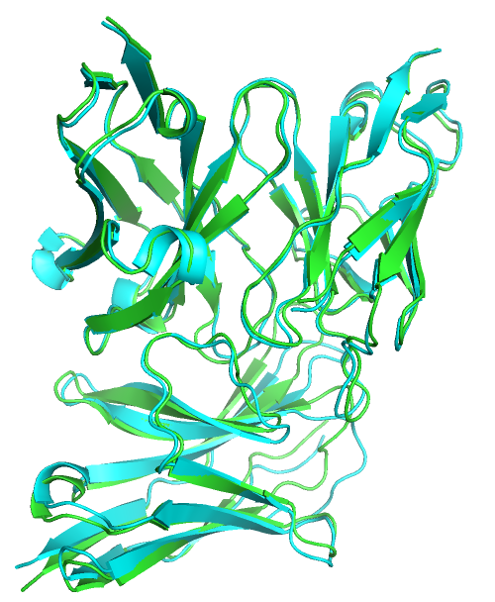
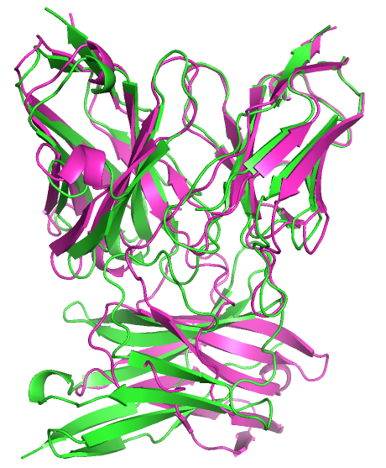
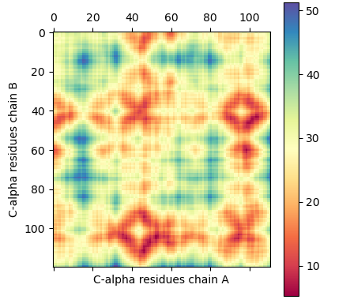
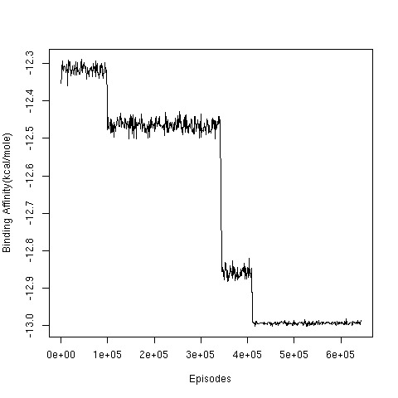
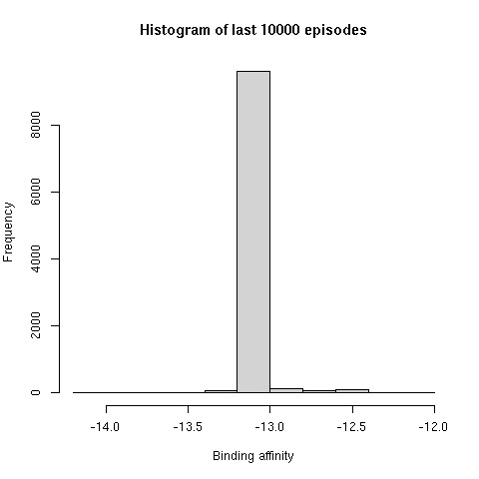
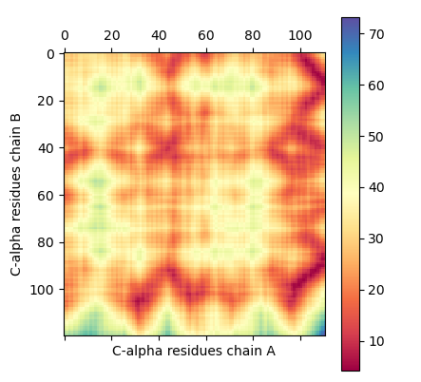
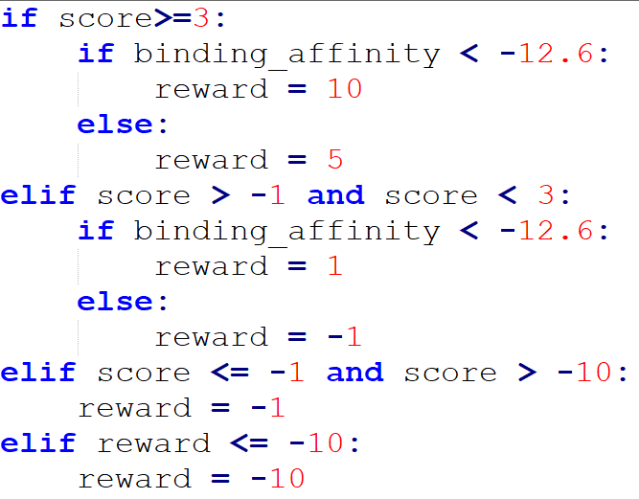
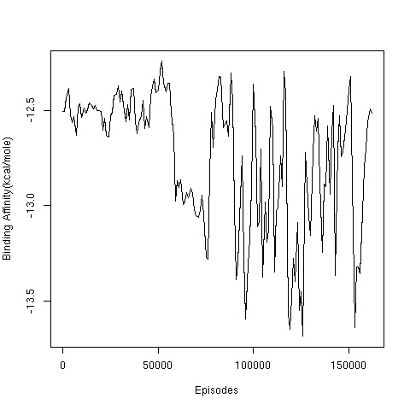
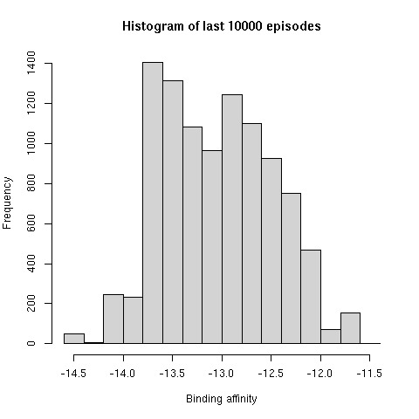
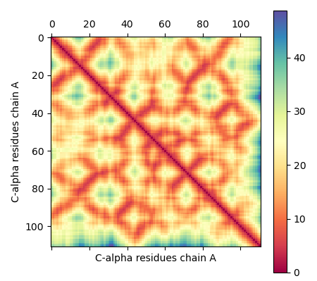
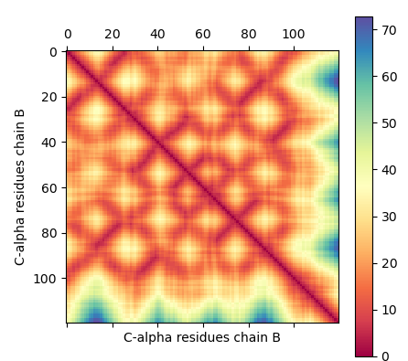
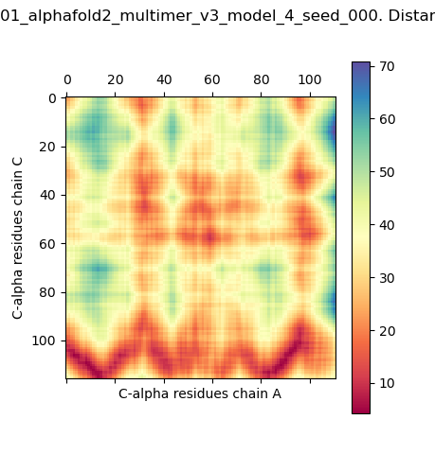
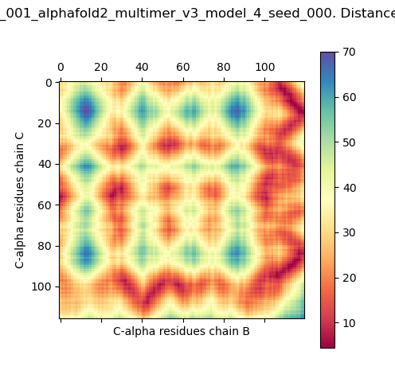
Modeling Somatic Hypermutations with Reinforcement Learning for PD1 and Pembrolizumab
Anmol Singh, Dr. Nithya Ramakrishnan, Prof. Subhashini Srinivasan
Institute of Bioinformatics and Applied Biotechnology - Biotech Park, Electronics City Phase 1, Electronic City, Bengaluru, Karnataka 560100
ABSTRACT
INTRODUCTION
CONCLUSION AND FUTURE WORK
We present a reinforcement learning model for Somatic Hypermutations, which mimics the natural selection process in a very short time scale. In this model, the agent can learn to preferentially mutate amino acids in the antibody, leading to affinity maturation. The model thus predicts a higher binding affinity antibody than the initial antibody-antigen complex. We have used the Pembrolizumab-PD1 (5b8c) complex to create the model, as Pembrolizumab (Pembro) is widely used in immunotherapy.
We were able to use Q-Learning in reinforcement learning to model SHM on a reduced state space to and provide better binding affinity antibodies. We validated the structure of the antibodies predicted by the SHM model by using AlphaFold2 and inter-residue distance plots to check for proper folding of chains and protein-protein interactions. This study provides a proof of concept that reinforcement learning can be used for modeling the biological process of SHM and can be later expanded into creating novel antibodies.
Somatic Hypermutations (SHM) are important part of the affinity maturation (AM) in B-cells. We can express the biological process of AM in terms of a Markov decision process, this allows us to create a Reinforcement learning model of SHM and AM, whereby the agent learns to prefer the higher affinity antibodies over time. For the model we have assumed that:
The relative configuration of PD1-Pembrolizumab complex remains the same irrespective of the type of amino acids mutations at the 17 positions
The 3D folds of light and heavy chains are not disrupted by the mutations in loops on pembrolizumab
Q-learning simulations were able to simulate the SHM, especially in case of restricted states of mutations on heavy chain positions. This gives us the confidence to move forward with DQL and other deep reinforcement approaches, which may be better suited for our problem statement.
We are currently working on a DQL model, but due to the complex nature of the problem it requires optimization to simulate SHM which was not possible in the time frame available.
We were able to find multiple states with better binding affinity than Pembrolizumab according to assessment with Prodigy, but these states need to be further validated and reduced using other tools to confidently provide with an antibody which can be engineered in a wet lab.
OBJECTIVES
A
Major Objective: To create a reinforcement learning model for somatic hypermutations using Pembro and PD1.
Minor Objective: To find states/antibodies which have better binding affinity than Pembro, and validating the good states using AlphaFold2 and C-alpha distance plots of the predicted structures.
B
Figure 1. Broad overview of the affinity maturation (AM) process by which antibodies (Abs) evolve against vaccine-candidate antigens (Ags) in a germinal center (GC) reaction (Faris J et al., 2022)
DESIGN AND WORKFLOW
A
B
Chain A : Pembro light chain variable region
Chain B : Pembro heavy chain variable region
Chain C : Programmed cell death protein 1
(PD1-Antigen)
Figure 2. The interaction of agent and environment in a Markov decision process (MDP),
Agent: B-cells
Action: Point mutations on Pembrolizumab (using PyMOL)
Environment: Affinity Maturation of Pembrolizumab-PD1
State: Pembrolizumab with mutated amino acids
Figure 3. A Reference crystal structure of Pembrolizumab (PDB ID: 5B8C), B A schematic diagram of interactions between PD1 and antiPD1. Direct protein/protein hydrogen bonds are in blue;water-mediated hydrogen bonds are in green; and salt bridges are in red (Horita S et al., 2016)
A
RESULTS
C a
D
B
C b
Figure 5. A a RL SHM simulations, Red: Using Soft-Max: Mutating 3 residues on Heavy chain into 17 residues, Blue: Epsilon Greedy: Mutating 6 residues in Light chain into 6 a.a. Orange: Epsilon greedy: Mutating 4 residues in Heavy chain into 16 a.a. Green: Mutating 4 residues in Heavy chain into 16 a.a. with constraint looping Yellow: DQL: Epsilon Greedy: mutating 3 residues on Heavy chain into 17 a.a. A b Higher Binding affinity(BA) states after AlphaFold2(AF) Blue: Epsilon Greedy: Mutating 6 residues in Light chain into 6 a.a. Orange: Epsilon greedy: Mutating 4 residues in Heavy chain into 16 a.a. Green: DQL: Epsilon Greedy: mutating 3 residues on Heavy chain into 17 a.a., B AF predicted structures aligned with Pembro and their corresponding C-alpha distance plots Purple: DDDSGDTYYNSNTNRYR (Folded Properly)
Red: SYYYSDTWYNYNTNGYR (improper folding)
REFERENCES
Faris, J. G., Orbidan, D., Wells, C., Petersen, B. K., & Sprenger, K. G. (2022). Moving the needle: Employing deep reinforcement learning to push the boundaries of coarse-grained vaccine models. Frontiers in Immunology, 13. https://doi.org/10.3389/FIMMU.2022.1029167
Horita, Shoichiro, et al. "High-resolution crystal structure of the therapeutic antibody pembrolizumab bound to the human PD-1." Scientific reports 6.1 (2016): 35297
Sutton, R. S., & Barto, A. G. (2018). Reinforcement learning: An introduction, 2nd ed. In Reinforcement learning: An introduction, 2nd ed. The MIT Press.
Vangone, A., & Bonvin, A. M. J. J. (2017). PRODIGY: A Contact-based Predictor of Binding Affinity in Protein-protein Complexes. Bio-Protocol, 7(3). https://doi.org/10.21769/BIOPROTOC.2124
Figure 4. A Flowchart of Basic Q-learning, B Representation of Q-Table, C a Scoring vector, b Score to reward function, D Flowchart of Deep Q Learning,
ACKNOWLEDGEMENT
This study is supported by Dept. of electronics, IT, BT and S&T, Government of Karnataka. We would also like to extend our gratitude to the faculty of IBAB and Mr. Balakrishna Prabhu B N, Ms. Namita Menon, Mr. Chindarkar Yash Dhondu and Ms. Apoorva Ganesh for their contribution and guidance.

Slide 2

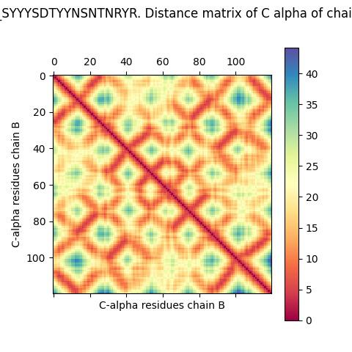

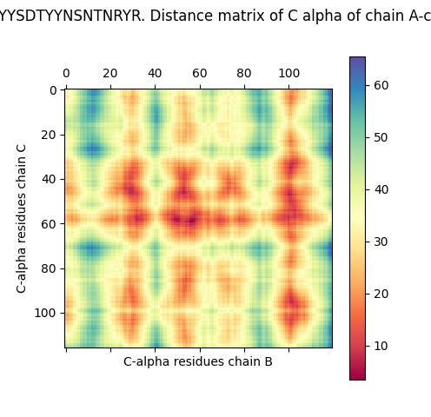
Modeling Somatic Hypermutations with Reinforcement Learning for PD1 and Pembrolizumab
Anmol Singh, Dr. Nithya Ramakrishnan, Prof. Subhashini Srinivasan
Institute of Bioinformatics and Applied Biotechnology - Biotech Park, Electronics City Phase 1, Electronic City, Bengaluru, Karnataka 560100
ABSTRACT
INTRODUCTION
CONCLUSION AND FUTURE WORK
We present a reinforcement learning model for Somatic Hypermutations, which mimics the natural selection process in a very short time scale. In this model, the agent can learn to preferentially mutate amino acids in the antibody, leading to affinity maturation. The model thus predicts a higher binding affinity antibody than the initial antibody-antigen complex. We have used the Pembrolizumab-PD1 (5b8c) complex to create the model, as Pembrolizumab (Pembro) is widely used in immunotherapy.
We were able to use Q-Learning in reinforcement learning to model SHM on a reduced state space to and provide better binding affinity antibodies. We validated the structure of the antibodies predicted by the SHM model by using AlphaFold2 and inter-residue distance plots to check for proper folding of chains and protein-protein interactions. This study provides a proof of concept that reinforcement learning can be used for modeling the biological process of SHM and can be later expanded into creating novel antibodies.
Somatic Hypermutations (SHM) are important part of the affinity maturation (AM) in B-cells. We can express the biological process of AM in terms of a Markov decision process, this allows us to create a Reinforcement learning model of SHM and AM, whereby the agent learns to prefer the higher affinity antibodies over time. For the model we have assumed that:
The relative configuration of PD1-Pembrolizumab complex remains the same irrespective of the type of amino acids mutations at the 17 positions
The 3D folds of light and heavy chains are not disrupted by the mutations in loops on pembrolizumab
Q-learning simulations were able to simulate the SHM, especially in case of restricted states of mutations on heavy chain positions. This gives us the confidence to move forward with DQL and other deep reinforcement approaches, which may be better suited for our problem statement.
We are currently working on a DQL model, but due to the complex nature of the problem it requires optimization to simulate SHM which was not possible in the time frame available.
We were able to find multiple states with better binding affinity than Pembrolizumab according to assessment with Prodigy, but these states need to be further validated and reduced using other tools to confidently provide with an antibody which can be engineered in a wet lab.
OBJECTIVES
A
Major Objective: To create a reinforcement learning model for somatic hypermutations using Pembro and PD1.
Minor Objective: To find states/antibodies which have better binding affinity than Pembro, and validating the good states using AlphaFold2 and C-alpha distance plots of the predicted structures.
B
Figure 1. Broad overview of the affinity maturation (AM) process by which antibodies (Abs) evolve against vaccine-candidate antigens (Ags) in a germinal center (GC) reaction (Faris J et al., 2022)
DESIGN AND WORKFLOW
A
B
Chain A : Pembro light chain variable region
Chain B : Pembro heavy chain variable region
Chain C : Programmed cell death protein 1
(PD1-Antigen)
Figure 2. The interaction of agent and environment in a Markov decision process (MDP),
Agent: B-cells
Action: Point mutations on Pembrolizumab (using PyMOL)
Environment: Affinity Maturation of Pembrolizumab-PD1
State: Pembrolizumab with mutated amino acids
Figure 3. A Reference crystal structure of Pembrolizumab (PDB ID: 5B8C), B A schematic diagram of interactions between PD1 and antiPD1. Direct protein/protein hydrogen bonds are in blue;water-mediated hydrogen bonds are in green; and salt bridges are in red (Horita S et al., 2016)
A
RESULTS
C a
B
D
B
C b
Figure 5. A a RL SHM simulations, Red: Using Soft-Max: Mutating 3 residues on Heavy chain into 17 residues, Blue: Epsilon Greedy: Mutating 6 residues in Light chain into 6 a.a. Orange: Epsilon greedy: Mutating 4 residues in Heavy chain into 16 a.a. Green: Mutating 4 residues in Heavy chain into 16 a.a. with constraint looping Yellow: DQL: Epsilon Greedy: mutating 3 residues on Heavy chain into 17 a.a. A b Higher Binding affinity(BA) states after AlphaFold2(AF) Blue: Epsilon Greedy: Mutating 6 residues in Light chain into 6 a.a. Orange: Epsilon greedy: Mutating 4 residues in Heavy chain into 16 a.a. Green: DQL: Epsilon Greedy: mutating 3 residues on Heavy chain into 17 a.a., B AF predicted structures aligned with Pembro and their corresponding C-alpha distance plots Purple: DDDSGDTYYNSNTNRYR (Folded Properly)
Red: SYYYSDTWYNYNTNGYR (improper folding)
REFERENCES
Faris, J. G., Orbidan, D., Wells, C., Petersen, B. K., & Sprenger, K. G. (2022). Moving the needle: Employing deep reinforcement learning to push the boundaries of coarse-grained vaccine models. Frontiers in Immunology, 13. https://doi.org/10.3389/FIMMU.2022.1029167
Horita, Shoichiro, et al. "High-resolution crystal structure of the therapeutic antibody pembrolizumab bound to the human PD-1." Scientific reports 6.1 (2016): 35297
Sutton, R. S., & Barto, A. G. (2018). Reinforcement learning: An introduction, 2nd ed. In Reinforcement learning: An introduction, 2nd ed. The MIT Press.
Vangone, A., & Bonvin, A. M. J. J. (2017). PRODIGY: A Contact-based Predictor of Binding Affinity in Protein-protein Complexes. Bio-Protocol, 7(3). https://doi.org/10.21769/BIOPROTOC.2124
Figure 4. A Flowchart of Basic Q-learning, B Representation of Q-Table, C a Scoring vector, b Score to reward function, D Flowchart of Deep Q Learning,
ACKNOWLEDGEMENT
This study is supported by Dept. of electronics, IT, BT and S&T, Government of Karnataka. We would also like to extend our gratitude to the faculty of IBAB and Mr. Balakrishna Prabhu B N, Ms. Namita Menon, Mr. Yash Chindarkar and Ms. Apoorva Ganesh for their contribution and guidance.

Slide 3
Modelling Somatic Hypermutations with Reinforcement Learning for PD1 and Pembrolizumab
Anmol Singh, Prof. Subhashini Srinivasan, Dr. Nithya Ramakrishnan
Institute of Bioinformatics and Applied Biotechnology - Biotech Park, Electronics City Phase 1, Electronic City, Bengaluru, Karnataka 560100
ABSTRACT
INTRODUCTION
DISCUSSION AND FUTURE WORK
We present a reinforcement learning (RL) model for Somatic Hypermutations (SHM), which mimics the natural selection process in a very short time scale. In this model, the agent can learn to preferentially mutate amino acids in the antibody, leading to affinity maturation. The model thus predicts a higher binding affinity antibody than the initial antibody-antigen complex. We have used the Pembrolizumab-PD1 (5b8c) complex to create the model, as Pembrolizumab (Pembro) is widely used in immunotherapy.
We use Q-Learning in RL to model SHM on a reduced state space to provide better binding affinity antibodies. We validated the structure of the antibodies predicted by the RL model using AlphaFold2 and inter-residue distance plots to check for proper folding of chains and protein-protein interactions. This study provides a proof of concept that RL can be used for modeling the biological process of SHM and can further be employed for creating novel antibodies.
Somatic Hypermutations (SHM) are an important part of the affinity maturation (AM) in B-cells.
We express the biological process of AM as a Markov decision process (MDP), creating a RL model of SHM and AM.
Model Assumptions:
The relative configuration of PD1-Pembro complex remains the same irrespective of the type of amino acids mutations at the 17 positions
The 3D folds of light and heavy chains are not disrupted by the mutations in loops on Pembro
Q-Learning simulated SHM and provided a better binding Pembro-PD1 complex using a reduced state space.
Deep Q-Learning can be employed to predict alternate complexes to Pembro-PD1 – Currently underway.
Protein Language Models (PLM) can be employed in conjunction with our SHM-RL model for drug discovery.
OBJECTIVES
A
Major Objective: To create a reinforcement learning model for somatic hypermutations using Pembro and PD1.
Minor Objective: To find states/antibodies which have better binding affinity than Pembro, and validating the good states using AlphaFold2 and C-alpha distance plots of the predicted structures.
B
Figure 1. Broad overview of the affinity maturation (AM) process by which antibodies (Abs) evolve against vaccine-candidate antigens (Ags) in a germinal center (GC) reaction (Faris J et al., 2022)
DESIGN AND WORKFLOW
A
B
Chain A : Pembro light chain variable region
Chain B : Pembro heavy chain variable region
Chain C : Programmed cell death protein 1
(PD1-Antigen)
Figure 2. The interaction of agent and environment in a Markov decision process (MDP),
Agent: B-cells
Action: Point mutations on Pembrolizumab (using PyMOL)
Environment: Affinity Maturation of Pembrolizumab-PD1
State: Pembrolizumab with mutated amino acids
Figure 3. A Reference crystal structure of Pembrolizumab (PDB ID: 5B8C), B A schematic diagram of interactions between PD1 and antiPD1. Direct protein/protein hydrogen bonds are in blue;water-mediated hydrogen bonds are in green; and salt bridges are in red (Horita S et al., 2016)
RESULTS
A a
A b Higher Affinity States/Abs
C a
Table: Simulation parameters
Q-Learning
Soft-max
Chain | Residues position | No. of Mutation a.a. | No. of Mutation a.a. | No. of Mutation a.a. | Mutations Residues | Temperature |  | Temperature |  | Temperature decay |  | Temperature decay interval |  | Minimum Temperature |  | Learning rate |  | Discount factor | Random Seed | Random Seed
Heavy | Tyr33, Ser54, Arg99 |  | 17 | 17 | A,D,E,F,G,H,I,K,L,N,Q,R,S,T,V,W,Y |  |  | 100 |  | 0.5 |  | 1000 |  | 1 |  | 0.01 |  | 0.9 |  | 717
Epsilon Decay
Chain | Residues position | No. of Mutation a.a. | No. of Mutation a.a. | No. of Mutation a.a. | Mutations Residues | Exploration rate |  | Exploration rate |  | Exploration decay |  | Exploration decay interval |  | Minimum Exploration |  | Learning rate |  | Discount factor | Random Seed | Random Seed
Light | Ser32, Tyr34, Tyr53, Tyr57, Ser95, Asp97 |  | 6 | 6 | S,Y,N,R,T,D |  |  | 1 |  | 0.005 |  | 1000 |  | 0.01 |  | 0.01 |  | 0.9 |  | 643
Heavy | Ser54, Arg99,Tyr101, Arg102 |  | 16 | 16 | A,D,E,F,G,H,I,K,L,N,Q,R,S,T,V,W,Y |  |  | 1 |  | 0.005 |  | 1000 |  | 0.05 |  | 0.01 |  | 0.9 |  | 71
Heavy* | Ser54, Arg99,Tyr101, Arg102 |  | 16 | 16 | A,D,E,F,G,H,I,K,L,N,Q,R,S,T,V,W,Y |  |  | 1 |  | 0.005 |  | 1000 |  | 0.05 |  | 0.01 |  | 0.9 |  | 17
Deep Q Learning
Chain | Residues position | No. of Mutation a.a. | Mutations Residues |  |  | Exploration rate | Exploration decay | Exploration decay | Exploration decay interval | Exploration decay interval | Minimum Exploration | Learning rate | Learning rate | Discount factor | Network Sync Rate | Network Sync Rate | Replay Memory Size | Replay Memory Size | Mini Batch Size | Random Seed | Random Seed
Heavy | Tyr33, Ser54, Arg99 | 17 | A,D,E,F,G,H,I,K,L,N,Q,R,S,T,V,W,Y |  |  | 1 | 0.01 |  | 1000 |  | 0.01 |  | 0.01 | 0.9 | 5000 |  | 5000 |  | 200 |  | 7
*Looping from starting state upon reaching -10 reward
D
B
C b
Figure 5. A a RL SHM simulations, A b Higher Binding affinity(BA) states after AlphaFold2(AF), Red: Using Soft-Max: Mutating 3 residues on Heavy chain into 17 residues, Blue: Epsilon Greedy: Mutating 6 residues in Light chain into 6 a.a. Orange: Epsilon greedy: Mutating 4 residues in Heavy chain into 16 a.a. Green: Mutating 4 residues in Heavy chain into 16 a.a. with constraint looping Yellow: DQL: Epsilon Greedy: mutating 3 residues on Heavy chain into 17 a.a. B AF predicted structures aligned with Pembro and their corresponding C-alpha distance plots Purple: DDDSGDTYYNSNTNRYR (Folded Properly) Red: SYYYSDTWYNYNTNGYR (improper folding)
REFERENCES
Faris, J. G., Orbidan, D., Wells, C., Petersen, B. K., & Sprenger, K. G. (2022). Moving the needle: Employing deep reinforcement learning to push the boundaries of coarse-grained vaccine models. Frontiers in Immunology, 13. https://doi.org/10.3389/FIMMU.2022.1029167
Horita, Shoichiro, et al. "High-resolution crystal structure of the therapeutic antibody pembrolizumab bound to the human PD-1." Scientific reports 6.1 (2016): 35297
Sutton, R. S., & Barto, A. G. (2018). Reinforcement learning: An introduction, 2nd ed. In Reinforcement learning: An introduction, 2nd ed. The MIT Press.
Vangone, A., & Bonvin, A. M. J. J. (2017). PRODIGY: A Contact-based Predictor of Binding Affinity in Protein-protein Complexes. Bio-Protocol, 7(3). https://doi.org/10.21769/BIOPROTOC.2124
Figure 4. A Flowchart of Basic Q-learning, B Representation of Q-Table, C a Scoring vector, b Score to reward function, D Flowchart of Deep Q Learning,
ACKNOWLEDGEMENT
This study is supported by Dept. of electronics, IT, BT and S&T, Government of Karnataka. We would also like to extend our gratitude to the faculty of IBAB and Mr. Balakrishna Prabhu B N, Ms. Namita Menon, Mr. Yash Chindarkar and Ms. Apoorva Ganesh for their contribution and guidance.

Slide 4
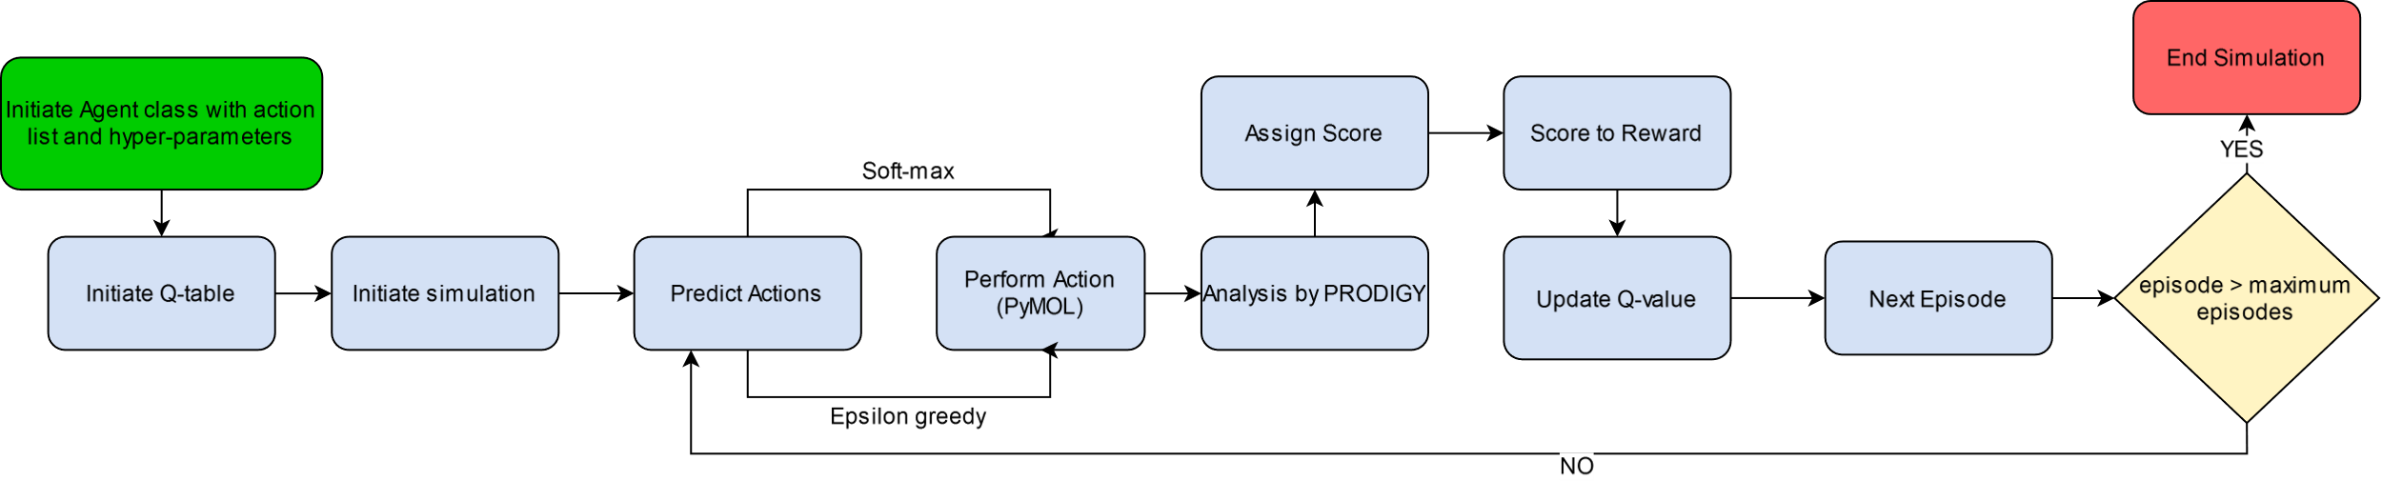
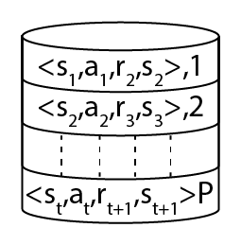
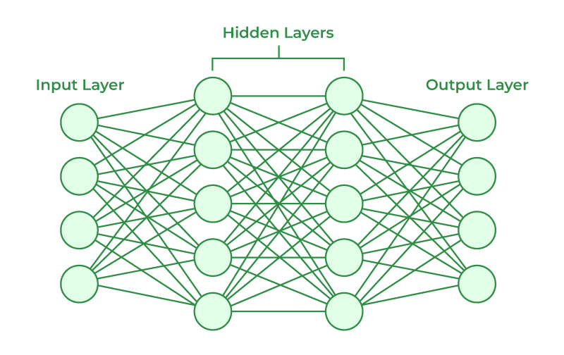
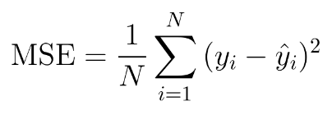
Modelling Somatic Hypermutations with Reinforcement Learning for PD1 and Pembrolizumab
Anmol Singh, Prof. Subhashini Srinivasan, Dr. Nithya Ramakrishnan
Institute of Bioinformatics and Applied Biotechnology - Biotech Park, Electronics City Phase 1, Electronic City, Bengaluru, Karnataka 560100
ABSTRACT
INTRODUCTION
We present a reinforcement learning (RL) model for Somatic Hypermutations (SHM), which mimics the natural selection process in a very short time scale. In this model, the agent can learn to preferentially mutate amino acids in the antibody, leading to affinity maturation. The model thus predicts a higher binding affinity antibody than the initial antibody-antigen complex. We have used the Pembrolizumab-PD1 (5b8c) complex to create the model, as Pembrolizumab (Pembro) is widely used in immunotherapy.
We use Q-Learning in RL to model SHM on a reduced state space to provide better binding affinity antibodies. We validated the structure of the antibodies predicted by the RL model using AlphaFold2 and inter-residue distance plots to check for proper folding of chains and protein-protein interactions. This study provides a proof of concept that RL can be used for modeling the biological process of SHM and can further be employed for creating novel antibodies.
Somatic Hypermutations (SHM) are an important part of the affinity maturation (AM) in B-cells.
We express the biological process of AM as a Markov decision process (MDP), creating a RL model of SHM.
Model Assumptions:
The relative configuration of PD1-Pembro complex remains the same irrespective of the type of amino acids mutations at the 17 positions
The 3D folds of light and heavy chains are not disrupted by the mutations in loops on Pembro
Figure 2. The interaction of agent and environment in a MDP Agent: B-cells Action: Point mutations on Pembrolizumab (using PyMOL) Environment: Affinity Maturation of Pembrolizumab-PD1
State: Pembro with mutated amino acids
OBJECTIVES
A
B
Major Objective: To create a reinforcement learning model for somatic hypermutations using Pembro and PD1.
Minor Objective: To find states/antibodies which have better binding affinity than Pembro, and validating the good states using AlphaFold2 and C-alpha distance plots of the predicted structures.
Chain A : Pembro light chain variable region
Chain B : Pembro heavy chain variable region
Chain C : Programmed cell death protein 1 (PD1-Antigen)
Figure 3. A Reference crystal structure of Pembrolizumab (PDB ID: 5B8C), B A schematic diagram of interactions between PD1 and antiPD1. Direct protein/protein hydrogen bonds are in blue, water-mediated hydrogen bonds are in green and salt bridges are in red (Horita S et al., 2016)
DESIGN AND WORKFLOW
Figure 1. Broad overview of the affinity maturation (AM) process by which antibodies (Abs) evolve against vaccine-candidate antigens (Ags) in a germinal center (GC) reaction (Faris J et al., 2022)
A
C a
C b
Table. Score to Reward function
Score | Binding Affinity (kcal/mole) | Reward
>=3 | < -12.6 | 10
>=3 | >= -12.6 | 5
3>score>-1 | < -12.6 | 1
3 > score > -1 | > -12.6 | -1
-1>= score > -10 | - | -1
< -10 | - | -10
A a
B
RESULTS
Figure 4. A Flowchart of Basic Q-learning B Representation of Q-Table C a Scoring vector b Score to reward function
A b Higher Affinity States/Abs
Figure 5. General Representation of
Deep Q-Learning
Policy Network
Loss Function
Update Policy network
Replay Memory
Memory Mini Batch
Network Sync
Optimization
Target Network
Table: Simulation parameters
RESULTS
Table. Parameters of Simulations
Simulations and Predicted Antibodies
Q-Learning
Soft-max
Chain | Residues position | No. of Mutation a.a. | No. of Mutation a.a. | No. of Mutation a.a. | Mutations Residues | Temperature |  | Temperature |  | Temperature decay | Temperature decay | Temperature decay interval |  | Minimum Temperature | Minimum Temperature |  | Learning rate |  | Discount factor | Random Seed | Random Seed
Heavy | Tyr33, Ser54, Arg99 |  | 17 | 17 | A,D,E,F,G,H,I,K,L,N,Q,R,S,T,V,W,Y |  |  | 100 |  | 0.5 | 0.5 | 1000 |  | 1 | 1 |  | 0.01 |  | 0.9 |  | 717
Epsilon Decay
Chain | Residues position | No. of Mutation a.a. | No. of Mutation a.a. | No. of Mutation a.a. | Mutations Residues | Exploration rate |  | Exploration rate |  | Exploration decay |  | Exploration decay interval |  | Minimum Exploration | Minimum Exploration |  | Learning rate |  | Discount factor | Random Seed | Random Seed
Light | Ser32, Tyr34, Tyr53, Tyr57, Ser95, Asp97 |  | 6 | 6 | S,Y,N,R,T,D |  |  | 1 |  | 0.005 |  | 1000 |  | 0.01 | 0.01 |  | 0.01 |  | 0.9 |  | 643
Heavy | Ser54, Arg99,Tyr101, Arg102 |  | 16 | 16 | A,D,E,F,G,H,I,K,L,N,Q,R,S,T,V,W,Y |  |  | 1 |  | 0.005 |  | 1000 |  | 0.05 | 0.05 |  | 0.01 |  | 0.9 |  | 71
Heavy* | Ser54, Arg99,Tyr101, Arg102 |  | 16 | 16 | A,D,E,F,G,H,I,K,L,N,Q,R,S,T,V,W,Y |  |  | 1 |  | 0.005 |  | 1000 |  | 0.05 | 0.05 |  | 0.01 |  | 0.9 |  | 17
Deep Q Learning
Chain | Residues position | No. of Mutation a.a. | Mutations Residues |  |  | Exploration rate | Exploration decay |  | Exploration decay interval |  | Minimum Exploration |  | Learning rate | Discount factor |  | Network Sync Rate |  | Replay Memory Size |  | Mini Batch Size | Random Seed | Random Seed
Heavy | Tyr33, Ser54, Arg99 | 17 | A,D,E,F,G,H,I,K,L,N,Q,R,S,T,V,W,Y |  |  | 1 | 0.01 |  | 1000 |  | 0.01 |  | 0.01 | 0.9 |  | 5000 |  | 5000 |  | 200 |  | 7
Structure Validation using AlphaFold2 and C-alpha distance plots
*Looping from starting state upon reaching -10 reward, simulating apoptosis
REFERENCES
Figure 5. A a RL SHM simulations, A b Higher Binding affinity(BA) states after AlphaFold2(AF), Red: Using Soft-Max: Mutating 3 residues on Heavy chain into 17 residues, Blue: Epsilon Greedy: Mutating 6 residues in Light chain into 6 a.a. Orange: Epsilon greedy: Mutating 4 residues in Heavy chain into 16 a.a. Green: Mutating 4 residues in Heavy chain into 16 a.a. with constraint looping Yellow: DQL: Epsilon Greedy: mutating 3 residues on Heavy chain into 17 a.a. B AF predicted structures aligned with Pembro and their corresponding C-alpha distance plots Purple: DDDSGDTYYNSNTNRYR (Folded Properly) Red: SYYYSDTWYNYNTNGYR (improper folding)
DISCUSSION AND FUTURE WORK
Faris, J. G., Orbidan, D., Wells, C., Petersen, B. K., & Sprenger, K. G. (2022). Moving the needle: Employing deep reinforcement learning to push the boundaries of coarse-grained vaccine models. Frontiers in Immunology, 13. https://doi.org/10.3389/FIMMU.2022.1029167
Horita, Shoichiro, et al. "High-resolution crystal structure of the therapeutic antibody pembrolizumab bound to the human PD-1." Scientific reports 6.1 (2016): 35297
Sutton, R. S., & Barto, A. G. (2018). Reinforcement learning: An introduction, 2nd ed. In Reinforcement learning: An introduction, 2nd ed. The MIT Press.
Vangone, A., & Bonvin, A. M. J. J. (2017). PRODIGY: A Contact-based Predictor of Binding Affinity in Protein-protein Complexes. Bio-Protocol, 7(3). https://doi.org/10.21769/BIOPROTOC.2124
Q-Learning simulated SHM and provided a better binding Pembro-PD1 complex using a reduced state space.
Deep Q-Learning can be employed to predict alternate complexes to Pembro-PD1 – Currently underway.
Protein Language Models (PLM) can be employed in conjunction with our SHM-RL model for drug discovery.
Further validation of predicted antibodies using molecular dynamics and different binding affinity tools is required.
ACKNOWLEDGEMENT
This study is supported by Dept. of electronics, IT, BT and S&T, Government of Karnataka. We would also like to extend our gratitude to the faculty of IBAB and Mr. Balakrishna Prabhu B N, Ms. Namita Menon, Mr. Yash Chindarkar and Ms. Apoorva Ganesh for their contribution and guidance.

