Slide 1

CSP-251 Problem Based Learning Malware Detection And Analyzer
Submitted By :
Prakash Chand Thakuri
Anmol Garg Shivam Singh Panwar
Rohit Kumar
Department of Computer Science and Engineering
SET, Sharda University
Section G (G2)
Submitted To :
Preeti Kaushik
Assistant Professor
Department of Computer Science and Engineering
SET, Sharda University

Slide 2
Contents
Introduction to Malware
Types of Malware
Behaviour of Malware
Malware Detection
Malware Detection Techniques
Introduction of Tool (Malware Analyzer)
Tool Algorithm
Detection technique on Which tool works
Samples of Tool functionality
Drawbacks of the tool

Slide 3
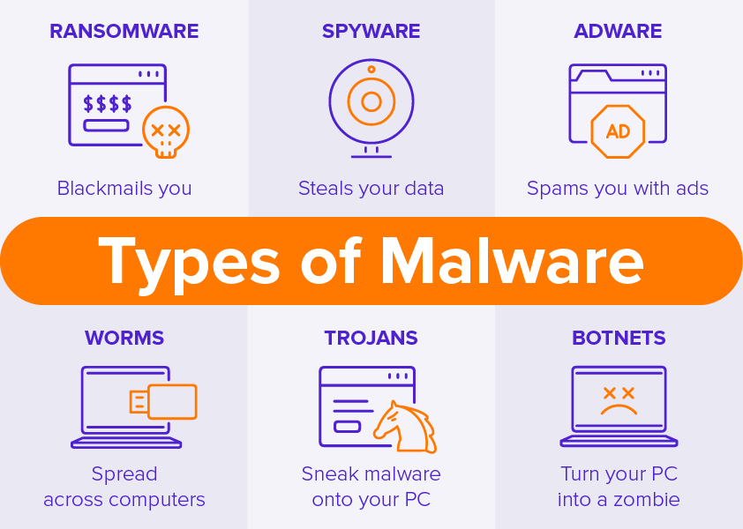
Malware And It’s type
Malware is any software intentionally designed to cause damage to a computer, server, client, or computer network.
Types:
Ransomware
Spyware
Worms
Trojans
Botnets
Worm
Rootkit

Slide 4
General Rules of Malware Analysis
Don’t get too caught up in the details. Most malware programs are large and complex, and you can’t possibly understand every detail.
Focus instead on the key features. When you run into difficult and complex sections, try to get a general overview before you get stuck in the weeds.
Every situation is different, and the various tools and techniques that you’ll learn will have similar and sometimes overlapping functionality.
If you’re not having luck with one tool, try another. If you get stuck, don’t spend too long on any one issue; move on to something else.
Try analyzing the malware from a different angle, or just try a different approach.
As new malware analysis techniques are developed, malware authors respond with new techniques to thwart analysis.
To succeed as a malware analyst, you must be able to recognize, understand, & defeat these techniques, and respond to changes in the art of malware analysis.

Slide 5
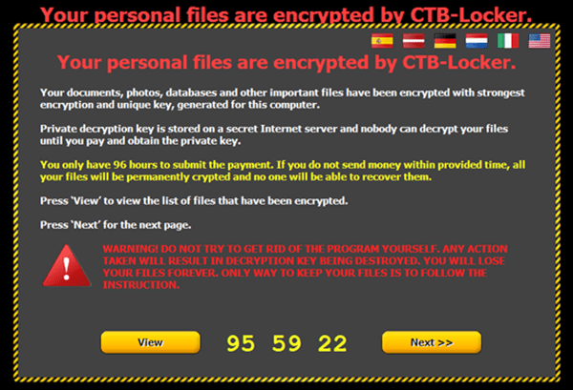
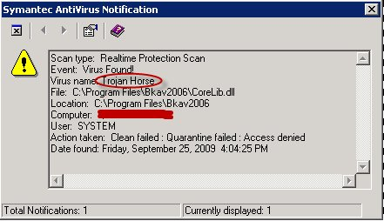
Who are the creators of Malware
1.Black Hat
2.Terrorist
3.Black Mailer
4.Evil Corp
5.Fun Boss

Slide 6
Malware Analysis Technique
Basic Analysis:
• Static Analysis:
o Examines malware without running it
o Tools: Virus-Total, strings, a disassembler like IDA Pro
• Dynamic Analysis:
o Run the malware and monitor its effect
o Use a virtual machine and take snapshots
o Tools: Reg-Shot, Process Monitor, Process Hacker, Capture-BAT
Advanced Analysis:
• Static Analysis:
o Reverse Engineering with disassembler
o Highly complex
• Dynamic Analysis:
o Run code in Debugger
o Examines internal state of running malicious executable

Slide 7
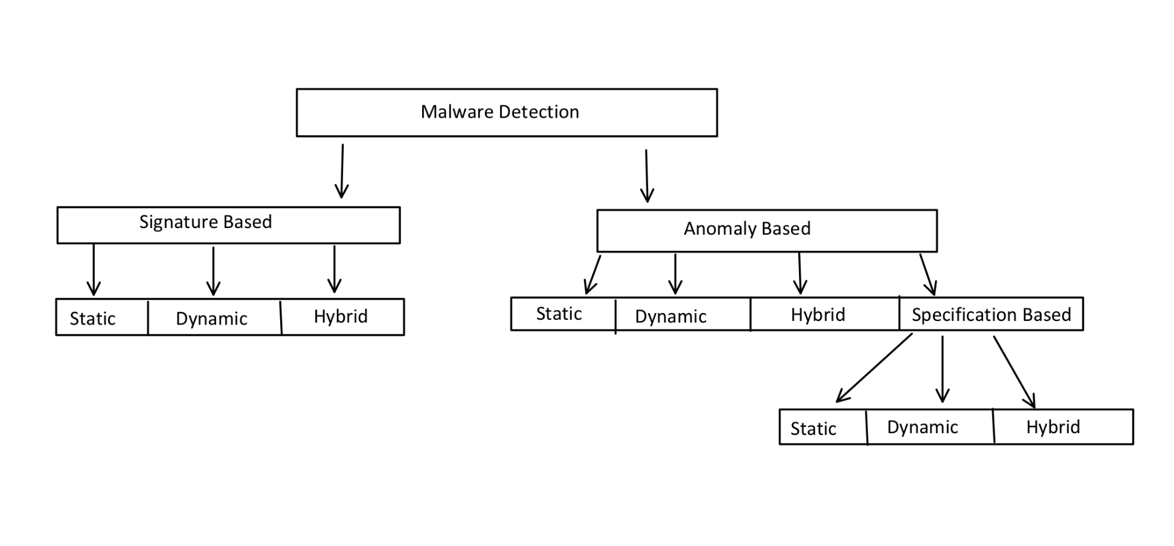
Malware Detection Technique

Slide 8
Signature Based Technique
Type of Signatures
Host Based Signature
Network Signature
Identify files or registry keys on a victim computer that indicate an infection
Focus on what the malware did to the system, not the malware itself
Detect malware by analyzing network traffic

Slide 9
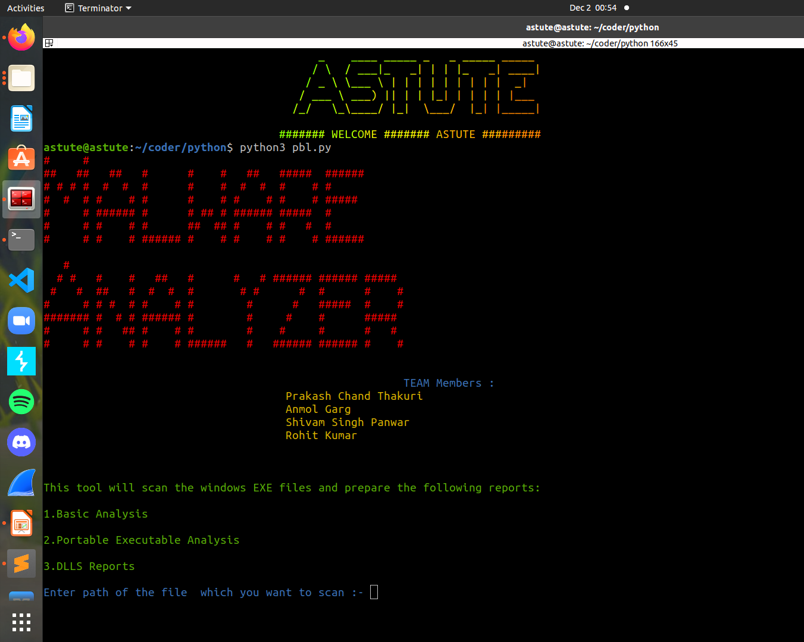
General Functions of Tool

Slide 10
Algorithm
Step:1 The tool takes the path of an exe file.
Step:2 Verification of the file if it is an exe or not.
Step:3 Analyze the file
Step:4 Prepare the P.E report of the file
Step:5 On the basis of P.E file it analyze the file.

Slide 11
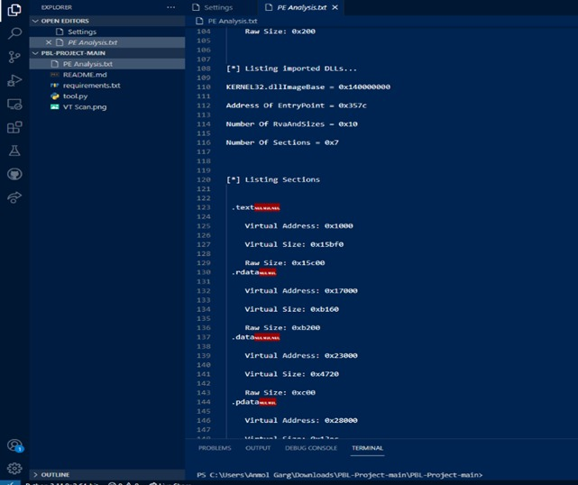
Scan Result

Slide 12
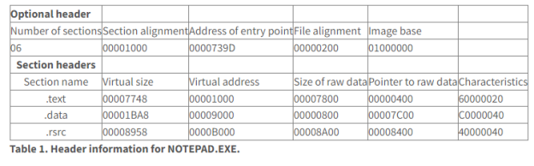
Notepad exe scan Result

Slide 13
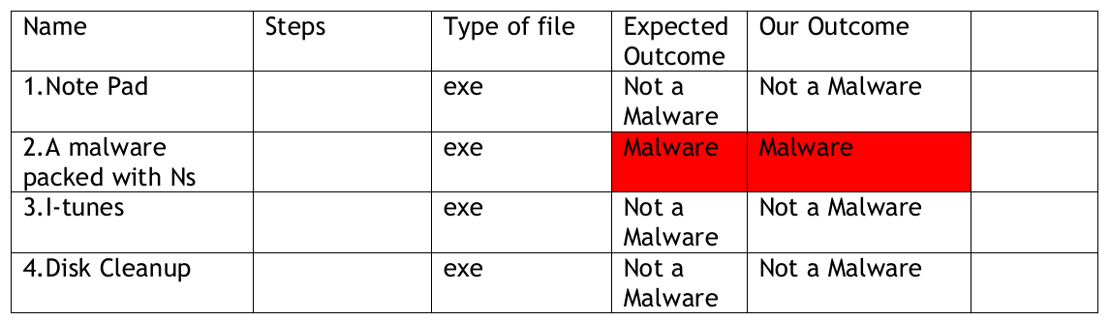
Summary of Scan Result

Slide 14
DrawBacks of the tool
It can only scan the .exe file extension
It is only limited to signature based
Output of the program is not well managed
Written on python2

Slide 15
Thank you

