Slide 1
REPORT
Anmol Harsh 18CS10005
Ayudh Saxena 18CS10007
Assignment 1 : Decision Trees
Procedure
Converted the .data file to .csv and read the data using the Python csv library.
Defined classes for tree nodes, attribute set etc.
Implemented the ID3 algorithm using information gain heuristic.
Tackled examples with missing attribute values by assigning the value which is most common in the examples having its target classification.
Implemented a best_depth function that takes in a dataset and returns a tree with highest test accuracy.
Iterated over possible depths (in this case, 10)
For each depth, shuffled the data set and then divided it in the ratio 60:20:20.
1st part : Training set to train the tree,
2nd part : Validation set which is used in pruning
the tree
3rd part : Test set to test the accuracy of the tree
constructed
Used Reduced Error Pruning to prune the tree
Tested nodes from bottom to up (leaf to root)
If pruning the node, increases the accuracy on the validation set (obtained from the best_depth function), then the node is replaced with a leaf node having most common classification at that node.
Used the matplotlib library to plot the graph between Depth vs Accuracy on both test-set as well as training set
Implemented a function to write a graphviz file (.gv) for printing the tree.
Non-leaf nodes are colored purple.
Leaf Nodes are colored red/green
Red :- Non-recurrence event
Green :- Recurrence event

Slide 2
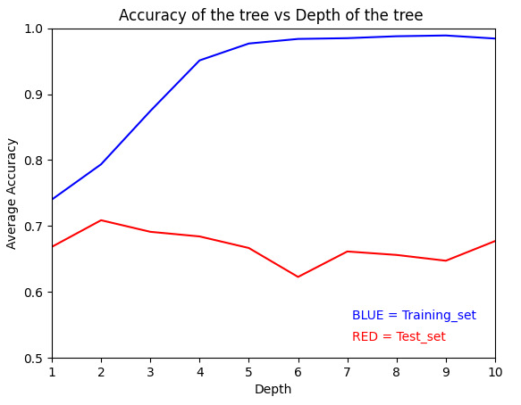
Results
Step II : Finding the best depth
Depth | Average accuracy on test-set (%) | Accuracy on test-set of the best tree (%) | Accuracy on training set (%)
1 | 66.84 | 78.94 | 72.02
2 | 70.87 | 80.70 | 76.57
3 | 69.12 | 77.19 | 83.91
4 | 68.42 | 77.19 | 93.70
5 | 66.66 | 75.43 | 97.02
6 | 62.28 | 71.92 | 97.02
7 | 66.14 | 73.68 | 97.02
8 | 65.61 | 75.43 | 97.02
9 | 64.73 | 73.68 | 97.02
10 | 67.71 | 70.87 | 97.02

Slide 3
Step III : Pruning the tree
The tree with maximum accuracy of of depth 2 is chosen for pruning
Three nodes are pruned.
Accuracy increases from 70.87% to 75.43%.
Depth of the node pruned | Attribute name | Accuracy on validation set before pruning (%) | Accuracy after on validation set after pruning (%)
1 | Tumor-size | 70.87 | 71.92
1 | Breast-quad | 71.92 | 73.68
1 | Tumor-size | 73.68 | 75.43

