Slide 1
REPORT
Anmol Harsh 18CS10005
Ayudh Saxena 18CS10007
Assignment 1
Bayesian Learning and Dimensionality Reduction
Procedure
Converted the .data file to .csv and read the data using the Pandas library and thus converting the data-set into a Pandas DataFrame.
Defined classes for attributes, probabilities, Naïve Bayes Classifier etc.
Handled the missing values in the training set and the test set by assigning for :
Categorical attributes : Most frequent value
Continuous attributes : Mean value
Encoded the categorical attributes using integer encoding.
Implemented a Naïve Bayes classifier
Normalized the data set using MinMaxScaler() of the sklearn library.
Calculated the class conditional probabilities and returned a probability_class object to be used by the classifier
Used frequencies for categorical attributes.
Used Gaussian probability for continuous attributes.
Performed 5-fold Cross Validation.
Performed Principal Component Analysis using the sklearn library
Standardized the data set using StandardScaler() function of the sklearn library.
Used the ‘PCA’ function from sklearn.decomposition.
Passed the total number of columns of our dataset as the new number of components.
Took the variance ratio of each column in an array and its cumulative_sum in another.
Plotted a bar graph of variance ratio of each component vs number of components using the matplotlib library.
Components are chose up until the cumulative sum becomes greater than 0.95. This gives the new reduced number of components (= new_n).
Applied PCA with this new_n and extracted the new data_set
Applied 5-fold Cross Validation over this new data_set using the Naïve Bayes classifier constructed earlier.
Removed erroneous samples from the data set having large number of outliers.
Performed Sequential Backward Selection using the Naïve Bayes Classifier constructed above and then performed 5-fold Cross Validation on the new set of features obtained

Slide 2
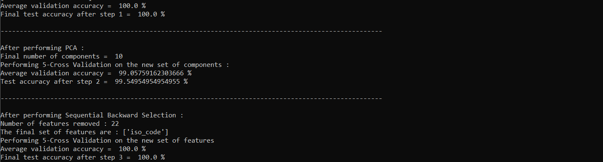
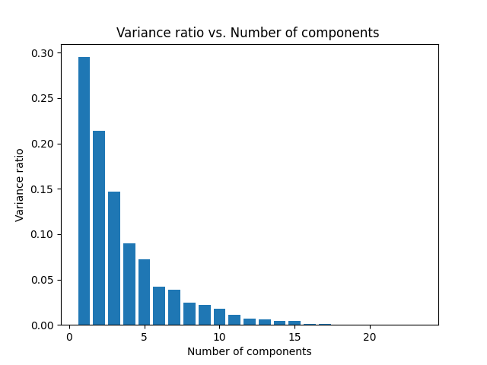
Results
\
Step I : Performed 5-fold Cross Validation on the Naïve Bayes
classifier constructed
Validation Accuracy = 100%
Test Accuracy = 100%
Step II : Performed Principal Component Analysis (PCA)
Total number of components chosen : 10

Slide 3
Performed 5-fold Cross Validation on the new set of
components using the Naïve Bayes Classifier constructed in
Step I :
Validation Accuracy = 99.06%
Test Accuracy = 99.55%
NOTE : The validation/test accuracy might change due to
Random shuffling
Step III : Performed Sequential Backward Selection with the help of Naïve Bayes Classifier :
Number of features removed = 22
Features retained = ‘iso-code’
Performed 5-fold Cross Validation on the new set of features :
Validation Accuracy = 100%
Test Accuracy = 100%

