Slide 1
REPORT
Anmol Harsh 18CS10005
Ayudh Saxena 18CS10007
Assignment 3
SVM and ANN
Procedure
Converted the .data file to .csv and read the data using the Pandas library and thus converting the data-set into a Pandas DataFrame.
Handled the missing values in the training set and the test set by assigning for :
Categorical attributes : Most frequent value
Continuous attributes : Mean value
Performed Multi-Layer Perceptron (MLP) classification using the sklearn library.
First, standardized the dataset using StandardScaler() function of the sklearn library.
Built an MLP classifier using the MLPClassifier function from sklearn.neural_network package by passing on some hyperparameters like hidden layer sizes, learning rate, max iterations, solver etc.
First, the classifier was built by varying the learning rates for each type of architecture (hidden layer size)
Plotted a semi-log line graph with x axis as log axis of accuracy vs learning rate for each architecture using the matplotlib library
Then the classifier was built for by varying the architecture for each value of learning rate.
Plotted a bar graph of accuracy vs model for each value of the learning rate using the matplotlib library
Performed Principal Component Analysis using the sklearn library
Standardized the data set using StandardScaler() function of the sklearn library.
Used the ‘PCA’ function from sklearn.decomposition.
Passed the total number of columns of our dataset as the new number of components.
Took the variance ratio of each column in an array and its cumulative_sum in another.
Plotted a bar graph of variance ratio of each component vs number of components using the matplotlib library.
Components are chose up until the cumulative sum becomes greater than 0.95. This gives the new reduced number of components (= new_n).
Applied PCA with this new_n and extracted the new data_set
Applied 5-fold Cross Validation over this new data_set using the Naïve Bayes classifier constructed earlier.
Removed erroneous samples from the data set having large number of outliers.
Performed Sequential Backward Selection using the Naïve Bayes Classifier constructed above and then performed 5-fold Cross Validation on the new set of features obtained

Slide 2
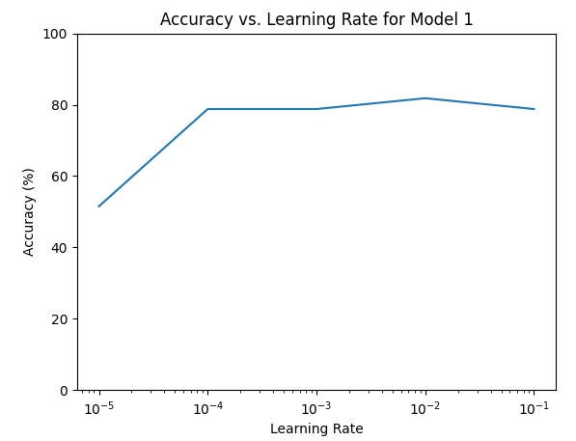
Results
Part II : Built an MLP classifier using the stochastic gradient
descent (sgd) optimiser for various combinations of
architecture and learning rates and for the following
hyperparameters :
solver = ‘sgd’ (Stochastic Gradient Descent)
activation function = ‘logistic’
max iterations = 2000
hidden_layer_sizes :
0 hidden layer
1 hidden layer with 2 nodes
1 hidden layer with 6 nodes
2 hidden layer with 2 and 3 nodes resp.
2 hidden layer with 3 and 2 nodes resp.
learning_rate_init : 0.1, 0.01, 0.001, 0.0001, 0.00001
tol = 0.0001 (default)
Number of input nodes = number of features = 49
Number of output nodes = 1, since it’s a binary
classification problem.
Variation of accuracy with learning rate for each architecture
0 Hidden Layer (Model 1)

Slide 3
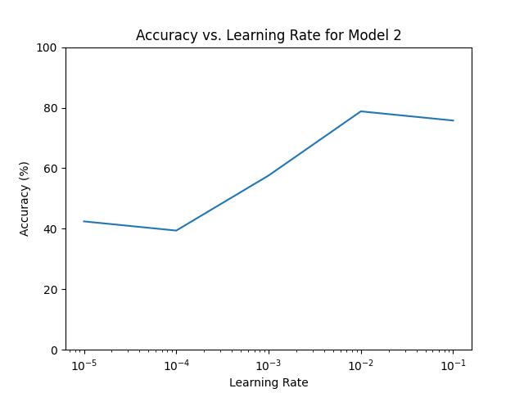
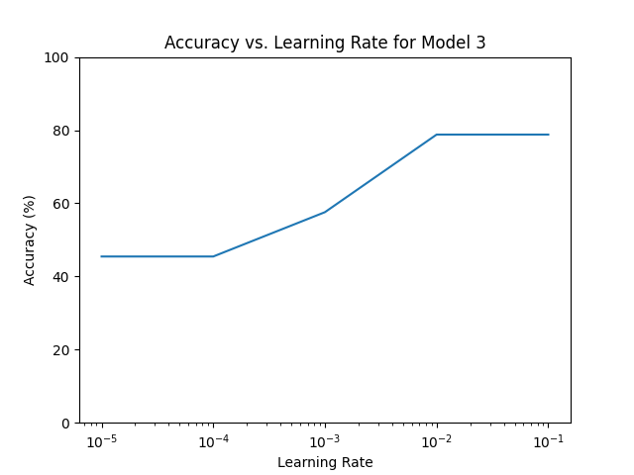
1 hidden layer with 2 nodes (Model 2)
1 hidden layer with 6 nodes (Model 3)

Slide 4
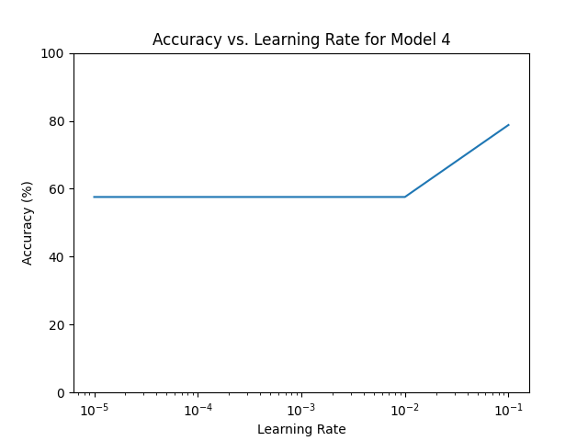
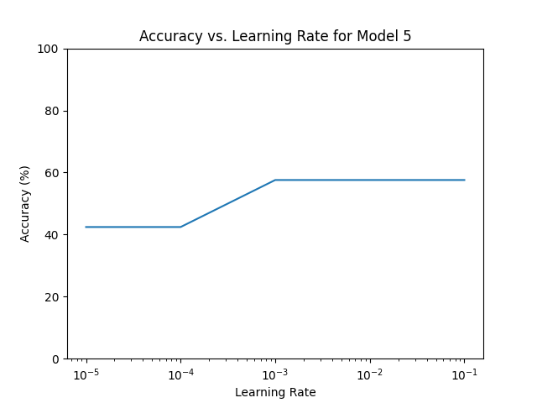
2 hidden layer with 2 and 3 nodes respectively (Model 4)
2 hidden layers with 3 and 2 nodes resp. (Model 5)

Slide 5
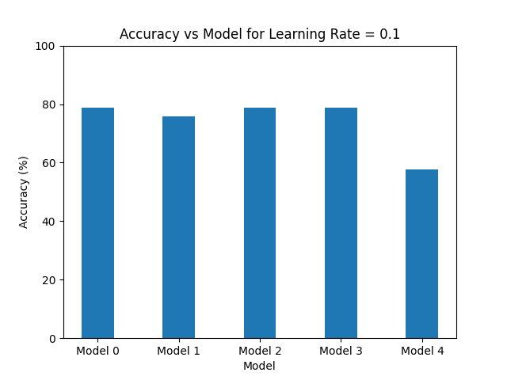
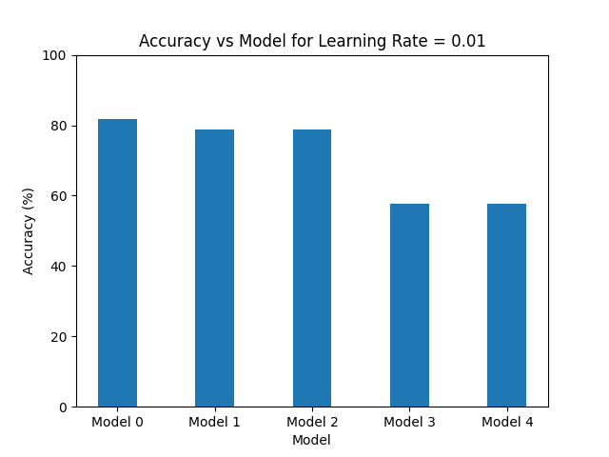
Variation of accuracy with Models for each learning rate
Learning rate = 0.1
Learning Rate = 0.01

Slide 6
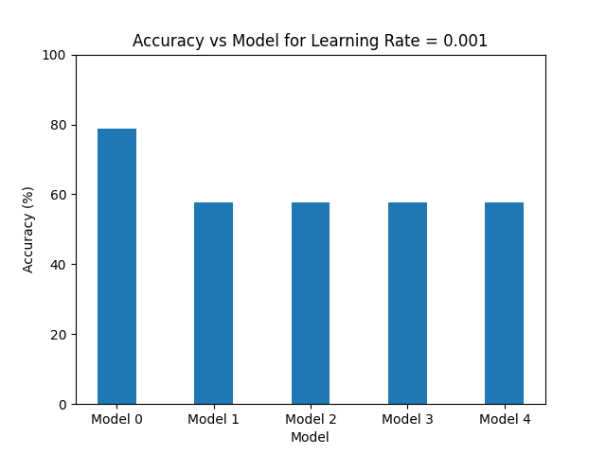
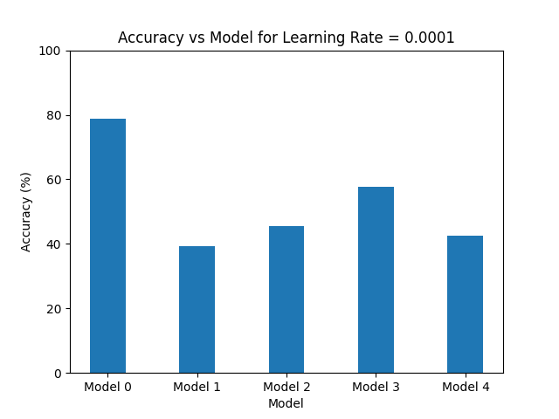
Learning rate = 0.001
Learning Rate = 0.0001

Slide 7
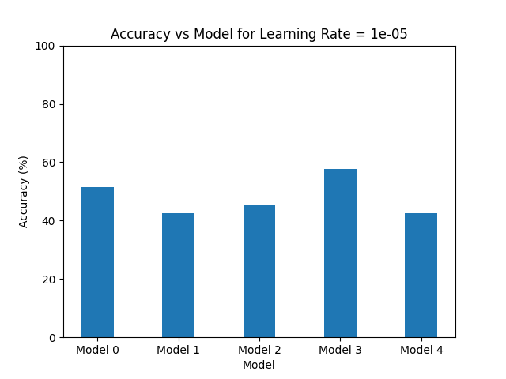
Learning rate = 0.00001
The best model found had accuracy = 81.81% with the following hyperparameters :
learning_rate_init = 0.01
hidden_layer_size = 0
solver = ‘sgd’ (Stochastic Gradient Descent)
activation function = logistic
max_iterations = 2000
tol = 0.0001 (default)

