Slide 1

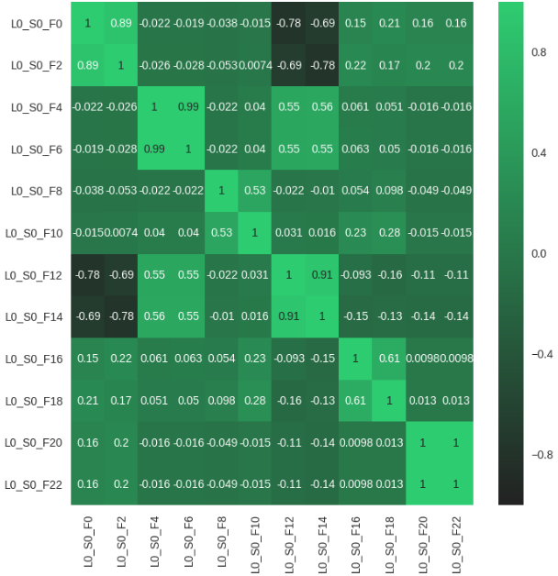
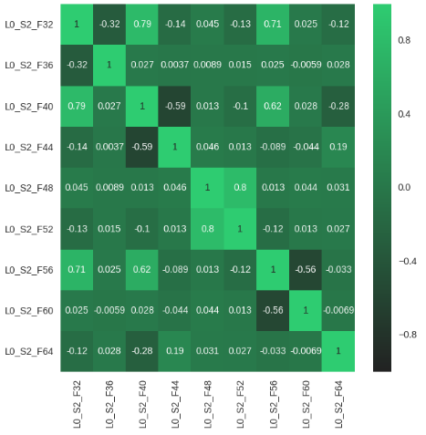






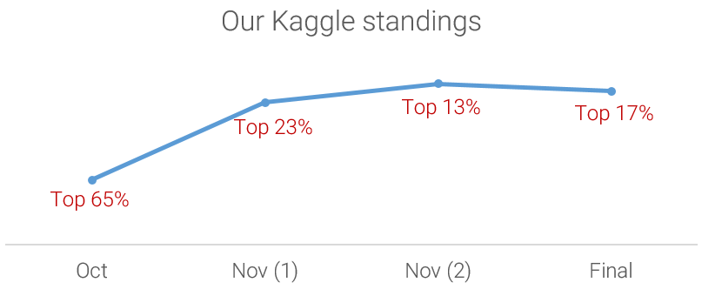

PREDICT MANUFACTURING FAILURES FOR COMPONENTS USING SENSOR DATA FROM AN ASSEMBLY LINE
What is the business?
Bosch has been designing home and kitchen appliances for over 125 years, consistently raising the standards in quietness, efficiency and integrated design.
Accuracy measurement : Matthews correlation coefficient
Model improvement
Tools and technologies used
The MCC is a correlation coefficient between the observed and predicted binary classifications (Range: -1 to 1).
It is regarded as a balanced measure which can be used even if the classes are of very different sizes
Checking correlation between stations
Why is a solution needed?
Data manipulation and processing categorical dataset
This would enable Bosch to bring quality products at lower costs to the end user.
The Data
Pandas | Scikit learn | XGBoost | seaborn Modeling, Data cleaning, manipulation
Categorical
Numeric
Dates
Analytical dataset and modeling
Data manipulation and conversion
1.18M rows
2140 columns
97% missing
1.18M rows
969 columns
81% missing
1.18M rows
1156 columns
82% missing
Categorical
ONE HOT ENCODING
125 features
Numeric
63 features
188 model features
Important features - 22
Working with large categorical dataset
Sparse data – Highly imbalanced
Estimators = 80
Learning rate = 0.1
Kaggle rank progression
Child weight = 1
Extreme Gradient Boosting
Depth = 5
# columns
139 out of 969 columns have more than 70% data filled
Subsample = 0.8
Logistic binary
% filled
AUC comparison in XGBoost
From 188 features selected earlier, only 22 were considered to improve the model and the depth of classifier trees was increased to 25 from the earlier 5
Model stops boosting when the difference in AUC ceases to change
# columns
60 out of 2140 columns have more than 70% data filled
MCC comparison in XGBoost (stopping condition:20)
Team members
% filled
MCC variation by training samples
Anmol Jain | Hardik Dave
# columns
151 out of 1156 columns have more than 70% data filled
Accuracy: 99.42%
Response rate: 5%
References:
https://en.wikipedia.org/wiki/Matthews_correlation_coefficient
https://www.kaggle.com/c/bosch-production-line-performance
https://github.com/dmlc/xgboost
Highest MCC: 0.1819
Artist Influence on Weeks and Peak
% filled
Model: Inconsistent
Final MCC score: 0.458734

