Slide 1


ML Based Smoke Detection System
Capstone Project
Final Presentation
Domain: IOT Data Analytics
Submitted By:
Vimalan R, Anmol Sharma, Deepak Jinjheria , Harshita Das & Rajan Surya

Slide 2
Problem Statement
Critical Need for Efficient Smoke Detection: The increasing importance of accurate and timely smoke detection to mitigate risks such as property damage, personal injury, and loss of life. Traditional detectors often fail due to false alarms and delayed responses.
Developing a Machine Learning-Based Model that accurately predicts smoke presence using comprehensive environmental sensor data (temperature, humidity, gas concentrations) to enhance the reliability of smoke detection systems.
Methodology
Structured Approach: Data Collection and Pre-processing: Gathering and cleaning sensor data.
Exploratory Data Analysis (EDA): Uncovering key insights from the data.
Feature Engineering: Creating new variables to improve model prediction.
Model Training and Evaluation: Using machine learning algorithms, specifically Gradient Boosting and Random Forest, for their accuracy and robustness.
Final Model
Ensemble Techniques : With the help of these algorithms we achieve high accuracy and robustness in smoke detection, providing a more reliable solution compared to traditional methods.

Slide 3
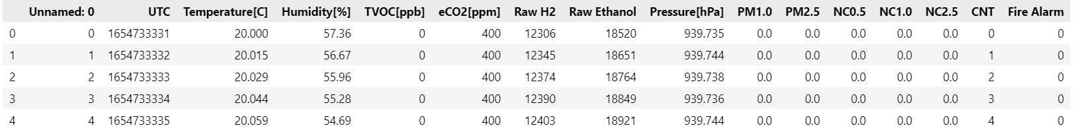
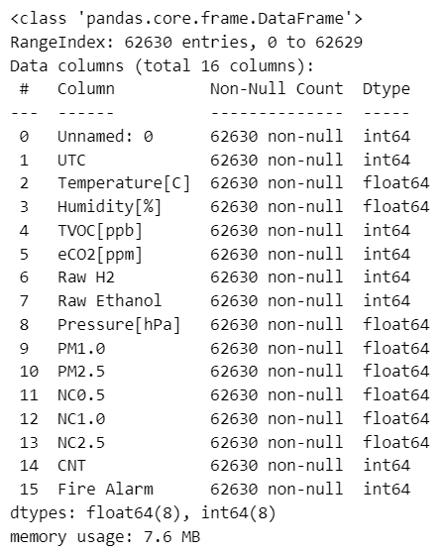
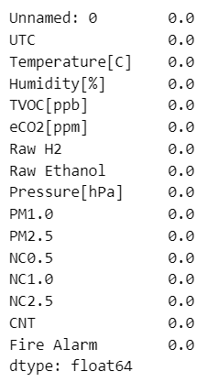
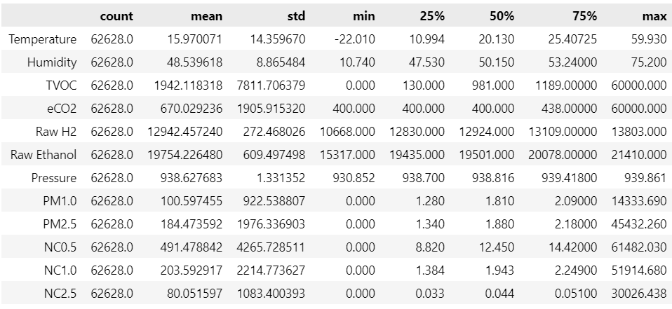
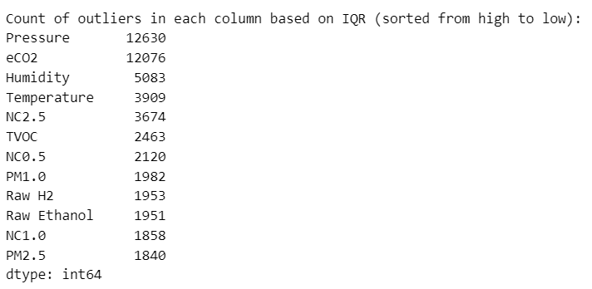
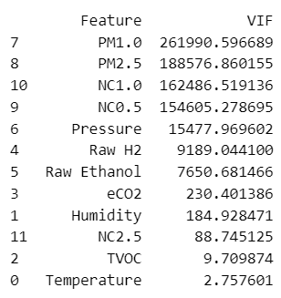
Data Collection, Analysis & Cleaning
Missing Values : No missing values remain in the dataset.
Five-Point Summary: Data variability is high, with consistent readings in some variables (e.g., pressure) and significant outliers in others (e.g., TVOC, PM2.5), indicating a complex environment.
Multicollinearity, Normalization, and Scaling: Multicollinearity was assessed using VIF values and standardized using Robust Scaler.
Outlier Detection and Treatment: Outliers identified via the IQR method were treated, with pressure and eCO2 having the highest counts, while PM2.5 and NC1.0 had the fewest.
Class Imbalance and SMOTE Application: The initial class imbalance in the 'Fire Alarm' target variable was balanced using SMOTE, resulting in equal instances for both classes and a new resampled DataFrame suitable for modeling.

Slide 4
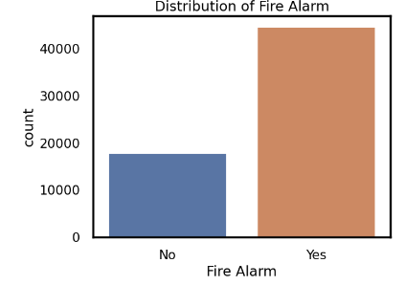
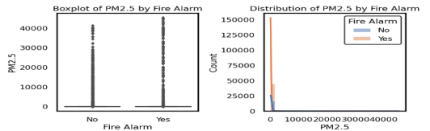
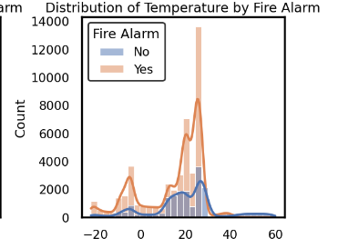
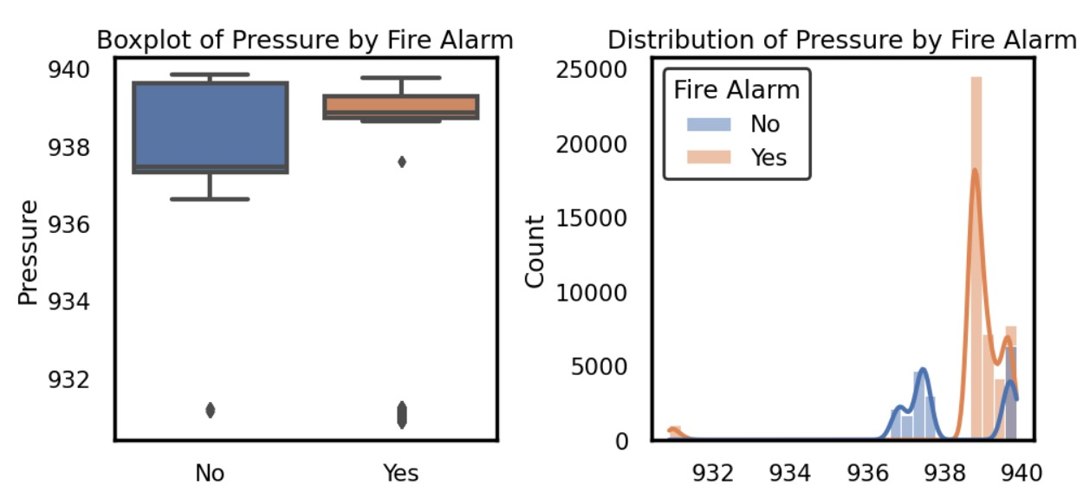
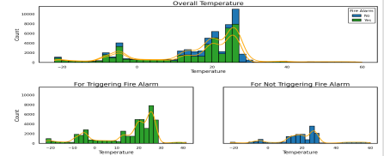
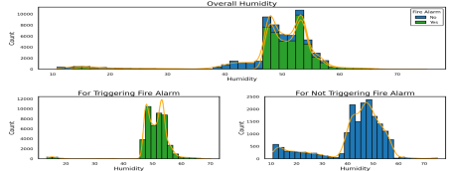
Visualization and Interpretation
Fire Alarm Distribution
Boxplot of PM2.5
Time Series of Temperature
Fire alarms are relatively rare events. - Compare metrics when the alarm is triggered vs. not triggered.
Presence of outliers. - Most values are concentrated at the lower end of the scale
Temperature shows periodic fluctuations.
The boxplot suggest that when the fire alarm is activated ("Yes"), the pressure values are generally higher and less variable compared to when the fire alarm is not activated ("No").
Histogram of Temperature
Histogram of Humidity
Most temperatures are clustered around 20°C. There is a slight skew towards higher temperatures.
Humidity values are fairly spread out with a concentration around 55-60%.

Slide 5
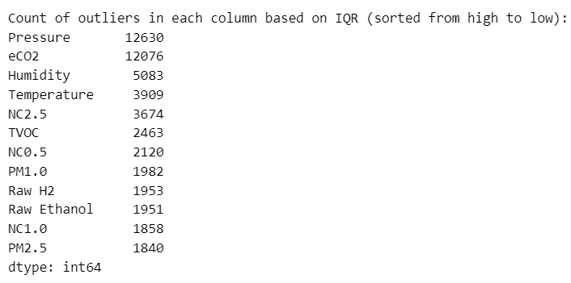
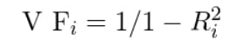
Multi collinearity:
Treating Outliers:
Outliers : Deal with them using IQR Quantile method.
Shape of the dataset after capping outliers: (62628, 13)
Minimizing false alarms by developing fine-tune machine learning models with robust feature engineering and anomaly detection techniques to reduce false positives.
FEATURE | VIF
Humidity | 6.578728
NC0.5 | 6.374706
TVOC | 2.599747
Temperature | 2.399299
VIF (Variance inflation factor) :
Where R Square is the Coefficient of determination of variable.
Final list of features: ['Temperature', 'Humidity', 'TVOC', 'NC0.5']
Our feature selection process successfully reduce multicollinearity. It removed features like PM2.5, and pressure that had very high VIF scores. The remaining features (temperature, humidity, TVOC, NC0.5) all have VIF<10 indicating they are less likely to cause problems in our analysis.

Slide 6
Hypothesis testing
Variable | U-statistic | P-value | Inference
Humidity | 1.52E+09 | 0.0 | High significance, crucial for identifying fire alarm conditions.
Pressure | 1.32E+09 | 0.0 | High significance, important for distinguishing fire alarm statuses.
eCO2 | 1.21E+09 | 0.0 | Least significant among the listed variables, still relevant for fire alarm prediction.
TVOC | 1.54E+09 | 0.0 | Most significant difference, strong association with fire alarm status.
Raw H2 | 1.16E+09 | 0.0 | Significant difference, important predictor for fire alarm status.
Raw Ethanol | 3.83E+08 | 0.0 | Significant difference, relevant for fire alarm prediction.
NC0.5 | 1.32E+09 | 0.0 | Significant difference, relevant for fire alarm prediction.
PM1.0 | 1.32E+09 | 0.0 | Significant difference, relevant for fire alarm prediction.
PM2.5 | 1.32E+09 | 0.0 | Significant difference, relevant for fire alarm prediction.
NC1.0 | 1.31E+09 | 0.0 | Significant difference, relevant for fire alarm prediction.
NC2.5 | 1.26E+09 | 0.0 | Significant difference, relevant for fire alarm prediction.
As the P-value < 0.05, we reject the null hypothesis

Slide 7






Solution Architecture
Data
(csv, xls, xlsx)
Data cleaning & Preprocessing
Feature extraction
Evaluation
Training
Modelling
Qualify
No
Yes
Prediction
New Data
(csv, xls, xlsx)
Data cleaning & Preprocessing
Feature extraction
Modelling

Slide 8
Base Model
Algorithm | Pros | Cons
Logistic Regression | 1. Simple and easy to implement. 2. Works well with linearly separable data. 3. Provides probabilistic outputs. | 1. Assumes a linear relationship between features and the target. 2. Prone to underfitting with complex datasets.
Decision Tree | 1. Easy to interpret and visualize. 2. Handles both numerical and categorical data. 3. Captures non-linear relationships. | 1. Prone to overfitting. 2. Unstable with small changes in data.
Random Forest | 1. High accuracy and robustness. 2. Reduces overfitting by averaging multiple trees. 3. Handles large datasets and high-dimensional data. | 1. Less interpretable compared to single decision trees. 2. Computationally intensive.
Gradient Boosting | 1. High predictive accuracy. 2. Effective for a variety of data types and distributions. 3. Reduces bias and variance. | 1. Can overfit if not properly tuned. 2. Computationally expensive and slow to train.
K-Nearest Neighbors (KNN) | 1. Simple and easy to implement. 2. Non-parametric and versatile. 3. Good for small datasets. | 1.Computationally expensive during prediction. 2. Sensitive to irrelevant features and data scaling.
AdaBoost | 1. Improves the performance of weak learners. 2. Reduces both bias and variance. 3. Handles a variety of base learners. | 1. Sensitive to noisy data and outliers. 2. Requires careful tuning of parameters.
Techniques like Random Forest and AdaBoost, which aggregate multiple models or focus on boosting weak learners, tend to offer better control over overfitting.
Models like Decision Tree and Gradient Boosting are more susceptible to overfitting due to their flexibility and capacity to fit complex patterns in data.
*Note: - Regularization techniques, cross-validation, and monitoring training versus cross-validation scores are critical for assessing and mitigating overfitting risks across all models.

Slide 9
Model Tuning & Evaluation
Methods used :
1. Hyperparameter Tuning: GridSearchCV
2. Cross-Validation: K-fold cross-validation (with k=5).
3. Feature Engineering: Robust Scaler
4. Ensemble Methods: Techniques like Random Forest, Gradient Boosting, and AdaBoost were employed.
5. Regularization: For models like Logistic Regression, regularization techniques (L1 and L2 penalties) were applied
6. Evaluation Metrics: Accuracy, Precision, Recall, and area under the ROC curve (ROC AUC).

Slide 10
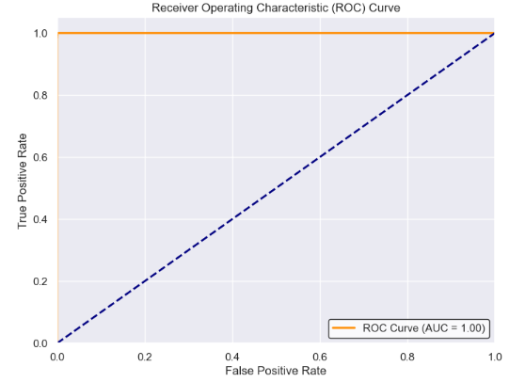
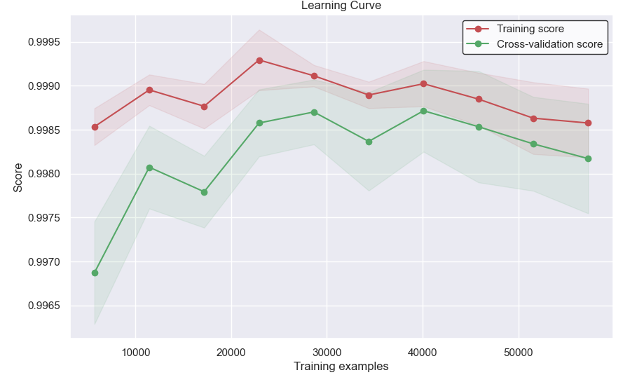
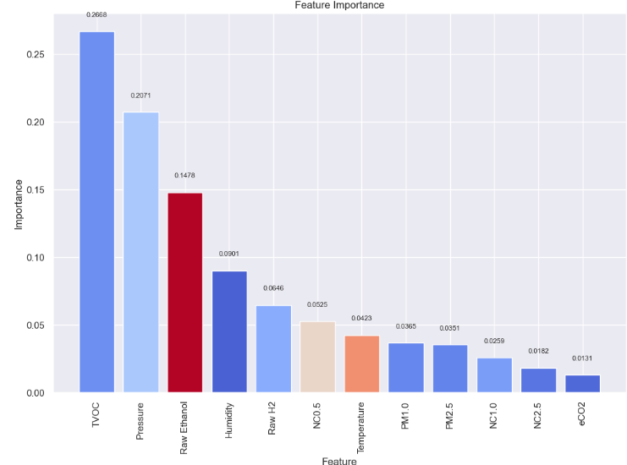
Conclusion
Best Model : Random Forest
1. Highest Accuracy: Random Forest achieves an accuracy of 99.97%, which is the second-highest among all models, indicating its capability to predict correctly almost all the time.
2. Highest Precision and Recall: Random Forest achieves the highest precision (99.98%) and recall (100.00%) among all models
3. Consistent Cross-Validation Score: The cross-validation score of 99.97% for Random Forest is also the highest among all models.
4. Low Variance (CV Score): The coefficient of variation (CV Score), which measures the variation of the accuracy across different folds in cross-validation, is 0.9997 for Random Forest. This indicates low variance in performance, implying stability and consistency in predictions.
5. Feature Importance: Random Forest relies on key features such as TVOC, Pressure, and Raw Ethanol, which are critical indicators in predicting fire alarms.
6. Ensemble Method Advantages: Random Forest leverages ensemble learning, combining multiple decision trees to improve accuracy and generalization.
7. Scalability: Random Forest can handle large datasets with many features and instances efficiently, making it suitable for real-world applications where scalability is crucial.
8. Versatility: Random Forest can be applied to both classification and regression tasks, showcasing its versatility across different predictive modeling scenarios.
9. Interpretability: While not as interpretable as simpler models like Logistic Regression or Decision Trees, Random Forest provides insights into feature importance, helping stakeholders understand which variables are most influential in making predictions.

Slide 11
Way Forward
How to Take to Production ?
Model Deployment: Use containerization (Docker) and deploy on cloud platforms (AWS, GCP).
Continuous Monitoring: Implement monitoring for model performance and data drift.
Scalability: Leverage auto-scaling features in cloud environments to handle varying loads.
Maintenance: Regularly update the model with new data and retrain to ensure accuracy.
Follow-up Potential Project Problems
Data Drift: Changes in the environment could alter feature distributions, necessitating frequent model updates.
Scalability: Ensuring the system can handle increasing amounts of data and users.
Integration: Seamless integration with existing fire alarm systems and protocols.
Regulatory Compliance: Adhering to safety and data protection regulations.
Conclusions
Best Model: Random Forest due to its high accuracy and robustness.
Feature Insights: TVOC, Pressure, and Raw Ethanol are critical for fire alarm predictions.
Deployment Readiness: The solution is ready for production with robust architecture and monitoring.
Future Work: Address potential issues such as data drift and scalability to ensure long-term success.

Slide 12
Thank you

