Slide 1

Project Name : Green Corridor
Presented by -
Anmol Koul
Abhay Madan
Ankit Gupta
Harsh Maheshwari

Slide 2
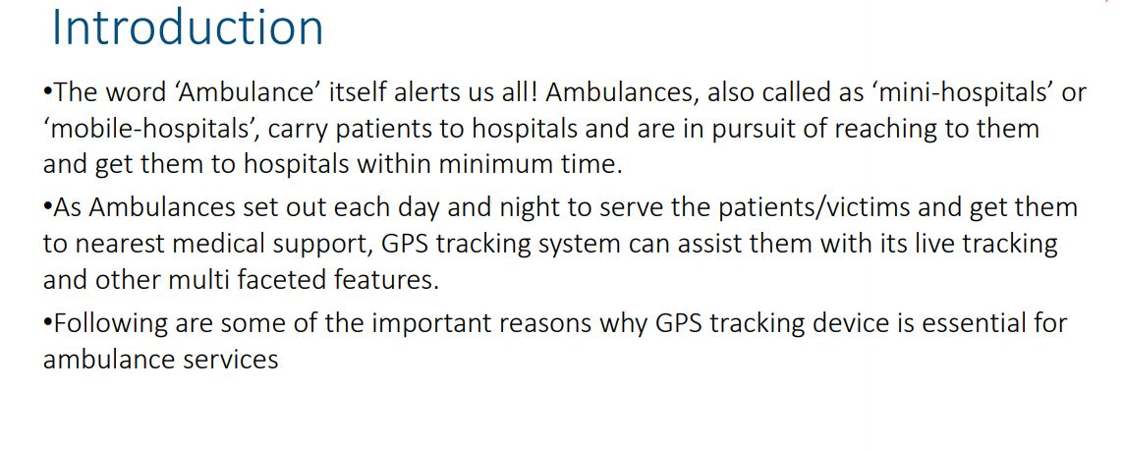

Slide 3
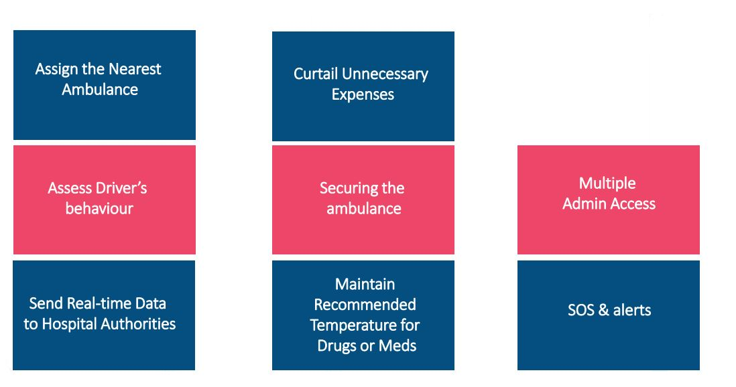

Slide 4
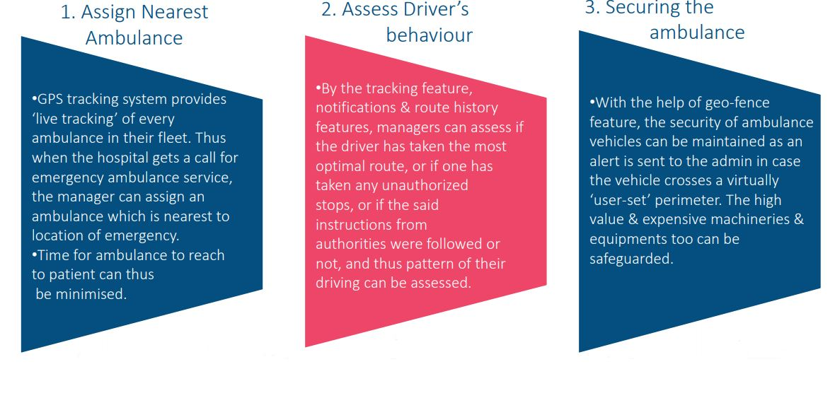

Slide 5
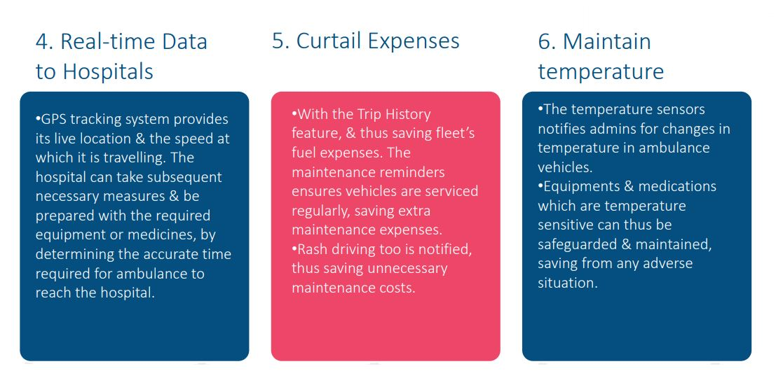

Slide 6
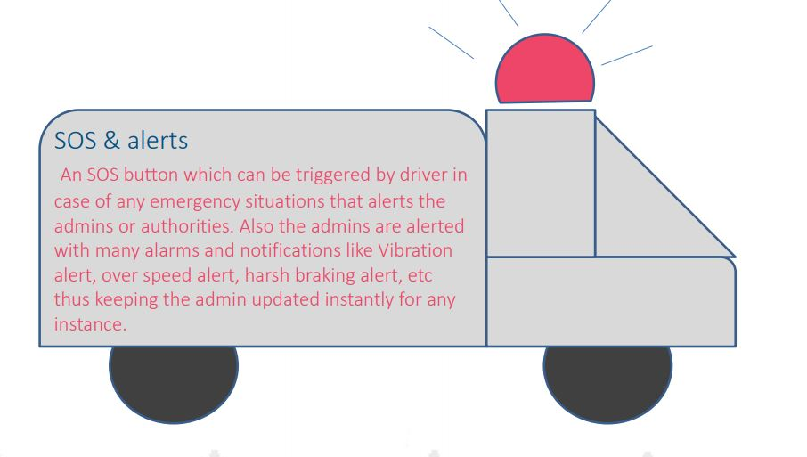

Slide 7
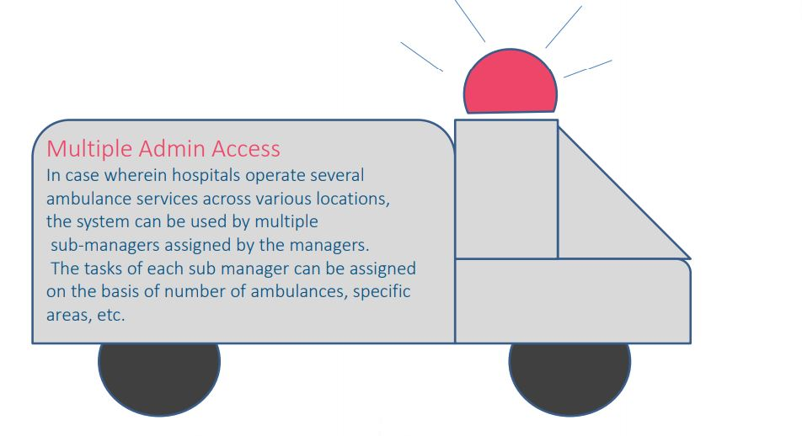

Slide 8
