Slide 1
DATA STRUCTURES & ALGORITHMS LAB · MINI PROJECT
Huffman File Compression
A lossless data-compression algorithm using Huffman coding and binary trees
Being Presented by:-
Abhinav Gupta
SAP :- 70022500060
Anmol Mathur
SAP :- 70022500527
Atharv Sharma
SAP :- 70022500336
B.Tech – C.E. , Section – A1
Presented To :-
Dr. Divya Gautam

Slide 2
OVERVIEW
What We'll Cover
1
The Problem Statement
2
The Idea & Data Structures
Why files need to get smaller
Why Huffman coding, and what we store data in
3
The Algorithm
4
Worked Example
Building the tree, compressing, decompressing
A tiny input, done by hand
5
Our Code
6
Results, Demo & Conclusion
The C functions behind it
How well it works, and it running live
Huffman File Compression · DSA Lab Mini Project
2

Slide 3
01 · PROBLEM & MOTIVATION
The Problem Statement
UPLOAD LIMITS YOU'VE PROBABLY HIT
Ever hit a "file too large" error uploading a project report, dataset or source code to a college portal or job application form? Most online systems cap file size — and big text files, logs and datasets blow past that limit fast.
That's because most files store far more bits than they need to. Standard encodings like ASCII spend a fixed 8 bits on every character, no matter how often it repeats — so a lot of that size is pure redundancy waiting to be squeezed out.
Email attachments
~25 MB
College / LMS portals
often 5–10 MB
Exam & government forms
100 KB – 1 MB
GOAL
Design a lossless algorithm that shrinks a file by giving shorter codes to frequent bytes and longer codes to rare ones — so it fits under those limits without losing any information.
Huffman coding is one of the tools that helps files fit
Huffman File Compression · DSA Lab Mini Project
3

Slide 4
02 · THE IDEA
Why Huffman Coding?
There are lots of ways to shrink a file. We picked Huffman coding because the core idea is simple: things that show up a lot get short codes, rare things get longer codes — the same idea Morse code uses, giving 'E' one dot because it's common and 'Q' four symbols because it's rare. It's also lossless — you get back the exact original file, not an approximation.
L
S
N
Lossless
Common bytes get shorter codes
No mix-ups decoding
You get back the exact original file — nothing is approximated or lost.
Bytes that appear often get short codes and rare ones get longer codes, so the file needs fewer bits overall.
No code is ever the beginning of another, so the computer always knows where one byte ends and the next begins.
Huffman File Compression · DSA Lab Mini Project
4

Slide 5
02 · THE IDEA
Data Structures Used
and why each one was the right fit
1
Array — Frequency Table
frequency[256]: counts how many times each of the 256 possible byte values occurs.
2
Array of Node pointers — Huffman Nodes
nodes[256]: stores the currently available tree nodes while building the tree. Each round we scan it to find the two smallest.
3
Binary Tree — Huffman Tree
struct Node with left and right pointers. Bytes sit at the ends (leaves); the left/right path to a byte IS its code.
4
2D Array — Code Table
codes[256][256]: stores each byte's code as text like "110", looked up while writing the compressed file.
Huffman File Compression · DSA Lab Mini Project
5

Slide 6
03 · THE ALGORITHM
Algorithm 1 — Building the Huffman Tree
1
Count byte frequencies
pseudocode
Scan the file once; tally how many times each byte value (0–255) occurs into an array.
count[0..255] = 0
for each byte in file:
count[byte] += 1
list = one node per byte
that has count > 0
while list has more than 1 node:
a = remove smallest from list
b = remove smallest from list
p = new node(a.count + b.count)
p.left = a
p.right = b
add p to list
root = the one node left in list
2
Create the node list
Create one node for every byte that appears in the file and store the node in an array.
3
Repeatedly find and merge the two smallest
Search the array for the two nodes with the smallest frequencies. Remove them, create a new parent node with their combined frequency, and add it back to the array.
4
One node remains — the root
The last node left in the array is the root of the completed Huffman Tree.
Special case: if only one kind of byte appears, we give it a parent node so it still gets a code ("0").
Huffman File Compression · DSA Lab Mini Project
6

Slide 7
03 · THE ALGORITHM
Algorithm 2 — Compressing the File
Turn the tree into codes
pseudocode
1
Walk down from the root: write '0' for left and '1' for right. At a byte (leaf), the path so far is that byte's code.
make_codes(node, path):
if node is a leaf:
code[node.byte] = path
return
make_codes(node.left, path+"0")
make_codes(node.right, path+"1")
write original_size, count[0..255]
for each byte in file:
for each bit in code[byte]:
add bit to buffer
if buffer has 8 bits:
write buffer to file
if bits are left over:
pad with 0s and write them
2
Write a small header
Save the original file size and the 256 counters, so the file can be decompressed later.
3
Write the codes bit by bit
Read the file again; for every byte, write its code one bit at a time.
4
Pack 8 bits into each byte
Every 8 bits become one byte in the output. The last byte is padded with 0s if needed.
Huffman File Compression · DSA Lab Mini Project
7

Slide 8
03 · THE ALGORITHM
Algorithm 3 — Decompressing
1
Read the header
Read the original file size and the frequency table from the compressed file.
pseudocode
read original_size, count[0..255]
root = build_tree(count)
node = root
for each bit in compressed file:
if bit == 0: node = node.left
else: node = node.right
if node is a leaf:
write node.byte to output
node = root
if bytes_written == original_size:
stop
2
Re-Run the identical tree
Run the same tree-building step on the stored frequency table. It is deterministic, so it gives the exact tree used to compress — the tree itself is never stored.
3
Walk bit by bit
Read the compressed bits one at a time: move left on 0, right on 1.
4
Leaf reached → output and restart
Write that byte, then jump back to the root. Stop once the original file size has been restored — this ignores the padding bits in the last byte.
Key insight: we save only the 256 counters, not the tree — it is rebuilt the same way every time.
Huffman File Compression · DSA Lab Mini Project
8

Slide 9
04 · WORKED EXAMPLE
Building the Tree, by Hand
Input string: "ABRACADABRA" (11 bytes) — our program builds this exact tree
11
Byte
Freq.
0
1
A
5
A
6
B
2
(5)
0
1
R
2
R
4
C
1
(2)
0
1
D
1
B
2
(2)
0
1
C
D
Huffman File Compression · DSA Lab Mini Project
(1)
(1)
9

Slide 10
04 · WORKED EXAMPLE
Reading Off the Codes
Each byte's path from the root (left = 0, right = 1) becomes its binary code:
Byte
Frequency
Code
Bits
Total Bits
A
5
0
1
5
R
2
10
2
4
B
2
110
3
6
C
1
1110
4
4
D
1
1111
4
4
23 bits
88 bits
~74%
vs
Huffman-coded
(11 bytes → 3 bytes)
Fixed-length ASCII
(11 bytes × 8 bits)
fewer bits for this example
Huffman File Compression · DSA Lab Mini Project
10

Slide 11
05 · OUR CODE
The Node & Helper Functions
compression_project.c — struct Node, createNode, isLeaf
findSmallest, freeTree
#include <stdio.h>
#include <stdlib.h>
#include <string.h>
#define SIZE 256
struct Node
{
unsigned char data;
unsigned long frequency;
struct Node *left;
struct Node *right;
};
struct Node* createNode(unsigned char data, unsigned long frequency)
{
struct Node *newNode;
newNode = (struct Node*)malloc(sizeof(struct Node));
newNode->data = data;
newNode->frequency = frequency;
newNode->left = NULL;
newNode->right = NULL;
return newNode;
}
int isLeaf(struct Node *root)
{
if(root->left == NULL && root->right == NULL)
return 1;
return 0;
}
int findSmallest(struct Node *nodes[], int count)
{
int i;
int smallest = 0;
for(i = 1; i < count; i++)
{
if(nodes[i]->frequency < nodes[smallest]->frequency)
{
smallest = i;
}
}
return smallest;
}
void freeTree(struct Node *root)
{
if(root == NULL)
return;
freeTree(root->left);
freeTree(root->right);
free(root);
}
Huffman File Compression · DSA Lab Mini Project
11

Slide 12
05 · OUR CODE
Building the Tree — buildTree()
buildTree() — part 1
buildTree() — part 2
struct Node* buildTree(unsigned long frequency[])
{
struct Node *nodes[SIZE];
int count = 0;
int i;
for(i = 0; i < SIZE; i++)
{
if(frequency[i] > 0)
{
nodes[count] = createNode((unsigned char)i,
frequency[i]);
count++;
}
}
if(count == 0)
return NULL;
if(count == 1)
{
struct Node *parent;
parent = createNode(0, nodes[0]->frequency);
parent->left = nodes[0];
return parent;
}
while(count > 1)
{
int first;
int second;
struct Node *firstNode;
struct Node *secondNode;
struct Node *newNode;
first = findSmallest(nodes, count);
firstNode = nodes[first];
nodes[first] = nodes[count - 1];
count--;
second = findSmallest(nodes, count);
secondNode = nodes[second];
newNode = createNode(0,
firstNode->frequency +
secondNode->frequency);
newNode->left = firstNode;
newNode->right = secondNode;
nodes[second] = nodes[count - 1];
count--;
nodes[count] = newNode;
count++;
}
return nodes[0];
}
Huffman File Compression · DSA Lab Mini Project
12

Slide 13
05 · OUR CODE
Generating the Codes — generateCodes()
generateCodes() — recursive tree walk
Recursion
void generateCodes(struct Node *root,
char code[],
int position,
char codes[SIZE][SIZE])
{
if(root == NULL)
return;
if(isLeaf(root))
{
code[position] = '\0';
strcpy(codes[root->data], code);
return;
}
code[position] = '0';
generateCodes(root->left,
code,
position + 1,
codes);
code[position] = '1';
generateCodes(root->right,
code,
position + 1,
codes);
}
The function calls itself on the left child, then the right child — like walking down every branch of the tree.
'0' left, '1' right
Each step down adds one character to code[], so at a leaf the path so far is that byte's code.
strcpy at a leaf
codes[root->data] gets the finished code, for example codes['A'] = "0".
Huffman File Compression · DSA Lab Mini Project
13

Slide 14
06 · ANALYSIS
How Fast Is It?
Step
Time
Count how often each byte appears
O(n)
Build the tree (scan for the smallest, repeatedly)
O(k²)
Generate the codes
O(k)
Compress (write the bits)
O(n)
Decompress (read the bits)
O(n)
Overall
O(n + k²) ≈ O(n)
Huffman File Compression · DSA Lab Mini Project
14

Slide 15
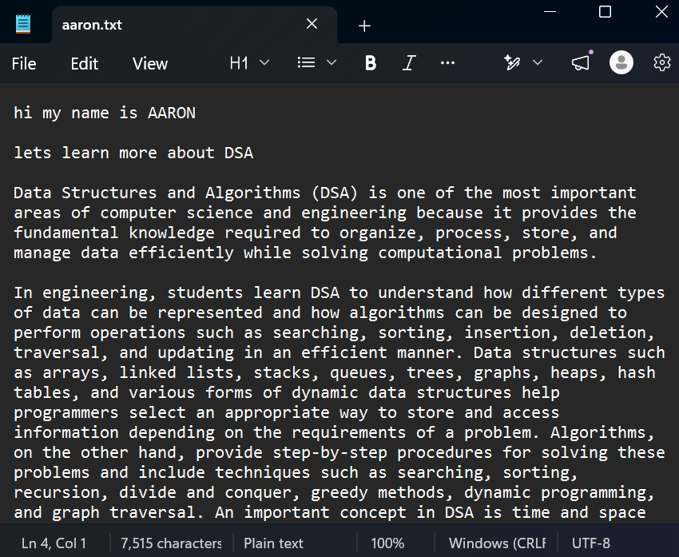
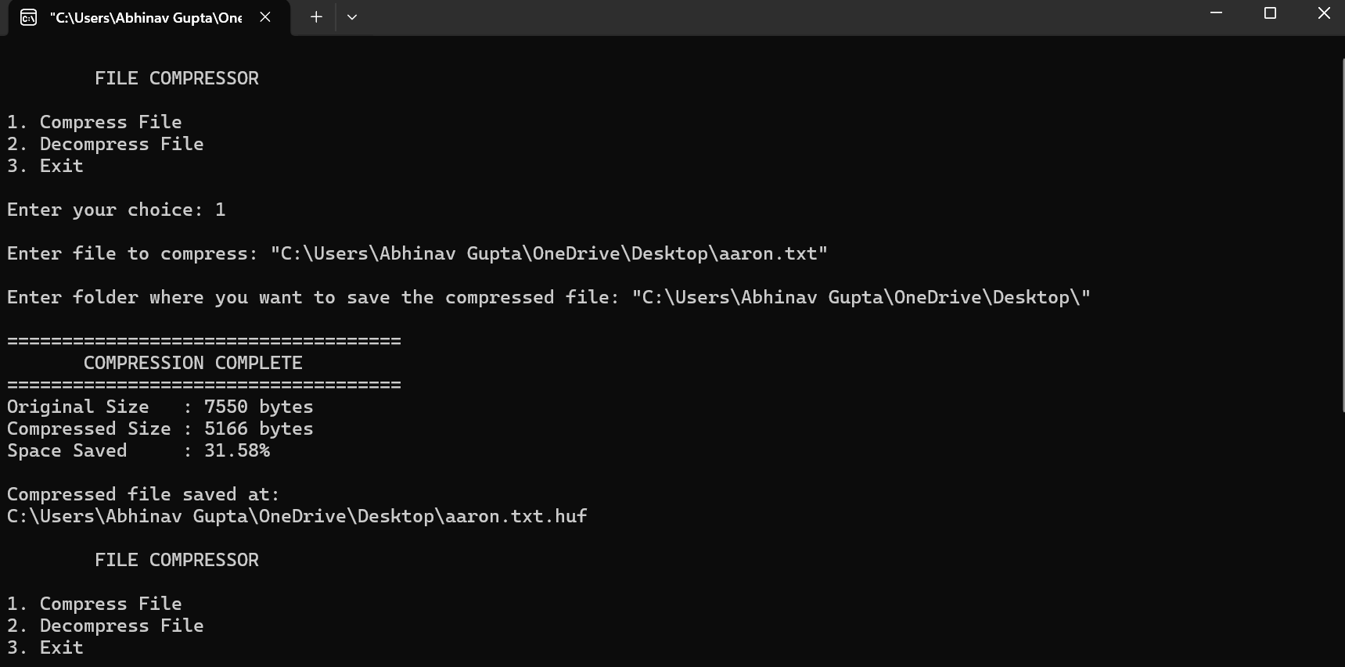
06 · LIVE DEMO
Demonstration
Demo File to Compress
1. Run the program — main menu
2. Compress — file path, save folder, sizes and space saved
3. Decompress — .huf file, output name, restored size
Huffman File Compression · DSA Lab Mini Project
16

Slide 16
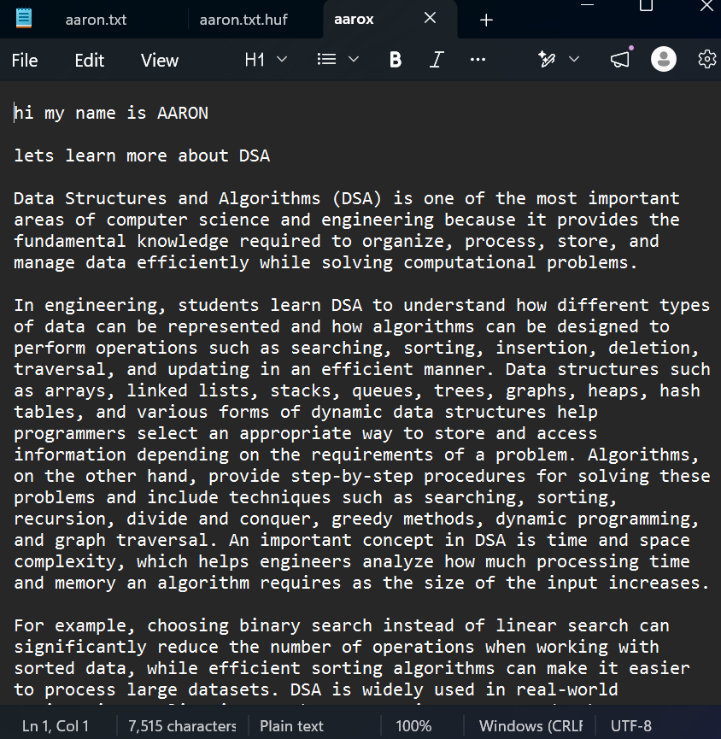
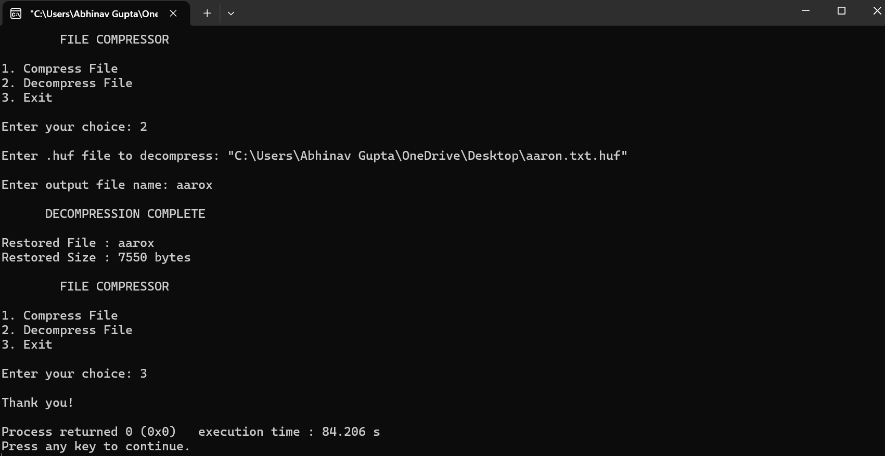
06 · LIVE DEMO
Demonstration
File after Decompression
3. Decompress — .huf file, output name, restored size

Slide 17
06 · CONCLUSION
Strengths, Limitations & What We'd Improve
Strengths
Limitations
What We'd Improve
Lossless — the exact file comes back
Stores 256 counters (~1 KB), so tiny files grow
Store only the counters that are used (smaller header)
Works on any type of file
Little gain on already-compressed files (JPG, ZIP, DOCX)
Reject wrong files with a friendly message
Time grows in a straight line with file size
Decompress doesn't check the file is really a .huf
Same idea used inside ZIP, PNG and JPEG
Huffman File Compression · DSA Lab Mini Project
17

Slide 18
Thank You
Questions & Discussion
Huffman File Compression · DSA Lab Mini Project

Slide 19
APPENDIX · FULL CODE (BLANK LINES REMOVED TO FIT)
compressFile() — part 1 of 3
compressFile() 1/3
compressFile() 1/3 (cont.)
void compressFile()
{
FILE *input;
FILE *output;
char inputName[500];
char folderPath[500];
char outputName[600];
unsigned long frequency[SIZE] = {0};
struct Node *root;
char codes[SIZE][SIZE] = {{0}};
char code[SIZE];
int ch;
int i;
unsigned long originalSize;
unsigned long compressedSize;
printf("\nEnter file to compress: ");
scanf(" %499[^\n]", inputName);
removeQuotes(inputName);
input = fopen(inputName, "rb");
if(input == NULL)
{
printf("\nERROR: File could not be opened.\n");
return;
}
while((ch = fgetc(input)) != EOF)
{
frequency[(unsigned char)ch]++;
}
fseek(input, 0, SEEK_END);
originalSize = ftell(input);
rewind(input);
if(originalSize == 0)
{
printf("\nFile is empty.\n");
fclose(input);
return;
}
root = buildTree(frequency);
if(root == NULL)
{
printf("\nCould not build Huffman tree.\n");
fclose(input);
return;
}
generateCodes(root,
code,
0,
codes);
printf("\nEnter folder where you want to save the compressed file: ");
scanf(" %499[^\n]", folderPath);
Huffman File Compression · DSA Lab Mini Project
19

Slide 20
APPENDIX · FULL CODE (BLANK LINES REMOVED TO FIT)
compressFile() — part 2 of 3
compressFile() 2/3
compressFile() 2/3 (cont.)
removeQuotes(folderPath);
char *fileName;
fileName = strrchr(inputName, '\\');
if(fileName == NULL)
{
fileName = strrchr(inputName, '/');
}
if(fileName == NULL)
{
fileName = inputName;
}
else
{
fileName++;
}
strcpy(outputName, folderPath);
int length;
length = strlen(outputName);
if(outputName[length - 1] != '\\' &&
outputName[length - 1] != '/')
{
strcat(outputName, "\\");
}
strcat(outputName, fileName);
strcat(outputName, ".huf");
output = fopen(outputName, "wb");
if(output == NULL)
{
printf("\nERROR: Could not create output file.\n");
printf("Please check the folder path.\n");
fclose(input);
freeTree(root);
return;
}
fwrite(&originalSize,
sizeof(unsigned long),
1,
output);
fwrite(frequency,
sizeof(unsigned long),
SIZE,
output);
unsigned char buffer = 0;
int bitCount = 0;
while((ch = fgetc(input)) != EOF)
{
char *currentCode;
currentCode = codes[(unsigned char)ch];
for(i = 0;
currentCode[i] != '\0';
Huffman File Compression · DSA Lab Mini Project
20

Slide 21
APPENDIX · FULL CODE (BLANK LINES REMOVED TO FIT)
compressFile() — part 3 of 3
compressFile() 3/3
compressFile() 3/3 (cont.)
i++)
{
buffer = buffer << 1;
if(currentCode[i] == '1')
{
buffer = buffer | 1;
}
bitCount++;
if(bitCount == 8)
{
fwrite(&buffer,
sizeof(unsigned char),
1,
output);
buffer = 0;
bitCount = 0;
}
}
}
if(bitCount > 0)
{
buffer = buffer << (8 - bitCount);
fwrite(&buffer,
sizeof(unsigned char),
1,
output);
}
fclose(input);
fclose(output);
compressedSize = getFileSize(outputName);
printf("\n=====================================");
printf("\n COMPRESSION COMPLETE");
printf("\n=====================================");
printf("\nOriginal Size : %lu bytes",
originalSize);
printf("\nCompressed Size : %lu bytes",
compressedSize);
if(originalSize > 0)
{
double saved;
saved = ((double)(originalSize -
compressedSize)
/ originalSize) * 100;
printf("\nSpace Saved : %.2f%%",
saved);
}
printf("\n\nCompressed file saved at:");
printf("\n%s\n", outputName);
freeTree(root);
}
Huffman File Compression · DSA Lab Mini Project
21

Slide 22
APPENDIX · FULL CODE (BLANK LINES REMOVED TO FIT)
decompressFile() — part 1 of 2
decompressFile() 1/2
decompressFile() 1/2 (cont.)
void decompressFile()
{
FILE *input;
FILE *output;
char inputName[500];
char outputName[500];
unsigned long frequency[SIZE];
unsigned long originalSize;
struct Node *root;
struct Node *current;
unsigned long decoded = 0;
int ch;
int i;
printf("\nEnter .huf file to decompress: ");
scanf(" %499[^\n]", inputName);
removeQuotes(inputName);
input = fopen(inputName, "rb");
if(input == NULL)
{
printf("\nERROR: File could not be opened.\n");
return;
}
fread(&originalSize,
sizeof(unsigned long),
1,
input);
fread(frequency,
sizeof(unsigned long),
SIZE,
input);
root = buildTree(frequency);
if(root == NULL)
{
printf("\nERROR: Invalid compressed file.\n");
fclose(input);
return;
}
printf("\nEnter output file name: ");
scanf(" %499[^\n]", outputName);
removeQuotes(outputName);
output = fopen(outputName, "wb");
if(output == NULL)
{
Huffman File Compression · DSA Lab Mini Project
22

Slide 23
APPENDIX · FULL CODE (BLANK LINES REMOVED TO FIT)
decompressFile() — part 2 of 2
decompressFile() 2/2
decompressFile() 2/2 (cont.)
printf("\nERROR: Could not create output file.\n");
fclose(input);
freeTree(root);
return;
}
current = root;
while((ch = fgetc(input)) != EOF &&
decoded < originalSize)
{
unsigned char byte;
byte = (unsigned char)ch;
for(i = 7; i >= 0; i--)
{
int bit;
bit = (byte >> i) & 1;
if(bit == 0)
{
current = current->left;
}
else
{
current = current->right;
}
if(isLeaf(current))
{
fputc(current->data,
output);
decoded++;
current = root;
if(decoded == originalSize)
break;
}
}
}
fclose(input);
fclose(output);
printf("\n DECOMPRESSION COMPLETE\n");
printf("\nRestored File : %s",
outputName);
printf("\nRestored Size : %lu bytes\n",
decoded);
freeTree(root);
}
Huffman File Compression · DSA Lab Mini Project
23

Slide 24
APPENDIX · FULL CODE (BLANK LINES REMOVED TO FIT)
Utilities & main()
removeQuotes, getFileSize
main()
void removeQuotes(char path[])
{
int length;
length = strlen(path);
if(length >= 2)
{
if(path[0] == '"' &&
path[length - 1] == '"')
{
path[length - 1] = '\0';
memmove(path,
path + 1,
length - 1);
}
}
}
unsigned long getFileSize(char filename[])
{
FILE *file;
unsigned long size;
file = fopen(filename, "rb");
if(file == NULL)
return 0;
fseek(file, 0, SEEK_END);
size = ftell(file);
fclose(file);
return size;
}
int main()
{
int choice;
do
{
printf("\n FILE COMPRESSOR\n");
printf("\n1. Compress File");
printf("\n2. Decompress File");
printf("\n3. Exit");
printf("\n\nEnter your choice: ");
scanf("%d", &choice);
switch(choice)
{
case 1:
compressFile();
break;
case 2:
decompressFile();
break;
case 3:
printf("\nThank you!\n");
break;
default:
printf("\nInvalid choice!\n");
}
} while(choice != 3);
return 0;
}
Huffman File Compression · DSA Lab Mini Project
24

