Slide 1
Data Objects
Primitive data objects
Data objects
Collection or set of instances
integer = {0, +1, -1, +2, -2, +3, -3, …}
Weekdays = {S,M,T,W,Th,F,Sa}
Does the instances need to be related
Not Necessarily,
should it be homogeneous?
{apples, oranges, rubber, Guava, pencil}

Slide 2
Data Structures
Data object +
relationships that exist among instances
and elements that comprise an instance
Elements comprising an object: 478
Among instances of integer
369 < 370 -- ordering relationships
280 + 4 = 284 --- elements related through operations

Slide 3
Data Structures
Relationships are usually specified by
specifying operations on one or more instances.
example: add, multiply, div, succ, pred

Slide 4
Linear Lists
Ordered Lists
instances are of the form
(e₀, e₁, e₂, …, e_{n-1})
Where
e_{i} denotes a list element
n >= 0 is finite
list size is n

Slide 5
Linear Lists
L = (e₀, e₁, e₂, e₃, …, e_{n-1})
e₀ is the zero’th element
e_{n-1} is the last element
e_{i} immediately precedes e_{i+1}
Data object → set of instances;
An instance of a linear list is an ordered set of elements.

Slide 6
Linear List Examples/Instances
Days of Week = (S, M, T, W, Th, F, Sa)
data object -- days of the week
(S, M, T, W, Th, F, Sa), (M, T, W, Th, F, Sa, S)
Two instances of the linear list
Months = (Jan, Feb, Mar, Apr, …, Nov, Dec)
Linear List itself may be viewed as data object, which is simply the set of all possible linear list instances

Slide 7
Operations on Linear List
size : (a,b,c,e,f) is 5
get (index)
Get (1) = a
Get(4) = e
Get (-2) = error …
Indexof(a) = 1
Indexof(f) = 5
Indexof (R) = -1 -- error

Slide 8
Linear List - Operations
remove and return element with given index
Remove(theindex)
L = (a,b,c,d,e,f,g)
remove(2) returns c and L becomes (a,b,d,e,f,g)
index of d,e,f, and g decrease by 1
remove (8) = error

Slide 9
Linear list --operations
add an element so that the new element has a specified index
Add(theindex,theelement)
L = (a,b,c,d,e,f,g)
add(0,h) => L = (h,a,b,c,d,e,f,g)
index of a,b,c,d,e,f, and g increase by 1
add(10,h) => error
add(-6,h) => error

Slide 10
Specification of Data Structure
Abstract Datatype
Language Independent
AbstractDataType LinearList
{
instances
ordered finite collections of zero or more elements
operations
isEmpty(): return true iff the list is empty, false otherwise
size(): return the list size (i.e., number of elements in the list)
get(index): return the indexth element of the list
indexO f(x): return the index of the first occurrence of x in
the list, return -1 if x is not in the list
remove(index): remove and return the indexth element,
elements with higher index have their index reduced by 1
add(theIndex, x): insert x as the indexth element, elements
with theIndex >= index have their index increased by 1
output(): output the list elements from left to right
}

Slide 11
Points to look
Specification vs Implementation
In Programming languages -- is there a separation?
Hidden Functions
Hidden variables

Slide 12
Is List ADT unique?
No
List is essentially a sequence with operations needed for the algorithmic computation on hand

Slide 13
Lists – Another Design as an ADT
A list is a sequence of zero or more elements of a given type
a1, a2, . . . , an (n ≥ 0)
n : length of the list
a1 : first element of the list
an : last element of the list
n = 0 : empty list
Elements can be linearly ordered according to their position in the list
We say ai precedes ai+1, ai+1 follows ai, and ai is at position i

Slide 14
What have we assumed?
L : list of objects of type element type
x : an object of this type
p : of type position
END(L) : a function that returns the position following the last position in the list L

Slide 15
Operations
1. Insert (x, p, L)
Insert x at position p in list L
If p = END(L), insert x at the end
If L does not have position p, result is undefined
2. Locate (x, L)
returns position of x on L
returns END(L) if x does not appear
3. Retrieve (p, L)
returns element at position p on L
undefined if p does not exist or p = END(L)
4. Delete (p, L)
delete element at position p in L
undefined if p = END(L) or does not exist
5. Next (p, L)
returns the position immediately following position p
6. Prev (p, L)
returns the position previous to p
7. Makenull (L)
causes L to become an empty list and returns position END(L)
8. First (L)
returns the first position on L
9. Printlist (L)
print the elements of L in order of occurrence

Slide 16
An Example Program with ADT
Problem: Eliminate all duplicates from a list
Given:
1. Elements of list L are of element type
2. function same (x, y), where x and y are of element type,
returns true if x and y are same, false otherwise
3. p and q are of type position
p : current position in L
q : moves ahead to find equal elements

Slide 17
Pseudocode in C
{
p = first (L) ;
while (p! = end(L))
{
q = next(p, L) ;
while (q! = end(L))
{
if (same (retrieve (p,L), retrieve (q, L))))
delete (q,L);
else
q = next (q, L) ;
}
p = next (p, L) ;
}
}

Slide 18
Data Encapsulation
Encapsulation is an OOP concept that binds together the data and functions that manipulate the data,
Keeps both safe from outside interference and misuse.
Data encapsulation → data hiding.

Slide 19
Data Encapsulation
Encapsulation :
mechanism of wrapping the data (variables) and code acting on the data (methods) together as a single unit.
In encapsulation the variables of a class will be hidden from other classes, and can be accessed only through the methods of their current class, therefore it is also known as data hiding.

Slide 20
Other Concepts
Other concepts of OOP (inheritance, polymorphism, and abstraction)
Hidden Variables, Hidden Functions
Abstract Specification:
O, succ, pred -- Counting numbers
Succ(succ(0)) = 2 = succ(pred(succ(succ(0))))
Pred(0) = error= pred(pred(succ(o)))

Slide 21
Records
type Complex =
record
X: real;
y: real
complex
type date = record
Month = 1..12;
Day: 1..31;
year : integer
end
type info = record
Name = string;
Bday: date end

Slide 22
Variant Records
type Form = (book, article);
publication =
record
Author: string;
year: integer;
case kind:form of
book: Pubdata
article:Journaldata
end

Slide 23
Implementation of Lists
1. Arrays
2. Pointers (singly linked, doubly linked, etc.)
3. Cursors (arrays with integer pointers)

Slide 24
Array Implementation of Lists
Here, elements of list are stored in the (contiguous) cells of an array.
List is a structure with two members.
member 1 : an array of elements
member 2 : last —of the last element of the list indicates position
Position is of type integer and has the range 0 to maxlength–1

Slide 25
# define maxlength 1000
typedef int elementtype; /∗ elements are integers ∗/
typedef struct list–tag {
elementtype elements [maxlength];
int last;
} list–type;
end(L)
int end (list–type ∗ℓp)
{
return (ℓp → last + 1)
}

Slide 26
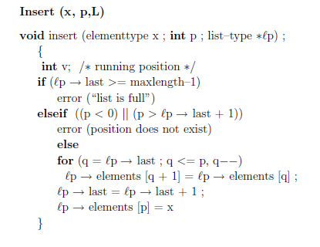

Slide 27
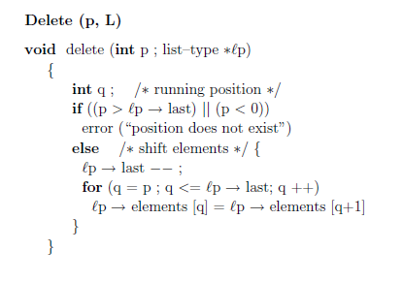

Slide 28
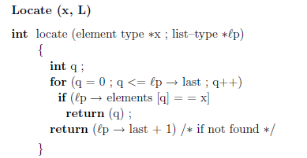

Slide 29
Pointer Implementation
In the array implementation,
1. we are constrained to use contiguous space in the memory
2. Insertion, deletion entail shifting the elements
Pointers overcome the above limitations at the cost of extra space for pointers.

Slide 30

Singly Linked List Implementation
A list a1, a2, . . . , an is organized as shown

Slide 31
Convention:
Position i is a pointer to the cell holding the pointer to the cell containing ai, (for i = 1, 2, . . . , n).
Thus,
– Position 1 is a pointer to the header
-- End (L) is a pointer to the last cell of list L
• Delete (x, L)

Slide 32
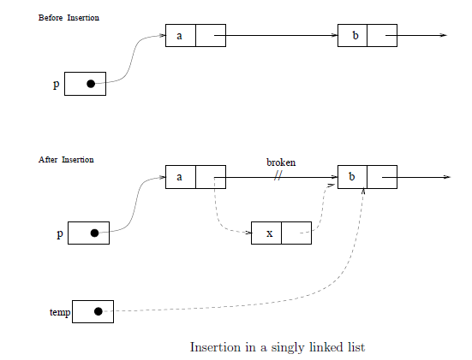
• Insert (x, p, L)

Slide 33
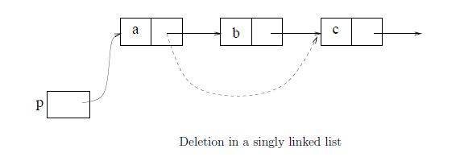
Delete (x, L)

Slide 34
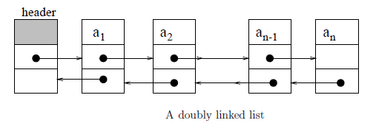
Doubly linked list

