Slide 1

Customer Shopping Behavior Analysis
3,900 purchases · 18 columns · goal: uncover spending patterns, segments, subscriptions

Slide 2
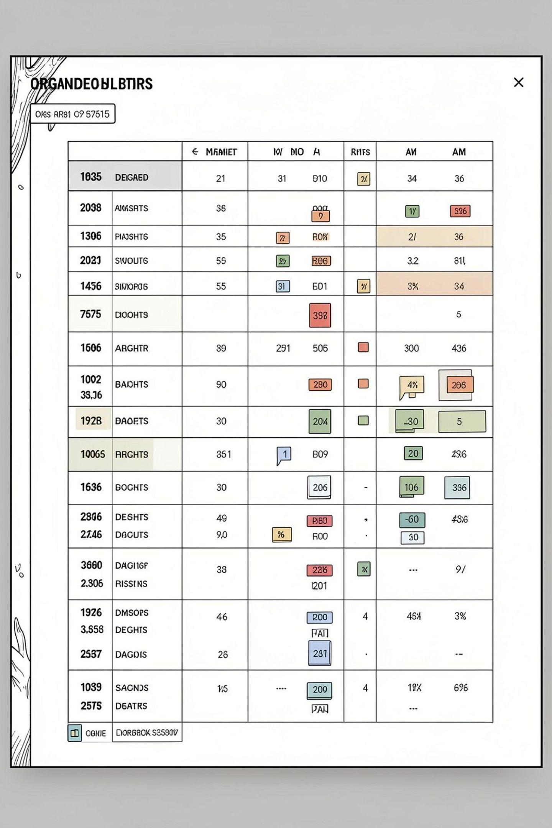
Dataset Snapshot
Rows / Columns
Key Features
Missing Data
3,900 rows · 18 columns
Demographics, Purchase details, Behavior
37 missing values in Review Rating

Slide 3

Python: EDA & Preparation
01
Load & Explore
pandas, df.info(), .describe()
02
Missing values
Imputed Review Rating by category median
03
Standardize
Renamed columns to snake_case
04
Feature Eng.
age_group, purchase_frequency_days
05
Clean-up
Dropped promo_code_used (redundant)

Slide 4

Database Integration
PostgreSQL Load
Cleaned DataFrame loaded for SQL analysis
Why SQL
Structured queries for business questions

Slide 5
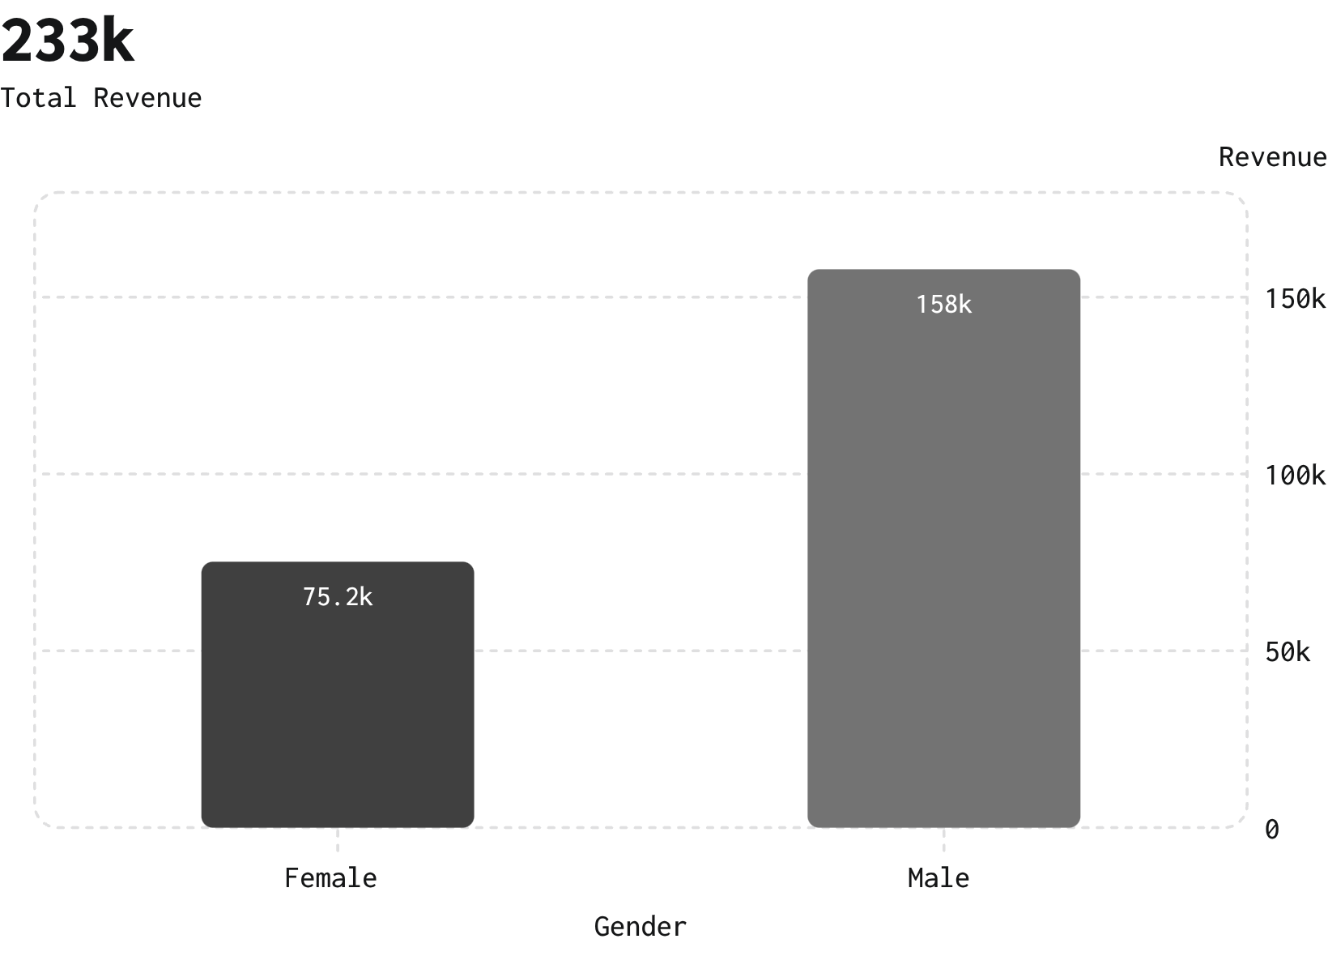
Revenue & Demographics
Revenue by gender: Male > Female
Avg purchase: $59.76 · Avg rating: 3.75 · Total customers: 3,900

Slide 6
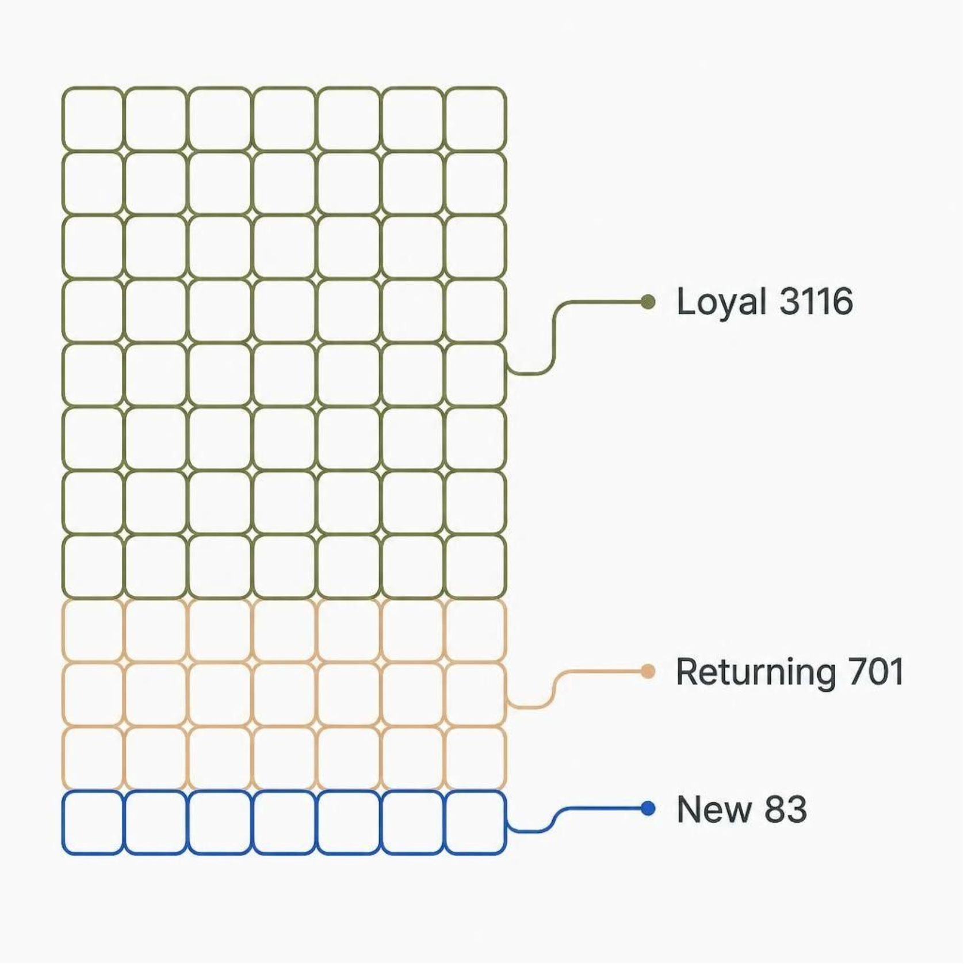



Segments & Loyalty
Loyal
3,116 customers — priority for retention
Returning
701 customers — convert to loyal
New
83 customers — onboarding focus

Slide 7

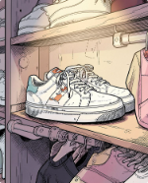
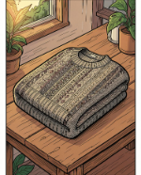
Top Products & Discounts
Top by Rating
Hat
Sneakers
Sweater / Coat
Gloves 3.86 · Sandals 3.84 · Boots 3.82 · Hat 3.80 · Skirt 3.78
Top-rated (3.80) · Discount rate 50%
High discount rate 49.66%
Discount rates ~48–49%
High-spending discount users
839 rows identified (examples shown)

Slide 8
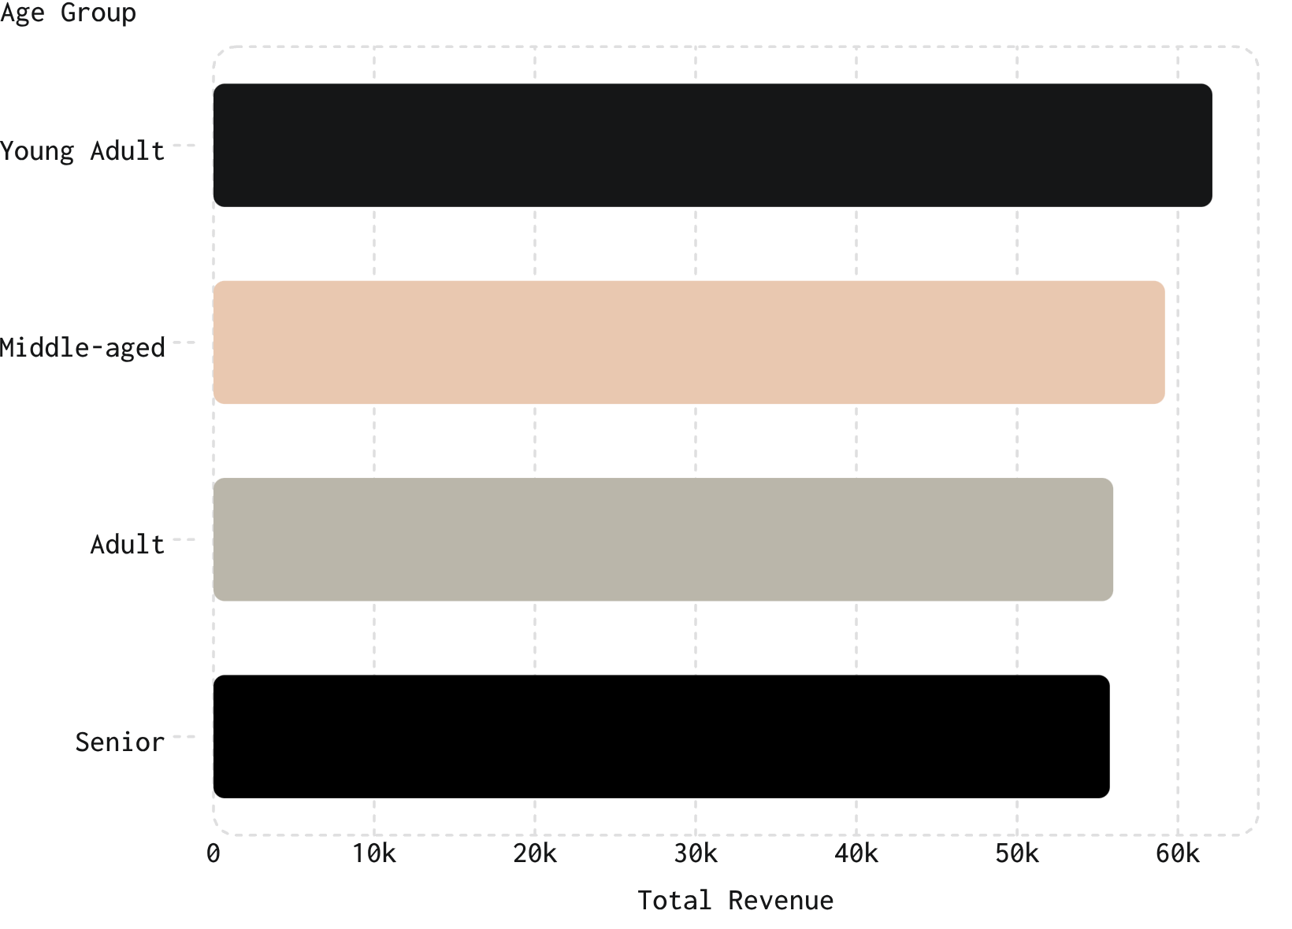
Age Groups & Revenue
High-revenue groups: Young Adult & Middle-aged
Purchase counts by age: Young Adult 1,028 · Middle-aged 986 · Adult 942 · Senior 944

Slide 9
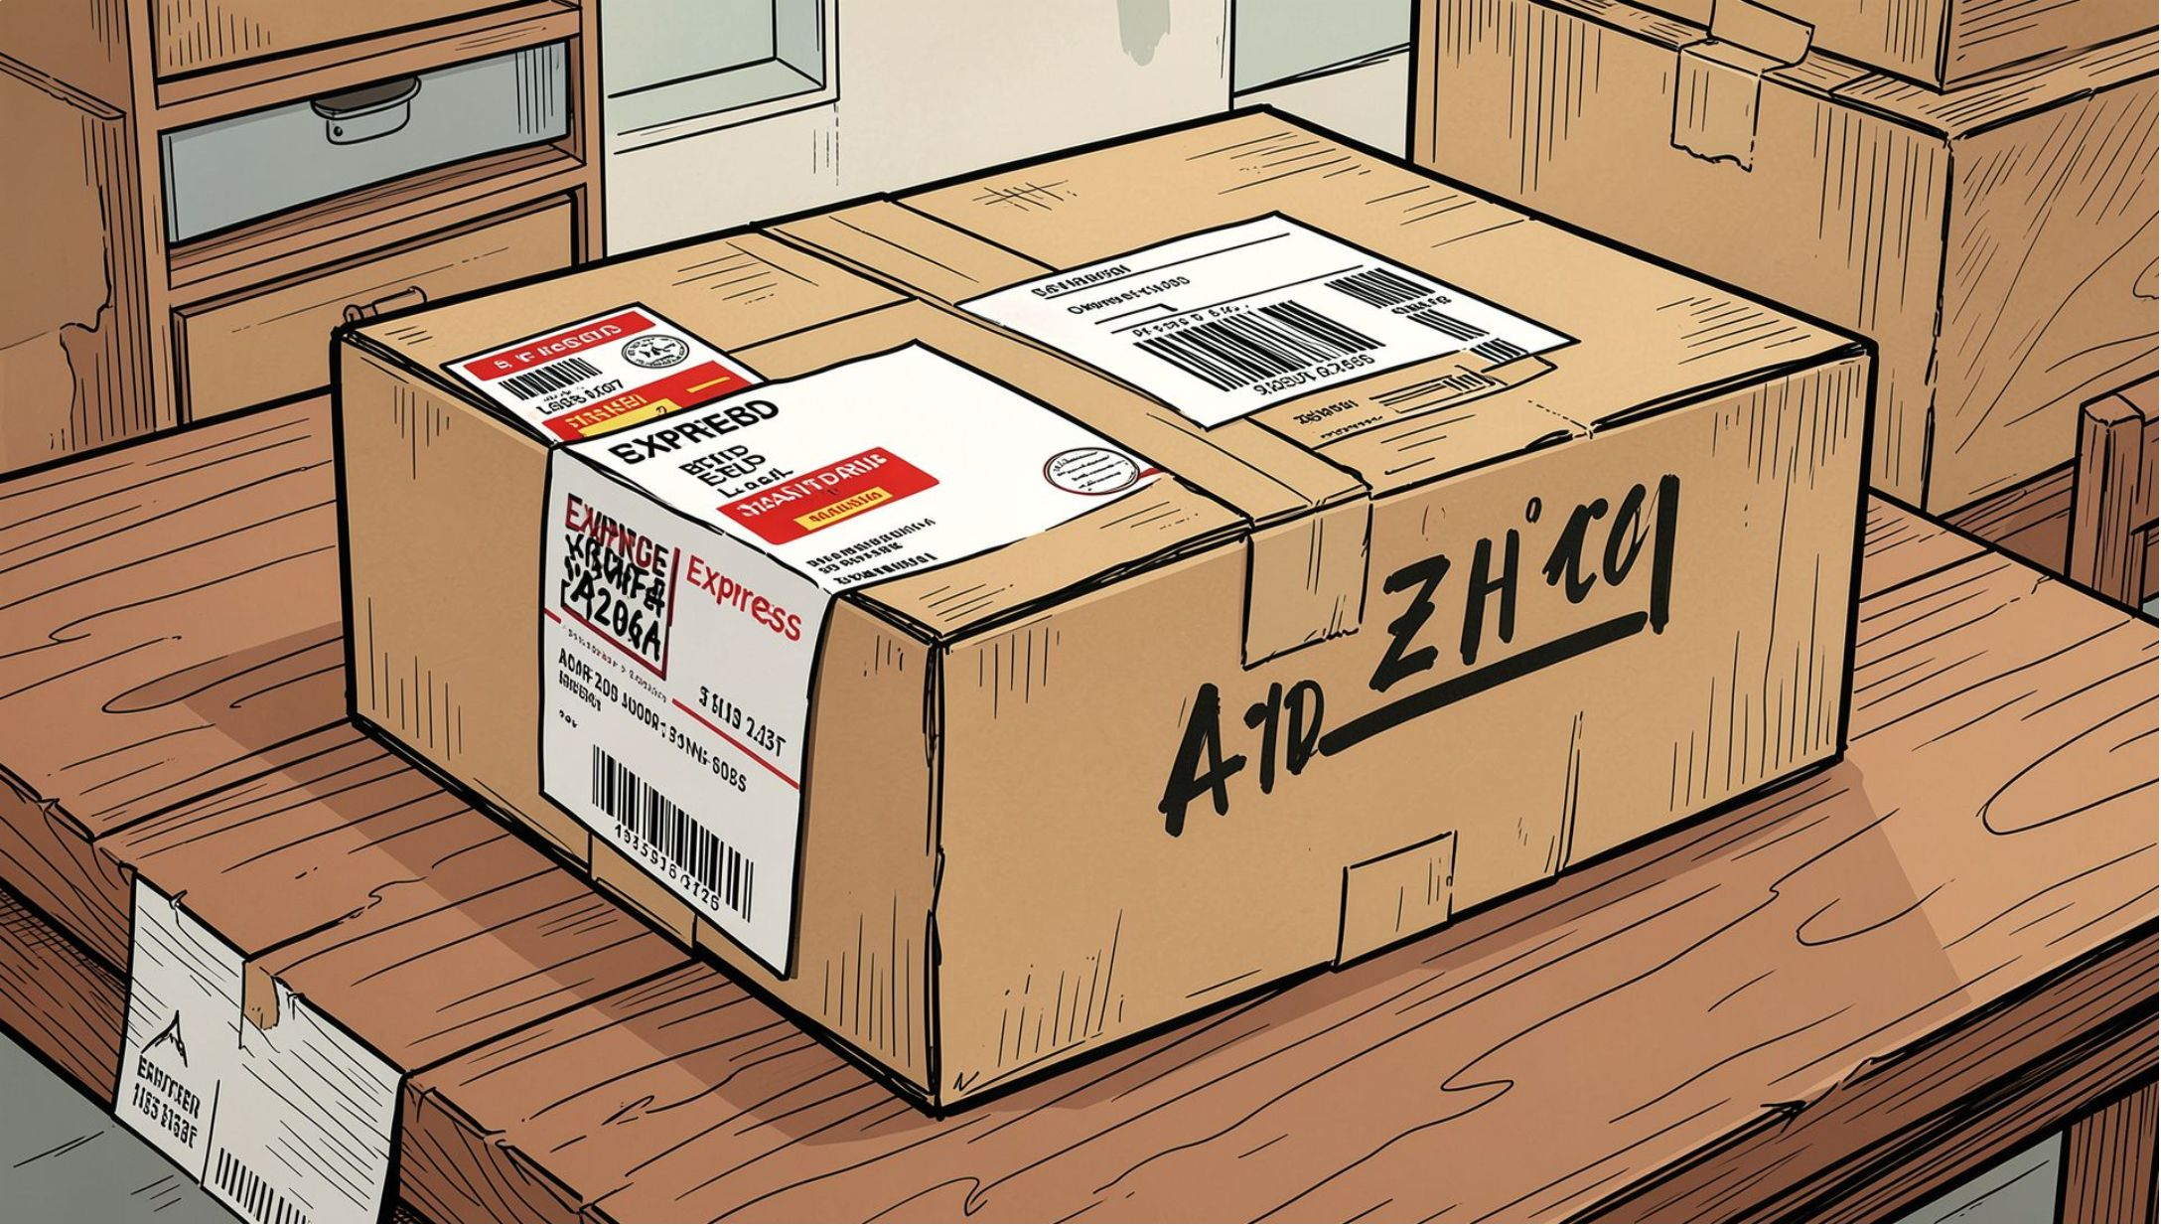
Shipping & Subscription Insights
Shipping
Express avg $60.48 · Standard avg $58.46
Subscriptions
Yes: 1,053 customers · No: 2,847 customers
Subscriber Spend
Avg spend: $59.49 (subscribers) vs $59.87 (non-subs)

Slide 10



Recommendations
Boost Subscriptions
Promote exclusive subscriber benefits
Loyalty Programs
Reward repeat buyers to grow 'Loyal' segment
Discount Policy
Balance promotions with margin control
Product Positioning
Highlight top-rated & best-sellers in campaigns
Targeted Marketing
Focus on high-revenue age groups & express-shipping users

