Slide 1

Data Analytics and Decision Analytics Models across Different Domains
Professor Subodha Kumar
Director, Center for Data Analytics

Slide 2
Data Analytics and Decision Analytics
Business Analytics
Data Analytics
Decision Analytics
Collecting raw data
Data cleansing
Data analytics models
Convert data analytics into valuable business decisions
Analytical and Optimization Models
Exploratory Data Analysis (EDA)
Confirmatory Data Analysis (CDA)
Qualitative Data Analysis (QDA)

Slide 3

Data Analytics and Decision Analytics Models

Slide 4
Emergence and Future Roadmap of Big Data
S. Guha and S. Kumar, “Emergence of Big Data Research in Operations Management, Information Systems, and Healthcare: Past Contributions and Future Roadmap,” Production and Operations Management, 2018.
S. Kumar, V. Mookerjee, and A. Shubham, “Research in Operations Management and Information Systems Interface,” Production and Operations Management, 2018.

Slide 5
Different Applications
Digital Advertising
Food Delivery
Omni-Channel Retailing
Social Media Analytics
Healthcare Analytics
Manufacturing

Slide 6
Web Advertising

Slide 7
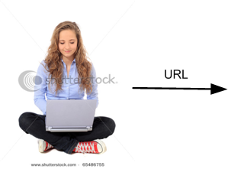
How is an Internet Ad Served?

Slide 8
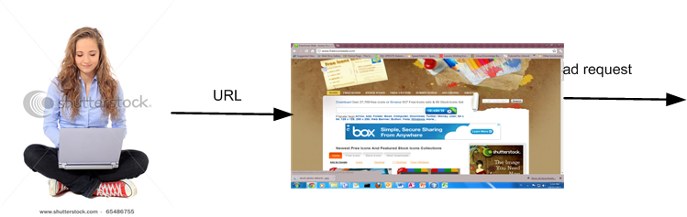
How is an Internet Ad Served?

Slide 9
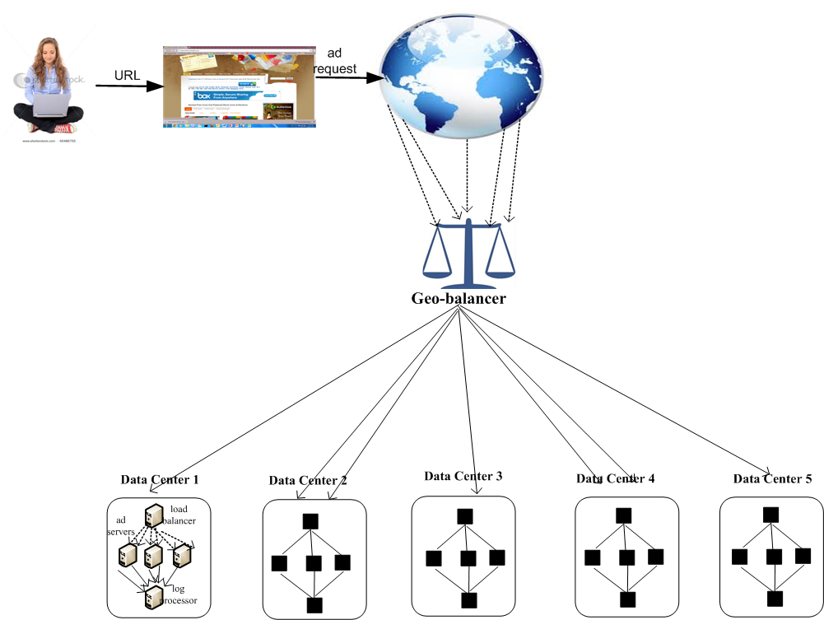

Slide 10
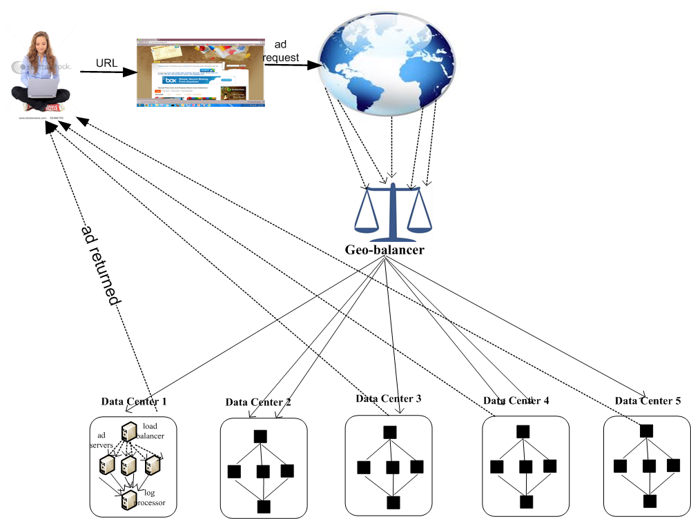
How is an Internet Ad Served?

Slide 11
Different Players
Advertisers or Ad-Aggregators
Ad
Ad Firm

Slide 12
Different Players
Advertisers or Ad-Aggregators
Ad Firm
Ad
Perspective of the Ad Firm (Chitika)

Slide 13
To Show or Not to Show
To respect the interests of the publisher, ads are only shown to users that are likely to click on them
However, too much filtering can lead to a large loss of ad-revenue (clicks)
The goal therefore, is to maximize ad-revenue subject to an efficiency constraint

Slide 14
Solution: Show Ads to Select Users

Slide 15
Solution: Show Ads to Select Users

Slide 16
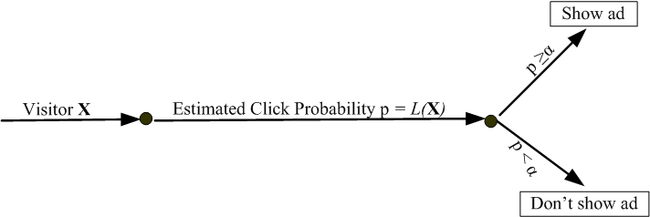
Solution: Show Ads to Select Users

Slide 17
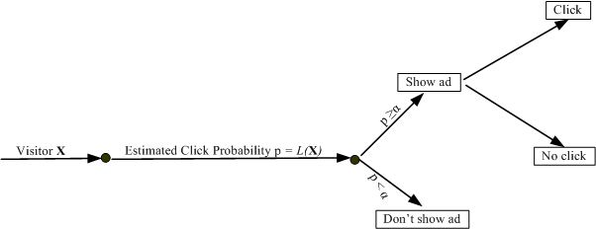
Solution: Show Ads to Select Users

Slide 18
Solution: Show Ads to Select Users
Prediction
(Data Analytics)

Slide 19
Solution: Show Ads to Select Users
Optimization
(Decision Analytics)

Slide 20
Solution: Show Ads to Select Users
Real-time Feedback

Slide 21
Data Analytics
Developed a predictive model called “Prophet”
More than 50 predictor variables
Uses Logit Model
Click Probability = f (Predictor Variables)

Slide 22
Logit Model
The logit model can be expressed as
where X is the vector of variables used for prediction.
To estimate the logit function, we use the logit estimation procedure in STATA

Slide 23
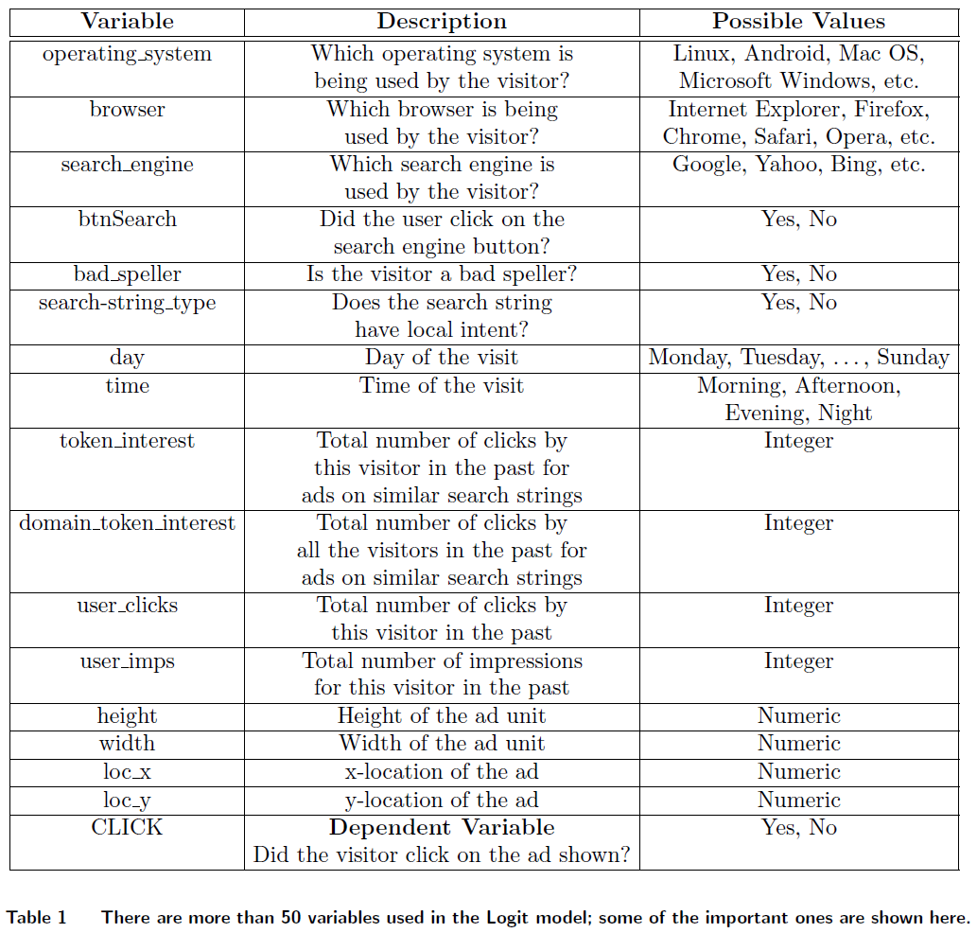

Slide 26
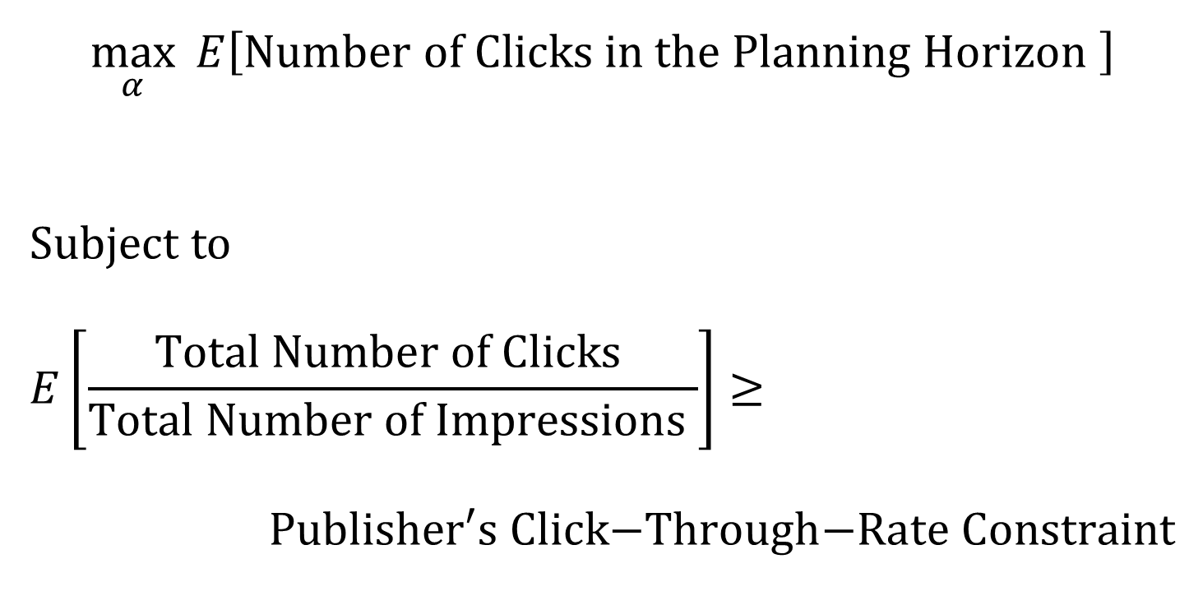
Maximize Clicks subject to a click-through-rate constraint
$$\max_{α}{ E\left[Number of Clicks in the Planning Horizon \right]}$$
Subject to
$$E\left[\frac{Total Number of Clicks }{Total Number of Impressions }\right]≥$$
$$\text{Publisher}\text{′}\text{s} \text{Click}\text{−}\text{Through}\text{−}\text{Rate} \text{Constraint}$$

Slide 27
Real-time Bidding
Ad-exchange
Advertisers
Ad-firms
Publishers

Slide 28
Mobile Advertising

Slide 29
Illustration of the Process

Slide 31
Results
Solution of the Existing Practice at Chitika
Solution of the Proposed Optimization Model

Slide 32
Related Works on Digital Advertising
Book
S. Kumar, "Optimization Issues in Web and Mobile Advertising: Past and Future Trends," Springer, 2016.
https://www.amazon.com/Optimization-Issues-Mobile-Advertising-SpringerBriefs/dp/3319186442
Papers
R. Mookerjee, S. Kumar, and V.S. Mookerjee, “Optimizing Performance Based Internet Advertisement Campaigns,” Operations Research.
S. Kumar, “To Show or Not To Show: How to Manage Internet Advertisement Campaigns,” ISB Insight, Cover Story, Vol. 10, Issue 2, 2013, pp. 12-14.
R. Mookerjee, S. Kumar, and V.S. Mookerjee, “To Show or Not Show: Using User Profiling to Manage Internet Advertisement Campaigns,” Interfaces, Vol. 42, No. 5, Sep – Oct 2012, pp. 449–464.
R. Mookerjee, S. Kumar, V.S. Mookerjee, and C. Sriskandarajah, "Demand-Supply Optimization in Mobile Advertising," Proceedings of the 24th Annual Workshop on Information Technologies and Systems (WITS), Poster Session, December 17-19, 2014, Auckland, New Zealand.
S. Kumar, M. Dawande, and V.S. Mookerjee, “Optimal Scheduling and Placement of Internet Banner Advertisements,” IEEE Transactions on Knowledge and Data Engineering (Featured Article), Vol. 19, No. 11, Nov 2007, pp. 1571-1584.
S. Kumar, V.S. Jacob, and C. Sriskandarajah, “Scheduling Advertisements on a Web Page to Maximize Revenue,” European Journal of Operational Research, Vol. 173, Issue 3, Sep 2006, pp. 1067-1089.

Slide 33
Habitat Logistics: Food Delivery Company
(https://www.tryhabitat.com/)

Slide 34
How does Habitat Logistics operate?
Customers order food directly to restaurants
Restaurants contract with Habitat Logistics to deliver food
Difference from Gruhub or Swiggy
Customers don’t directly order through them
Charge much less to customers
Don’t charge anything to restaurants (in fact, gives them part of the revenue)
The goal is to minimize the total cost of delivery

Slide 35
Data Analytics
Predict the number of orders in each habitat in each tome slot
Several predictor variables
Uses Multiple Linear Regression, and
Advanced Machine Learning Algorithms
Such as the gradient boosting algorithm (gbm)

Slide 36
Decision Analytics
Minimize delivery time and cost of delivery
Mixed-Integer Programming Scheduling Problem

Slide 37
Omni-Channel Retailing: Data Analytics
Key Questions
What factors determine customers’ choice of online channel vs. in-store channels
What factors determine customers’ propensity to return products
What is the effect of in-store technology implementation on customer behavior
Spending and product return behavior
What is the effect of opening of new stores on customer buying behavior
Both in online and in-store channels

Slide 38
Data
Department store
Operates via online and in-store

Slide 39
Model: Channel Choice
Discrete choice ≡ Consumers maximize expected utility
Consumers utility function
Model accounts for observed heterogeneity (Age & Income)
Model accounts for unobserved heterogeneity
Perceived Quality
Captures Risk Aversion
i: consumer
j: channel
k: category
t: shopping occasion

Slide 40
Model: Customers’ propensity to return products
Return or not decision
Size of the basket from the previous shopping occasion
Channel that was used (Store dummy)
Interaction Effects
Return Habit: Returned items in the previous shopping trip or not

Slide 41
Decision Analytics: Key Questions
Is “showrooming” really a threat to profits of the Brick-and-Mortar store?
Examine different strategies for brick-and-mortar store to mitigate lower profits from showrooming
How to design assortments for in-store channel and online channel for a multichannel retailer?

Slide 42
Decision Analytics

Slide 43
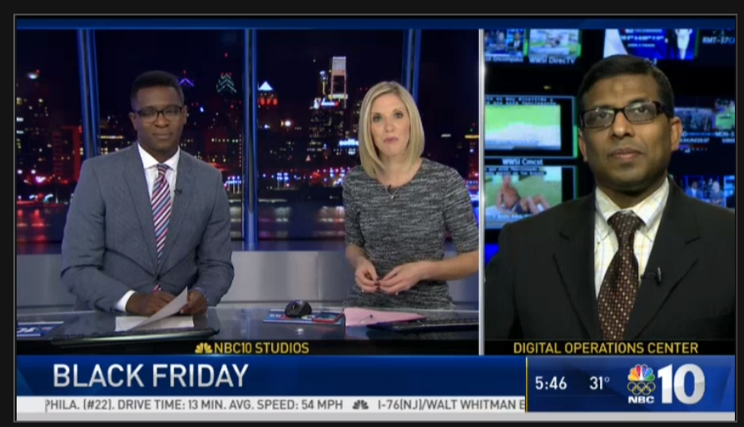
Omni-Channel Strategy

Slide 44
Related Works on Omnichannel Retailing
A. Mehra, S. Kumar, and J.S. Raju, "Showrooming and the Competition between Store and Online Retailers," Management Science.
A. Kumar, A. Mehra, and S. Kumar, “Why do Stores Drive Online Sales? Evidence of Underlying Mechanisms from a Multichannel Retailer,” Information Systems Research.
R. Janakiraman, Y. Liu, R. Bezawada, and S. Kumar, “A Structural Model of Consumers’ Perception of Channel Fit and Consumer Channel Choice: Evidence From a Multichannel Retailer,” Conference on Information Systems and Technology (CIST), October 5-6, 2013, Minneapolis, Minnesota.
R. Janakiraman, Y. Liu, R. Bezawada, and S. Kumar, “The Effect of Product Returns on Consumers’ Perception of Channel Quality and Channel Choice: An Empirical Investigation,” working paper.

Slide 45
Social Media Analytics: Indian General Election
Key Questions
Examine the drivers of popularity of Human Brands on Social Media
First, we study how the sentiment of the tweet ( i.e., negative vs positive) affects the social media engagement of human brands
Second, we investigate the spillover effect between the individual human brands (candidates) and related brands (parties)

Slide 46
Data Analytics: Data Description
Extracted 22.8 million tweets that discussed Indian Elections
Data collected from December 1, 2013 to May 31, 2014
Indian Elections held in 9 phases from April 7, 2014 to May 12, 2014
544,250 unique users were recorded.

Slide 47
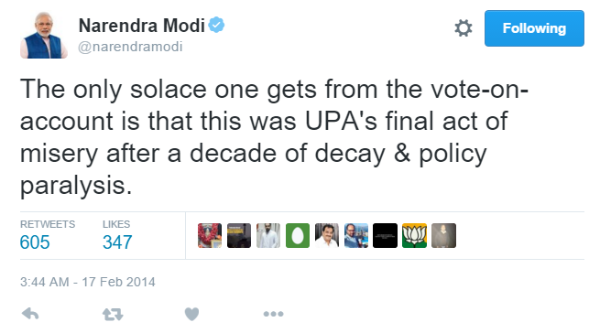
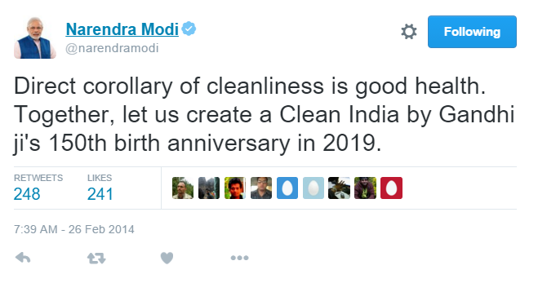
Sentiment of Tweets
Negative Toned Tweet
Positive Toned Tweet

Slide 48
Sentiment Methodology
Naïve Bayes
Maximum Entropy
Support Vector Machines

Slide 49
Sentiment Methodology
Naïve Bayes
Maximum Entropy
Support Vector Machines

Slide 50
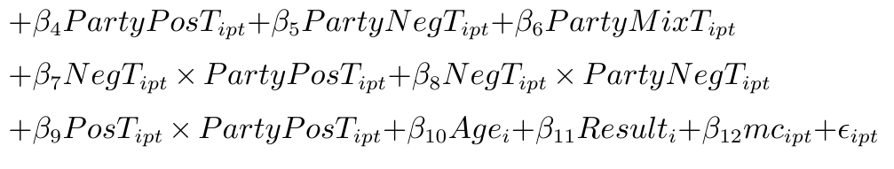
Econometric Model
We formulate our model as a random coefficients model to account for unobserved party level heterogeneity.
Model is at candidate and weekly level.
Effect of Sentiment
Spillover Effects
i: candidate, t: time (week), p: party

Slide 51
Decision Analytics: Key Questions
How to identify influencers or network seeders who can maximize both the reach and the effect of the seed.
Campaign Management
Collaborations within organizations

Slide 52
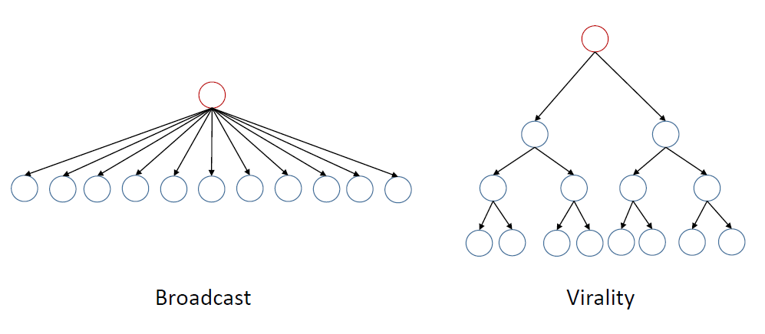
Broadcast vs Virality

Slide 53
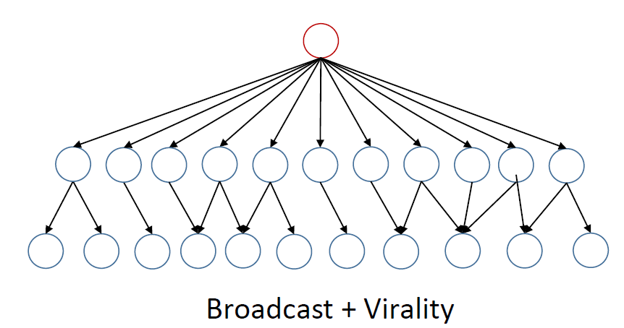
Broadcast and Virality

Slide 54
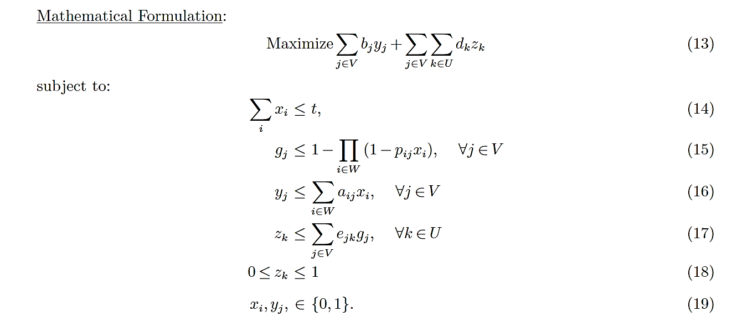
IP Formulation

Slide 55
Related Works on Social Media Analytics
Mallipeddi, R., R. Janakiraman, R., S. Gupta, and S. Kumar, “Evolution of Social Media Sentiments for Individual Human Brands: Evidence from Indian Election.” Production and Operations Management Society Annual Conference, May 2015.
Mallipeddi, R., R. Janakiraman, R., S. Gupta, and S. Kumar, “The Effects of Social Media Sentiment on Engagement.” working paper.
Mallipeddi, R., Y. Zhu, S. Kumar, and C. Sriskandarajah, “Models for Finding Network Seeders: Application to Twitter.” working paper.

Slide 56
Healthcare Information Exchange (HIE): Data Analytics
Key Questions
Understanding the HIE use patterns
General HIE use/adoption patterns
Usage behavior of providers
Patient consent behavior
Understanding the benefits of HIE usage
Benefits to patients
Benefits to providers

Slide 57
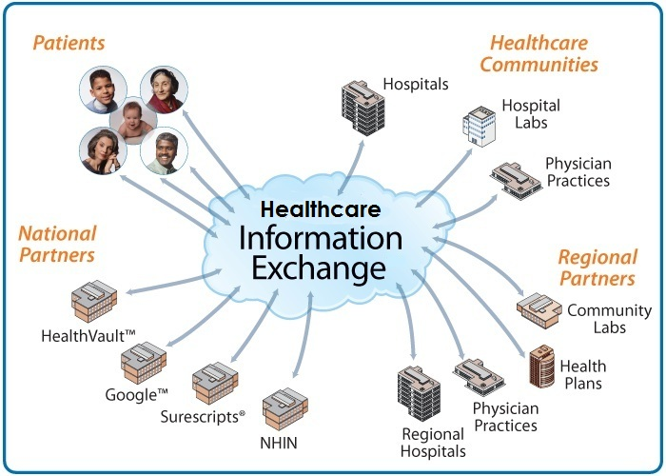
IMPACT of HealthLinkNY on Length of Stay, Readmissions, and Medical Personnel Utilization
https://papers.ssrn.com/sol3/papers.cfm?abstract_id=2915190
Featured in EHRIntelligence, 2017; Healthcare Informatics, 2017; Healthcare IT News, 2017, Pharma & Healthcare Monitor Worldwide, 2017; New York City High tech News, 2017; San Antonio Express-News, 2017; SeattlePI.com, 2017; University Chronicle, 2017; News West 9, 2017; KNHL-TV online; WCSC-TV online; KCBD-TV online; KWES-TV online; WLBT-TV online; WUPV-TV online; WWBT-TV online; WFIE-TV online; KSLA-TV online; WECT-TV online; WVUE-TV online; WFMJ-TV online; KTRE-TV online; KTVN-TV online; KFVE-TV online; KLKN-TV online; WBRC-TV online; WRCB-TV online; WOIO-TV online; WMBF-TV online; WTOL-TV online; WTOC-TV online; WVZN-TV online

Slide 58
Dataset Information
Number of unique encounter ids = 29,230,513
Number of unique HIE use ids = 1,619,539
Number of unique patient ids = 180,451
Number of unique provider ids = 7,612
Number of facilities = 4 (OLLH, UHSH, STI, UMH)
Number of different provider locations = 376
Time window: 01 Jan, 2011 to 30 Apr, 2014

Slide 59
The Effect of HIE Usage
During hospital visit
After hospital visit
Length of Stay
HIE Usage
Readmission
Number of Doctors

Slide 60
IMPACT of the Hospital Readmission Reduction Program (HRRP)

Slide 61
Conclusion
The introduction of the HRRP significantly reduces the readmission rate in all three diseases (HF, AMI, and Pneumonia).
The introduction of the HRRP does not necessarily decrease the mortality rate:
We find that the mortality rates of HF and Pneumonia have increased significantly.
HRRP is less effective in reducing readmission rates in veteran hospitals and critical access hospitals than those in acute care hospitals.
After the HRRP introduction, large hospitals have experienced a larger reduction in readmission rates than small hospitals.
After the introduction of HRRP, the zip code regions with a higher percent of Hispanic and African population experience a significantly larger reduction in readmission rates.
15

Slide 62
The Effect of Surgical Process Changes on Patient Flow: Evidence from Field Research
Justin Kistler*
Ramkumar Janakiraman*
Vikram Tiwari#
Subodha Kumar^
*University of South Carolina, Darla Moore School of Business
#Vanderbilt University Medical Center
^Temple University
Surgical Process Change (Kistler et al., 2017)

Slide 63
Study Motivation
How to optimize resource flow to the operating room?
Costly to starve the operating room of resources
Cannot have inventory waiting in the process either
What is the appropriate balance?
Surgical Process Change (Kistler et al., 2017)
2

Slide 64
Research Setting
Academic medical center conducting ~ 30,000 surgeries annually
39 operating rooms serviced by 28 surgical specialties
Patient level data pre and post process change
Control and treatment group for each period
Pre-op
Intra-op
Post-Op
Admit Status Destination
Surgical Process Change (Kistler et al., 2017)
4

Slide 65
Study Timeline
Operational Process Change
IT Process Change
H1
9,896 cases
11,860 cases
November 2014
April 2015
November 2015
Surgical Process Change (Kistler et al., 2017)
5

Slide 66
Study Timeline
Operational Process Change
IT Process Change
H2
9,896 cases
6,978 cases
November 2014
April 2015
November 2015
Surgical Process Change (Kistler et al., 2017)
6

Slide 67
Operational Process Change
Next patient please
Next patient please
OR1
OR2
OR3
OR39
OR1
OR2
OR3
OR39
. . .
. . .
Control desk
Next patient for OR3 please
Control desk
Next patient for OR39 please
Surgical Process Change (Kistler et al., 2017)
7

Slide 68
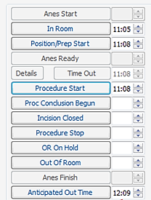
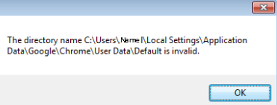
IT Intraoperative Prompt
Anticipated Out Time Check
Is the Anticipated Out Time correct? Please update the time as necessary.
Surgical Process Change (Kistler et al., 2017)
9

Slide 69
Conclusion
Centralized decision making resulted in a 3% reduction in average holding room length of stay versus the control group
The intraoperative prompt resulted in a 10% reduction in average holding room length of stay versus the control group
Surgical Process Change (Kistler et al., 2017)
15

Slide 70
Decision Analytics: Key Questions
How can HIEs improve their sustainability
By pricing their services optimally
By adding additional value-added services
By contracting with independent vendors
……….
https://pubsonline.informs.org/doi/abs/10.1287/isre.2016.0626

Slide 71
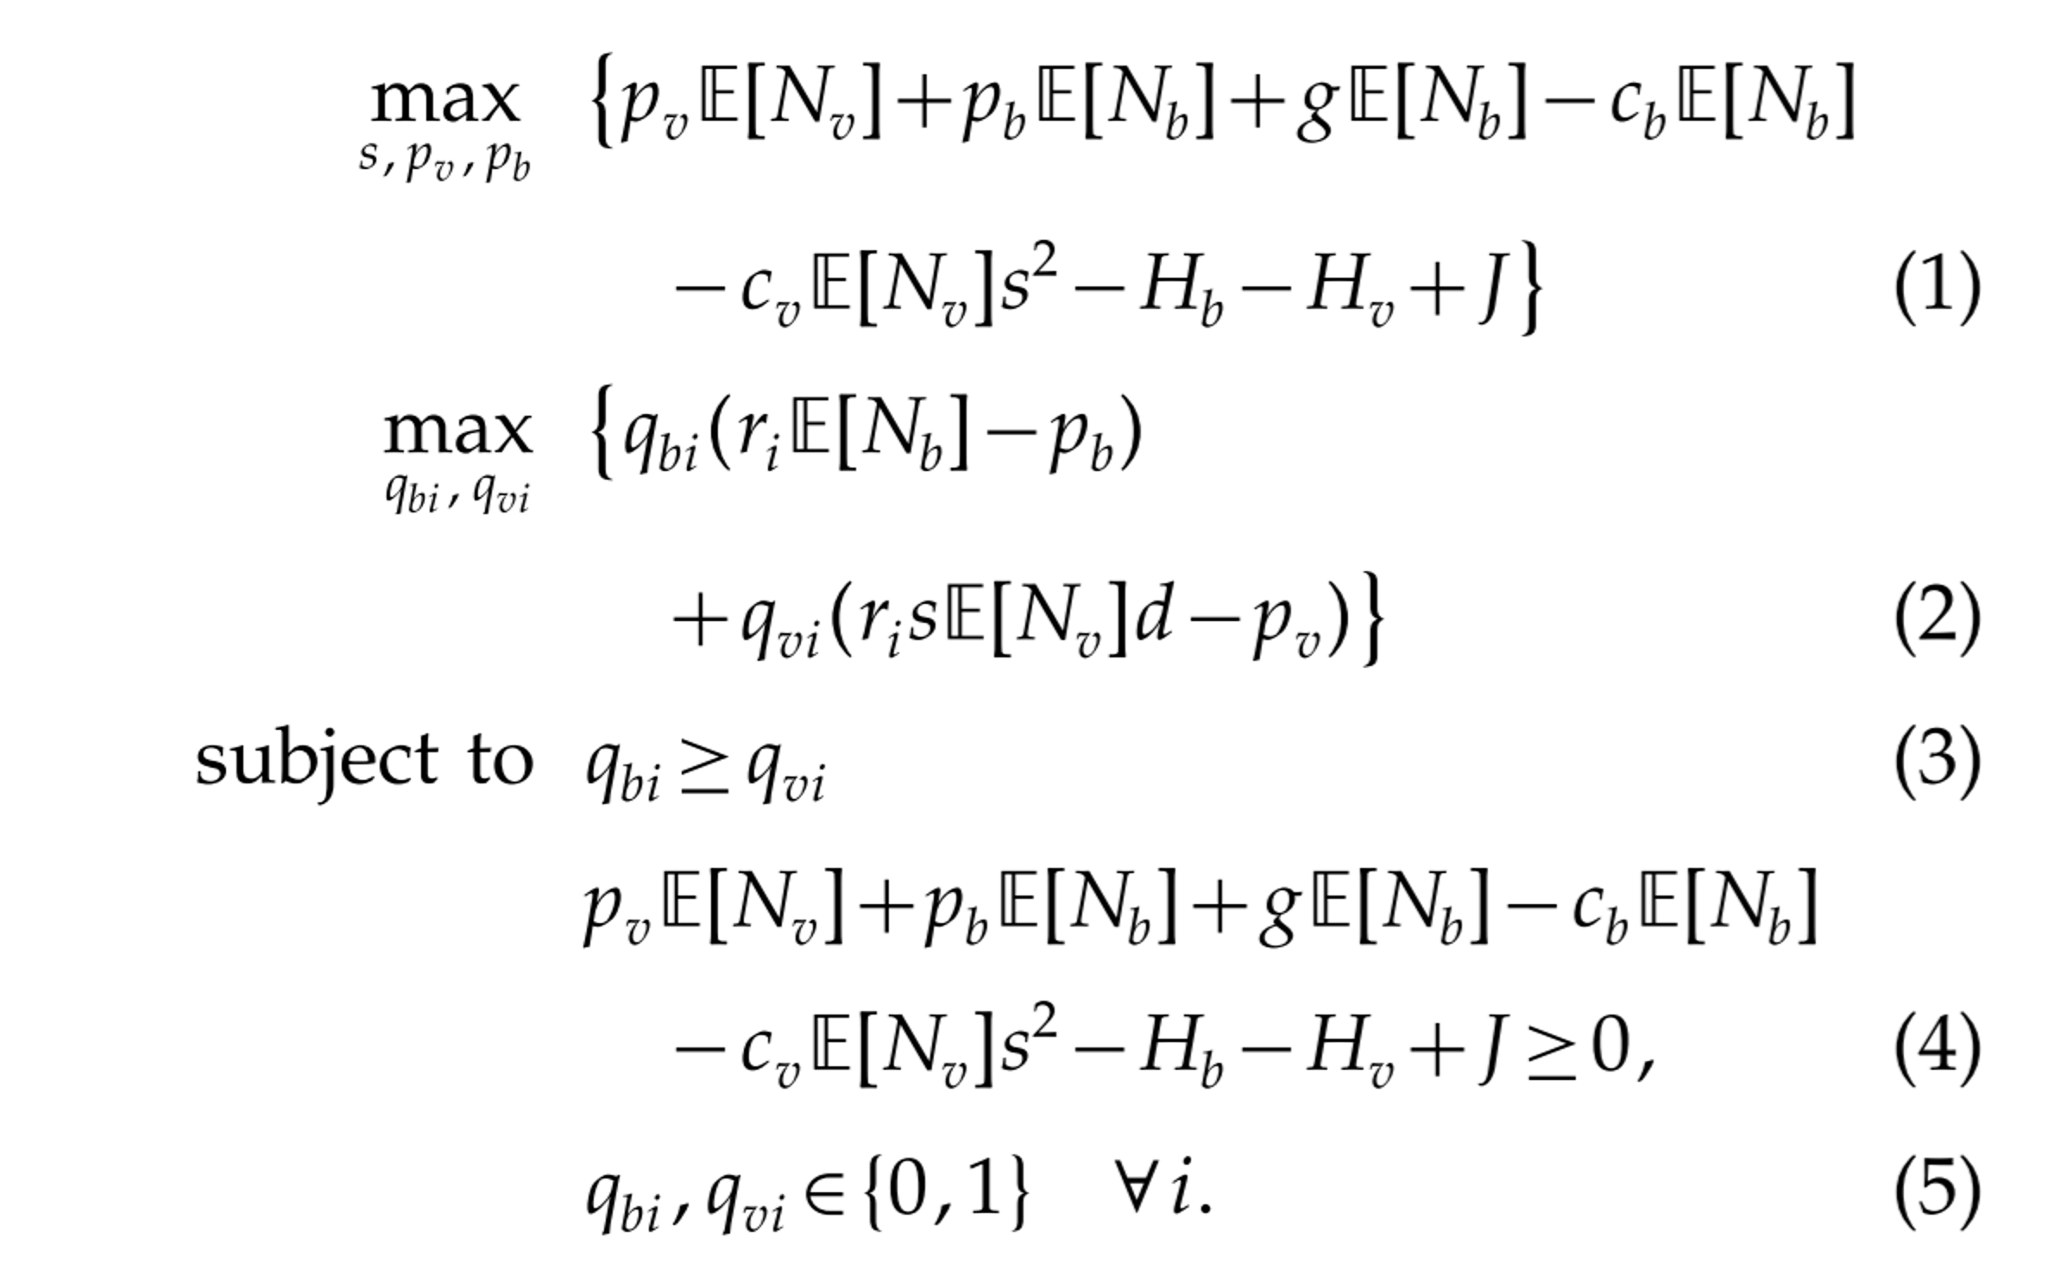
Decision Analytics

Slide 72
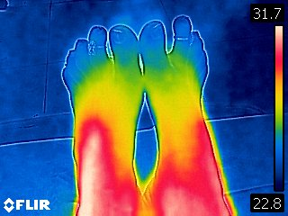
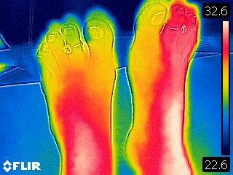
Image Analytics

Slide 73
Related Works on HIE
E.M. Demirezen, S. Kumar, and A. Sen, “Sustainability of Healthcare Information Exchanges: A Game-Theoretic Approach,” Information Systems Research.
T. Rajapakshe, S. Kuamr, A. Sen, and C. Sriskandarajah, “Sustainability Planning for Healthcare Information Exchanges with Supplier Discount Program,” Operations Research.
E.M. Demirezen, S. Kumar, and A. Sen, “Double Sided Network Externalities in Healthcare Information Exchanges,” Production and Operations Management Society Conference, Orlando, Florida, May 6-9, 2016.
E.M. Demirezen, E. Park, R. Janakiraman, and S. Kumar, “Share Your Health Information and Help Me Save Your Life: Effects of HIE Use on Healthcare Outcomes - An Empirical Investigation,” working paper.
,

Slide 74
India’s largest producer of secondary aluminum and zinc alloys

Slide 75
How does the company operate?
Buy raw material from global market
Produce automotive parts

Slide 76
Data Analytics
Predict the bidding price
Predict demand
Predict delivery time of raw material
Uses Multiple Linear Regression, and
Advanced Machine Learning Algorithms

Slide 77
Decision Analytics
Maximize profit by finding the optimal mix
Mixed-Integer Programming Problem

Slide 78
Insightzz
http://www.insightzz.com/

