Slide 1



RETAIL AND SUPPLY CHAIN ANALYTICS
Professor Subodha Kumar

Slide 2
Brief Bio
Paul R. Anderson Distinguished Chair Professor
Fox School of Business, Temple University, Philadelphia, USA
Professor of Supply Chain, Marketing, Information Systems, and Statistical Science
Director, Center for Data Analytics
Ph.D. Concentration Advisor, Operations and Supply Chain Management
Finished MBA in 2000 and PhD in 2001: University of Texas at Dallas
2001-2009: Faculty at Foster School of Business, University of Washington
2009-2017: Carol and G. David Van Houten, Jr. '71 Professor at Mays Business School, Texas A&M University
Visiting Positions:
Distinguished Visiting Professor at the Dongbei University of Finance and Economics, China
Awarded Chang Jiang Scholarship by the Chinese Government, 2018
The highest academic award issued to an individual in higher education by the Chinese Government (https://en.wikipedia.org/wiki/Changjiang_Scholars_Program)
Visiting Professor at the Indian School of Business, Hyderabad, India (Since 2010)
Associate Member of the Graduate Faculty, University of North Carolina at Charlotte
Regularly Visit
Indian Institute of Management, Bangalore, India
Harbin Institute of Technology, China

Slide 3
Brief Bio
Webpage: https://sites.temple.edu/subodha/
Research and teaching interests
Blockchain, Fintech, Artificial intelligence, Machine learning, Data mining, Social media analytics, Supply chain analytics, Healthcare, Digital marketing, Cybersecurity, Multi-channel retailing.
Published 50 papers in reputed journals and 83 papers in refereed conferences.
Authored a book.
Has a patent.
Co-authored 2 Harvard Business School cases and 4 Ivey Business School cases.
Co-authored several book chapters.
Editorship:
Deputy Editor and Department Editor of Production and Operations Management Journal
Executive Editor, Management and Business Review
Associate Executive Director, Production and Operations Management Society (POMS)

Slide 4
Recent Media Appearances
“Temple University Professors Says Retail Stores Closing Like A.C. Moore Are Its Own Worst Enemy,” CBS 3 Philadelphia News, November 26, 2019.
“The new Fashion District store may fit into Forever 21’s post-bankruptcy plan,” WHYY (PBS and NPR member station), October 1, 2019.
“Production and Operations Management (POM) - Kalyan Singhal and Subodha Kumar,” Academy of Management Podcast, April 29, 2019.
Invited in the CBS 3 Philadelphia Morning News to discuss Carvana Car Vending Machine Coming To Philadelphia, September 24, 2018.
Invited in the NBC 10 Philadelphia Evening News to discuss Comcast winning bidding war for rights to Sky, September 22, 2018.
Invited in the NBC 10 Philadelphia Morning News to discuss the Black Friday phenomenon and related retail trends, November 24, 2017.
“Data Analytics and Decision Analytics Models,” Featured in Indian School of Business “Management Briefs,” Vol 2, Issue 1, 2017.

Slide 5
Recent Teaching and Research Awards
Fox Crystal Apple Award (for teaching), Fox School of Business, Temple University, December 2019.
Dean’s Research Honor Roll, Fox School of Business, Temple University, December 2019.
Faculty of the Year Award for the MS Business Analytics program, Temple University, 2019.
Research Award, Department of Marketing and Supply Chain Management, Fox School of Business, Temple University, 2018 and 2019.
Elected to become a Production and Operations Management Society (POMS) Fellow, 2019.
Becoming a POMS Fellow is the Society’s highest recognition.
Chang Jiang Scholarship by the Chinese Government, 2018
The highest academic award issued to an individual in higher education by the Chinese Government (https://en.wikipedia.org/wiki/Changjiang_Scholars_Program)
Paul R. Anderson Distinguished Professorship by Temple University, Philadelphia, USA, 2017
Association of Former Students University Level Distinguished Achievement Award in Teaching, Texas A&M University, 2016
The most prestigious award at Texas A&M University
Summer Research Performance Recognition Grant, 2010 - 2016
Summer Teaching Performance Recognition Grant, 2014 - 2015
Association of Former Students College Level Teaching Award, 2013
Texas A&M Montague-CTE Teacher/Scholar for 2011
Numerous faculty-determined and student-initiated teaching awards

Slide 6
Course Information
Teaching Assistant
Harish Ramadurgam
E-mail: RSCA_CBA@ISB.EDU

Slide 7
Course Objectives
This course will assist you in understanding the importance of data in the supply chain and how organizations can gain competitive advantage using the analytics tools at various stages in the supply chain.
Numerous examples of firms that have been successful in implementing such tools will be discussed.
In order to ensure that students have in-depth understanding of supply chain analytics implementation in different industries, we will analyze different cases using real data.
We will also play a simulation game to provide you hands-on experience.
This course incudes applications of the tools learned in earlier classes.
Have Fun!!

Slide 8
Course Material and other Readings
Recommended Textbook
Chopra, S. and Meindl, P. Supply Chain Management: Strategy, Planning, and Operations (C&M), 6th Edition.
Other Useful Readings
Fisher M. and Raman A. (2010). The New Science of Retailing: How analytics are transforming the supply chain and improving performance, Harvard Business Press, Boston, Massachusetts, USA.
Feigin G. (2011). Supply Chain Planning and Analytics: The right product to the right place at the right time, Business Expert Press, New York, USA.
Davenport, T. H. and Harris, J. G. (2007). Competing on Analytics: The new science of winning. Harvard Business Press.
Davenport, T. H., Harris, J. G., and Morison, R. (2010). Analytics at Work: Smarter decisions, better results. Harvard Business Press.

Slide 9
Course Home Page
This page will guide you to all the downloadable files related to the course, in particular:
Excel spreadsheets for cases (posted in the course of the term)
Class notes (posted in the course of the term).
Links to other web locations that may be of interest to the class.
I encourage you to inform me of interesting links so I can make them available to the entire class.

Slide 10
Grading

Slide 11
Case Discussions
Cases are important since they give the opportunity to apply tools learned in class to real situations.
5 cases will be assigned and discussed in class.
There is no submission required for Case #5.
Written case analyses are due by 8 a.m. on the day for which they are assigned.
Late assignments are not acceptable - no credit will be given.

Slide 12
Case Discussions
Case studies will require you to understand and solve unstructured problems for the real companies.
The goal is to improve your decision making process in the real-world scenario, which is extremely important to be a successful senior executive.
You need to discuss each case within your group before the assigned class discussion date for that case.
Any team member might be called on in class to discuss the analysis and key conclusions of the group.

Slide 13
Case Discussions
Please provide quantitative analysis (either in the form of tables or excel file) wherever necessary. Such analysis if done well will essentially improve the strength of the case report.
Be concise and organized
Summarize your recommendations on the first page and support it by a clear analysis and explanation.
Make sure that all of your recommendations are supported by qualitative and/or quantitative analysis.
Provide exhibits wherever necessary, and all such exhibits must be referred in the report.
The write up should not exceed 4 pages (12pt, 1½ lines spaced), excluding exhibits.
Remember you are writing for someone who knows the facts of the case
Focus on your recommendation and reasons behind it.

Slide 14
Class Participation Grade
Each student is expected to arrive in class on time and ready to participate.
Numerous examples and a number of cases will be discussed in class. Each student may be called upon to answer questions from time to time.
Because of the concentrated format, it is extremely important to keep up with the material covered in class.
Your class participation grade will be based on the quality (NOT quantity) of your individual contributions to the discussion in every class.
Your questions and comments in the class will be the part of your class participation, because all of these things contribute to the learning of class.
Keep your eyes open for any news/analysis/report related to the course material, and share them in class.
We will try to begin each class session with such news/analysis/report.

Slide 15
Beer Game Report
Each group will play an online supply chain simulation game and develop a report on how they made their decisions and their final outcomes.
The game will be played in the classroom.
Instructions on how to play the game will be provided in class.
Your team report on the decisions you made and outcomes you achieved in the beer game will be due at 5:00 pm in one week from the last day of the class.
The report should include:
Details of your results (with appropriate visuals).
Discussion of your initial strategy. What worked and what didn't work?
Discussion of what you could have done differently and why.
Discussion of key take-aways. How would you use these take-aways in your workplace?
There is no specific format and length for these reports.
The groups will be evaluated on how you perform in the game and how you explain your strategies in the report.

Slide 16
Classroom Behavior
Please arrive on time.
If you choose to attend class, it would be appreciated if you do not leave early.
If you need to leave early for any unavoidable reason, let me know before the class.
Cell phones must be switched off in the classroom.
There will be penalty for using cell phones in the classroom.
During class, computers can be used only for the classroom related activities.
Again, there will be penalty for violating this rule.

Slide 17
Course Outline
The tentative course outline, including cases and readings, is provided in the Syllabus.
Everything is also available at the course platform

Slide 18
Data Analytics and Decision Analytics
Business Analytics
Data Analytics
Decision Analytics

Slide 19
Data Analytics and Decision Analytics
Business Analytics
Data Analytics
Decision Analytics
Collecting raw data
Data cleansing
Data analytics models

Slide 20
Data Analytics and Decision Analytics
Business Analytics
Data Analytics
Decision Analytics
Collecting raw data
Data cleansing
Data analytics models
Convert data analytics into valuable business decisions
Analytical and Optimization Models
Machine Learning, Artificial Intelligence, Deep Learning, etc.
Exploratory Data Analysis (EDA)
Confirmatory Data Analysis (CDA)
Qualitative Data Analysis (QDA)

Slide 21
Supply Chain
What is a supply chain?
What is supply chain management?

Slide 22
Examples of supply chains
Dell / Apple / IBM
Toyota / Tata Motors / GM / Maruti
Amazon / Google / Flipkart
Delta / Jet Airways
ISB
Notes:
Some SCM related companies
Retailers: 7-Eleven, Wal-Mart, Amazon, Borders
Distributors: McMaster-Carr, W.W. Grainger; Alliance, Maclean
Manufacturers: Dell Direct; HP/Compaq: direct and store; Gateway: phys. Direct.
Logistics Service Providers: Schneider, Ryder logistics
SCM software: SAP, i2, Manugistics
What are some supply chain related decisions that any of the above firms faces (5-10 minutes)? What should a SC Manager worry about? What questions should be answered?
Organize answers in rows for of strategic/design, planning, operation and in columns for the four drivers: facilities, inventory, transportation, information, + customer needs. Maybe use overhead, set aside for later reference.

Slide 23
The Logistics View
Customers,
demand
centers
sinks
Sources:
plants
vendors
ports
Regional Warehouses: stocking points
Field
Warehouses:
stocking
points
Supply
Inventory &
Warehousing
costs
Transportation
costs
Production/
purchase
costs
Inventory &
warehousing
costs
Transportation costs

Slide 24
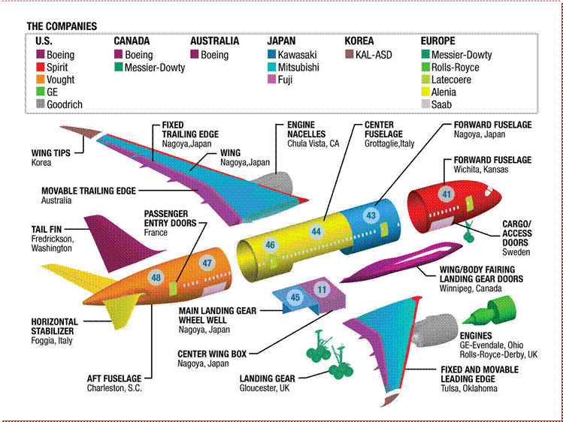
Manufacturing Aircraft – Boeing 787

Slide 25
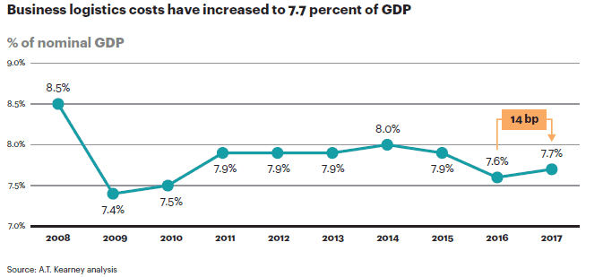
The Logistics Costs in the US

Slide 26
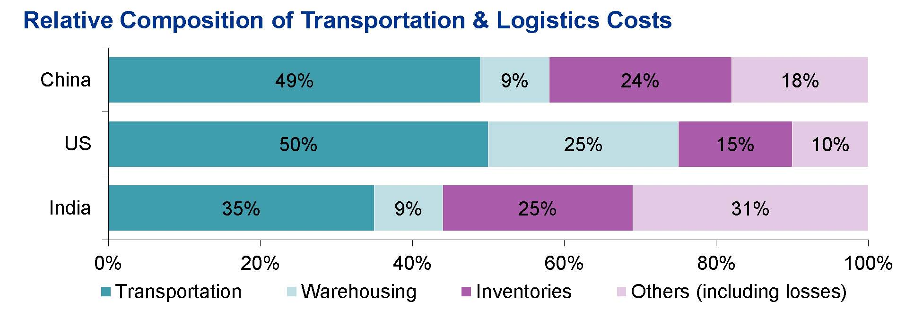
The Logistics Costs
As a percentage of GDP, approximately
7 to 9% in the US
Around 13 to 14% in India

Slide 27
Typical supply chain processes
Buy
Procurement / Financing / Hiring
Make / Create
Design / Manufacturing / Production / Service
Sell
Distribution / Marketing
Move
Logistics / Transportation / Warehousing
Buy + Make / Create + Sell + Move = SCM processes
Buy
Make/create
Sell
Inputs
Outputs
Move
Move

Slide 28
Typical supply chain flows
PHYSICAL FLOW
INFORMATION FLOW
CASH FLOW
Firm 1
Value-added
Processing
Firm 2
Value-added
Processing
Firm 3
Value-added
Processing
End User
Raw
Finished
Materials
Goods

Slide 29
Drivers of supply chain performance
Efficiency
Responsiveness
Supply chain structure
Facilities
Inventory
Transportation
Information
Drivers
Notes:
So far: we have focused on comp. strategy => gives implied demand uncertainty and SC strategy => desired SC capabilities and how much responsiveness SC should exhibit as a whole. This raises the question: How does a supply chain manager achieve strategic fit?
These four drivers characterize the supply chain (structure and operation) and its performance in terms of responsiveness/efficiency, and the degree of strategic fit, i.e., consistency with targeted customer needs (across SC.) (Think of race car analogy.) How do we build the SC?
Note: Responsiveness spectrum is 1-dimensional. Convenient to summarize the level of SC responsiveness and for comparisons. But for design need to disaggregate. (E.g.: Dell vs. steel mill).
Transp./Inv./Facility: How do McMaster and Grainger provide a high variety of products (over 200,000) quickly to customers? They use inventory and responsive transportation to provide same day to 2-day delivery to their customers. Grainger further increases responsiveness by having about 370 storefronts (facilities) where they provide same day delivery.
Inventory: How does Amazon provide higher variety than Borders? Amazon provides high product variety by consolidating inventory into a few storage locations.
Facility: Toyota has decided to increase responsiveness by making each production facility flexible enough to be able to supply a primary and a secondary market. Until 1998 their strategy was to have production facilities focused on only the local market.
Information: Dell and Wal-Mart have shared sales and inventory information with their suppliers to improve supply chain responsiveness and eliminate waste.
Note: The tradeoffs are qualitatively the same in each industry, but they play out differently depending on magnitudes of the different effects – that’s the hard and fascinating part of SCM!
Note: We said course is about managing flows. Drivers & flows closely linked. Flow routes determined by facility and customer locations (where); flow rates & patterns by facility & transportation capacities, demand and push-pull boundary; flow accumulation = inventory location and push/pull boundary; flow and buffer content (location of transformation). If time: course outline.

Slide 30
Comparison between efficiency and responsiveness
 | Efficient | Responsive
Primary goal | Lowest cost | Quick response
Product design strategy | Min product cost | Modularity to allow postponement
Mfg strategy | High utilization | Capacity flexibility
Inventory strategy | Minimize inventory | Buffer inventory
Lead time strategy | Reduce but not at expense of greater cost | Aggressively reduce even if costs are significant
Supplier selection strategy | Low cost and quality | Speed, flexibility, quality
Transportation strategy | Greater reliance on low cost modes | Greater reliance on responsive (fast) modes

Slide 31
Data in Supply Chain
Many firms are rich in data
Enterprise Resource Planning (ERP) Systems provide voluminous business data
The internet offers customer and market data and the opportunity to experiment with different product, promotion, and pricing plans
RFID devices will be placed on virtually every pallet or carton generating vast amounts of new data

Slide 32
Data in Supply Chain
These trends are leading firms to use and analyze data to improve business performance and make better decisions
Competing on Analytics by Davenport and Harris:
some firms use analytics as a competitive weapon

Slide 33
Supply Chain Analytics
Descriptive analytics applications
Predictive analytics
Prescriptive analytics

Slide 34
Supply Chain Analytics
Descriptive analytics applications
the use of data from
global positioning systems (GPSs),
radio frequency identification (RFID) chips, and
data-visualization tools
to provide managers with real-time information regarding location and quantities of goods in the supply chain.

Slide 35
Supply Chain Analytics
Predictive analytics
demand forecasting at
strategic,
tactical, and
operational levels,
all of which drive the planning process in supply chains in terms of
network design,
capacity planning,
production planning, and
inventory management.

Slide 36
Supply Chain Analytics
Prescriptive analytics
focuses on the use of
mathematical optimization, and
simulation techniques
to provide
decision-support tools built upon descriptive and predictive analytics models.

Slide 37
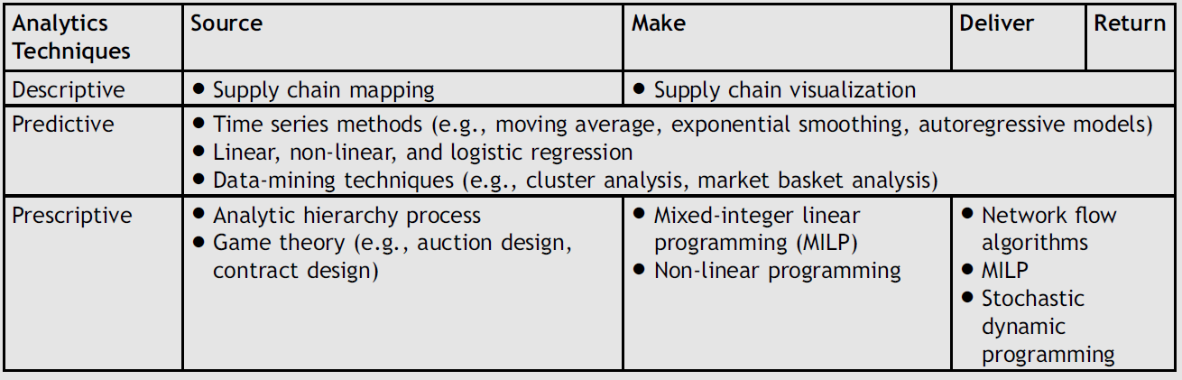
Analytic techniques used in supply chain management

Slide 38
Examples
Product rationalization at Hewlett-Packard
Fleet planning for Coca-Cola Enterprises
Multi-echelon inventory management at P&G
Vehicle routing at Waste Management, Inc.

Slide 39
Examples of Supply Chain Analytics
Big Data Comes to the Farm, Sowing Mistrust
https://www.wsj.com/articles/no-headline-available-1393372266
Fashion Industry Meets Big Data
https://www.wsj.com/articles/fashion-industry-meets-big-data-1378682452
How Big Data Helped Cut Emergency Room Visits by 10 Percent
http://www.businessweek.com/articles/2014-03-25/how-big-data-helped-cut-emergency-room-visits-by-10-percent
Retailers using data analysis to reduce waiting
http://online.wsj.com/article/SB10001424127887323798104578453293807869744.html
Facebook launces new advertiser tool to help advertisers directly target Facebook users based on their offline spending history
http://online.wsj.com/article/SB10001424127887324504704578412960951909032.html
Targeted ad at individual stores
http://online.wsj.com/article/SB10001424127887324077704578358231107272180.html

Slide 40
Harrah’s Entertainment
Customer loyalty card data used in near-real time to optimize yield, set prices for slots and rooms, and design traffic through the casinos
Predict the “pain point”
Which marketing initiatives to move through which channels

Slide 41
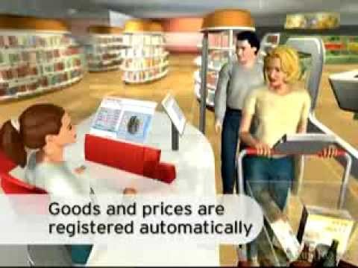
RFID Chips

Slide 42
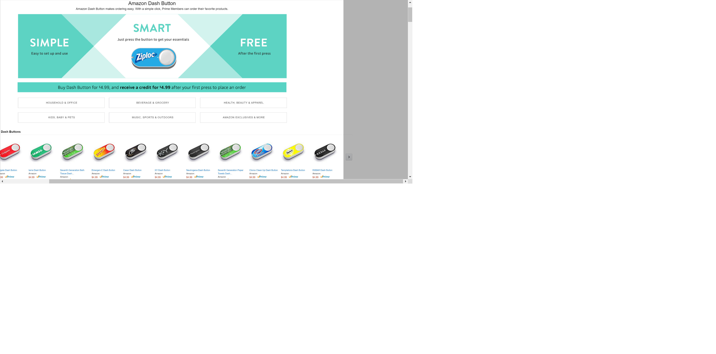
Retail Analytics
Introduced in March 2015

Slide 43
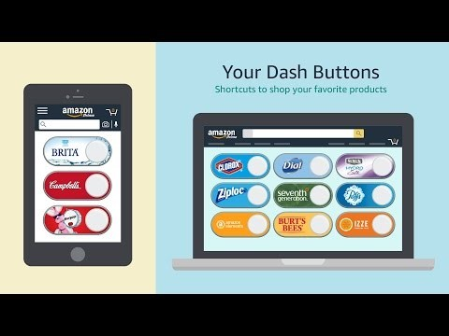
Dash Buttons

Slide 44

Dash Wand

Slide 45
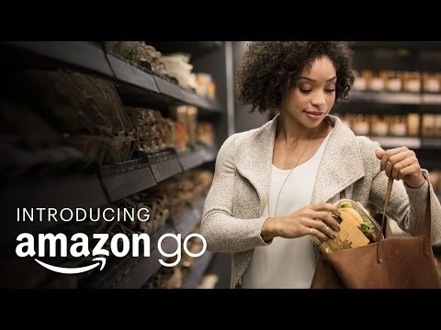
Retail Analytics
Introduced in December 2016

Slide 46
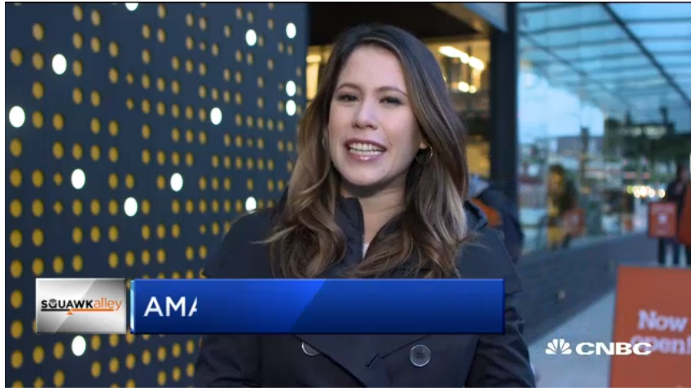
Retail Analytics
Introduced for everybody on January 22, 2018

Slide 47
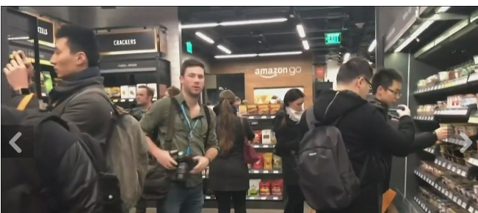
Amazon Go (Second Store)
Opened on August 27, 2018

Slide 48
Amazon Go: Latest Status
The third Amazon Go store, at the Troy Block complex in South Lake Union, is the largest at 2,100 square feet (200 m2) and opened in September 2018.
In September 2018, Amazon Go opened its first location outside of Seattle at the company's offices in the Chicago Loop.
Amazon Go location number 9 was opened on October 23, 2018 at 98 Post Street in San Francisco.
In September 2018, Bloomberg News reported Amazon was considering plans to open as many as 3,000 Amazon Go locations across the United States by 2021.
In response to potential discrimination against low-income people, San Francisco, Philadelphia, and New Jersey have passed legislation banning cash-less stores and retailers.
A new Amazon Go store in New York City opened on May 6, 2019, with cash acceptance in response to previous criticism over the use of app-only purchases and its effects on the poor.

Slide 49
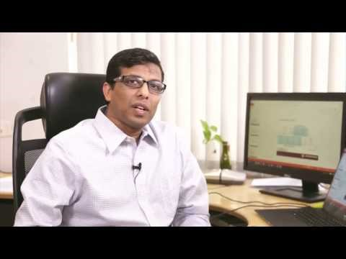
Data Analytics and Decision Analytics Models

Slide 50
How do firms / practitioners view SCM?
There is no consensus
“No two supply chains are alike. Very few companies define the supply chain in the same way. Of the supply chain leaders with which we spoke, almost all had different spans of control.”
Aquino and Draper (2008); a study by AMR Research and the Supply Chain Council based on a survey of almost 200 organizations
A narrow definition limits the potential of supply chain management
A very broad definition risks a loss of focus

Slide 51

So it depends on who you ask?

Slide 52
The boundary of SCM: A supply chain for pencils
Equipment
supplier
Customer
Bank
Retailer
Graphite
supplier
Distributor
Pencil
manufacturer
Retailer
Wood
supplier
Distributor
Labour
Retailer
Eraser
supplier
Institutions, norms, laws, tariffs, taxes, infrastructure, etc.

Slide 53
Session 2: What’s Next
Supply chain drivers and metrics
Facility location and Network design in the supply chain
Suggested Reading: Chapters 3 and 5 (Chopra and Meindl)

