Slide 1



Modeling Discrete Choice
Categorical dependent variables, logistic regression, and maximum likelihood estimation
Professor Subodha Kumar

Slide 2


Logistic Regression: The Gold Standard?
Logit
Don’t be afraid of logit models....

Slide 3

What is Logistic Regression?
Also known as Logit Models
Used when you have a binary dependent variable
e.g., Buyer -- Non-buyer
e.g., Responder -- Non-responder
e.g., Stays -- Leaves (attrition or churn models)
e.g., Fraudulent -- Valid
Like regression, it can include both continuous and categorical predictors, as well as interactions, and non-linear terms

Slide 4
Example - Why OLS Doesn’t Work for Response
Suppose a company is launching a new product and will promote it via a direct mail campaign using its current customer database
A test mailing is conducted on a random sample of n=200,000 customers
0.5% (n=1000) respond
Regression equation would be computed as follows:
Y = .00975 - .0000172(last) + .0000792 (# purch) + .00000514 (totdol)
This is essentially a regression equation using R,F, and M as predictors of response

Slide 5

Example (cont.)
If a customer last purchased their only product from this company 72 months ago, spending $1.25, their predicted Y would be -0.0002
Clearly, this customer can not have a negative probability of response
Regression results CAN NOT be interpreted as probabilities of response, but only as a score that makes sense only relative to other customers’ scores.
Logistic regression actually computes a probability of response for each customer, which makes intuitive sense, and which allows you to calculate total expected profits/return from a promotion.

Slide 6
Out-of-range predicted probabilities
Y
1
0
X
−∞ ≤ Y ≤ ∞
Regression can result in probabilities less than zero and greater than one (because it’s a line, not an S curve).

Slide 7
Some Responses are Nonlinear
OLS is a linear model, and this is not always appropriate
Consider the probability of owning a home as a function of income...
Prob. owning home
Prob. default on loan
Income
Income
Note: the effect of an increase – say $10,000 -- in income on the probability of owning a home (or defaulting on a loan) depends on the starting point. That is, an increase from $40,000 to $50,000 will not have the same effect as an increase from $1,000,000 to $1,010,000.
This type of pattern is not captured well by OLS.
Notes:
Note - while intuitive, this complicates the interpretation

Slide 8
Logit Models: The Basics
Recall that in OLS: Y = a + b₁(X₁)+ b₂(X₂)+…
We want to take this linear function and make it into an S-curve. We do this by transforming the measure of probability (p) into an odds ratio...
p is the probability of an event happening (e.g., a person buying)
p/(1-p) is the called the "odds”
Odds = probability it will happen/probability it won’t happen
If there is a 50% probability of response, the odds of response are .5/.5 = 1 (for every responder, there is a non-responder)
If there is a 25% probability of response, the odds of response are .25/.75 = .33

Slide 9

Logit Models: The Basics
Logit models work with the natural logarithm, e = 2.718, approximately
(try taking e¹ on your calculators)
Make sure you can take the natural log of a number e.g., ln(27.5) = 3.31418
taking the natural log of a number is kind of like taking its square root, but it shrinks it even more since e>2
Make sure you can calculate the value of the base natural log to a power, e.g., e ^{3.31418} = 27.5
Try this on your scientific calculator

Slide 10
Logit Models: The Basics
We take the natural log of the odds, or: ln[p/(1-p)], which is called the "logit"
We model the logit in a manner similar to that of OLS: ln[p/(1-p)] = a + b₁X₁ + b₂X_{2+...}
(this equation gives us a straight line)
Or, flipping things around and solving for p, we get:
p/(1-p) = e ^{(a + b}1^{X}1^{... )}
p = 1/[1+ e ^{-(a + b}1^{X}1^{...)}]
or p = e ^{(a + b}1^{X}1^{... )}/(1 + e ^{(a + b}1^{X}1^{... )})
(this equation gives us the S-curve we want)

Slide 11
Logit Models: The Basics
The logistic distribution constrains the estimated probabilities (p) to lie between 0 and 1:
if you let (a + b₁X₁ + b₂X₂+…) =0, then p = .50
because e ⁻⁽⁰⁾ = 1
as (a + b₁X₁ + b₂X₂+…) gets really big, the exponent of e becomes a large negative number, e approaches zero, and p approaches 1
as (a + b₁X₁ + b₂X₂+…) gets really small (i.e., large negative number), the exponent of e becomes a large positive number, e approaches infinity, and p approaches 0
Try the above on your calculator using
p = 1/[1+ e ^{-(a + bX...)}]

Slide 12
Comparing Linear Regression and Logit Models
Linear Regression
1
Logit Model
0
Logit: You see the endpoints never exceed 1 or go below 0.
The relationship “flattens out” at each extreme, for an
S-shaped curve.

Slide 13
A Simple Logit Model Example : P(respond) = f(coupon value in $)
Collected data on response to an offer as a function of value of coupon included in mailing
P(Respond) = 1/[1+ e ^{-(-2.18506 + .1087 X)}]
How do you interpret b = .1087?
e ^{(.1087)} = 1.1148 [try this on your calculators]
Thus, an additional $1 off is estimated to increase the odds that the customer will respond by 11.48% (i.e. multiply the odds by 1.1148)

Slide 14
Probabilities, odds and odds ratios
Here’s the critical part of logit model applications
p(respond) = 1/[1+ e ^{-(-2.18506 + .1087x)} ]
When X=$10: p(respond) = 1/[1+e ^{-(-2.18506 + .1087(10))} ] = .2501
When X=$11: p(respond) = 1/[1+e ^{-(-2.18506 + .1087(11))} ] = .2710
p(y=1) p(y=0) odds
$10 .2501 .7499 .3335
$11 .2710 .7290 .3717
effect on odds of $1 increase = .3717/.3335 = 1.114

Slide 15
How Good is the Model?
Pseudo- R²
Nagelkerke’s R² in SPSS is similar to the familiar R² in linear regression
Can also be calculated in “R”

Slide 16
Another Example
Think of a situation where you have to choose between two or more discrete alternatives
A shopper in grocery store
Have to decide between apple or orange juice
A prospective student
Have to decide which university offer to accept from the available several university offers

Slide 17
The concept of Utility
Utility
It is the measure of one’s relative satisfaction or pleasure resulting from a particular action
Suppose that, the utility from consumption of apple juice equals uA and for orange juice it is uO
To get sense of utility we can rate on a 100% scale – how much I like apple juice and how much I like orange juice
Say for example, apple juice = 0.6 and orange juice = 0.5
Now a simple model implies that uA > uO

Slide 18
The concept of Utility(2)
If uA = uO, one would be indifferent between the two
The difference uA - uO is called surplus
This model is called deterministic utility
Random Utility
As long as uA > uO, the individual always chooses apple juice regardless of the magnitude of surplus.
The concept of random utility is to choose from a particular distribution

Slide 19
A logit model
Here we assume that utilities follow a Gumbel distribution
Given the expected utilities uA and uO , the Gumbel distribution suggests that the choice probabilities equal
Prob (apple juice is chosen) = exp (uA)/[exp (uO)+ exp (uA)]
Prob (Orange juice is chosen) = exp (uO)/[exp (uO)+ exp (uA)]

Slide 20

A logit model If uA = 0.6 and uO = 0.5 as given in the previous example, then

Slide 21

A logit model - Since utility is a measure of relative satisfaction/pleasure, without loss of generality, we can assume that either of the two utilities equals zero and rescale the other. - For example, if uO=0, then uA = 0.6-0.5= 0.1 - Then exp (0) = 1, we see that

Slide 22
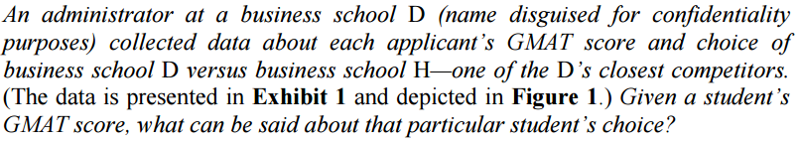
Estimating a logit model Conceptually similar to standard linear regression Look at the following example (Data in next page)

Slide 23
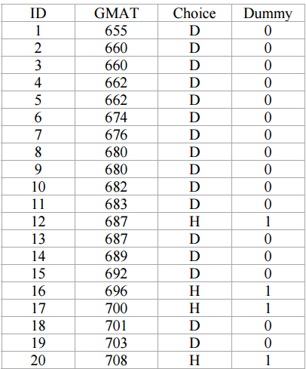
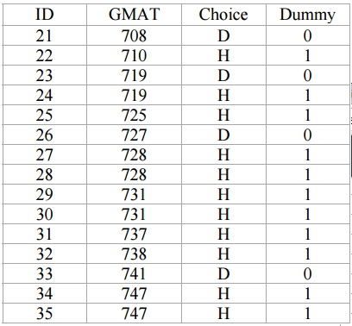
Exhibit 1- Sample GMAT score Data

Slide 24
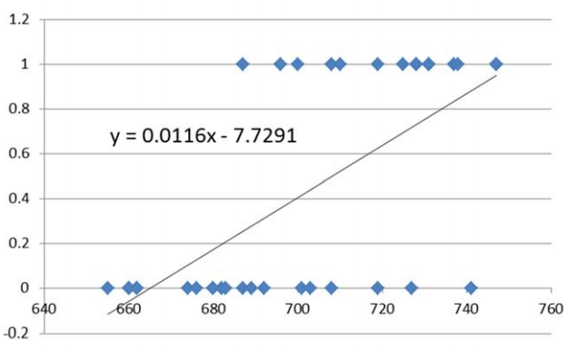
Figure 1 Fitting the D versus H choice data to a linear model

Slide 25
Maximum likelihood estimation (MLE)
The process of estimating a logit model is called Maximum likelihood estimation (MLE)
Is counterpart to the least squares minimization used in estimating linear regression
It accounts for the fact that estimated quantities are probabilities

Slide 26
Maximum likelihood estimation (MLE) (2)
Express the utility of the choice given a GMAT score as a linear model
Compute the corresponding choice probabilities
Given the probabilities, estimate the likelihood of observing the data you have
Compute the total likelihood
Solve an optimization problem that will maximize the total likelihood by changing coefficients a and b
Look at Exhibit 2 and Figure 2

Slide 27
A logit model
1. uH|GMAT = a + b GMAT
uD = 0
2. Prob (H is chosen given GMAT) =
exp(uH|GMAT) / [1 + exp(uH|GMAT)]
Prob (D is chosen given GMAT) =
1 / [1 + exp(uH|GMAT)]

Slide 28
3. Given these probabilities, estimate the likelihood of observing the
data you have.
Applicant ID1 chose D, and the likelihood of that is
Prob(D is chosen given GMAT = 655) = 1/[1 + exp( a + b x 655)]
Applicant ID2 also chose D and the likelihood of that is again
Prob(D is chosen given GMAT = 660). The likelihood of ID1
and ID2 choosing what they choose is
Prob(D is chosen given GMAT =655) x Prob(D is chosen given
GMAT=660)
(iii) …and so on.

Slide 29
4. Compute the total likelihood (a product of the
likelihoods for each data points)
5. Solve an optimization problem that will maximize the
total likelihood by changing the coefficients a and
b (e.g. using Excel Solver)

Slide 30
Hint:
Objective function (the total likelihood) involves the product of non–linear .
- Hence, highly non-linear optimization model.
Taking the log of the likelihood function simplifies the model
A helpful property of the logarithms is :
log(L1 X L2 X L3 X…) = log(L1)+log(L2)+log(L3)+….
Further, log[exp(uH)] = uH = a + b x GMAT, which is a linear
function of coefficients a and b.
These features make the model of the log likelihood easier to solve.

Slide 31
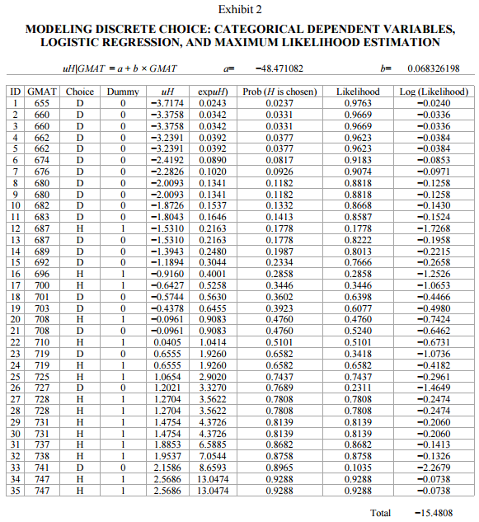
Exhibit 2

Slide 32
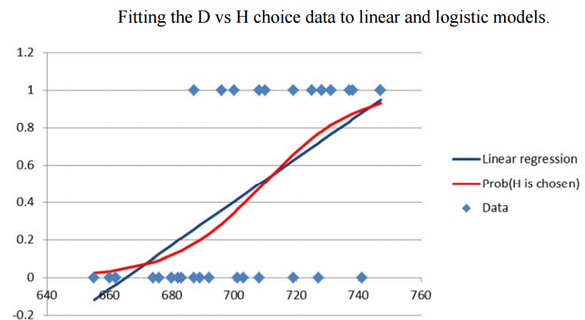
Figure 2

Slide 33
From Exhibit 2, the resulting equation is
Prob(H is chosen given GMAT) = exp(-48.47 +0.0683 X GMAT)
1+ exp(-48.47 +0.0683 X GMAT)
For GMAT = 700, the resulting probability is
Prob (H is chosen given GMAT = 700) = exp(-48.47 +0.0683 X 700)
1+ exp(-48.47 +0.0683 X 700)
= 0.5258/1.5258 =34.46%
From Figure 2,
Likewise for GMAT = 650, it equals 1.7%

Slide 34
Statistical Methods & Models to estimate more complex logit models
Multinomial logit (MNL)
When there are three or more alternatives to choose from
Latent class logits
When, in addition to estimating an MNL, one also wants to determine whether the respondents come from different subgroups that have different underlying preferences/utilities
Nested Logit
When several choices are embedded in one another
As when a customer first chooses a store from which to buy and then chooses the brand to buy.

Slide 35
Case Study : Predicting Customer Churn at QWE INC.
Can be done in Solver, R, or XLMiner.
- The problem with Solver is that you don’t know
the significance of variables

Slide 36
Session 5: What’s Next
Case Discussion #1: Applichem (A) (HBS 9-685-051)

