Slide 1
Beer Data Analysis
By Anmol More
PoweredTemplate.com

Slide 2
Before Jumping to Answers
Exploratory Analysis
Review data from 1998-2012. Good data for 2009-2011
Duplicate reviews, repositing same review with different ratings : ~ 1%
Some beers were reviewed only in specific year. Breweries or Beer Brand might not be available now (Avoided for recommendation)
Review rating items are highly correlated > 0.7 for overall rating, palette, aroma and taste
Fun Fact
Reviews are written during drinking hours, 50k+ reviews past midnight every hour

Slide 3
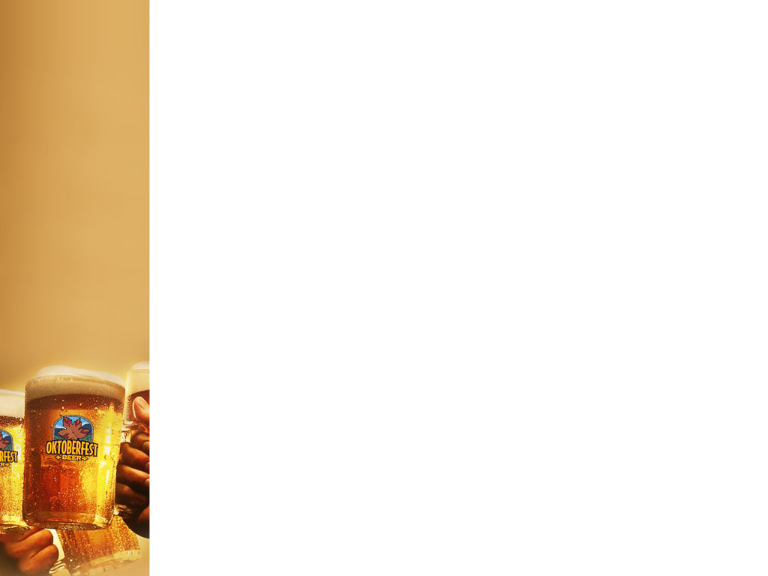
Question 1 : Rank top 3 Breweries which produce the strongest beers ?
Top two – Brewer Id : 36 and 6513
Third position (No clear winner) – 2796 (~10 ABV)
36 consistently came at higher ABV (Average Beer by Volume) by filtering across different criteria, ~ 12-13 % ABV
6513 is the company producing beers with ABV as high as 57, 39 (quite an outlier)
Considerations
Considering at least 30 samples for a brewer, producing min 5 different beer varieties
95th percentile ABV is 11, looking in top 5% range
ABV mean=7, median=6.5 and SD=2.2
Brewer 2830, 2958 not considered for third spot, some verities they produce on much lower ABV

Slide 4
Question 2 : Which year did beers enjoy the highest ratings ?
Choice : 2010 (3.9 mean rating, 3.8 consistently in other three rating scales)
Considerations
Excluding 1998-2002, 2012, just 2 % of total data
Considered 1 decimal place, to remove objectivity of too granular numbers
Aroma being most important in rating, highly correlated to overall rating
TODO
2009 and 2010 are close in numbers
Prove statistical significance with hypothesis testing, 95% CI of 2010 rating is 3.9 and 3.8 on other fronts

Slide 5
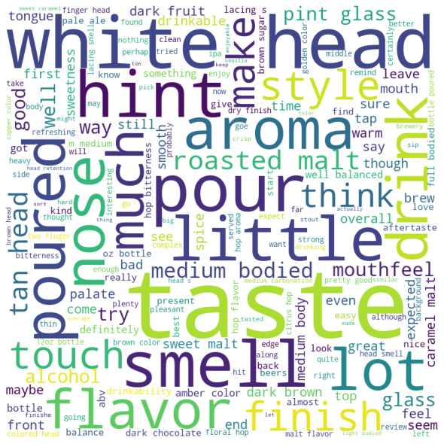
Question 3 : Based on the user’s ratings which factors are important among taste, aroma, appearance, and palette?
Choice : Aroma
Considerations
Aroma is highly correlated to overall review score ~ 0.8
Aroma, Nose, Smell together >>> Taste
Feature importance of fitment in regression, 90% contribution in overall rating
Taste and palette are correlated to aroma ~ 0.7

Slide 6
Question 4. If you were to recommend 3 beers to your friends based on this data which ones will you recommend ?
Recommendations
Hop Rod Rye
Racer 5 India Pale Ale
La Fin Du Monde
Considerations
Lot of beers have mean/median rating of 5, even after filtering based on No. of reviews threshold
Take top 100 reviewers top rated beers, these can be food bloggers, influencers
Recommend most reviewed top 3 beers

Slide 7
Natural Language Processing (Text Reviews Analysis)
Tried :
Text reviews sentiment analysis GCP NLP sentiment analysis. Failed few times, tried with smaller set
Huggingface models on local machine
NLTK

Slide 8
Question 5 : Which Beer style seems to be the favorite based on reviews written by users?
Favorite : English Bitter
Considerations
Tried GCP NLP API on sample set of 500
Take mean of all reviews, grouped by beer style
Top 3 – A bigger sample set is required
English Bitter - 0.7
American Black Ale - 0.6
Dunkelweizen - 0.5

Slide 9
Question 6 : How does written review compare to overall review score for the beer styles?
Text review mean sentiment : 3.3 on scale of (1,5)
Mean review score : 3.8
Text reviews are good proxy to beer user rating

Slide 10
Question 7 : How do find similar beer drinkers by using written reviews only?
TODO
Apply user – user, reviews – reviews collaborative filtering
Use user – reviews

