Slide 1
Angular 2.x Architecture

Slide 2
Agenda
Template Syntax
Directives
Component Model
Dependency Injection
Change Detection

Slide 3
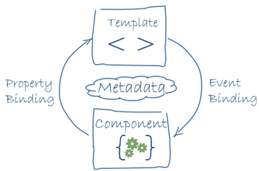

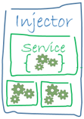
Building Blocks of an Angular 2
Application
Angular Frameworks
Router
Http
Forms
Upgrade
Compiler
Platform
Router
Libraries
core & common
Rx
Reflect
Zone
System
shim

Slide 4
Building Blocks of an Angular 2
Property Binding (Input)
<todo-list [source]="todos" (selected-change)="update($event)" />
Event Binding (Output)
Application
Angular Frameworks
Router
Router
Http
Forms
Upgrade
Compiler
Platform
Libraries
core & common
Rx
Reflect
Zone
System
shim

Slide 5
Template Syntax

Slide 6
Binding Syntax
One-way (Input):
<h1> Hi {{name}} </h1>
<div [property]="value" ></div>
One-way (Output):
<div (click)="setActive(todo)" ></div>
Two-way:
<input type="text" [(ngModel)]="todo.done">

Slide 7
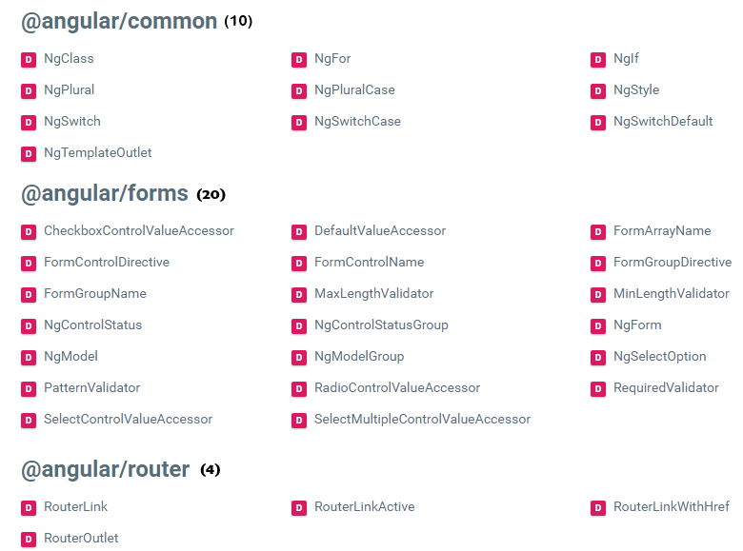
Directives
D
D
D
D
D
D
D
D
D
D
D
D
D

Slide 8
Sample Template
<div *ngFor="let todo of todos" >
<input type="checkbox" [(ngModel)]="todo.done" >
<span (click)="setActive(todo)"
[class.done]="todo.done" >
{{todo.text}}
</span>
</div>

Slide 9
@Component({ selector: 'todo-list', template: ` <div *ngFor="let todo of todos">
<input type="checkbox" [(ngModel)]="todo.done">
<span (click)="setActive(todo)"
[class.done]="todo.done">
{{todo.text}}
</span>
</div>
`})
export class TodoList {
@Output() selectedChange = new EventEmitter() @Input('source') todos: Todo[] = [];
constructor(private db:Db, private proxy:Proxy){} }
Component

Slide 10
@Component({ selector: 'todo-list', template: ` <div *ngFor="let todo of todos">
<input type="checkbox" [(ngModel)]="todo.done">
<span (click)="setActive(todo)"
[class.done]="todo.done">
{{todo.text}}
</span>
</div>
`})
export class TodoList {
@Output() selectedChange = new EventEmitter() @Input('source') todos: Todo[] = [];
constructor(private db:Db, private proxy:Proxy){} }
Component
<todo-list [source]="todos" (selected-change)="update($event)" />

Slide 11
Dependency Injection

Slide 12
Injector Overview
@Injectable()
class Engine {} @Injectable()
class Car {
constructor( public engine : Engine ) {}
}
var injector = Injector.resolveAndCreate([ Car , Engine ] );
var car = injector.get(Car);

Slide 13
Child Injector
Parent Injector A,B,C
var p = Injector.resolveAndCreate([A,B,C])
Child Injector A,B
var c1 = p.resolveAndCreateChild([A,B])
Child Injector A
var c2 = c1.resolveAndCreateChild([A])
c2.get(A) =>
A
@Injectable() class A{ constructor(b:B,c:C){ //... } }
B
C

Slide 14
Injection Resolution
3
Platform Injectors
2
Application Injectors
1
Component Injectors

Slide 15
Configuring The Component Injector
@Component({ selector: 'todo-list', providers : [UserProxy], template: `...`}) export class TodoListComponent { }

Slide 16
Configuring The Application Injector
@NgModule({ declarations:[AppComponent, ... ], providers :[UserProxy], bootstrap :[AppComponent], imports :[...] }) export class AppModule{} platformBrowserDynamic() .bootstrapModule(AppModule);

Slide 17
NgModule

Slide 18
Angular Modules (NgModule)
Organize an application into cohesive blocks of functionality.
Template Context (Components, Directives & Pipes)
Injector (Services)

Slide 19
Template Context
@NgModule({ declarations:[...],
imports :[...],
exports :[...],
bootstrap :[...]
}) export class XxxModule{}
Template Context
@NgModule({
}) export class XxxModule{}
@NgModule({ declarations:[...]
}) export class XxxModule{}
@NgModule({ declarations:[...],
imports :[...],
exports :[...],
}) export class XxxModule{}
@NgModule({ declarations:[...],
imports :[...]
}) export class XxxModule{}
imports
declarations
My Components, Directives & Pipes
FormsModule
CommonModule
imports
imports
exports (NgModel…)
exports ( NgIf , … )
declarations
declarations

Slide 20
Modules & Service Providers
@NgModule({ declarations:[...],
imports :[...],
exports :[...],
bootstrap :[...],
providers :[...]
}) export class XxxModule{}
@NgModule({ declarations:[...],
imports :[...],
exports :[...],
bootstrap :[...],
providers :[...]
}) export class XxxModule{}
@NgModule({ declarations:[...],
imports :[...],
exports :[...],
bootstrap :[...],
providers :[...]
}) export class XxxModule{}
Platform Injector
Application Injector
XxxModule
providers
RouterModule
providers
Lazy Loading Boundary
Module Injector
MathModule
providers
UsersModule
providers

Slide 21
Three Types of NgModules
Core module Import once when the app starts.
Examples of core modules:
BrowserModule
HttpModule
Application Injector
Core Module
App Module
Lazy Loading Boundary
Feature I Module
Feature II Module
Feature III Module
Shared Module
Shared Module

Slide 22
Three Types of NgModules
Feature module
Extend the App. Can expose or hide its implementation from other modules.
Application Injector
Core Module
App Module
Lazy Loading Boundary
Feature I Module
Feature II Module
Feature III Module
Shared Module
Shared Module

Slide 23
Three Types of NgModules
Shared module
Hold the common components, directives, and pipes and share them with the modules that need them.
Examples of modules:
CommonModule
FormsModule
Application Injector
Core Module
App Module
Lazy Loading Boundary
Feature I Module
Feature II Module
Feature III Module
Shared Module
Shared Module

Slide 24
Core Module Options
@NgModule({
imports: [...],
declarations: [...],
exports: [...],
providers: [...]
})
export class CoreModule {
constructor (@Optional() @SkipSelf() parentModule: CoreModule) {
if (parentModule) {
throw new Error('CoreModule is already loaded.');
}
}
static forRoot(config: UserServiceConfig): ModuleWithProviders {
return {
ngModule: CoreModule,
providers: [
{provide: UserServiceConfig, useValue: config }
]
};
}
}
Prevent reimport
Configure core services

Slide 25
Change Detection

Slide 26
Model Challenges
<div *ngFor="#todo of todos">
<input [(ngModel)]="todo.done">
<span (click)="setActive(todo)"
[class.done]="todo.done">
{{todo.text}}
</span>
</div>
UI
(DOM)
Model
?
Template

Slide 27
Angular 2.0 Tick Cycle
NgZone
Timers,
Communication,
UI Events
{{interpolation}}
[property] = "exp"
Component (7 expressions)
Time
Component
(5 expressions)
Component
(3 expressions)
Component (2 expressions)
Component
(6 expressions)
Component
(9 expressions)
Screen Update

Slide 28
Thanks

