Slide 1
Template Syntax
In Angular 2.0

Slide 2
Agenda
Interpolation
Binding Syntax
Binding Targets
Events Bindings
Built-in Directives
Local Template Variables

Slide 3
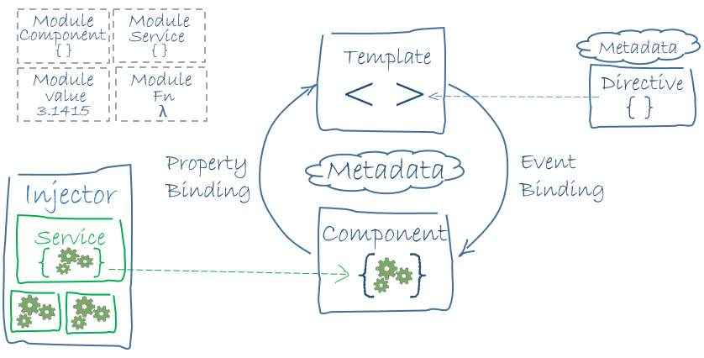
Building Blocks of an Angular 2
Application
<todo-list [source]="todos" (selected-change)="update($event)" />
Angular Frameworks
Router
Http
Compiler
Platform
Libraries
core & common
Rx
Reflect
Zone
System
shim

Slide 4
@Component({ selector: 'todo-list', styles: [` .done{ text-decoration: line-through; color: grey; }`], template: ` <ul class="list-unstyled"> <li *ngFor="#todo of todos"> <input type="checkbox" [(ngModel)]="todo.done"> <span [class.done]="todo.done">{{todo.text}}</span> </li> </ul>` })
export class TodoList {
@Output() selectedChange = new EventEmitter() @Input('source') todos: Todo[] = [];
constructor(private db:Db, private proxy:Proxy){} }
{{exp}}
[property]="exp"
(event) ="exp"
*ngIf ="exp"
*ngFor ="exp"

Slide 5
HTML
Almost all HTML syntax is valid template syntax.
The <script> element is a notable exception; it is forbidden, eliminating the risk of script injection attacks.
The <html>, <body>, and <base> elements have no useful role in our repertoire.
<h3>My First Angular Application</h3>

Slide 6
Interpolation
We use interpolation to weave calculated strings into the text between HTML element tags and within attribute assignments.
Template expressions cannot refer to anything in the global namespace.
<h3> {{title}} <img src = "{{heroImageUrl}}" > </h3>
first evaluates and then converts to a string.

Slide 7
The Safe Navigation Operator
Field is optional and if undefined, the rest of the expression should be ignored.
<p>
Employer: {{ employer?.companyName }}
</p>

Slide 8
Template Expressions
<todo-list [source]="expression" ></todo-list>
A template expression produces a value.
Angular executes the expression and assigns it to a property of a binding target.
The target might be an HTML element, a component, or a directive.
Prohibited expressions:
Assignments ( = , += , -= )
The new, ++, --, |, and & operators
Chaining expressions with ; or ,

Slide 9
Template Statements
<todo-list (click)="statement" ></todo-list>
Supports assignment (=) and chaining expressions with semicolons (;) and commas (,).
Not allowed:
new, ++, --, +=, -=, |, and & operators.
<todo-list (click)="task = $event" ></todo-list>

Slide 10
Event Binding
The binding conveys information about the event, including data values, through an event object named $event.
Custom events with EventEmitter:
<div (click)="clickMessage = $event">...</div>
deleted = new EventEmitter<User>(); onDelete() { this.deleted.emit(this.user); }
<user-detail (deleted)="onUserDeleted($event)"></user-detail>

Slide 11
Binding Syntax
One-way (data source → view target):
{{Interpolation}}
[target] = "expression"
bind-target = "expression"
One-way (view target → data source):
(target) = "statement"
on-target = "statement"
Two-way:
[(target)] = "expression"
bindon-target = "expression"

Slide 12
HTML Attribute vs. DOM Property
Attributes are defined by HTML. Properties are defined by the DOM (Document Object Model).
Attributes initialize DOM properties and then they are done.
Property values can change; attribute values can't.

Slide 13
A World Without Attributes
Template binding works with properties and events, not attributes.
The only role of attributes is to initialize element and directive state.

Slide 14
Property Binding or Interpolation?
Angular translates those interpolations into the corresponding property bindings before rendering the view.
<img src="{{heroImageUrl}}"> <img [src]="'' + heroImageUrl"> <div>The title is {{title}}</div> <div [textContent]="'The title is ' + title"></div>

Slide 15
Attribute, Class, & Style Bindings
We can set the value of an attribute directly with an attribute binding.
We must use attribute binding when there is no element property to bind.
<tr><td colspan="{{1 + 1}}">Three-Four</td></tr> Template parse errors: Can't bind to 'colspan' since it isn't a known native property
<!-- expression calculates colspan=2 --> <tr><td [attr.colspan]="1 + 1">One-Two</td></tr>

Slide 16
Binding Targets
Target | Sample
Property | [property] = "expression"
Event | (event) = "expression"
Two-Way | [(ngModel)] = "expression"
Attribute | [attr.aria-label] = "expression"
Class | [class.special] = "expression"
Style | [style.color] = "expression"

Slide 17
Built-in Directives

Slide 18
NgClass
Control how elements appear by adding and removing CSS classes dynamically.
We can bind to NgClass to add or remove several classes simultaneously.
<!-- toggle the "special" class on/off with a property --> <div [class.special]="isSpecial">
The class binding is special
</div>
<div [ngClass]="setClasses()">...</div> setClasses() { return { modified: !this.isUnchanged, // false special : this.isSpecial, // true } }

Slide 19
NgStyle
Set inline styles dynamically, based on the state of the component.
Binding to NgStyle lets us set many inline styles simultaneously.
<div [style.fontSize]="isSpecial ? 'x-large' : 'smaller'" > This div is x-large </div>
<div [ngStyle]="setStyles()">...</div>
setStyles() { return { 'font-style': this.canSave ? 'italic' : 'normal', 'font-weight': !this.isUnchanged ? 'bold' : 'normal', 'font-size': this.isSpecial ? '24px' : '8px', } }

Slide 20
NgIf
add an element subtree to the DOM by binding an NgIf directive to a truthy expression.
When NgIf is false:
Angular physically removes the element subtree from the DOM.
Destroys components in the subtree, along with their state, potentially freeing up substantial resources.
Resulting in better performance for the user.
<div *ngIf="currentUser"> Hello, {{currentUser.firstName}} </div>

Slide 21
NgSwitch
We bind to NgSwitch when we want to display one element tree from a set of possible element trees, based on some condition.
Angular puts only the selected element tree into the DOM.
<span [ngSwitch]="toeChoice"> <template [ngSwitchWhen]="'Eenie'"> Eenie </template> <template [ngSwitchWhen]="'Meanie'">Meanie </template> <template [ngSwitchWhen]="'Miney'"> Miney </template> <template [ngSwitchWhen]="'Moe'"> Moe </template> <template ngSwitchDefault> Other </template> </span>

Slide 22
NgFor
Repeater directive.
Present a list of items.
We can capture the index in a local template variable
<div *ngFor="let user of users; #i=index"> {{user.fullName}} </div>
Creates a local template variable.

Slide 23
*ngFor
<template
ngFor
let-item
[ngForOf]="items"
let-i="index" [ngForTrackBy]="trackByFn">
<li>...</li>
</template>
<li *ngFor="let item of items; let i = index; trackBy: trackByFn">
...
</li>
=

Slide 24
Template Reference Variables
A template reference variable is a vehicle for moving data across element lines.
The # character can use its canonical alternative, the ref- prefix.
<!-- phone refers to the input element --> <input #phone placeholder="phone number">
<button (click)="callPhone(phone.value)">Call</button>
<!-- fax refers to the input element --> <input ref-fax placeholder="fax number">
<button (click)="callFax(fax.value)">Fax</button>

Slide 25
Resources
Angular.io site (Developer guides)
GitHub (Angular code source)

Slide 26
Thanks

