Slide 1


Practicum Presentation IIoT 260
Title: “Smart-ASHA: A Multi-Modal, Edge-AI Cardiopulmonary & Biochemical Triage Framework”
Student’s Name: Anmol Nandwani, Vansh Sharma, Gauri Gupta
Enrollment No. : 35117711724, 02717711724, 03417711724
Branch& Section: IIOT - A
Supervisor: Dr. Divya Agarwal

Slide 2
Contents
Introduction
Problem Statement
SDG Mapped
Literature Review
Technology Stack
Timeline
Expected Outcome
Conclusion
References

Slide 3
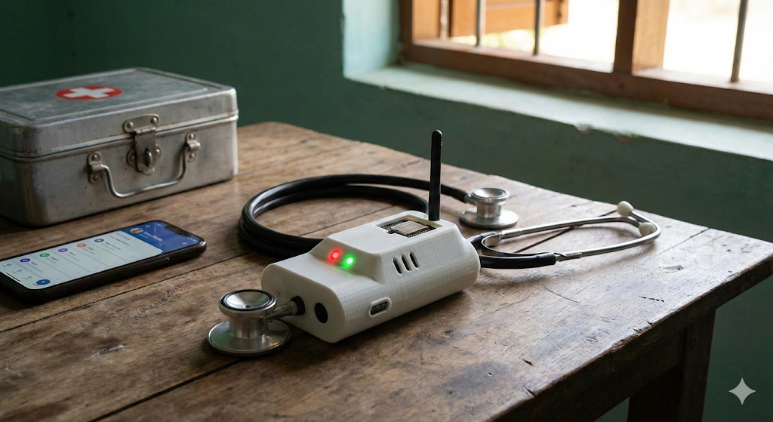
1. Introduction
Overview: Smart-ASHA is an innovative medical triage framework utilizing an AI-powered "Tri-Corder" sleeve to enhance rural healthcare.
● Functionality: It transforms a standard stethoscope into a sensing hub by combining high-performance edge processing with cloud integration.
● Key Features:
○ Real-time Edge Processing: Uses quantized TinyML on ESP32-S3 for low-latency diagnostics (e.g., arrhythmia detection).
○ Offline Capability: Hardware-gated noise reduction and on-device logic allow for "Red/Green" triage even without internet.
○ Cloud Integration: Offloads complex tasks like language translation and facilitates epidemiological data synchronization.

Slide 4

2. Problem Statement
Economic Unaffordability:
Specialised diagnostic tools (ECG, thermal imagers, etc.) are prohibitively expensive for rural PHCs, often costing over ₹2,20,000.
The "Noisy Clinic" Failure:
Standard digital stethoscopes fail in chaotic rural clinics (60-70dB ambient noise), rendering acoustic AI models useless.
Diagnostic Silos:
ASHA workers often cannot distinguish between symptoms that appear identical (e.g., Pneumonia vs. Heart Failure) or identify metabolic emergencies without invasive blood tests.

Slide 5


3. SDG Mapped
○ Promotes proactive, data-driven disease mapping and reduces mortality in resource-constrained settings.
○ Bridges the gap in healthcare access by providing low-cost (~₹10,000), high-tech diagnostic tools to rural populations.

Slide 6
4. Literature Review
● Digital Auscultation: Rocha et al. (2019) utilised CNNs for respiratory sounds, while Arjoune et al. (2023) highlighted noise challenges in digital stethoscopes.
● TinyML: Dutta & Bharali (2021) demonstrated the use of microcontrollers for real-time Edge AI.
● Multi-Modal Fusion: Majumder et al. (2017) proposed fusing ECG, lung acoustics, and SpO2 to overcome diagnostic silos.
● Non-Invasive Screening: Sarkar et al. (2021) explored spectral analysis for needle-free haemoglobin estimation.
● Piezoelectric Sensing: Sun et al. (2020) used piezoelectric film sensors to capture chest vibrations, bypassing airborne noise. .

Slide 7
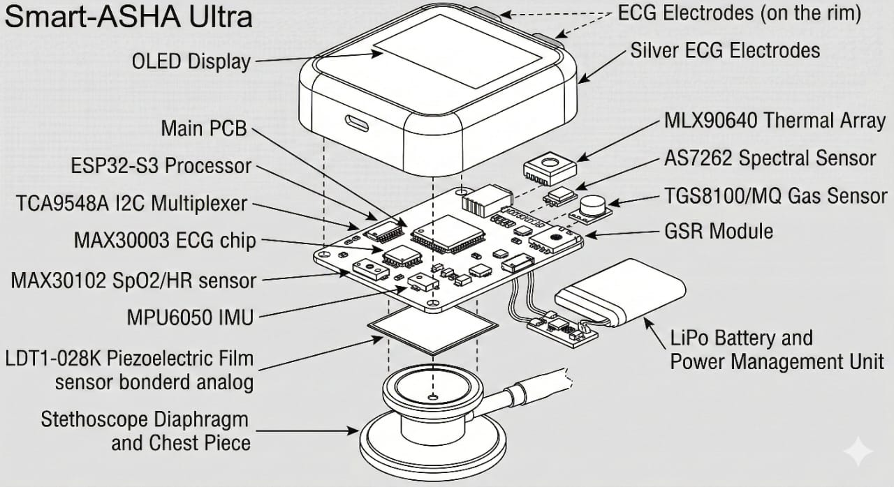
6. Technical Stack
Hardware:
● Microcontroller: ESP32-S3 (AI & Low Power).
● Sensors:
○ LDT1-028K (Piezoelectric Vibration Sensor).
○ MAX30003/AD8232 (ECG) & MAX30102 (SpO2/PPG).
○ MLX90640/AMG8833 (Thermal Grid) & MPU6050 (IMU).
○ AS7262/AS7343 (Spectral Analysis) & MQ-135 (VOCs).
● Connectivity: 7Semi 4G Modem & GPS.
Software:
● Frameworks: TensorFlow Lite (Edge AI Inference), Arduino IDE 2.3+.
● DSP: STFT (Spectrograms), Bandpass Filtering (0.5Hz-40Hz).
● Models: Quantized CNN (Lung Sounds), 1D-CNN (Cardiac Rhythm).

Slide 8
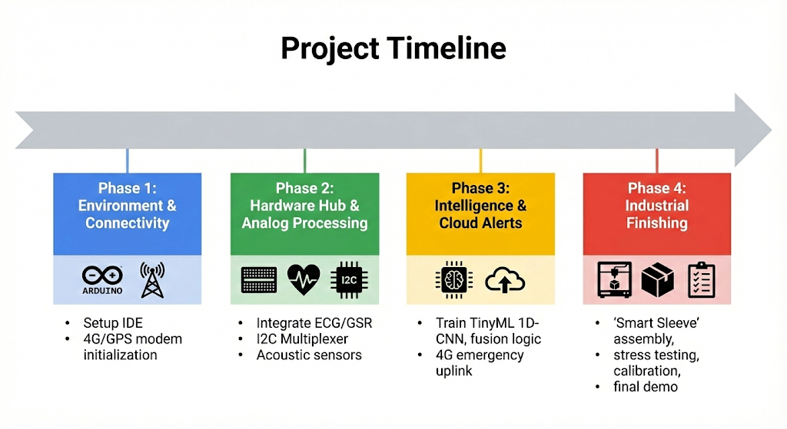
7. Timeline
Phase 1: Environment & Connectivity (16 jan – 2 feb)
○ Set up Arduino IDE, libraries (Adafruit_GFX, TinyGSM), and 4G/GPS modem initialisation.
Phase 2: Hardware Hub & Analogue Processing (3 feb – 2 march)
○ Integrate ECG/GSR "Front-End", implement I2C Multiplexer (TCA9548A) for sensor hub, and integrate metabolic/acoustic sensors.
Phase 3: Intelligence & Cloud Alerts (3 march – 10April)
○ Train TinyML 1D-CNN using Edge Impulse, implement heuristic fusion logic for triage, and set up 4G emergency uplink (MQTT/HTTP).
Phase 4: Industrial Finishing (10 April – 25 April)
○ "Smart Sleeve" assembly (3D printed adapter), stress testing, calibration, and final demo recording.

Slide 9
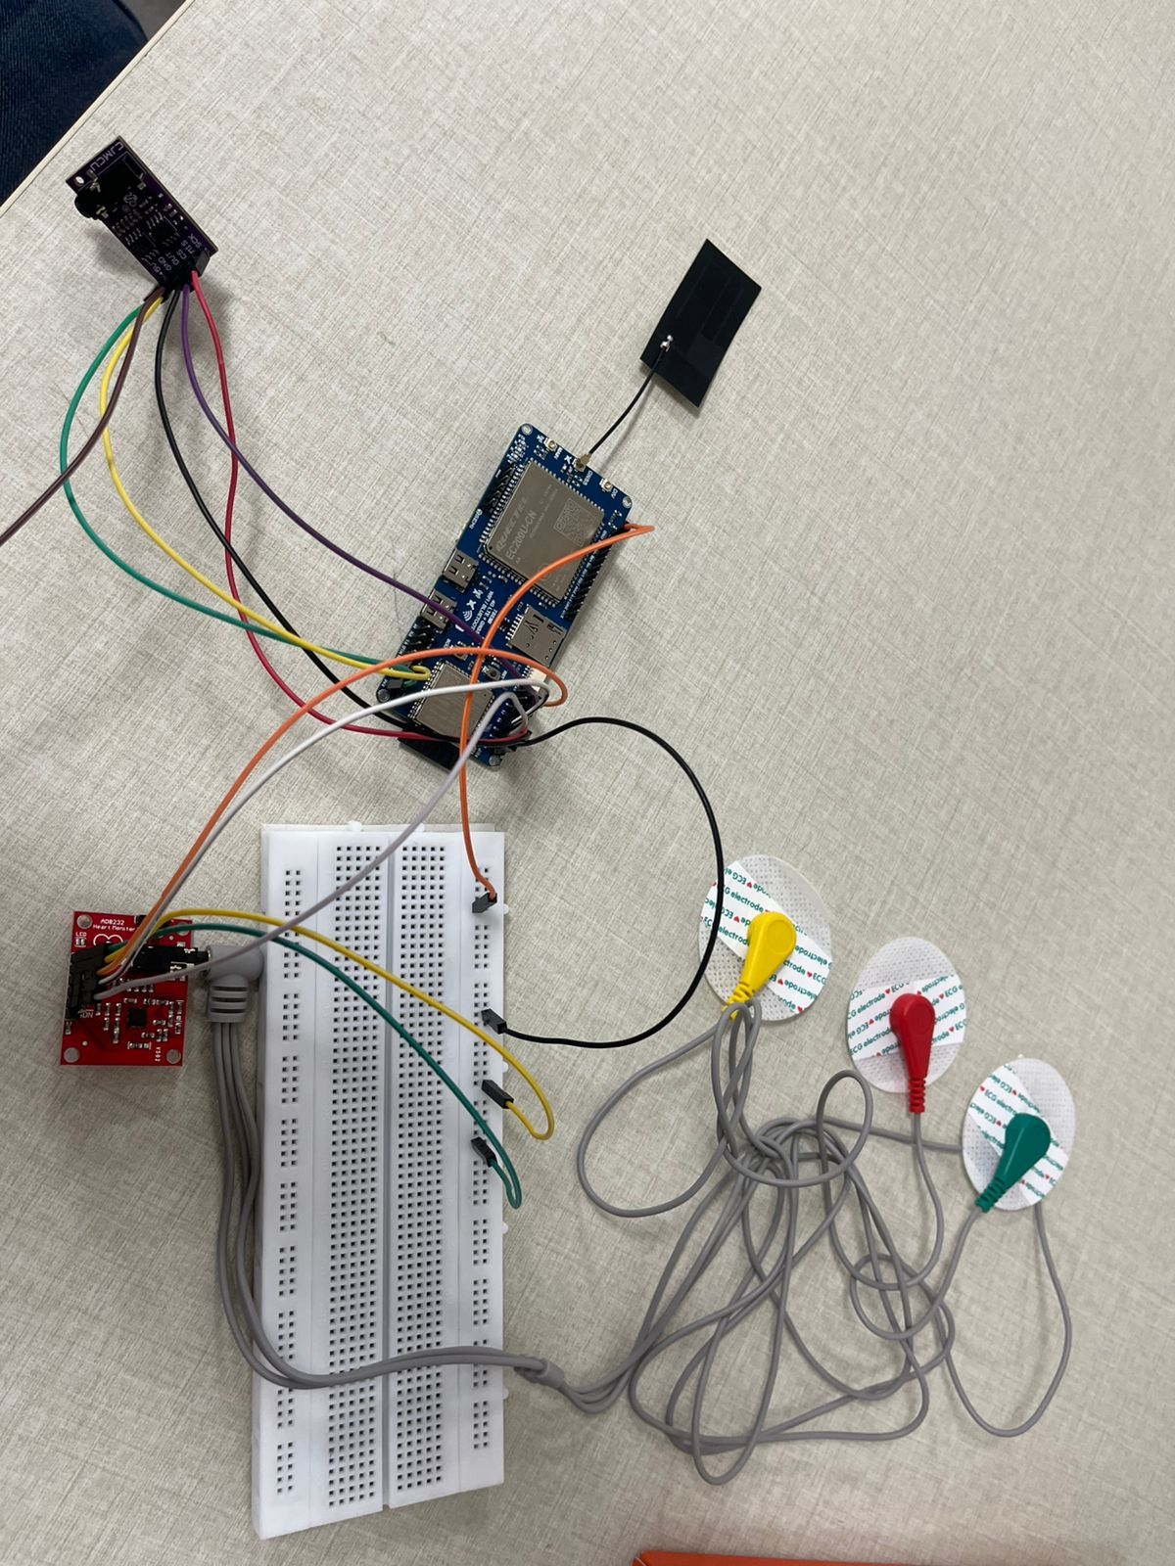

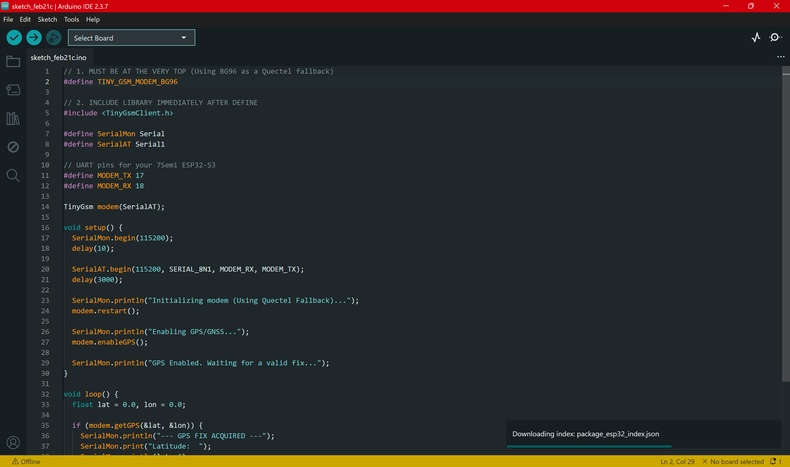
8. Work Done Till Date
Core Sensor Integration
ECG (AD8232): Bio-potential capture & heart rate validation
GSR: Baseline Electrodermal Activity established
Real-time signal visualization & stable data transmission achieved
System Expansion (Procured)
CD74HC4067 MUX: Scalable 16+ sensor architecture
AMG8833 : Infrared Array Sensor : Non-contact thermal fever screening
Piezo Sensors: Digital stethoscope (heart & lung sound capture)
Next Phase
Dataset development for TinyML
Mathematical modelling of multi-sensor fusion
Edge-AI health inference logic

Slide 10
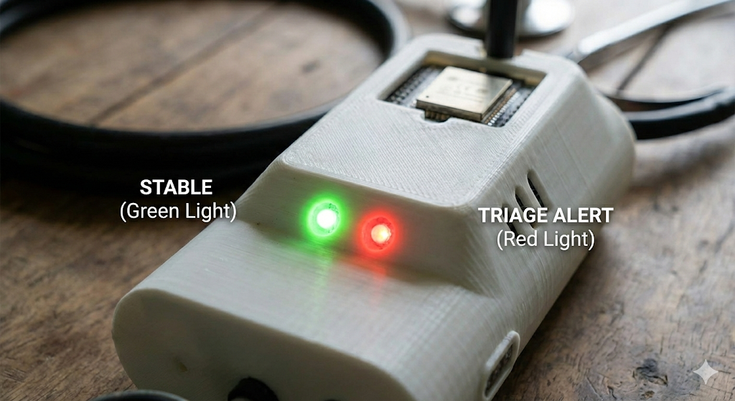
9. Expected Outcome
● Cost Efficiency: A diagnostic device built for ~₹10,000, significantly cheaper than the >₹2,20,000 industry standard.
● Usability: A "Zero-Literacy Interface" using Red/Green LEDs to indicate patient status, removing the burden of complex interpretation.
● Functional Prototype: A field-ready device capable of non-invasive cardiac, respiratory, and metabolic screening with 4G cloud connectivity

Slide 11
9. Conclusion
Synthesis of Tech: The project successfully synthesises TinyML, piezoelectric sensing, and spectral analysis into a single wearable "sleeve".
● Impact: It empowers ASHA workers with objective, multi-modal data, enabling instant triage and reducing referral latency.
● Shift in Care: Smart-ASHA shifts rural healthcare from reactive symptom management to proactive, data-driven disease mapping.

Slide 12
10. References
Rocha et al., "Open Access Database for Respiratory Sound Classification Algorithms," Physiological Measurement, 2019.
Arjoune et al., "Technical Characterization of Digital Stethoscopes," IEEE Access, 2023.
Dutta and Bharali, "TinyML-Based Edge Computing for IoT Healthcare Applications," IEEE Access, 2021.
Warden and Situnayake, TinyML: Machine Learning with TensorFlow Lite..., O'Reilly Media, 2019.
Majumder et al., "Wearable Sensors for Remote Health Monitoring," Sensors, 2017.
Sarkar et al., "Non-invasive Hemoglobin Estimation...," Biomedical Signal Processing and Control, 2021.
Sun et al., "Simultaneous piezoelectric noninvasive detection...," Scientific Reports, 2020.

