Slide 1
Cloud Computing: Overview

Slide 2
This lecture
What is cloud computing?
What are its essential characteristics?
Why cloud computing?
Classification/service models
Deployment models
Challenges/state-of-the-art
What it means for software-defined clouds

Slide 3
NIST Definition
A model for enabling ubiquitous, convenient, on-demand network access to a shared pool of configurable computing resources (e.g., networks, servers, storage, applications, and services) that can be rapidly provisioned and released with minimal management effort or service provider interaction.

Slide 4
Essential characteristics
On-demand self-service: unilaterally provision computing capabilities, such as server time and network storage; do so automatically – no human interaction with service provider.
Broad network access. Capabilities are available over the network; heterogeneous thin or thick client platforms.
Resource pooling. Storage, processing, memory, and network bandwidth, are pooled to serve multiple consumers using a multi-tenant model
different physical and virtual resources dynamically assigned and reassigned according to demand.
Customer generally has no control/knowledge over the exact location of the resources

Slide 5
Essential Characteristics
Rapid elasticity. Capabilities can be elastically provisioned and released, in some cases automatically, to scale rapidly outward and inward commensurate with demand.
Illusion of infinite resources, available on-demand
Measured service. Automatic control and optimization of resource use by leveraging a metering capability
at some level of abstraction appropriate to the type of service (e.g., storage, processing, bandwidth, and active user accounts).
Resource usage can be monitored, controlled, and reported, providing transparency for both the provider and consumer of the utilized service.

Slide 6
Example: EC2
Amazon Elastic Compute Cloud (EC2)
“Compute unit” rental: $0.10-0.80/hr.
1 CU ≈ 1.0-1.2 GHz 2007 AMD Opteron/Xeon core
N
No up-front cost, no contract, no minimum
Billing rounded to nearest hour; pay-as-you-go storage also available
“Instances” | Platform | Cores | Memory | Disk
Small - $0.10 / hr | 32-bit | 1 | 1.7 GB | 160 GB
Large - $0.40 / hr | 64-bit | 4 | 7.5 GB | 850 GB – 2 spindles
XLarge - $0.80 / hr | 64-bit | 8 | 15.0 GB | 1690 GB – 3 spindles
6

Slide 7
Why Now (not then)?
Old idea: Software as a Service (SaaS)
Software hosted in the infrastructure vs. installed on local servers or desktops
Build-out of extremely large datacenters (1,000’s to 10,000’s of commodity computers)
Economy of scale: 5-7x cheaper than provisioning a medium-sized (100’s machines) facility
Build-out driven by demand growth (more users)
Infrastructure software: eg Google FileSystem
Operational expertise: failover, DDoS, firewalls...
Other factors
More pervasive broadband Internet
x86 as universal ISA, fast virtualization
Standard software stack, largely open source (LAMP)

Slide 8
Cloud Economics 101
Static provisioning for peak: wasteful, but necessary for SLA
Capacity
Resources
Resources
Demand
Capacity
Demand
Time
Time
“Statically provisioned” data center
“Virtual” data center in the cloud
Unused resources

Slide 9
Risk of underutilization
Underutilization results if “peak” predictions are too optimistic
Capacity
Unused resources
Resources
Demand
Time
Static data center

Slide 10




Risks of underprovisioning
Resources
Capacity
Demand
Resources
Capacity
1
2
3
Time (days)
Demand
Lost revenue
1
2
3
Time (days)
Resources
Capacity
Demand
1
2
3
Time (days)
Lost users

Slide 11
Killer apps?

Slide 12
New Scenarios Enabled by “Risk Transfer”
“Cost associativity”: 1,000 computers for 1 hour same price as 1 computer for 1,000 hours
Washington Post converted Hillary Clinton’s travel documents to post on WWW <1 day after released
Major enabler for SaaS startups
Animoto traffic doubled every 12 hours for 3 days when released as Facebook plug-in
Scaled from 50 to >3500 servers
...then scaled back down

Slide 13
Classifying Clouds
Instruction Set VM (Amazon EC2, 3Tera)
Managed runtime VM (Microsoft Azure)
Framework VM (Google AppEngine, Force.com)
Tradeoff: flexibility/portability vs. “built in” functionality
Lower-level,
Less managed
Higher-level,
More managed
EC2
Azure
AppEngine
Force.com

Slide 14
Another popular classification
SaaS: use the provider’s applications running on a cloud infrastructure; little control over apps or infrastructure
PaaS: deploy onto the cloud infrastructure consumer-created or acquired applications created using programming languages, libraries, services, and tools supported by the provider; control over apps, but not infrastructure
IaaS: provision processing, storage, networks, and other fundamental computing resources where the consumer is able to deploy and run arbitrary software, which can include operating systems and applications

Slide 15
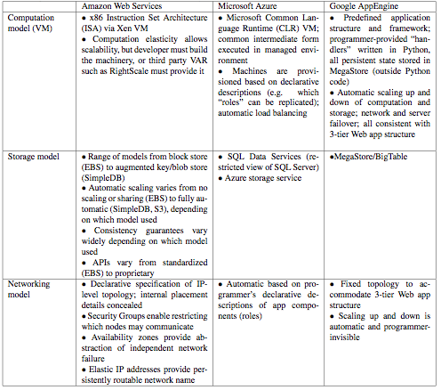

Slide 16
Challenges & Opportunities
Challenges to adoption, growth, & business/policy models
Both technical and nontechnical
Most translate to 1 or more opportunities
Complete list in paper; a few discussed here
Paper also provides worked examples to quantify tradeoffs (“Should I move my service to the cloud?”)

Slide 17
Adoption Challenges
Challenge | Opportunity
Availability / business continuity | Multiple providers & DCs; open APIs (AppScale, Eucalyptus); surge computing
Data lock-in | Standardization; FOSS implementations (HyperTable)
Data Conﬁdentiality and Auditability | Encryption, VLANs, Firewalls; Geographical Data Storage

Slide 18
Growth Challenges
Challenge | Opportunity
Data transfer bottlenecks | FedEx-ing disks, Data Backup/Archival, dedup
Performance unpredictability | Improved VM support, flash memory, scheduling VMs
Scalable structured storage | Major research opportunity; today, non-relational storage
Bugs in large distributed systems | Invent Debugger that relies on Distributed VMs
Scaling quickly | Invent Auto-Scaler that relies on ML; Snapshots

Slide 19
Long Term Implications
Application software:
Cloud & client parts, disconnection tolerance
Infrastructure software:
Resource accounting, VM awareness
Hardware systems:
Containers, energy proportionality

Slide 20
State-of-the-art/Challenges
Networking
Storage

Slide 21
Policy and Business Challenges
Challenge | Opportunity
Reputation Fate Sharing | Offer reputation-guarding services like those for email
Software Licensing | Pay-as-you-go licenses; Bulk licenses
Breaking news (2/11/09): IBM WebSphere™ and other service-delivery software will be available on Amazon AWS with pay-as-you-go pricing

