Slide 1
Dryad and DryadLINQ
Aditya Akella
CS 838: Lecture 6

Slide 2
Distributed Data-Parallel Programming using Dryad
By
Andrew Birrell, Mihai Budiu,
Dennis Fetterly, Michael Isard, Yuan Yu
Microsoft Research Silicon Valley
EuroSys 2007

Slide 3
Dryad goals
General-purpose execution environment for distributed, data-parallel applications
Concentrates on throughput not latency
Assumes private data center
Automatic management of scheduling, distribution, fault tolerance, etc.

Slide 4
A typical data-intensive query (Quick Skim)
var logentries =
from line in logs
where !line.StartsWith("#")
select new LogEntry(line);
var user =
from access in logentries
where access.user.EndsWith(@"\aditya")
select access;
var accesses =
from access in user
group access by access.page into pages
select new UserPageCount("aditya", pages.Key, pages.Count());
var htmAccesses =
from access in accesses
where access.page.EndsWith(".htm")
orderby access.count descending
select access;
Notes:
4

Slide 5
Steps in the query
var logentries =
from line in logs
where !line.StartsWith("#")
select new LogEntry(line);
var user =
from access in logentries
where access.user.EndsWith(@"\aditya")
select access;
var accesses =
from access in user
group access by access.page into pages
select new UserPageCount("aditya", pages.Key, pages.Count());
var htmAccesses =
from access in accesses
where access.page.EndsWith(".htm")
orderby access.count descending
select access;
Go through logs and keep only lines that are not comments. Parse each line into a LogEntry object.
Go through logentries and keep only entries that are accesses by aditya.
Group aditya’s accesses according to what page they correspond to. For each page, count the occurrences.
Sort the pages aditya has accessed according to access frequency.
Notes:
5

Slide 6
Serial execution
var logentries =
from line in logs
where !line.StartsWith("#")
select new LogEntry(line);
var user =
from access in logentries
where access.user.EndsWith(@"\aditya")
select access;
var accesses =
from access in user
group access by access.page into pages
select new UserPageCount("aditya", pages.Key, pages.Count());
var htmAccesses =
from access in accesses
where access.page.EndsWith(".htm")
orderby access.count descending
select access;
For each line in logs, do…
For each entry in logentries, do..
Sort entries in user by page. Then iterate over sorted list, counting the occurrences of each page as you go.
Re-sort entries in access by page frequency.
Notes:
6

Slide 7
Parallel execution
var logentries =
from line in logs
where !line.StartsWith("#")
select new LogEntry(line);
var user =
from access in logentries
where access.user.EndsWith(@"\aditya")
select access;
var accesses =
from access in user
group access by access.page into pages
select new UserPageCount("aditya", pages.Key, pages.Count());
var htmAccesses =
from access in accesses
where access.page.EndsWith(".htm")
orderby access.count descending
select access;
Notes:
7

Slide 8
How does Dryad fit in?
Many programs can be represented as a distributed execution graph
The programmer may not have to know this
“SQL-like” queries: LINQ
Dryad will run them for you

Slide 9
Runtime
V
V
V
Services
Name server
Daemon
Job Manager
Centralized coordinating process
User application to construct graph
Linked with Dryad libraries for scheduling vertices
Vertex executable
Dryad libraries to communicate with JM
User application sees channels in/out
Arbitrary application code, can use local FS
Notes:
Let us move back to discussing the graph execution.
The Job Manager (JM) handles the scheduling of all the processes in the vertices of the graph.
It does this using a topological sort of the graph.
When nodes in the graph fail execution, parts of the subgraph may need to be re-executed, because the inputs that are needed may no longer be available. The vertices that had generated these inputs may have to be re-run. The JM will attempt to re-execute a minimal part of the graph to recompute the missing data.
On executing a vertex, the JM must choose a machine

Slide 10
Job = Directed Acyclic Graph
Outputs
Processing
vertices
Channels
(file, pipe,
shared
memory)
Inputs
Notes:
A dryad application is composed of a collection of processing vertices (processes).
The vertices communicate with each other through channels.
The vertices and channels should always compose into a directed acyclic graph.

Slide 11
What’s wrong with MapReduce?
Literally Map then Reduce and that’s it…
Reducers write to replicated storage
Complex jobs pipeline multiple stages
No fault tolerance between stages
Map assumes its data is always available: simple!
Output of Reduce: 2 network copies, 3 disks
In Dryad this collapses inside a single process
Big jobs can be more efficient with Dryad

Slide 12
What’s wrong with Map+Reduce?
Join combines inputs of different types
“Split” produces outputs of different types
Parse a document, output text and references
Can be done with Map+Reduce
Ugly to program
Hard to avoid performance penalty
Some merge joins very expensive
Need to materialize entire cross product to disk

Slide 13
How about Map+Reduce+Join+…?
“Uniform” stages aren’t really uniform

Slide 14
How about Map+Reduce+Join+…?
“Uniform” stages aren’t really uniform

Slide 15
Graph complexity composes
Non-trees common
E.g. data-dependent re-partitioning
Combine this with merge trees etc.
Distribute to equal-sized ranges
Sample to estimate histogram
Randomly partitioned inputs

Slide 16
Scheduler state machine
Scheduling is independent of semantics
Vertex can run anywhere once all its inputs are ready
Constraints/hints place it near its inputs
Fault tolerance
If A fails, run it again
If A’s inputs are gone, run upstream vertices again (recursively)
If A is slow, run another copy elsewhere and use output from whichever finishes first

Slide 17
Dryad DAG architecture
Simplicity depends on generality
Front ends only see graph data-structures
Generic scheduler state machine
Software engineering: clean abstraction
Separates scheduling logic from execution semantics

Slide 18
Some Case Studies (Take a peek offline)
Starts at slide 39…

Slide 19
DryadLINQ A System for General-Purpose Distributed Data-Parallel Computing
By
Yuan Yu, Michael Isard, Dennis Fetterly, Mihai Budiu,
Úlfar Erlingsson, Pradeep Kumar Gunda, Jon Currey
Microsoft Research Silicon Valley
OSDI 2008

Slide 20
Distributed Data-Parallel Computing
Research problem: How to write distributed data-parallel programs for a compute cluster?
The DryadLINQ programming model
Sequential, single machine programming abstraction
Same program runs on single-core, multi-core, or cluster
Familiar programming languages
Familiar development environment

Slide 21
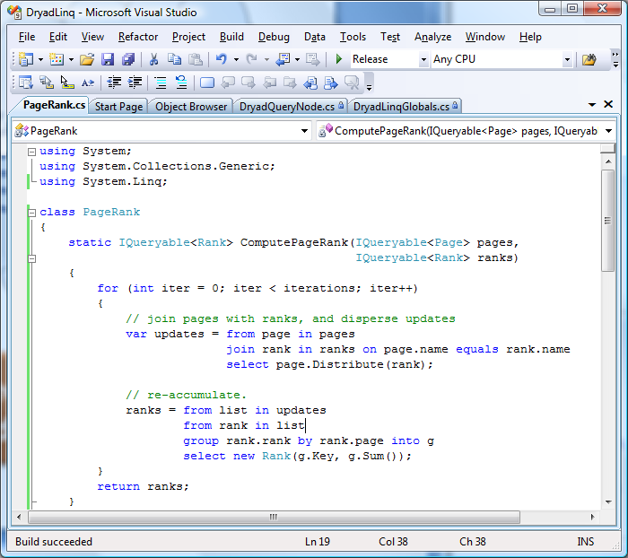
DryadLINQ Overview
Automatic query plan generation by DryadLINQ Automatic distributed execution by Dryad

Slide 22
LINQ
Microsoft’s Language INtegrated Query
Available in Visual Studio products
A set of operators to manipulate datasets in .NET
Support traditional relational operators
Select, Join, GroupBy, Aggregate, etc.
Integrated into .NET programming languages
Programs can call operators
Operators can invoke arbitrary .NET functions
Data model
Data elements are strongly typed .NET objects
Much more expressive than SQL tables
Highly extensible
Add new custom operators
Add new execution providers

Slide 23
LINQ System Architecture
Local machine
Execution engines
Scalability
.Net program
(C#, VB, F#, etc)
DryadLINQ
Cluster
Query
PLINQ
LINQ provider interface
Multi-core
LINQ-to-SQL
Objects
LINQ-to-Obj
Single-core

Slide 24

Recall: Dryad Architecture
data plane
Files, TCP, FIFO, Network
job schedule
V
V
V
NS
PD
PD
PD
control plane
Job manager
cluster

Slide 25
A Simple LINQ Example: Word Count
Count word frequency in a set of documents:
var docs = [A collection of documents];
var words = docs.SelectMany(doc => doc.words);
var groups = words.GroupBy(word => word);
var counts = groups.Select(g => new WordCount(g.Key, g.Count()));

Slide 26
Word Count in DryadLINQ
Count word frequency in a set of documents:
var docs = DryadLinq.GetTable<Doc>(“file://docs.txt”);
var words = docs.SelectMany(doc => doc.words);
var groups = words.GroupBy(word => word);
var counts = groups.Select(g => new WordCount(g.Key, g.Count()));
counts.ToDryadTable(“counts.txt”);

Slide 27
Distributed Execution of Word Count
LINQ expression
Dryad execution
IN
SM
DryadLINQ
GB
S
OUT

Slide 28
DryadLINQ System Architecture
Client machine
.NET program
DryadLINQ
Data center
Distributed query plan
Query Expr
Invoke
Query
Vertex code
Input Tables
ToTable
JM
Dryad Execution
.Net Objects
Output DryadTable
Results
foreach
(11)
Output Tables

Slide 29
DryadLINQ Internals
Distributed execution plan
Static optimizations: pipelining, eager aggregation, etc.
Dynamic optimizations: data-dependent partitioning, dynamic aggregation, etc.
Automatic code generation
Vertex code that runs on vertices
Channel serialization code
Callback code for runtime optimizations
Automatically distributed to cluster machines
Separate LINQ query from its local context
Distribute referenced objects to cluster machines
Distribute application DLLs to cluster machines

Slide 30
Execution Plan for Word Count
SM
SelectMany
Q
sort
SM
pipelined
GB
groupby
GB
C
count
(1)
S
D
distribute
MS
mergesort
GB
groupby
pipelined
Sum
Sum

Slide 31
Execution Plan for Word Count
SM
SM
SM
SM
Q
Q
Q
Q
SM
GB
GB
GB
GB
GB
C
C
C
C
(1)
(2)
S
D
D
D
D
MS
MS
MS
MS
GB
GB
GB
GB
Sum
Sum
Sum
Sum

Slide 32
MapReduce in DryadLINQ
MapReduce(source, // sequence of Ts
mapper, // T -> Ms
keySelector, // M -> K
reducer) // (K, Ms) -> Rs
{
var map = source.SelectMany(mapper);
var group = map.GroupBy(keySelector);
var result = group.SelectMany(reducer);
return result; // sequence of Rs
}

Slide 33
Map-Reduce Plan (When reduce is combiner-enabled)
M
M
M
map
Q
Q
Q
sort
G₁
G₁
G₁
groupby
map
C
C
C
combine
D
D
D
distribute
MS
MS
mergesort
Dynamic aggregation
G₂
G₂
groupby
R
R
reduce
MS
MS
mergesort
G₂
G₂
groupby
reduce
R
R
reduce

Slide 34
PageRank: A more complex example (Take a peek offline)
Starts at slide 56…

Slide 35
LINQ System Architecture
Local machine
Execution engines
Scalability
.Net program
(C#, VB, F#, etc)
DryadLINQ
Cluster
Query
PLINQ
LINQ provider interface
Multi-core
LINQ-to-SQL
Objects
LINQ-to-Obj
Single-core

Slide 36
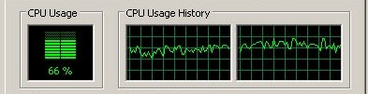



Combining with PLINQ
Query
DryadLINQ
subquery
PLINQ

Slide 37

Combining with LINQ-to-SQL
Query
DryadLINQ
Subquery
Subquery
Subquery
Subquery
Subquery
LINQ-to-SQL
LINQ-to-SQL

Slide 38
Software Stack
Machine Learning
Image
Processing
Graph
Analysis
…
Data Mining
Applications
Other Applications
DryadLINQ
Other Languages
Dryad
CIFS/NTFS
SQL Servers
Azure Platform
Cosmos DFS
Cluster Services
Windows Server
Windows Server
Windows Server
Windows Server

Slide 39
Future Directions
Goal: Use a cluster as if it is a single computer
Dryad/DryadLINQ represent a modest step
On-going research
What can we write with DryadLINQ?
Where and how to generalize the programming model?
Performance, usability, etc.
How to debug/profile/analyze DryadLINQ apps?
Job scheduling
How to schedule/execute N concurrent jobs?
Caching and incremental computation
How to reuse previously computed results?
Static program checking
A very compelling case for program analysis?
Better catch bugs statically than fighting them in the cloud?

Slide 40
Dryad Case Studies

Slide 41
SkyServer DB Query
3-way join to find gravitational lens effect
Table U: (objId, color) 11.8GB
Table N: (objId, neighborId) 41.8GB
Find neighboring stars with similar colors:
Join U+N to find
T = U.color,N.neighborId where U.objId = N.objId
Join U+T to find
U.objId where U.objId = T.neighborID
and U.color ≈ T.color

Slide 42
SkyServer DB query
H
Took SQL plan
Manually coded in Dryad
Manually partitioned data
[distinct]
[merge outputs]
(u.color,n.neighborobjid)
[re-partition by n.neighborobjid]
[order by n.neighborobjid]
Y
n
Y
select
u.color,n.neighborobjid
from u join n
where
u.objid = n.objid
U
U
select
u.objid
from u join <temp>
where
u.objid = <temp>.neighborobjid and
|u.color - <temp>.color| < d
S
4n
S
u: objid, color
n: objid, neighborobjid
[partition by objid]
M
4n
M
D
n
D
X
n
X
U
N
U
N

Slide 43
Optimization
H
Y
U
Y
n
Y
S
S
S
S
U
U
M
4n
S
S
M
M
4n
M
M
M
D
n
D
D
X
n
X
X
U
N
U
N
U
N

Slide 44
Optimization
H
Y
U
Y
n
Y
S
S
S
S
U
U
M
4n
S
S
M
M
4n
M
M
M
D
n
D
D
X
n
X
X
U
N
U
N
U
N

Slide 45
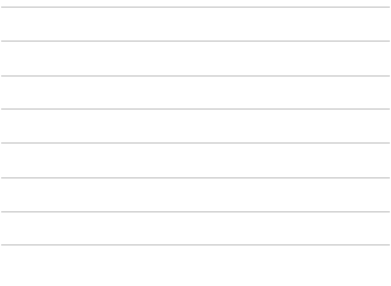
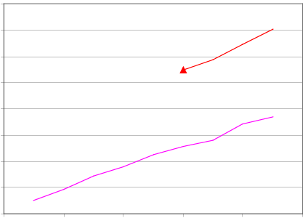
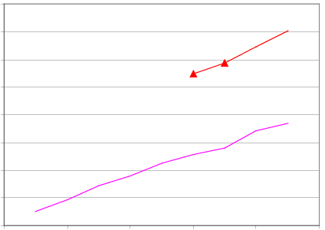
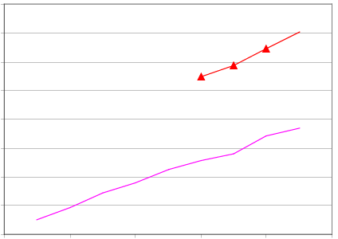
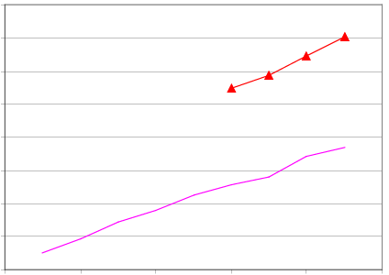
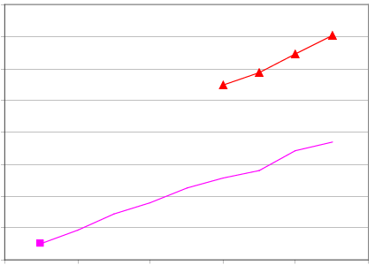
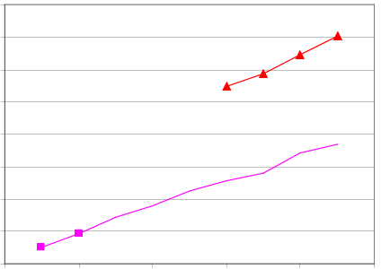
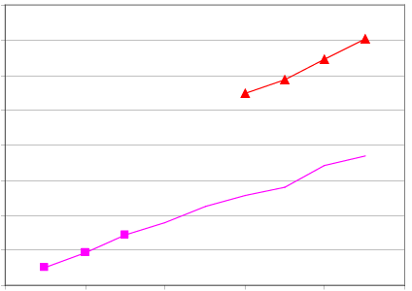
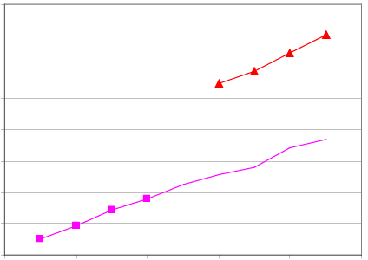
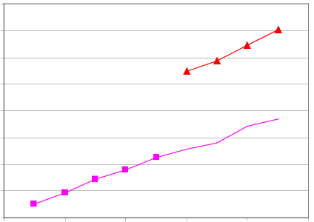
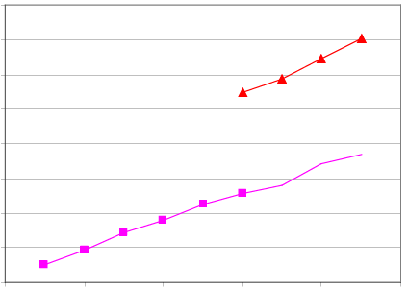
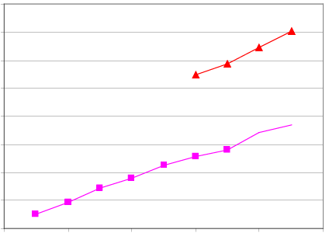
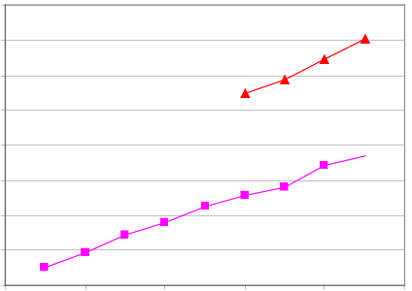
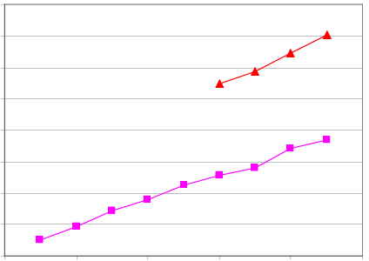
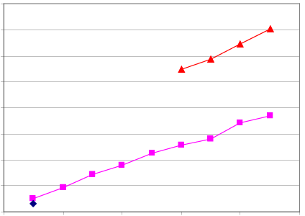



16.0
Dryad In-Memory
14.0
Dryad Two-pass
12.0
SQLServer 2005
10.0
Speed-up
8.0
6.0
4.0
2.0
0.0
0
2
4
6
8
10
Number of Computers

Slide 46
Query histogram computation
Input: log file (n partitions)
Extract queries from log partitions
Re-partition by hash of query (k buckets)
Compute histogram within each bucket

Slide 47
Naïve histogram topology
P parse lines
D hash distribute
S quicksort
C count occurrences
MS merge sort
Each
Q
is
:
k
C
C
Each
R
k
R
R
S
k
S
is
:
n
D
C
Q
Q
n
P
MS

Slide 48
Efficient histogram topology
P parse lines
D hash distribute
S quicksort
C count occurrences
MS merge sort
M non-deterministic merge
k
Each
Q'
is
:
Each
T
R
k
R
C
Each
is
:
R
T
S
is
:
D
P
C
C
Q'
n
M
MS
MS

Slide 49
MS►C
R
R
R
MS►C►D
T
M►P►S►C
Q’
P parse lines D hash distribute
S quicksort MS merge sort
C count occurrences M non-deterministic merge

Slide 50
MS►C
R
R
R
MS►C►D
T
M►P►S►C
Q’
Q’
Q’
Q’
P parse lines D hash distribute
S quicksort MS merge sort
C count occurrences M non-deterministic merge

Slide 51
MS►C
R
R
R
MS►C►D
T
T
M►P►S►C
Q’
Q’
Q’
Q’
P parse lines D hash distribute
S quicksort MS merge sort
C count occurrences M non-deterministic merge

Slide 52
MS►C
R
R
R
MS►C►D
T
T
M►P►S►C
Q’
Q’
Q’
Q’
P parse lines D hash distribute
S quicksort MS merge sort
C count occurrences M non-deterministic merge

Slide 53
MS►C
R
R
R
MS►C►D
T
T
M►P►S►C
Q’
Q’
Q’
Q’
P parse lines D hash distribute
S quicksort MS merge sort
C count occurrences M non-deterministic merge

Slide 54
MS►C
R
R
R
MS►C►D
T
T
M►P►S►C
Q’
Q’
Q’
Q’
P parse lines D hash distribute
S quicksort MS merge sort
C count occurrences M non-deterministic merge

Slide 55
Final histogram refinement
450
33.4 GB
1,800 computers
43,171 vertices
11,072 processes
11.5 minutes
R
450
R
118 GB
T
217
T
154 GB
Q'
10,405
Q'
99,713
10.2
TB

Slide 56
Optimizing Dryad applications
General-purpose refinement rules
Processes formed from subgraphs
Re-arrange computations, change I/O type
Application code not modified
System at liberty to make optimization choices
High-level front ends hide this from user
SQL query planner, etc.

Slide 57
DryadLINQ: PageRank example

Slide 58
An Example: PageRank
Ranks web pages by propagating scores along hyperlink structure
Each iteration as an SQL query:
Join edges with ranks
Distribute ranks on edges
GroupBy edge destination
Aggregate into ranks
Repeat

Slide 59
One PageRank Step in DryadLINQ
// one step of pagerank: dispersing and re-accumulating rank
public static IQueryable<Rank> PRStep(IQueryable<Page> pages,
IQueryable<Rank> ranks)
{
// join pages with ranks, and disperse updates
var updates = from page in pages
join rank in ranks on page.name equals rank.name
select page.Disperse(rank);
// re-accumulate.
return from list in updates
from rank in list
group rank.rank by rank.name into g
select new Rank(g.Key, g.Sum());
}

Slide 60
The Complete PageRank Program
public static IQueryable<Rank> PRStep(IQueryable<Page> pages,
IQueryable<Rank> ranks) {
// join pages with ranks, and disperse updates
var updates = from page in pages
join rank in ranks on page.name equals rank.name
select page.Disperse(rank);
// re-accumulate.
return from list in updates
from rank in list
group rank.rank by rank.name into g
select new Rank(g.Key, g.Sum());
}
public struct Page {
public UInt64 name;
public Int64 degree;
public UInt64[] links;
public Page(UInt64 n, Int64 d, UInt64[] l) {
name = n; degree = d; links = l; }
public Rank[] Disperse(Rank rank) {
Rank[] ranks = new Rank[links.Length];
double score = rank.rank / this.degree;
for (int i = 0; i < ranks.Length; i++) {
ranks[i] = new Rank(this.links[i], score);
}
return ranks;
}
}
public struct Rank {
public UInt64 name;
public double rank;
public Rank(UInt64 n, double r) {
name = n; rank = r; }
}
var pages = DryadLinq.GetTable<Page>(“file://pages.txt”);
var ranks = pages.Select(page => new Rank(page.name, 1.0));
// repeat the iterative computation several times
for (int iter = 0; iter < iterations; iter++) {
ranks = PRStep(pages, ranks);
}
ranks.ToDryadTable<Rank>(“outputranks.txt”);

Slide 61
One Iteration PageRank
…
J
J
J
Join pages and ranks
S
S
S
Disperse page’s rank
G
G
G
Group rank by page
C
C
C
Accumulate ranks, partially
D
D
D
Hash distribute
Dynamic aggregation
…
M
M
M
Merge the data
G
G
G
Group rank by page
R
R
R
Accumulate ranks

Slide 62
Multi-Iteration PageRank
pages
ranks
Iteration 1
Iteration 2
Memory FIFO
Iteration 3

