Slide 1
FlumeJava Easy, Efficient Data-Parallel Pipelines
Google @PLDI’10
Mosharaf Chowdhury

Slide 2
Problem
Efficient data-parallel pipelines
Chain of MapReduce programs
Iterative jobs
…
Exposes a limited set of parallel operations on immutable parallel collections

Slide 3
Goals
Expressiveness
Abstractions
Data representation
Implementation strategy
Performance
Lazy evaluation
Dynamic optimization
Usability & deployability
Implemented as a Java library
Inspired by the failure of Lumberjack

Slide 4
FlumeJava Workflow
1
Write a Java program using the FlumeJava library
2
3
FlumeJava.run();
Optimize
PCollection<String> words =
lines.parallelDo(new DoFn<String, String>() {
void process(String line, EmitFn<String> emitFn) {
for (String word : splitIntoWords(line)) {
emitFn.emit(word);
}
}
}, collectionOf(strings()));
4
Execute

Slide 5
Core Abstractions
Parallel Collections
Data-parallel Operations
PCollection<T>
PTable<K, V>
Primitives
parallelDo()
groupByKey()
combineValues()
flatten()
Derived operations
count()
join()
top()

Slide 6
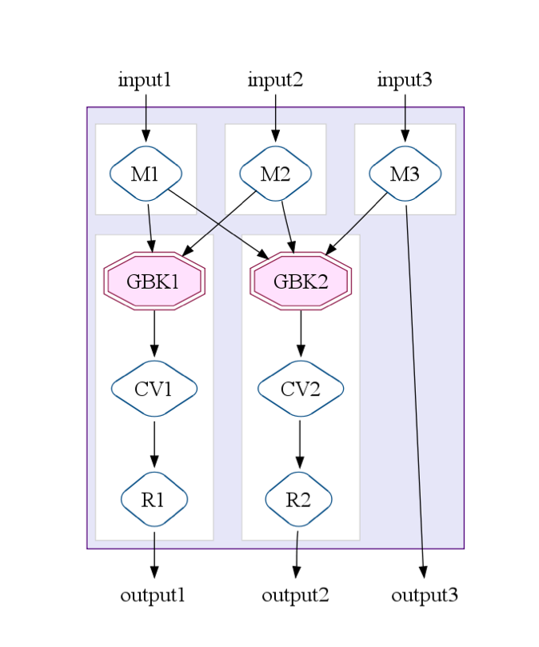
MapShuffleCombineReduce (MSCR)
Transform combinations of the four primitives into single MapReduce
Generalizes MapReduce
Multiple reducers/combiners
Multiple output per reducer
Pass-through outputs

Slide 7
Optimization
Optimizer Strategy
Optimizer Output
Sink flattens
Lift CombineValues
Insert fusion blocks
Fuse parallelDos
Fuse MSCRs
MSCR
Flatten
Operate

Slide 8
Hit or Miss?
Sizable reduction in SLOC
Except for Sawzall
5x reduction in average number of stages
Faster than other approaches
Except for Hand-optimized MapReduce chains
319 users over a year period

