Slide 1
SDN Abstractions
Lecture 20
Aditya Akella

Slide 2
Going beyond defining a virtual network, configuring specific network functions
Application interface
PANE: Participatory networking
Management
HFT: Delegation and conflict resolution
Splendid isolation: Slicing/isolation

Slide 3
Participatory networking and HFT
PANE: user interface for the network control plane
End-users, devices or applications
Key components:
Privilege delegation to reconcile requests and network constraints
A protocol and API to interaction
A suitable control logic

Slide 4
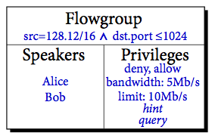
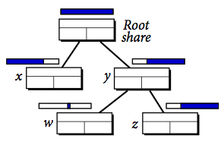
Privilege delegation
Hierarchy of shares
All shares can sub-delegate
Subsets defined on subset of parent’s flow group
May not have more permissive privileges
Which speakers can issue which messages on which flowgroups

Slide 5
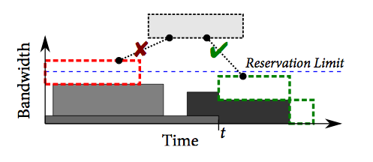
“API”
Requests → allow/deny, reserve, limit
Could be associated with time
“Come back later”
Hints → for traffic prioritization, future traffic patterns
Queries → read network state
Accept a message if
it passes privilege check,
referenced flowgroup is subset of share’s group,
if the request can co-exist with previously accepted requests

Slide 6
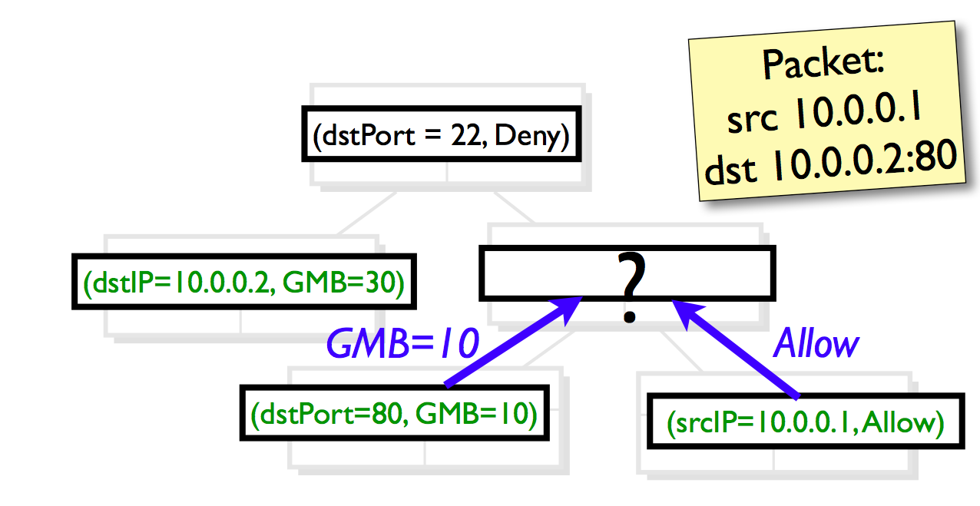
HFT
Hierarchy of privileges → hierarchy of policies

Slide 7
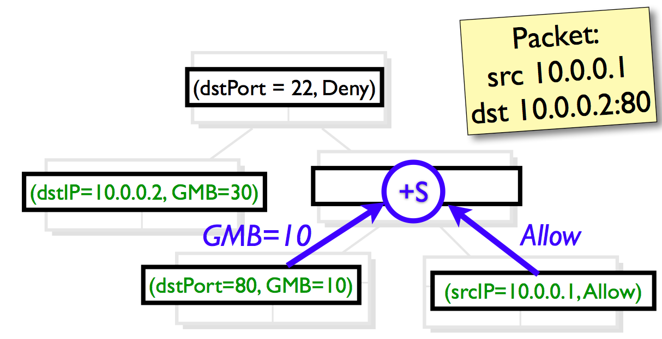
HFT
Conflict resolution operators: node-internal, inter-sibling and parent-child

Slide 8
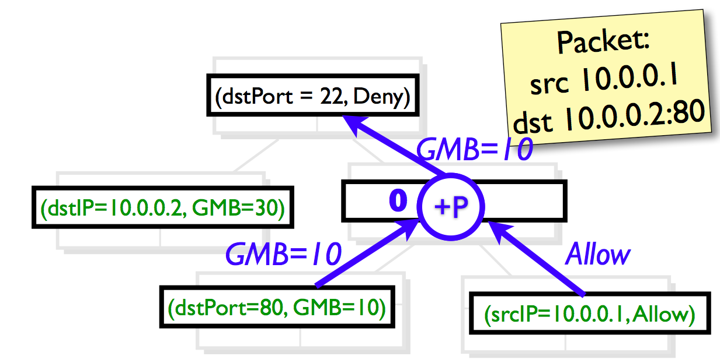
HFT
Conflict resolution operators: node-internal, inter-sibling and parent-child

Slide 9
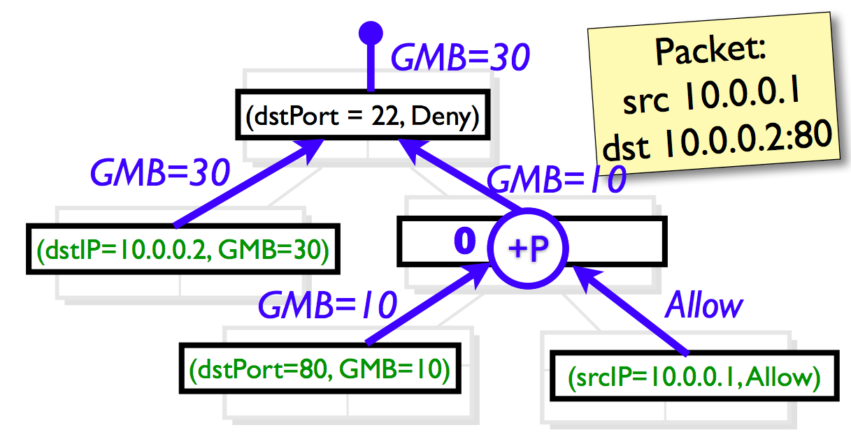
HFT

Slide 10
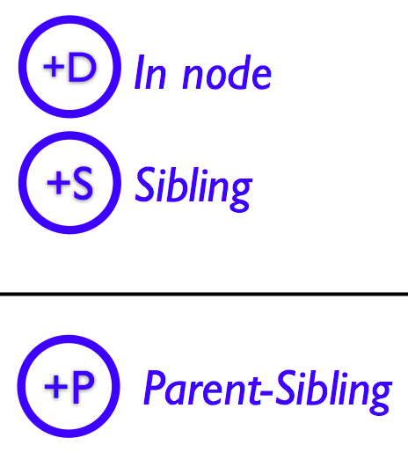
HFT Operators
Only Requirements: Associative, 0-identity
D and S identical.
Deny overrides Allow.
GMB combines as max
Child overrides Parent for Access Control GMB combines as max

Slide 11
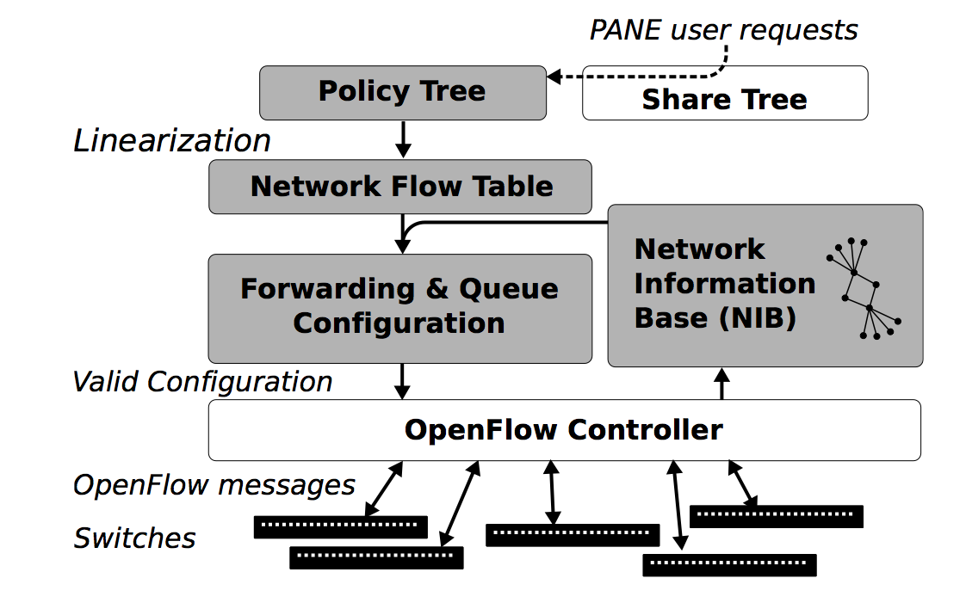
HFT and PANE

Slide 12
Critique of PANE + HFT?

Slide 13
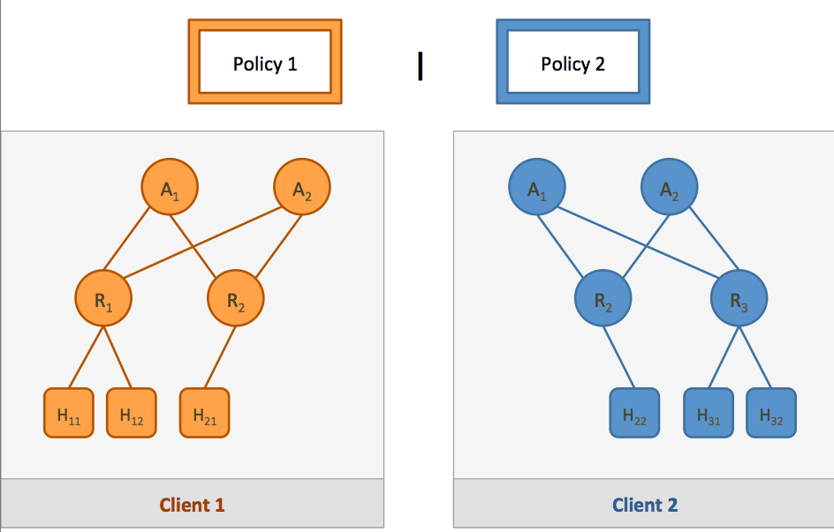
Isolation

Slide 14
Traffic isolation
Physical isolation
Control isolation

Slide 15
Some possibilities
VLANs → obviously bad (why?)
Flowvisor
“Splendid”

Slide 16
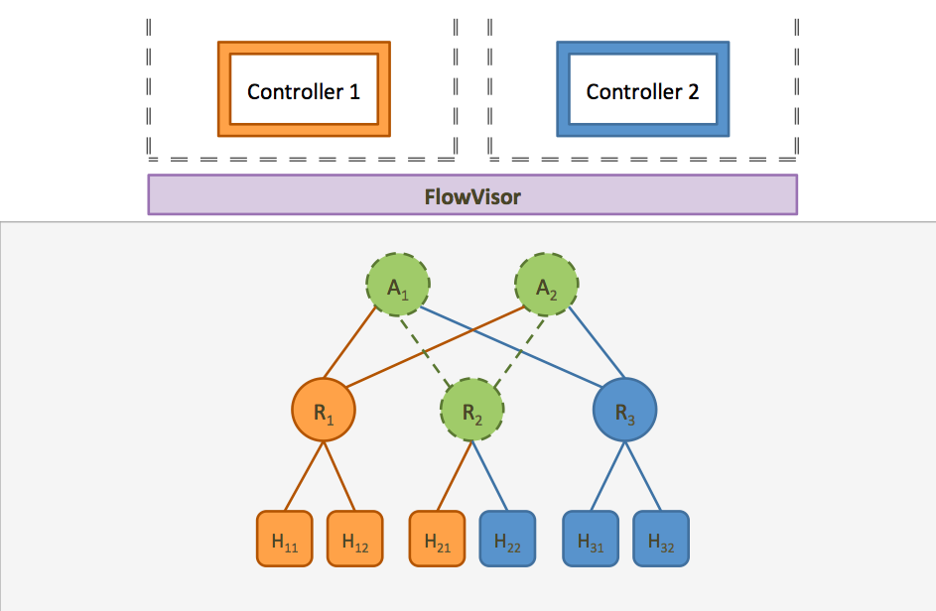
Flowvisor
Intercepts/analyzes/ multiplexes events

Slide 17
Slices in Splendid
Make isolation part of the language.
– For security and modularity.
Give each client a slice of the network which they can assume complete control over, as if they were alone on the network.
Given a set of slices and a policy for each slice, compile them into one whole network program that enforces isolation.

Slide 18
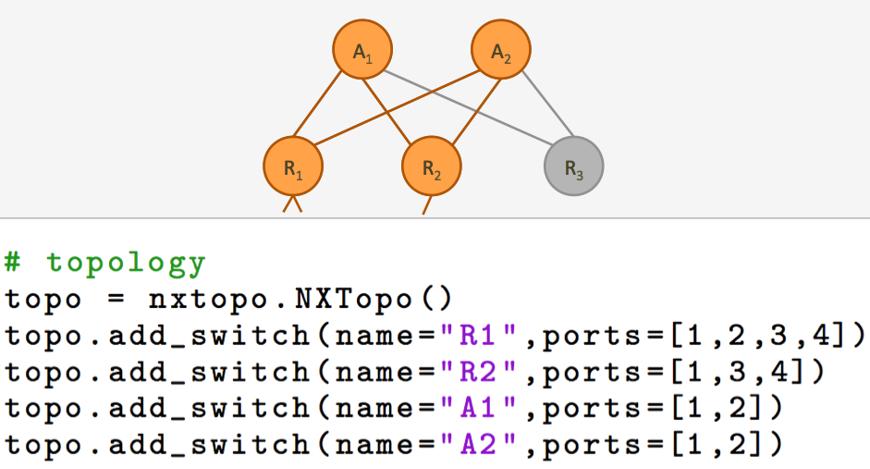
Slices

Slide 19
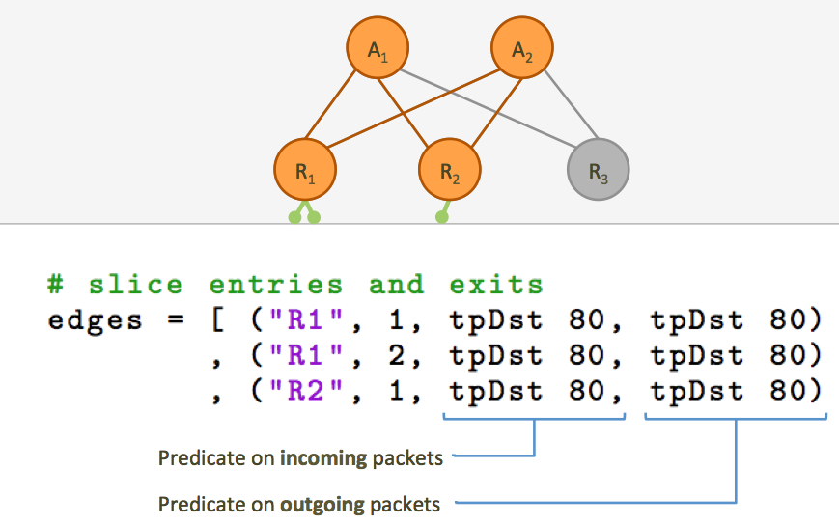
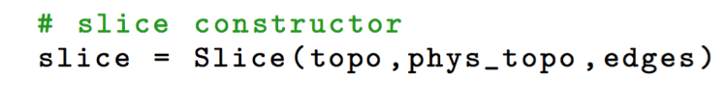
Slices
Outgoing pkts

Slide 20
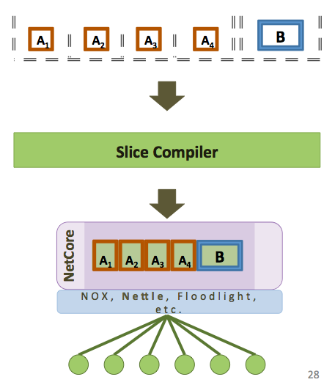
Implementation
Input: a set of slices and policies.
(Must be VLAN-­‐independent.)
Output: a single, global policy that enforces isolation.

Slide 21
Issues with Splendid
Read-only slices.
Consider an admin/billing slice that monitors use. Isolation is too strong
Isolation as the way to “enforce” program modularity?

Slide 22
Flowvisor vs. Splendid
Why is FV better?
Why is Splendid better?

