Slide 1
Cloud Storage
Yizheng Chen

Slide 2
Outline
Cassandra
Megastore
Hadoop/HDFS in Cloud

Slide 3
Overview
Extension of Bigtable with aspects of Dynamo
Motivations:
High Availability
High Write Throughput
Fail Tolerance

Slide 4
Data Model
Table is a multi dimensional map indexed by key (row key).
Columns are grouped into Column Families.
2 Types of Column Families
Simple
Super (nested Column Families)
Each Column has
Name
Value
Timestamp

Slide 5
Data Model
* Figure taken from Eben Hewitt’s (author of Oreilly’s Cassandra book) slides.

Slide 6
System Architecture
Partitioning
How data is partitioned across nodes
Replication
How data is duplicated across nodes

Slide 7
Partitioning
Nodes are logically structured in Ring Topology.
Hashed value of key associated with data partition is used to assign it to a node in the ring.
Hashing rounds off after certain value to support ring structure.
Lightly loaded nodes moves position to alleviate highly loaded nodes.

Slide 8
Replication
Each data item is replicated at N (replication factor) nodes.
Different Replication Policies
Rack Unaware – replicate data at N-1 successive nodes after its coordinator
Rack Aware – uses ‘Zookeeper’ to choose a leader which tells nodes the range they are replicas for
Datacenter Aware – similar to Rack Aware but leader is chosen at Datacenter level instead of Rack level.

Slide 9
Partitioning and Replication
h(key1)
1
0
E
A
N=3
C
h(key2)
F
B
D
1/2
* Figure taken from Avinash Lakshman and Prashant Malik (authors of the paper) slides.
9

Slide 10
Local Persistence
Relies on local file system for data persistency.
Write operations happens in 2 steps
Write to commit log in local disk of the node
Update in-memory data structure.
Read operation
Looks up in-memory ds first before looking up files on disk.
Uses Bloom Filter (summarization of keys in file store in memory) to avoid looking up files that do not contain the key.

Slide 11
Read Operation
Client
Query
Result
Cassandra Cluster
Read repair if digests differ
Closest replica
Result
Replica A
Digest Query
Digest Response
Digest Response
Replica B
Replica C
* Figure taken from Avinash Lakshman and Prashant Malik (authors of the paper) slides.

Slide 12
Outline
Cassandra
Megastore
Hadoop/HDFS in Cloud

Slide 13
Motivation
online services should be highly scalable (millions of users)
responsive to users
highly available
provide a consistent view of data (update should be visible immediately and durable)
it is challenging for the underlying storage system to meet all these potential conflicting requirements

Slide 14
Motivation
Existing solutions not sufficient
NoSQL vs. RDBMS

Slide 15
NoSQL vs. RDBMS
NoSQL (Bigtable, HBase, Cassandra)
Merits:
+ Highly scalable
Limitations:
‐ Less features to build applications (transaction at the granularity of single key, poor schema support
and query capability, limited API (put/get))
‐ Loose consistency models with asynchronous replication (eventual consistency)

Slide 16
NoSQL vs. RDBMS
RDBMS (mysql)
Merits:
+ Mature, rich data management features, easy to build applications
+ Synchronous replication comes with strong transactional semantics
Limitations:
‐ Hard to scale
‐ Synchronous replication may have performance and scalability issues
- may not have fault‐tolerant replication mechanisms

Slide 17
Contribution
Megastore combines the merits from both NoSQL and RDBMS
it is both scalable and highly available,
allows fast development and provides enhanced replication consistency
A Paxos‐based wide‐area synchronous replication method for primary user data on every write across datacenters to meet scalability and performance requirements

Slide 18
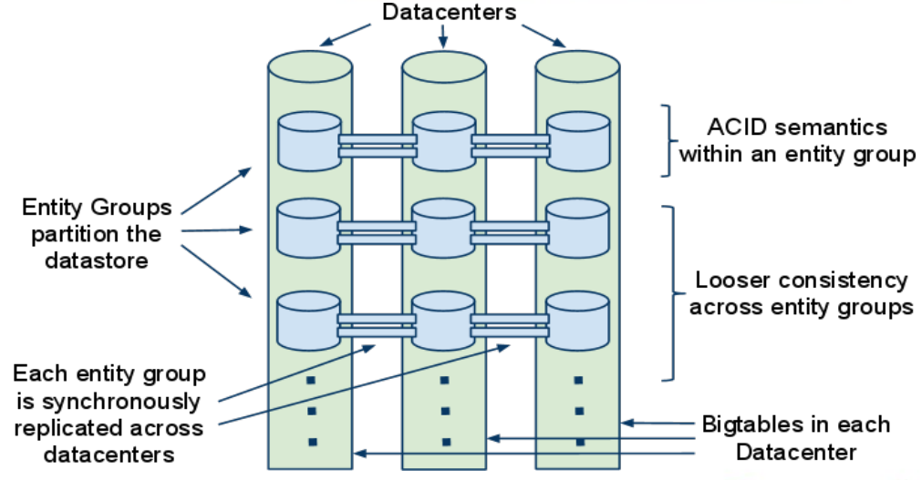
Scale Axis vs. Wide Replication Axis
For scalability and throughput, based on the observation that most internet services can be suitably partitioned, Megastore partitions the database into entity groups (small sub‐databases), each with its replicated log stored in per‐replica/per‐datacenter Bigtable.
Notes:
Paxos [3] is a simple protocol that a group of machines in a distributed system can use to agree
on a value proposed by a member of the group.

Slide 19
More Features
adds rich primitives to Bigtable such as ACID transactions, several kinds of indexes and queues under the constraint of tolerable latency and scalability requirements
ease the application development
provides transactional features within an entity group, but only gives limited consistency guarantees across entity groups
Operations across entity groups usually use asynchronous
messaging and rely on two‐phase commits

Slide 20
Consistency
In an entity group which provides serializable ACID semantics, read and write could happen at the same time
leverages the feature of Bigtable – multiple values can be stored in a cell with multiple timestamps
Megastore also provides different kinds of read with different consistency
Current read
Snapshot read
Inconsistent read

Slide 21
Outline
Cassandra
Megastore
Hadoop/HDFS in Cloud

Slide 22
Hadoop in Cloud
Hadoop on a virtualized infrastructure
Benefits:
Datacenter efficiency (server consolidation), Multi-tenancy
multiple application servers consolidated onto one physical server, with little or no decrease in overall performance
Simple to operate
Rapid Provisioning/deployment
Easy clone/move of Cluster (encapsulate an application into an image)
High Availability (HA)
No more single point of failure
Any affected virtual machines are restarted on another host in a VMware cluster
Virtual machines may be moved from server to server with no downtime using
VMware vMotion™
Elastic Scaling
On demand shrink/expand
Resource guarantee
Independent scaling of compute and data

Slide 23
Hadoop in Cloud
Hadoop on a virtualized infrastructure
Concerns:
Data locality for performance: move computation to data
Replica placement for reliability
What’s different in virtualized environment:
Extra redundancy: Windows Azure Blob Storage
VMs on the same physical host are affected by the same hardware failure
The “network” between VMs on the same physical host is better

Slide 24
Hadoop in Cloud
How Hadoop could be running on a virtual platform
Solutions from VMWare:
Hadoop Virtualization Extensions (HVE)
Make Hadoop virtualization-aware
Enhance the support for failure and locality topologies
Serengeti project in CloudFoundry (open source PaaS)
http://serengeti.cloudfoundry.com/
Enable the rapid deployment of an Apache Hadoop cluster (HDFS, MapReduce, Pig, Hive, ..) on a virtual platform
Several options
Add/remove VMs (virtual nodes)
Grow/shrink a VM
Separate compute from data
2012 Hadoop Summit by Richard McDougall, Application Infrastructure CTO/ Big Data Chief Architect at VMWare

Slide 25


Add/remove VMs (virtual nodes)
Other
Workload
Virtual
Hadoop
Node
Virtual
Hadoop
Node
Task Tracker
Task Tracker
Slot
Slot
Slot
Slot
Datanode
Datanode
Virtualization Host
VMDK
VMDK
* Powering off the Hadoop VM
would in effect fail the datanode
* Adding a node would require TBs of
data replication

Slide 26
Grow/shrink a VM
Other
Workload
Virtual
Hadoop
Node
Task Tracker
Add/Remove
Slots
Slot
Slot
Datanode
Virtualization Host
VMDK

Slide 27
Separate compute from data
Virtual
Hadoop
Node
Virtual
Hadoop
Node
Other
Workload
Task Tracker
Virtual
Hadoop
Node
Virtual
Hadoop
Node
Task Tracker
Slot
Task Tracker
Slot
Slot
Slot
Slot
Slot
Virtual
Hadoop
Node
Datanode
Virtualization Host
VMDK
VMDK
Truly Elastic Hadoop:
Scalable through virtual nodes; Enable shared workloads

Slide 28


Dataflow with separated Compute/Data
Virtual
Hadoop
Node
Virtual
Hadoop
Node
NodeManager
Slot
Slot
Datanode
Virtual NIC
Virtual NIC
Virtualization Host
Virtual Switch
VMDK
NIC Drivers

Slide 29



Separate Compute Clusters
Coke
Pepsi
Virtual
Hadoop
Virtual
Hadoop
Queue
Virtual
Hadoop
Virtual
Hadoop
Runtime
Layer
Data Layer
Public
Namespace
Public
Namespace
Namespace
Secret
Distributed File System (HDFS, KFS, GPFS, MAPR, Isilon,…)
Host
Host
Host
Host
Host
Host

Slide 30
Separate Compute Clusters
Separate virtual clusters per tenant
Performance isolation: SLA
Configuration isolation: enable deployment of multiple Hadoop runtime versions
Security isolation: stronger VM-grade security and resource isolation

Slide 31
Thanks

