Slide 1




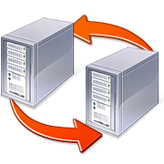
Stratos: Virtual Middleboxes as First-Class Entities
Aaron Gember, Robert Grandl, Aditya Akella
University of Wisconsin-Madison
Ashok Anand Theophilus Benson
Bell Labs – India Princeton University

Slide 2
Importance of Middleboxes
Enterprises rely heavily on middleboxes for security and performance
Wide range of middleboxes
Sherry et al., SIGCOMM 2012
Sherry et al., SIGCOMM 2012

Slide 3



Middleboxes in the Cloud
Deploy applications and middleboxes to clouds
Vendors providing virtual middlebox images
Clouds lack ground-up support for middleboxes
Limited cloud provided middleboxes
Tenants forced to retrofit middleboxes into existing service abstractions
+

Slide 4

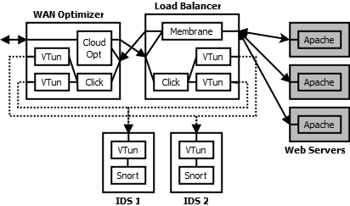
Middleboxes in EC2 Today
Setup in Local Data Center
Setup in Amazon EC2
Several third-party tools and configurations strewn across VMs
Complicated to identify bottlenecks due to middlebox diversity and network effects

Slide 5





Major Challenges
How do we direct traffic through a sequence of middleboxes? (Composition)
How do we identify and eliminate middlebox bottlenecks efficiently? (Scaling)
How do we maximally leverage each middlebox? (Flow distribution & Placement)

Slide 6
Overview of Stratos
Tenants specify chains of middleboxes
Place application and middlebox VMs to minimize inter-rack traffic
Monitor application performance and conduct scaling trials to eliminate bottlenecks
Place new middlebox VMs near existing ones
Distribute traffic between middlebox VMs in a network-aware manner

Slide 7
Two Deployment Models
Over-the-Cloud
Deployed by tenant or third-party
Compatible with today’s clouds
Under-the-Cloud
Deployed by cloud provider
Benefits from increased control

Slide 8
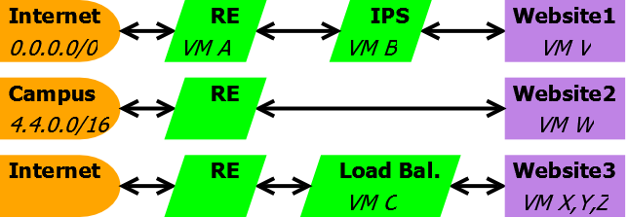
Composition
Logical View
Use abstractions to specify chains with servers, external subnets and middleboxes
Physical View
VMs running middlebox processes, connected via a configurable overlay network

Slide 9
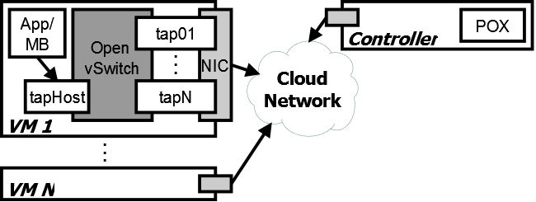
Composition Implementation
Each VM runs Click and Open vSwitch
Outbound packets sent to virtual network (tap) interfaces is encapsulated in an IP/UDP packet
Packets directed to the correct interface based on forwarding rules installed by controller

Slide 10
Scaling
Simple approaches are insufficient/impractical
Scale all middleboxes – wastes resources
Functionality-specific monitoring – requires knowledge of middlebox semantics
Per-packet processing time estimates – not all middleboxes are one-packet-in-one-packet-out
Scale based on CPU/memory load – will not detect bottlenecks due to the network

Slide 11
Greedy Heuristic
Use application-reported performance
Try one middlebox instance at a time, starting with the first middlebox in a chain
Keep and try another if performance improves
Discard and move on if no performance change

Slide 12

Heuristic Extension
Limit set of middleboxes to scale based on overlap between chains
Scale shared middleboxes if both chains have poor application performance, otherwise scale unique middleboxes
Client A
MB W
Server A
MB X
MB Y
Client B
MB Z
Server B

Slide 13
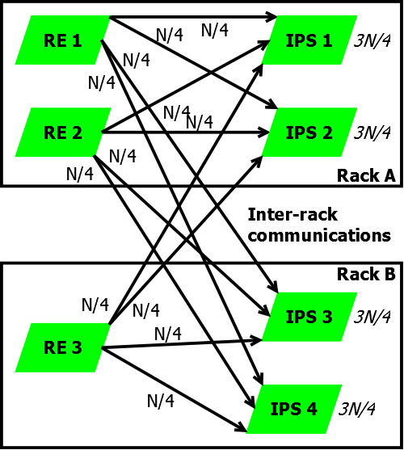
Flow Distribution
Want to use the full capacity of each middlebox instance; do not overload any instance
Simple approach: Divide flows equally among all instances of the next middlebox
Ignores network costs

Slide 14
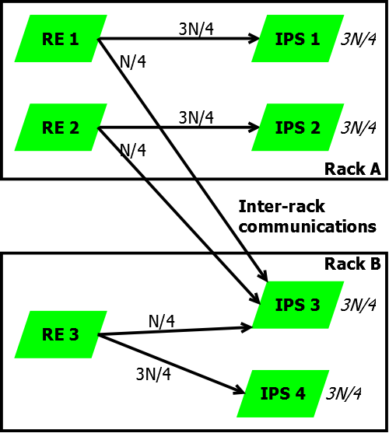
Network-Aware Distribution
Prefer instances of the next middlebox which have better link quality (e.g., in same rack)
Each instance should still get an equal number of flows
Easier with Under-the-Cloud

Slide 15



Placement
Only possible Under-the-Cloud
Initial placement
Divide logical topology into clusters – want fewer clusters and minimal traffic flow between clusters
Assign clusters to racks – choose racks with maximum available bandwidth between them

Slide 16
Placement
New middlebox instance placement
Prefer same racks as input or output VMs
Otherwise, pick rack with maximum available bandwidth to rack(s) with input and output VMs
Assume network-aware flow distribution

Slide 17
Network Traffic Characteristics of Data Centers in the Wild
Theophilus Benson*, Aditya Akella*, David A. Maltz⁺
*University of Wisconsin, Madison
⁺Microsoft Research

Slide 18
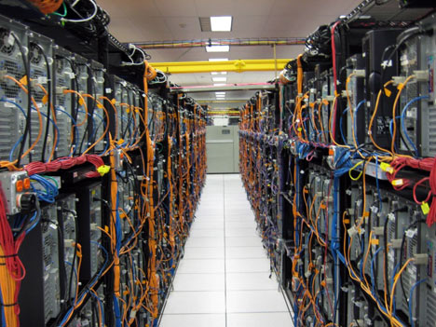

The Case for Understanding Data Center Traffic
Better understanding → better techniques
Better traffic engineering techniques
Avoid data losses
Better Quality of Service techniques
Better control over jitter
Better energy footprint
Energy proportional DCs
Initial stab→ network level traffic + app relationships

Slide 19


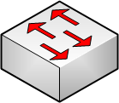




Canonical Data Center Architecture
Core (L3)
Aggregation (L2)
Edge (L2)
Top-of-Rack
Application
servers
Notes:
Rack of application servers
Point out 3 layers (core, gag, edge), show how 2-Tier and 3-Tier are different
Show links captured by SNMP
Show links captured by packet sniffers

Slide 20
Dataset: Data Centers Studied
10 data centers
3 classes
Universities
Private enterprise
Clouds
University: internal use, some Web servers
Enterprise: internal/external
Clouds: Internet-facing apps
CLD4, 5 are MapReduce DCs
DC Role | DC Name | Location | Number Devices
Universities | EDU1 | US-Mid | 22
 | EDU2 | US-Mid | 36
 | EDU3 | US-Mid | 11
Private Enterprise | PRV1 | US-Mid | 97
 | PRV2 | US-West | 100
Commercial Clouds | CLD1 | US-West | 562
 | CLD2 | US-West | 763
 | CLD3 | US-East | 612
 | CLD4 | S. America | 427
 | CLD5 | S. America | 427
Notes:
Data from 10 date centers -- 5 clouds, 3 uni, 2 enterprise
Big data centers used for clouds
Enterprise/uni data located closer to premise of users

Slide 21
Dataset: Collection
SNMP
Poll SNMP MIBs
Bytes-in/bytes-out/discards
> 10 Days
Averaged over 5 mins
Packet traces
Few switches
Cisco port span
12 hours
Topology
Cisco Discovery Protocol
DC Name | SNMP | Packet Traces | Topology
EDU1 | Yes | Yes | Yes
EDU2 | Yes | Yes | Yes
EDU3 | Yes | Yes | Yes
PRV1 | Yes | Yes | Yes
PRV2 | Yes | Yes | Yes
CLD1 | Yes | No | No
CLD2 | Yes | No | No
CLD3 | Yes | No | No
CLD4 | Yes | No | No
CLD5 | Yes | No | No

Slide 22
Canonical Data Center Architecture
Core (L3)
SNMP & Topology
From ALL Links
Aggregation (L2)
Packet
Sniffers
Edge (L2)
Top-of-Rack
Application
servers
Notes:
Rack of application servers
Point out 3 layers (core, gag, edge), show how 2-Tier and 3-Tier are different
Show links captured by SNMP
Show links captured by packet sniffers

Slide 23
Applications
Core (L3)
Aggregation (L2)
Edge (L2)
Top-of-Rack
Application
servers
Notes:
Rack of application servers
Point out 3 layers (core, gag, edge), show how 2-Tier and 3-Tier are different
Show links captured by SNMP
Show links captured by packet sniffers

Slide 24
Applications
Study app diversity, traffic contribution, deployment patterns
BroID tool for app identification
Packet traces for EDU and PRV data centers

Slide 25
Applications
PRV2: authentication services, 3-tier apps, custom apps
Deployment patterns:
Clustering of application components: PRV2_2(3) hosts secured (unsecured) portions of applications
Custom apps spread everywhere; predominantly behind PRV2_4
Notes:
App mix found in the dc impact the results we look at next

Slide 26
Applications
EDU2/3: predominantly file system traffic; EDU1: split between Web apps and others
Notes:
App mix found in the dc impact the results we look at next

Slide 27
Application Communication Patterns
Core (L3)
Aggregation (L2)
Edge (L2)
Top-of-Rack
Application
servers
Notes:
Rack of application servers
Point out 3 layers (core, gag, edge), show how 2-Tier and 3-Tier are different
Show links captured by SNMP
Show links captured by packet sniffers

Slide 28
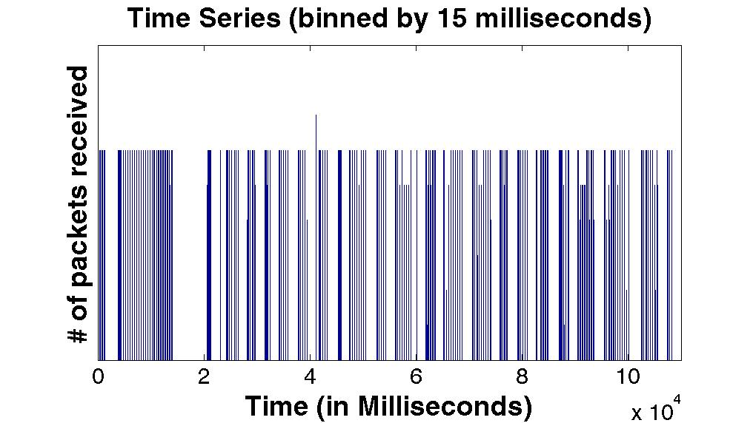
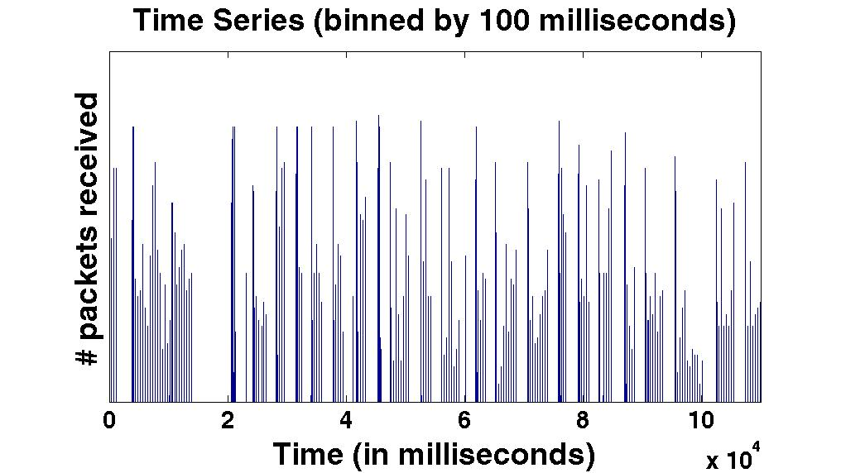
Packet Transmission
Impacts network provisioning, routing/traffic engineering, application design
ON-OFF traffic at edges
Binned in 15 and 100 m. secs; ON-OFF persists across both
Notes:
Important for understanding effective assumptions and types of techniques that can be used

Slide 29
Data-Center Traffic is Bursty
What is the arrival process?
Heavy-tail for the 3 distributions
ON, OFF times, inter-arrival during ON
Different from Pareto of WAN
Impact: need new models
Digging deeper
EDU* switches: dominant apps drive pattern
PRV* switches: aggregate behavior different from dominant app
Data Center | Off Period Dist | ON periods Dist | Inter-arrival Dist
Prv2_1 | Lognormal | Lognormal | Lognormal
Prv2_2 | Lognormal | Lognormal | Lognormal
Prv2_3 | Lognormal | Lognormal | Lognormal
Prv2_4 | Lognormal | Lognormal | Lognormal
EDU1 | Lognormal | Weibull | Weibull
EDU2 | Lognormal | Weibull | Weibull
EDU3 | Lognormal | Weibull | Weibull
Notes:
What are you curvingfitting for log normal parameters or the actual distributions
Not fit == different
We == conventionally

Slide 30
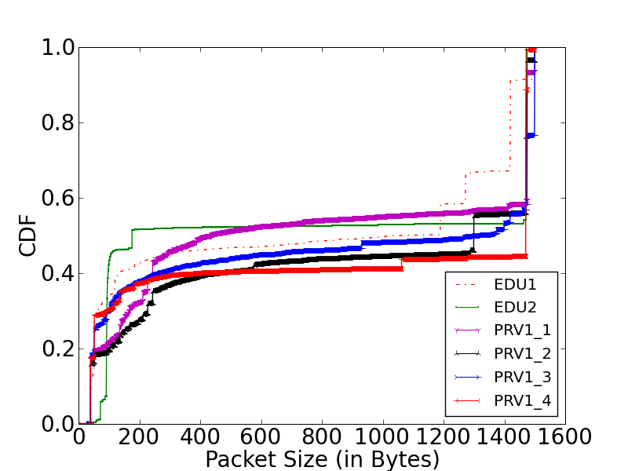
Packet Size Distribution
Trimodal (40B, 200B and 1400B)
Small packets
TCP acknowledgements (40B)
Keep alive packets: plenty!!
Persistent connections → important to apps

Slide 31
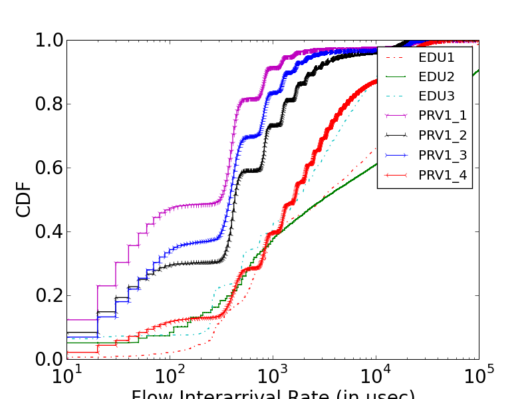
Flow-level Inter-arrivals
Flow Inter-arrival Times (in usecs)
Median: 100us – 10ms; As low as 10us for 2-13% of flows
OpenFlow/SDN: Determines required speed for centralized processing at the controller

Slide 32
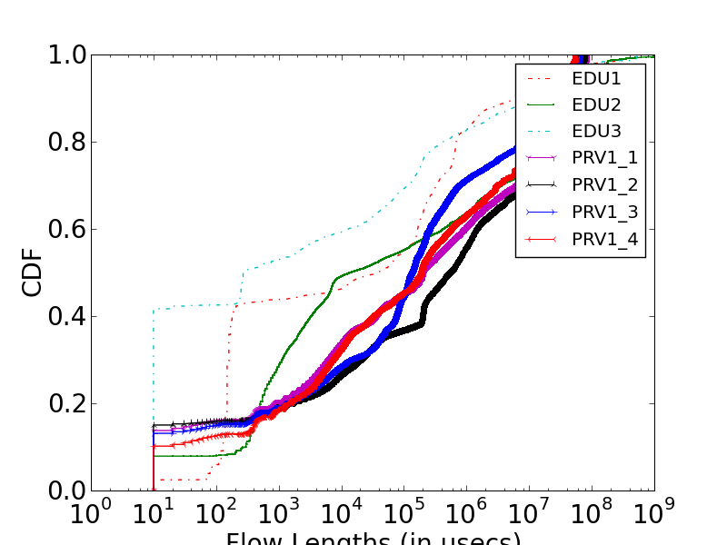
Flow Duration
Flow durations (in usecs)
80% of flow < 1 sec
OpenFlow/SDN: delay involved in controller setting network state must be small

Slide 33
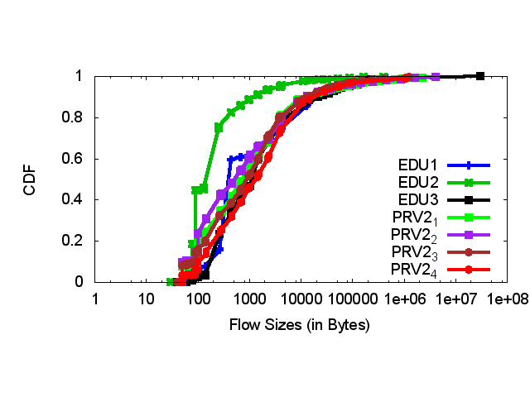
Flow Sizes
Most (80%) flows smaller than 10KB
Most bytes in top 5% of flows

Slide 34
Impact on Interconnect
Core (L3)
Aggregation (L2)
Edge (L2)
Top-of-Rack
Application
servers
Notes:
Rack of application servers
Point out 3 layers (core, gag, edge), show how 2-Tier and 3-Tier are different
Show links captured by SNMP
Show links captured by packet sniffers

Slide 35
Intra-Rack vs. Extra-Rack
Quantify amount of traffic using interconnect
Perspective for interconnect analysis
Extra-Rack
Edge
Intra-Rack
Application
servers
Extra-Rack = Sum of Uplinks
Intra-Rack = Sum of Server Links – Extra-Rack
Notes:
intra-rack - traffic within
extra-rack – traffic leaving
Use equation to show how derived

Slide 36
Intra-Rack vs. Extra-Rack
Clouds: most traffic stays within a rack (75%)
Colocation of apps and dependent components to avoid sharing racks
Other DCs: > 50% leaves the rack
Apps similar to CLD1-3, but placement not optimized for network
Notes:
Fault tolerance/replication

Slide 37
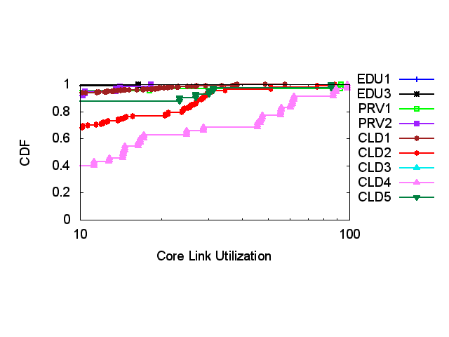
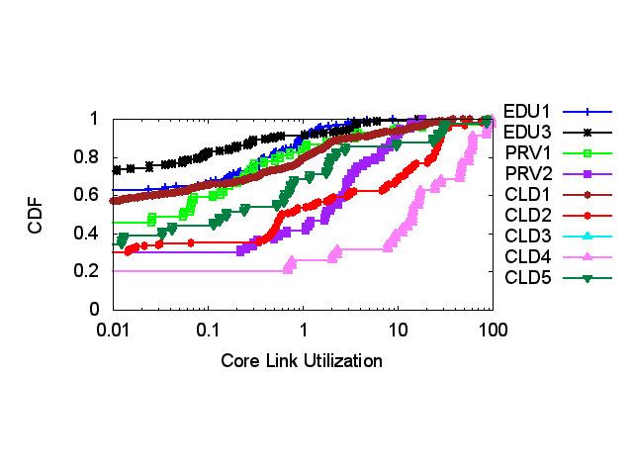
Extra-Rack Traffic on DC Interconnect
Utilization: core > agg > edge
Aggregation of many unto few
Tail of core utilization differs
Hot-spots → links with > 70% util
Prevalence of hot-spots differs across data centers
Note: no hotspots outside the core
Notes:
In some there is a greater prevalence of high utilization links. In others there are none at all.

Slide 38
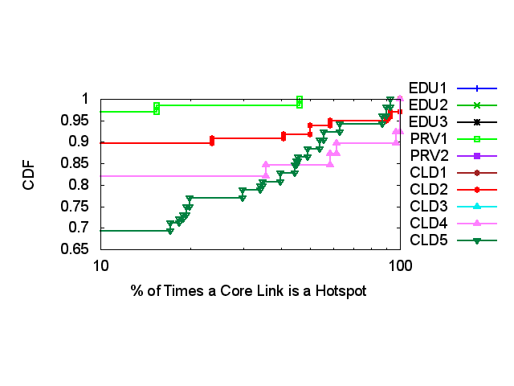
Persistence of Core Hotspots
Low persistence: PRV2, EDU1, EDU2, EDU3, CLD1, CLD3
High persistence/low prevalence: PRV1, CLD2
2-8% are hotspots > 50%
High persistence/high prevalence: CLD4, CLD5 (both run M/R apps)
15% are hotspots > 50%
Notes:
In general, few links in the aggr or edge are hotstpots
Low persistence: hotspots are not localized to any set of links

Slide 39
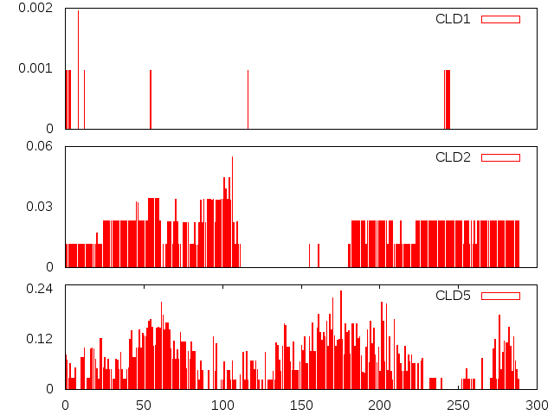
Prevalence of Core Hot-Spots
0.6%
0.0%
6.0%
Y-axis: fraction of links
0.0%
24.0%
0.0%
0 10 20 30 40 50
Time (in Hours)
Low persistence: very few concurrent hotspots
High persistence: few concurrent hotspots
High prevalence: time-of-day; < 25% are hotspots at any time

Slide 40
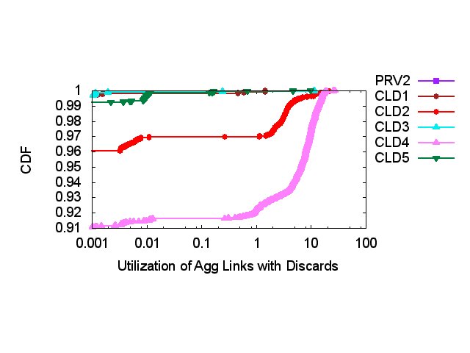
Links with Discards (Losses)
None of the hotspot links saw any losses!
E.g., aggr links with losses had util < 10%
In general, losses: edge > aggr > core
Loss is not correlated with high utilization
Bursty traffic is the cause; bursts “smooth out” in the core

Slide 41
Key Measurement Insights
75% of traffic stays within a rack (Clouds)
Applications are not uniformly placed
At most 25% of core links highly utilized; other links are not hotspots
Effective routing/migration algorithms to reduce utilization/improve performance
Traffic is bursty, not always explained by dominant app; leads to losses at edge/aggregation layers
Half packets are small (< 200B); flows are short and small
Keep alive integral in application design

Slide 42
Impact on Design

Slide 43
Current Design “Trends”
Increase “bisection” bandwidth
Fat-Tree [Sigcomm ‘08], Hedera [NSDI ’10], VL2 [Sigcomm ’09]
Eliminate congestion at oversubscribed core links
Centralization
OpenFlow/SDN

Slide 44
Calculating Core Demand
Core
Core
Links
(hotspots)
Aggregation
Edge
App
Links
Application
servers
If Σ traffic (App ) > 1 then more core capacity needed
Σ capacity(Core)
Notes:
intra-rack - traffic within
extra-rack – traffic leaving
Use equation to show how derived

Slide 45
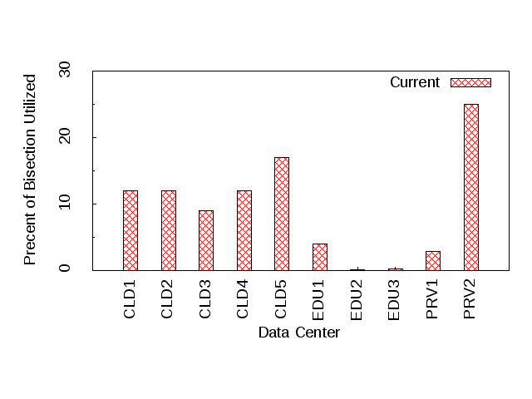
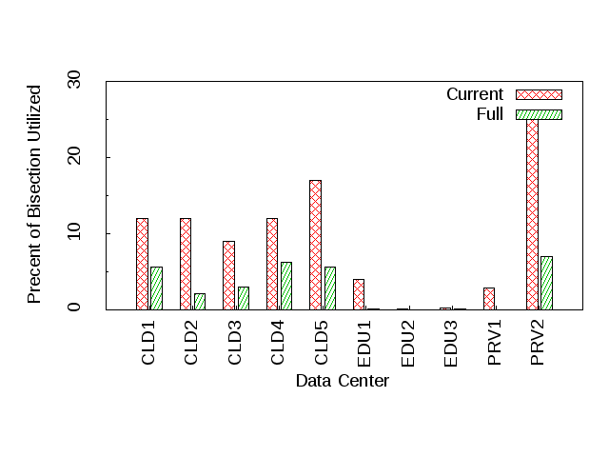
Core Demand
% of core capacity utilized
Given current applications and DC designs
Aggregate core capacity is only 30% utilized
More core capacity is not required
Need to better utilize existing network
Load balance across paths, migrate VMs across racks

Slide 46

OpenFlow/SDN Framework
Flow based centralized framework driven by a “controller”
Directly install entries in forwarding table
Reactive: compute entries when new flow arrives
Flows must wait for processing
Controller must scale
Proactive: pre-compute and install entries
Controller must predict
Flows do not need to wait

Slide 47
Feasibility: Flow Processing Throughput
Controller → 50K flows/ sec [Tavakoli ’09]
Worst case inter-arrival rate determines required speed
10us or 10 mil flows/sec for a modest-sized DC
Reactive processing:
Employ multiple controllers
Scales to 20mil flows/sec
Proactive processing:
Single controller
Flow Inter-arrival Times (in usecs)

Slide 48
Feasibility: Flow Processing Latency
Processing time→ 10 msecs [Tavakoli ’09]
Average flow lengths determines impact of delay
80% of flow < 1 sec
Reactive processing:
10% increase in flow lengths
Proactive processing:
Processing delay = 0 msecs
Proactive → No delays + Single controller
Reactive → 10% overhead + parallel controllers
Flow Lengths (in usecs)

Slide 49
Design Insights
Evaluated popular design choices
Do we need more core capacity? No
Is centralization feasible? Yes

