Slide 1
Inter-DC Measurements; App Workloads: Google, Facebook, Microsoft
Aditya Akella
Lecture 11

Slide 2
A First Look at Inter-DC Characteristics via Yahoo! Datasets, Infocom 2011
Toward Characterizing Cloud Backend Workloads, Sigmetrics PER 2010

Slide 3
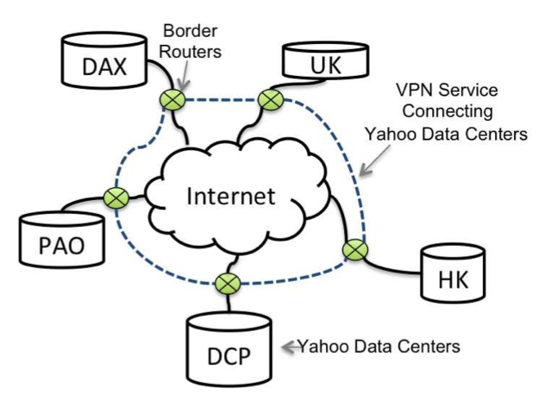
Yahoo! DC Topology

Slide 4
Five Major Yahoo! DCs
Dallas, DC, Palo Alto
Provide most of the core services
Form backbone
Largest in terms of amount of traffic exchanged
Hong Kong, UK
Border routers connect to several other ISPs to reach clients and other DCs
DCs are directly connected through a private network service

Slide 5
Classification of Flows
Netflow records at border routers
D2C
Traffic between clients and a given DC
D2D
Traffic exchanged between different Yahoo! DCs

Slide 6
Classification of Flows
Prune out non-Yahoo addresses
Extract D2C and D2D prefixes
D2C: talks to a large number of other IPs and traffic uses popular ports
D2D traffic: mostly symmetric

Slide 7
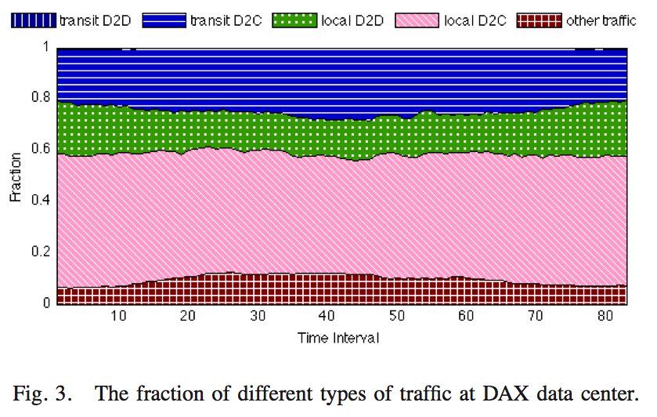
Traffic Statistics at DAX

Slide 8
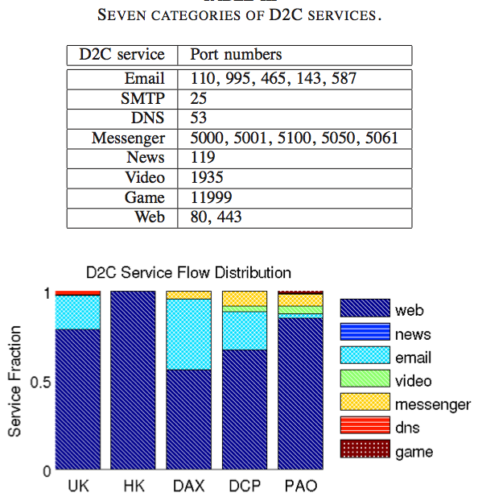
D2C Traffic

Slide 9
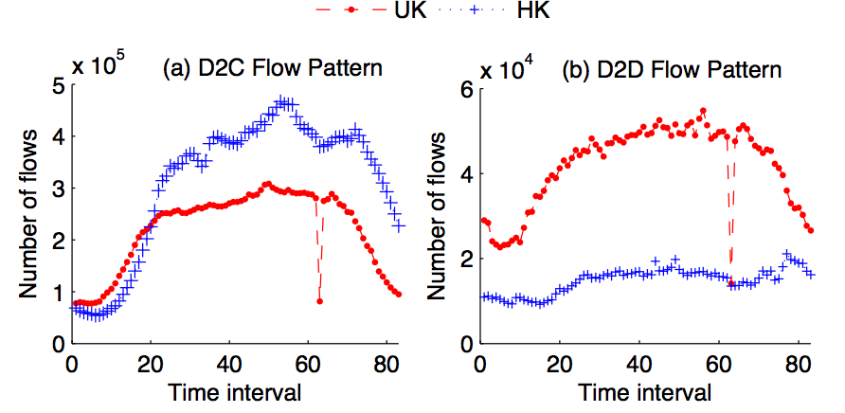
Traffic Patterns

Slide 10
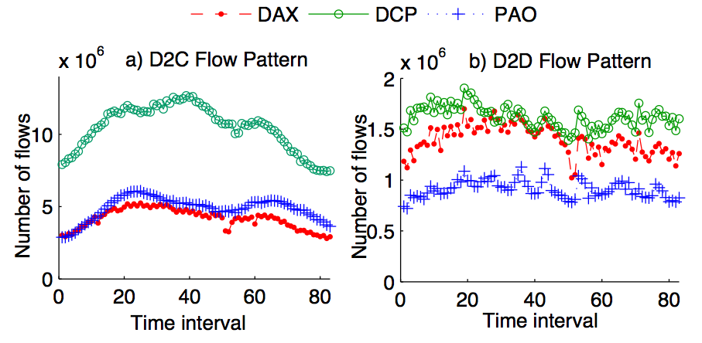
Traffic Patterns

Slide 11
Traffic Patterns
HK and UK act as “satellite data centers”
US Data centers are more like backbone data centers
HK, UK → most D2D traffic is triggered by local D2C traffic

Slide 12
Two Types of D2D Traffic
D2C-triggerred D2D
Local D2C-triggerred D2D
Foreign D2C-triggerred D2D
Background D2D
Regular traffic exchanged across backends

Slide 13
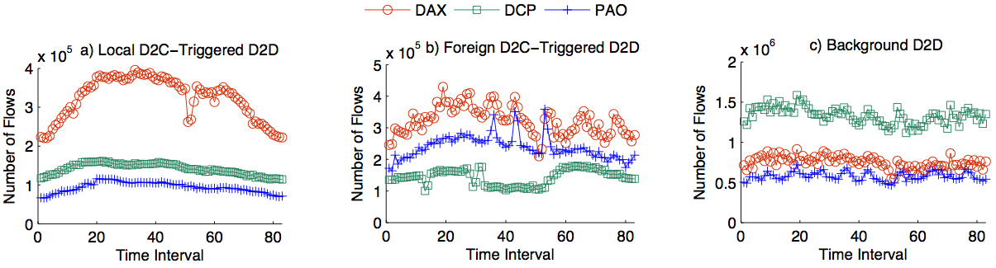
Comparing the three types
Background D2D is dominant
Background D2D stays “flat”

Slide 14
Takeaways/Lessons?

Slide 15
A First Look at Inter-DC Characteristics via Yahoo! Datasets, Infocom 2011
Toward Characterizing Cloud Backend Workloads, Sigmetrics PER 2010

Slide 16
Google Backend
Many jobs → thousands of tasks, each running on a machine
Tasks have SLAs → throughput, latency, jitter
Tasks place varied demands on machines → CPU, memory, network, disk
Capacity planning and scheduling crucial
Planning: need to predict demands
Scheduling: bin packing
Modeling demand crucial

Slide 17
Workload characterization
Models of how resources are consumed by tasks
Simple: few parameters
Accurate
Task grouping: paper adopts a “coarse-grained approach”
Group all tasks with similar resource footprints
Resource usage same resources day-to-day on a cluster
It should show differences across cluster resource usages

Slide 18
Task Grouping
Identify workload resource dimensions (time, CPU, mem)
Cluster tasks (k-means)
Determine break points
Merge task clusters

Slide 19
Approach
Focus on time, CPU, mem; ignore disk and network
Normalize resource use to map to the same range ([0, 4])
K-means: SML → 27 clusters; duration is bimodal → 18 clusters
Manually adjust results so that CV in each cluster small

Slide 20
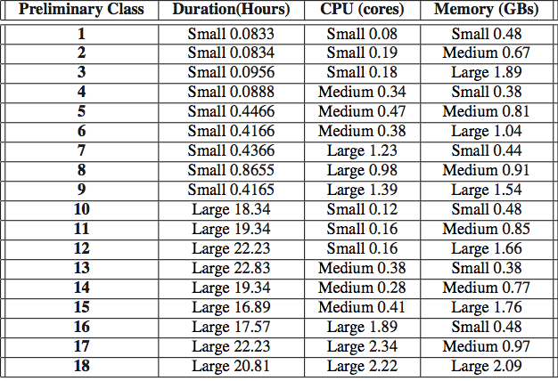
Clusters

Slide 21
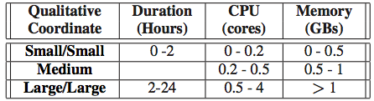
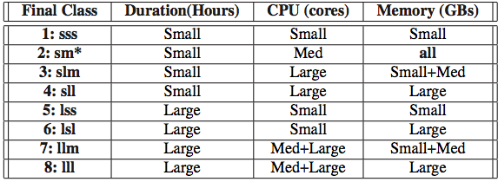
Merged classes and Breakpoints
Merge adjacent classes if CV of merged class not much worse

Slide 22
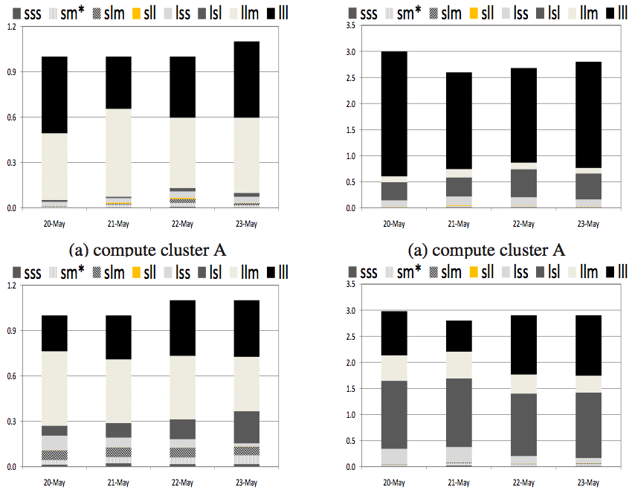
Clusters

Slide 23
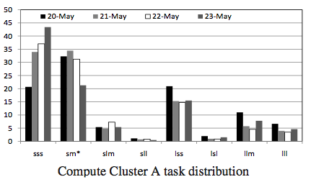
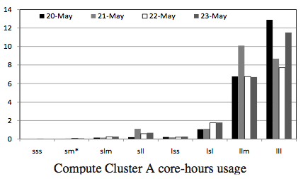
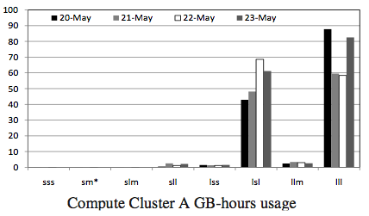
Resource Consumption

Slide 24
Capacity Planning
Forecast growth → propose config → model/simulate app performance
Track resource changes by group → Task classifications are useful in forecast app growth

Slide 25
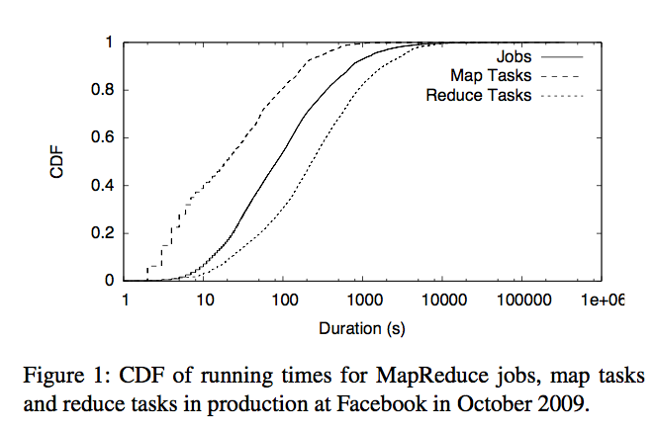
Facebook Study

Slide 26
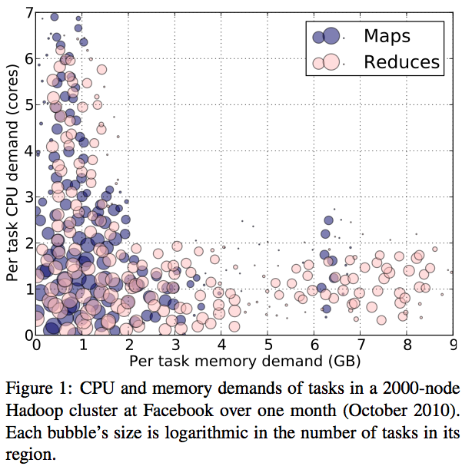
Facebook study

Slide 27
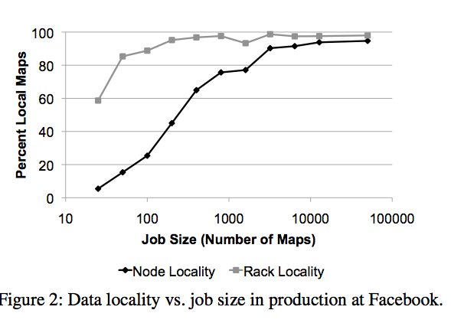
Facebook study

Slide 28
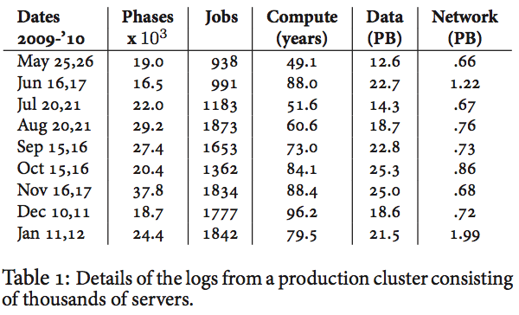
Cosmos Cluster

Slide 29
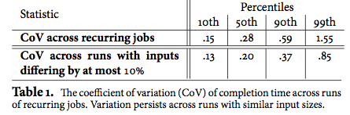
Cosmos study: Meeting SLAs
Cause: scheduling → no guaranteed capacity

Slide 30
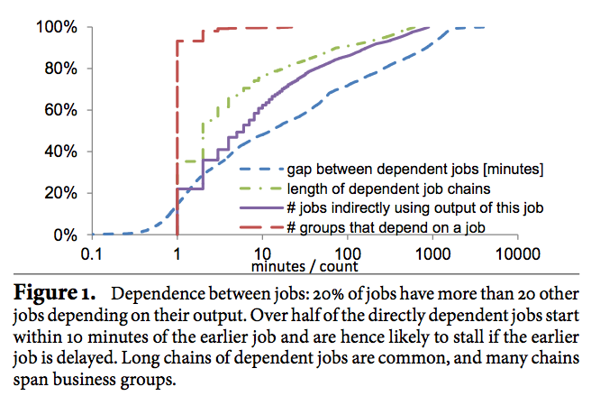
Cosmos Variance: Pipelines

Slide 31
Scheduling
Profile tasks → identify group
Using group to make scheduling decisions
“Sticky” slot problem needs to be addressed
Using the next available slot -> not good for locality
Wait: Most tasks are short → likely to find a local slot
Long tasks can be reassigned
Guaranteed slots for SLA-bound jobs

