Slide 1
Data Center Fabrics
Lecture 12
Aditya Akella

Slide 2
PortLand: Scalable, fault-tolerant L-2 network
c-through: Augmenting DCs with an optical circuit switch

Slide 3
PortLand: A Scalable Fault-Tolerant Layer 2 Data Center Network Fabric
In a nutshell:
PortLand is a single “logical layer 2” data center network fabric that scales to millions of endpoints
PortLand internally separates host identity from host location
uses IP address as host identifier
introduces “Pseudo MAC” (PMAC) addresses internally to encode endpoint location
PortLand runs on commodity switch hardware with unmodified hosts

Slide 4
Design Goals for Network Fabric
Support for Agility!
Easy configuration and management: plug-&-play
Fault tolerance, routing and addressing: scalability
Commodity switch hardware: small switch state
Virtualization support: seamless VM migration

Slide 5
Forwarding Today
Layer 3 approach:
Assign IP addresses to hosts hierarchically based on their directly connected switch.
Use standard intra-domain routing protocols, eg. OSPF.
Large administration overhead
Layer 2 approach:
Forwarding on flat MAC addresses
Less administrative overhead
Bad scalability
Low performance
Middle ground between layer 2 and layer 3:
VLAN
Feasible for smaller scale topologies
Resource partition problem

Slide 6
Requirements due to Virtualization
End host virtualization:
Needs to support large addresses and VM migrations
In layer 3 fabric, migrating the VM to a different switch changes VM’s IP address
In layer 2 fabric, migrating VM incurs scaling ARP and performing routing/forwarding on millions of flat MAC addresses.

Slide 7
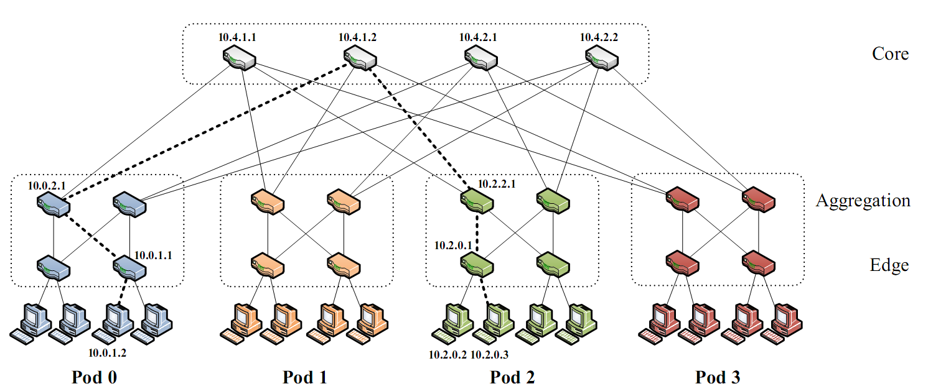
Background: Fat-Tree
Inter-connect racks (of servers) using a fat-tree topology
Fat-Tree: a special type of Clos Networks (after C. Clos)
K-ary fat tree: three-layer topology (edge, aggregation and core)
each pod consists of (k/2)² servers & 2 layers of k/2 k-port switches
each edge switch connects to k/2 servers & k/2 aggr. switches
each aggr. switch connects to k/2 edge & k/2 core switches
(k/2)² core switches: each connects to k pods
Fat-tree
with K=2

Slide 8
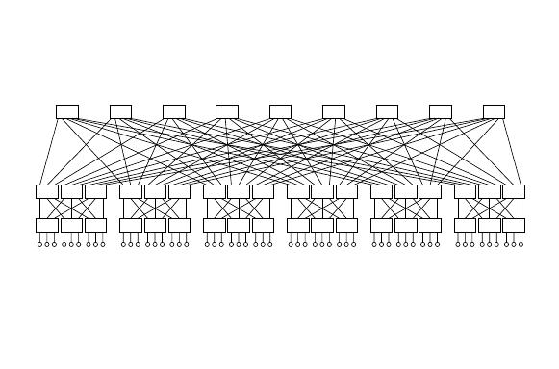
Why?
Why Fat-Tree?
Fat tree has identical bandwidth at any bisections
Each layer has the same aggregated bandwidth
Can be built using cheap devices with uniform capacity
Each port supports same speed as end host
All devices can transmit at line speed if packets are distributed uniform along available paths
Great scalability: k-port switch supports k³/4 servers
Fat tree network with K = 3 supporting 54 hosts

Slide 9
PortLand
Assuming: a Fat-tree network topology for DC
Introduce “pseudo MAC addresses” to balance the pros and cons of flat- vs. topology-dependent addressing
PMACs are “topology-dependent,” hierarchical addresses
But used only as “host locators,” not “host identities”
IP addresses used as “host identities” (for compatibility w/ apps)
Pros: small switch state & Seamless VM migration
Pros: “eliminate” flooding in both data & control planes
But requires a IP-to-PMAC mapping and name resolution
a location directory service
And location discovery protocol & fabric manager
for support of “plug-&-play”

Slide 10
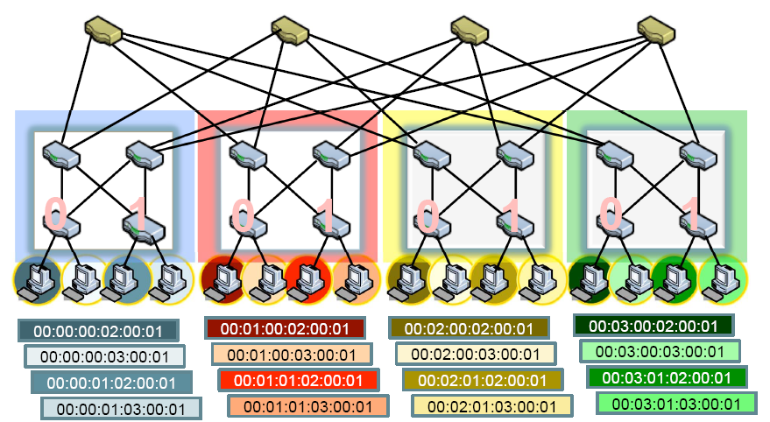
PMAC Addressing Scheme
PMAC (48 bits): pod.position.port.vmid
Pod: 16 bits; position and port (8 bits); vmid: 16 bits
Assign only to servers (end-hosts) – by switches
pod
position

Slide 11

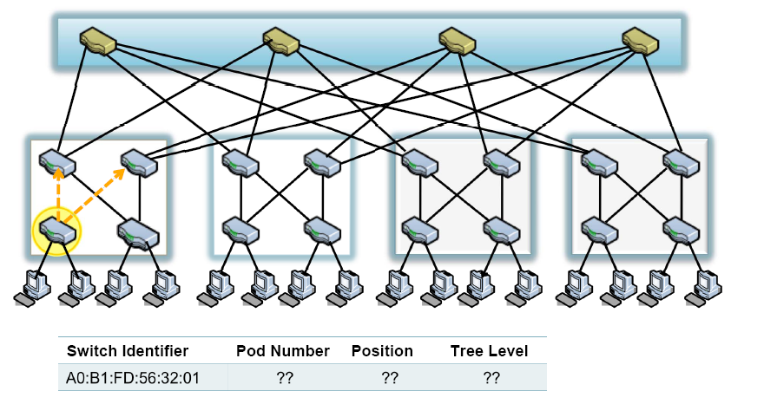

Location Discovery Protocol
Location Discovery Messages (LDMs) exchanged between neighboring switches
Switches self-discover location on boot up
Location Characteristics Technique
Tree-level (edge, aggr. , core) auto-discovery via neighbor connectivity
Position # aggregation switch help edge switches decide
Pod # request (by pos. 0 switch only) to fabric manager

Slide 12
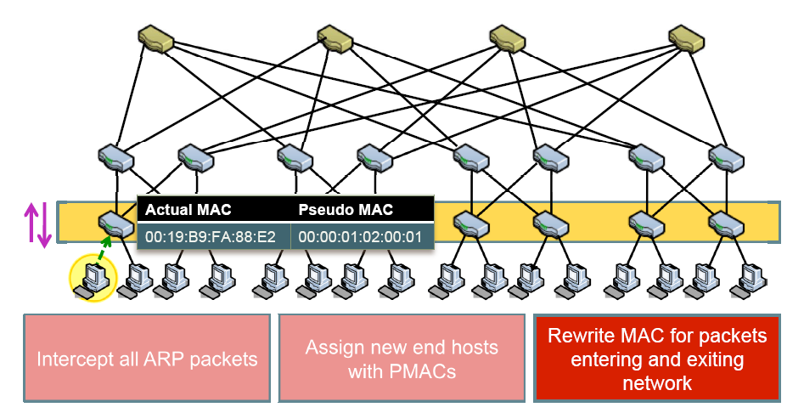
PortLand: Name Resolution
Edge switch listens to end hosts, and discover new source MACs
Installs <IP, PMAC> mappings, and informs fabric manager

Slide 13
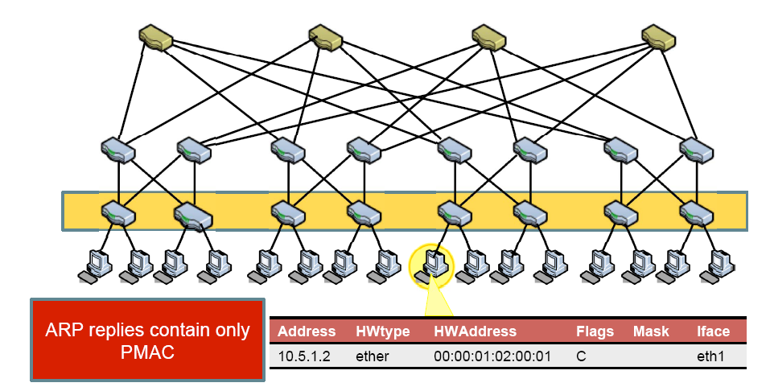
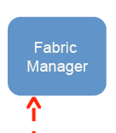
PortLand: Name Resolution …
Edge switch intercepts ARP messages from end hosts
send request to fabric manager, which replies with PMAC

Slide 14
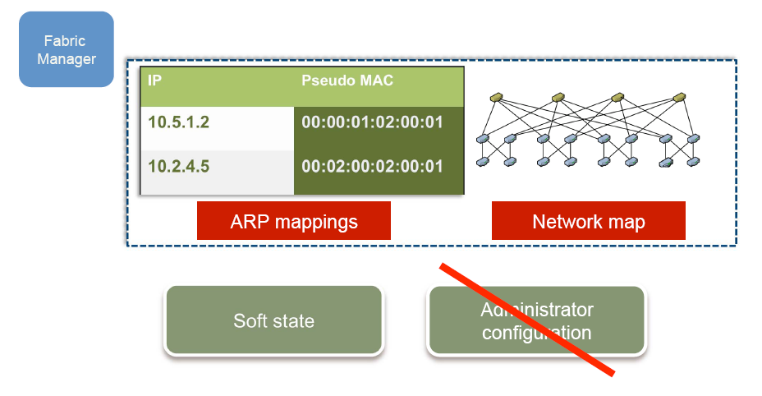
PortLand: Fabric Manager
fabric manager: logically centralized, multi-homed server
maintains topology and <IP,PMAC> mappings in “soft state”

Slide 15
Loop-free Forwarding and Fault-Tolerant Routing
Switches build forwarding tables based on their position
edge, aggregation and core switches
Use strict “up-down semantics” to ensure loop-free forwarding
Load-balancing: use any ECMP path via flow hashing to ensure packet ordering
Fault-tolerant routing:
Mostly concerned with detecting failures
Fabric manager maintains logical fault matrix with per-link connectivity info; inform affected switches
Affected switches re-compute forwarding tables

Slide 16
c-Through: Part-time Optics in Data Centers

Slide 17



Current solutions for increasing data center network bandwidth
FatTree
BCube
1. Hard to construct
2. Hard to expand
Notes:
Data intensive application operating on large volumes of data have motivated a lot of research work on data center networking. The basic problem is traditional tree-structure Ethernet are heavily over-subscribed when a large amount of data are shuffled across different server racks. Recent solutions propose to construct full bisection bandwidth network using commodity packet switches. Full bisection bandwidth network means each server can talk to another server at full NIC rate. Full bisection bandwidth is a nice property, but as you can see , these full bisection bandwidth network is quite complicated. They requires a lot of wires and we have to follow restricted rules to construct such networks. When the network is constructed, it is hard to expand because they requires major rewiring to expand.

Slide 18

An alternative: hybrid packet/circuit switched data center network
Goal of this work:
Feasibility: software design that enables efficient use of optical circuits
Applicability: application performance over a hybrid network
Notes:
In this work, we explore an alternate design that using optical circuit switching technology to construct a simple network
yet still achieve good performance. In particular, we propose a hybrid data center network which augment the existing
Electrical network with circuit switched optical paths. Optical paths can be provisioned dynamically to provide high bandwidth
For applications. The goal of our work is trying to answer the fundamental feasibility and applicability question of hybrid
data center network. We study the software design that can enable optical circuits in data center networks, and understand how application would perform over such a network.

Slide 19
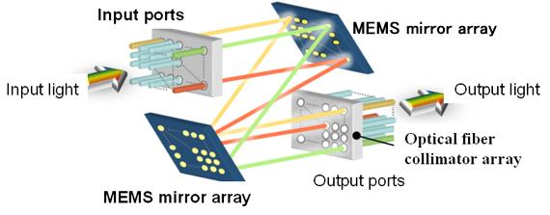
Optical circuit switching v.s. Electrical packet switching
 | Electrical packet switching | Optical circuit switching
Switching technology | Store and forward | Circuit switching
Switching capacity
Switching time
16x40Gbps at high end
e.g. Cisco CRS-1
320x100Gbps on market, e.g. Calient FiberConnect
Packet granularity
Less than 10ms
e.g. MEMS optical switch
Notes:
Shorten for time 2:05, too long !!!
To understand our solution, let’s first take a look at the fundamental difference between electrical packet switching and optical circuit switching technologies. As you know, packet switches are based on the store-and-forward architecture.
Optical switches are circuit switched. There exist different technologies to realize optical circuit switching. For example, MEMS optical switches use MEMS mirror array to set up optical path by reflecting light beams between input and output ports.
These optical switches can switch at whatever rate modulated at input and output ports. Which can achieve very high switching capacity. For example, there already exist optical MEMS switches that can switch 320 optical links with 100Gbps rate.
On the contrast, today’s high end packet switched cisco routers can only switch 16 ports with 40gbps rate.
But the problem is that, the switching time of optical circuits are relatively long. Of course, packet switches can switch at packet granularity. But it takes a few ms to reconfigure optical paths. So, optical switches cannot provide full bisection bandwidth for all-to-all communication at packet granularity.

Slide 20
Optical circuit switching is promising despite slow switching time
[IMC09][HotNets09]: “Only a few ToRs are hot and most their traffic goes to a few other ToRs. …”
[WREN09]: “…we find that traffic at the five edge switches exhibit an ON/OFF pattern… ”
Full bisection bandwidth at packet granularity
may not be necessary
Notes:
But why do we still believe that optical circuit still worth considering in data centers?
The reason is because many measurement studies have observed evidence of traffic concentration in data centers. For example, in IMC09, microsoft researcher measured the traffic of their production data centers and observe that ….,
In another paper, WREN09 , researcher observe ON/OFF traffic pattern on data center switches. All this suggestion that, applications
are not sending to all destinations at full speed anyway. Full bisection….. may not be necessary. So there is a potential that we can ….

Slide 21
Hybrid packet/circuit switched network architecture
Electrical packet-switched network for low latency delivery
Optical circuit-switched network for high capacity transfer
Optical paths are provisioned rack-to-rack
A simple and cost-effective choice
Aggregate traffic on per-rack basis to better utilize optical circuits
Notes:
So, our idea is, we augment the traffic tree-structure Ethernet with a simple, rack-to-rack optical circuit-switched network. The electrical packet-switched network is always available there for low latency delivery and high speed optical circuits are provisioned dynamic for high capacity transfer based on traffic demands.
Optical circuits are provisioned rack-to-rack so that we only need to one optical transcer and one optical fiber for one rack, to keep the network simple and reduce the cost. Given one optical circuits can send more than 40gbps, we can aggregate traffic on per-rack basis to ….

Slide 22
Design requirements
Traffic demands
Control plane:
Traffic demand estimation
Optical circuit configuration
Data plane:
Dynamic traffic de-multiplexing
Optimizing circuit utilization (optional)
Notes:
How can we manage optical circuits over such a hybrid network? We identify a set of design requirements that are needed.
On the control plane, we need to collect dynamic traffic demand and config …
When optical paths are provisioned, there exist two paths among different server racks. So on the data plane, we need to de-multiplex traffic to different network dynamically based on the current configuration. When optical paths are provisioned, applications may not be able to send fast enough to leverage optical paths. So the improve system performance, we also need to optimize circuit utilization. But this requirement is optional, the system can still work with out this.

Slide 23
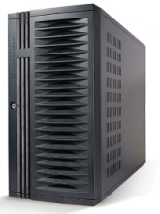
c-Through (a specific design)
No modification to applications and switches
Leverage end-hosts for traffic management
Centralized control for circuit configuration
Notes:
There is many design choice to accomplish these design requirements. We have a detailed discussion in the paper about the design choices and their trade-offs. Please refer to the paper for the discussion. Here I will go directly to a specific system, called c-Through, we have built to manage optical circuits in a hybrid network. The design strategy for c-Through system is:
C-Through use a centralized controller for …, c-Through does not need any modification on …, it leverage end-hosts in the traffic management.

Slide 24
c-Through - traffic demand estimation and traffic batching
Applications
Per-rack traffic demand vector
1. Transparent to applications.
Socket buffers
2. Packets are buffered per-flow
to avoid HOL blocking.
Accomplish two requirements:
Traffic demand estimation
Pre-batch data to improve optical circuit utilization
Notes:
c-Through estimate traffic demands by simply enlarge output buffer limits of sockets. When an application is trying to send a large amount of data and network bandwidth is not enough, the data will be queued up in socket output buffers. But look at the occupancy of socket output buffer, we can infer which flow has high traffic demands. Then we can aggregate the socket buffer occupancy based on the destination rack to get a per-rack traffic demand vector. For example, in this vector, darker color means high traffic demands for a particular destination rack.
This technique is transparent to …, packets are buffered … But with this simple technique, we can accomplish two-requirements: (1) traffic demand estimation (2) Socket buffers can be used to pre-batch data when optical path is not available. When optical path is provisioned, we can release the data quickly to optical path to improve circuit utilization.

Slide 25
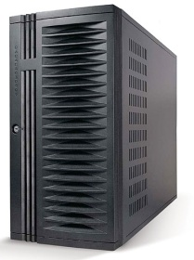
c-Through - optical circuit configuration
configuration
Traffic demand
Controller
configuration
Use Edmonds’ algorithm to compute optimal configuration
Many ways to reduce the control traffic overhead
Notes:
>2min too long !!!
C-Through use a centralize controller to collect traffic demands and configure optical circuits. The controller collect per-rack traffic demand vector from all the servers and aggregate them into a cross-rack traffic matrix. Then it compute a optimal configuration that can maximize the traffic volume that can be offload to optical network using a polynomial Edmonds’ alg. Everytime when the optical circuits are reconfigured, it will notified servers to tear down the path and configure it and then notify them about the new configuration. In a large data center, there could a significant overhead for the control traffic. But many ways can be used to reduce the overhead of control traffic.
For example, for traffic demand collection, servers only need to send to the controller when the demands change dramatically, traffic demand vectors can be aggregated within rack first, then send to the control. The configuration notification can be done using multicast.

Slide 26
c-Through - traffic de-multiplexing
VLAN-based network isolation:
No need to modify switches
Avoid the instability caused by circuit reconfiguration
VLAN #1
VLAN #2
traffic
circuit configuration
Traffic control on hosts:
Controller informs hosts about the circuit configuration
End-hosts tag packets accordingly
Traffic
de-multiplexer
VLAN #1
VLAN #2
Notes:
When optical path are configured, c-Through uses two techniques to realize traffic de-multiplexing.
First, we configure VLAN on all the ToR switches to isolate the electrical network and optical network into different VLANs.
As we mentioned before, it is a dynamic network. When optical circuits are reconfigured, the network topology is changing. If optical network and electrical network is organized into a unified network, this topology changes can cause instability in the control protocols in electrical network, such as spanning tree..
We isolate network to avoid the potential network instability caused by circuit reconfiguration.
C-Through leverage end-hosts to perform traffic de-multiplexing. Each server is configured with two virtual interface with VLAN1 and VLAN2 that mapping to electrical network and optical network. Everytime optical path is configured, controller will inform hosts about the current configuration. So a traffic de-multiplexer will tag packets accordingly to send them into appropriate network.

Slide 27
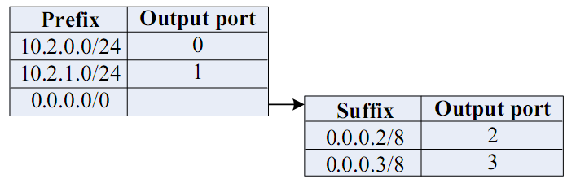
FAT-Tree: Special Routing
Enforce a special (IP) addressing scheme in DC
unused.PodNumber.switchnumber.Endhost
Allows host attached to same switch to route only through switch
Allows inter-pod traffic to stay within pod
Use two level look-ups to distribute traffic and maintain packet ordering
First level is prefix lookup
used to route down the topology to servers
Second level is a suffix lookup
used to route up towards core
maintain packet ordering by using same ports for same server

