Slide 1
Network Sharing Issues
Lecture 15
Aditya Akella

Slide 2
Is this the biggest problem in cloud resource allocation? Why? Why not?
How does the problem differ wrt allocating other resources?
FairCloud: Sharing the Network in Cloud Computing, Sigcomm 2012
What are the assumptions? Drawbacks?

Slide 3
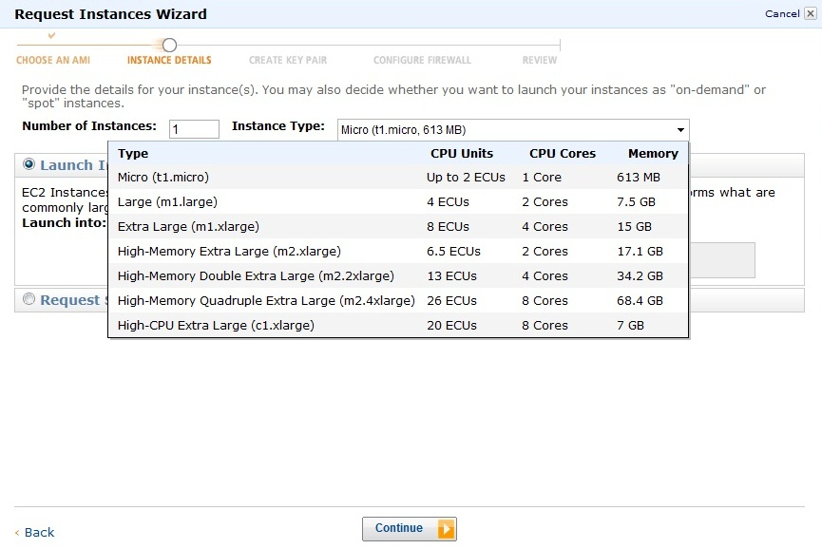
Motivation
Network?

Slide 4
Context
Networks are more difficult to share than other resources
X
Notes:
When talking about CPU is very simple, ask for 10CPUs get 10CPUs, but what it means to share the network is not clear. The network is formed by multiple links and the bandwidth of one VM …

Slide 5
Context
Several proposals that share network differently, e.g.:
proportional to # source VMs (Seawall [NSDI11])
statically reserve bandwidth (Oktopus [Sigcomm12])
…
Provide specific types of sharing policies
Characterize solution space and relate policies to each other?
Notes:
These are great proposals that achieve specific sharing policies, but they are in essence point solutions in the broader space of network sharing policies. A challenge is that we don’t have a way to characterize the solution space and to relate these policies to each other.

Slide 6
FairCloud Paper
Framework for understanding network sharing in cloud computing
Goals, tradeoffs, properties
Solutions for sharing the network
Existing policies in this framework
New policies representing different points in the design space
Notes:
This work
Shed light on the tradeoffs involved in the design of sharing policies
Uncover new policies that navigate tradeoffs more systematically

Slide 7
Goals
Minimum Bandwidth Guarantees
Provides predictable performance
Example: file transfer finishes within time limit
B_{min}
A₁
A₂
Time_{max} = Size / B_{min}

Slide 8
Goals
Minimum Bandwidth Guarantees
High Utilization
Do not leave useful resources unutilized
Requires both work-conservation and proper incentives
A
B
B
B
Both tenants active
Non work-conserving
Work-conserving

Slide 9
Goals
Minimum Bandwidth Guarantees
High Utilization
Network Proportionality
As with other services, network should be shared proportional to payment
Currently, tenants pay a flat rate per VM ➔ network share should be proportional to #VMs
(assuming identical VMs)

Slide 10
Goals
Minimum Bandwidth Guarantees
High Utilization
Network Proportionality
Example: A has 2 VMs, B has 3 VMs
A₁
Bw_{A}
Bw_{B}
B₃
Bw_{A}
2
=
Bw_{B}
3
B₁
A₂
When exact sharing is not possible use max-min
B₂

Slide 11
Goals
Minimum Bandwidth Guarantees
High Utilization
Network Proportionality
Not all goals are achievable simultaneously!

Slide 12

Tradeoffs
Min Guarantee
Network Proportionality
High Utilization
Not all goals are achievable simultaneously!

Slide 13
Tradeoffs
Min Guarantee
Network Proportionality

Slide 14
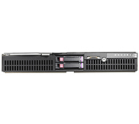
Tradeoffs
Min Guarantee
Network Proportionality
Minimum Guarantee
A
B
Access Link L
Capacity C
Bw_{A} = 1/2 C
Bw_{B} = 1/2 C
Bw_{A}
Bw_{B}
Network Proportionality
Bw_{A} = 2/13 C
Bw_{B} = 11/13 C
Bw_{A} ≈ C/N_{T} → 0
10 VMs
#VMs in the network

Slide 15
Tradeoffs
Network Proportionality
High Utilization

Slide 16
Tradeoffs
Network Proportionality
High Utilization
A₁
A₂
L
A₃
A₄
B₁
B₂
B₃
B₄

Slide 17
Tradeoffs
Network Proportionality
High Utilization
Network Proportionality
Bw_{A} = 1/2 C
Bw_{B} = 1/2 C
A₁
A₂
L
A₃
A₄
B₁
B₂
B₃
B₄

Slide 18
Tradeoffs
Network Proportionality
High Utilization
Uncongested path
P
A₁
A₂
L
A₃
A₄
B₁
B₂
B₃
B₄

Slide 19
Tradeoffs
Network Proportionality
High Utilization
Network Proportionality
Uncongested path
^{P}
^{L}
^{L}
Bw_{A}+Bw_{A} = Bw_{B}
P
^{L}
^{L}
Bw_{A} <
Bw_{B}
A₁
A₂
L
A₃
A₄
Tenants can be disincentivized
to use free resources
B₁
B₂
If A values A₁→A₂ or A₃→A₄ more than A₁→A₃
B₃
B₄

Slide 20
Tradeoffs
Network Proportionality
High Utilization
Congestion Proportionality
Uncongested path
P
Network proportionality applied only for flows traversing congested links shared by multiple tenants
A₁
A₂
L
A₃
A₄
B₁
B₂
B₃
B₄

Slide 21
Tradeoffs
Network Proportionality
High Utilization
Congestion Proportionality
Uncongested path
P
A₁
A₂
Congestion Proportionality
L
A₃
A₄
^{L}
^{L}
Bw_{A} =
Bw_{B}
B₁
B₂
B₃
B₄

Slide 22
Tradeoffs
Network Proportionality
High Utilization
Congestion Proportionality
Still conflicts with high utilization

Slide 23
Tradeoffs
Network Proportionality
High Utilization
Congestion Proportionality
C₁ = C₂ = C
L₁
A₁
A₂
B₁
B₂
L₂
A₃
A₄
B₃
B₄

Slide 24
Tradeoffs
Network Proportionality
High Utilization
Congestion Proportionality
C₁ = C₂ = C
Congestion Proportionality
L₁
A₁
A₂
^{L1}
^{L1}
Bw_{A} =
Bw_{B}
B₁
B₂
^{L2}
^{L2}
Bw_{A} =
Bw_{B}
L₂
A₃
A₄
B₃
B₄

Slide 25
Tradeoffs
Network Proportionality
High Utilization
Congestion Proportionality
C₁ = C₂ = C
L₁
A₁
A₂
B₁
B₂
L₂
A₃
A₄
Demand drops to
B₃
B₄
ε

Slide 26
Tradeoffs
Network Proportionality
High Utilization
Congestion Proportionality
Tenants incentivized to not fully utilize resources
C₁ = C₂ = C
L₁
A₁
A₂
ε
B₁
B₂
C - ε
L₂
A₃
A₄
C - ε
B₃
B₄
ε

Slide 27
Tradeoffs
Network Proportionality
High Utilization
Congestion Proportionality
Tenants incentivized to not fully utilize resources
C₁ = C₂ = C
L₁
A₁
A₂
ε
B₁
B₂
C - ε
L₂
A₃
A₄
C - 2ε
Uncongested
B₃
B₄
ε

Slide 28
Tradeoffs
Network Proportionality
High Utilization
Congestion Proportionality
Tenants incentivized to not fully utilize resources
C₁ = C₂ = C
L₁
A₁
A₂
C/2
B₁
B₂
C/2
L₂
A₃
A₄
C - 2ε
Uncongested
B₃
B₄
ε

Slide 29
Tradeoffs
Network Proportionality
High Utilization
Congestion Proportionality
Link Proportionality
L₁
A₁
A₂
Proportionality applied to each link independently
B₁
B₂
L₂
A₃
A₄
B₃
B₄

Slide 30
Tradeoffs
Network Proportionality
High Utilization
Congestion Proportionality
Link Proportionality
L₁
A₁
A₂
Full incentives for
high utilization
B₁
B₂
L₂
A₃
A₄
B₃
B₄

Slide 31
Goals and Tradeoffs
Min Guarantee
Network Proportionality
High Utilization
Congestion Proportionality
Link Proportionality

Slide 32
Guiding Properties
Min Guarantee
Network Proportionality
High Utilization
Congestion Proportionality
Link Proportionality
Break down goals into lower-level necessary properties
Notes:
In the process of going from goals to solutions, we take an intermediary step and break down goals into lower level, simpler properties that are required by the goals. We do not claim this to be a complete set of properties.

Slide 33
Properties
Min Guarantee
Network Proportionality
High Utilization
Congestion Proportionality
Link Proportionality
Work
Conservation

Slide 34
Work Conservation
Bottleneck links are fully utilized
Static reservations do not have this property

Slide 35
Properties
Min Guarantee
Network Proportionality
High Utilization
Congestion Proportionality
Link Proportionality
Work
Conservation
Utilization
Incentives

Slide 36
Utilization Incentives
Tenants are not incentivized to lie about demand to leave links underutilized
Network and congestion proportionality do not have this property
Allocating links independently provides this property

Slide 37
Properties
Min Guarantee
Network Proportionality
High Utilization
Congestion Proportionality
Link Proportionality
Comm-Pattern
Independence
Work
Conservation
Utilization
Incentives

Slide 38
Communication-pattern Independence
Allocation does not depend on communication pattern
Per flow allocation does not have this property
(per flow = give equal shares to each flow)
←Same Bw→

Slide 39
Properties
Min Guarantee
Network Proportionality
High Utilization
Congestion Proportionality
Link Proportionality
Symmetry
Comm-Pattern
Independence
Work
Conservation
Utilization
Incentives

Slide 40
Symmetry
Swapping demand directions preserves allocation
Per source allocation lacks this property
(per source = give equal shares to each source)
←Same Bw→
←Same Bw→

Slide 41
Goals, Tradeoffs, Properties
Min Guarantee
Network Proportionality
High Utilization
Congestion Proportionality
Link Proportionality
Symmetry
Comm-Pattern
Independence
Work
Conservation
Utilization
Incentives

Slide 42
Outline
Framework for understanding network sharing in cloud computing
Goals, tradeoffs, properties
Solutions for sharing the network
Existing policies in this framework
New policies representing different points in the design space

Slide 43
Per Flow (e.g. today)
Min Guarantee
Network Proportionality
High Utilization
Congestion Proportionality
Link Proportionality
Symmetry
Comm-Pattern
Independence
Work
Conservation
Utilization
Incentives

Slide 44
Per Source (e.g., Seawall [NSDI’11])
Min Guarantee
Network Proportionality
High Utilization
Congestion Proportionality
Link Proportionality
Symmetry
Comm-Pattern
Independence
Work
Conservation
Utilization
Incentives

Slide 45
Static Reservation (e.g., Oktopus [Sigcomm’11])
Min Guarantee
Network Proportionality
High Utilization
Congestion Proportionality
Link Proportionality
Symmetry
Comm-Pattern
Independence
Work
Conservation
Utilization
Incentives

Slide 46
New Allocation Policies
3 new allocation policies that take different stands on tradeoffs

Slide 47
Proportional Sharing at Link-level (PS-L)
Min Guarantee
Network Proportionality
High Utilization
Congestion Proportionality
Link Proportionality
Symmetry
Comm-Pattern
Independence
Work
Conservation
Utilization
Incentives

Slide 48
Proportional Sharing at Link-level (PS-L)
Per tenant WFQ where weight = # tenant’s VMs on link
WQ_{A}= #VMs A on L
A
Bw_{A}
#VMs A on L
=
Bw_{B}
#VMs B on L
B
Can easily be extended to use heterogeneous VMs (by using VM weights)

Slide 49
Proportional Sharing at Network-level (PS-N)
Min Guarantee
Network Proportionality
High Utilization
Congestion Proportionality
Link Proportionality
Symmetry
Comm-Pattern
Independence
Work
Conservation
Utilization
Incentives

Slide 50
Proportional Sharing at Network-level (PS-N)
Congestion proportionality in severely restricted context
Per source-destination WFQ, total tenant weight = # VMs

Slide 51
Proportional Sharing at Network-level (PS-N)
Congestion proportionality in severely restricted context
Per source-destination WFQ, total tenant weight = # VMs
A₁
WQ_{A1→A2}= 1/N_{A1} + 1/N_{A2}
A₂
N_{A2}
N_{A1}
Total WQ_{A}
=
#VMs A

Slide 52
Proportional Sharing at Network-level (PS-N)
Congestion proportionality in severely restricted context
Per source-destination WFQ, total tenant weight = # VMs
WQ_{A}
#VMs A
=
WQ_{B}
#VMs B

Slide 53
Proportional Sharing on Proximate Links (PS-P)
Min Guarantee
Network Proportionality
High Utilization
Congestion Proportionality
Link Proportionality
Symmetry
Comm-Pattern
Independence
Work
Conservation
Utilization
Incentives

Slide 54
Proportional Sharing on Proximate Links (PS-P)
Assumes a tree-based topology: traditional, fat-tree, VL2
(currently working on removing this assumption)

Slide 55
Proportional Sharing on Proximate Links (PS-P)
Assumes a tree-based topology: traditional, fat-tree, VL2
(currently working on removing this assumption)
Min guarantees
Hose model
Admission control
Bw_{A1}
Bw_{A2}
Bw_{An}
A₁
A₂
…
A_{n}

Slide 56
Proportional Sharing on Proximate Links (PS-P)
Assumes a tree-based topology: traditional, fat-tree, VL2
(currently working on removing this assumption)
Min guarantees
Hose model
Admission control
High Utilization
Per source fair sharing towards tree root

Slide 57
Proportional Sharing on Proximate Links (PS-P)
Assumes a tree-based topology: traditional, fat-tree, VL2
(currently working on removing this assumption)
Min guarantees
Hose model
Admission control
High Utilization
Per source fair sharing towards tree root
Per destination fair sharing from tree root

Slide 58
Deploying PS-L, PS-N and PS-P
Full Switch Support
All allocations can use hardware queues (per tenant, per VM or per source-destination)
Partial Switch Support
PS-N and PS-P can be deployed using CSFQ [Sigcomm’98]
No Switch Support
PS-N can be deployed using only hypervisors
PS-P could be deployed using only hypervisors, we are currently working on it

Slide 59
Evaluation
Small Testbed + Click Modular Router
15 servers, 1Gbps links
Simulation + Real Traces
3200 nodes, flow level simulator, Facebook MapReduce traces

Slide 60
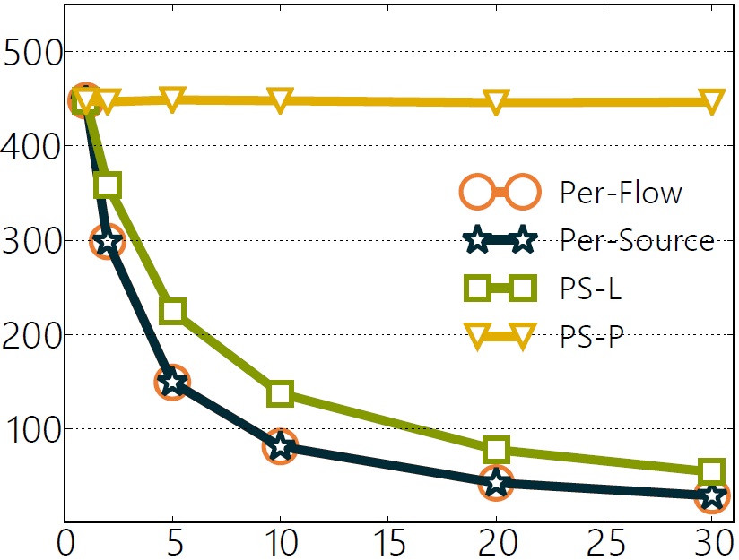
Many to one
One link, testbed
PS-P offers guarantees
A
B
Bw_{A}
Bw_{B}
Bw_{A}
N
N

Slide 61
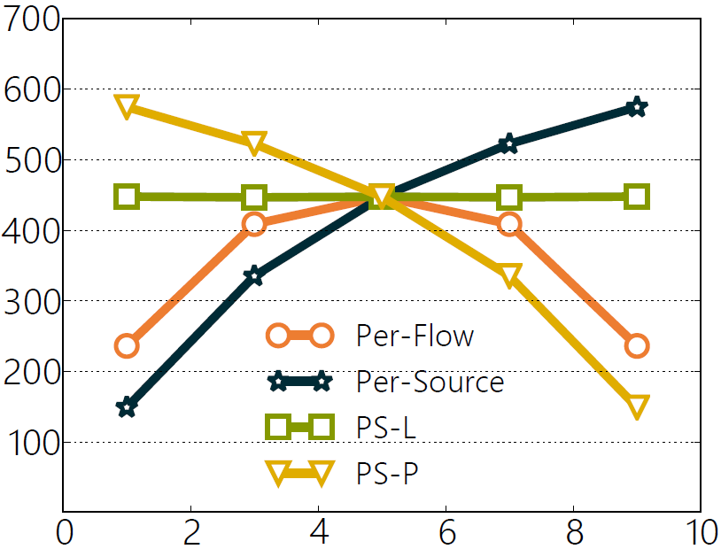
MapReduce
One link, testbed
5
M
PS-L offers link proportionality
Bw_{B (Mbps)}
Bw_{A}
Bw_{B}
5
R
M+R = 10
M

Slide 62
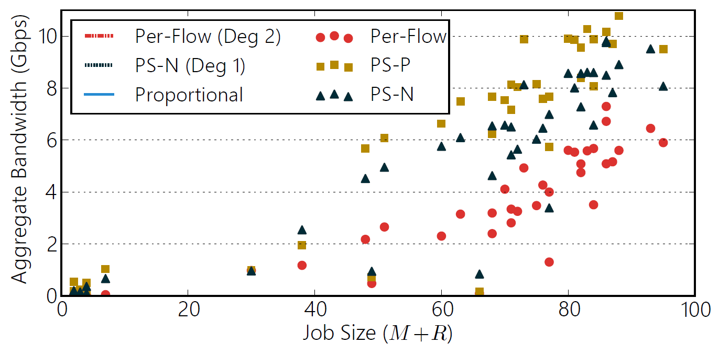
MapReduce
Network, simulation, Facebook trace

Slide 63
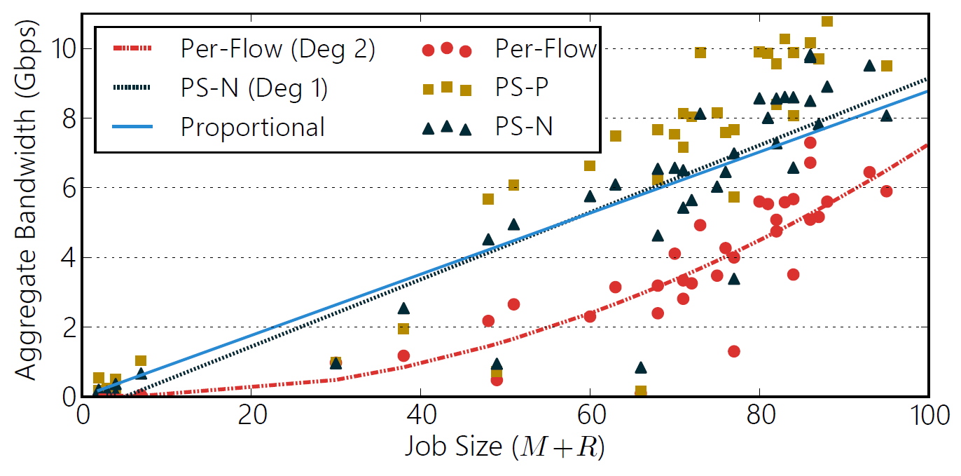
MapReduce
Network, simulation, Facebook trace
PS-N is close to network proportionality
Notes:
(each tenant has one job, showing small jobs only)

Slide 64
MapReduce
Network, simulation, Facebook trace
PS-N and PS-P reduce shuffle time of small jobs by 10-15X

Slide 65
Summary
Sharing cloud networks is not trivial
First step towards a framework to analyze network sharing in cloud computing
Key goals (min guarantees, high utilization and proportionality), tradeoffs and properties
New allocation policies, superset properties from past work
PS-L: link proportionality + high utilization
PS-N: restricted network proportional
PS-P: min guarantees + high utilization
What are the assumptions, drawbacks?

