Slide 1
Enterprise Usecases
Lecture 9
Aditya Akella

Slide 2
Traditional enterprise applications:
Migrating applications: Cloud-ward bound
In-cloud support
Basic networking: CloudNaaS
Rich L3-L7 services: Stratos
Virtual cages (very new)
New models/usecases
Middleboxes hosted in the cloud
Disaster recovery
Others?

Slide 3
Cloudward Bound: Planning for Beneficial Migration of Enterprise Applications to the Cloud
Mohammad Hajjat , Xin Sun, Yu-Wei Sung (Purdue University)
David Maltz (Microsoft Research),
Sanjay Rao (Purdue University),
Kunwadee Sripanidkulchai (IBM T.J. Watson)
Mohit Tawarmalani (Purdue University)

Slide 4
Concerns with cloud computing
Data privacy
National Privacy Laws
Industry-specific privacy laws (e.g., Health Care)
SLA Requirements
Application response time
Availability

Slide 5




Hybrid Cloud Architectures
“And there are some things they might not want to put in the cloud for security and reliability reasons….So, you've got
to have these kinds of hybrid solutions.”
Steve Ballmer, Microsoft CEO
Cloud
back-end
frontend
an ACL
“We think it's a combination of putting applications in your own data center, and then use the cloud to take out peaks, or you could put specific things in the cloud.”
Joe Tucci, EMC CEO
Internet
front- end
back-end
(sensitive
databases)
“Virtually every enterprise will adopt a hybrid format”
Russ Daniels, CTO of cloud computing, HP
Local Data Center

Slide 6


#1 : Planning hybrid cloud layouts
Cost savings, Application response times, Bandwidth costs
Scale and complexity of enterprises applications
Cloud
back- end
back-end
frontend
an ACL
Internet
front- end
back end
Local Data Center
front- end
back end
Local Data Center

Slide 7
#2: migrating security policies
Security most important initiative for 83% of surveyed operators
Security policies often realized using Access Control Lists (ACLs)
Typical to see hundreds of firewall contexts, ACLs with hundreds
of rules
Cloud
back- end
back-end
?
frontend
an ACL
permit frontend→backend port 8000 deny any→backend
Internet
front- end
back end
Local Data Center
front- end
back
end
Local Data Center

Slide 8
Contributions
Highlight complexity of enterprise applications, data-center policies
Framing and providing first-cut solutions for two key challenges in migrating enterprises to hybrid cloud
Models for planning hybrid cloud deployments
Abstractions and algorithms for assurable migration of security policies
Validations using real enterprise applications, Azure-based cloud deployments

Slide 9
Enterprise Applications
E.g., Payroll, travel and expense reimbursement, customer relationship management etc.
FE1
Front End
(FE)
FE
FE2
BL1
BL2
Business Logic
(BL)
BL4
BL5
BL
BL3
BL1
BL2
BL3
BL4
BL5
Back End
(BE)
BE
3-tier Application Structure

Slide 10







Enterprise Applications
E.g., Payroll, travel and expense reimbursement, customer relationship management etc.
FE
BL
BE

Slide 11
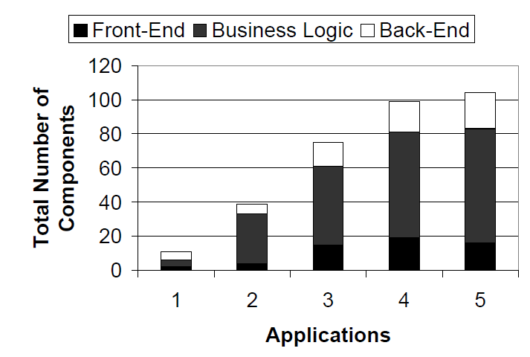
Scale of enterprise applications

Slide 12
Abstracting the planning problem
E
External
I
Internal
Ci
N_{i} = number of servers in component C_{i}
C₀
C₁
T_{ij}= number of transactions per second along (i,j)
S_{ij}= average size of transactions along (i,j)
C₂
C_{i}
Enterprise
C₃
C₄
C_{j}
Cj
To determine:
m_{i}= number of servers of component C_{i} to migrate to the cloud (m_{i} ≤ N_{i})
C_{k}
C₅
App1
App2

Slide 13
Formulating the planning problem
Objective: Maximize cost savings on migration
Benefits due to hosting servers in the cloud
Cost increase/savings related to wide area Internet communication
Constraints:
Policy constraints
Bounds on increase in transaction delay
Future work:
Application availability
Cloud
back-end
frontend
front- end
back-end
(sensitive
databases)
Local Data Center

Slide 14
Partitioning requests after migration
T’_{iR,jR}
C_{iR}
C_{jR}
T_{i,j}
Cloud
Migrate
T’_{iR,jL}
C_{i}
C_{j}
T’_{iL,jR}
C_{iL}
C_{jL}
Local DC
T’_{iL,jL}
Local DC
(1) Location sensitive routing
(2) Location Independent routing
Split in proportion to the number of servers in C_{jL} and C_{jR}
Introduces non-linearity in constraints.

Slide 15
Modeling user response times
Ideally, desirable to bound increase in:
Mean response time
Response time variations (e.g., 95%ile response times).
Bounding changes to mean delay relatively easier
Bounding delay variations harder

Slide 16
Benefits/costs on migration
Benefits due to hosting servers in the cloud
Economies of scale, lowered operational expenses
Estimates from Armbrust et al (Berkeley TR, 2009)
Benefits dependent on compute or storage servers
Future extension: savings due to using cloud for peaks
Focus on recurring costs associated with migration
Modeling costs related to Internet communication
Linear cost model
Matches charging model of EC2, Azure etc.

Slide 17

Migration algorithm overview
Reachability Matrix (R)
Transform R
Cloud
fe₁
t(a₂)
Entities:
 | fe₁ | fe₂ | BE₁ | BE₂ | INT
fe₁
fe₂ |  |  | t(a₃) | t(a₃)
BE₁ | t(a₂) | t(a₂) |  | t(a₃)
BE₂ | t(a₂) | t(a₂) | t(a₃)
INT |  | t(a₁)∩ t(a₂) | t(a₁)∩ t(a₃) | t(a₁)∩ t(a₃)
 | fe₁ | fe₂ | BE₁ | BE₂ | INT
fe₁
fe₂ |  |  | a₃ | a₃
BE₁ | a₂ | a₂ |  | a₃
BE₂ | a₂ | a₂ | a₃
INT |  | a₁∩ a₂ | a₁∩ a₃ | a₁∩ a₃
 | fe₁ | fe₂ | BE₁ | BE₂ | INT
fe₁
fe₂
BE₁
BE₂
INT
 | fe₁ | fe₂ | BE₁ | BE₂ | INT
fe₁
fe₂
BE₁
BE₂
INT | a₁∩ a₂ | a₁∩ a₂
Internet (INT)
 | fe₁ | fe₂ | BE₁ | BE₂ | INT
fe₁
fe₂ |  |  | t(a₃) | t(a₃)
BE₁ | t(a₂) | t(a₂) |  | t(a₃)
BE₂ | t(a₂) | t(a₂) | t(a₃)
INT | t(a₁)∩ t(a₂) | t(a₁)∩ t(a₂) | t(a₁)∩ t(a₃) | t(a₁)∩ t(a₃)
Internet (INT)
a₁
migrate
a₁
t(a₃)
a₃
t(a₃)
R
a₃
t(a₂)
R
a₂
R
a₂
R
R
R
R
a₂
a₃
a₃
R
R
R
FE
FE
BE₁
BE₂
fe₁
fe₂
fe₂
BE₁
BE₂
BR = Border Router, AR = Access Router
t(a₁)∩ t(a₂)
a₁∩ a₂
Local Data Center
Local Data Center
Extract common ACLs and place them in new setting.
Edge-cut-set between source and destination entities.
Avoid unnecessary wide-area communication
Symbolic representation for scalability

Slide 18
Experiments on cloud test-bed
Thumbnail example application
Two Azure data centers (DCs), represent local/remote
Internal users: hosts in campus close to internal DC
External users: Planetlab
Reengineer application for hybrid cloud deployment

Slide 19
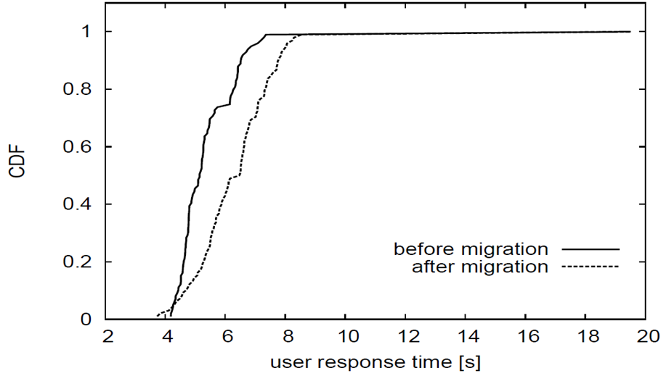
Results
Plan requirements: increase in mean delay less than 10%, increase in variance less than 50%
Algorithm Recommendation: Migrate 1 FE , 3 BL servers
Observed: 17% increase in mean, 12% increase in variance

Slide 20
Campus ERP application architecture
users
78% Internal 22% external
30%
30%
20%
FE₁
FE
10%
FE₂
5%
(3)
5%
(2)
30%
1%
20%
BL₁
BL₂
BL₃
BL₄
BL₅
BL
(7)
(3)
1%
(2)
(2)
(2)
59%
9%
22%
5%
5%
BE₁
BE₂
BE₃
BE₄
BE₅
BE
(1)
(1)
(1)
(1)
(1)
500GB
300GB
700GB
50GB
50GB

Slide 21
Recommendations from planned migration approach
 |  | Recommended components to migrate
Bound on increase in mean delay | Yearly Savings | FE | BL | BE
30% | $58K | migrate all components in full
15% | $38K | FE1(1),FE2 | BL1(1),BL2,BL3,BL4,BL5 | BE2,BE3,BE4,BE5
15% w/ policy | $14K | FE1(1) | BL1(2),BL2,BL4,BL5 | …
Hybrid clouds can achieve cost savings while meeting enterprise policies and delay bounds
See paper for sensitivity studies to benefit ratios

Slide 22
Takeaways
Hybrid cloud models often make sense
Enable cost savings, while meeting enterprise policies and
application response time requirements
Planned approach to migration important and feasible
Algorithms for hybrid cloud layouts
Algorithms for correct reconfiguration of security policies
Open problems
Exploring model complexity and performance inaccuracy
Wider range of application case studies
Take workload and network dynamics into account
What is the right in-cloud approach?
App-rewriting?

Slide 23
CloudNaaS: A Cloud Networking Platform for Enterprise Applications
Theophilus Benson*, Aditya Akella*, Anees Shaikh⁺, Sambit Sahu⁺
(*University of Wisconsin, ⁺ IBM Research)

Slide 24




Current Cloud Offerings
Limited control of the network
Limits the opportunity to migrate production applications
Requires integration of third-party solutions
introduction of cloud networking functions
Subnets and ACLs e.g., “VPC” enhancements
Examples of Missing Features
No ability to create VLANs in the cloud
No facility to manage bandwidth or QoS
Limited ability to craft network segments
No intelligence for dynamically structured networks
Network monitoring e.g., “CloudWatch”
VPN to the enterprise e.g., “Virt Private Cloud”
Third-party
virtual appliances

Server load balancing e.g., “Elastic Load Balancing”
persistent connectivity for services e.g., “elastic IP”
reference: http://broadcast.oreilly.com/2010/12/ cloud-2011-the-year-of-the-network-in-the-cloud.html
base IP connectivity

Slide 25
Contributions
Design and implementation of CloudNaaS
Enforce enterprise policies
Fine-grained control over network
Optimizations to improve scalability
Overcome hardware limitations
Prototyped and evaluated
Different workloads and topologies
Notes:
SDN …. Instead of just PD
Remove this

Slide 26


Questions
 | Currently Supported |  |  |  |  |  | Ideal
 | AWSEC2 | 3Terra | AWS VPC | Amazon Cluster | Oktupus (Microsoft) | SecondNet (Microsoft) | CloudNaaS
Vlan
QoS
Firewall
Middlebox Interposition
Broadcast
Static Addressing
AWS VPC and AWS Cluster can’t be used together

Slide 27
Design Challenges
Operate within physical limitations
Limited network bandwidth
Limited network state (switch memory)
Operate efficiently at large scale
Compute , install, and teardown virtual networks
Recovering virtual network when failures occur
Notes:
Slide 11

Slide 28






Cloud Networking-as-a-Service
self-service UI
Cloud controller
Provides base IaaS service for managing VM instances and images
Self-service provisioning UI
Connects VMs via host virtual switches
Network controller
Provides VM placement directives to cloud controller
Generates virtual network between VMs
Configures physical and virtual switches
Network specification
Cloud controller
Network controller
application
application
middleware
application
middleware
OS
middleware
OS
VM
OS
VM
VM
virtual network

Slide 29

Supported Abstractions
middlebox
resv bandwidth
VLAN / scoped bcast
…
EXTERNAL
virtualnet
- Segments connect groups of VMs
- Associated with network services
networkservice
- Attach capabilities to a virtualnet
- Supports combination of network services
Traffic is allowed to flow only over explicitly defined virtual network segments (“default off”)
Notes:
*remove group
*remove address
Animate backwards…
Remove second bullet.

Slide 30




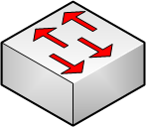
Using CloudNaaS
Cloud Controller
User enter policies
Comm. Matrix created
N/W forwarding state
VM placement decided
VMs placed
Virtual switch installed
N/W state installed
VM
Virtual
Switch
Physical Host
Programmable
Switch
Network Controller
Notes:
Reverse 6/7

Slide 31



Prototype
Cloud Controller: OpenNebula 1.4
Modified to accept user-specified network policies
Modified to accept placement decisions from Network Controller
Network Controller: NOX and OpenFlow-enabled switches
Network controller implemented as a C++ NOX application (~2500 LOC)
HP Procurve 5400 switches w/ OpenFlow 1.0 firmware
VM2
VM4
Network Controller
OpenNebula
Cloud Controller
HOST5
VM8
HOST1
VM1
VM5
SWITCH 2
SWITCH 3
SWITCH 5
VM3
HOST3
HOST2
SWITCH 1
SWITCH 4
HOST4
Notes:
Sub bullets need to be caps
Add the size of the bullets.
Where are the controllers in this picture?

Slide 32
Evaluations
Driven by experiments and simulations
Topology: Canonical 3-tier tree
Size (largest): 270K VMs, 1000 ToR switches, 30K hosts
Default placement scheme: striping
Workloads
Interactive N-tier application (e.g. SharePoint/Exchange)
Batch cluster application (e.g. Hadoop job)
Notes:
Simulations → emulator??
Experimental too microbench performance!!!
List experiments!!
Implementation and evaluation

Slide 33
Results
Speed to compute virtual networks?
120s for largest data center (worst case)
Speed to recover from host failure?
0.2s (with optimizations)
Speed to recover from link/device failure?
2-10s for link failures (0.2s with optimizations)
Device is an order of magnitude more
Notes:
Bullet 2 → Optimize by caching XXXX
Bullet 3 → we propose a list of

Slide 34
Impact of State Optimizations?
Optimizations allow support of 3X more VNs
Most savings at the core
VM placement allows even better scaling
Applications supported: 4X
Algorithms | Virtual switch | ToR | Aggregation | Core | # of Apps
Default Placement | 313 | 13K | 235K | 1068K | 4k
Default placement + Optimizations | 0% | 93% | 95% | 99% | 12.2K
Placement Heuristic + Optimizations | 0% | 99.8% | 99% | 99% | 15.9K

Slide 35
Efficiency of Optimizers
How many more virtual networks are permitted?
Allows applications with more
Bandwidth requirements

Slide 36
Efficiency of Optimizers
What are the performance implications?
Path lengths under different placement schemes

Slide 37
Efficiency of Optimizers
How much network state is saved?

Slide 38
Summary
CloudNaaS allows enterprises to enforce network policies
Recreate data-plane in the cloud
Showed effectiveness and robustness
Increases cloud’s capacity by 4X
Low overhead for creation or deletion of virtual nets
Notes:
Bullet 1 → more like intro .. Recreating n/w in cloud … reword!!!

Slide 39
Questions

