Slide 1
S3 Performance Update
In July 2018, Amazon announced a massive increase in S3 performance
3,500 PUT requests per second
5,500 GET requests
This new increased performance negates the previous guidance to
randomise your object keynames to achieve faster performance
This means logical and sequential naming patterns can now be used
without any performance implication

Slide 2
Question 1
If you encrypt a bucket on S3, what type of encryption does AWS use?
Data Encryption Standard (DES)
International Data Encryption Algorithm (IDEA).
Advanced Encryption Standard (AES) 128
Advanced Encryption Standard (AES) 256

Slide 3
Question 2
When you first create an S3 bucket, this bucket is publicly accessible by
default.
True
False

Slide 4
Question 3
If you want to enable a user to download your private data directly from S3,
you can insert a pre-signed URL into a web page before giving it to your user.
True
False

Slide 5
Question 4
The minimum file size allowed on S3 is 1 byte.
True
False

Slide 6
Question 5
What is the largest size file you can transfer to S3 using a PUT operation?
100MB
1GB
5GB
5TB

Slide 7
Question 6
You are hosting a static website in an S3 bucket that uses Java script to
reference assets in another S3 bucket. For some reason, these assets are
not displaying when users browse to the site. What could be the problem?
Amazon S3 does not support Javascript.
You cannot use one S3 bucket to reference another S3 bucket.
You haven't enabled Cross Origin Resource Sharing (CORS) on the bucket
where the assets are stored.
You need to open port 80 on the appropriate security group in which the S3
bucket is located.

Slide 8
Question 7
You are using S3 in ap-northeast-1 to host a static website in a bucket called
“anmols-bucket”. What would the new URL endpoint be?
https://anmols-bucket.s3-website.ap-northeast-1.amazonaws.com
https://s3.ap-northeast-1.amazonaws.com/anmols-bucket/
http://anmols-bucket.s3-website.ap-northeast-1.amazonaws.com
http://anmols-bucket.s3-website.ap-southeast-1.amazonaws.com

Slide 9
Question 8
S3 provides unlimited storage.
True
False

Slide 10
Question 9
Your application is consistently reading and writing 100s of objects per second to S3 and your workload is steadily rising. What can you do to to achieve the best performance from S3?
Add a hex hash prefix to the objects key name
Configure a CloudFront CDN and use the S3 bucket as the origin
Add a hex hash suffix to the objects key name
Configure an additional bucket and distribute the files evenly between the
two buckets

Slide 11
Question 10
How does S3 determine which partition to use to store files?
S3 automatically stores your files on a random partition
The bucket name determines which partition the file is stored in
By default, all files in the same bucket are stored on the same partition
The key name determines which partition the file is stored in

Slide 12
Question 11
Which of the following encryption methods are supported in S3?
SSE-S3, SSE-AES, SSE-KMS
SSE-S3, SSE-KMS, SSE-C
SSE-C, SSE-AES, SSE-KMS
SSE-S3, SSE-AES, SSE-C

Slide 13
Question 12
Which feature of AWS can you use to configure S3 to allow one S3 bucket
to access files in another S3 bucket?
Bucket ACL
Bucket Policy
IAM Role
CORS

Slide 14
Question 13
What is the HTTP code you would see once you successfully place a file
in an S3 bucket?
404
300
200
512

Slide 15
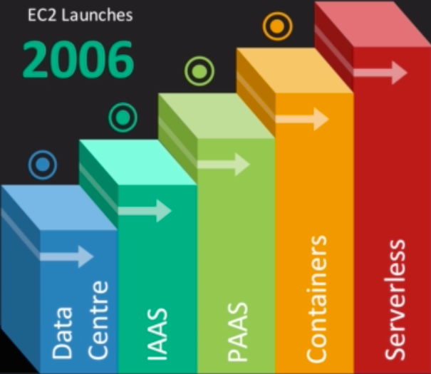
A Brief History of Cloud

Slide 16
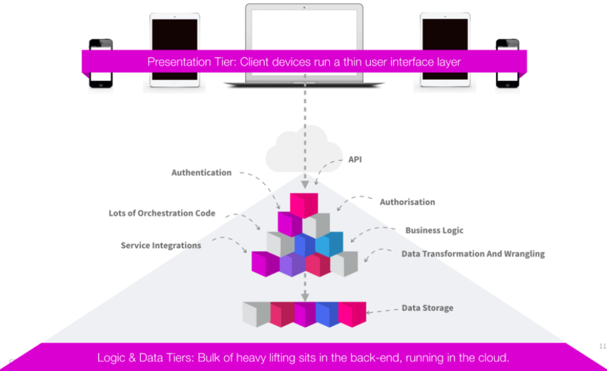
Serverless — the future of software architecture

Slide 17
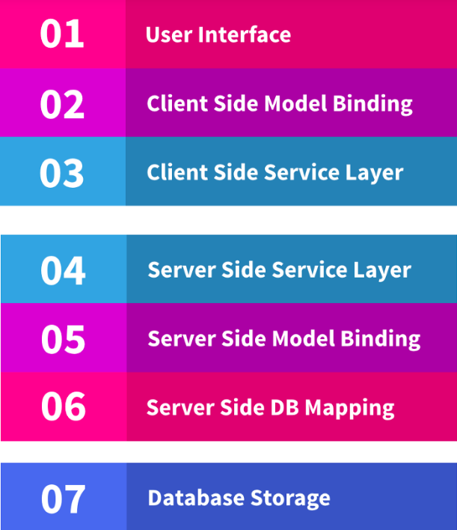

Slide 18
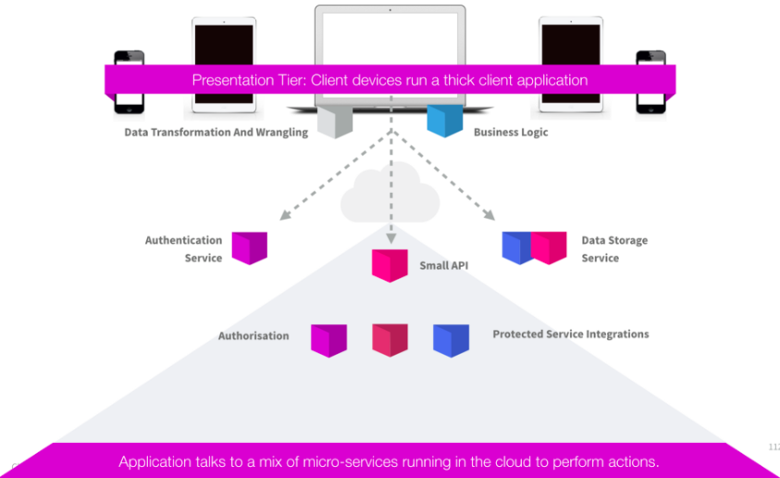
Serverless — the future of software architecture

Slide 19
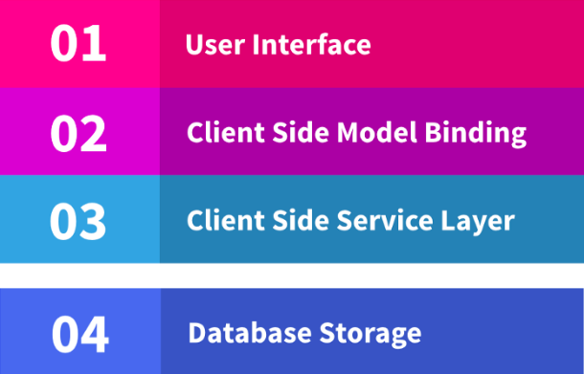
Serverless — the future of software architecture
The future is transitioning from 3-tiered architectures to thick-client apps connected to cloud-based micro-service functions

Slide 20
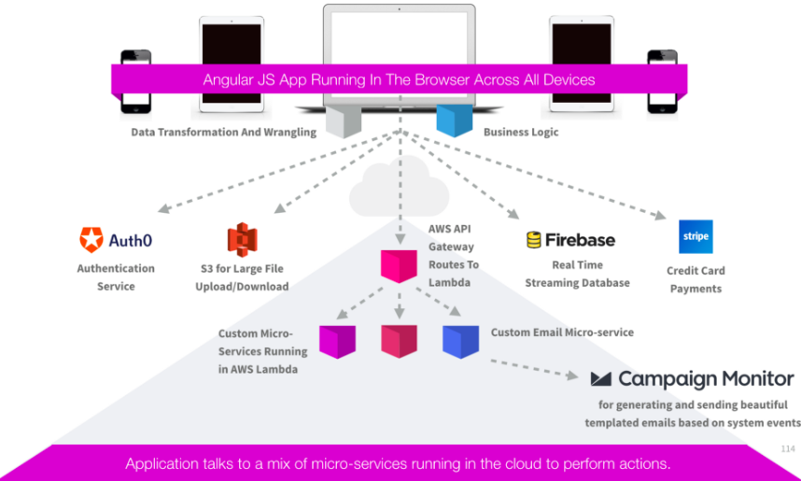
Serverless — the future of software architecture

Slide 21
Serverless Computing
Serverless computing is a cloud computing model which aims to abstract server management and low-level infrastructure decisions away from developers. In this model, allocation of resources is managed by the cloud provider instead of the application architect, which can bring some serious benefits. In other words, serverless aims to do exactly what it sounds like — allow applications to be developed without concerns for implementing, tweaking, or scaling a server (at least, to the perspective of a user).

Slide 22

Functions as a Service
FaaS is a relatively new concept that was first made available in 2014 by hook.io and is now implemented in services such as AWS Lambda, Google Cloud Functions, IBM OpenWhisk and Microsoft Azure Functions. It provides a means to achieve the serverless dream allowing developers to execute code in response to events without building out or maintaining a complex infrastructure. What this means is that you can simply upload modular chunks of functionality into the cloud that are executed independently. Imagine the possibilities! Instead of scaling a monolithic REST server to handle potential load, you can now split the server into a bunch of functions which can be scaled automatically and independently.

Slide 23
So what defines serverless architecture?
Operators do not need to run and maintain back-end servers themselves
The vast majority (~ 95% +) of the code-base resides in the front-end
The code that resides in the cloud is only the code that absolutely must —
as an example, for security purposes some work must be done with access
to secrets that the user’s browser cannot be trusted with
The front end acts as the orchestrator calling a rich array of cloud-based
services to perform specific functions — such as taking a credit card
payment, giving access to protected resources, shooting off emails or push
notifications in response to events
It’s important to note that this doesn’t mean there aren’t any servers.
Of course there are, but someone else is managing, securing, maintaining
and patching them, taking the load and responsibility off your shoulders
and freeing you up to focus on building your unique product.

Slide 24
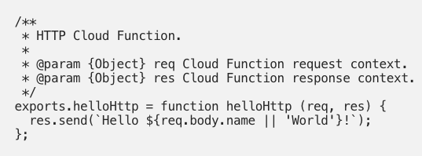
Functions as a Service
As an illustration, here’s all the code you would need to deploy a fully scalable and useable function to the cloud. This is a simple HTTP request written in NodeJS that displays “Hello World” or “Hello (name)” if you pass in a parameter.

Slide 25
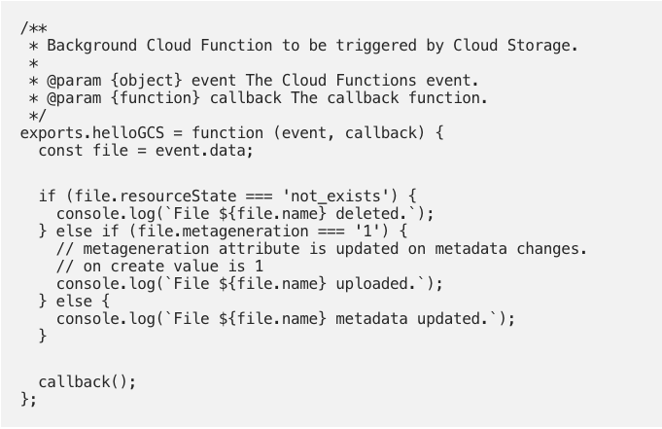
Functions as a Service
This is an example of a function that can react to changes in a Google Cloud Storage bucket (i.e. file upload, deletion and metadata changes). It’s pretty damn cool that we can simply write and deploy a JavaScript function and be confident in its availability, scalability AND cost-efficiency!

Slide 26
FaaS Advantages
Fewer developer logistics — server infrastructure management is handled
by someone else.
More time focused on writing code / app specific logic — higher developer
velocity.
Inherently scalable. Rather than scaling your entire application you can
scale your functions automatically and independently with usage.
Never pay for idle resources.
Built in availability and fault tolerance.
Business logic is necessarily modular and conform to minimal shippable
unit sizes.
Faas Use Cases - Web apps, Backends, Data/stream processing, Chatbots,
Scheduled tasks, IT Automation

Slide 27
FaaS Disadvantages
Decreased transparency. Someone else is managing your infrastructure
so it can be tough to understand the entire system.
Potentially tough to debug. There are tools that allow remote debugging
and some services provide a mirrored local development environment but
there is still a need for improved tooling.
Auto-scaling of function calls often means auto-scaling of cost. This can
make it tough to gauge your business expenses.
You now have a ton of functions deployed and it can be tough to keep track
of them. This comes down to a need for better tooling (developmental:
scripts, frameworks, diagnostic: step-through debugging, local runtimes,
cloud debugging, and visualisation: user interfaces, analytics, monitoring).
Solutions for caching resources between stateless requests
It’s important to note that FaaS isn’t a hammer that you can use for every
nail. Many of its disadvantages can be attributed to its infancy.

Slide 28
AWS Lambda
Run code without thinking about servers.
Pay only for the compute time you consume.

Slide 29
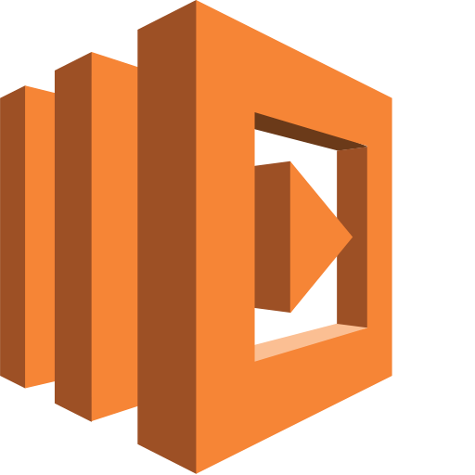
With Lambda, you can run code for virtually any type of application or backend service - all with zero administration. Just upload your code and Lambda takes care of everything required to run and scale your code with high availability. You can set up your code to automatically trigger from other AWS services or call it directly from any web or mobile app.

Slide 30





When you’re building applications you want them to deliver a great experience for your users
Maybe you want your application to generate in-app purchase options during a gaming session
Rapidly validate street address updates
Or make image thumbnails available instantly after a user uploads photos

Slide 31

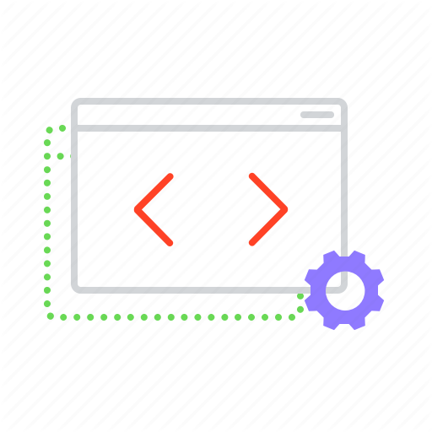
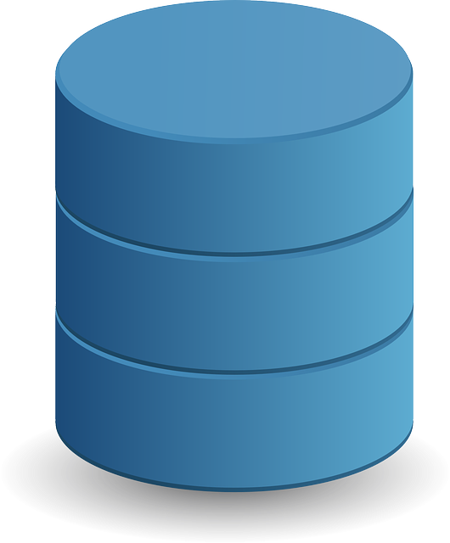
S3
To make this magic happen your application needs back-end code that runs in response to events like image uploads, in-app activity, website clicks or sensor outputs
Wouldn’t it be nice if you could just focus on building great applications without having to spend lots of time managing servers
But managing the infrastructure to host and execute back-end code requires you to size, provision and scale a bunch of servers, manage operating system updates, apply security patches and then monitor all this infrastructure for performance and availability

Slide 32



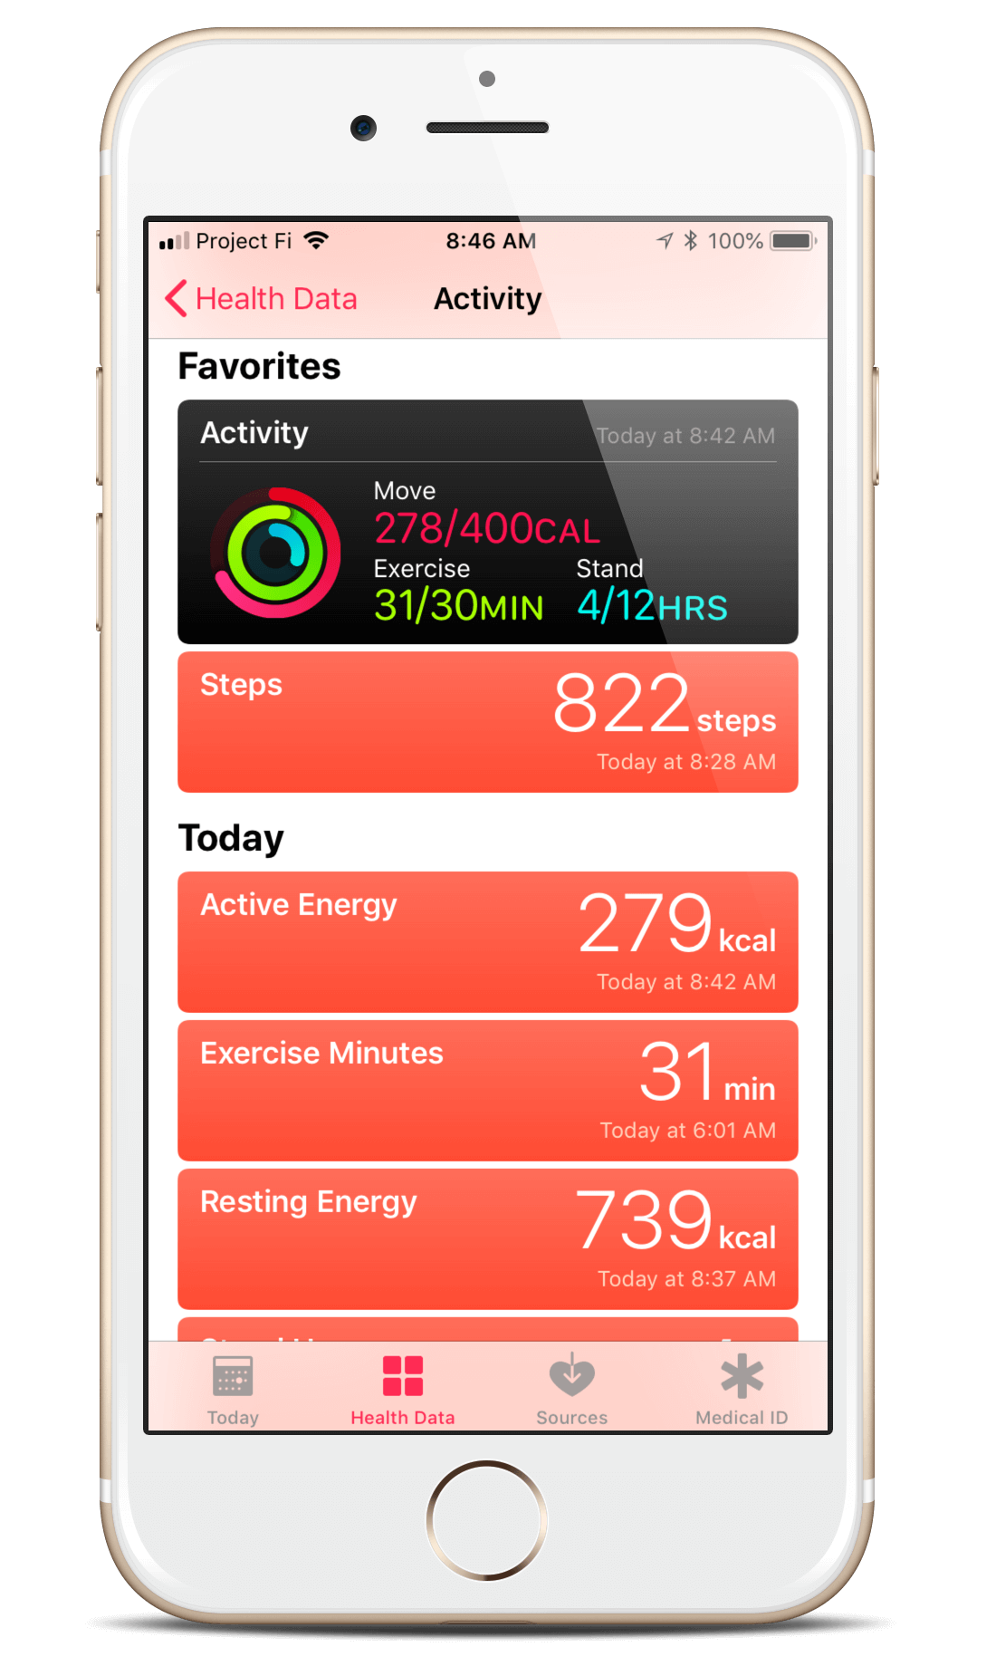
AWS Lambda is a compute service that runs your backend code in response to events like -
Object uploads to Amazon S3 buckets
Updates to Amazon DynamoDB tables
Data in Amazon Kinesis streams
Or in-app activity

Slide 33

S3
Once you upload your code to Lambda the service handles all the capacity, scaling, patching and administration of the infrastructure to run your code
And provides visibility into performance by publishing real-time metrics and logs to Amazon CloudWatch
All you need to do is write the code

Slide 34
AWS Lambda is very low cost and does not require any upfront investment

Slide 35
S3
When you use AWS Lambda you’re simply charged a low fee per request and for the time your code runs measured in increments of 100 milliseconds

Slide 36
Getting started with AWS Lambda is easy

Slide 37



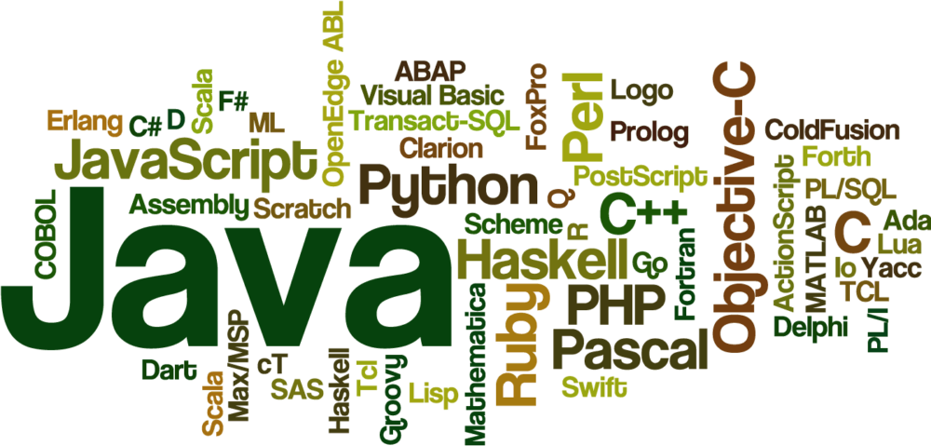
You can use any third-party library even native ones
There are no new languages, tools or frameworks to learn

Slide 38






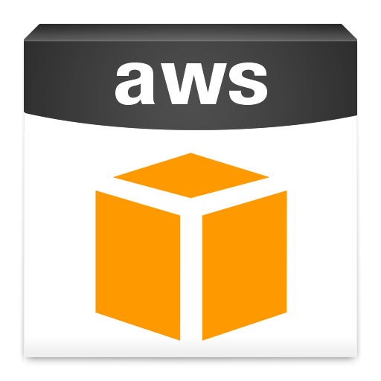
The code you run on AWS Lambda is called a Lambda function
You just upload your code as a zip file
Or design it in the integrated development environment in the AWS management console
Or you can select from a list of function samples pre-built for common use cases such as -
Image Conversion
File Compression
And Change Notifications
And built-in support for the AWS SDK makes it easy to call other AWS services

Slide 39

Once your function is loaded you select the event source to monitor such as an Amazon S3 bucket or Amazon DynamoDB table
And within a few seconds Lambda will be ready to trigger your function automatically when an event occurs
With Lambda any event can trigger your function making it easy to build applications that respond quickly to new information

Slide 40
What is Lambda?
Data Centres
Hardware
Assembly Code / Protocols
High Level Languages
Operating Systems
Application Layer / AWS APIs
AWS Lambda

Slide 41
AWS Lambda Benefits
No servers to manage
Continuous Scaling
Sub-second metering

Slide 42
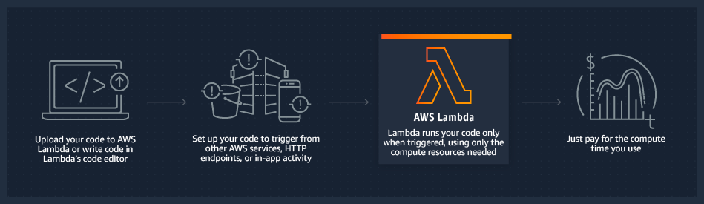
How Lambda Works

Slide 43
AWS Lambda
You can use Lambda in the following ways:
As an event-driven compute service where AWS Lambda runs your code
in response to events. These events could be changes to data in an
Amazon S3 bucket or an Amazon DynamoDB table.
As a compute service to run your code in response to HTTP requests
using Amazon API Gateway or API calls made using AWS SDKs.

Slide 44





Slide 45


Slide 46
AWS Lambda Use Cases
Data Processing
You can use AWS Lambda to execute code in response to triggers such as
changes in data, shifts in system state, or actions by users. Lambda can be
directly triggered by AWS services such as S3, DynamoDB, Kinesis, SNS,
and CloudWatch, or it can be orchestrated into workflows by AWS
Step Functions. This allows you to build a variety of real-time serverless
data processing systems.

Slide 47
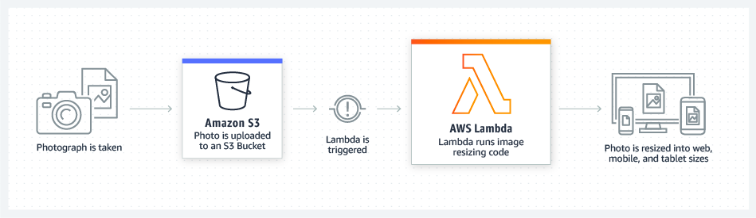
AWS Lambda Use Cases
Real-Time File Processing
You can use Amazon S3 to trigger AWS Lambda to process data
immediately after an upload. For example, you can use Lambda to
thumbnail images, transcode videos, index files, process logs,
validate content, and aggregate and filter data in real-time.

Slide 48

AWS Lambda Use Cases
The Seattle Times uses AWS Lambda to resize images for viewing on different devices such as desktop computers, tablets, and smartphones.

