Slide 1
Step Functions Benefits
Build and update apps quickly
Improve resiliency
Write less code

Slide 2
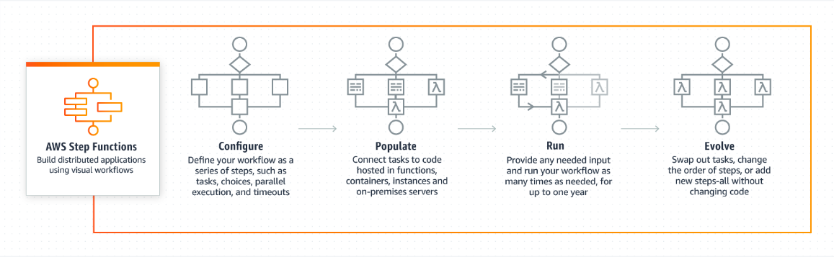
How Step Functions works

Slide 3
Step Functions Use Cases
Data processing
Automate tasks
Modernize a monolith
Application orchestration

Slide 4

Step Functions Customers
Alpha Apps sped up innovation in the fast-moving apps market

Slide 5

Step Functions Customers
The Guardian orchestrated data flow between multiple systems

Slide 6

Step Functions Customers
SGK implemented a dynamic ETL pipeline for significant cost savings

Slide 7

Step Functions Customers
Bigfinite delivered analytics in a highly regulated industry

Slide 8

Step Functions Customers
Yelp used orchestration to safely refactor their largest code base

Slide 9
X-Ray

Slide 10

AWS X-Ray is a service that collects data about requests that your application serves, and provides tools you can use to view, filter, and gain insights into that data to identify issues and opportunities for optimisation. For any traced request to your application, you can see detailed information not only about the request and response, but also about calls that your application makes to downstream AWS resources, micro services, databases and HTTP web APIs.

Slide 11


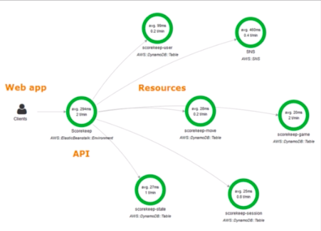

X-Ray Architecture
X-Ray SDK
X-Ray Daemon
X-Ray Console
Scripts & Tools
X-Ray API

Slide 12
X-Ray SDK
The X-Ray SDK provides:
Interceptors to add to your code to trace incoming HTTP requests
Client handlers to instrument AWS SDK clients that your application
uses to call other AWS services
An HTTP client to use to instrument calls to other internal and external
HTTP web services

Slide 13
X-Ray Integration
The X-Ray integrates with the following AWS services:
Elastic Load Balancing
AWS Lambda
Amazon API Gateway
Amazon Elastic Compute Cloud
Amazon Elastic Beanstalk

Slide 14
X-Ray Languages
X-Ray supported languages:
Java
Go
Node.js
Python
Ruby
.Net

Slide 15
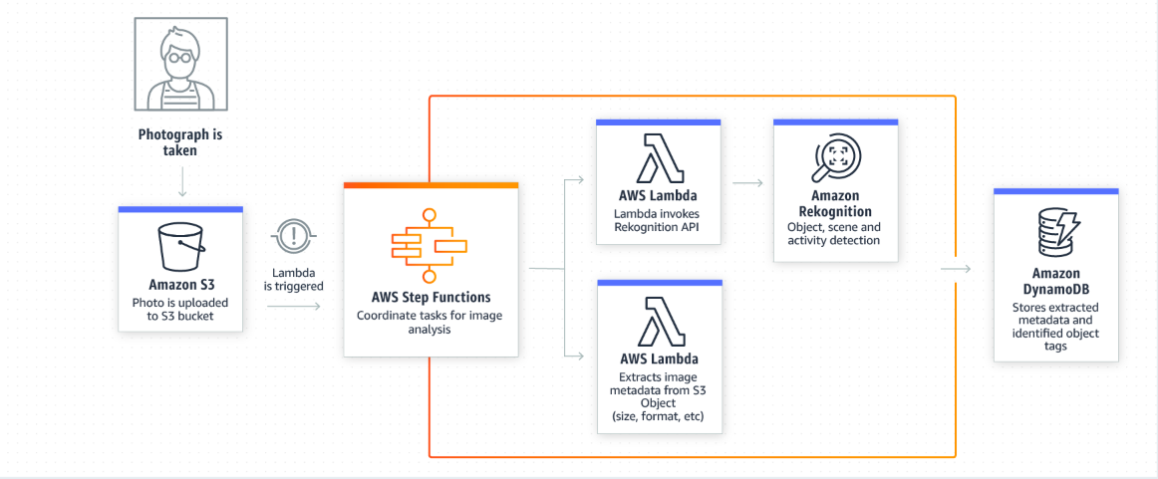
Step Functions Use Cases
Transcode Media Files
You can use Amazon S3 to trigger AWS Lambda to process data
immediately after an upload. For example, you can use Lambda
to thumbnail images, transcode videos, index files, process logs,
validate content, and aggregate and filter data in real-time.

Slide 16
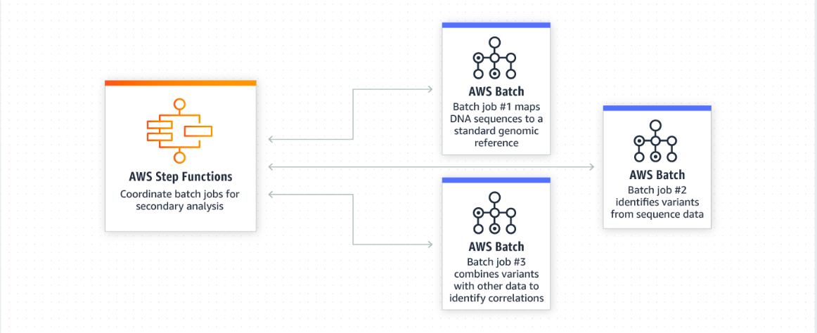
Step Functions Use Cases
Sequence Batch Processing Jobs
You can perform secondary analysis on genomic data to identify
meaningful information that clinicians and researchers can act on
in a timely fashion. Step Functions can coordinate multiple AWS Batch
jobs that takes raw reads generated from sequencers and then processes
them in a genomics pipeline to identify the variation in a biological sample
compared to a standard genome reference. Step Functions will wait for
each job to complete before moving to the next step in the pipeline.

Slide 17
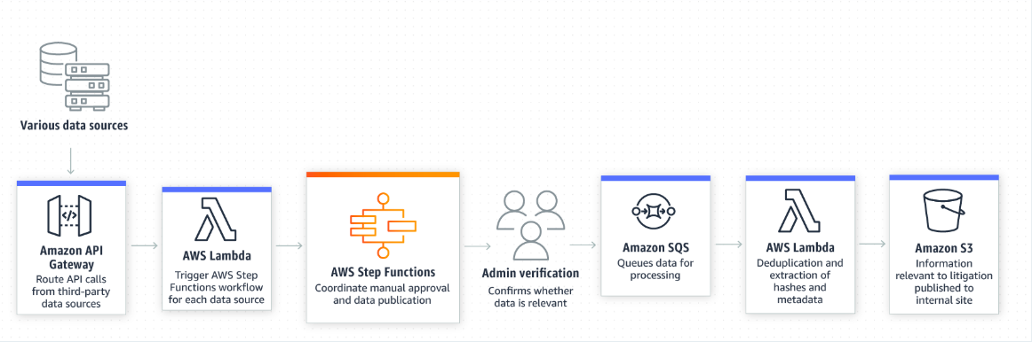
Step Functions Use Cases
Send messages from automated workflows
You can identify valuable data that fits specific criteria related to litigation
cases by using Step Functions to automate processing of the datasets,
which can easily contain millions of records. In this example, various
internet sites and data repositories are monitored, and the Step Functions
workflow manages a manual approval from an administrator before
continuing on to ingest the data. Data is then sent to Amazon SQS.
SQS expands the data, extracts the hashes and metadata about the hashes,
performs any necessary de-duplication, and publishes it to Amazon S3.

Slide 18
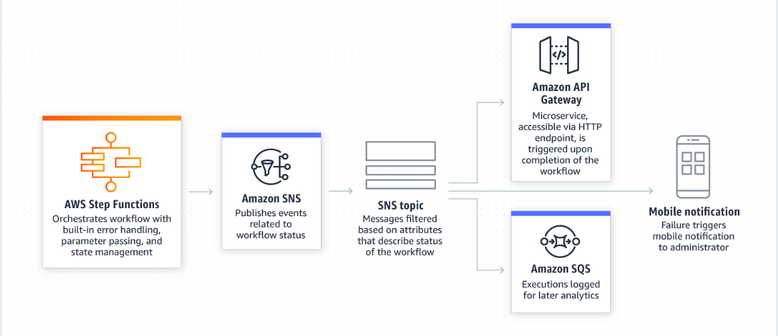
Step Functions Use Cases
Publish Events From Serverless Workflows
You can integrate Amazon SNS into your Step Functions workflows in order
to trigger notifications regarding the success or failure of the workflow.
By taking advantage of SNS message filtering, you can trigger another
micro-service if your workflow succeeds, or notify developers with a
mobile notification if it fails, including the error type and exactly at what
point in the execution the failure happened. At the same time, you can log
the status of each workflow execution in Amazon SQS for later analytics.

Slide 19
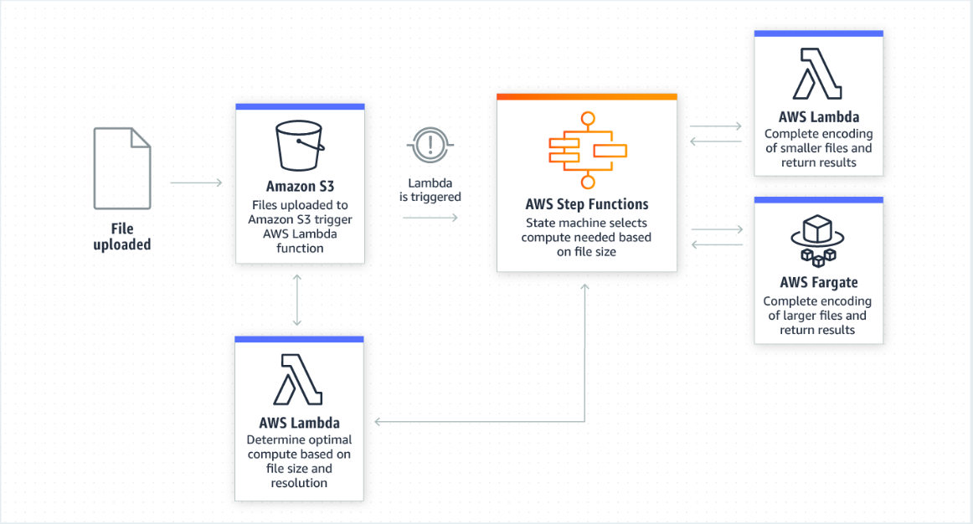
Step Functions Use Cases
Coordinate Container Tasks in Micro-services and Serverless Applications
You can use Step Functions to make decisions about how best to process
data, for example, to do post processing of groups of satellite images to
determine the amount of trees per acre of land. Depending on the size and
resolution of the image, this Step Functions workflow will determine
whether to use AWS Lambda or AWS Fargate to complete post-processing
of each file, in order to optimise runtime and costs.

Slide 20
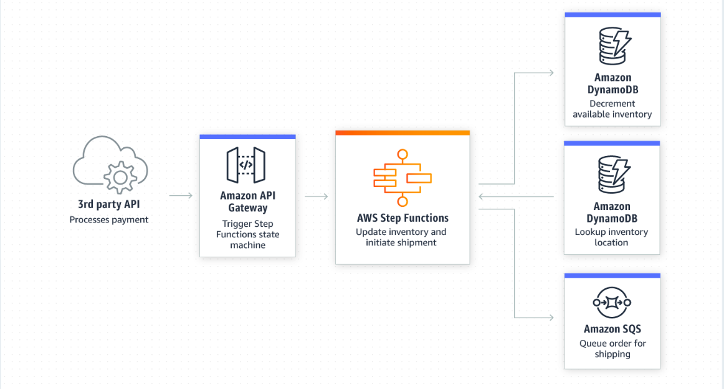
Step Functions Use Cases
Access Databases From Serverless Workflows
Step Functions is ideal for coordinating session-based applications.
You can use Step Functions to coordinate all of the steps of a checkout
process on an ecommerce site, for example. Step Functions can read and
write from Amazon DynamoDB as needed to manage inventory records.

Slide 21
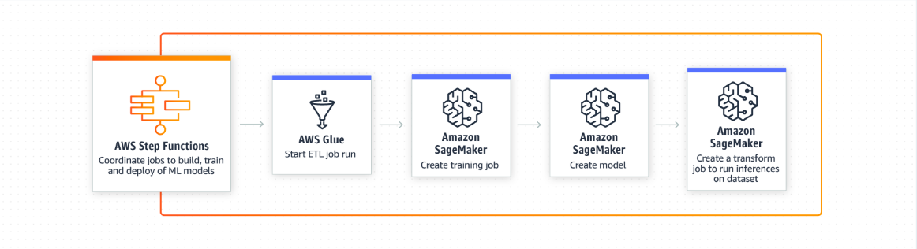
Step Functions Use Cases
Sequence Steps of Machine Learning Workflows
You can use Step Functions to accelerate the delivery of secure, resilient
machine learning applications, all while reducing the amount of code that
you have to write and maintain. Using Step Functions, you can automate
the pre-processing of your data with AWS Glue, create an Amazon
SageMaker job to train your ML model on the data, and then trigger another
SageMaker job to deploy your model into production for online prediction.

Slide 22
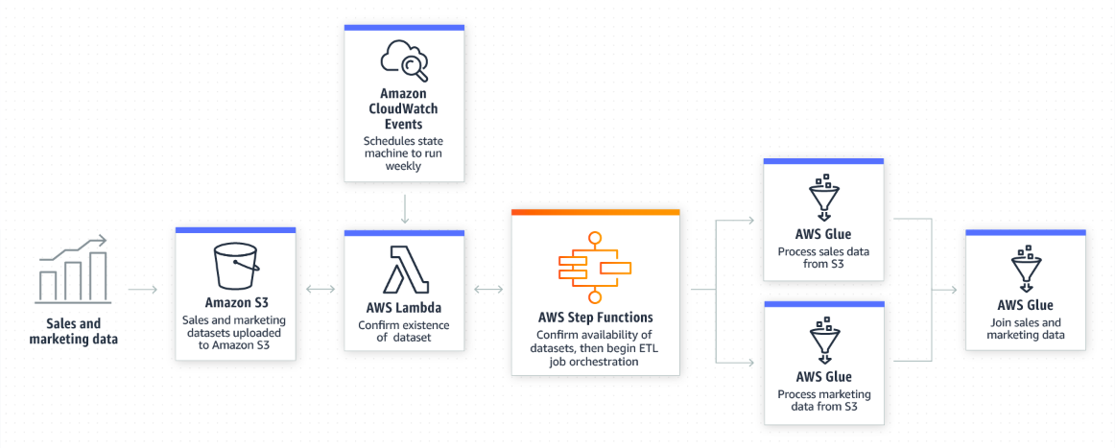
Step Functions Use Cases
Coordinate Extract, Transform and Load (ETL) Jobs
You can use Step Functions to orchestrate multiple ETL jobs involving
a diverse set of technologies in an arbitrarily complex ETL workflow.
For example, you may want to explore the correlations between online
user engagement and forecasted sales revenue and opportunities.
You can use Step Functions to coordinate multiple AWS Glue jobs
to blend and prepare the data for analysis.

Slide 23
Import APIs
You can use the API Gateway Import feature to import an API from
an external definition file into API Gateway. Currently, the Import API
feature supports Swagger v2.0 definition files.
With the Import API, you can either create a new API by submitting a
POST request that includes a Swagger definition in the payload and
endpoint configuration, or you can update an existing API by using a
PUT request that contains a Swagger definition in the payload. You
can update an API by overwriting it with a new definition, or merge a
definition with an existing API. You specify the options using a mode
query parameter in the request URL.

Slide 24
API Throttling
By default, API Gateway limits the steady-state request rate to 10,000
requests per second (rps).
The maximum concurrent requests is 5,000 requests across all APIs
within an AWS account.
If you go over 10,000 requests per second or 5,000 concurrent requests
you will receive a ‘429 Too Many Requests’ error response.

Slide 25
API Throttling
If a caller submits 10,000 requests in a one second period evenly
(for example, 10 requests every millisecond), API Gateway processes
all requests without dropping any.
If the caller sends 10,000 requests in the first millisecond, API Gateway
serves 5,000 of those requests and throttles the rest in the one-second
period.
If the caller submits 5,000 requests in the first millisecond and then
evenly spreads another 5,000 requests through the remaining 999
milliseconds (for example, about 5 requests every millisecond), API
Gateway processes all 10,000 requests in the one-second period
without returning ‘429 Too Many Requests’ error responses.

Slide 26
Question 1
You work for a gaming company that has built a serverless application on
AWS using Lambda, API Gateway and DynamoDB. They release a new version
of the Lambda function and the application stops working. You need to get
the application up and back online as fast as possible. What should you do?
Roll your Lambda function back to the previous version.
Create a CloudFormation template of the environment. Deploy this template
to a separate region and then redirect Route 53 to the new region.
The new function has some dependencies not available to Lambda.
Redeploy the application on EC2 and put the EC2 instances behind a
network load balancer.
DynamoDB is not serverless and is causing the error. Migrate your database
to RDS and redeploy the lambda function.

Slide 27
Question 2
You have created a serverless application which converts text into speech
using a combination of S3, API Gateway, Lambda, Polly, DynamoDB and SNS.
Your users complain that only some text is being converted, whereas longer
amounts of text do not get converted. What could be the cause of this
problem?
AWS X-Ray service is interfering with the application and should be disabled.
Your Lambda function needs a longer execution time. You should check
how long is needed in the fringe cases and increase the timeout inside the
function to slightly longer than that.
You've placed your DynamoDB table in a single availability zone which is
currently down, causing an outage.
Polly has built-in censorship, so if you try and send it text that is deemed
offensive, it will not generate an MP3.

Slide 28
Question 3
You have created a simple serverless website using S3, Lambda, API Gateway
and DynamoDB. Your website will process the contact details of your
customers, predict an expected delivery date of their order and store their
order in DynamoDB. You test the website before deploying it in to production
and you notice that although the page executes, and the lambda function is
triggered, it is unable to write to DynamoDB. What could be the cause of this
issue?
The availability zone that DynamoDB is hosted in is down.
The availability zone that Lambda is hosted in is down.
Your lambda function does not have the sufficient Identity Access
Management (IAM) permissions to write to DynamoDB.
You have written your function in Python which is not supported as a
run time environment for Lambda.

Slide 29
Question 4
You have created an application using serverless architecture using Lambda,
API Gateway, S3 and DynamoDB. Your boss asks you to do a major upgrade
to API Gateway and you do this and deploy it to production. Unfortunately
something has gone wrong and now your application is offline. What should
you do to bring your application up as quickly as possible?
Restore your previous API gateway configuration using an EBS snapshot.
Roll back your API Gateway to the previous stage.
Restart API Gateway for the new changes to take effect.
Delete the existing API Gateway.

Slide 30
Question 5
You have an internal API that you use for your corporate network. Your
company has decided to go all in on AWS to reduce their data centre footprint.
They will need to leverage their existing API within AWS. What is the most
efficient way to do this.
Use the Swagger Importer tool to import your API in to API Gateway.
Replicate your API to API Gateway using the API Replication Master.
Recreate the API manually.
Use AWS API Import/Export feature of AWS Storage Gateway.

Slide 31
Question 6
You have launched a new web application on AWS using API Gateway,
Lambda and S3. Someone posts a thread to reddit about your application
and it starts to go viral. You start receiving 10,000 requests every second
and you notice that most requests are similar. Your web application begins
to struggle. What can you do to optimise performance of your application?
Enable API Gateway caching to cache frequent requests.
Enable API Gateway Accelerator.
Migrate your API Gateway to a Network Load Balancer and enable
session stickiness for all sessions.
Change your route53 alias record to point to AWS Neptune and then
configure Neptune to filter your API requests to genuine requests only.

Slide 32
Question 7
You are developing a new application using serverless infrastructure and
are using services such as S3, DynamoDB, Lambda, API Gateway, CloudFront,
CloudFormation and Polly. You deploy your application to production and
your end users begin complaining about receiving a HTTP 429 error.
What could be the cause of the error?
Your lambda function does not have sufficient permissions to read to
DynamoDB and this is generating a HTTP 429 error.
You have an S3 bucket policy which is preventing Lambda from being able
to write files to your bucket, generating a HTTP 429 error.
You enabled API throttling for a rate limit of 1000 requests per second while
in development and now that you have deployed to production your API
Gateway is being throttled.
Your CloudFormation stack is not valid and is failing to deploy properly
which is causing a HTTP 429 error.

Slide 33
Question 8
You are a developer for a busy real estate company and you want to enable
other real estate agents to the ability to show properties on your books, but
skinned so that it looks like their own website. You decide the most efficient
way to do this is to expose your API to the public. The project works well,
however one of your competitors starts abusing this, sending your API tens
of thousands of requests per second. This generates an HTTP 429 error.
Each agent connects to your API using individual API keys. What actions
can you take to stop this behaviour?
Deploy multiple API Gateways and give the agent access to another
API Gateway.
Throttle the agents API access using the individual API Keys
Use AWS Shield Advanced API protection to block the requests.
Place an AWS Web Application Firewall in front of API Gateway and filter the requests.

Slide 34
Question 9
How does API Gateway deal with legacy SOAP applications?
Converts the response from the application to REST.
Converts the response from the application to XML.
Converts the response from the application to HTML.
Provides web-service passthrough for SOAP applications.

Slide 35
DynamoDB

Slide 36
Amazon DynamoDB is a fast and flexible NoSQL database service for all applications that need consistent, single-digit millisecond latency at any scale. It is a fully managed database and supports both document and key-value data models. Its flexible data models and reliable performance make it a great fit for mobile, web, gaming, ad-tech, IoT, and many other applications.

Slide 37
DynamoDB
Stored on SSD storage
Spread across 3 geographically distinct data centres
Choice of 2 consistency models:
Eventual Consistent Reads (Default)
Strongly Consistent Reads

Slide 38
DynamoDB
Eventually Consistent Reads:
Consistency across all copies of data is usually reached within a second.
Repeating a read after a short time should return the updated data.
(Best Read Performance)
Strongly Consistent Reads:
A strongly consistent read returns a result that reflects all writes that
received a successful response prior to the read.

Slide 39
DynamoDB
Tables
Items (think a row of data in a table)
Attributes (think of a column of data in a table)
Supports key-value and document data structures
Key = the name of the data, Value = the data itself
Documents can be written in JSON, HTML or XML

Slide 40
DynamoDB - Primary Keys
DynamoDB stores and retrieves data based on a Primary Key
2 types of Primary Key:
Partition Key - unique attribute (e.g. userID)
Value of the partition key is input to an internal hash function which
determines the partition or physical location on which the data is stored.
If you are using the partition key as your primary key, then no two items
can have the same partition key

Slide 41
DynamoDB - Primary Keys
Composite Key (Partition Key + Sort Key) in combination
E.g. Same user posting multiple times to a forum
Primary key would be a composite key consisting of:
Partition Key - userID
Sort Key - timestamp of the post
2 items may have the same partition key, but they must have a
different sort key
Allows you to store multiple items with the same partition key

Slide 42
DynamoDB - Students Table
{
“UniqueID” : 1975,
“FirstName” : “Allan”,
“Surname” : “Brown”,
“Phone” : “555-2323”
}
Partition Key
{
“UniqueID” : 1976,
“FirstName” : “Riad”,
“Surname” : “Ramanov”,
“CourseName” : “AWS_Developer_Associate”
“Address” : {
“Number” : 5,
“Street” : “River Road”
}
}
Partition Key
Sort Key

Slide 43
DynamoDB Access Control
Authentication and Access Control is managed using AWS IAM
You can create an IAM user within your AWS account which has specific
permissions to access and create DynamoDB tables.
You can create an IAM role which enables you to obtain temporary access
keys which can be used to access DynamoDB.
You can also use a special IAM Condition to restrict user access to only
their own records.

Slide 44
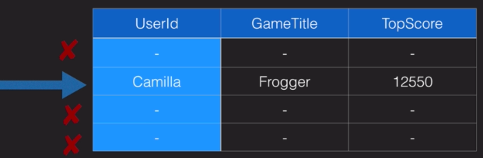
IAM Conditions Example
Imagine a mobile gaming application with millions of users
Users need to access the high scores for each game they are playing
Access must be restricted to ensure they cannot view anyone else’s data
This can be done by adding a condition to an IAM Policy to allow access
only to items where the Partition Key value matches their UserID

Slide 45
IAM Conditions Example
“Sid”: “AllowAccessToOnlyItemsMatchingUserID”,
“Effect”: “Allow”,
“Action”: [
“dynamodb:GetItem”,
“dynamodb:PutItem”,
“dynamodb:UpdateItem”,
],
“Resource”: [
“arn:aws:dynamodb:eu-west-1:123456789012:table/HighScores”
],
“Condition”: {
“ForAllValues:StringEquals”: {
“dynamodb:LeadingKeys”: [
“${www.mygame.com:user_id}"
],
“dynamodb:Attributes”: [
“UserID”,
“GameTitle”,
“TopScore”
]
}
}
Statement
Identifier
Defines the actions that
the policy allows
Allows users to access
only the items where
the Partition Key value
matches their UserID
Defines the attributes
that the policy applies to

Slide 46
What is an Index ?
In SQL databases, an index is a data structure which allows you to perform
fast queries on specific columns in a table. You select the columns that
you want included in the index and run your searches on the index - rather
than on entire dataset
In DynamoDB, 2 types of index are supported to help speed-up your
DynamoDB queries:
Local Secondary Index
Global Secondary Index

Slide 47
Local Secondary Index
Can only be created when you are creating your table
You cannot add, remove, or modify it later
It has the same Partition Key as your original table
But a different Sort Key
Gives you a different view of your data, organised according to an
alternative Sort Key
Any queries based on this Sort Key are much faster using the index
than the main table
E.g. Partition Key : UserID
Sort Key : account creation date

Slide 48
Global Secondary Index
You can create when you create your table, or add it later
Different Partition Key as well as a different Sort Key
So gives a completely different view of the data
Speeds up any queries relating to this alternative Partition and Sort Key
E.g. Partition Key : email address
Sort Key : last log-in date

