Slide 1
Identity Access Management

Slide 2

IAM allows you to manage users and their level of access to the AWS console. It is important to understand IAM and how it works, both for the exam and for administrating an AWS account in real life.

Slide 3
What does IAM give you?
Centralised control of your AWS account
Shared access to your AWS account
Granular permissions
Identity Federation (including Active Directory, Facebook, LinkedIn, etc.)
Multi-factor authentication
Provides temporary access for users/devices and services
Allows you to set up your own password rotation policy
Integrates with many different AWS services
Supports PCI DSS Compliance
IAM is universal. It does not apply to regions at this time.

Slide 4
Critical Terms
Users - End users
Groups - A collection of users under one set of permissions
Roles - You create roles and can then assign them to AWS resources
Policies - A document that defines one (or more) permissions
Root Account - The account created when you first setup your AWS
account. It has complete Admin access.

Slide 5
Question 1
Which of the following is NOT a feature of IAM?
Centralised control of your AWS account
Integrates with existing active directory account allowing single sign on
Fine-grained access control to AWS resources
Allows you to setup biometric authentication, so that no passwords are
required

Slide 6
Question 2
AWS recommends that EC2 instances have credentials stored on them so
that the instances can access other resources (such as S3 buckets).
True
False

Slide 7
Question 3
Which IAM entity can you use to delegate access to your AWS resources to
users, groups or services?
IAM User
IAM Web Identity Federation
IAM Role
IAM Group

Slide 8
Question 4
In AWS, what is IAM used for?
Secure VPN access to AWS
Creating and managing users and groups, managing access to AWS
services & assigning permissions to allow and deny access to AWS
resources
To move large amounts of data (Terrabytes) in to AWS
IAM is a serverless compute platform

Slide 9
Question 5
What is an IAM Policy?
A csv file which contains a user’s Access Key and Secret Access Key
A JSON document which defines one or more permissions
A file containing a user’s private ssh key
The policy which determines how your AWS bill will be paid

Slide 10
Question 6
Which is the best way to enable your EC2 instance to read files in an S3
bucket?
Create a new IAM user and grant read access to S3. Store the user’s
credentials locally on the EC2 instance and configure your application to
to supply the credentials with each API request
Configure a bucket policy which grants read access based on the EC2
instance name
Create an IAM role with read access to S3 and assign the role to the EC2
instance
Create a new IAM role and grant read access to S3. Store the role’s
credentials locally on the EC2 instance and configure your application to
supply the credentials with each API request

Slide 11
Question 7
Which statement best describes IAM?
IAM allows you to manage users, groups, and roles and their
corresponding level of access to the AWS Platform
IAM allows you to manage users' passwords only. AWS staff must
create new users for your organisation. This is done by raising a ticket.
IAM allows you to manage permissions for AWS resources only.
IAM stands for Improvised Application Management, and it allows you
to deploy and manage applications in the AWS Cloud

Slide 12
EC2
Secure and resizable compute capacity in the cloud. Launch applications when needed without upfront commitments.

Slide 13

Amazon EC2’s simple web service interface allows you to obtain and configure capacity with minimal friction. It provides you with complete control of your computing resources and lets you run on Amazon’s proven computing environment. Amazon EC2 reduces the time required to obtain and boot new server instances to minutes, allowing you to quickly scale capacity, both up and down, as your computing requirements change.

Slide 14
Amazon EC2 changes the economies of computing by allowing you to pay only for capacity that you actually use. Amazon EC2 provides developers the tools to build failure resilient applications and isolate themselves from common failure scenarios

Slide 15
EC2 Benefits
Elastic web-scale computing
Completely controlled
Flexible cloud hosting services
Integrated
Reliable
Secure
Inexpensive
Easy to Start

Slide 16








EC2 Featured Customers

Slide 17
EC2 Options
On Demand - Allows you to pay a fixed rate by the hour (or by the second)
with no commitment
Reserved - Provides you with a capacity reservation, and offer a significant
discount on the hourly charge for an instance. 1 year or 3 year terms.
Spot - Enables you to bid whatever price you want for instance capacity,
providing for even greater savings if your applications have flexible start
and end times.
Dedicated Hosts - Physical EC2 servers dedicated for your use. Dedicated
Hosts can help you reduce costs by allowing you to use your existing
server-bound software licenses.

Slide 18
On Demand
Perfect for users that want the low cost and flexibility of Amazon EC2
without any up-front payment or long-term commitment
Applications with short term, spiky, or unpredictable workloads that
cannot be interrupted
Applications being developed or tested on Amazon EC2 for the first time

Slide 19
Reserved Instances
Applications with steady state or predictable usage
Applications that require reserved capacity
Users can make up-front payments to reduce their total computing costs
even further
Standard RIs (up to 75% off On-Demand)
Convertible RIs (up to 54% off on-demand) feature the capability to
change the attributes of the RI as long as the exchange results in the
creation of Reserved Instances of equal or greater value
Scheduled RIs are available to launch within the time window you
reserve. This option allows you to match your capacity reservation to a
predictable recurring schedule that only requires a fraction of a day,
a week, or a month

Slide 20
Spot Instances
Applications that have flexible start and end times
Applications that are only feasible at very low compute prices
Users with an urgent need for large amounts of additional computing
capacity
If a Spot instance is terminated by Amazon EC2, you will not be charged
for a partial hour of usage. However, if you terminate the instance yourself,
you will be charged for the complete hour in which the instance ran.

Slide 21
Dedicated Hosts
Useful for regulatory requirements that may not support multi-tenant
virtualisation
Great for licensing which does not support multi-tenancy or cloud
deployments
Can be purchased On-Demand (hourly)
Can be purchased as a Reservation for up to 70% off the On-Demand price

Slide 22
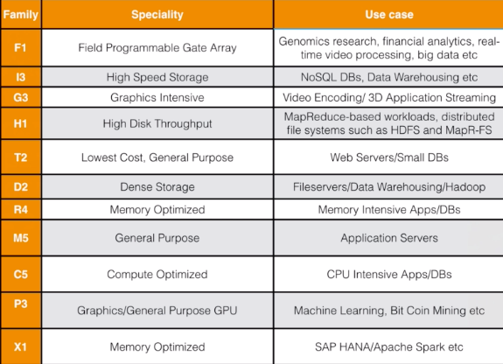
EC2 Instance Types

Slide 23
EC2 Instance Types (2017)
D - Density
R - RAM
M - Main choice for general purpose apps
C - Compute
G - Graphics
I - IOPS
F - FPGA
T - Cheap general purpose (think T2 Micro)
P - Graphics (think Pictures)
X - Extreme memory

Slide 24
EC2 Instance Types (2018)
F - FPGA
I - IOPS
G - Graphics
H - High Disk Throughput
T - Cheap general purpose (think T2 Micro)
D - Density
R - RAM
M - Main choice for general purpose apps
C - Compute
P - Graphics (think Pics)
X - Extreme Memory

Slide 25
EBS

Slide 26

Amazon EBS allows you to create storage volumes and attach them to Amazon EC2 instances. Once attached, you can create a file system on top of these volumes, run a database, or use them in any other way you would use a block device. Amazon EBS volumes are placed in a specific Availability Zone, where they are automatically replicated to protect you from the failure of a single component.

Slide 27
EBS Volume Types
General Purpose SSD - Balances price and performance for a wide variety
of workloads
Provisioned IOPS SSD - Highest-performance SSD volume for mission-
critical low-latency or high-throughput workloads
Throughput Optimised HDD - Low cost HDD volume designed for
frequently accessed, throughput-intensive workloads
Cold HDD - Lowest cost HDD volume designed for less frequently
accessed workloads
Magnetic - Previous generation. Can be a boot volume.

Slide 28
EBS Volume Types
General Purpose SSD (GP2)
General purpose, balances both price and performance
Ratio of 3 IOPS per GB with up to 10,000 IOPS for volumes at 3334
GiB and above and the ability to burst up to 3000 IOPS for extended
periods of time
Provisioned IOPS SSD (IO1)
Designed for I/O intensive applications such as large relational or
NoSQL databases
Use if you need more than 10,000 IOPS
Can provision up to 20,000 IOPS per volume

Slide 29
EBS Volume Types
Throughput Optimised HDD (ST1)
Big Data
Data warehouses
Log processing
Cannot be a boot volume
Cold HDD (SC1)
Lowest Cost Storage for infrequently accessed workloads
File Server
Cannot be a boot volume

Slide 30
EBS Volume Types
Magnetic (Standard)
Lowest cost per gigabyte of all EBS volume types that is bootable.
Magnetic volumes are ideal for workloads where data is accessed
infrequently, and applications where the lowest storage cost is
important.

Slide 31
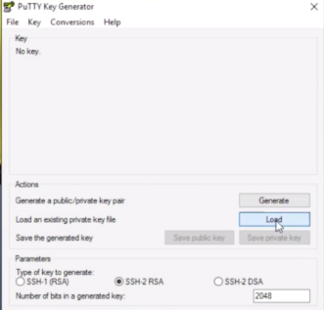

Slide 32
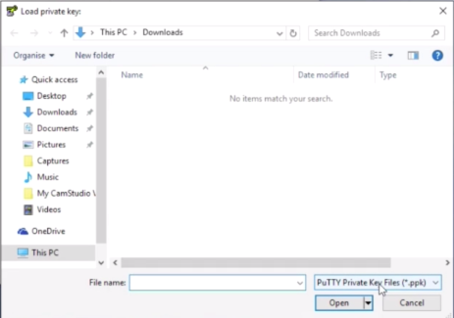

Slide 33
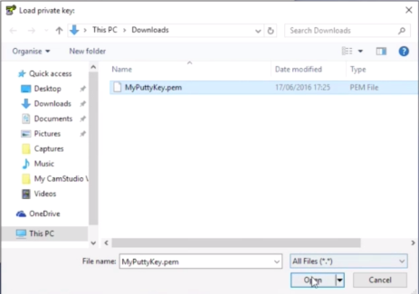

Slide 34
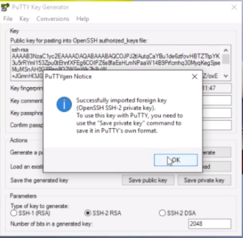

Slide 35
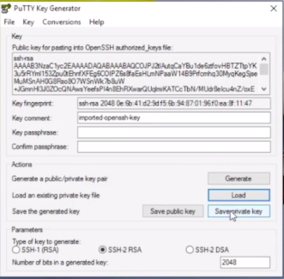

Slide 36
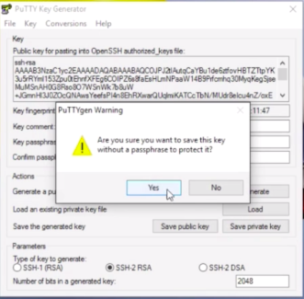

Slide 37
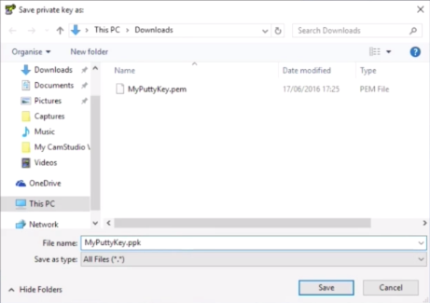

Slide 38
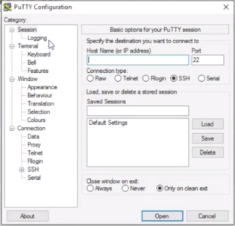

Slide 39
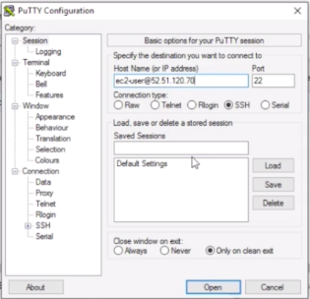

Slide 40
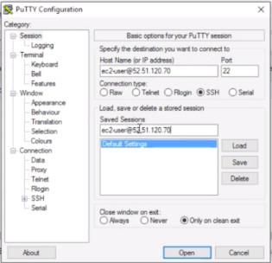

Slide 41


Slide 42
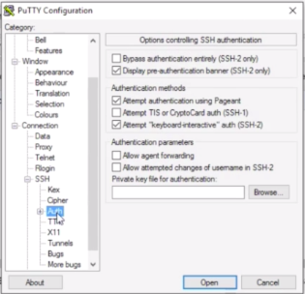

Slide 43
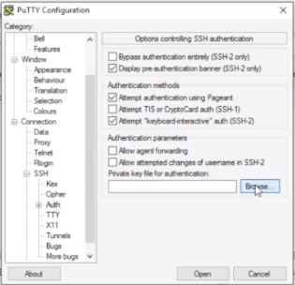

Slide 44
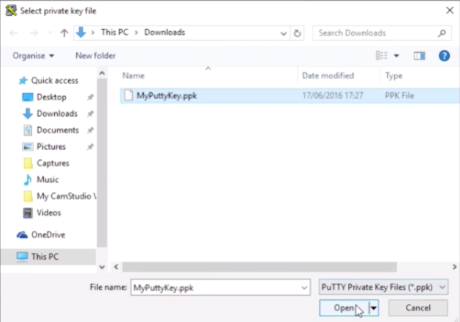

Slide 45
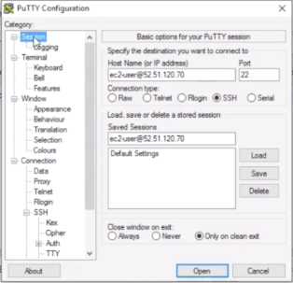

Slide 46
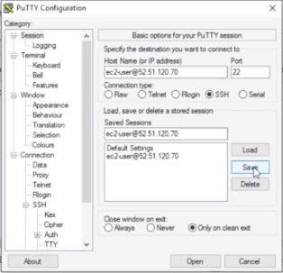

Slide 47
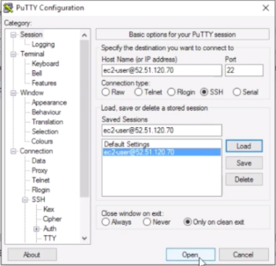

Slide 48
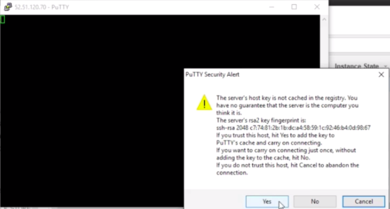

Slide 49
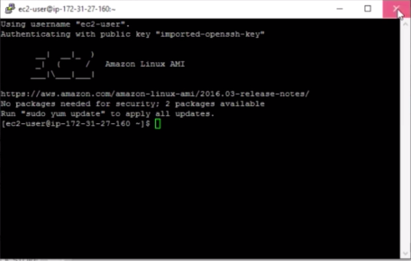

Slide 50
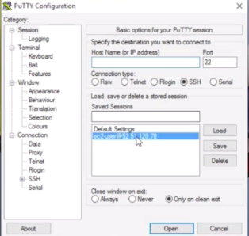

Slide 51
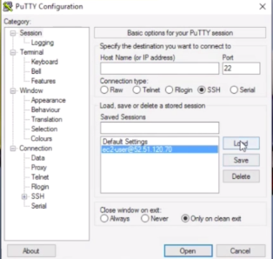

Slide 52
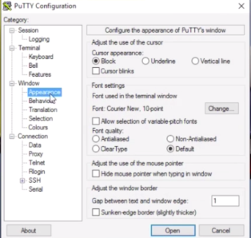

Slide 53
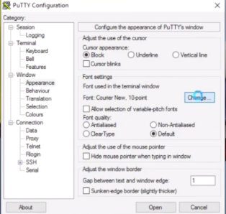

Slide 54
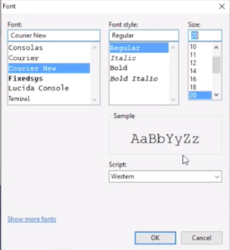

Slide 55
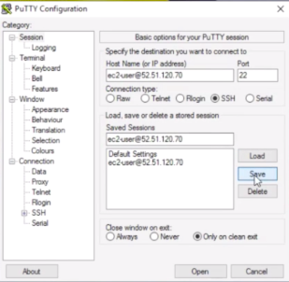

Slide 56
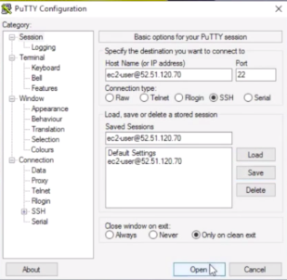

Slide 57
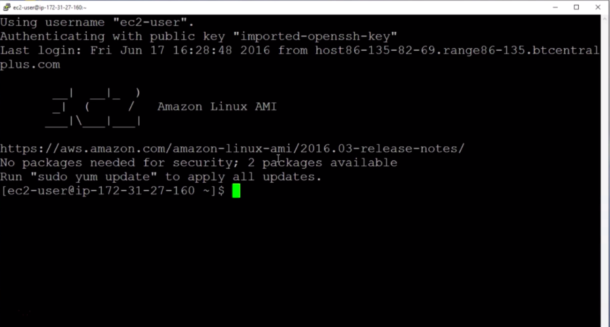

Slide 58
Elastic Load Balancing
Achieve fault tolerance for any application by ensuring scalability, performance, and security

Slide 59

Elastic Load Balancing automatically distributes incoming application traffic across multiple targets, such as Amazon EC2 instances, containers, IP addresses, and Lambda functions. It can handle the varying load of your application traffic in a single Availability Zone or across multiple Availability Zones. Elastic Load Balancing offers three types of load balancers that all feature the high availability, automatic scaling, and robust security necessary to make your applications fault tolerant.

Slide 60
ELB Benefits
Highly available
Secure
Elastic
Flexible
Robust monitoring & auditing
Hybrid load balancing

Slide 61
ELB Use Cases
Achieve better fault tolerance for your applications
Automatically load balance your containerised applications
Automatically scale your applications
Using Elastic Load Balancing in your Amazon Virtual Private Cloud (VPC)
Hybrid load balancing with Elastic Load Balancing
Invoking Lambda functions over HTTP(S)

Slide 62
ELB Features
High availability
Health checks
Security features
TLS termination
Layer 4 or Layer 7 load balancing
Operational monitoring

Slide 63
Types of Load Balancers
Application Load Balancer
Network Load Balancer
Classic Load Balancer

Slide 64
Application Load Balancers
Application Load Balancer operates at the request level (layer 7), routing traffic to targets – EC2 instances, containers, IP addresses and Lambda functions based on
the content of the request. Ideal for advanced load balancing of HTTP and HTTPS
traffic, Application Load Balancer provides advanced request routing targeted at delivery of modern application architectures, including microservices and container-based applications. Application Load Balancer simplifies and improves the security
of your application, by ensuring that the latest SSL/TLS ciphers and protocols are
used at all times.

Slide 65
Application ELB Key Features
Layer-7 Load Balancing
HTTPS Support
Server Name Indication (SNI)
IP addresses as Targets
Lambda functions as Targets
High Availability
Security Features
Content-based Routing - Host-based, Path-based, HTTP header-based,
HTTP method-based, Query string parameter-based, Source IP-based

Slide 66
Application ELB Key Features
Containerised Application Support
HTTP/2 Support
WebSockets Support
Native IPv6 Support
Sticky Sessions
Health Checks
Operational Monitoring
Logging

Slide 67
Application ELB Key Features
Delete Protection
Request Tracing
Web Application Firewall
Slow Start mode with Load-Balancing Algorithm
User Authentication
Redirects
Fixed Response

Slide 68
Network Load Balancers
Network Load Balancer is best suited for load balancing of Transmission Control Protocol (TCP) and Transport Layer Security (TLS) traffic where extreme
performance is required. Operating at the connection level (Layer 4), Network Load Balancer routes traffic to targets within Amazon Virtual Private Cloud (Amazon VPC)
and is capable of handling millions of requests per second while maintaining
ultra-low latencies. Network Load Balancer is also optimised to handle sudden and volatile traffic patterns.

Slide 69
Network ELB Key Features
Connection-based Load Balancing
High Availability
High Throughput
Low Latency
Preserve source IP address
Static IP support
Elastic IP support
TLS Offloading
Health Checks

Slide 70
Network ELB Key Features
DNS Fail-over
Integration with Amazon Route 53
Integration with AWS services
Long-lived TCP Connections
Central API Support
Robust Monitoring and Auditing
Enhanced Logging
Zonal Isolation

Slide 71
Classic Load Balancers
Classic Load Balancers are the legacy Elastic Load Balancers. You can load
balance HTTP/HTTPS applications and use Layer-7 specific features, such as
X-Forwarded and sticky sessions. You can also use strict Layer 4 load balancing
for applications that rely purely on the TCP protocol.
If your application stops responding, the ELB (Classic Load Balancer) responds
with a 504 error.
This means that the application is having issues. This could be
either at the Web Server layer or at the Database Layer.
Identify where the application is failing, and scale it up or out where possible.

Slide 72
Classic ELB Key Features
High Availability
Health Checks
Security Features
SSL Offloading
Sticky Sessions
IPv6 Support
Layer 4 or Layer 7 Load Balancing
Operational Monitoring
Logging

Slide 73




X-Forwarded-For Header

Slide 74
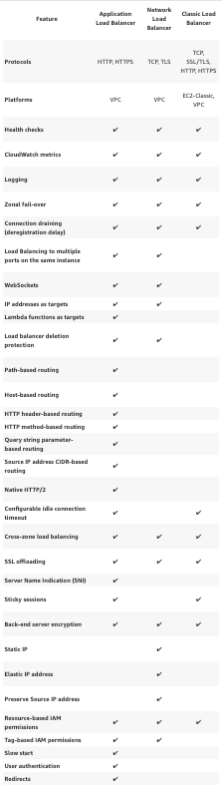
ELB Comparisons

Slide 75
Route 53

Slide 76
Amazon Route 53 is a highly available and scalable Domain Name System (DNS) web service. You can use Route 53 to perform three main functions in any combination: domain registration, DNS routing, and health checking.

Slide 77
Route 53
Allows you to map your domain names to -
EC2 Instances
Load Balancers
S3 Buckets

Slide 78
Amazon Simple Storage Service

Slide 79

Amazon Simple Storage Service (Amazon S3) is storage for the internet. You can use Amazon S3 to store and retrieve any amount of data at any time, from anywhere on the web.

Slide 80
Amazon Relational Database Service (RDS)
Set up, operate, and scale a relational database in the cloud with just a few clicks

Slide 81

Amazon Relational Database Service (Amazon RDS) makes it easy to set up, operate, and scale a relational database in the cloud. It provides cost-efficient and resizable capacity while automating time-consuming administration tasks such as hardware provisioning, database setup, patching and backups. It frees you to focus on your applications so you can give them the fast performance, high availability, security and compatibility they need.

Slide 82
Amazon RDS is available on several database instance types - optimised for memory, performance or I/O - and provides you with six familiar database engines to choose from, including Amazon Aurora, PostgreSQL, MySQL, MariaDB, Oracle Database, and SQL Server. You can use the AWS Database Migration Service to easily migrate or replicate your existing databases to Amazon RDS.

Slide 83
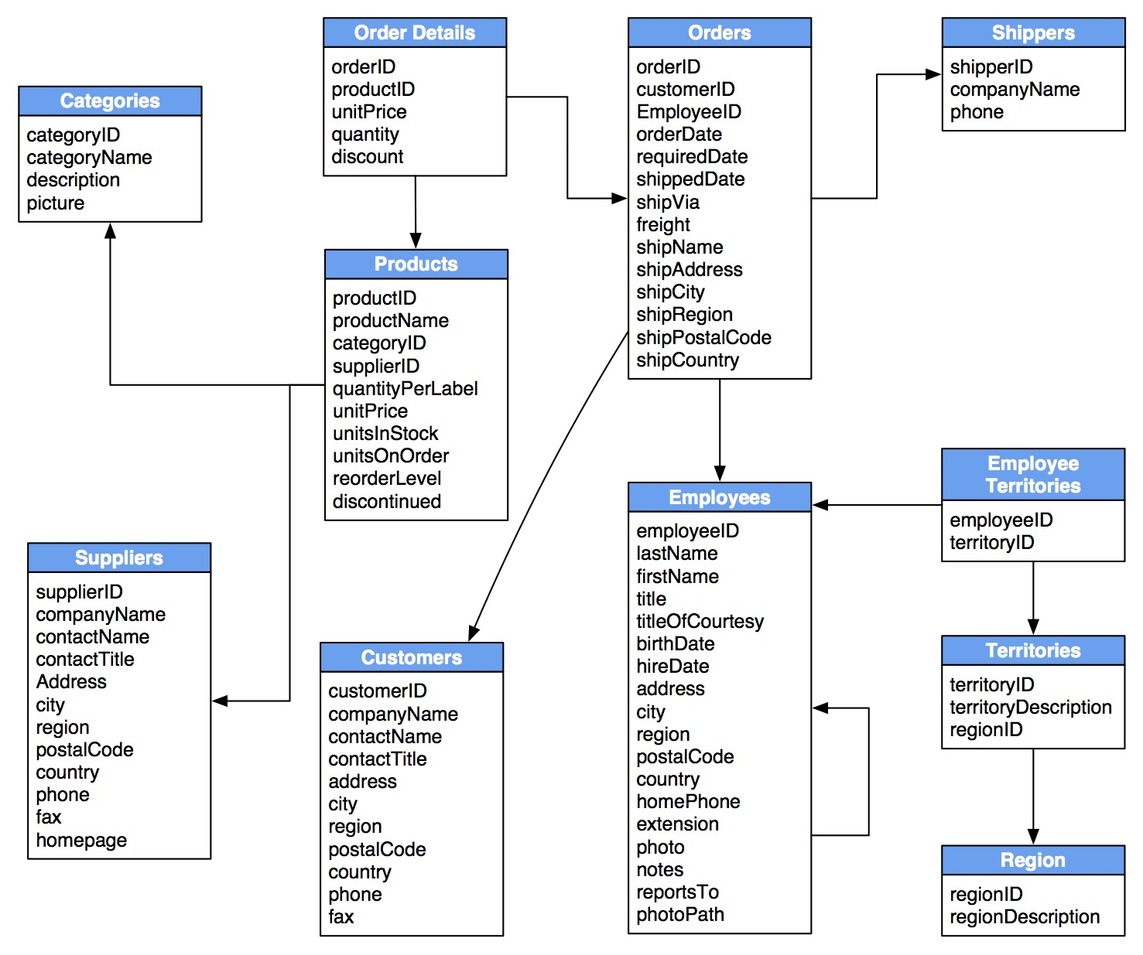

Slide 84






Relational Database Types

Slide 85
Non Relational Databases
Database
Collection = Table
Document = Row
Key Value Pairs = Fields

