Slide 1



What is a Read Replica?

Slide 2
What is a Read Replica?
Amazon RDS Read Replicas enable you to create one or more read-only
copies of your database instance within the same AWS Region or in a
different AWS Region. Updates made to the source database are then
asynchronously copied to your Read Replicas. In addition to providing
scalability for read-heavy workloads, Read Replicas can be promoted to
become a standalone database instance when needed.
MySQL Server
PostgreSQL
MariaDB
Aurora

Slide 3
Read Replica Databases
Used for scaling, not for DR!
Must have automatic backups turned on in order to deploy a read replica
You can have up to 5 read replica copies of any database
You can have read replicas of read replicas (but watch out for latency)
Each read replica will have its own DNS end point
You can have read replicas that have Multi-AZ
You can create read replicas of Multi-AZ source database
Read replicas can be promoted to be their own databases. This breaks
the replication
You can have a read replica in a second region
Combining Read Replicas with Multi-AZ enables you to build a resilient
disaster recovery strategy and simplify your database engine upgrade
process.

Slide 4
Read Replica Databases
You can now use Read Replicas with Multi-AZ as part of a disaster
recovery (DR) strategy for your production databases. A well-designed
and tested DR plan is critical for maintaining business continuity after a
disaster. A Read Replica in a different region than the source database
can be used as a standby database and promoted to become the new
production database in case of a regional disruption.
You can also combine Read Replicas with Multi-AZ for your database
engine upgrade process. You can create a Read Replica of your production
database instance and upgrade it to a new database engine version.
When the upgrade is complete, you can stop applications, promote the
Read Replica to a standalone database instance, and switch over your
applications. Since the database instance is already a Multi-AZ deployment,
no additional steps are needed.

Slide 5
ElastiCache
Managed, Redis or Memcached-compatible in-memory data store

Slide 6

Amazon ElastiCache offers fully managed Redis and Memcached. Seamlessly deploy, run, and scale popular open source compatible in-memory data stores. Build data-intensive apps or improve the performance of your existing apps by retrieving data from high throughput and low latency in-memory data stores. Amazon ElastiCache is a popular choice for Gaming, Ad-Tech, Financial Services, Healthcare, and IoT apps.

Slide 7
Caching improves application performance by storing critical pieces of data in memory for low-latency access. Cached information may include the results of I/O-intensive database queries or the results of computationally-intensive calculations.

Slide 8
ElastiCache Benefits
Extreme Performance
Fully Managed
Scalable

Slide 9
Amazon ElastiCache Engines
ElastiCache supports two open-source in-memory caching engines :
Amazon ElastiCache for Memcached - Manage and analyse fast moving
data with a versatile in-memory data store
Amazon ElastiCache for Redis - Build a scalable Caching Tier for
data-intensive apps

Slide 10
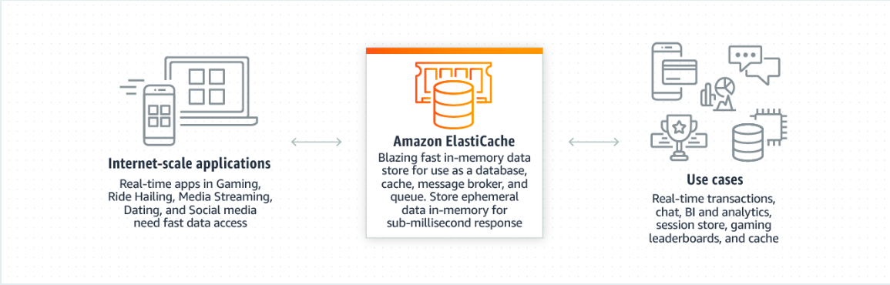
How It Works

Slide 11




ElastiCache Customers

Slide 12

Types of ElastiCache
Memcached
A widely adopted memory object caching system. ElastiCache is protocol
compliant with Memcached, so popular tools that you use today with
existing Memcached environments will work seamlessly with the service.

Slide 13
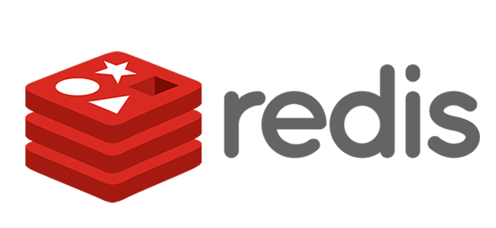
Types of ElastiCache
Redis
A popular open-source in-memory key-value store that supports data
data structures such as sorted sets and lists. ElastiCache supports
Master / Slave replication and Multi-AZ which can be used to achieve
cross AZ redundancy.

Slide 14
Although both Memcached and Redis appear similar on the surface (in that they are both in-memory key stores), they are actually quite different in practice. Because of the replication and persistence features of Redis, ElastiCache manages Redis more as a relational database. Redis ElastiCache clusters are managed as stateful entities that include failover, similar to how Amazon RDS manages database failover.

Slide 15
Because Memcached is designed as a pure caching solution with no persistence, ElastiCache manages Memcached nodes as a pool that can grow and shrink, similar to an Amazon EC2 Auto Scaling Group. Individual nodes are expendable, and ElastiCache provides additional capabilities here, such as automatic node replacement and Auto Discovery.

Slide 16
Existing applications that use Memcached can use ElastiCache with almost no modification. Your applications simply need information about the host names and port numbers of the ElastiCache nodes that you have deployed. The ElastiCache Auto Discovery feature for Memcached lets your applications identify all of the nodes in a cache cluster and connect to them. This means that you don't have to maintain a list of available host names and port numbers. In this way, your applications are effectively insulated from changes to node membership in a cluster.

Slide 17
Amazon ElastiCache for Memcached
ElastiCache for Memcached has multiple features to enhance reliability for critical production deployments:
Automatic detection and recovery from cache node failures.
Automatic discovery of nodes within a cluster enabled for automatic
discovery, so that no changes need to be made to your application when
you add or remove nodes.
Flexible Availability Zone placement of nodes and clusters.
Integration with other AWS services such as Amazon EC2, Amazon
CloudWatch, AWS CloudTrail, and Amazon SNS to provide a secure, high-
performance, managed in-memory caching solution.

Slide 18
Memcached - Use Cases
Is object caching your primary goal, for example to offload your database?
If so, use Memcached.
Are you interested in as simple a caching model as possible? If so, use
Memcached.
Are you planning on running large cache nodes, and require multithreaded
performance with utilisation of multiple cores? If so, use Memcached.
Do you want the ability to scale your cache horizontally as you grow? If so,
use Memcached.

Slide 19
Redis - Use Cases
Are you looking for more advanced data types, such as lists, hashes, and
sets? If so, use Redis.
Does sorting and ranking datasets in memory help you, such as with
leaderboards? If so, use Redis.
Is persistence of your key store important? If so, use Redis.
Do you want to run in multiple AWS Availability Zones (Multi-AZ) with
failover? If so, use Redis.

Slide 20
ElastiCache Exam Tips
Typically, you will be given a scenario where a particular database is under
a lot of stress / load. You may be asked which service you should use to
alleviate this.
ElastiCache is a good choice if your database is particularly read-heavy
and not prone to frequent changing.
Redshift is a good answer if the reason your database is feeling stress is
because management keep running OLAP transactions on it etc.

Slide 21
Question 1
In order to enable encryption at rest using EC2 and Elastic Block Store,
you must ________.
Configure encryption when creating the EBS volume
Configure encryption using the appropriate Operating Systems file system
Configure encryption using X.509 certificates
Mount the EBS volume in to S3 and then encrypt the bucket using a bucket
policy.

Slide 22
Question 2
Individual instances are provisioned ________.
In Regions
In Availability Zones
Globally

Slide 23
Question 3
You are a developer for a genomics firm who are moving their infrastructure
to AWS. Their environment consists of a three tier web application, a web tier,
an application tier and a relational database tier. They have a separate fleet of
virtual machines that are used to access large HPC clusters on the fly. Their
lab researches run multiple projects simultaneously and they will need to
launch and de-commission 1,000's of nodes on-demand while reducing the
time required to complete genomic sequencing from weeks to days. In order
to stay competitive they need to do this at as low cost as possible, with no
long term contracts. These HPC clusters can run any time day or night and
their workloads store information in S3, so the instances can be terminated
at any time without any effect on the data. What is the most COST EFFECTIVE
ec2 pricing model for their requirements?
On-demand.
Spot Instances.
Dedicated Instances.
Reserved Instances.

Slide 24
Question 4
You run the internal intranet for a corporate bank. The intranet consists of a
number of web-servers and single relational database running Microsoft SQL
Server. Your peak demand occurs at 9am every week morning when users are
first logging in to the intranet. They can only log in using the company's
internal network and it is not possible to access the intranet from any location
other than within the office building for security purposes. Management is
considering a change and to move this environment to AWS where users will
be able to access the intranet via a software VPN. You have been asked to
evaluate a migration to AWS and to identify the best EC2 billing model for your
company's intranet. You must keep costs low and to be able to scale at
particular times of day. You must maintain availability of the intranet
throughout office hours. Management do not want to be locked in to any
contracts in case for some reason they want to go back to hosting internally.
What EC2 billing model should you recommend?
On-demand.
Spot Instances.
Dedicated Instances.
Reserved Instances.

Slide 25
Question 5
You are the IT manager at a furniture retailer and they are considering moving
their web application to AWS. They currently colocate their servers in a
colocation facility and the contract for this facility is now coming to an end.
Management are comfortable signing a 3 year contract and want to get the
cheapest web servers as possible while still maintaining availability. Their
traffic is very steady and predictable. What EC2 pricing model would you
recommend to maintain availability and to get the lowest cost price available?
On-demand.
Spot Instances.
Dedicated Instances.
Reserved Instances.

Slide 26
Question 6
You work for a government contractor who supply services that are critical to
national security. Because of this your corporate IT policy states that no
multi-tenant virtualisation is authorised within the company. Despite this,
they are interested in moving to AWS but they cannot violate corporate IT
policy. Which EC2 billing model would you recommend that they use to
achieve this?
On-demand.
Spot Instances.
Dedicated Instances.
Reserved Instances.

Slide 27
Question 7
Your company has a web application on AWS. The application computes
thousands of algorithms per second and is very CPU and disk intensive.
The application runs on a c4.8xlarge, the largest C class instance available.
The application stores its data locally on a standard SSD disk. Your application
starts to perform slow. You check the logs and notice that your disk IO is
routinely going above 10,000 IOPS. What should you do to remediate the
issue?
Change the instance family from a c4.8xlarge to an r4.8xlarge so that you
have more memory available to cope with the increased IO.
Migrate the EBS volume from a standard EBS volume to a provisioned IOPS
EBS volume.
Migrate the EBS volume from a standard EBS volume to a magnetic
volume.
Decrease the size of the EBS volume so as to increase its IOPS
performance.

Slide 28
Question 8
You work for a media production company that streams popular TV shows to
millions of users. They are migrating their web application from an in house
solution to AWS. They will have a fleet of over 10,000 web-servers to meet the
demand and will need a reliable layer 4 load balancing solution capable of
handling millions of requests per second. What AWS load balancing solution
would suit their needs?
AWS Direct Connect
Elastic Load Balancer.
Application Load Balancer.
Network Load Balancer.

Slide 29
Question 9
You work for a web analytics firm who have recently migrated their application
to AWS. The application sits behind an Elastic Load Balancer and it monitors
user traffic to their website. You have noticed that in the application logs you
are no longer seeing your users public IP addresses, instead you are seeing
the private IP address of the elastic load balancer. This data is critical for your
business and you need to rectify the issue immediately. What should you do?
Migrate the application in front of a Network Load Balancer and then
reverse proxy traffic to your RDS instance.
Update the application to log the x-forwarded-for header to get your users
public IPv4 addresses.
Install a cloudwatch logs agent on the EC2 instances behind the elastic
load balancer to monitor the public IPv4 addresses and then stream this
data to AWS Neptune.
Migrate the application to AWS Lambda instead of EC2 and put the Lambda function behind a Network Load Balancer.

Slide 30
Question 10
A new CIO joins your company and implements a new company policy that all
EC2 instances must have encryption at rest. What is the quickest and easiest
way to apply this policy to your existing EC2 instances?
In the AWS console, click on the EC2 instances, click actions and click
encrypt EBS volumes.
Create a snapshot of the EC2 volume. Then create a copy of that volume,
checking the box to enable encryption. Create an AMI of the copied
snapshot and then redeploy the EC2 instance using the encrypted AMI.
Delete the old EC2 instance.
Create an encrypted snapshot of the EC2 volume using the encrypt on the
fly option. Create an AMI of the copied snapshot and then redeploy the EC2
instance using the encrypted AMI. Delete the old EC2 instance.
Create an encrypted AMI of the EC2 volume using Windows Bit-locker.

Slide 31
Question 11
You have a very popular blog site, which has recently had a surge in traffic.
You want to implement an elasticache solution to help take the load off the
production database and you want to keep it as simple as possible. You will
need to scale your cache horizontally and object caching will be your primary
goal. Which elasticache solution will best suit your needs?
ArangoDB
Redis
Memcached
Couchbase

Slide 32
Question 12
You work for an online gaming store which has a global world wide
leaderboard for players of the game. You need to implement a caching
system for your leaderboard that has multiple availability zones in order
to prevent an outage. Which elasticache solution should you use?
ArangoDB
Redis
Memcached
Couchbase

Slide 33
Question 13
You have an EC2 instance in a single availability zone connected to an RDS
instance. The EC2 instance needs to communicate to S3 to download some
important configuration files from it. You try the command aws s3 cp
s3://yourbucket /var/www/html however you receive an error message. You
log in to Identity Access Management (IAM) and discover there is no role
created to allow EC2 to communicate to S3. You create the role and attach it
to the existing EC2 instance. How fast will the changes take to propagate?
Immediately
The same duration as Cloudwatch standard monitoring – 5 minutes.
The same duration as Cloudwatch detailed monitoring – 1 minute.
It depends on the region and availability zone.

Slide 34
Amazon Simple Storage Service

Slide 35

Amazon Simple Storage Service (Amazon S3) is an object storage service that offers industry-leading scalability, data availability, security, and performance. This means customers of all sizes and industries can use it to store and protect any amount of data for a range of use cases, such as websites, mobile applications, backup and restore, archive, enterprise applications, IoT devices, and big data analytics. Amazon S3 provides easy-to-use management features so you can organise your data and configure finely-tuned access controls to meet your specific business, organisational, and compliance requirements. Amazon S3 is designed for 99.999999999% (11 9's) of durability, and stores data for millions of applications for companies all around the world.

Slide 36
S3 is a safe place to store your files.
It is object-based storage.
The data is spread across multiple devices and facilities.

Slide 37





Companies today need to simply and securely collect, store and analyse their data at a massive scale
And slow down innovation
But today’s fragmented data storage portfolios force businesses to struggle with complexity

Slide 38




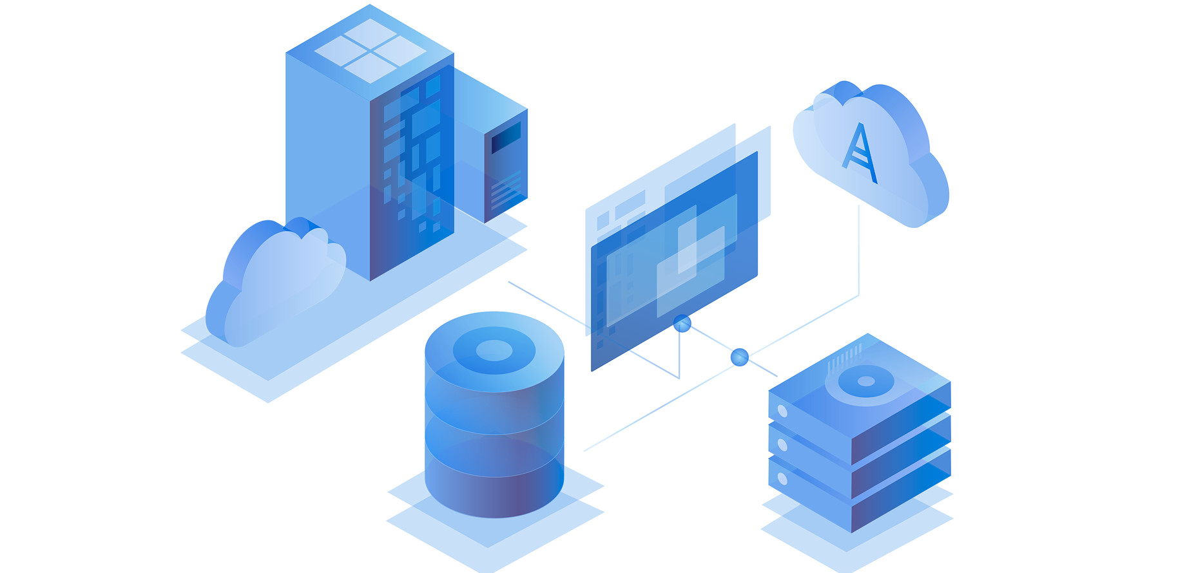


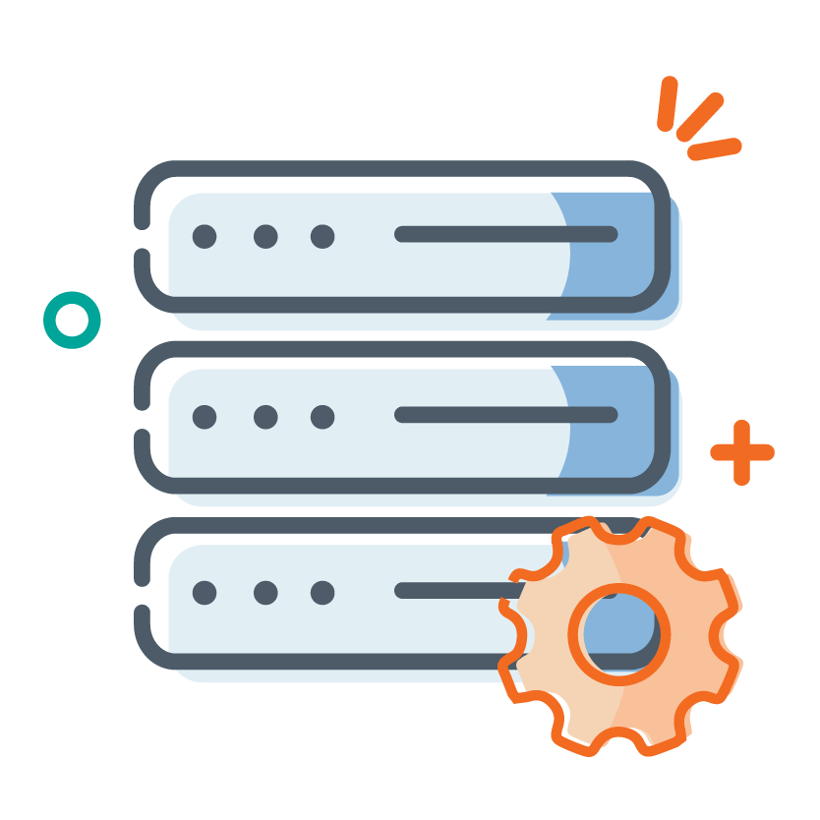
That’s why AWS storage services give you a place to store all of your data
With Unmatched Durability
Availability
And Scalability
With a Reliable Infrastructure
Tools for Compliance
Security
And Storage Management

Slide 39





A massive ecosystem of integrated third-party software and systems integrator partners

Slide 40
And that works with your business processes and even enhances those processes by allowing anyone to securely run queries of their data without moving it to a separate analytics platform

Slide 41
S3
Amazon Simple Storage Service or S3 lets you collect, store and analyse data

Slide 42
In Any Amount
From Anywhere

Slide 43

1. Durability

Slide 44
With the largest global cloud infrastructure Amazon S3 was built from the ground up to deliver 11 9s of durability

Slide 45

S3 Standard, S3 Standard Infrequent Access and Amazon Glacier storage classes store all of your data redundantly across three availability zones
That are separated by miles
On separate power substations
And connected to other AZs and the internet on multiple physically separate fibre paths
Keeping data written to a single AWS region protected even in the event of an entire availability zone loss

Slide 46
S3 One Zone IA gives you the option to store reproducible data in a single availability zone trading lower fault tolerance for lower cost

Slide 47
And with all of these storage classes you have the ability to replicate that data to any other AWS region

Slide 48


2. Security and Compliance Features
S3 supports three different forms of encryption and offer sophisticated integration with tools like AWS CloudTrail for auditing
It’s integrated with Amazon Macie - a machine learning service that can automatically -
Discover
Classify
And protect sensitive data

Slide 49



That help satisfy compliance requirements for virtually every regulatory agency
And it supports the security standards and compliant certifications

Slide 50

Highly regulated organisations like CapitalOne say they can operate more securely in the AWS cloud than in their own data centres

Slide 51



3. Management
Amazon S3 gives storage administrators the most flexible set of storage management and administration capabilities for -
Classifying
Reporting
Inventorying
And Analysing Data
This means you can understand -
What data you have!
Make the best decisions about it
And automatically keep your costs down

