Slide 1


S3
Amazon S3 also works with AWS Lambda
So you can develop workflows without adding dedicated computing resources

Slide 2

S3
4. Query in Place
Amazon S3 lets you run sophisticated big data analytics on your data without requiring you to extract and move the data to a separate analytics platform

Slide 3

Anyone who knows SQL can use Amazon Athena to analyse vast amounts of unstructured data in Amazon S3 on-demand

Slide 5
S3
And run queries that span both the data you have in S3 and in your Redshift data warehouses
And with Amazon Redshift Spectrum you can run analytics against exabytes of data in S3

Slide 6

These query and place tools make it simple for anyone to use simple SQL commands against your entire dataset
And now you can even query data directly in Amazon Glacier making archive data useful without requiring a restore

Slide 7



And even when application data increases automatic scaling means performance stays fast

Slide 8

And finally the Partner Network
In addition to integration with most AWS services the Amazon S3 ecosystem includes tens of thousands of consulting, systems integrator and independent software vendor partners with more joining every month

Slide 9






The AWS Marketplace offers software pre-configured to deploy on the AWS cloud
This means customers can easily use Amazon S3 with popular solutions for -
Backup and Restore
Archiving
Disaster Recovery
Data Lakes and many more
No other cloud provider has more partners with pre-integrated solutions

Slide 10
S3
Amazon S3 is the single place for whatever data your business needs to store, manage and analyse

Slide 11
S3 Benefits
Industry-leading performance, scalability, availability, and durability
Wide range of cost-effective storage classes
Unmatched security, compliance, and audit capabilities
Management tools for granular data control
Query in place services for analytics
Most supported cloud storage service

Slide 12
S3 - The Basics
S3 is Object-based - i.e. allows you to upload files
Files can be from 0 Bytes to 5 TB
There is unlimited storage
Files are stored in Buckets (similar to a folder)
S3 is a universal namespace. That is, names must be unique globally.
https://anmols-bucket.s3.ap-south-1.amazonaws.com
When you upload a file to S3, you will receive a HTTP 200 code if the
upload was successful

Slide 13
Data Consistency Model for S3
Read after Write consistency for PUTS of new Objects
Eventual Consistency for overwrite PUTS and DELETES (can take some
time to propagate)

Slide 14
S3 is a Simple Key-Value Store
S3 is Object based. Objects consist of the following -
Key (this is simply the name of the object)
Value (this is simply the data, which is made up of a sequence of bytes)
Version ID (important for versioning)
Metadata (data about data you are storing)
Sub-resources - bucket specific configuration:
Bucket Policies, Access Control Lists
Cross Origin Resource Sharing (CORS)
Transfer Acceleration

Slide 15
S3 - The Basics
Built for 99.99% availability for the S3 platform
Amazon guarantee 99.9% availability
Amazon guarantees 99.999999999% durability for S3 information
(remember 11 x 9s)
Tiered Storage available
Lifecycle Management
Versioning
Encryption
Secure your data - Access Control Lists and Bucket Policies

Slide 16
Amazon S3 Storage Classes
Amazon S3 offers a range of storage classes designed for different use cases.
These include S3 Standard for general-purpose storage of frequently accessed
data; S3 Intelligent-Tiering for data with unknown or changing access patterns;
S3 Standard-Infrequent Access (S3 Standard-IA) and S3 One Zone-Infrequent
Access (S3 One Zone-IA) for long-lived, but less frequently accessed data;
and Amazon S3 Glacier (S3 Glacier) and Amazon S3 Glacier Deep Archive
(S3 Glacier Deep Archive) for long-term archive and digital preservation.
Amazon S3 also offers capabilities to manage your data throughout its lifecycle.
Once an S3 Lifecycle policy is set, your data will automatically transfer to a
different storage class without any changes to your application.

Slide 17
S3 - Storage Tiers / Classes
S3: 99.99% availability, 99.999999999% durability, stored redundantly across
multiple devices in multiple facilities, and is designed to sustain the loss of
2 facilities concurrently.
S3 - IA (Infrequently Accessed): For data that is accessed less frequently,
but requires rapid access when needed. Lower fee than S3, but you are
charged a retrieval fee.
S3 - One Zone IA: Same as IA however data is stored in a single
Availability Zone only, still 99.999999999% durability, but only 99.5%
availability. Cost is 20% less than regular S3 - IA.
Reduced Redundancy Storage: Designed to provide 99.99% durability and
99.99% availability of objects over a given year. Used for data that can be
recreated if lost, e.g. thumbnails. (Starting to disappear from AWS
documentation but may still feature in exam)
Glacier: Very cheap, but used for archival only. Optimised for data that is
infrequently accessed and it takes 3 - 5 hours to restore from Glacier.

Slide 18
General Purpose Storage Class
Amazon S3 Standard
S3 Standard offers high durability, availability, and performance object
storage for frequently accessed data. Because it delivers low latency and
high throughput, S3 Standard is appropriate for a wide variety of use cases,
including cloud applications, dynamic websites, content distribution, mobile
and gaming applications, and big data analytics. S3 Storage Classes can be
configured at the object level and a single bucket can contain objects
stored across S3 Standard, S3 Intelligent-Tiering, S3 Standard-IA, and S3
One Zone-IA. You can also use S3 Lifecycle policies to automatically
transition objects between storage classes without any application
changes.

Slide 19
Amazon S3 Standard
Low latency and high throughput performance
Designed for durability of 99.999999999% of objects across multiple
Availability Zones
Resilient against events that impact an entire Availability Zones
Designed for 99.99% availability over a given year
Backed with the Amazon S3 Service Level Agreement for availability
Supports SSL for data in transit and encryption of data at rest
S3 Lifecycle management for automatic migration of objects to other
S3 Storage Classes

Slide 20
Unknown or Changing Access Storage Class
Amazon S3 Intelligent-Tiering
The S3 Intelligent-Tiering storage class is designed to optimise costs by
automatically moving data to the most cost-effective access tier, without
performance impact or operational overhead. It works by storing objects in
two access tiers: one tier that is optimised for frequent access and another
lower-cost tier that is optimised for infrequent access. For a small monthly
monitoring and automation fee per object, Amazon S3 monitors access
patterns of the objects in S3 Intelligent-Tiering, and moves the ones that
have not been accessed for 30 consecutive days to the infrequent access
tier. If an object in the infrequent access tier is accessed, it is automatically
moved back to the frequent access tier. There are no retrieval fees when
using the S3 Intelligent-Tiering storage class, and no additional tiering fees
when objects are moved between access tiers. It is the ideal storage class
for long-lived data with access patterns that are unknown or unpredictable.
S3 Storage Classes can be configured at the object level and a single
bucket can contain objects stored in S3 Standard, S3 Intelligent-Tiering,
S3 Standard-IA, and S3 One Zone-IA. You can upload objects directly to
S3 Intelligent-Tiering, or use S3 Lifecycle policies to transfer objects from
S3 Standard and S3 Standard-IA to S3 Intelligent-Tiering. You can also
archive objects from S3 Intelligent-Tiering to S3 Glacier.

Slide 21
Amazon S3 Intelligent-Tiering
Same low latency and high throughput performance of S3 Standard
Small monthly monitoring and auto-tiering fee
Automatically moves objects between two access tiers based on changing
access patterns
Designed for durability of 99.999999999% of objects across multiple
Availability Zones
Resilient against events that impact an entire Availability Zone
Designed for 99.99% availability over a given year
Backed with the Amazon S3 Service Level Agreement for availability
Supports SSL for data in transit and encryption of data at rest
S3 Lifecycle management for automatic migration of objects to other S3
Storage Classes

Slide 22
Infrequent Access
Storage Classes
Amazon S3 Standard-Infrequent Access (S3 Standard-IA)
S3 Standard-IA is for data that is accessed less frequently, but requires
rapid access when needed. S3 Standard-IA offers the high durability, high
throughput, and low latency of S3 Standard, with a low per GB storage
price and per GB retrieval fee. This combination of low cost and high
performance make S3 Standard-IA ideal for long-term storage, backups,
and as a data store for disaster recovery files. S3 Storage Classes can be
configured at the object level and a single bucket can contain objects
stored across S3 Standard, S3 Intelligent-Tiering, S3 Standard-IA, and
S3 One Zone-IA. You can also use S3 Lifecycle policies to automatically
transition objects between storage classes without any application changes.

Slide 23
S3 Standard-Infrequent Access
(S3 Standard-IA)
Same low latency and high throughput performance of S3 Standard
Designed for durability of 99.999999999% of objects across multiple
Availability Zones
Resilient against events that impact an entire Availability Zone
Data is resilient in the event of one entire Availability Zone destruction
Designed for 99.9% availability over a given year
Backed with the Amazon S3 Service Level Agreement for availability
Supports SSL for data in transit and encryption of data at rest
S3 Lifecycle management for automatic migration of objects to other S3
Storage Classes

Slide 24
Infrequent Access
Storage Classes
Amazon S3 One Zone-Infrequent Access (S3 One Zone-IA)
S3 One Zone-IA is for data that is accessed less frequently, but requires
rapid access when needed. Unlike other S3 Storage Classes which store
data in a minimum of three Availability Zones (AZs), S3 One Zone-IA stores
data in a single AZ and costs 20% less than S3 Standard-IA. S3 One Zone-IA
is ideal for customers who want a lower-cost option for infrequently
accessed data but do not require the availability and resilience of S3
Standard or S3 Standard-IA. It’s a good choice for storing secondary backup
copies of on-premises data or easily re-creatable data. You can also use it
as cost-effective storage for data that is replicated from another AWS
Region using S3 Cross-Region Replication.
S3 One Zone-IA offers the same high durability, high throughput, and low
latency of S3 Standard, with a low per GB storage price and per GB retrieval
fee. S3 Storage Classes can be configured at the object level, and a single
bucket can contain objects stored across S3 Standard, S3 Intelligent-Tiering,
S3 Standard-IA, and S3 One Zone-IA. You can also use S3 Lifecycle policies
to automatically transition objects between storage classes without any
application changes.

Slide 25
S3 One Zone-Infrequent Access
(S3 One Zone-IA)
Same low latency and high throughput performance of S3 Standard
Designed for durability of 99.999999999% of objects in a single Availability
Zone because S3 One Zone-IA stores data in a single AWS Availability Zone,
data stored in this storage class will be lost in the event of Availability Zone
destruction.
Designed for 99.5% availability over a given year
Backed with the Amazon S3 Service Level Agreement for availability
Supports SSL for data in transit and encryption of data at rest
S3 Lifecycle management for automatic migration of objects to other S3
Storage Classes

Slide 26
Archive Storage Classes
Amazon S3 Glacier
S3 Glacier is a secure, durable, and low-cost storage class for data
archiving. You can reliably store any amount of data at costs that are
competitive with or cheaper than on-premises solutions. To keep costs
low yet suitable for varying needs, S3 Glacier provides three retrieval
options that range from a few minutes to hours. You can upload objects
directly to S3 Glacier, or use S3 Lifecycle policies to transfer data between
any of the S3 Storage Classes for active data (S3 Standard, S3 Intelligent-
Tiering, S3 Standard-IA, and S3 One Zone-IA) and S3 Glacier.

Slide 27
Amazon S3 Glacier
Designed for durability of 99.999999999% of objects across multiple
Availability Zones
Data is resilient in the event of one entire Availability Zone destruction
Supports SSL for data in transit and encryption of data at rest
Low-cost design is ideal for long-term archive
Configurable retrieval times, from minutes to hours
S3 PUT API for direct uploads to S3 Glacier, and S3 Lifecycle management
for automatic migration of objects

Slide 28
Archive Storage Classes
Amazon S3 Glacier Deep Archive
S3 Glacier Deep Archive is Amazon S3’s lowest-cost storage class and
supports long-term retention and digital preservation for data that may
be accessed once or twice in a year. It is designed for customers —
particularly those in highly-regulated industries, such as the Financial
Services, Healthcare, and Public Sectors — that retain data sets for 7-10
years or longer to meet regulatory compliance requirements. S3 Glacier
Deep Archive can also be used for backup and disaster recovery use cases,
and is a cost-effective and easy-to-manage alternative to magnetic tape
systems, whether they are on-premises libraries or off-premises services.
S3 Glacier Deep Archive complements Amazon S3 Glacier, which is ideal
for archives where data is regularly retrieved and some of the data may be
needed in minutes. All objects stored in S3 Glacier Deep Archive are
replicated and stored across at least three geographically-dispersed
Availability Zones, protected by 99.999999999% of durability, and can be
restored within 12 hours.

Slide 29
S3 Glacier Deep Archive
Designed for durability of 99.999999999% of objects across multiple
Availability Zones
Lowest cost storage class designed for long-term retention of data that
will be retained for 7-10 years
Ideal alternative to magnetic tape libraries
Retrieval time within 12 hours
S3 PUT API for direct uploads to S3 Glacier Deep Archive, and S3 Lifecycle
management for automatic migration of objects

Slide 30
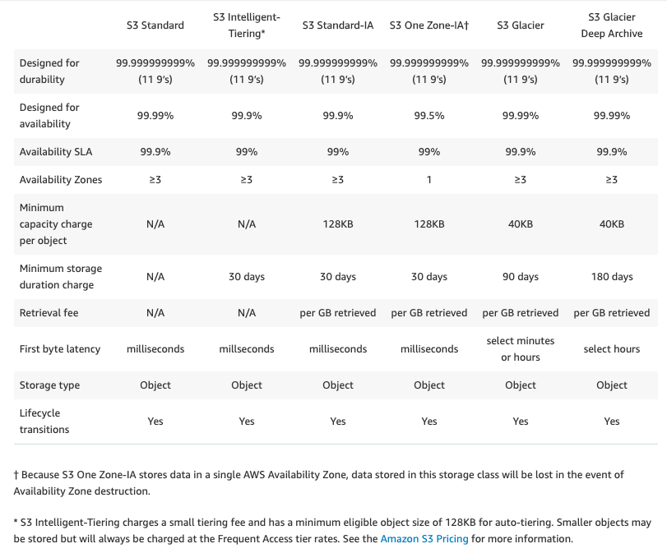
Performance across the S3 Storage Classes

Slide 31
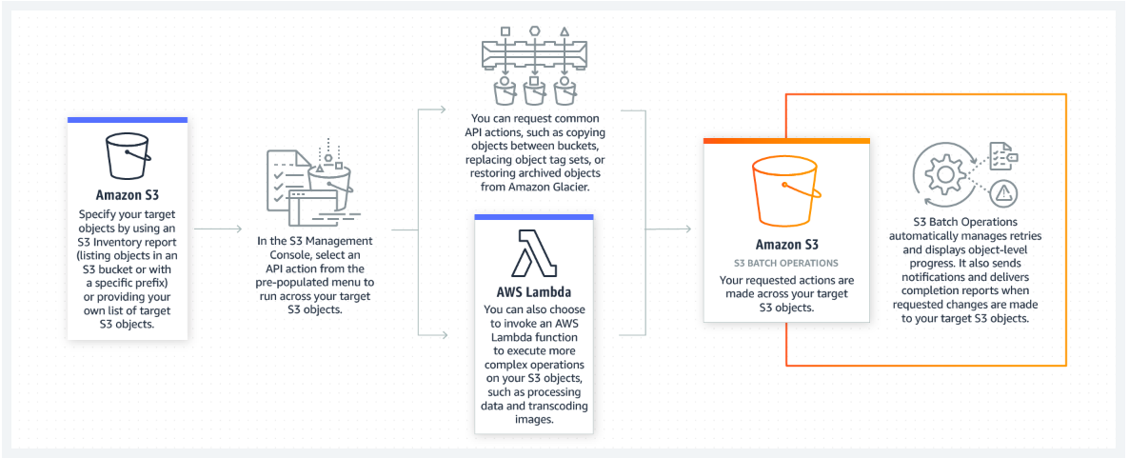
How It Works -
S3 Batch Operations
S3 Batch Operations lets you manage billions of objects at scale with just
a few clicks in the Amazon S3 Management Console or a single API request.
With S3 Batch Operations, you can make changes to object metadata and
properties, or perform other storage management tasks, such as copying
objects between buckets, replacing object tag sets, modifying access
controls, and restoring archived objects from S3 Glacier — instead of taking
months to develop custom applications to perform these tasks.

Slide 32
S3 Use Cases
Backup and restore
Disaster Recovery (DR)
Archive
Data lakes and big data analytics
Hybrid cloud storage
Cloud-native application data

Slide 33

Case Studies
Netflix delivers billions of hours of content from Amazon S3 to customers
around the world. Amazon S3 also serves as the data lake for their big data
analytics solution.

Slide 34

Case Studies
FINRA uses Amazon S3 to ingest and store data for over 75 billion market
events daily and AWS Lambda functions to format and validate the data
against more than 200 rules.

Slide 35

Case Studies
Airbnb houses backup data and static files on Amazon S3, including over 10
petabytes of user pictures. As a born-in-the-cloud solution, they continually
innovate new ways to analyse data stored on Amazon S3.

Slide 36

Case Studies
GE uses Amazon S3 to store and protect a petabyte of critical medical
imaging data for its GE Health Cloud service, which connects hundreds of
thousands of imaging machines and other medical devices.

Slide 37
S3 - Charges
Charged for:
Storage per GB
Requests (Get, Put, Copy, etc.)
Storage Management Pricing
Inventory, Analytics, and Object Tags
Data Management Pricing
Data transferred out of S3
Transfer Acceleration
Use of CloudFront to optimise transfers

Slide 38
Securing Your Buckets
By default, all newly created buckets are PRIVATE
You can set up access control to your buckets using:
Bucket Policies - Applied at a bucket level
Access Control Lists - Applied at an object level
S3 buckets can be configured to create access logs, which log all
requests made to the S3 bucket. These logs can be written to another
bucket.

Slide 39
IAM Policies vs.
S3 Bucket Policies
IAM policies specify what actions are allowed or denied on what AWS
resources (e.g. allow ec2:TerminateInstance on the EC2 instance with
instance_id=i-8b3620ec). You attach IAM policies to IAM users, groups,
or roles, which are then subject to the permissions you’ve defined.
In other words, IAM policies define what a principal can do in your AWS
environment.
S3 bucket policies, on the other hand, are attached only to S3 buckets.
S3 bucket policies specify what actions are allowed or denied for which
principals on the bucket that the bucket policy is attached to (e.g. allow
user Alice to PUT but not DELETE objects in the bucket).
You attach S3 bucket policies at the bucket level (i.e. you can’t attach a
bucket policy to an S3 object), but the permissions specified in the bucket
policy apply to all the objects in the bucket.
IAM policies and S3 bucket policies are both used for access control and
they’re both written in JSON using the AWS access policy language

Slide 40
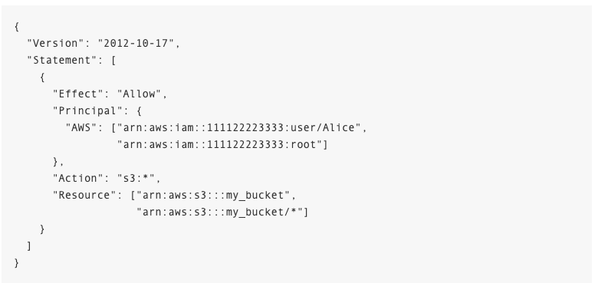
Sample S3 Bucket Policy
This S3 bucket policy enables the root account 111122223333 and
the IAM user Alice under that account to perform any S3 operation
on the bucket named “my_bucket”, as well as that bucket’s contents.

Slide 41
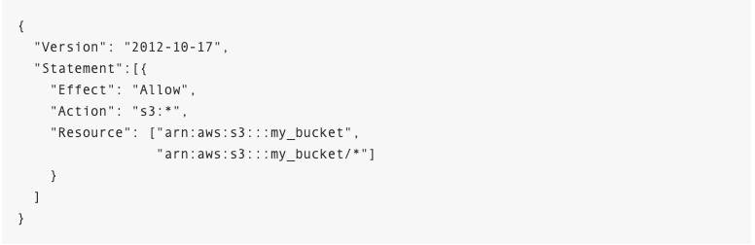
Sample IAM Policy
This IAM policy grants the IAM entity (user, group, or role) it is attached to
permission to perform any S3 operation on the bucket named “my_bucket”,
as well as that bucket’s contents.

Slide 42
IAM Policies vs.
S3 Bucket Policies
S3 bucket policy includes a “Principal” element, which lists the principals
that bucket policy controls access for. The “Principal” element is
unnecessary in an IAM policy, because the principal is by default the entity
that the IAM policy is attached to.
S3 bucket policies (as the name would imply) only control access to S3
resources, whereas IAM policies can specify nearly any AWS action.
One of the neat things about AWS is that you can actually apply both
IAM policies and S3 bucket policies simultaneously, with the ultimate
authorisation being the least-privilege union of all the permissions.

Slide 43
When to Use IAM Policies
vs. S3 Policies
Use IAM policies if:
You need to control access to AWS services other than S3. IAM policies
will be easier to manage since you can centrally manage all of your
permissions in IAM, instead of spreading them between IAM and S3.
You have numerous S3 buckets each with different permissions
requirements. IAM policies will be easier to manage since you don’t
have to define a large number of S3 bucket policies and can instead
rely on fewer, more detailed IAM policies.
You prefer to keep access control policies in the IAM environment.

Slide 44
When to Use IAM Policies
vs. S3 Policies
Use S3 bucket policies if:
You want a simple way to grant cross-account access to your S3
environment, without using IAM roles.
Your IAM policies bump up against the size limit (up to 2 kb for users,
5 kb for groups, and 10 kb for roles). S3 supports bucket policies of
up to 20 kb.
You prefer to keep access control policies in the S3 environment.

Slide 45
When to Use IAM Policies
vs. S3 Policies
If you’re still unsure of which to use, consider which audit question is most
important to you:
If you’re more interested in “What can this user do in AWS?” then IAM
policies are probably the way to go. You can easily answer this by looking
up an IAM user and then examining their IAM policies to see what rights
they have.
If you’re more interested in “Who can access this S3 bucket?” then S3
bucket policies will likely suit you better. You can easily answer this by
looking up a bucket and examining the bucket policy.
Whichever method you choose, you should stay as consistent as possible.
Auditing permissions becomes more challenging as the number of IAM
policies and S3 bucket policies grows.

Slide 46
What about S3 ACLs?
As a general rule, AWS recommends using S3 bucket policies or IAM
policies for access control. S3 ACLs is a legacy access control mechanism
that predates IAM. However, if you already use S3 ACLs and you find them
sufficient, there is no need to change.
An S3 ACL is a sub-resource that’s attached to every S3 bucket and object.
It defines which AWS accounts or groups are granted access and the type
of access. When you create a bucket or an object, Amazon S3 creates a
default ACL that grants the resource owner full control over the resource.
You can attach S3 ACLs to individual objects within a bucket to manage
permissions for those objects. S3 bucket policies and IAM policies define
object-level permissions by providing those objects in the Resource element
in your policy statements. The statement will apply to those objects in the
bucket. Consolidating object-specific permissions into one policy
(as opposed to multiple S3 ACLs) makes it simpler for you to determine
effective permissions for your users and roles.

Slide 47
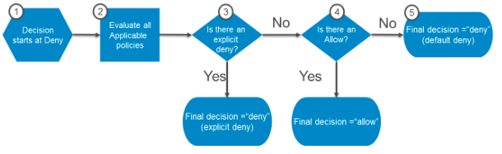
How does authorisation work with
multiple access control mechanisms?
Whenever an AWS principal issues a request to S3, the authorisation
decision depends on the union of all the IAM policies, S3 bucket policies,
and S3 ACLs that apply.
In accordance with the principle of least-privilege, decisions default to
DENY and an explicit DENY always trumps an ALLOW. For example, if an
IAM policy grants access to an object, the S3 bucket policies denies access
to that object, and there is no S3 ACL, then access will be denied. Similarly,
if no method specifies an ALLOW, then the request will be denied by default.
Only if no method specifies a DENY and one or more methods specify an
ALLOW will the request be allowed.

