Slide 1

INT 221 - MVC PROGRAMMING
Unit 2

Slide 2
Seems but not true General Answer But it is not True
Laravel Request Lifecycle
Route
Controller
View

Slide 3
a sequence of events and actions that occur during the execution of a request. Each request goes through several stages, and Laravel provides various mechanisms to perform actions at different points in this lifecycle
Lifecycle

Slide 4
Index.php – The ENTRY point
All requests are directed to this file by your web server (Apache / Nginx) configuration. The index.php file doesn't contain much code. Rather, it is a starting point for loading the rest of the framework.
The index.php file loads the Composer-generated autoloader definition and then retrieves an instance of the Laravel application from bootstrap/app.php.

Slide 5
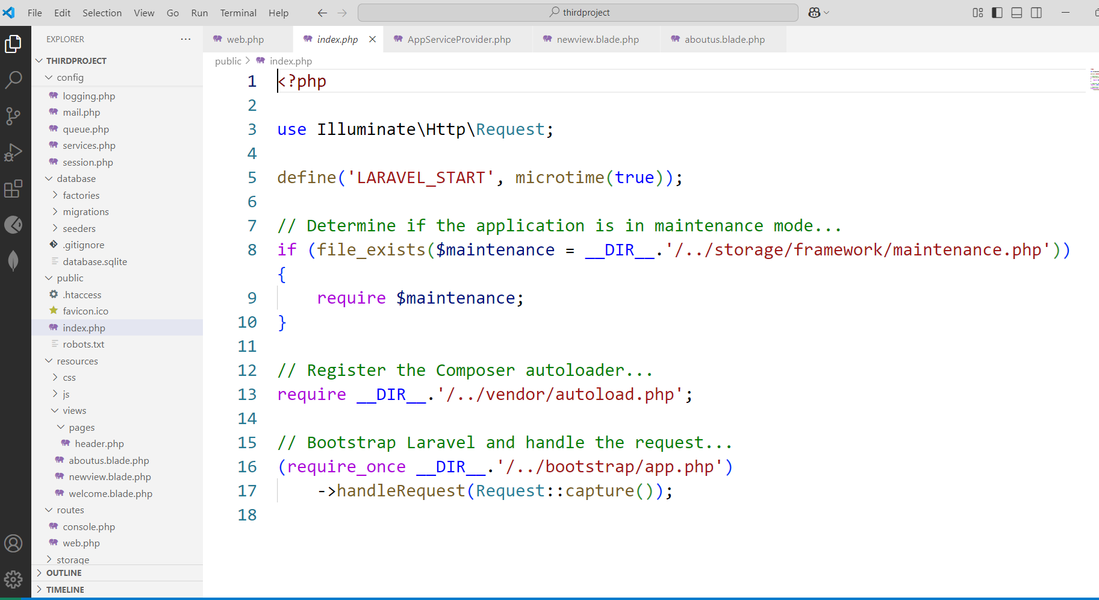
Structure of index.php file

Slide 6
Composer Autoloader
An autoloader in Laravel is like a smart library organizer for your code. It automatically finds and loads the right files when you use different parts of your Laravel project. This way, you don't have to search for and include files manually, making your coding life easier and more organized.

Slide 7
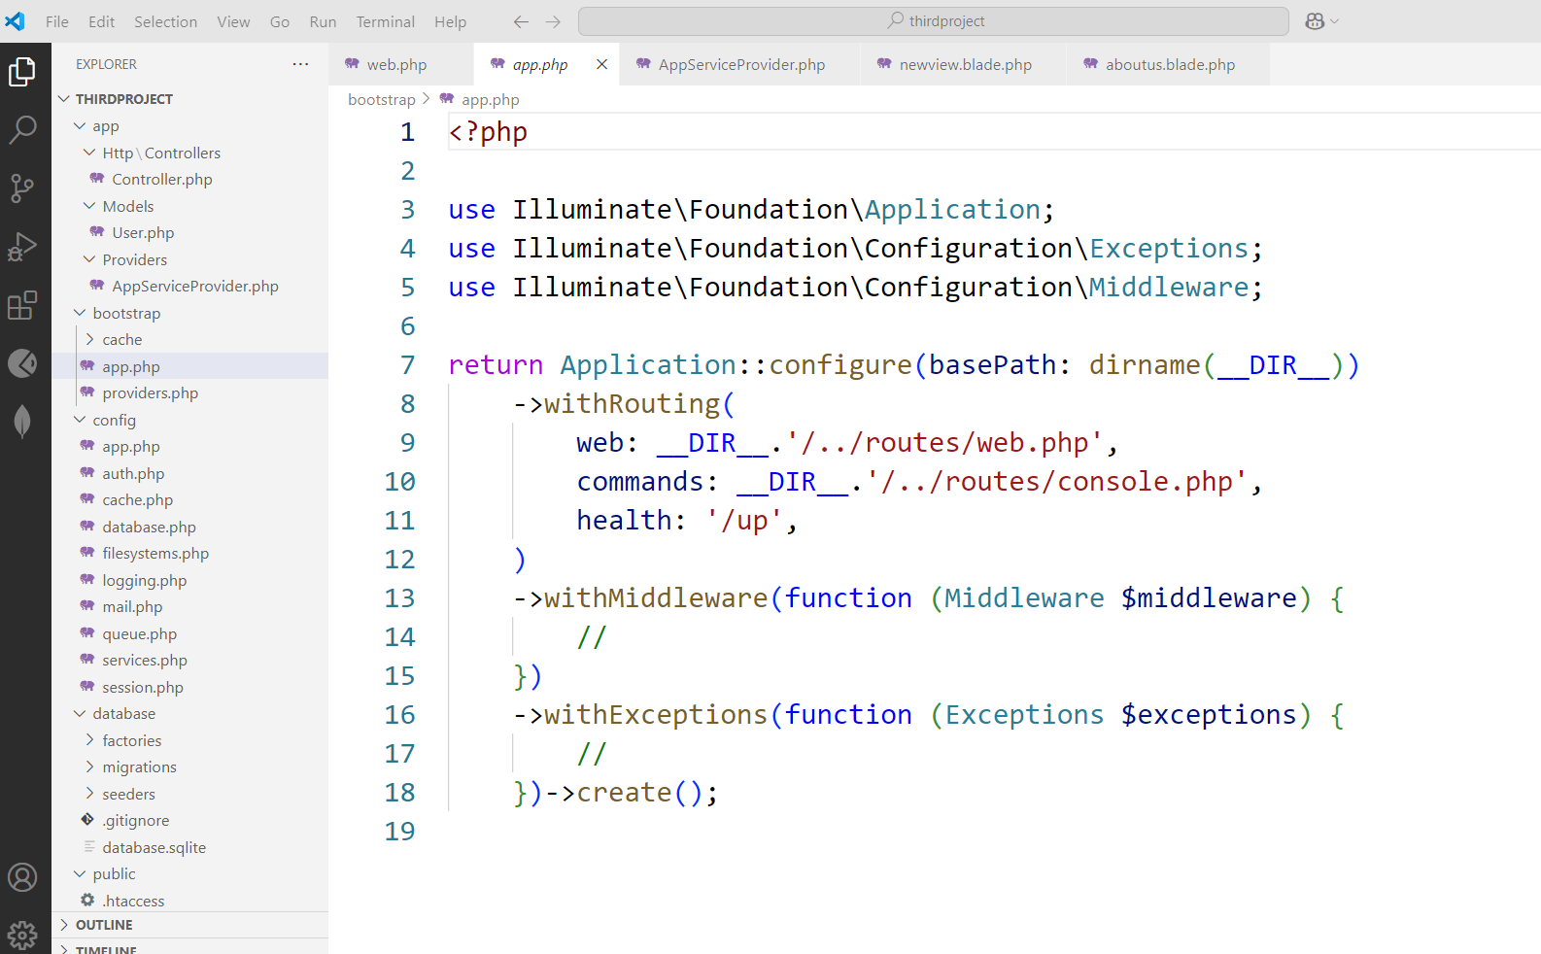
Bootstrap -> app.php (Instances are made here)
The bootstrap/app.php file sets up the Laravel application instance. It binds essential interfaces and prepares Laravel's service container.

Slide 8
Request is now sent to bootstrap/app.php
Two based on the request for routing:
Web routing-> routes/web.php (hitting the URL via web browser)
command -> routes/console.php
Service Provider
the request is sent to Service Providers
Implement core functionality e.g. Mailing, Sessions etc.

Slide 9
bootstrap/providers.php
You can find a list of the user-defined or third-party service providers that your application is using in the bootstrap/providers.php file.
Service providers
Service providers are responsible for bootstrapping all of the framework's various components, such as the database, queue, validation, and routing components, event management, session management.

Slide 10
Laravel comes with some default service providers:-
App\Providers\AppServiceProvider.php
(in Laravel-11)
App\Providers\AuthServiceProvider.php
App\Providers\BroadcastServiceProvider.php
App\Providers\EventServiceProvider.php
App\Providers\RouteServiceProvider.php

Slide 11
Service Providers Loading (bootstrap/providers.php)
Laravel loads all registered service providers to initialize core services like database, authentication, routing, etc.
Providers
Config-> Appserviceprovider—to declare the global variables (custom stuff)

Slide 12
Routes (routes/web.php)
Once the application has been bootstrapped and all service providers have been registered, the Request will be handed off to the router for dispatching.
The router will dispatch the request to a route or controller, as well as run any route specific middleware.
Laravel finds the appropriate route that matches the request URL.

Slide 13
Middleware (using construct method)
Middleware provides a convenient mechanism for filtering or examining HTTP requests entering your application.
For example, Laravel includes a middleware that verifies if the user of your application is authenticated.
If the user is not authenticated, the middleware will redirect the user to the login screen. However, if the user is authenticated, the middleware will allow the request to proceed further into the application.

Slide 14
Middleware Execution
Authenticate users.
Log requests.
Validate input data.

Slide 15
Example Middleware (app/Http/Middleware/CheckAge.php)
public function handle($request, Closure $next)
{ if ($request->age < 18) {
return response('Unauthorized', 403);
}
return $next($request);
}

Slide 16
Controller
In Laravel, controllers are found in the app/Http/Controllers directory.
They help organize request handling logic by grouping related functions into classes.
View
If the route returns an HTML view, Laravel loads a Blade template.

Slide 17
(resources/views/home.blade.php)
<!DOCTYPE html>
<html>
<head>
<title>
{{ $title }}
</title>
</head>
<body>
<h1>Hello, Laravel!</h1>
</body>
</html>

Slide 18
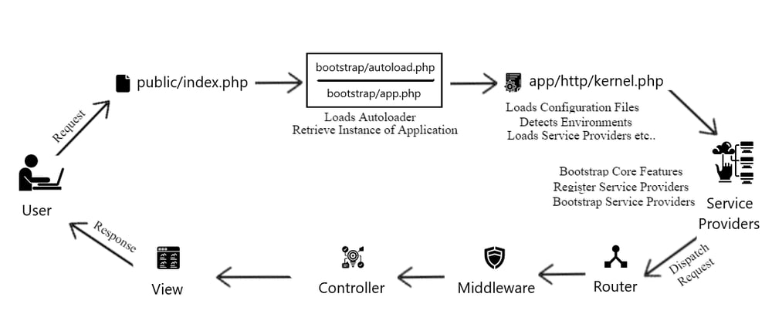
Laravel Request Life Cycle

Slide 19
By default laravel project runs on which PORT?
3000
5000
8000
7000
What's the command to check the current version of the Laravel framework?
php artisan main --version
php artisan --version status
php artisan check --version
php artisan --version

Slide 20
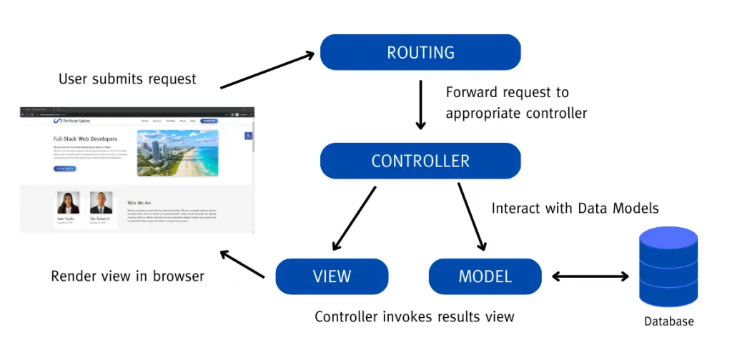
What is Routing?
The process of directing incoming requests (usually based on URLs) to the appropriate code or handler that will handle the request and generate a response.

Slide 21
Contd...
Routing is like a traffic director for web applications. When a user enters a URL in their browser or clicks a link, routing decides where that request should go within the application to generate the appropriate content or perform a specific action.
URL
URL stands for "Uniform Resource Locator." It's a reference or address used to access resources on the internet. In simpler terms, a URL is the unique web address that you enter into a web browser to access a specific web page, file, or resource.

Slide 22
By default one route is created by Laravel
use Illuminate\Support\Facades\Route;
Route::get('/', function () {
return view('welcome');
});
In the above case, Route is the class which defines the static method get(). The get() method contains the parameters '/' and the function() closure. The '/' defines the root directory, and function() defines the functionality of the get() method.

Slide 23
Paamayim Nekudotayim ::
It is a token that allows access to static, constant, and overridden properties or methods of a class. When referencing these items from outside the class definition, use the name of the class.
It's possible to reference the class using a variable. The variable's value can not be a keyword (e.g. self, parent and static).
Do you know?
Paamayim Nekudotayim would, at first, seem like a strange choice for naming a double-colon. However, while writing the Zend Engine 0.5 (which powers PHP 3), that's what the Zend team decided to call it. It actually does mean double-colon - in Hebrew!

Slide 24
Route::get('/')
Route::get('/') defines a route for a GET request to the root URL (/) of your application.
The root URL typically refers to the base of your web application, e.g., http://yourdomain.com/.
Closure Function:
The second parameter of Route::get is a closure (anonymous function). This function will execute when the route is accessed.
Returning a View:
Inside the closure, return view('welcome'); tells Laravel to render and return a Blade view named 'welcome'. Laravel assumes the view file is located at resources/views/welcome.blade.php.

Slide 25
What is the purpose of the web.php routes file in Laravel?
a) It defines routes for web application routes and middleware.
b) It defines routes specifically for API endpoints.
c) It defines routes for console commands and tasks.
d) It defines routes for unit testing
Command to get the route list in Laravel
php artisan route:list
In Laravel, where are the routes primarily defined?
a) In the app/routes.php file
b) In the routes folder within the app directory
c) In the .env configuration file
d) In the web.php or api.php files within the routes directory

Slide 26
HTTP Methods
GET, POST, PUT, PATCH, and DELETE are the five most common HTTP methods for retrieving from and sending data to a server.
The GET method
The GET method is used to retrieve data from the server. This is a read-only method, so it has no risk of mutating or corrupting the data. For example, if we call the get method on our API, we’ll get back a list of all to-dos.
The POST method
The POST method sends data to the server and creates a new resource. The resource it creates is subordinate to some other parent resource. When a new resource is POSTed to the parent, the API service will automatically associate the new resource by assigning it an ID (new resource URI). In short, this method is used to create a new data entry

Slide 27
The PUT method
The PUT method is most often used to update an existing resource. If you want to update a specific resource you can call the PUT method to that resource URI with the request body containing the complete new version of the resource you are trying to update.
The PATCH method
The PATCH method is very similar to the PUT method because it also modifies an existing resource. The difference is that for the PUT method, the request body contains the complete new version, whereas for the PATCH method, the request body only needs to contain the specific changes to the resource, specifically a set of instructions describing how that resource should be changed, and the API service will create a new version according to that instruction.
The DELETE method
The DELETE method is used to delete a resource specified by its URI.

Slide 28
View in Laravel
Views provide a convenient way to place all of our HTML in separate files.
Views separate your controller / application logic from your presentation logic and are stored in the resources/views directory. A simple view might look something like this:
<!-- View stored in resources/views/greeting.blade.php -->
<html>
<body>
<h1>Hello, {{ $name }}</h1>
</body>
</html>
Since this view is stored at resources/views/greeting.blade.php, we may return it using the global view helper like so:
Route::get('/', function () {
return view('greeting', ['name' => 'James']);
});

Slide 29
Creating & Rendering Views
You may create a view by placing a file with the .blade.php extension in your application's resources/views directory.
The .blade.php extension informs the framework that the file contains a Blade template.
Blade templates contain HTML as well as Blade directives that allow you to easily echo values, create "if" statements, iterate over data, and more.
command to create the view is:
php artisan make:view user (here user is the name of the view).
A view with name user.blade.php is created in resources/views.

Slide 30
Nested View Directories
Views may also be nested within subdirectories of the resources/views directory.
"Dot" notation may be used to reference nested views.
For example, if your view is stored at resources/views/admin/profile.blade.php, you may return it from one of your application's routes / controllers like so:
return view('admin.profile', $data);

Slide 31
Passing Data To Views
You may pass an array of data to views to make that data available to the view:
return view('greetings', ['name' => 'Victoria']);
When passing information in this manner, the data should be an array with key / value pairs.
After providing data to a view, you can then access each value within your view using the data's keys, such as <?php echo $name; ?>.

Slide 32
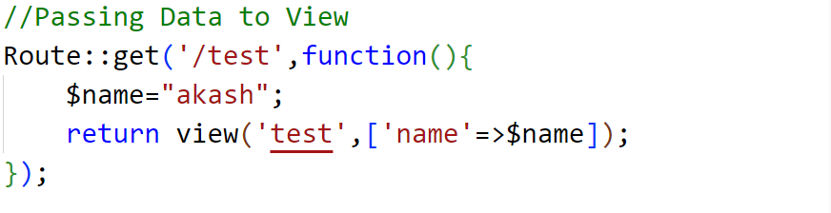

Contd…
Inside Web.php
create the view test:
in terminal: php artisan make:view test
Inside test.blade.php

Slide 33
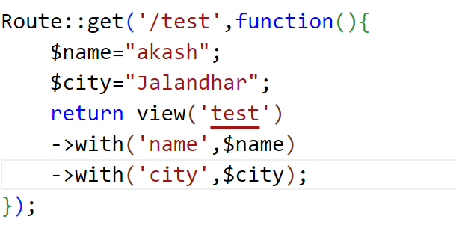
Passing Data To Views (contd.)
As an alternative to passing a complete array of data to the view helper function, you may use the with method to add individual pieces of data to the view.
The with method returns an instance of the view object so that you can continue chaining methods before returning the view:
return view('greeting')
->with('name', 'Victoria')
->with('occupation', 'Astronaut');

Slide 34
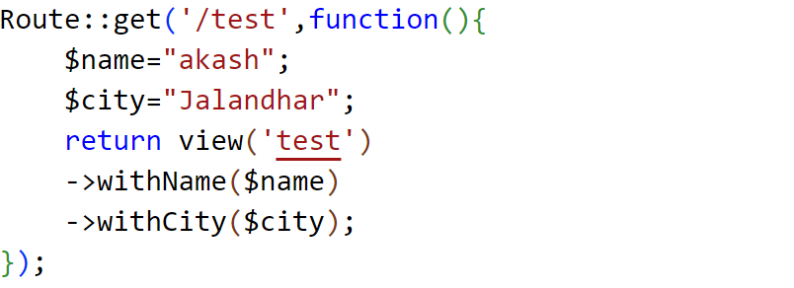
One More Shortcut
In web.php
In test.blade.php

Slide 35
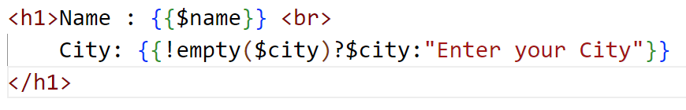
Suppose empty string is passed in city
Instead of printing empty string you can also use conditional expression in blade template file and print some default value.

Slide 36
Data passing methods
1. Using with() Method
return view('welcome')->with('name', 'Parveen');
In Blade (view file):
<h1>{{ $name }}</h1>
2. Using compact()
[$name = "Parveen", $age = 22];
return view('welcome', compact('name', 'age'));
In Blade:
<h1>{{ $name }}</h1>
<p>{{ $age }}</p>
compact() converts variables into an associative array:
['name' => $name, 'age' => $age]

Slide 37
Data passing methods
3. Passing Data as Array
return view('welcome', [ 'name' => 'Parveen', 'age' => 22]);
4. Passing Multiple Data Using with()
return view('welcome') ->with('name', 'Parveen') ->with('age', 22);
5. Passing Data from Route
Route::get('/test', function () {
$students = [
['name' => 'Aman', 'roll' => 1],
['name' => 'Riya', 'roll' => 2]
];
return view('students', compact('students'));
});

Slide 38
Data passing methods
7. Displaying Data in Blade (Loop)
@foreach($students as $student)
<p>{{ $student['name'] }} - {{ $student['roll'] }}</p>
@endforeach
8. Passing Data to All Views (Global Data)
use Illuminate\Support\Facades\View;
View::share('appName', 'My Laravel App');
Now accessible in all views:
<h1>{{ $appName }}</h1>
9. Using view()->with() Helper
return view('welcome')->with([
'name' => 'Parveen',
'age' => 22
]);

Slide 39
What is the purpose of views in Laravel?
A) To store database records.
B) To separate controller/application logic from presentation logic.
C) To define routes.
D) To manage authentication.
Where are views typically stored in a Laravel application?
A) In the public directory.
B) In the app/views folder.
C) In the resources/views directory.
D) In the database folder.

Slide 40
Which file extension is used for Blade templates in Laravel views?
A) .php
B) .html
C) .blade.php
D) .view
In Blade templates, how can you access data that has been passed to a view?
A) By using the {{ data }} syntax.
B) By using echo data; syntax.
C) By using $data directly.
D) By using the @data directive.

Slide 41
What method can you use to add individual pieces of data to a view in Laravel, allowing you to chain multiple data additions?
A) addData()
B) includeData()
C) with()
D) attachData()
How can you share data with all views rendered by your Laravel application?
A) By storing it in a database.
B) By using global variables.
C) By using the share method within a service provider's boot method.
D) By passing it to each view individually.

Slide 42
Sharing Data With All Views
Occasionally, you may need to share data with all views that are rendered by your application.
Typically, you should place calls to the share method within a service provider's boot method.
You are free to add them to the App\Providers\AppServiceProvider class or generate a separate service provider to house them:

Slide 43
Sharing Data With All Views(contd.)
?php
namespace App\Providers;
class AppServiceProvider extends ServiceProvider
{
public function boot()
{
view()::share('name', 'Pooja');
}
}
on any view
<h2>User name is :{{$name}}<\h2> // can be directly accessed

Slide 44
View Routes
If your route only needs to return a view, you may use the Route::view method.
This method provides a simple shortcut so that you do not have to define a full route or controller.
The view method accepts a URI as its first argument and a view name as its second argument.
Route::view('/welcome', 'welcome');

Slide 45
Route Parameters
Required Parameters - Sometimes you will need to capture segments of the URI within your route. For example, you may need to capture a user's ID from the URL. You may do so by defining route parameters:
Route::get('/user/{id}', function ($id) {
return 'User '.$id;
});
You may define as many route parameters as required by your route.
Route parameters are always encased within {} braces and should consist of alphabetic characters.
Underscores (_) are also acceptable within route parameter names.

Slide 46
Contd...
Optional Parameters - Occasionally you may need to specify a route parameter that may not always be present in the URI. You may do so by placing a ? mark after the parameter name. Make sure to give the route's corresponding variable a default value:
Route::get('/user/{name?}', function ($name = null) {
return $name;
});
Route::get('/user/{name?}', function ($name = 'John') {
return $name;
});

Slide 47
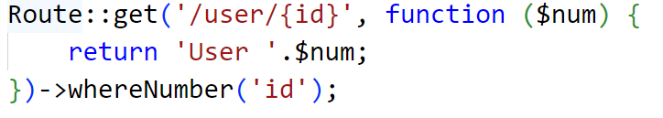
Route Parameters Constraints
You may constrain the format of your route parameters using the family of ‘where’ methods on a route instance.
whereNumber Constraint:
The whereNumber constraint is used to ensure that a route parameter is a numeric value.
It is useful when you want to restrict a parameter to only accept numeric input.

Slide 48
=> And -> are different
=> (Arrow or Fat Arrow)
-> (Arrow or Member Access Operator)
=> is primarily used in association with key-value pairs, often seen in data structures like dictionaries, associative arrays, or objects in various programming languages.
It is commonly used to assign values to keys or properties.
-> is used to access members (attributes or methods) of objects or structures in some programming languages, particularly in C-like languages such as C++ and PHP for object-oriented programming.
It's used to access properties and methods of objects or structs.

Slide 49
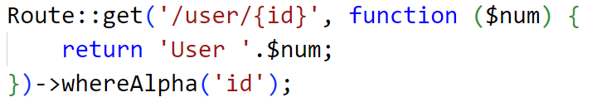
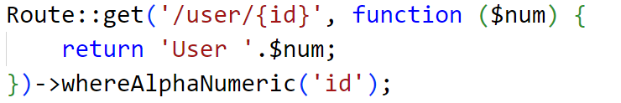
whereAlpha
The whereAlpha constraint is used to ensure that a route parameter contains only alphabetic characters.
It restricts the parameter to accept only letters (A-Z and a-z).
whereAlphaNumeric
The whereAlphaNumeric constraint is used to ensure that a route parameter contains only alphanumeric characters.
It restricts the parameter to accept letters (A-Z and a-z) and numbers (0-9).

Slide 50
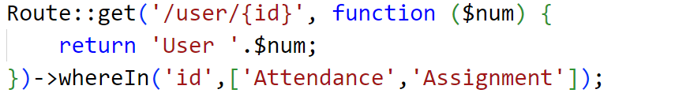
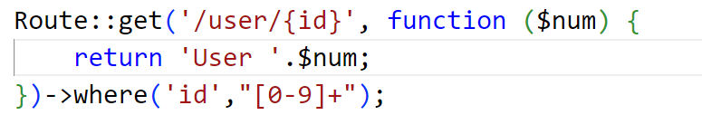
whereIn
The whereIn constraint is used when you want to constrain a parameter's value to a specific set of values.
It ensures that the parameter matches one of the specified values.
where
The where method is a more general constraint that allows you to specify custom constraints using regular expressions or closures.
It provides flexibility to define complex validation rules for a parameter.

Slide 51
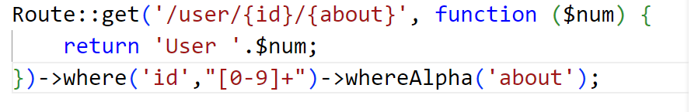
Handling Multiple Parameter Constraints
Suppose you have multiple parameters in URL, and you want to have different constrains for both, then one method for doing it is shown below.
Route Parameters Global Constraint
Global Constraints - In Laravel, you can define global route constraints by using the pattern method
This allows you to apply constraints to all routes in your application. Global constraints can be useful for enforcing common validation rules on various route parameters throughout your application.

Slide 52
Route Parameters Global Constraint
Here's how you can define a global route constraint for all routes:
Open App/Providers/AppServiceProvider.php.
use Illuminate\Support\Facades\Route;
public function boot()
{
parent::boot();
Route::pattern('id', '[0-9]+');
}
In the above code, we're using the Route::pattern method to specify a regular expression pattern [0-9]+ for the id parameter. This pattern requires that any id parameter in your routes must consist of numeric characters.

Slide 53
What is Laravel routing primarily used for?
A. Database management
B. Handling HTTP requests
C. Front-end development
D. Server configuration
In Laravel, where are the routes typically defined?
A. In the .env file
B. In the config/routes.php file
C. In the routes/web.php and routes/api.php files
D. In the resources/views directory

Slide 54
Which of the following is used to pass parameters in a Laravel route?
A. <param>
B. [param]
C. {param}
D. (param)
Which artisan command is used to list all registered routes in a Laravel application?
A. php artisan serve
B. php artisan list
C. php artisan routes
D. php artisan route:list

Slide 55
What is the primary purpose of Laravel routing constraints?
A. To define routes in the web.php file
B. To restrict access to certain routes
C. To specify rules that route parameters must follow
D. To create dynamic routes
Which built-in constraint is used to ensure that a route parameter is numeric?
A. whereNumber
B. whereInteger
C. whereNumeric
D. whereDigit

Slide 56
Returning Response in Laravel
The aim of the response is to provide the client with the resource it requested or inform the client that the action it requested has been carried out; or else, to inform the client that an error occurred in processing its request.
Route::get('/greet', function(){
return "Hello World";
});
If we write "abc," it will open at this URL.
Route::get('/abc', function(){
return "Hello World";
});

Slide 57
Creating Responses
Strings & Arrays - All routes and controllers should return a response to be sent back to the user's browser.
Laravel provides several different ways to return responses.
The most basic response is returning a string from a route or controller. The framework will automatically convert the string into a full HTTP response:
Route::get('/', function () {
return 'Hello World';
});
In addition to returning strings from your routes and controllers, you may also return arrays.
The framework will automatically convert the array into a JSON response:
Route::get('/', function () {
return [1, 2, 3];
});

Slide 58
Creating Responses (contd.)
Response Objects –
Route::get('/home', function () {
return response('Hello World', 200);
});
Attaching Headers To Responses
You may use the header method to add a series of headers to the response before sending it back to the user:
return response($content)
->header('Content-Type', 'text/html')

Slide 59
View Responses
If you need control over the response's status and headers but also need to return a view as the response's content, you should use the view method:
return response()
->view('hello')
->header('Content-Type', 'text/html');
JSON Responses
The json method will automatically set the Content-Type header to application/json, as well as convert the given array to JSON using the json_encode PHP function.
return response()->json([
'name' => 'Abigail',
'state' => 'CA',
]);

Slide 60
Do you know?
Douglas Crockford was the first to define and popularise
the JSON format. In April 2001, Douglas Crockford and Chip Morningstar sent the first JSON message.
What is the primary goal of the response in Laravel?
A) To confuse the client
B) To provide irrelevant data
C) To provide the requested resource or inform about the outcome
D) To prevent the client from accessing resources
How can you return a string as a response in a Laravel route or controller?
A) return 'Hello World';
B) return response('Hello World');
C) echo 'Hello World';
D) Response::send('Hello World');

Slide 61
Which method should be used if you want to return a view along with control over status and headers in Laravel?
A) return view('hello')
B) return response()->view('hello')
C) return respo('hello')->view()
D) return view('hello')->re()
What does the json method do in Laravel's response?
A) Converts the response to plain text
B) Sets the response content to JSON format
C) Converts the response to XML
D) Attaches JavaScript code to the response

Slide 62
Subrouting
Route::get('/home/page',function(){
return "<h1 style='color:red'> This is sub routing </h1>";
});
Named Routes
Route::get('/name/lpu/about',function(){
return view("aboutus");
});
Upon going on http://127.0.0.1:8000/name/lpu/about, it will open aboutus.blade.php

Slide 63
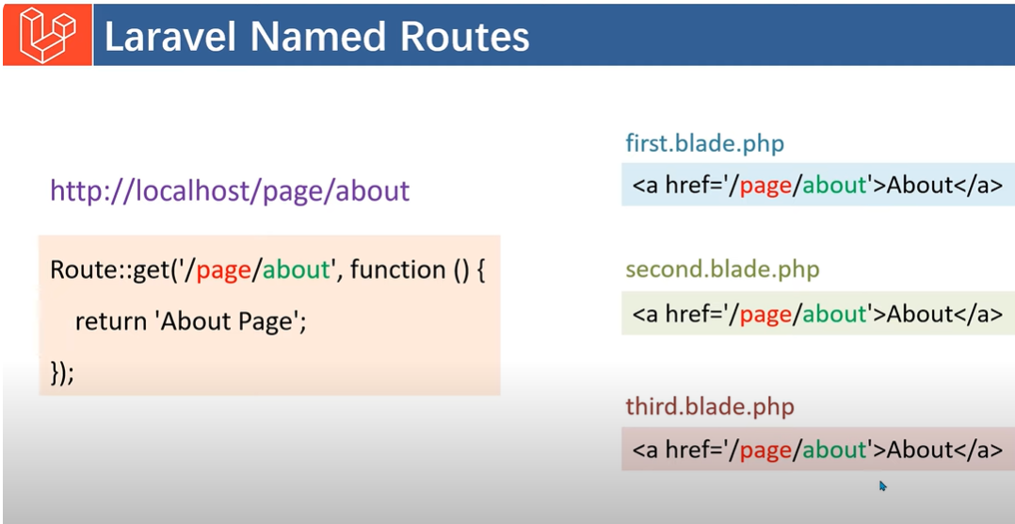
If I want to use the same route in multiple blade files

Slide 64
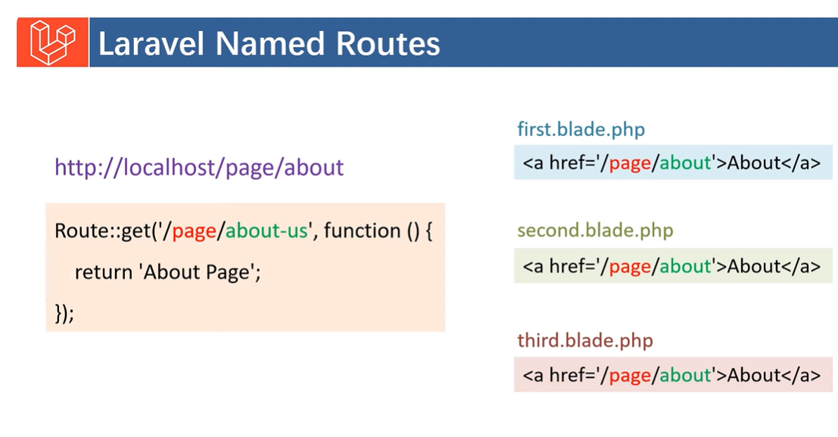
Suppose I need to change the Route name

Slide 65
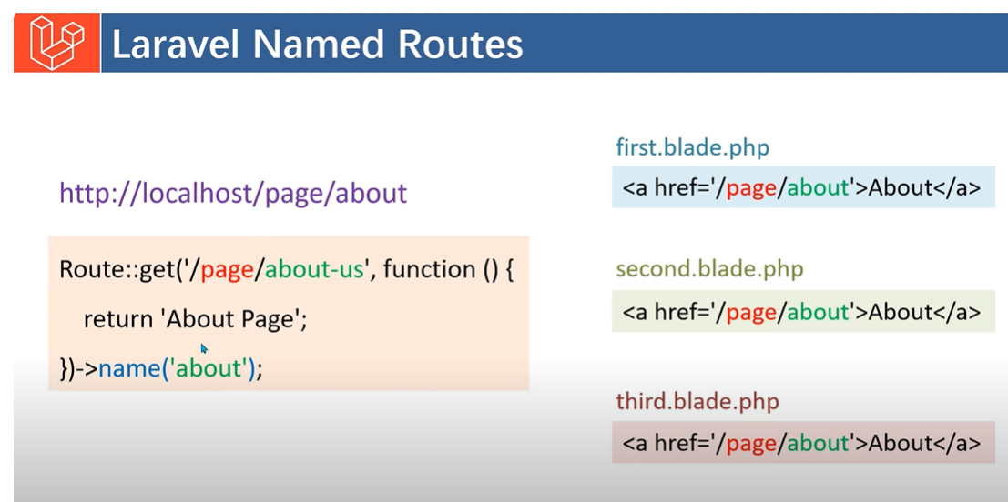
Add name(‘about’); in Routes

Slide 66
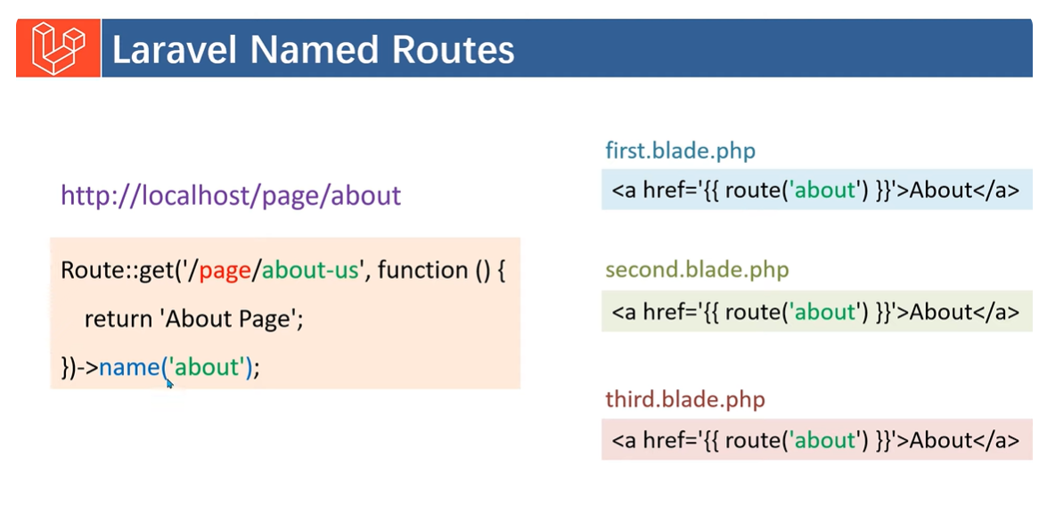
Add route function in blade template
Giving the name to route with name(‘about’);
Use route (‘about’) in Blade template

Slide 67
Benefits of named route
No need to change the <a> tag
Instead of using parent and sub-route naming (which is very large), we use named routes.
Anchor Tag
<h1> About Us </h1>
<h1> {{$name}} </h1>
<a href="/"> Welcome Page </a>
The Route for / must be declared in web.php
Route::get('/', function () { // URL to open
return view('welcome');
});

Slide 68
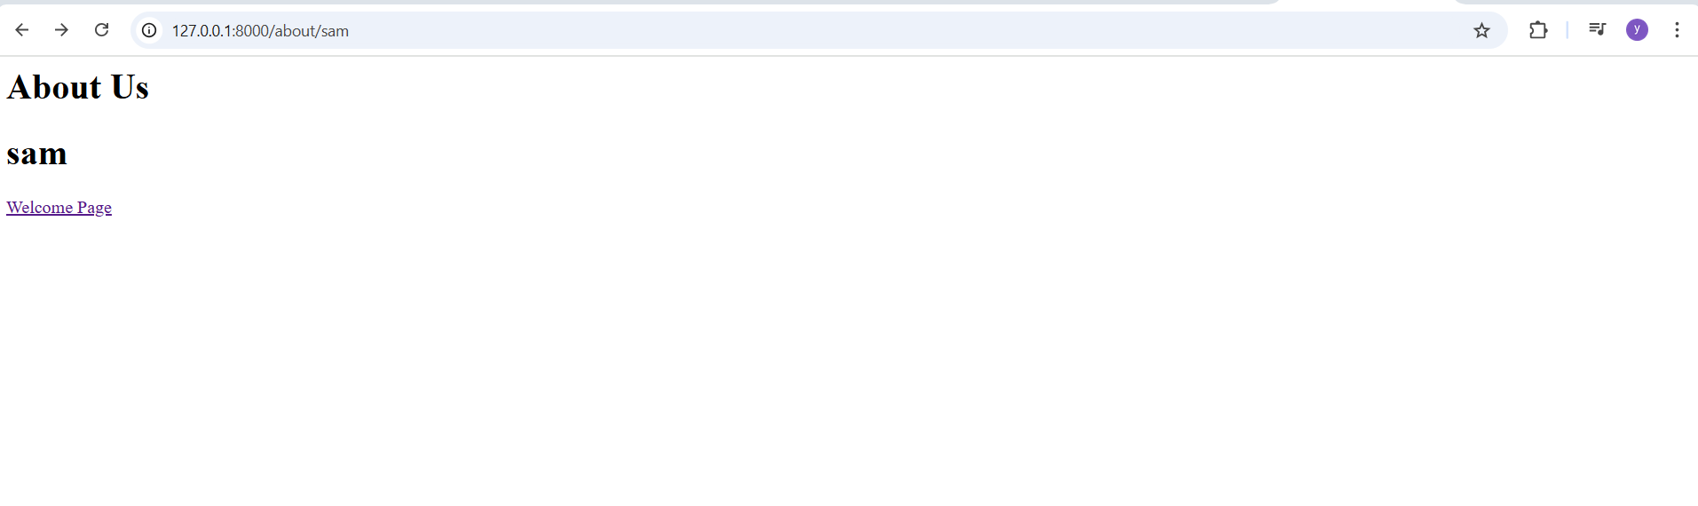
Output-On Clicking Welcome Page, http://127.0.0.1:8000 will get open

Slide 69
Redirection
Redirection in Laravel is used to send users from one URL/route to another. It’s very common after form submission, login, logout, or when access is restricted.
The simplest method is to use the global redirect helper:
Route::get('/dashboard', function () {
return redirect('home/dashboard');
});

Slide 70
Redirect to previous page
return redirect()->back();
Redirect to Named Routes
Route::get('/dashboard', function () {
return "Dashboard";
})->name('dashboard');
Redirect
return redirect()->route('dashboard');
Redirect to Controller Action
return redirect()->action([UserController::class, 'index']);

Slide 71
Redirect with Data (Flash Session)
Pass success message
return redirect('/home')->with('success', 'Login successful!');
Access in Blade
@if(session('success'))
<p>{{ session('success') }}</p>
@endif
Redirect with Input Data
return redirect()->back()->withInput();
Keeps old form values
In Blade
<input type=”text" name="name" value="{{ old('name') }}">

Slide 72
Redirect with Errors
return redirect()->back()->withErrors(['name' => 'Name is required']);
Used in validation
Redirect with HTTP Status Code
return redirect('/home', 301);
302 → Temporary (default)
301 → Permanent
Redirect to External URL
return redirect()->away('https://google.com');
Bypasses Laravel URL validation

Slide 73
Redirect in Routes
Route::get('/old-page', function () {
return redirect('/new-page');
});
Redirect using Route Shortcut
Route::redirect('/old', '/new', 301);
Redirect to fallback
Route::fallback('/route', function () {
return “page not existing;
});
// Here for the route, pass the route value that is not existing in the project, and then instead of 404/not found, it will display this return page not existing.

