Slide 1
Introduction to Data management with SQL Server

Slide 2
Introduction

Slide 3
What is this training about?
Data collection
Data management
Data
analysis
Instruments
Field based
Lab based
Surveys
Questionnaires
Cleaning
Storing
Aggregation
Statistics

Slide 4
Common issues in data management
Large files
Example: Personal monitor measuring 0.02s interval over 8h = 1,440,00 measurements per person
Data from many sources
Example: Multiple instruments measuring multiple variables at different intervals plus questionnaire data plus other notes

Slide 5

Recommended reading
Kellenberger & Shaw “Beginning T-SQL”

Slide 6
Recap: Data types
Text
Numeric
Date
Binary

Slide 7
Text data
Any character
Letters, numbers, special characters, combination of these
TextVar1 | TextVar2 | TextVar3 | TextVar4 | TextVar5
Blue | GU2 9XD | ‘1’ | One | Oops!
Red | HX4 9AF | ‘2’ | ‘2’ | X5
Yellow | EH41 4AG | ‘3’ | Three | Add 2?
Green | GU2 9XD | ‘4’ | Blue | #@ !?

Slide 8
Numeric data
Numbers
Integers, Decimals
IntegerVar | DecimalVar1 | DecimalVar2
1 | 0.1 | 1.25
2 | 0.2 | 1.00
3 | 3.5 | 0.99
4 | 100.6 | 1.24

Slide 9
Date data
Date, Time, Date and time
Most problematic:
Different start dates
Different formats
Recommended format is ISO 8601:
YYYY-MM-DD

Slide 10
Binary data
Two options
Stored as 0/1
BinaryVar1 | BinaryVar2 | BinaryVar3
1 | Yes | On
1 | No | Off
0 | Yes | Off
0 | No | On

Slide 11
Recap: Data formats
Wide vs Long

Slide 12
Wide format
Each column contains single measurement per ID
The ID does not repeat
Subject_ID | Gender | Height | DOB
1 | Female | 162 | 1995-10-11
2 | Male | 187 | 1994-04-17
3 | Male | 171 | 1989-07-13
4 | Female | 175 | 1997-07-01

Slide 13
Long format
Columns contain multiple (repeated) measurements for the same ID
The ID does repeat
Subject_ID | MoveInDate | HouseNumber | Postcode
1 | 2006-05-17 | 5 | GU2 9XD
1 | 2017-06-30 | 15 | HX4 9AF
1 | 2018-10-04 | 23 | EH41 4AG
2 | 1984-06-26 | 9 | TN1 1TA
3 | 1984-08-16 | 111 | KW1 5NR
3 | 1999-04-02 | 45 | RG1 5ZJ
3 | 2010-04-02 | 6 | UB4 8QB
3 | 2011-12-05 | 89 | HU4 9AX

Slide 14
Avoid combining wide and long…
Subject_ID | Gender | Height | DOB | MoveInDate1 | HouseNumber1 | Postcode1 | MoveInDate2 | HouseNumber2 | Postcode2 | MoveInDate3 | HouseNumber3 | Postcode3
1 | Female | 162 | 1995-10-11 | 2006-05-17 | 5 | GU2 9XD | 2017-06-30 | 15 | HX4 9AF
2 | Male | 187 | 1994-04-17 | 1984-06-26 | 9 | TN1 1TA
3 | Male | 171 | 1989-07-13 | 1984-08-16 | 111 | KW1 5NR | 1999-04-02 | 45 | RG1 5ZJ | 2010-04-02 | 6 | UB4 8QB

Slide 15
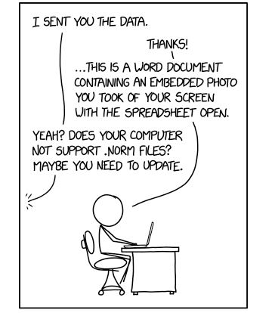
Storing data
Traditionally in academia: “Flat files”
Paper
Delimited text files (.txt, .csv, .dat)
Excel
Statistical software (SPSS, SAS, Stata)
Industry standard: “Data warehouse”
Relational Databases (SQL)
Non-relational Databases (NoSQL)

Slide 16
What is a relational database?
Structured way of storing data
SQL = Structured Query Language
Data stored in multiple tables (wide or long)
Tables have field types
Tables have primary keys
Tables are related via foreign keys
One to one
One to many
Many to many

Slide 17
Primary key
Unique identifier for each row
Can be set as multiple columns (=compound key)
MoveInDate | Postcode | HouseNumber
2018-12-19 | GU2 9XD | 7
2018-12-19 | GU2 9XD | 8
2018-12-19 | GU3 9XD | 7
2017-12-19 | GU2 9XD | 7
PK=MoveInDate + Postcode + HouseNumber

Slide 18
Primary key
Best practice to use integer variables as PK
Improves insert performance and join performance
Option 1 – Add integer ID for each record
Option 2 – Add integer ID for each Postcode
Option 3 – Add integer ID for each house
PK
Option 3
PK
Option 2
PK
Option 1
MoveInDate | Postcode | Postcode_ID | HouseNumber
2018-12-19 | GU2 9XD | 1 | 7
2018-12-19 | GU2 9XD | 1 | 8
2018-12-19 | GU3 9XD | 2 | 7
2017-12-19 | GU2 9XD | 3 | 7
Housing_ID | MoveInDate | Postcode | HouseNumber
1 | 2018-12-19 | GU2 9XD | 7
2 | 2018-12-19 | GU2 9XD | 8
3 | 2018-12-19 | GU3 9XD | 7
4 | 2017-12-19 | GU2 9XD | 7
MoveInDate | Postcode | HouseNumber | House_ID
2018-12-19 | GU2 9XD | 7 | 1
2018-12-19 | GU2 9XD | 8 | 2
2018-12-19 | GU3 9XD | 7 | 3
2017-12-19 | GU2 9XD | 7 | 1
MoveInDate | Postcode | HouseNumber
2018-12-19 | GU2 9XD | 7
2018-12-19 | GU2 9XD | 8
2018-12-19 | GU3 9XD | 7
2017-12-19 | GU2 9XD | 7

Slide 19
One to one relationship
PK
Foreign Key (FK)
Subject_ID | Name
1 | Peter Parker
2 | Miles Morales
3 | Gwen Stacey
4 | Peter Porker
Subject_ID | DOB
1 | 1995-10-11
2 | 1994-04-17
3 | 1989-07-13
4 | 1997-07-01

Slide 20
One to many relationship
PK
FK
PK
Subject_ID | Name
1 | Peter Parker
2 | Miles Morales
3 | Gwen Stacey
Subject_ID | MoveInDate | House_ID | Postcode
1 | 2006-05-17 | 1 | GU2 9XD
1 | 2017-06-30 | 2 | HX4 9AF
1 | 2018-10-04 | 3 | EH41 4AG
2 | 1984-06-26 | 4 | TN1 1TA
3 | 1984-08-16 | 5 | KW1 5NR
3 | 1999-04-02 | 6 | RG1 5ZJ
3 | 2010-04-02 | 7 | UB4 8QB
3 | 2011-12-05 | 3 | EH41 4AG

Slide 21
Many to many relationship
Name
Peter Parker
Miles Morales
Gwen Stacey
HouseNumber | Postcode
5 | GU2 9XD
15 | HX4 9AF
23 | EH41 4AG

Slide 22
In practice, try to avoid many to many…
FK
FK
Name_ID | House_ID | MoveInDate
1 | 1 | 2006-05-17
1 | 2 | 2017-06-30
1 | 3 | 2018-10-04
2 | 1 | 2006-05-17
2 | 2 | 2017-06-30
2 | 3 | 2018-10-04
3 | 1 | 2006-05-17
3 | 2 | 2017-06-30
3 | 3 | 2018-10-04
PK
PK
House_ID | HouseNumber | Postcode
1 | 5 | GU2 9XD
2 | 15 | HX4 9AF
3 | 23 | EH41 4AG
Name_ID | Name
1 | Peter Parker
2 | Miles Morales
3 | Gwen Stacey
…use intermediate tables!

Slide 23
What are the advantages?
Data validation
Fields only allow data types specified by database designer
Referential integrity
If row in top level is deleted all related data is deleted
Data can’t be added to lower level if top level doesn’t exist
Normalization = efficiently organise data
Minimise redundancy and replication
Meaningful dependencies

Slide 24
What are the advantages?
Clustered Indexes
Additional information stored in database to group (cluster) data that speeds up searches/joins
Chapter | Section | Paragraph | Wordcount
1 | 2 | 1 | 300
2 | 1 | 2 | 255
1 | 2 | 3 | 100
3 | 2 | 1 | 600
15 | 2 | 2 | 400
2 | 6 | 1 | 750
1 | 1 | 2 | 600
1 | 1 | 1 | 200

Slide 25
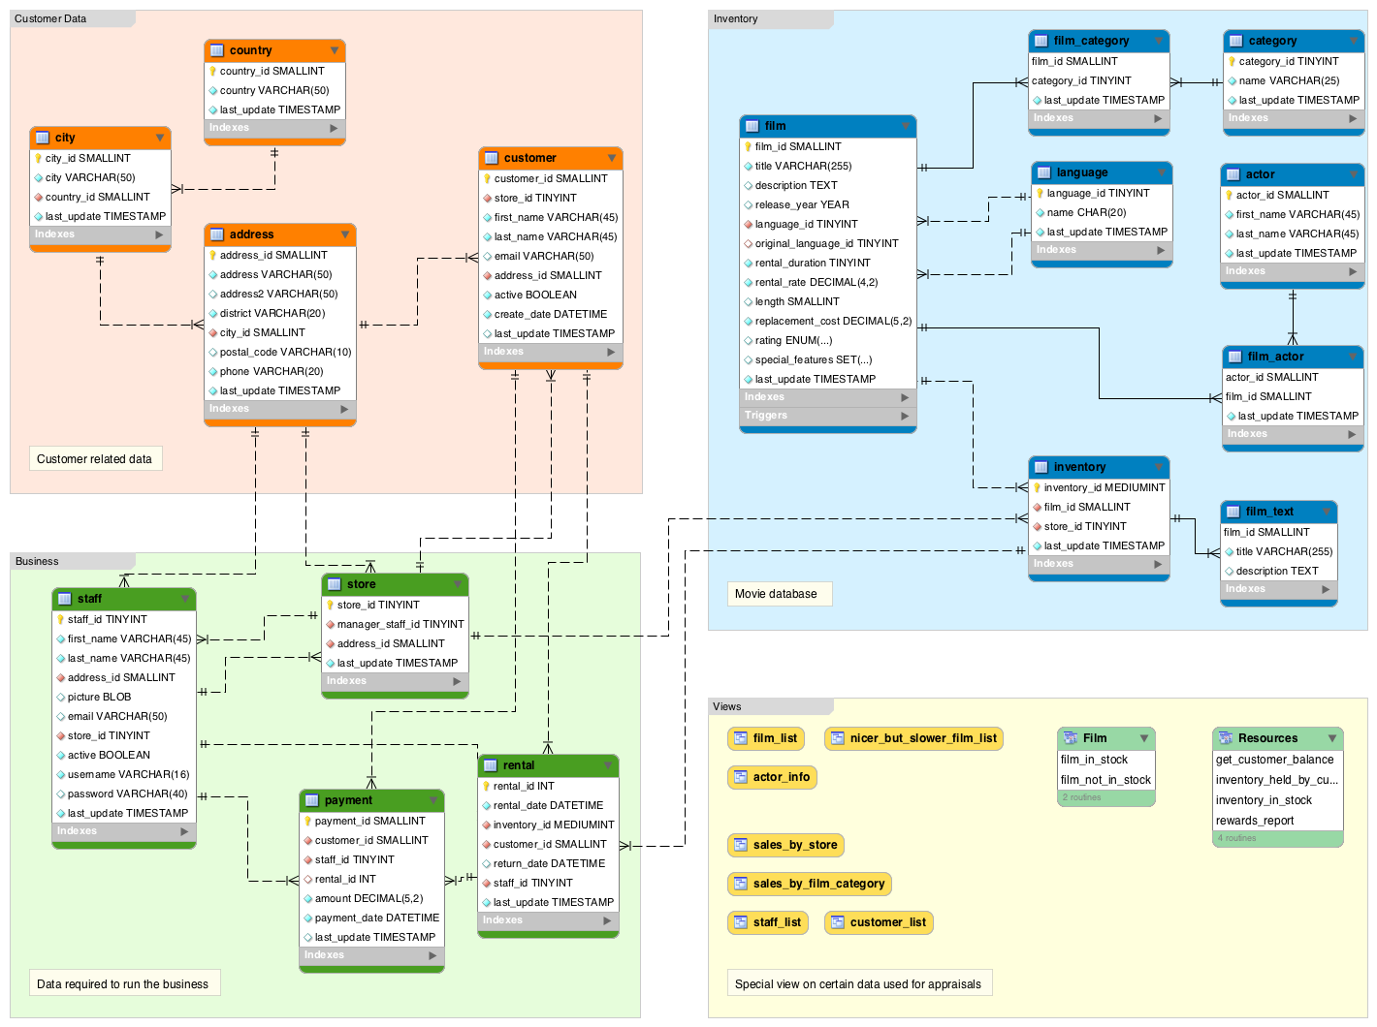
What are the advantages?
Schemas
Different definitions depending on database software
In essence a ‘Masterplan’ of the tables, relations and other objects
Source: https://database.guide/wp-content/uploads/2016/06/sakila_full_database_schema_diagram.png

Slide 26
Database software
Commercial
Microsoft Access
Microsoft SQL Server
Oracle
Open source
MySQL
Postgresql
SQLite

Slide 27
Microsoft SQL Server
SQL Server Express – Free, but databases limited to 10GB
SQL Server Developer – Free, but can only be used for learning or testing code
SQL Server Standard or Enterprise – Licensed by physical core = expensive!

