Slide 1

TEAM NAME
THE A4SM();
Team Members:-
Anupama Mishra
Ansh Varun
Archana Kumari
Anunay Prakash Sharma
Mexson Fernandes
Shiona Dutta

Slide 2
Problem Statement
To provide with Unified annual returns for employers under various acts using a web enabled applications of the employees, to be synchronized with website of Labour Department by giving unique identification number to each.

Slide 3
Need?
Recently many cases of fraud & cheating Delhi govt. have been registered.
Some people file the annual return more than once either by providing fake location and profession.
Till now, the process of filing annual returns was manual & thus had multiple security flaws.
No ID proof was required to file annual return in Delhi.

Slide 4
Proposed Solution
A java based web application which allows the user to register(requires Aadhar number)/login and file the annual return digitally.
Registering using Aadhar number along with UIN number(based on the nature of employement), provides proof of employer and his establishment.
This manual task been brought to an ease with the web application.

Slide 5
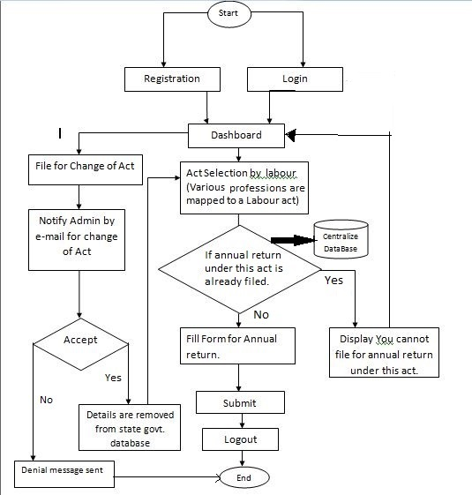
F
L
O
W
C
H
A
R
T

Slide 6
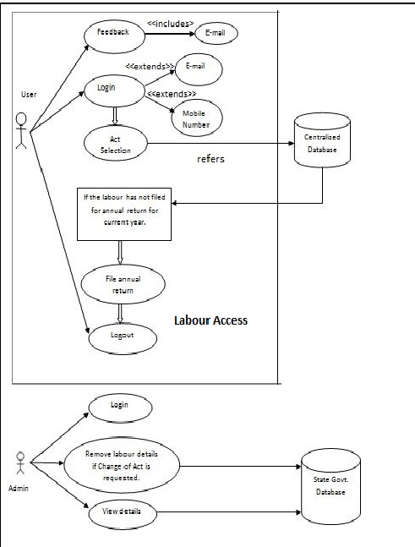
JAVA WEB APPLICATION
W
O
R
K
I
N
G

Slide 7
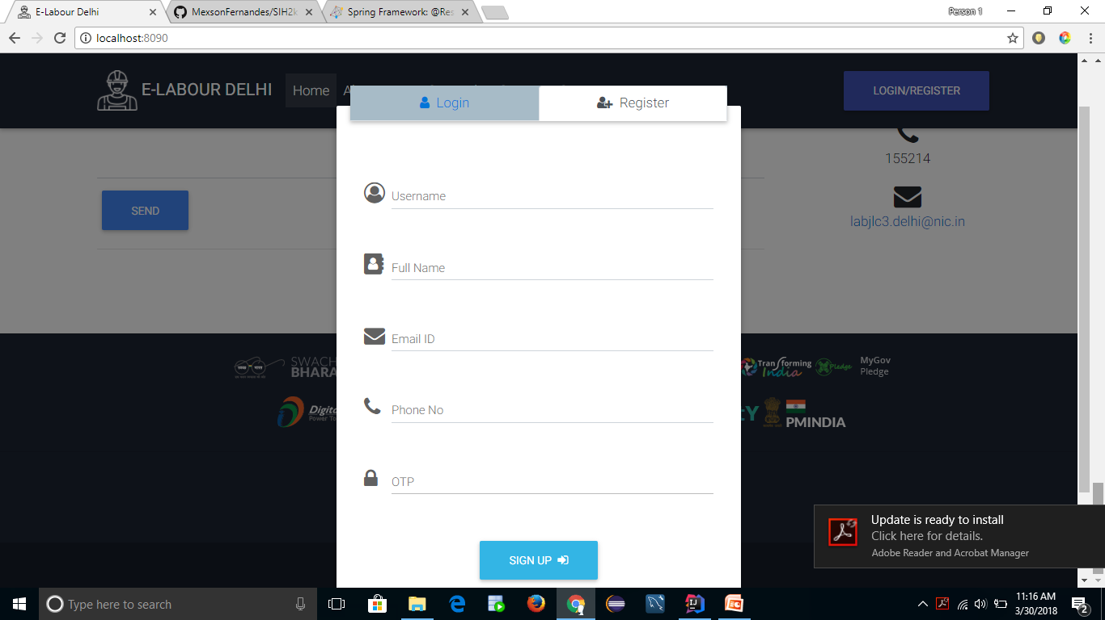
Registration

Slide 8
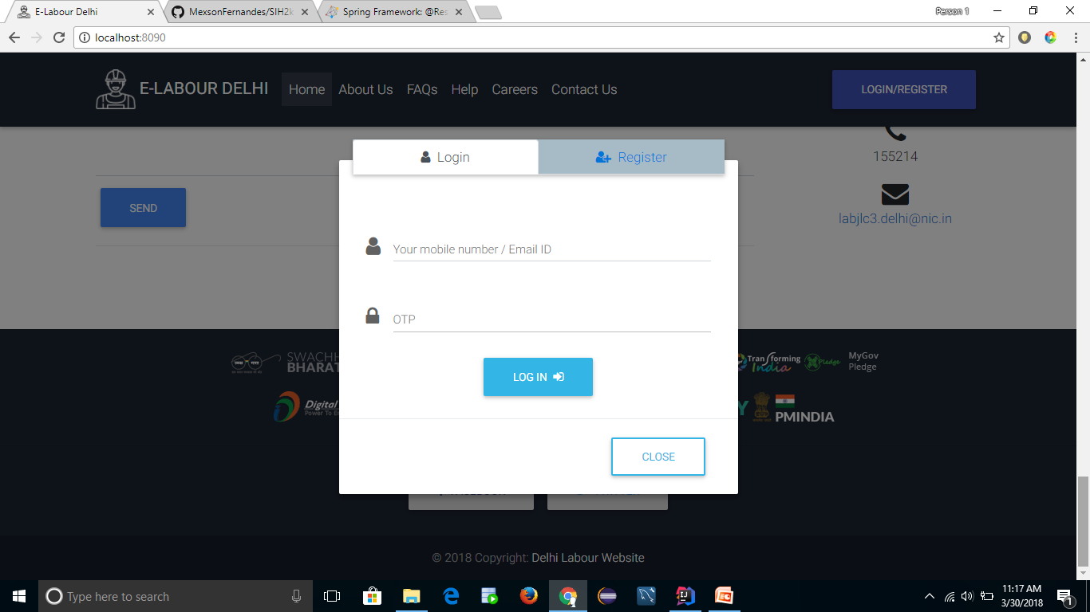
Login

Slide 9
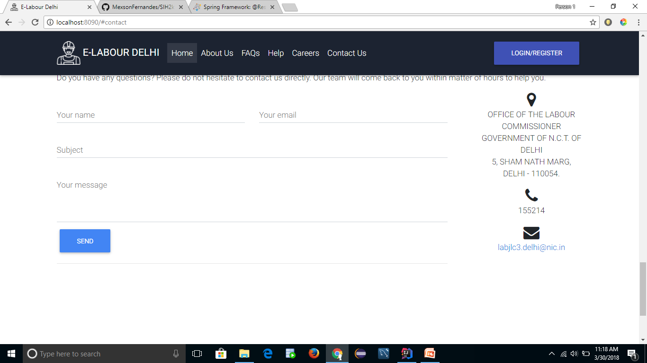
Contact Us

Slide 10
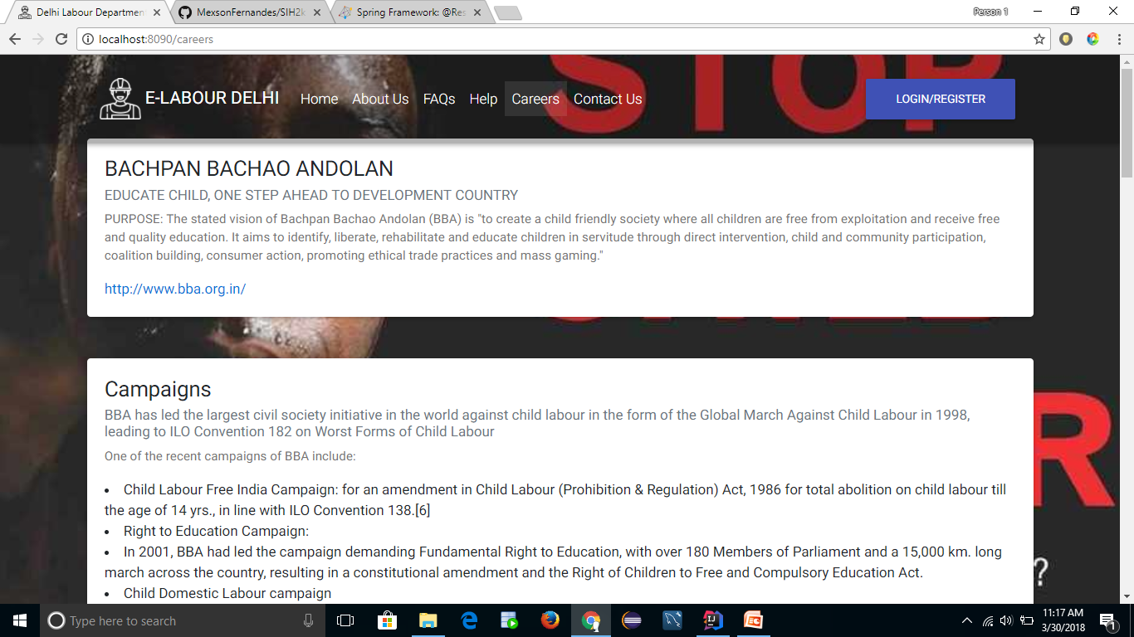
Careers and Education

Slide 11
Technology Stack
Front end- Back End-
> HTML 5 > Spring Boot Stack
> JSP > Spring MVC
> CSS 3 > Spring Data JPA
> AJAX > Hibernate
> JQuery > MySQL
> Material Design Bootstrap
> JavaScript
VERSION CONTROL using GITHUB

Slide 12
THANK YOU

