Slide 1
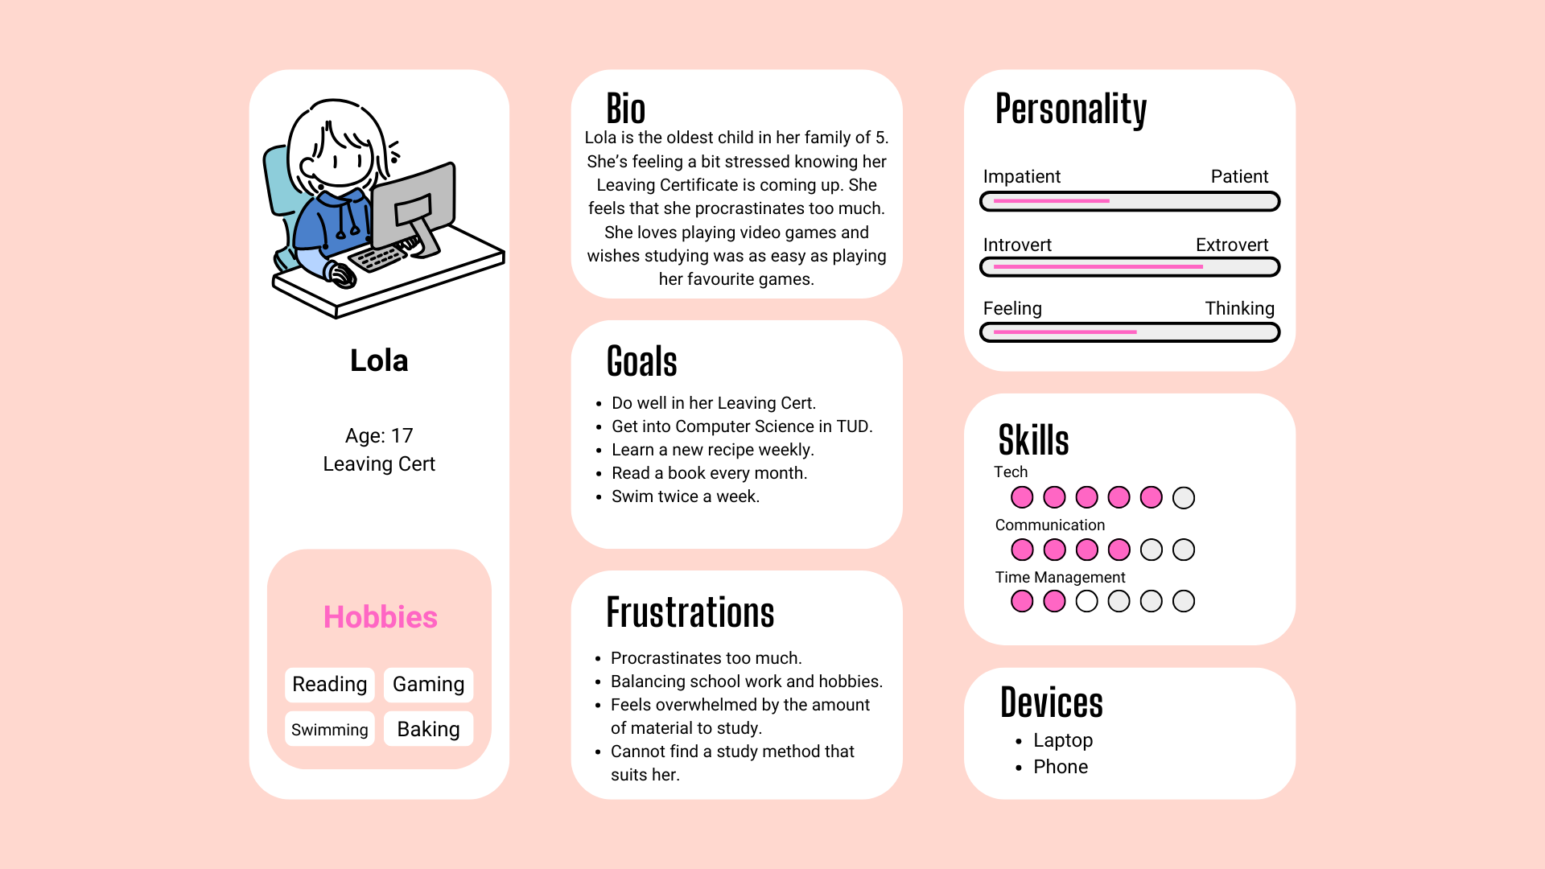



Introduction
Persona
Product
StudyRunner
Crumlin U7 Coding Champions 2019
X

Slide 2
Introduction
Persona
Product
StudyRunner
Crumlin U7 Coding Champions 2019
X

Slide 3
Introduction
Persona
Product
StudyRunner
Crumlin U7 Coding Champions 2019
X

Slide 4
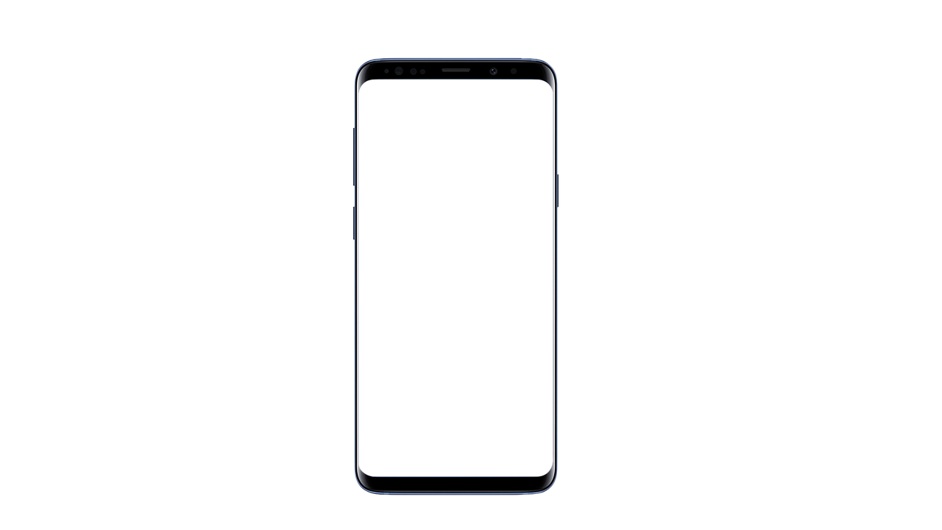

Introduction
Persona
Product
StudyRunner
Crumlin U7 Coding Champions 2019
X
StudyRunner
Crumlin U7 Coding Champions 2019
StudyRunner
Game-ify learning!
View your achievements and go over areas where you are lacking.
Continue
Add Notes
Insert your notes into the app and let the AI create levels for you.
Achievements

Slide 5
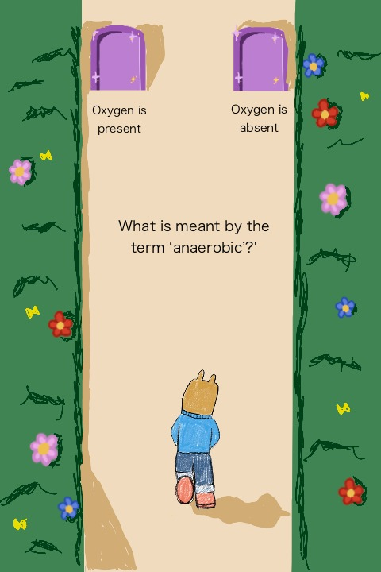
Introduction
Persona
Product
X
StudyRunner
Crumlin U7 Coding Champions 2019
StudyRunner
Game-ify learning!
View your achievements and go over areas where you are lacking.
Continue
Add Notes
Insert your notes into the app and let the AI create levels for you.
Achievements
Play with Friends!
Top the leaderboard!
Get rewards for good performance!

Slide 6


Introduction
Persona
Product
X
StudyRunner
Crumlin U7 Coding Champions 2019
StudyRunner
Play with Friends!
Game-ify learning!
View your achievements and go over areas where you are lacking.
Continue
Top the leaderboard!
Insert your notes into the app and let the AI create levels for you.
Add Notes
Get rewards for good performance!
Achievements
Content

Slide 7
Introduction
Persona
Product
X
StudyRunner
Crumlin U7 Coding Champions 2019
StudyRunner
Game-ify learning!
View your achievements and go over areas where you are lacking.
Continue
Add Notes
Insert your notes into the app and let the AI create levels for you.
Content
Achievements

Slide 8
Content
Thank You!
Persona
Product
StudyRunner
Thank You!

