Slide 1
Big Mountain Ski Resort
Abby Morgan

Slide 2
Problem Identification:
Big Mountain’s current pricing strategy: charge a premium above the average price of resorts in the same market segment.
This approach has many limitations, and a more data-driven business strategy could support raising the ticket price and/or cut costs without compromising ticket price.
Objectives:
Determine how Big Mountain’s facilities and offerings compare with its competitors across the US.
Determine if there are any opportunities to cut costs without devaluing ticket price.
Determine if there are any facilities or amenities especially favored by visitors that might support a raise in ticket price if invested in.

Slide 3
Recommendations:
Without any updates or changes to current facilities, Big Mountain could reasonably raise prices by $4.48 - $14.87 per ticket.
Additional facilities that support an increased ticket price:
Adding a run to increase the vertical drop by 150ft (and adding one chairlift to service that run)
Supports an increased price of $8.61 per ticket, or an estimated additional $15,065,471 per season.
Introducing two acres of additional snowmaking capabilities to the above-mentioned run.
Supports an increased price of $9.90 per ticket, or an estimated estimated $17,322,717 per season.
Cost cutting opportunities:
Closing one run didn’t seem to affect ticket price at all; supports current $81.00 ticket price.
Closing 3-5 runs supported a reduction in ticket price of approximately $0.70.
More data need regarding operating cost of runs to determine if these cost-cutting measures would be advantageous

Slide 4
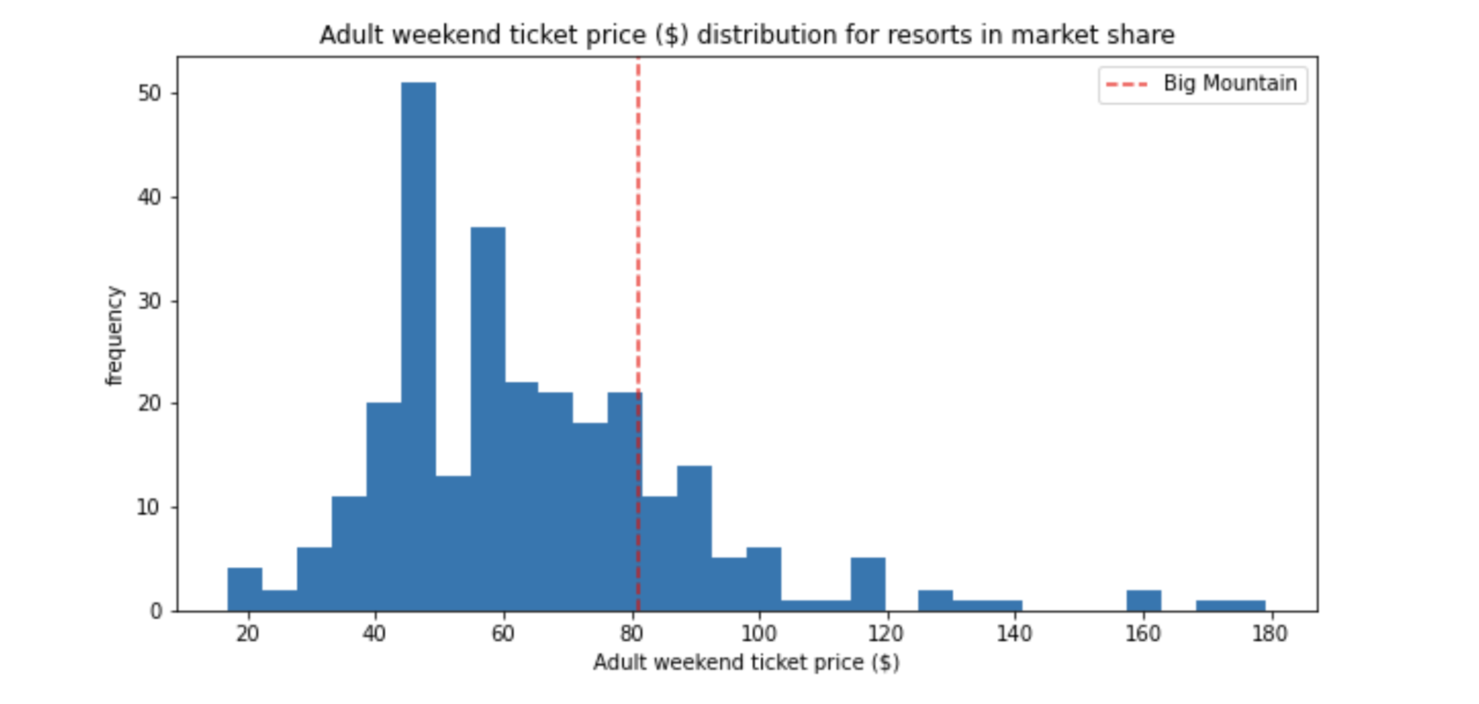
Baseline Ticket Price
Big Mountain has room to raise its ticket price in the marketspace.

Slide 5
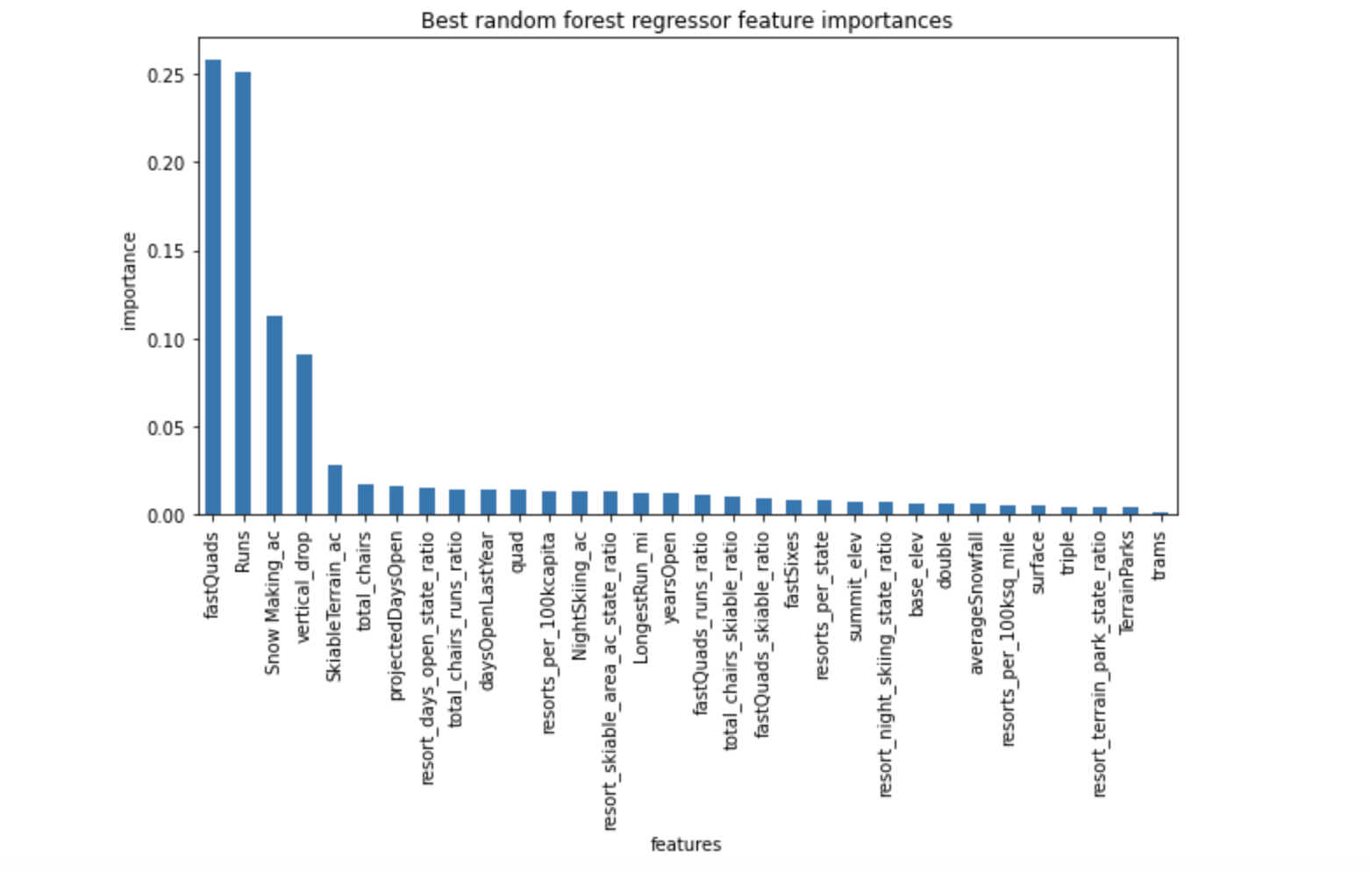
Features most (and least) valued by guests

Slide 6
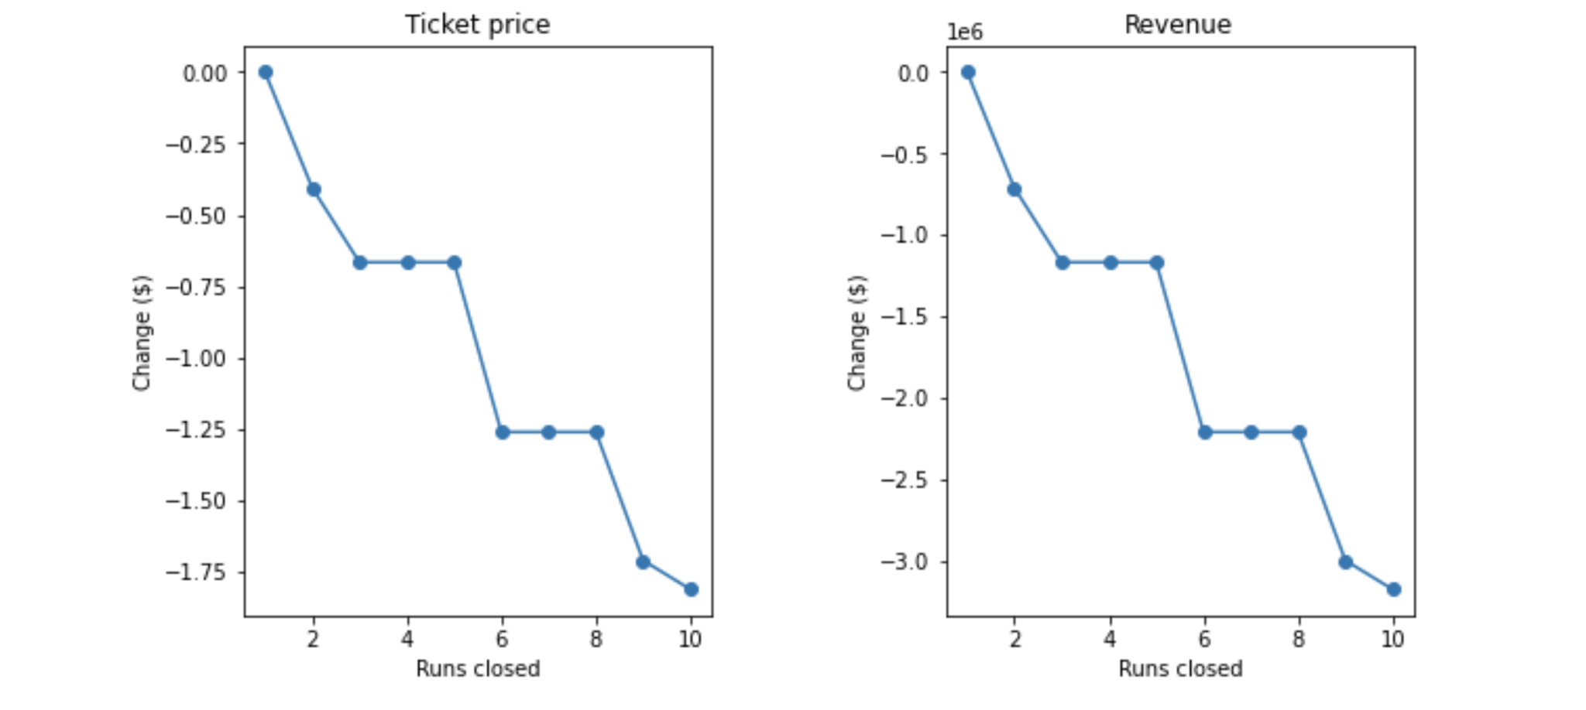
Cost Cutting Options:
Closing one run didn’t seem to affect ticket price at all; supports current $81.00 ticket price.
Closing 3-5 runs supported a reduction in ticket price of approximately $0.70.
More data need regarding operating cost of runs to determine if these cost-cutting measures would be advantageous

Slide 7
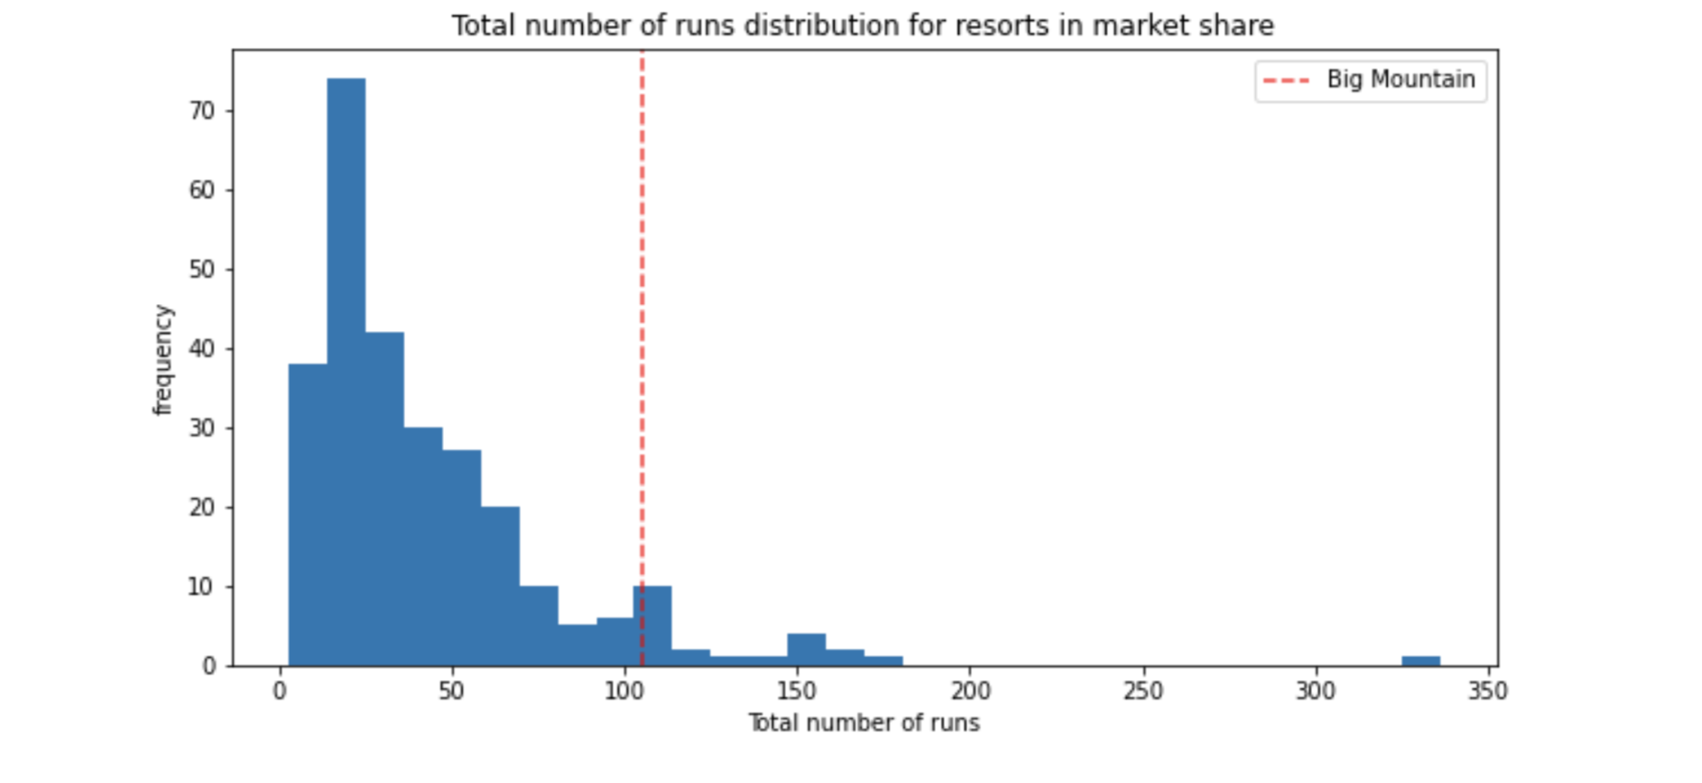
Big Mountain ranks high among its competitors in total number of runs, and could permanently close one or some without compromising much of ticket price.

Slide 8
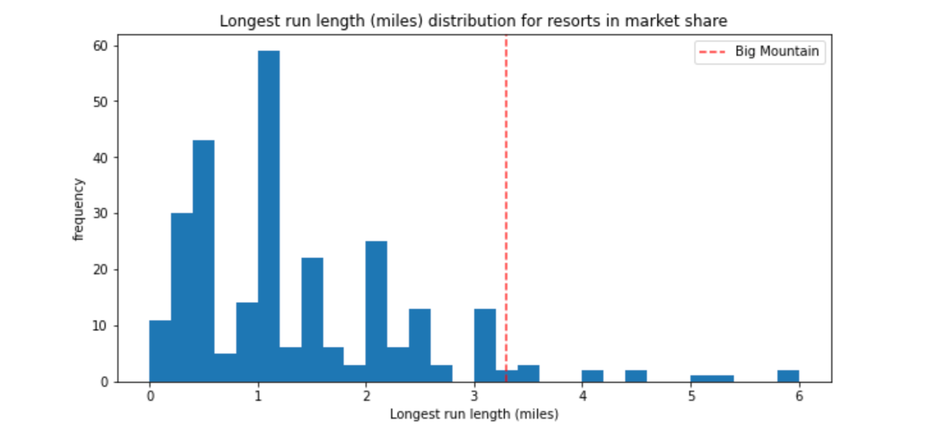
Vertical Drop
Big Mountain did well in amongst comparable resorts, but demonstrated some room for improvement.

Slide 9
Conclusion
Without any updates or changes to current facilities, Big Mountain could reasonably raise prices by $4.48 - $14.87 per ticket.
Adding a run to increase the vertical drop by 150 ft supports an increased price of $8.61 per ticket, or an estimated additional $15,065,471 per season.
Additional 2 acres of snow making capabilities to this new run supports an increased price of $9.90 per ticket, or an estimated estimated $17,322,717 per season.
One run could also be closed permanently without affecting ticket price at all.
3-5 runs could be closed, while only reducing ticket price by approximately $0.70 per ticket. (Additional data required to advise if this is recommended)

