Slide 1
On the Effectiveness of Task Off-loading in Edge based Federated Learning Environment
Sumiko Miyata, Institute of Science Tokyo
Takamichi Miyata, Chiba Institute of Technology
Irfanullah Khan, The University of Glasgow
Paul Harvey, The University of Glasgow
ANMS 2025

Slide 2
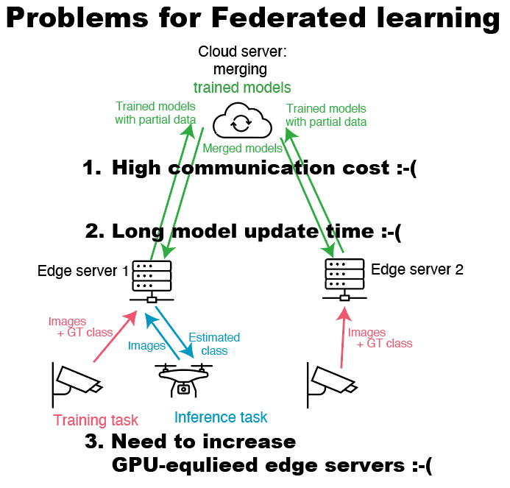
Background & Challenges
Smart City Applications & the Role of AI
  Traffic monitoring, AR, anomaly detection
  These applications increasingly rely on AI models that process data close to the source (e.g., IoT devices).
  Deploying and training such AI models in distributed environments poses significant challenges.
Why Federated Learning (FL)?
  FL enables distributed, privacy-preserving machine learning across many IoT devices.
  Particularly suited for collaborative AI in smart cities
Challenges in Practice
  High communication cost due to frequent model weight exchange
  Long model update time, especially for large-scale models
  Need to increase GPU-equipped edge servers, but deployment is costly
Toward a More Efficient FL: Federated Prompt Learning (FPL)
  To reduce communication overhead, FPL has been proposed.
  ➤ FPL shares prompts instead of full model weights, drastically cutting communication cost.

Slide 3
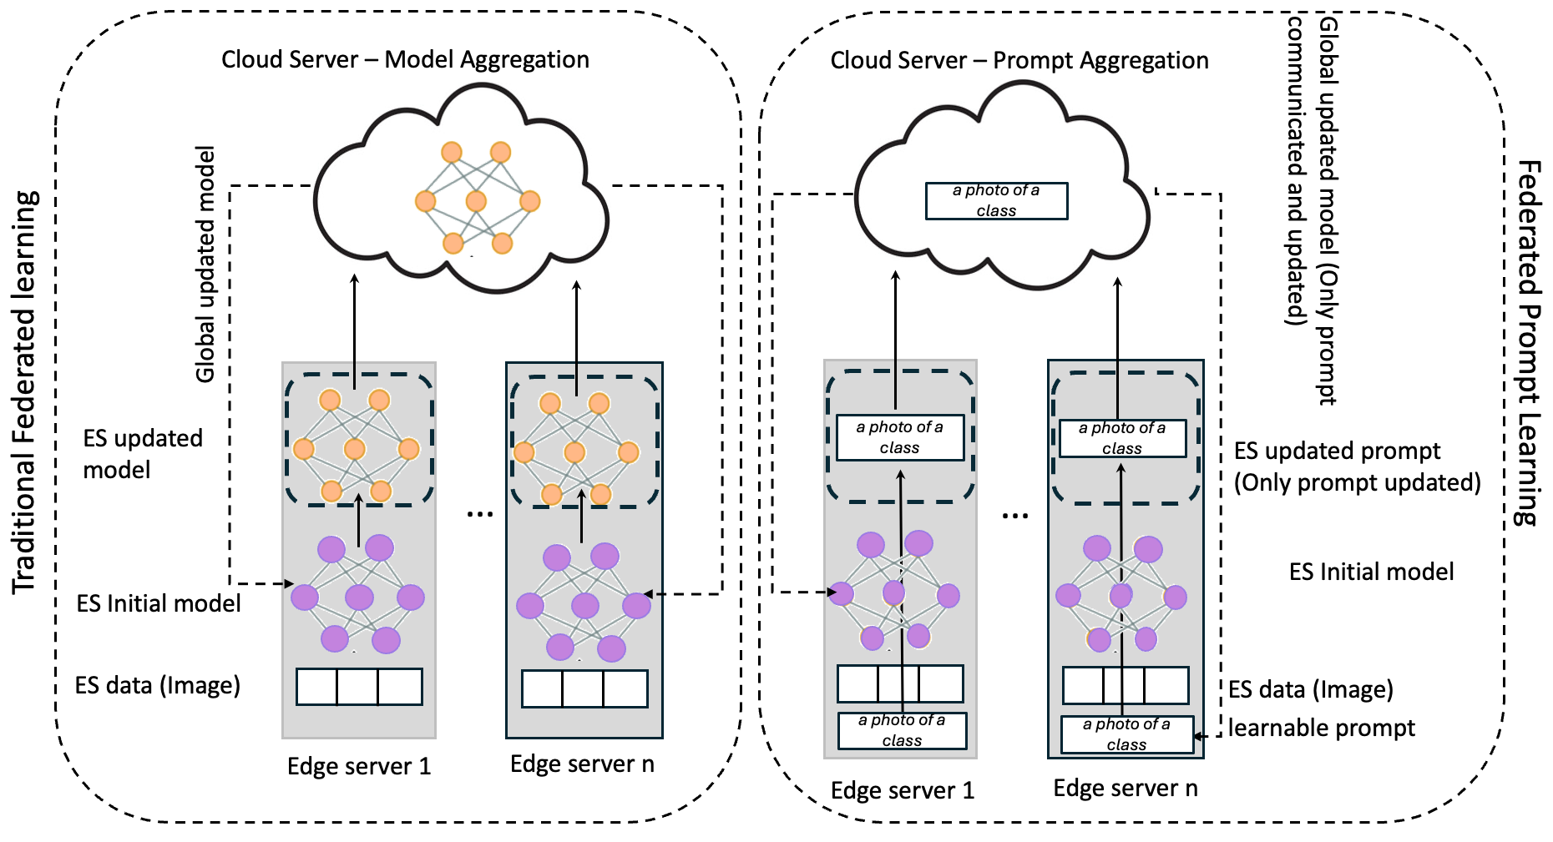
What is FPL?
FPL reduces overhead by sharing only prompts, not full models.
  E.g., Edge servers send learned prompt like “a photo of a cat” rather than uploading entire CLIP weights.
T. Guo, S. Guo, J. Wang, X. Tang, and W. Xu, “PromptFL: Let Federated Participants Cooperatively Learn Prompts Instead of Models – Federated Learning in Age of Foundation Model,” IEEE Transactions on Mobile Computing, vol. 23, no. 5, pp. 5179–5194, 2024.

Slide 4
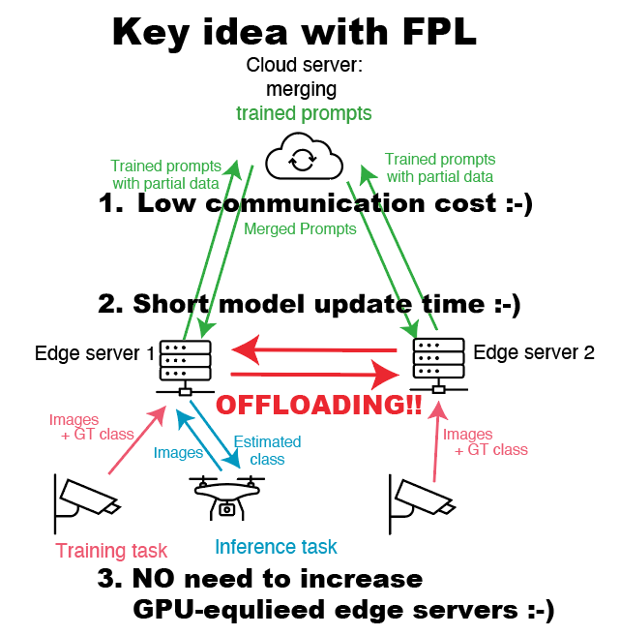



Federated Prompt Learning (FPL) and the Remaining Challenges
Step 1: FPL benefits
  Sends simple prompts instead of heavy model weights
  → can cut communication traffic
  Updates are faster and lighter → can reduces total delay
Step 2: Smart task assignment
  Inference (fast) and training (slow) often compete for GPU
  We offload and assign tasks smartly across edge servers
  → can avoid adding more GPU-equipped servers
What’s Needed
  Smart task scheduling to balance inference and training
  Lightweight, explainable analysis (e.g., queueing theory)

Slide 5
Comparison with Existing Approaches
What Existing Methods Cover (and Don’t)
Our Contribution
  Handles both inference and training tasks
  Enables efficient off-loading between edge servers
  Evaluated using lightweight, explainable queueing theory
"✓: addressed / ✗: not addressed"
 | FPL(=Low Communication cost) | Edge off loading | Both Inference and Training tasks | Light calculation cost by queueing theory
Federated Prompt Learning [Guo+, IEEE TMC 2024] | ✓ | ✗ | ✗ | ✗
Edge load balancing [Ogawa+, IEEE OJCS 2025] | ✗ | ✓ | ✗ | ✓
Our | ✓ | ✓ | ✓ | ✓
  Existing methods rarely handle both inference and training

Slide 6
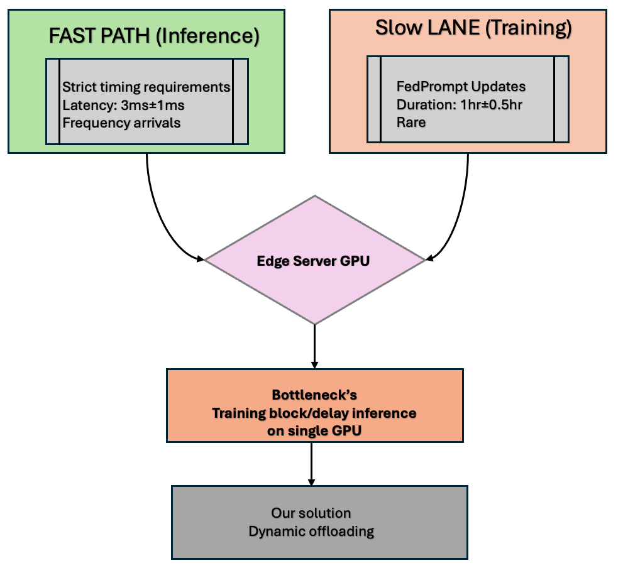
Objective: Task Conflict on the Edge
The Core Problem
  Inference: Fast & frequent → Needs low latency
  Training: Slow & rare → Long duration, sensitive to interruption
  Both tasks compete for the same GPU on edge devices
Our Insight
  Instead of running both tasks on the same server,
  → Separate and offload tasks based on application properties or characteristics
Design Direction (objectives)
  Preserve inference responsiveness
  Prevent training interruption
  Achieve balance with a simple, practical offloading strategy

Slide 7
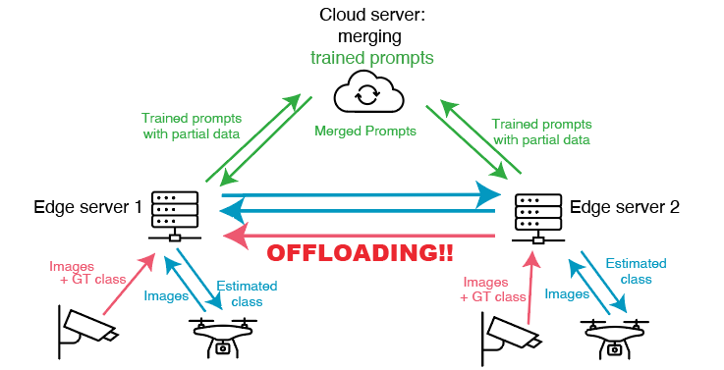
Overview of our assumed system
• Distributed visual sensing using edge servers and clients
• ES1 handles training and inference; ES2 supports task offloading
• Merged prompts are managed via the cloud for global coordination

Slide 8
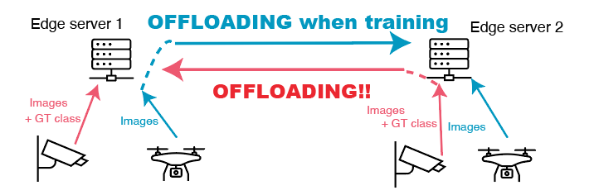
Our Offloading Strategy
Key Idea
  Assign different roles to edge servers:
    One server mainly handles training
    One server only handles inference
Server Roles
Benefits
  Inference tasks get low latency (no queuing behind training)
  Training tasks run without interruption
  Simple strategy → suitable for lightweight analytical modeling
Server | Task Executed | Task Offloaded
Edge Server 1 (ES1) | Training (class 2), Inference (class 1 if available) | Inference → ES2
Edge Server 2 (ES2) | Inference (class 1) | Training → ES1

Slide 9
Illustration of Task Offloading Behavior
Offloading in Action
  When ES1 is training, incoming inference tasks are offloaded to ES2
  When ES2 receives training tasks, they are offloaded to ES1
  Each server runs only one task at a time (single GPU per server)
Client
Inference or Training Requests
ES1: Mainly Training Server
Offload training
Offload Inference
When training
ES2: Inference Server
To derive delay time with our offloading behavior,
we use queueing theory.
Notes:
Why This Matters
Enables priority-aware scheduling
Avoids complex switching or queuing overhead
Foundation for analytical modeling via queueing theory

Slide 10
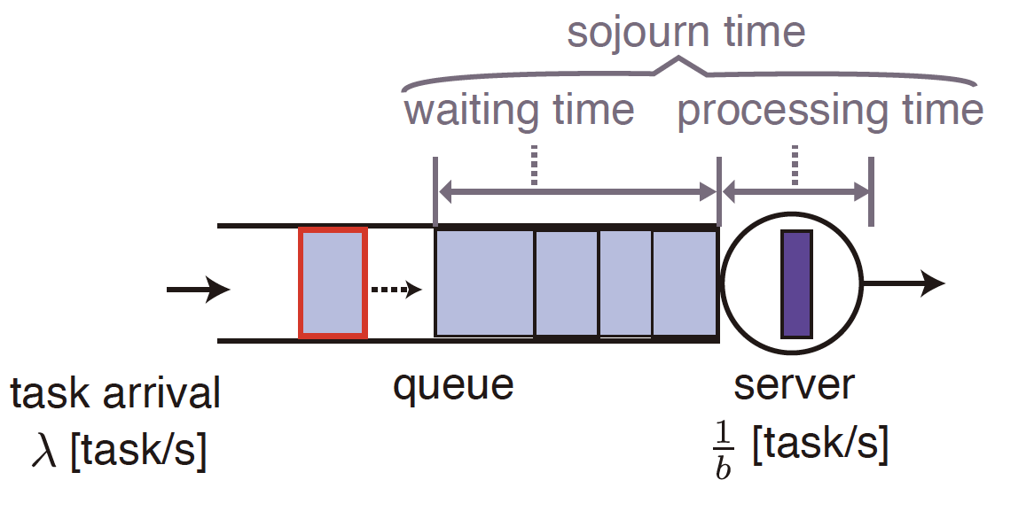
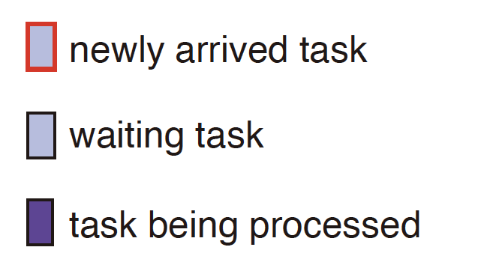
Modeling Task Scheduling via Queueing Theory
Why Queueing Theory?
  Lightweight and explainable evaluation
  No need for complex simulation
  Captures system delay characteristics
Assumptions
  Each edge server = single-server queue
  Two task types (classes):
    Class 1 = Inference (short, frequent)
    Class 2 = Training (long, rare)
Queueing Model
  Queue type: M/G/1
    M = Poisson arrivals (λ)
    G = General service time (b, variance supported)
    1 = Single server (1 GPU per ES)
Notes:
➤ Next: Priority control mechanisms under this mode

Slide 11




M/G/1 Queue with Priority Scheduling
Model Structure
  Single server with two task classes:
    Class 1 (Inference): high priority
    Class 2 (Training): low priority
  Arrival: Poisson process ( )
  Service time: General distribution (b₁, b₂)
Key Parameters
  (inference load)
  (training load)
  (total system load)
inference task λ₁
Each edge server
$$λ_{1},λ_{2}$$
Service time b₁, b₂
$$ρ_{1}=λ_{1}b_{1}$$
training task λ2
$$ρ_{2}=λ_{2}b_{2}$$
$$ρ=ρ_{1}+ρ_{2}$$

Slide 12
Modeling Our Offloading Strategy
System Overview (review)
  Two edge servers: ES1 and ES2
  Task classes:
    Class 1 (Inference): frequent, short
    Class 2 (Training): rare, long
  Each server = single-server M/G/1 queue
Analytical Modeling Approach
  ES1: Mixed queue
    Executes training + offloaded training from ES2
    Offloads inference to ES2 during training
  ES2: Primarily inference queue
    Receives offloaded inference tasks from ES1
Server | Task Executed | Task Offloaded
Edge Server 1 (ES1) | Training (class 2), Inference (class 1 if available) | Inference → ES2
Edge Server 2 (ES2) | Inference (class 1) | Training → ES1
Offload inference task
(conditional)
ES-1
ES-1
〜
Weak dependency
〜
approx. independency
Offload all training task
ES-2
ES-2
We can apply our offloading model
to conventional priority queueing model (= baseline method)

Slide 13
Baseline Methods: Priority Scheduling
Baseline 1: Non-Preemptive Priority
  Training task cannot be interrupted
  Inference must wait if training is in progress
  Stable training
  Inference latency becomes large
Baseline 2: Preemptive Priority
  Inference task interrupts training
  Training is paused and resumes after inference finishes
  Low inference latency
  Training may suffer from frequent interruptions
Common Assumption
  Both tasks are executed on the same edge server (No offloading)
  Server can run only one task at a time (single GPU)
Non-Preemptive
Preemptive
Training Interrupted
Training Runs
Inference Wait
High Latency
Inference Executes Overhead

Slide 14
Comparison of Scheduling Strategies
Method | Inference Latency | Training Latency | Implementation
Baseline 1: Non-Preemptive Priority | ✗ High (blocked by training) | ✓ Low (no interruption) | ✓ Simple
Baseline 2: Preemptive Priority | ✓ Low (always prioritized) | ✗ High (frequent pauses) | ✗ Complex (switch mechanism)
Our method | ✓ Low (offloaded to ES2) | ✓ Stable (no interruption) | ✓ Simple

Slide 15
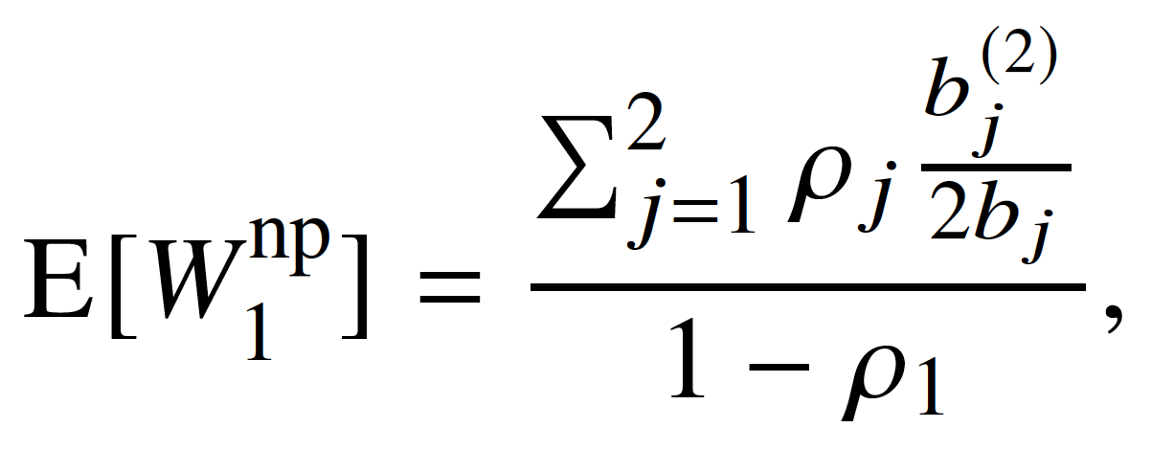
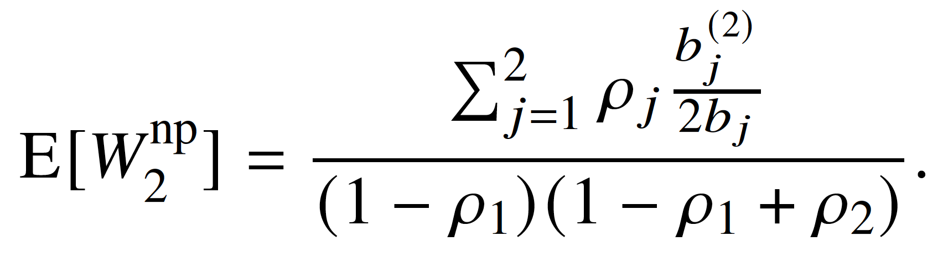
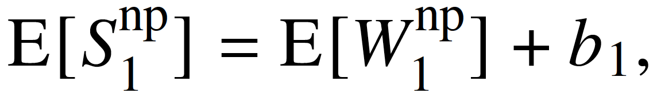
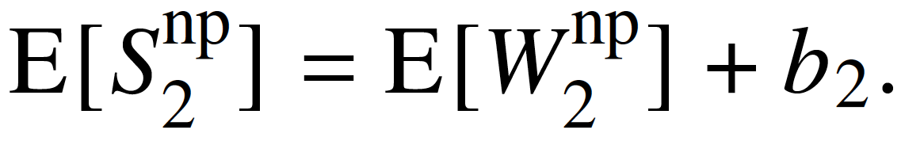
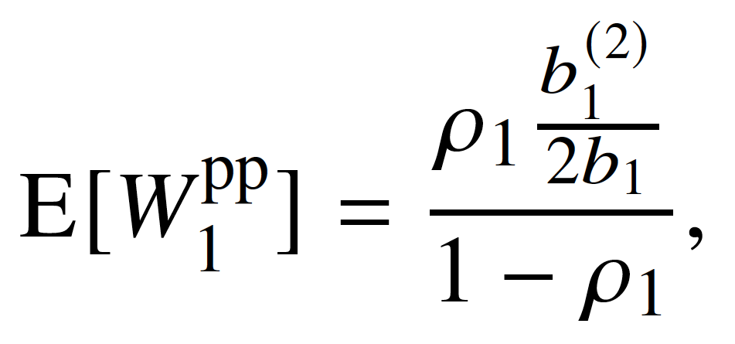
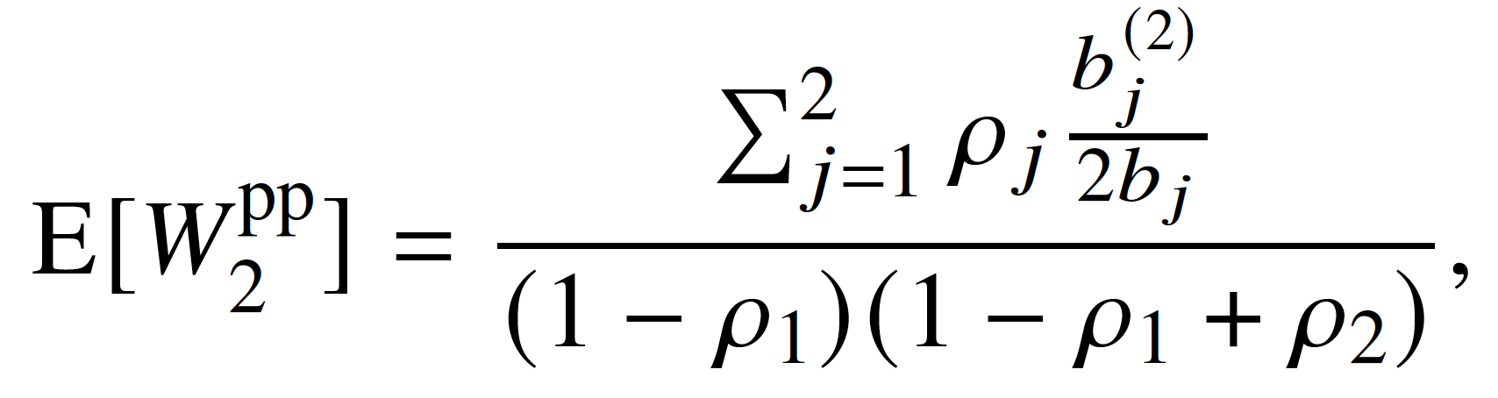
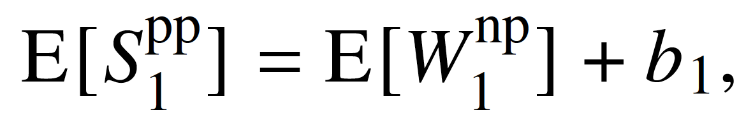
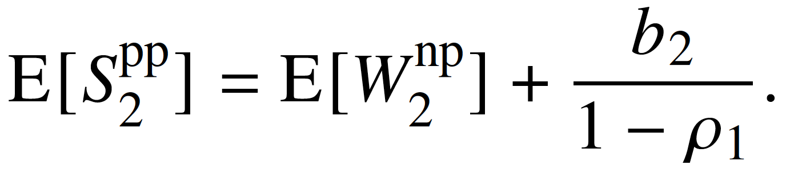
Mean Delay under Priority Scheduling
Non-Preemptive Priority (Baseline 1)
Preemptive Priority (Baseline 2)
 | Class 1 (Inference) | Class 2 (Training)
Mean waiting time
Sojourn time
High latency
Low latency
 | Class 1 (Inference) | Class 2 (Training)
Mean waiting time
Sojourn time
Low latency
High latency
We can use these formulas for our offloading model

Slide 16
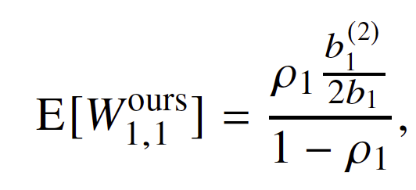
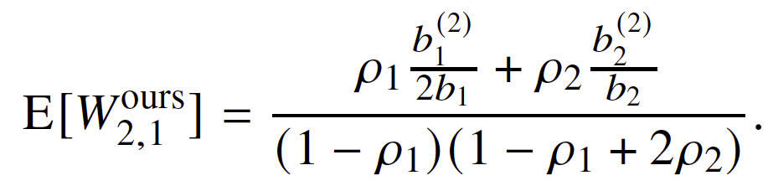




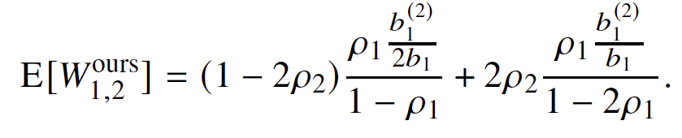







Approximate Delay under Our Offloading Strategy
Preemptive mode
ES1: Mixed Queue (Executes Class 2 and some Class 1)
  Approximate mean waiting time for Class 1 tasks at ES1:
  Approximate mean waiting time for Class 2 tasks at ES1:
ES2: Inference Queue (Receives Class 1 offloads)
  Approximate mean waiting time for Class 1 tasks at ES2:
Inference task is offloaded without interruption -> Low latency!!
Traffic load for training tasks becomes
2$ρ_{2}$
Probability of training task is not processing at ES1
=can process inference task at ES1:
1 - 2$ρ_{2}$
ES-1
ES-2
2$ρ_{2}$
Tasks at ES2
offloading tasks
from ES1+tasks at ES2
  Note: These formulas are analytical approximations derived from classical queueing theory, ignoring GPU switching overheads for simplicity.
For all task classes and edge servers, mean sojourn time is given by the sum of the mean waiting and mean service times.

Slide 17

Experiment Setup
Model: CLIP + PromptFL [1]
You can show how λ₁ and λ₂ are derived from ρ and r:
  System load: ρ = 0.3, proportion r = 0.9
  Inference: 3 ms avg., Training: 1 hr avg.
System Motivation
  The high imbalance in task frequency motivates task offloading.
Baseline Comparison Note
  Mention explicitly that the same parameters are used across all scheduling methods (for fair comparison).
[1] C. Qiu, X. Li, C. K. Mummadi, M. R. Ganesh, Z. Li, L. Peng, and W.-Y. Lin, “Federated Text-driven Prompt Generation for Vision-Language Models,” in Proceedings of the International Conference on Learning Representations, 2024.

Slide 18



Results & Discussion
In the non-preemptive priority control method, the mean waiting time for inference tasks becomes extremely long.
In the preemptive priority control method, the mean waiting time for inference tasks is reduced compared to the non-pre-emptive method. However, the mean sojourn time for training tasks increases as they are frequently interrupted. In practice, due to task-switching overhead, the delay for both task classes would likely be greater.
The proposed method, which offloads tasks between edge servers, effectively combines the advantages of both priority control approaches. Additionally, our method eliminates taskswitching overhead. Although some overhead is required for task offloading, it is expected to be relatively small.
ES-1
ES-2
Method | Mean waiting time [s] |  | Mean sojourn time [s]
 | Inference (class 1) | Training (class 2) | Inference (class 1) | Training (class 2)
Non-preemptive (BaseLine 1) | 92.4664 | 132 | 92.4694 | 3732
Preemptive (BaseLine 2) | 0.0006 | 132 | 0.0036 | 5064
Ours (Edge server 1) | 0.0006 | 276 | 0.0036 | 3876
Ours (Edge server 2) | 0.0007 | - | 0.0037 | -

Slide 19
Conclusion & Future Work
Conclusion:
  Proposed offloading improves inference and training efficiency
  Queueing theory enables lightweight and explainable evaluation
  Achieves near-optimal delay without context switching
Future Work:
  Scaling to multiple edge servers.
  Dynamic load allocation using game theory or clustering.
  Modeling communication and GPU resume overhead.
  Extending to bursty and multi-class traffic.

